Slide 1

Case Study Report
Ministry of Business,
Innovation & Employment

Slide 2





Team Introduction
Methodologies Researched
Data Preparation
Methodologies Applied
Findings

Slide 3
Team Introduction
Name | Email | Phone Number
Shi Liu | sliu472@aucklanduni.ac.nz | +86 19871752379
John Jia | cjia881@aucklanduni.ac.nz | +86 15964127139
Sharath Bhopal | sbho599@aucklanduni.ac.nz | +62 225191734
He Jinhao | hjin442@aucklanduni.ac.nz | +86 13622225027

Slide 4
Project Brief
Based on a dataset of a group of businesses, our team need to figure out who is most at risk after Covid-19 has shaken up the world as we know it. Some aged debtors information has been provided from a client as well as publicly available mapping data. Using this information, we would model key attributes that could affect the riskiness of a business.
The output for this will be a description of your modelling in finding at risk businesses and the steps taken to aggregate this less than perfect data together.

Slide 5
Methodologies Researched
K-Means
Perform better when datasets are distinct based on distances from cluster centroids.
Not applicable for categorical and continuous dataset. Perform worse in non-spherical or unusual shapes. (Rule-out)
K-Modes ( √ )
Suitable for categorical datasets and it’s more robust to noise and outliers.
Need to specify the number of clusters.
Gaussian Mixture Models (GMM)
Flexible and easy to characterize clusters by small number of parameters.
Not robust to noise and outliers. Limited accuracy as the shape is not flexible enough. (Rule-out)

Slide 6
Reasons of Using K-Modes
The level of riskiness would be a discrete, or categorical data. So, K-Modes is a good clustering algorithm for categorical dataset.
K-Means is better for numerical and continuous dataset and has higher time complexity (O) compared to K-Modes.
GMM is an algorithm using normal distribution and maximizing expectation so it also fits more for a continuous dataset

Slide 7
Data Preparation
Fill in null values
Binning: turning continuous data into categorical data type and labeling them with the amount scale
e.g. Amount Due -> Amount Due bin
[3281.82] -> [3000-6000]
numeric -> categorical

Slide 8
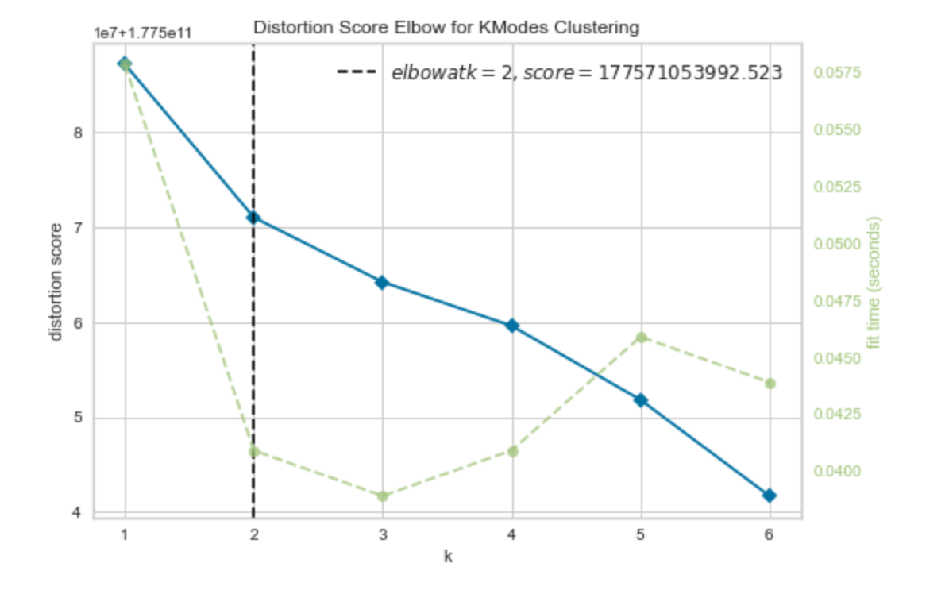
Model Fitting
Decide k = 3 by the ELBOW curve which calculates the within_cluster_sum_of_squared_error
Fit the K-Modes model using the data that are more relevant to clustering risk levels
Concatenate the data with the labels predicted by the clustering model
Deliver the outcome for further analysis

Slide 9
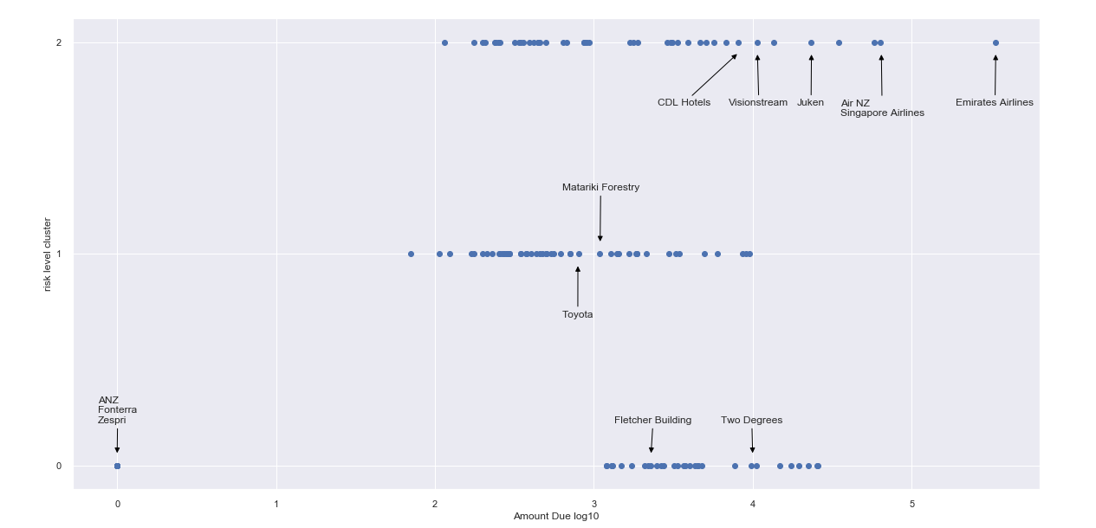
Plotting the businesses by risk levels

Slide 10
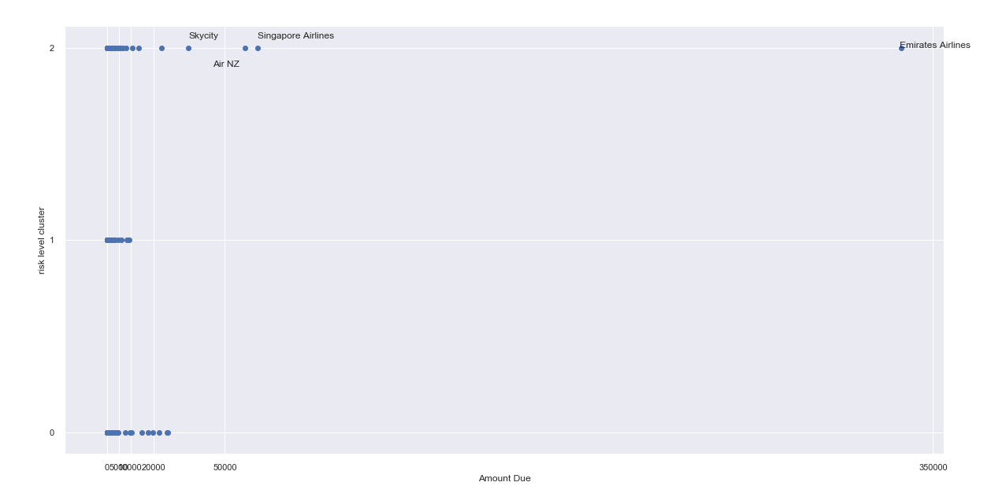
Plotting the most risky businesses

Slide 11
Low risk (Safe Investments)
(SOE) State-owned entity
Information Media and Telecommunications
Arts, Recreation and Other Services
Construction
Financial and Insurance Services
Health Care and Social Assistance
Transport, Postal and Warehousing
NZ private company owned Agriculture, forestry & fishing industries
Professional, Scientific, Technical, Administrative and Support Services

Slide 12
Moderate Risk (Business Tactic Deviation)
(COE) Council-owned entity
Electricity, Gas, Water and Waste Services
Transport, Postal and Warehousing
Overseas owned
Wholesale Trade
Retail Trade and Accommodation
Agriculture, Forestry and Fishing
Manufacturing - Metal Products, Wood and Paper Products Manufacturing

Slide 13
High risk (Businesses under pressure)
Overseas owned sectors
Construction
Electricity, Gas, Water and Waste Services
Transport, Postal and Warehousing
Manufacturing - Petroleum, Chemical, Polymer and Rubber Products
Information Media and Telecommunications
Rental, Hiring and Real Estate Services
Retail Trade and Accommodation sectors

Slide 14
Overseas owned
High risk (High Debt rate)
Agriculture, forestry & fishing industries
Wood and Paper Products, Petroleum, Chemical, Polymer and Rubber Product Manufacturing
Retail Trade and Accommodation
Low risk (Low Debt rate)
Food, Beverage and Tobacco Product Manufacturing
Mining
Information Media and Telecommunications
Health Care and Social Assistance
Financial and Insurance Services are less not at risk.

Slide 15
Maori Business
Investment in Maori businesses is comparatively safer.
Local business such as arts, recreation, agriculture, forestry, fishing etc are relatively less riskier due to following reasons:
Low Debt rate
Quick repayments
Higher investments and fundings

Slide 16
General Risk Level Categorization
Low | Moderate | High
Arts, Recreation and Other Services Construction Information Media and Telecommunications (SOE) Mining Agriculture, Forestry and Fishing (NZ private company) Financial and Insurance Services Health Care Professional, Scientific, and Support Services Manufacturing Transport, postal and warehousing | Agriculture, Forestry and Fishing, Retail trade, Manufacturing (Overseas owned) Wholesale trade (Overseas owned) Retail trade & accomodation (Overseas owned) Transport, postal, warehousing(COE) Electric, water & gas (COE) | Information Media and Telecommunications (Overseas owned) Construction (Overseas owned) Manufacturing (Overseas owned) Transport, postal & warehousing (Overseas owned) Rental, Hiring, Retail trade, Real estate & Accommodation sector

Slide 17
Business Insights
Large amount of forestry and wood related industry are in moderate risk level, even those companies listed in NZX.
Air and space transport business are in the highest risk level possibly due to budget reduction and less government subsidy on space industry.
Apart from air and space transport business, it is fairly safe to say that listed companies under all industries are more likely to have lower risk level

Slide 18
Appendix
Notebook file
Excel output file
Icons are partially retrieved from:
https://www.vectorstock.com/royalty-free-vector/peoplepuzzle-connected-team-of-four-logo-vector-19368303
https://www.vectorstock.com/royalty-free-vector/looking-book-logo-icon-design-vector-22504903
https://www.vectorstock.com/royalty-free-vector/productivity-growth-icon-vector-21628315
https://www.vectorstock.com/royalty-free-vector/idea-is-money-icon-vector-21134636
https://www.qresearchsoftware.com/market-research-guide-data-preparation

