Slide 1

Matt Koltun
SKANNER
Stock Investment Advisor

Slide 2

What is it? And, why bother?
Analytic tool for those who’d like to start trading
Sentiment Analysis + Machine learning = success?
Cash?
Challenge myself
Enough of DB read/write or authentication!

Slide 3


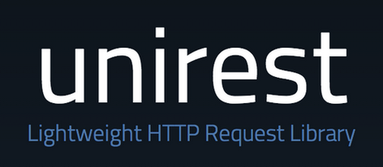



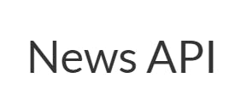



Platform and dependencies

Slide 4
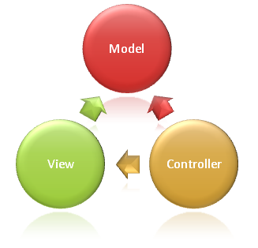
Design I
Model-Controller-View (MVC)
Software Design Patterns:
  Singletons
  Observers
  Builders
  Dependency injections
Callbacks
Object-Oriented Programming
Decoupled components!

Slide 5
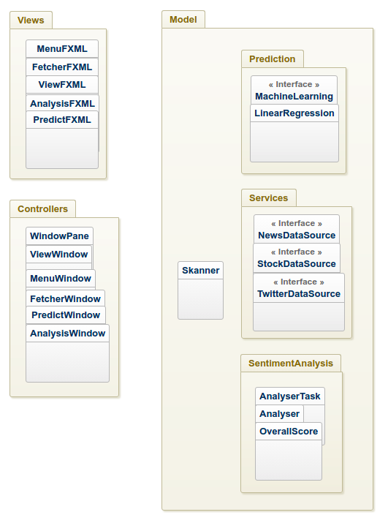
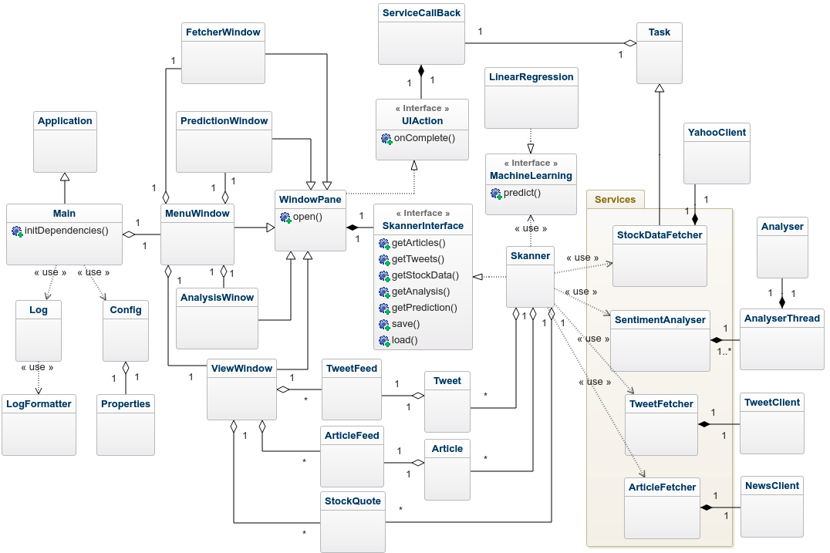
Design II

Slide 6


Data sources
Articles
Blogs
Tweets
Stock qoutes & prices

Slide 7
Implementation
Pure JAVA 11 application
News client!
Yahoo client!
Sentiment Analysis with Stanford NLP library
Machine learning and predictions with Weka
4300+ lines of code!

Slide 8
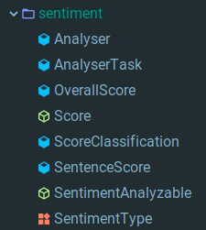
Sentiment Analysis
Stanford NLP:
  Per sentence basis
My 5 cents:
  Overall score average on metrices
  Interfaces, classification, enum, threads

Slide 9
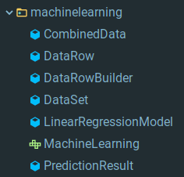
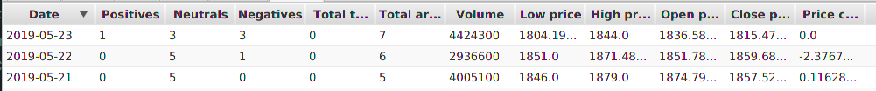
Machine learning and prediction
Dataset:
  Sum of Sentiment Results of articles and tweets
  Stock quote
Classifier
  Linear Regression

Slide 10
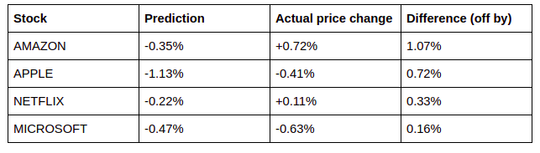
Evaluation

Slide 11
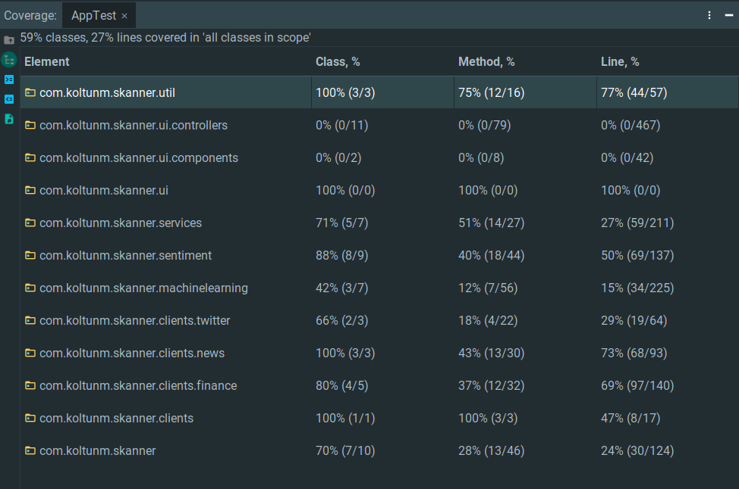
Testing
Coverage:
  31 out of 51 classes
  27% of 4300+ lines

Slide 12
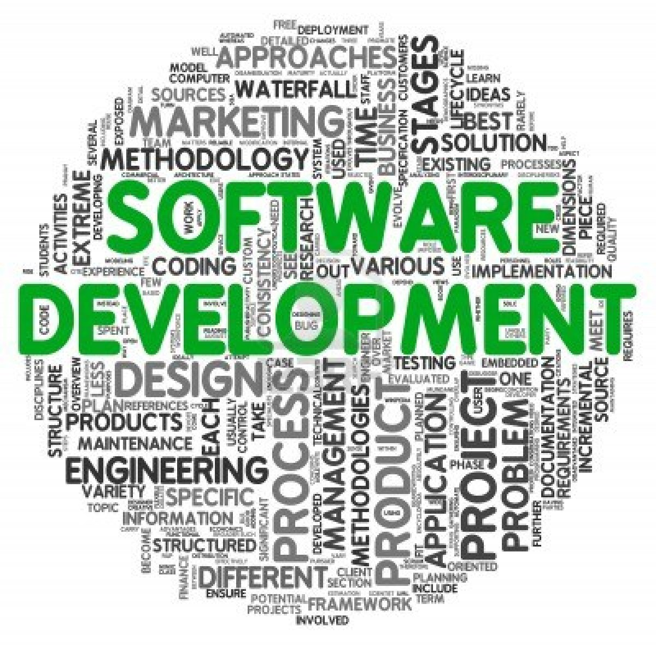
Development Process
Incremental software development
...
Some bit of chaotic development
Continues refactoring?

Slide 13
Future work
Increase limits of available data
Add more prediction models
Save and reuse already obtained and analysed data

