Slide 1
Kubernetes On Windows
On AWS
Owain Perry

Slide 2
Who am I?
Owain Perry
Principal engineer - Reliability engineering @ Just Eat

Slide 3

What makes us
Special?
London/Bristol/Kiev with 500+ people in Tech
19m active customers
30+ teams
390+ services
2,700+ orders/min
1,500+ AWS instances
1.6M+ metrics/min
1.5TB+ logs/day
500+ releases/week
42% Order Growth (2015-16)
FTSE250 >£4bn Market Cap
Fosduo dolores etoa jasom rebum. Steto clita kuasd gubogren, nosotra drs frone.

Slide 4
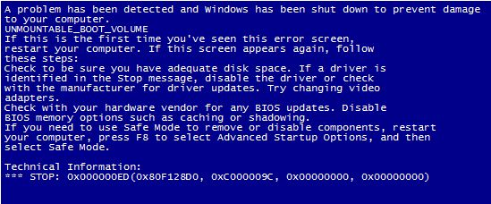
Was going to do a live demo
Notes:
2 min boot up times too long for this
Hold music

Slide 5
What are containers
“Immutable” deployment unit
Transportable package
Packaged Application
A widget

Slide 6
Dockerfile
FROM microsoft/iis
SHELL ["powershell"]
RUN mkdir C:\site
RUN Install-WindowsFeature NET-Framework-45-ASPNET
RUN Install-WindowsFeature Web-Asp-Net45
RUN Remove-WebSite -Name 'Default Web Site'
RUN New-Website -Name 'site' -Port 8000 -PhysicalPath 'c:\site' -ApplicationPool '.NET v4.5'
EXPOSE 8000
ADD webapp/PublishOutput /site

Slide 7
Kubernetes (k8s) 101 - a quick tour

Slide 8
kubectl
Administration Command line tool
Wrapper around the API
hint : install bash autocomplete

Slide 9
Main K8s Components
Master
  API
  Schedular
  Etcd (some installs)
  Kubelet
  Docker
Node (minion)
  Kubelet
  Docker

Slide 10
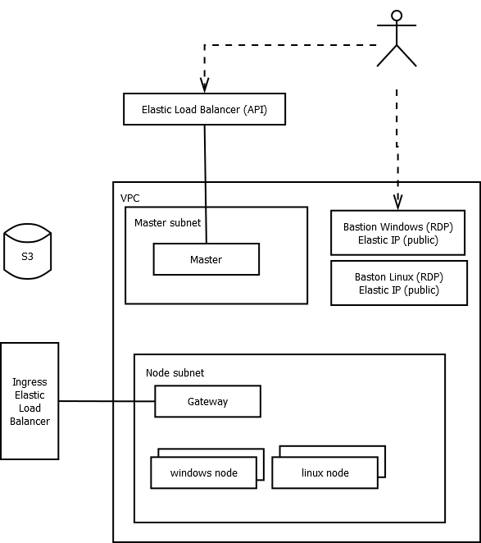
What is built with terraform
Private networking topology
Bastion hosts for admin via RDP and SSH
S3 used to store cluster info
Open Virtual switch network layer
Notes:
I wanted private networking
TLS Secrets and master ips stored in S3

Slide 11
Terraform
*Disclaimer - This is not industrial strength
Builds VPC
Windows and linux bastion hosts
Private network for nodes & masters etc
Brings up master , gateway and nodes
Installs and configures ovs
Writes keys down in S3
*should work*

Slide 12
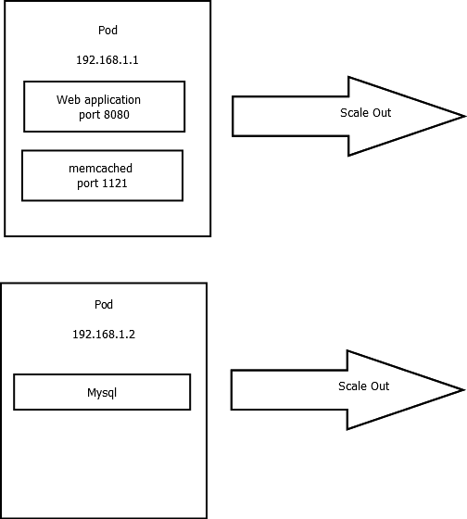
Pod
One or more containers
Tightly coupled and scaled together
Has it’s own IP address and port space
implemented on linux using iptables foo

Slide 13
Replication Controller (deployments)
Manages multiple pods
Scale in and out
Restart failed pods
Manages deployments

Slide 14
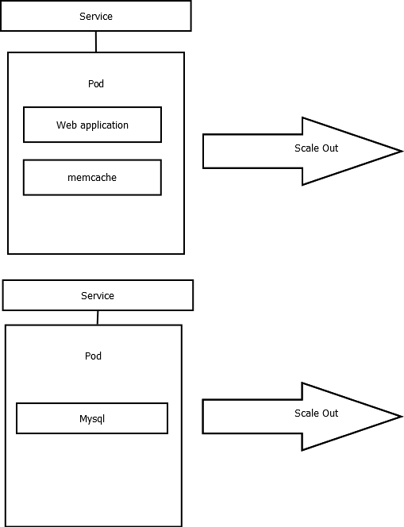
Service
Logical set of pods and policy to access them
Enable external communication into pods
Provides an internal DNS addressable endpoint
  servicename.<namespace>.<cluster.local>

Slide 15
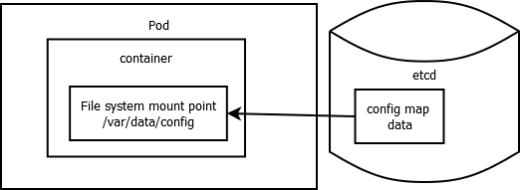
Config maps
Gets static configuration data from etcd
Mounted as a file(s) on the file system

Slide 16
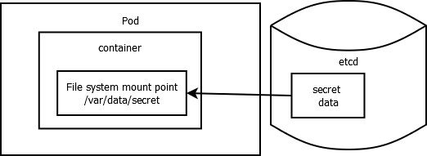
Secrets
Mount a secret as file(s) on the file system
Notes:
Examples:
Ssh keys
Connection strings
etc

Slide 17
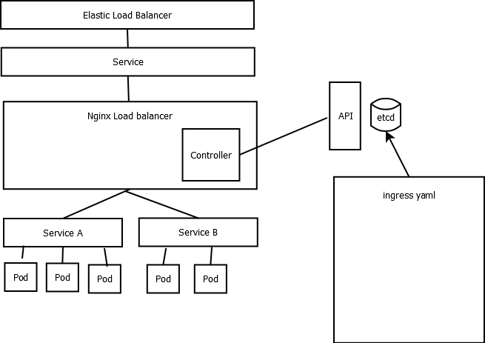
Ingress & ingress controller
Enable external communication into a cluster via a Load balancer (nginx , haproxy , trafik etc)
Controller gets ingress data from api and configures load balancer

Slide 18
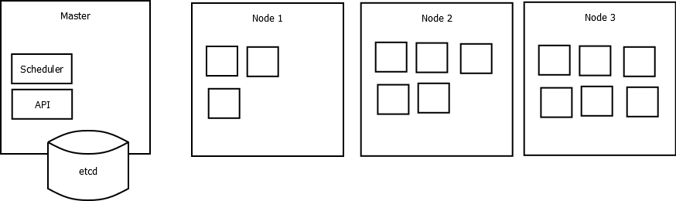
Orchestration

Slide 19
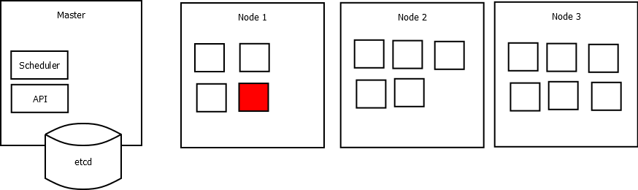
Orchestration

Slide 20
Kubernetes networking
Pod
  Unit of scaling
  1 or more containers
  Has it’s own IP address (mandatory requirement)
Ingress
  Takes ELB and wires it up to node ports

Slide 21
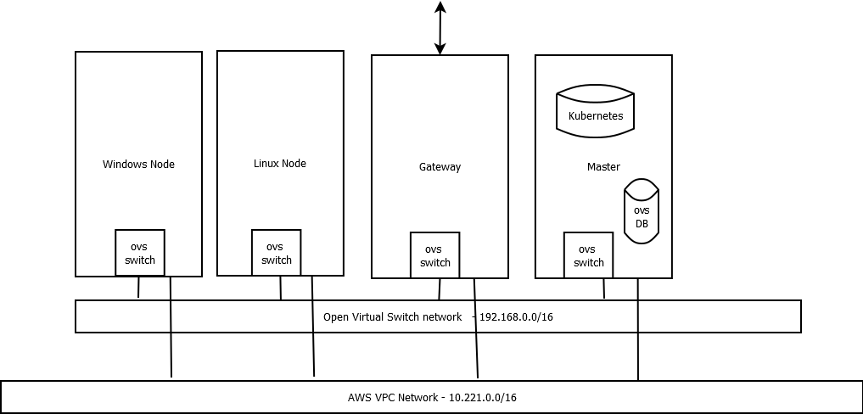
Open virtual switch - (hack?)
OVS is used in this example to support the need of pods to have own IP address
Adds some complexity
Short term requirement until feature parity with iptables

Slide 22
K8s ovs
K8s ovs binds pods to ovs switch ports
https://github.com/openvswitch/ovn-kubernetes

Slide 23
Things I have learned
Notes:
K8s on windows is very alpha
Full fat windows containers are BIG!
Open virtual switch is involved
Use virtual box
Build docker containers on win vm
Build linux containers on linux vm
Run minikube etc
Forget trying to have docker locally
Bash for windows works well
Will need a strategy to pre warm windows nodes with base containers - bakes ami’s?

Slide 24
Kubernetes community - it’s great
Windows Special Interest Group
https://github.com/kubernetes/community/tree/master/sig-windows
Slack channel link
https://kubernetes.slack.com/messages/sig-windows
Ovn-kubernetes
https://github.com/openvswitch/ovn-kubernetes

Slide 25
Future stuff
This is alpha!!
https://blog.docker.com/2017/10/docker-for-mac-and-windows-with-kubernetes-beta/
Windows 2016 iptables parity
https://blogs.windows.com/windowsexperience/2017/07/13/announcing-windows-server-insider-preview-build-16237/#XlALm9Ujg0VOmyIK.97
http://blog.kubernetes.io/2017/09/windows-networking-at-parity-with-linux.html
Windows support should be in beta - k8s 1.9 release (~3 months)
“i think 1.9 is very reasonable and achievable. we had a lot of PRs go in after 1.8, and now we are on the last stages of networking work” - Michael Michael

Slide 26
Thanks go to
Paulo Peres https://github.com/pires
https://github.com/apprenda/kubernetes-ovn-heterogeneous-cluster
Massive thanks to:
Alin Balutoiu https://github.com/alinbalutoiu
Alin Serdean https://github.com/aserdean

Slide 27
Questions?

