Slide 1








Viet Nam Import & Export
Implement the Model
Trần Ngọc Nhơn
Nguyễn Quốc Anh
Phan Quốc Trung
Group 6

Slide 2

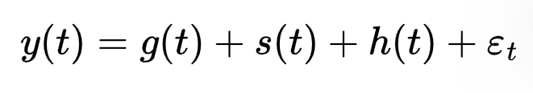

Prophet Model
In this project, we use the Prophet model developed by Facebook (Meta)
Prophet is a time series forecasting model that works well with data that has trend and seasonal patterns.
Where:
  g(t) represents the trend (long-term increase or decrease)
  s(t) represents the seasonality (repeating patterns such as months or years)
  h(t) can include holiday effects or special events
  εₜ is random noise

Slide 3


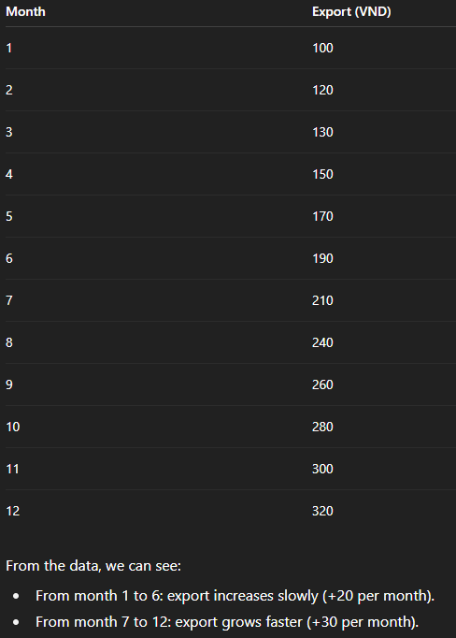
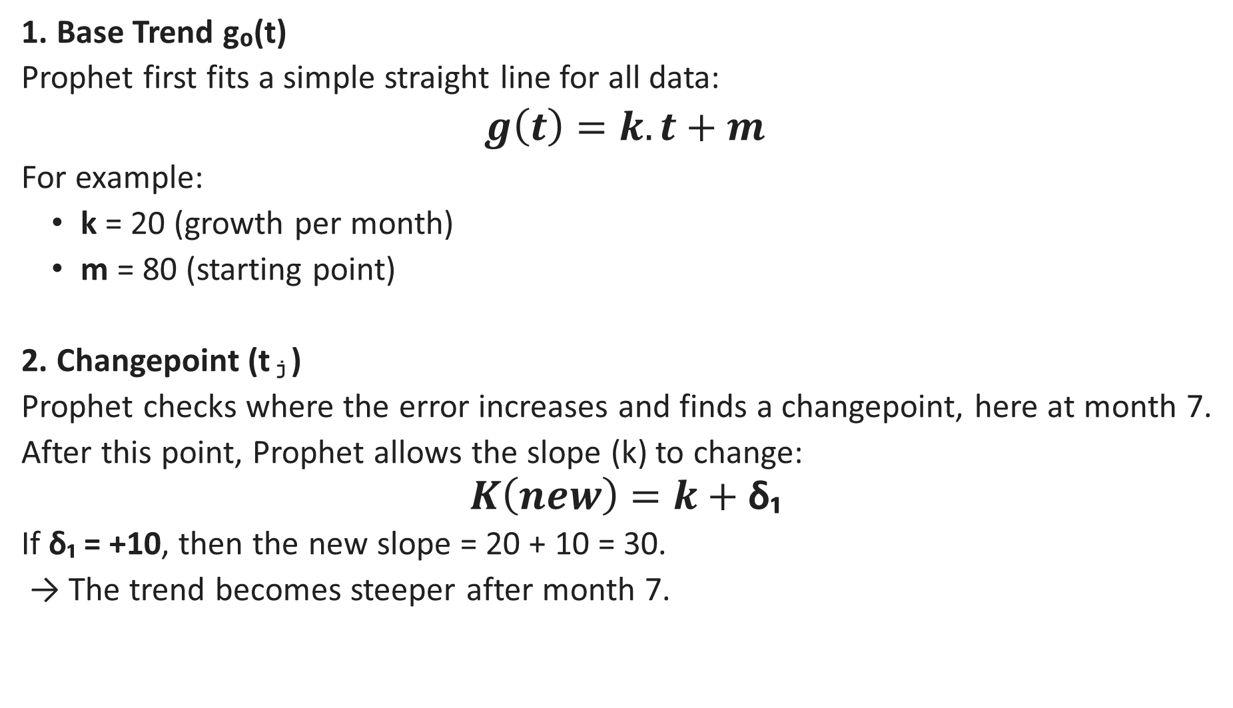
Comprehension about Trend Modeling - g(t)
1. Base Trend g₀(t)
Prophet first fits a simple straight line for all data:
$g\left(t\right)=k.t+m$
For example:
  k = 20 (growth per month)
  m = 80 (starting point)
2. Changepoint (tⱼ)
Prophet checks where the error increases and finds a changepoint, here at month 7.
After this point, Prophet allows the slope (k) to change:
$$K\left(new\right)=k+\text{δ}\text{₁}$$
If δ₁ = +10, then the new slope = 20 + 10 = 30.
→ The trend becomes steeper after month 7.

Slide 4
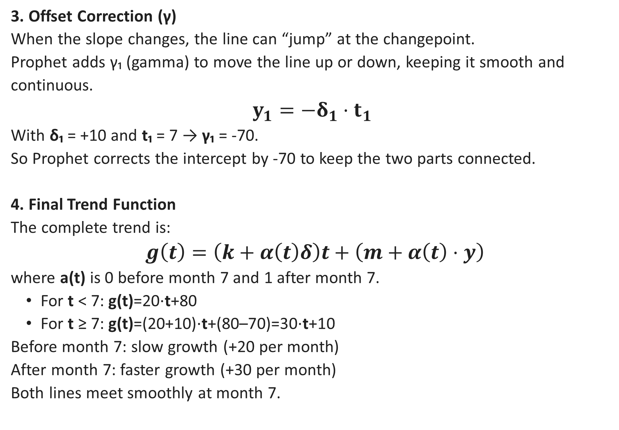
Comprehension about Trend Modeling - g(t)
3. Offset Correction (γ)
When the slope changes, the line can “jump” at the changepoint.
Prophet adds γ₁ (gamma) to move the line up or down, keeping it smooth and continuous.
$$y_{1}=−δ_{1}⋅t_{1}$$
With δ₁ = +10 and t₁ = 7 → γ₁ = -70.
So Prophet corrects the intercept by -70 to keep the two parts connected.
4. Final Trend Function
The complete trend is:
$$g\left(t\right)=\left(k+α\left(t\right)δ\right)t+\left(m+α\left(t\right)⋅y\right)$$
where a(t) is 0 before month 7 and 1 after month 7.
  For t < 7: g(t)=20⋅t+80
  For t ≥ 7: g(t)=(20+10)⋅t+(80–70)=30⋅t+10
Before month 7: slow growth (+20 per month)
After month 7: faster growth (+30 per month)
Both lines meet smoothly at month 7.

Slide 5

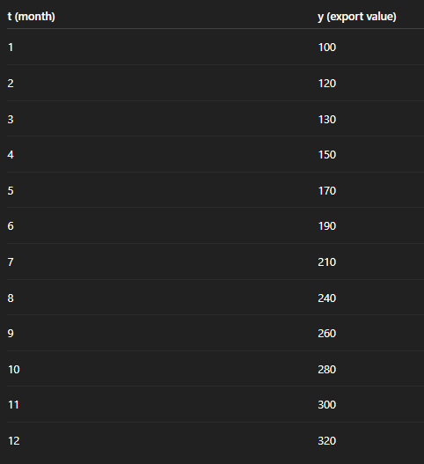


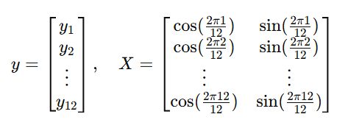

Comprehension about Seasonality Modeling – s(t)
1. Build the formula
With period P = 12 and N = 1: (Fourier series)
Goal:
Find a₁ and b₁ ​ that make the Loss (error) as small as possible:
2. Matrix form
We can write this as a matrix equation:
Then the best coefficients are found by:

Slide 6
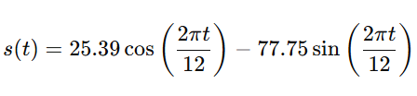

Comprehension about Seasonality Modeling – s(t)
3. Calculation result
Using linear regression:
a₁ = 25.39 , b₁ = −77.75
So, the seasonal function is:
4: Compute Loss (SSE)
This is the minimum error Prophet can reach using the two parameters a₁ and b₁.
If more harmonics are added (N=2,3,…), Prophet will have more parameters → more complex seasonal path → loss decreases.
N = number of seasonal waves (pairs of sine and cosine).

Slide 7




Comprehension about Holiday & Events – h(t)
In Prophet, h(t) represents the effect of holidays or special events on the forecast.
Where:
L – number of holidays or events.
Dᵢ(t) – dummy variable:
+ Dᵢ(t) = 1 if time t is within event i,
+ Dᵢ(t) = 0 otherwise.
δᵢ – the estimated impact of event i on y(t), learned by Bayesian regression.
+ If δᵢ > 0 → the event increases y(t).
+ If δᵢ < 0 → the event decreases y(t).
Example
Suppose there are 12 months with two events:
January: New Year → increases by 20
August: Trade Fair → increases by 15
Then:
With δ₁ = 20 and δ₂ = 15, we have:
When t = 1 → h(1) = 20
When t = 8 → h(8) = 15
For other months → h(t) = 0

Slide 8
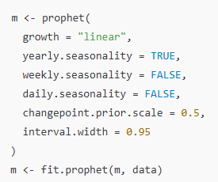

How The Model Works
Step 1: Data Preparation
Prophet needs two main columns:
  ds: the date or time column
  y: the value we want to predict (for example: export value)
The data should be in time order. Prophet can still work even if some months are missing.
Step 2: Fit the Prophet Model
Create the model and fit it to your data:
This step helps Prophet learn the pattern and trend in your data.

Slide 9



How The Model Works
Step 3: Make Future Dataframe
Create a new time series for the next 12 months:
Step 4: Forecast Future Values
Predict the export values for the next 12 months:
Prophet gives three main results:
yhat: predicted value
yhat_lower: lower bound of forecast interval
yhat_upper: upper bound of forecast interval
Step 5: Visualize the Forecast
The black dots show the actual data,
and the blue area shows the forecast with confidence interval.
Step 6: Evaluate the Model
Compare predicted values with real data.
Use metrics such as MAPE and RMSE to check accuracy.

Slide 10
Parameter of Model
1. Growth
Options: “linear” or “logistic”.
Meaning: Controls the overall trend Prophet uses.
  Linear: The series increases or decreases steadily over time.
  Logistic: Growth slows down when reaching a maximum value (saturation).
2. Changepoint.Prior.Scale
Default: 0.05
Meaning: Decides how much the trend can change at certain points.
Effect:
  Small value (e.g., 0.01) → smoother trend, less flexible.
  Large value (e.g., 0.5) → more flexible, follows sudden changes.
3. Yearly.Seasonality
Default: auto
Meaning: Adds patterns that repeat every year.
Effect: Helps model yearly cycles such as monthly export changes.
Tip: Set TRUE when you have more than two years of data.
4. Weekly.Seasonality
Default: auto
Meaning: Adds patterns that repeat every week.
Use: Only for daily data.
Tip: Set FALSE for monthly or yearly data.
5. Daily.Seasonality
Default: auto
Meaning: Adds daily patterns (hourly cycles).
Use: For hourly or minute data only.
6. Interval.Width
Default: 0.80
Meaning: The size of Prophet’s prediction interval (uncertainty range).
Effect:
  0.95 → wider interval (more uncertainty).
  0.80 → narrower interval (less uncertainty).
7. Changepoint.Range
Default: 0.8
Meaning: The proportion of history where Prophet can add changepoints.
Effect:
  Small value → fewer trend changes.
  Large value → more flexibility near the end.
8. Fourier.Order: 10
Meaning: Number of sine and cosine pairs Prophet uses to model seasonality.
Effect:
Small value (e.g. 3) → smooth, simple seasonality.
Large value (e.g. 15) → more complex seasonality, can overfit.

Slide 11
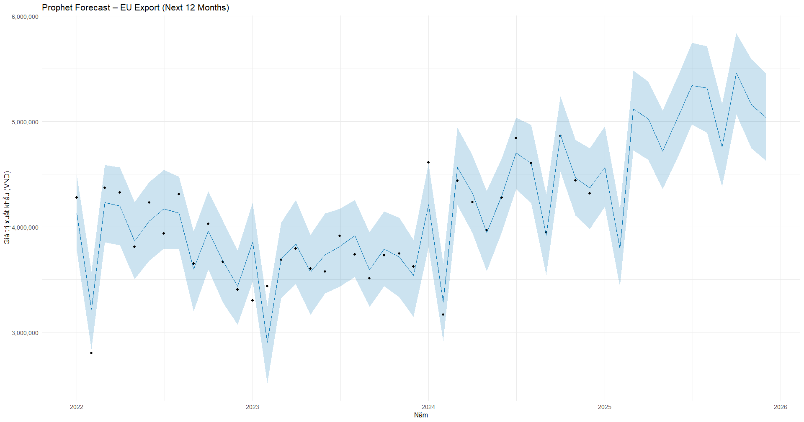

Implement Model
EU

Slide 12
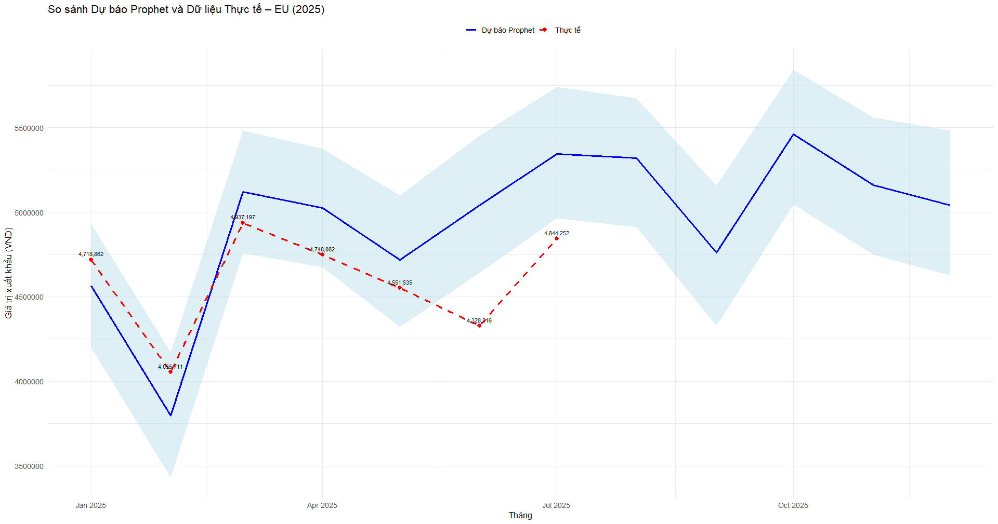
Implement Model
EU

Slide 13
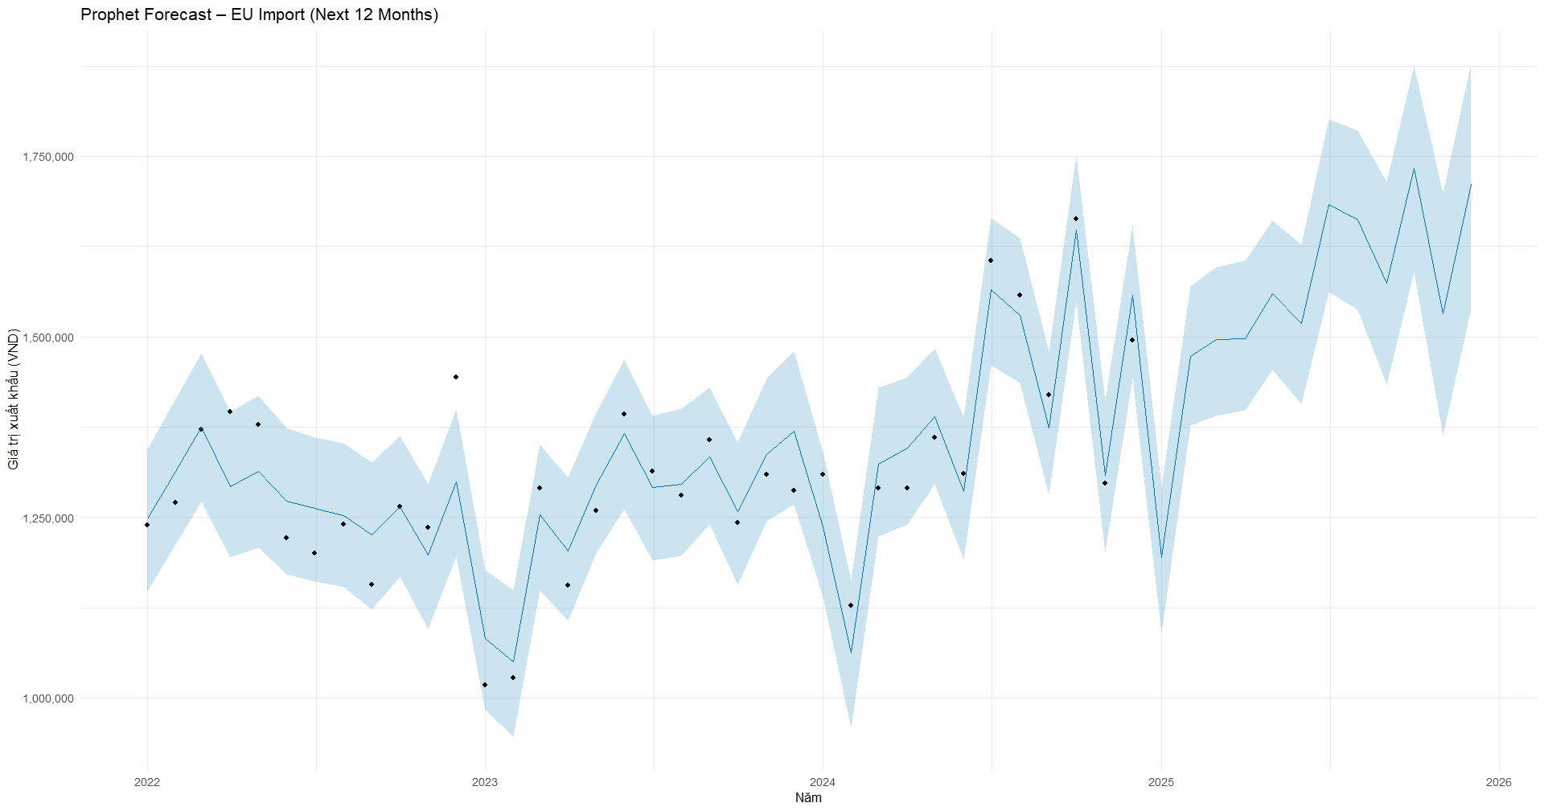
Implement Model
EU

Slide 14
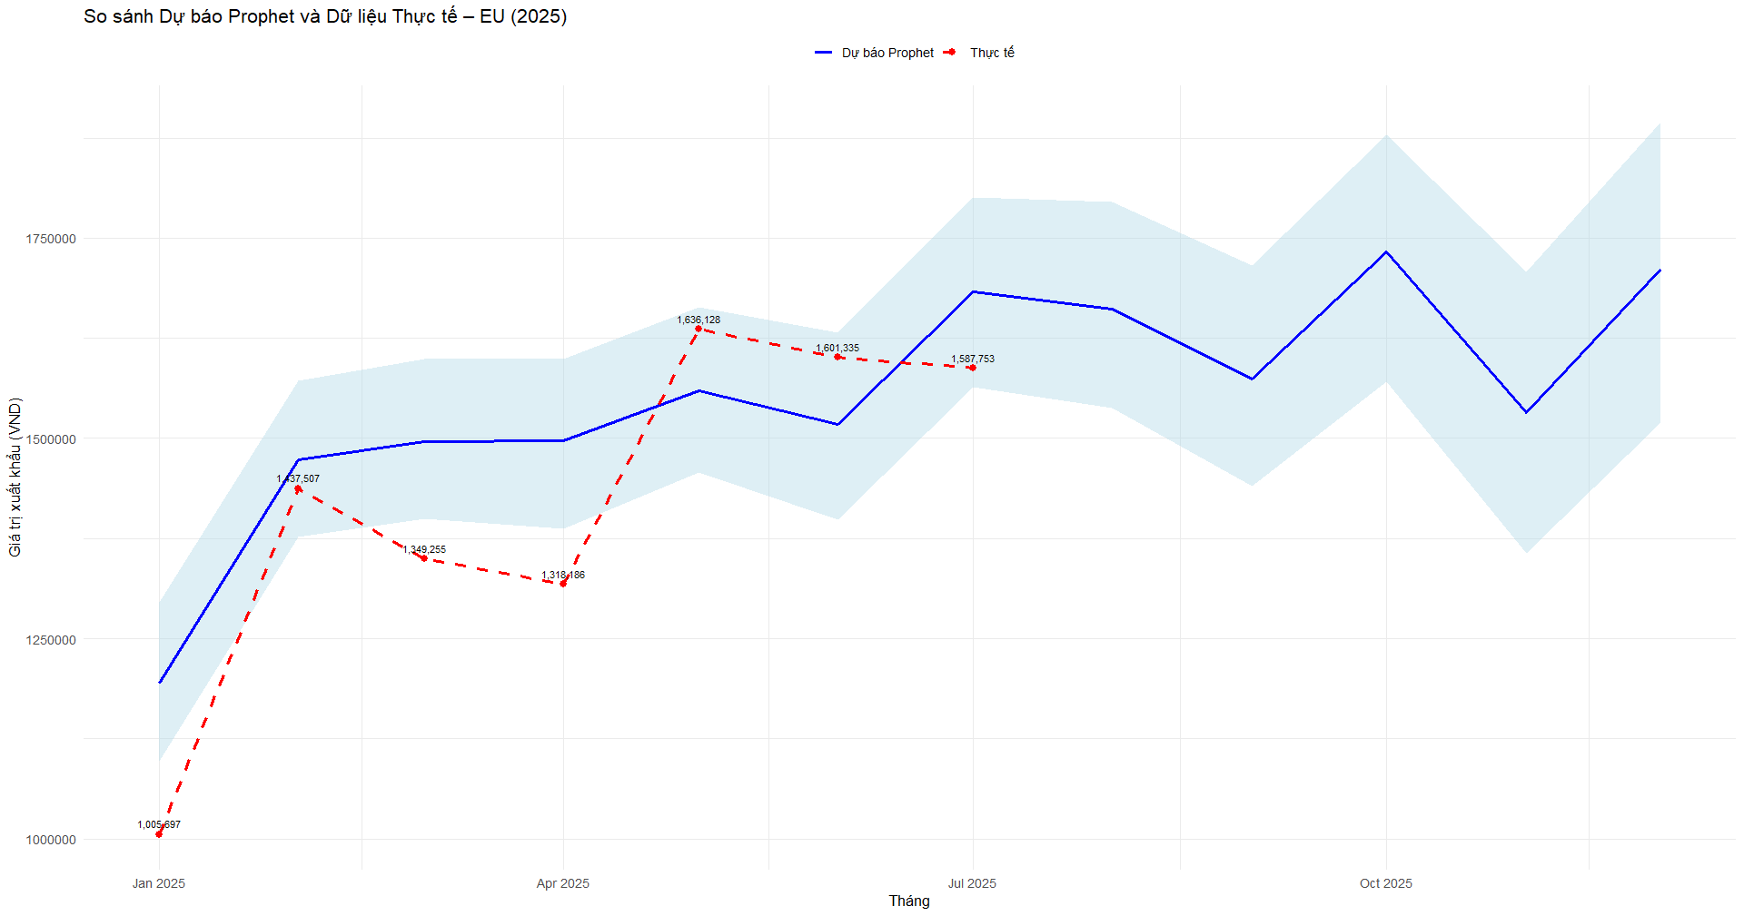
Implement Model
EU

Slide 15
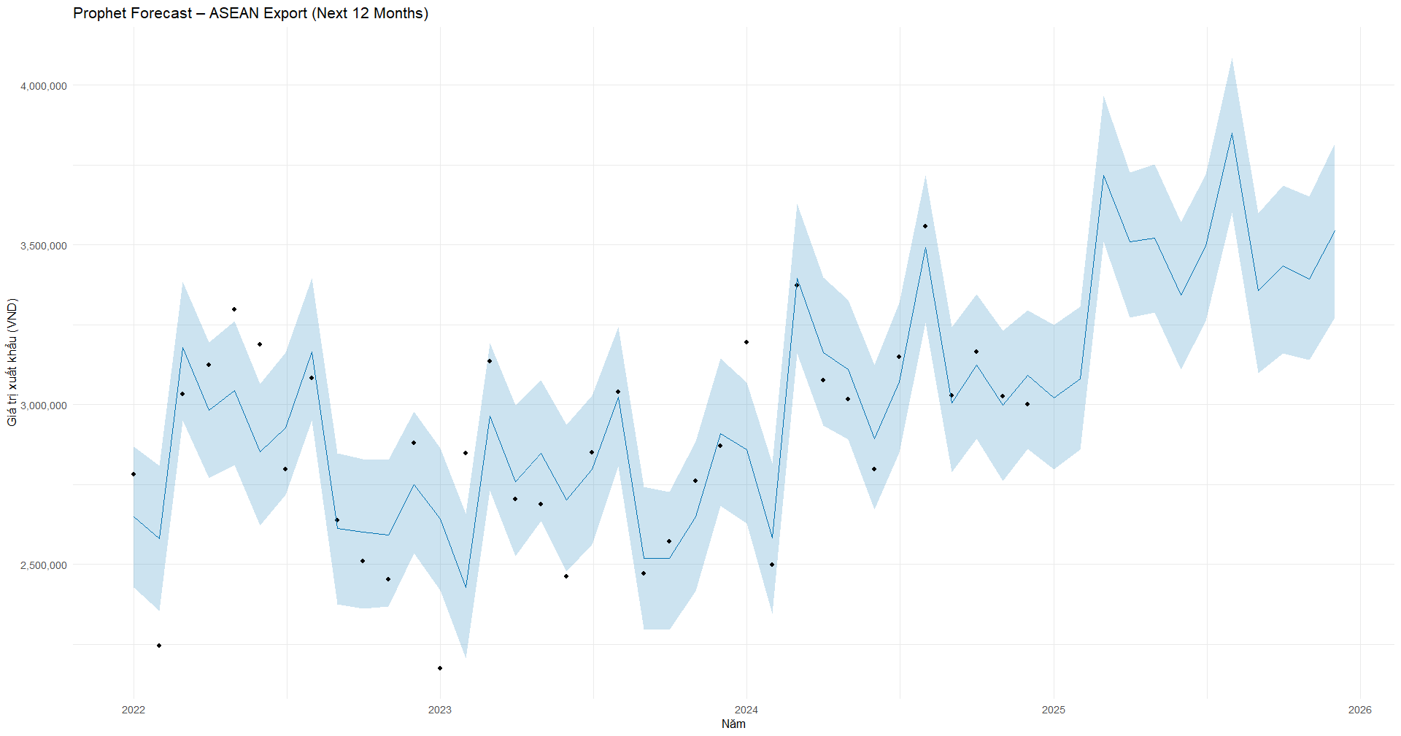
Implement Model
ASEAN

Slide 16
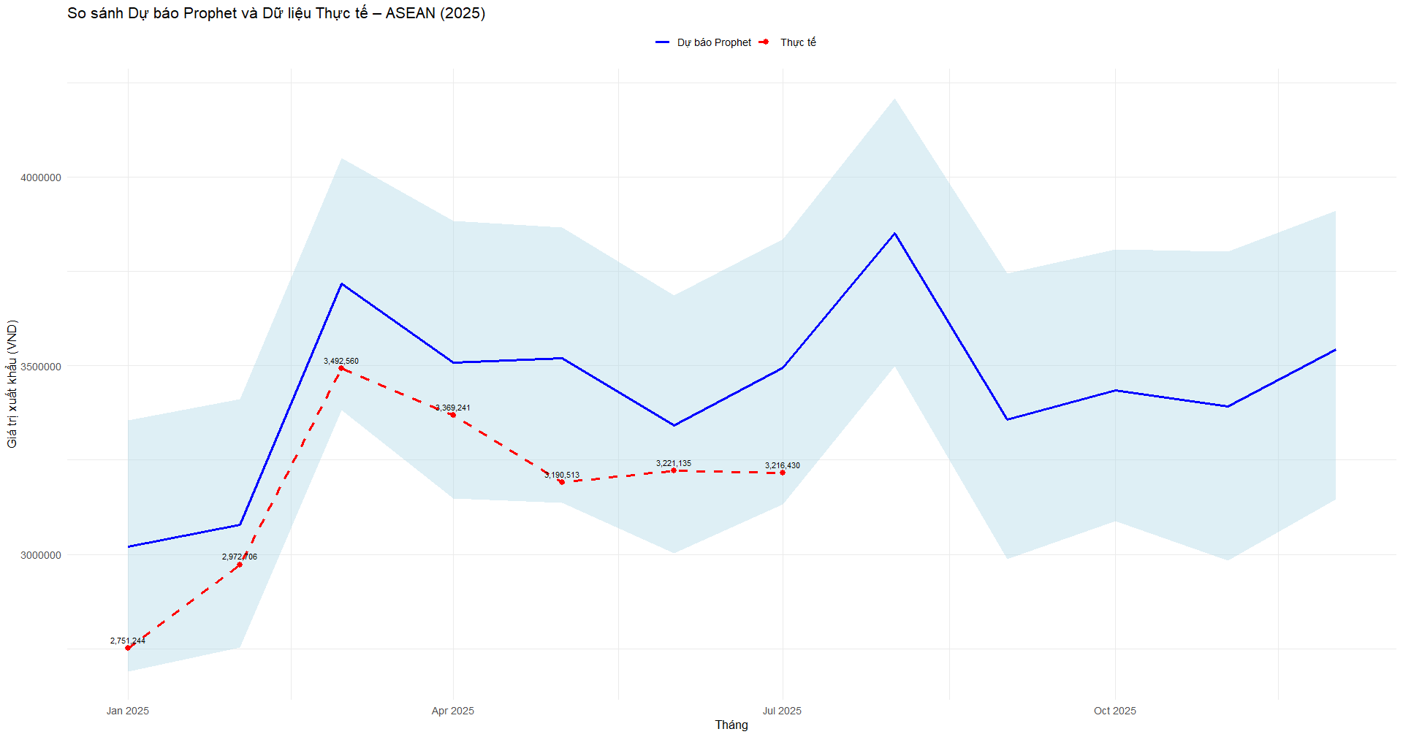
Implement Model
ASEAN

Slide 17
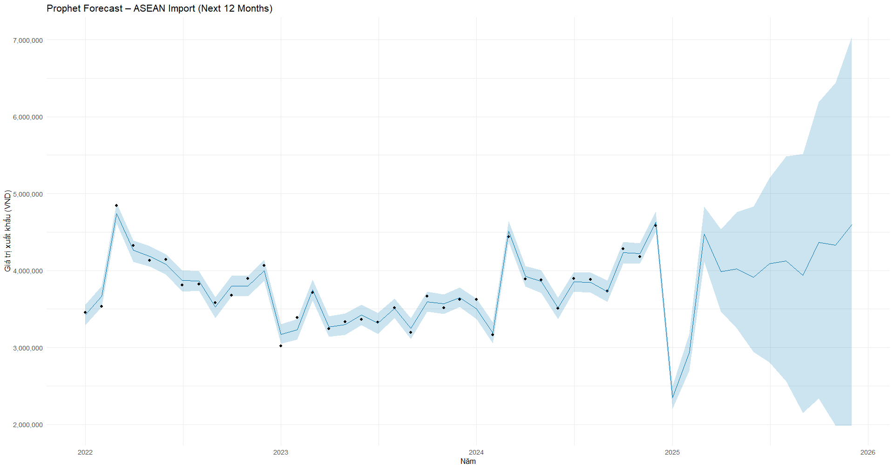
Implement Model
ASEAN

Slide 18
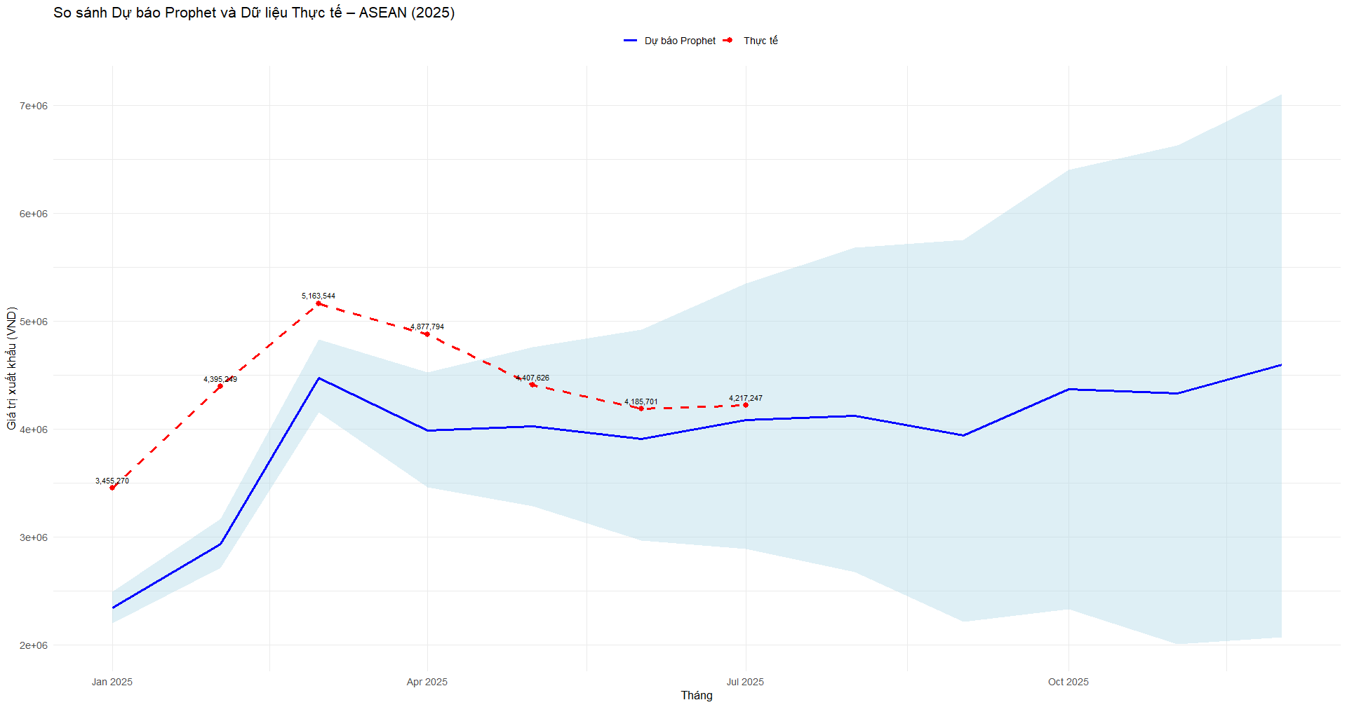
Implement Model
ASEAN

Slide 19
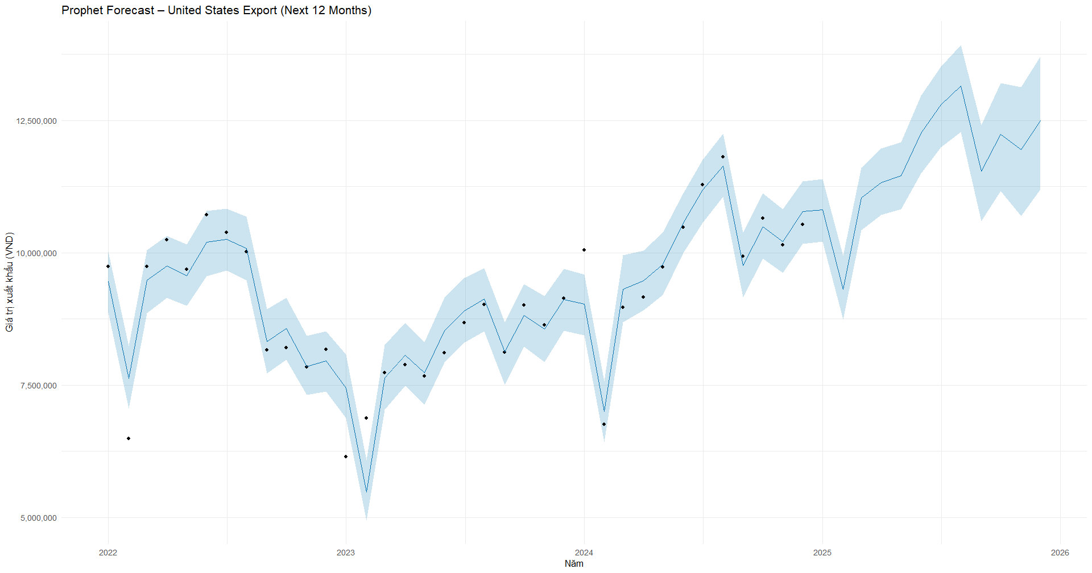
Implement Model
US

Slide 20
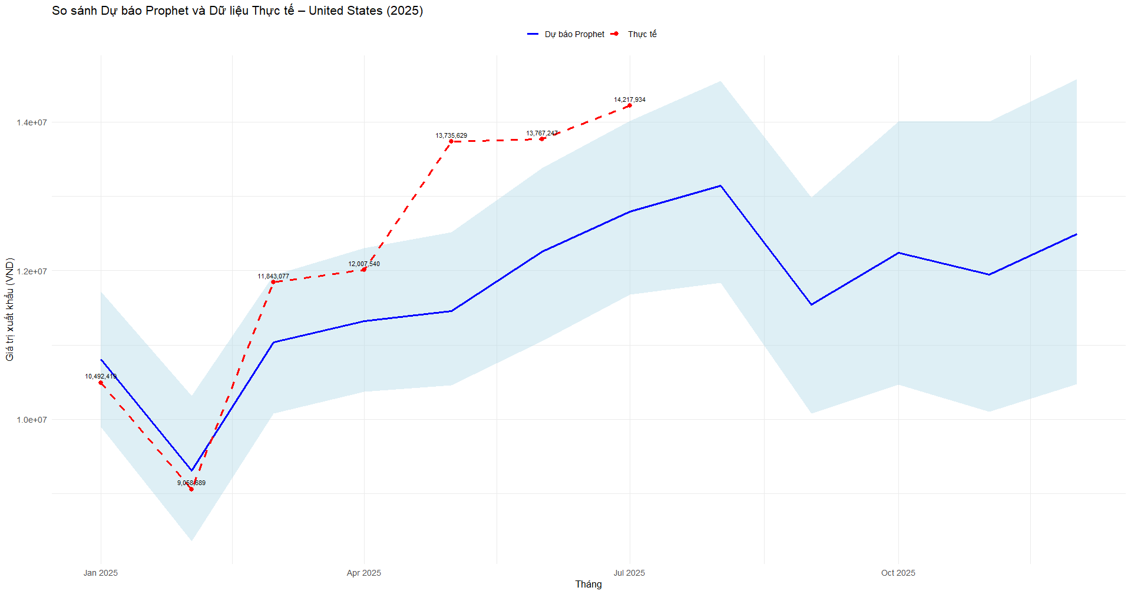
Implement Model
US

Slide 21
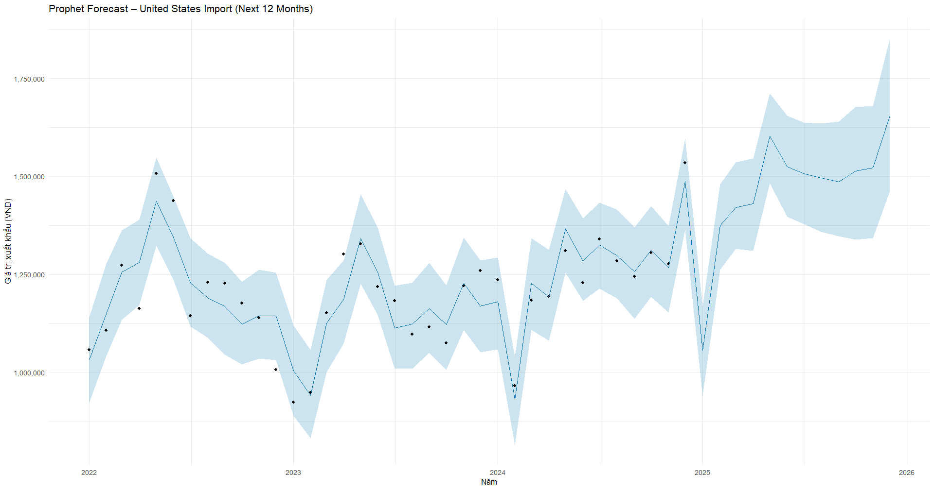
Implement Model
US

Slide 22
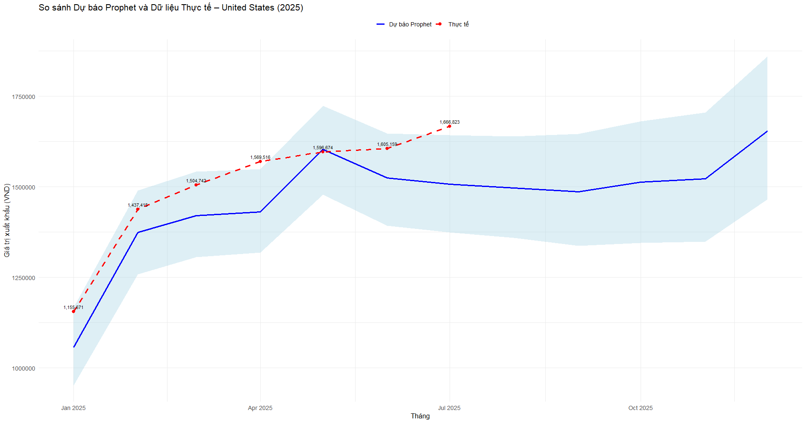
Implement Model
US

Slide 23
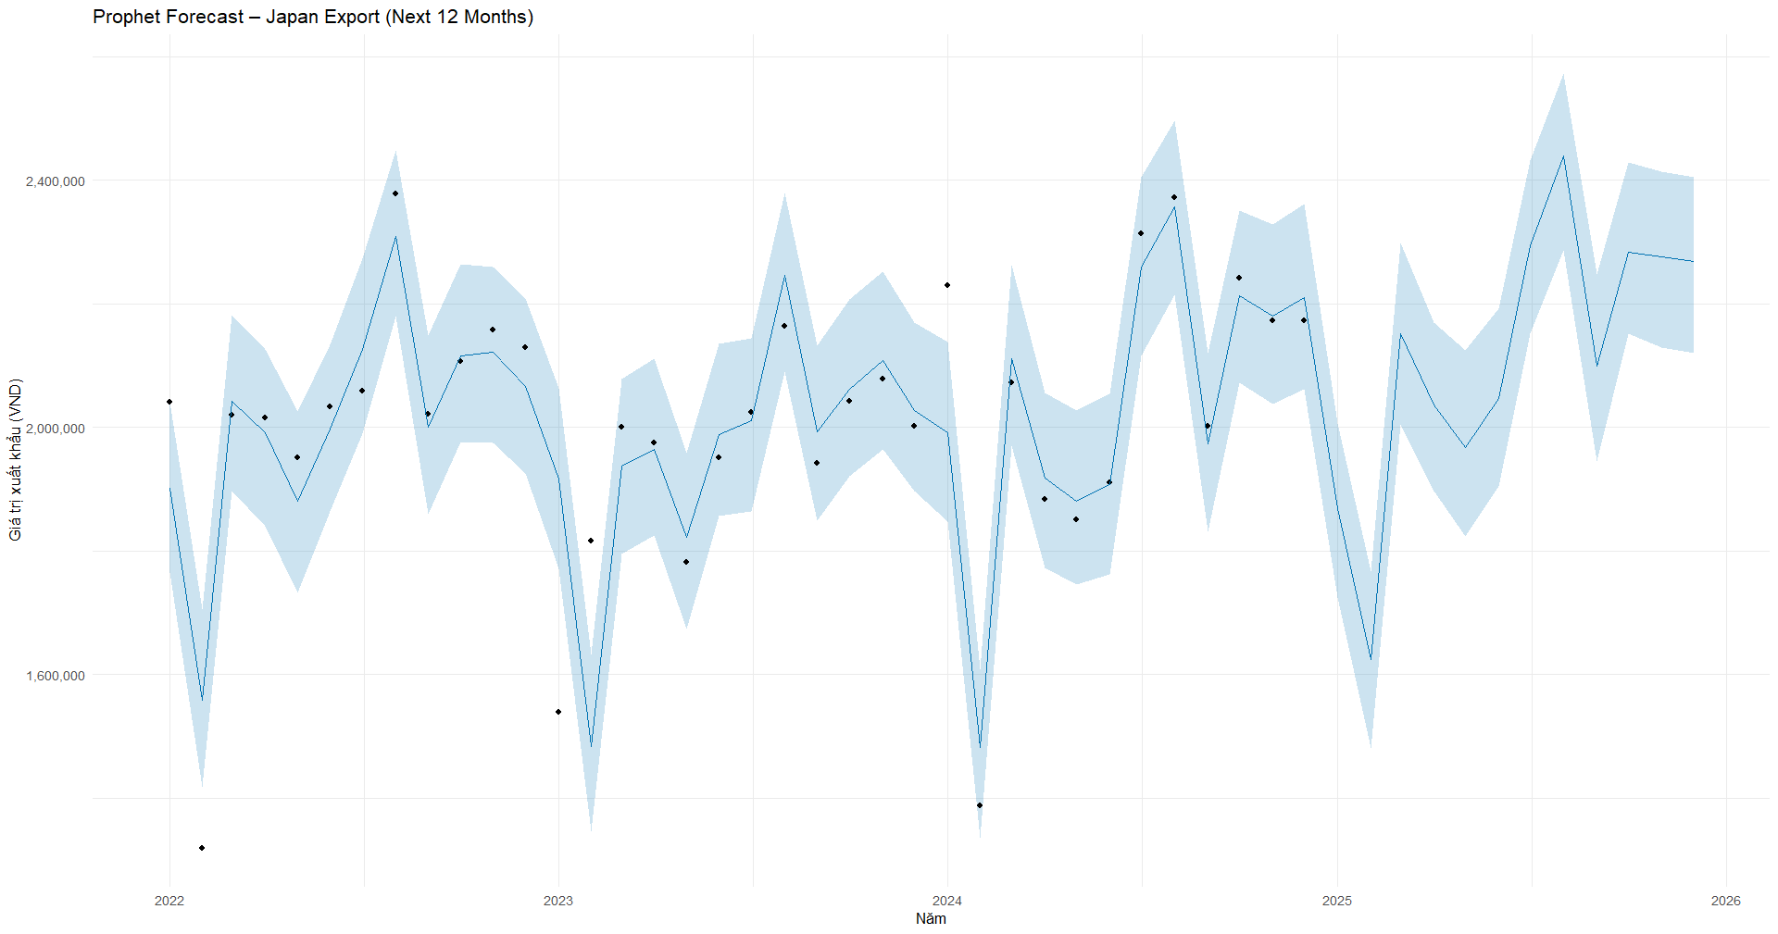
Implement Model
Japan

Slide 24
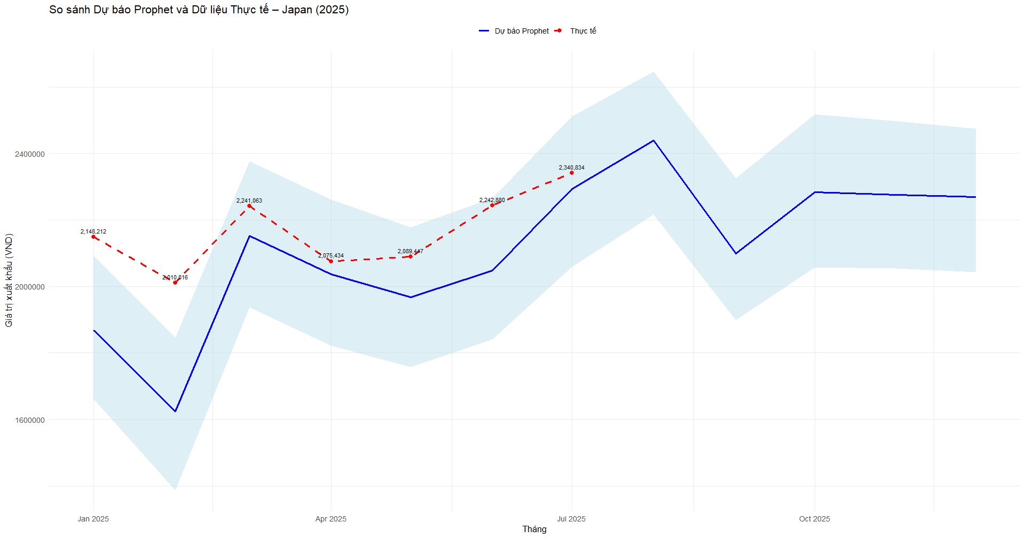
Implement Model
Japan

Slide 25
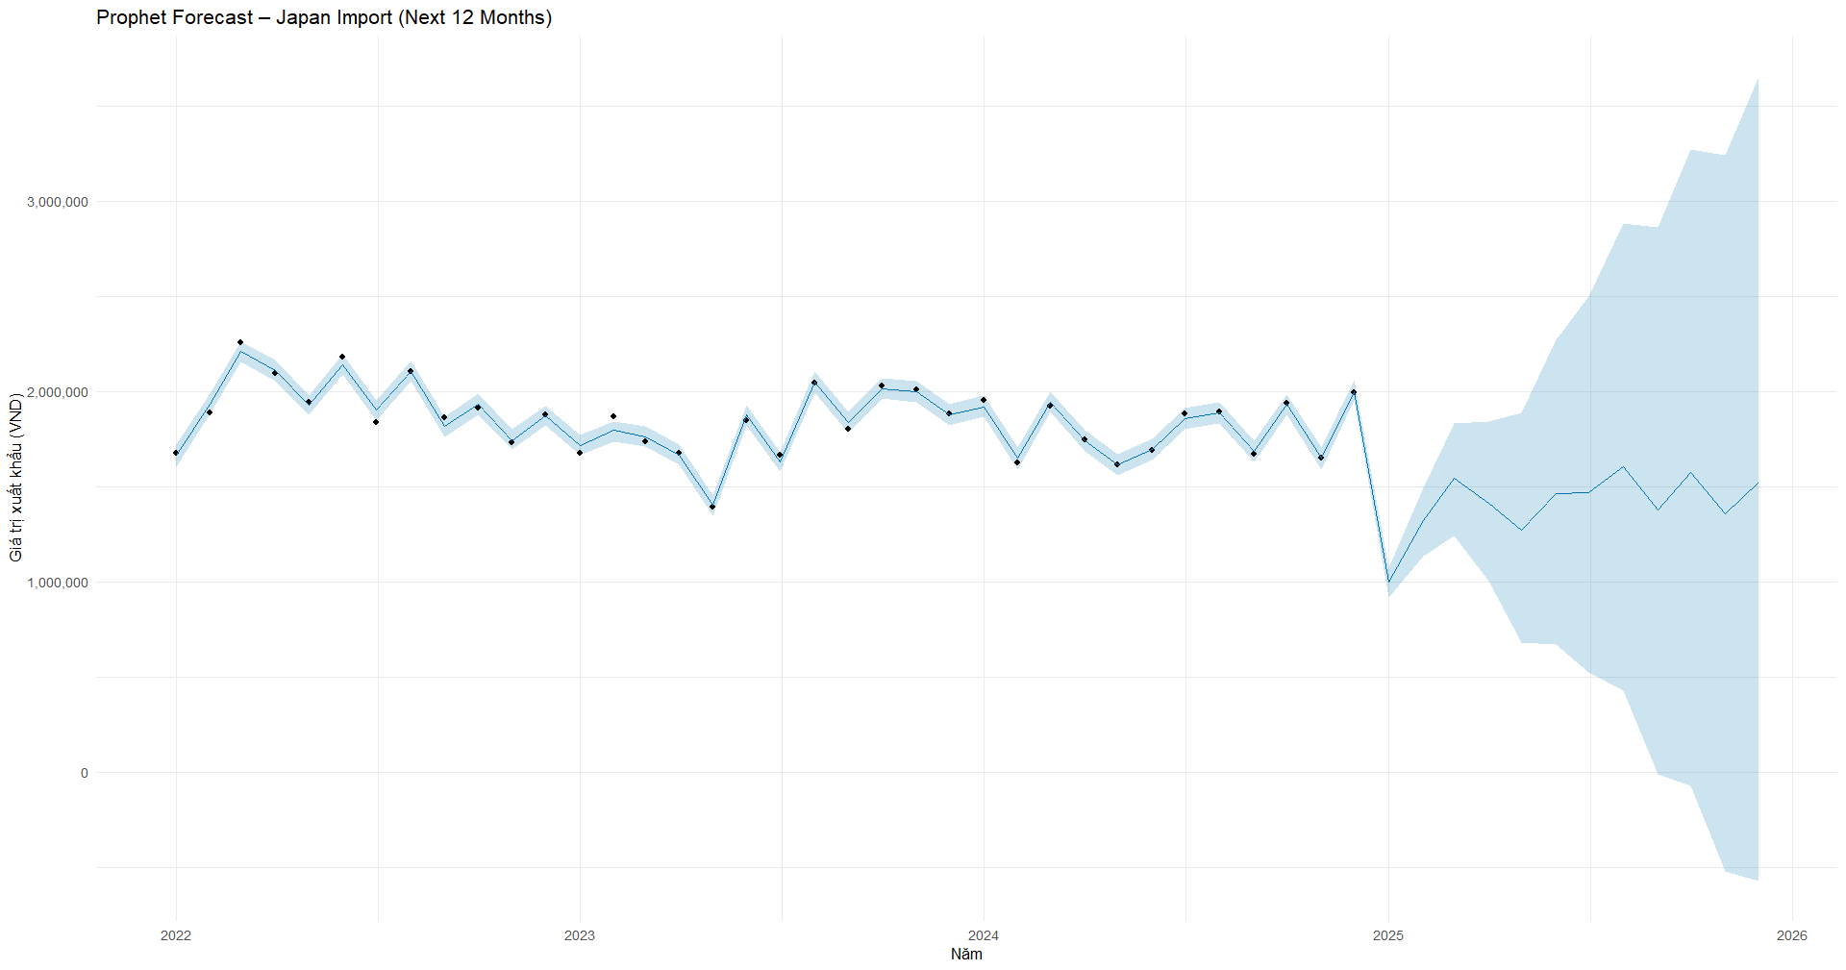
Implement Model
Japan

Slide 26
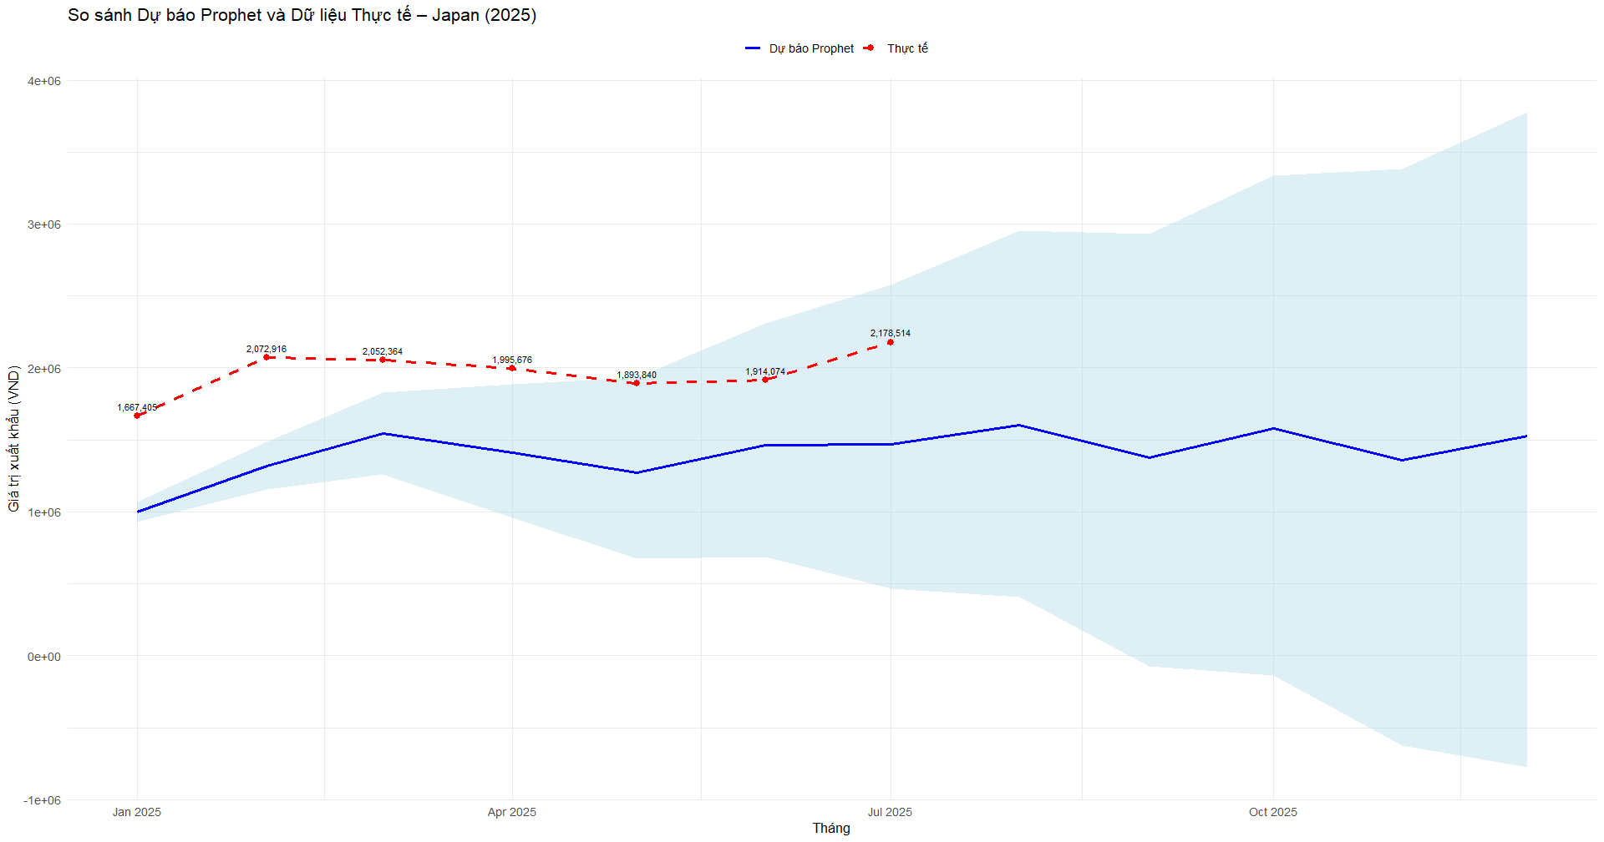
Implement Model
Japan

Slide 27
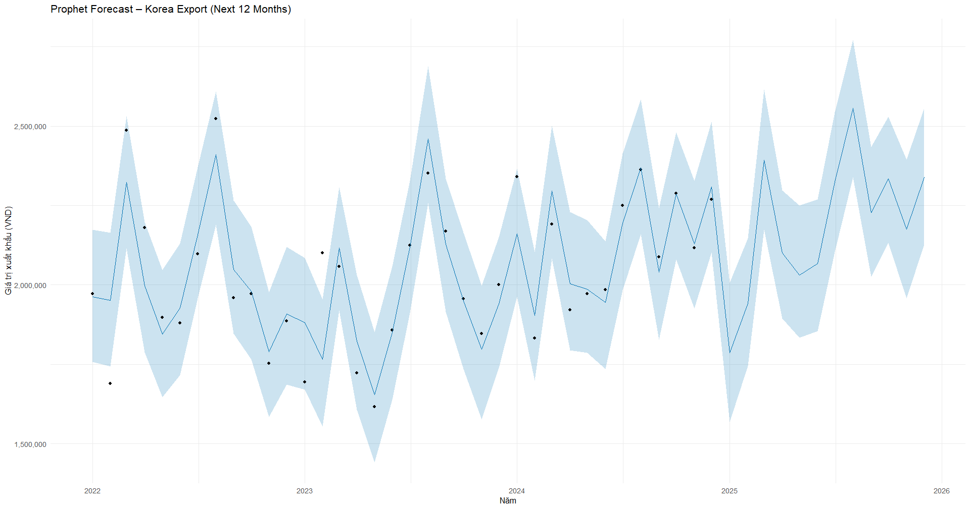
Implement Model
Korea

Slide 28
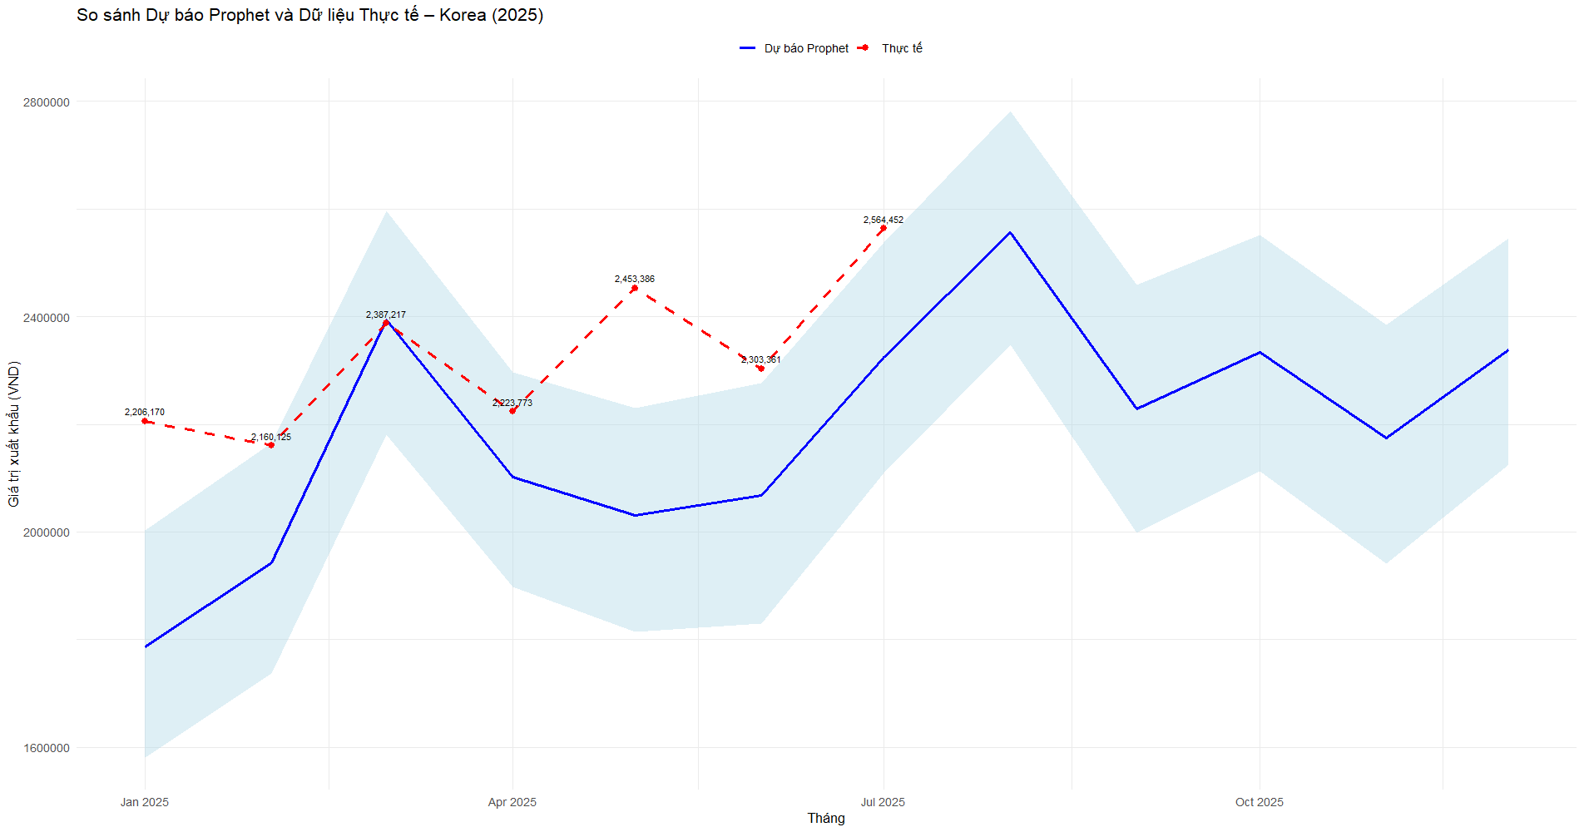
Implement Model
Korea

Slide 29
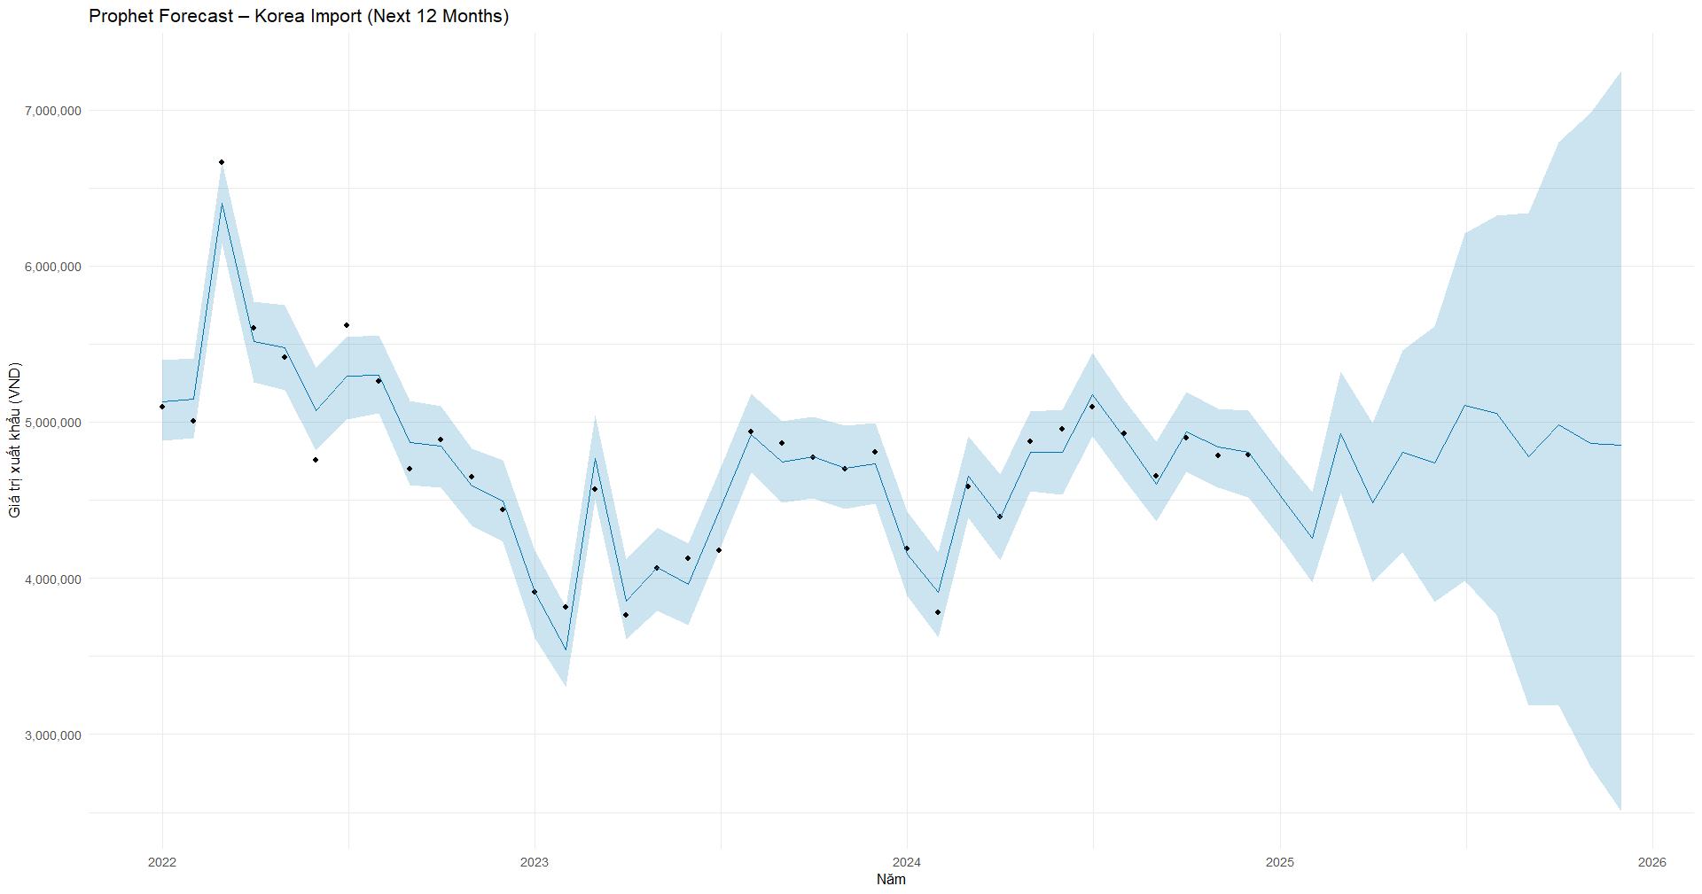
Implement Model
Korea

Slide 30
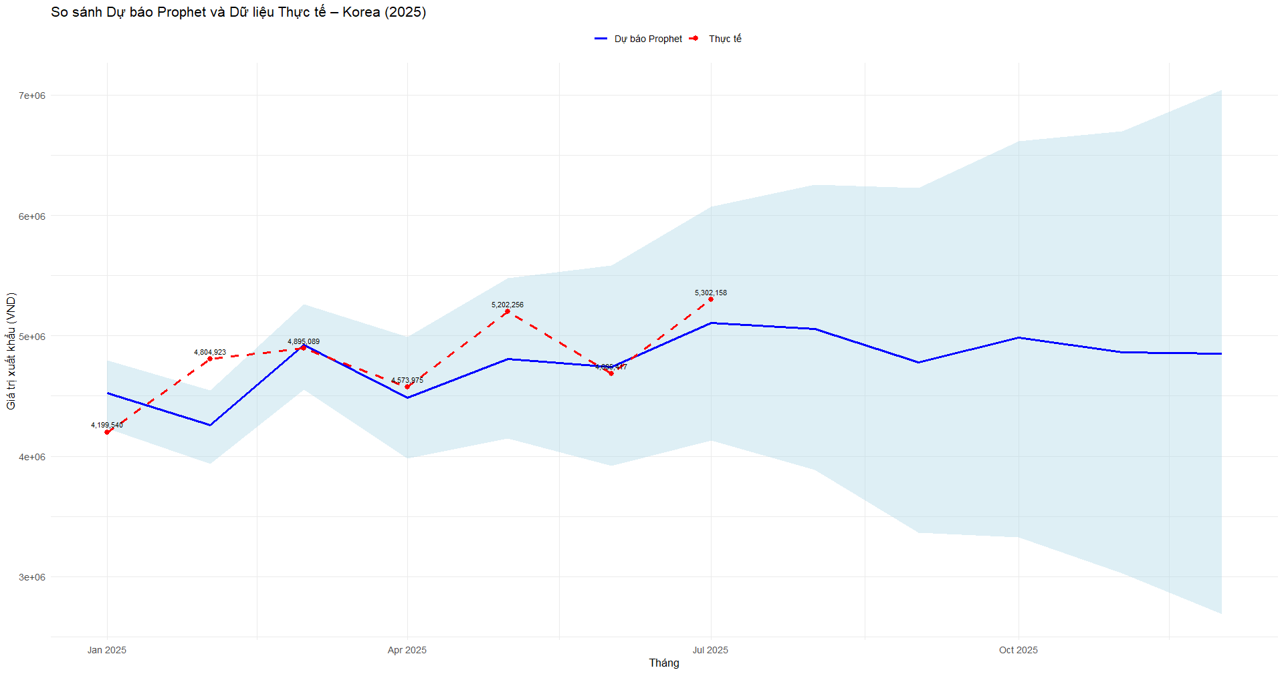
Implement Model
Korea

Slide 31
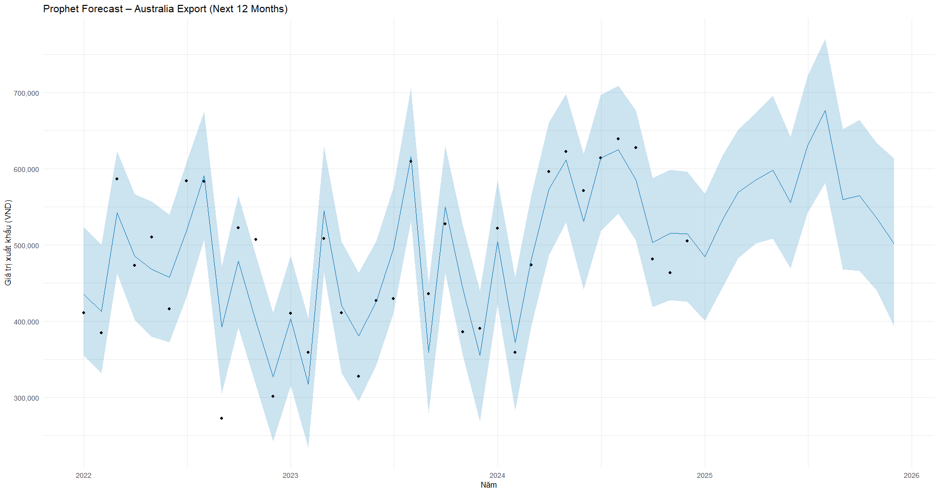
Implement Model
Australia

Slide 32
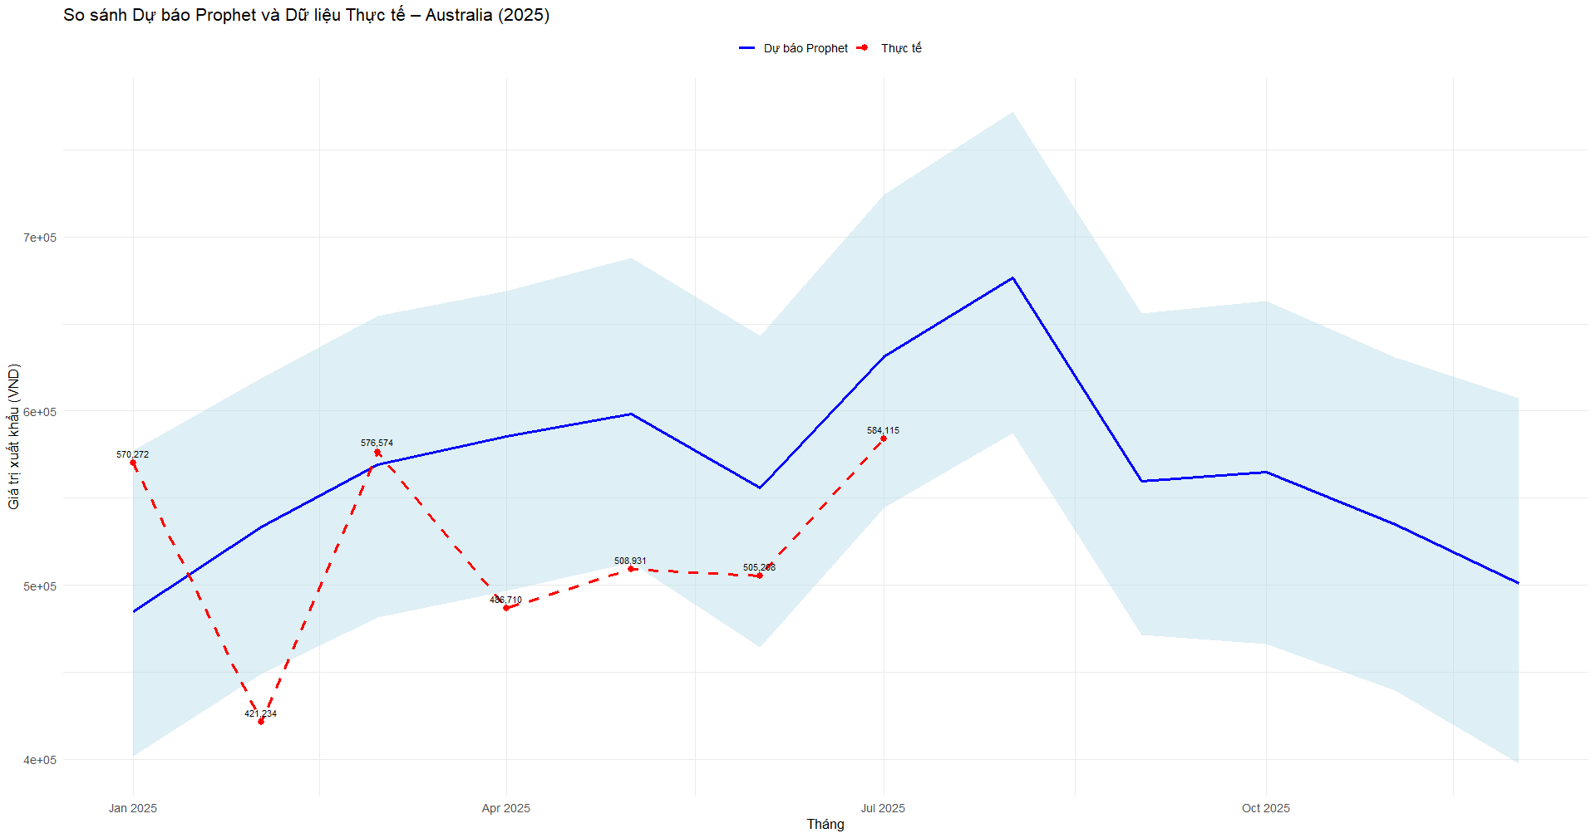
Implement Model
Australia

Slide 33
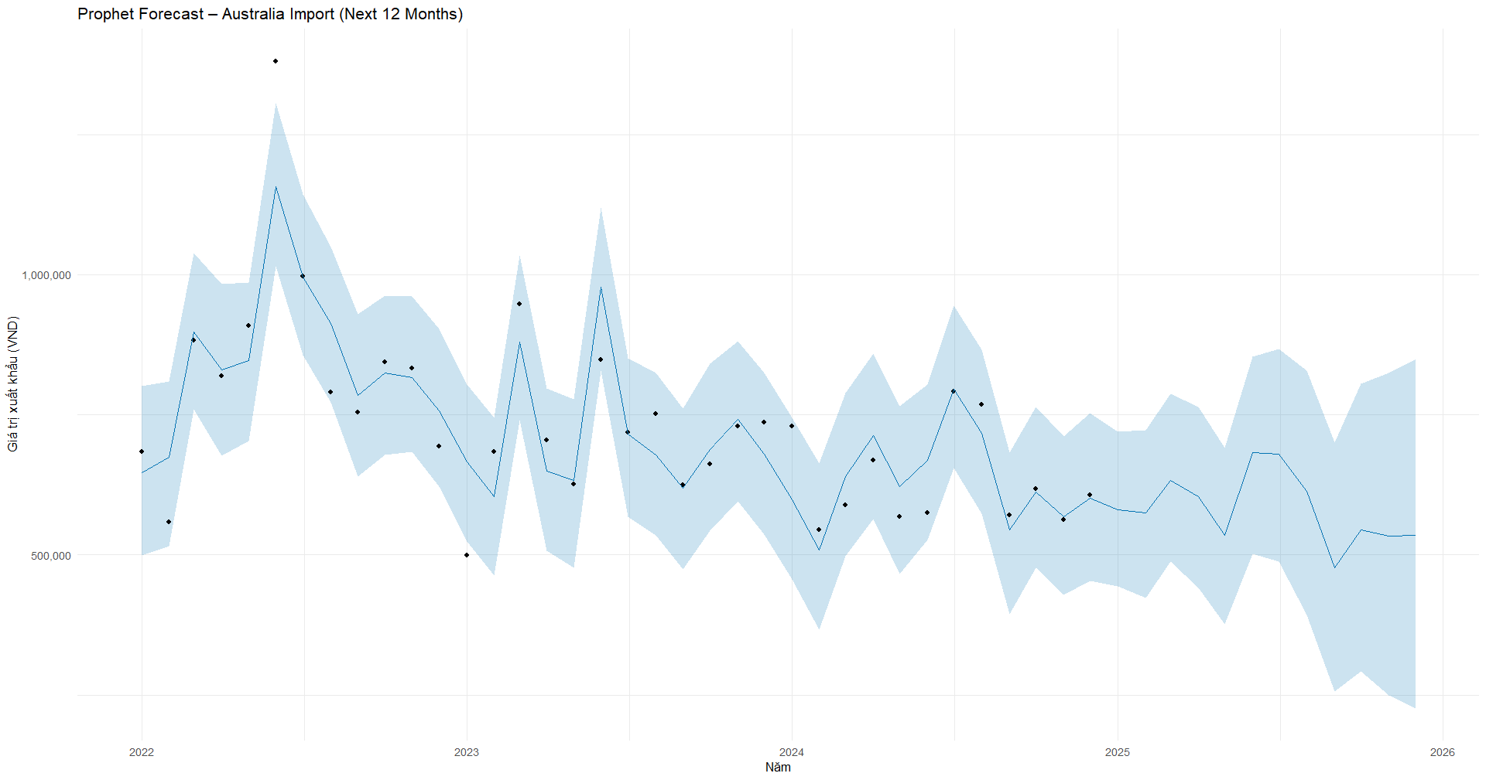
Implement Model
Australia

Slide 34
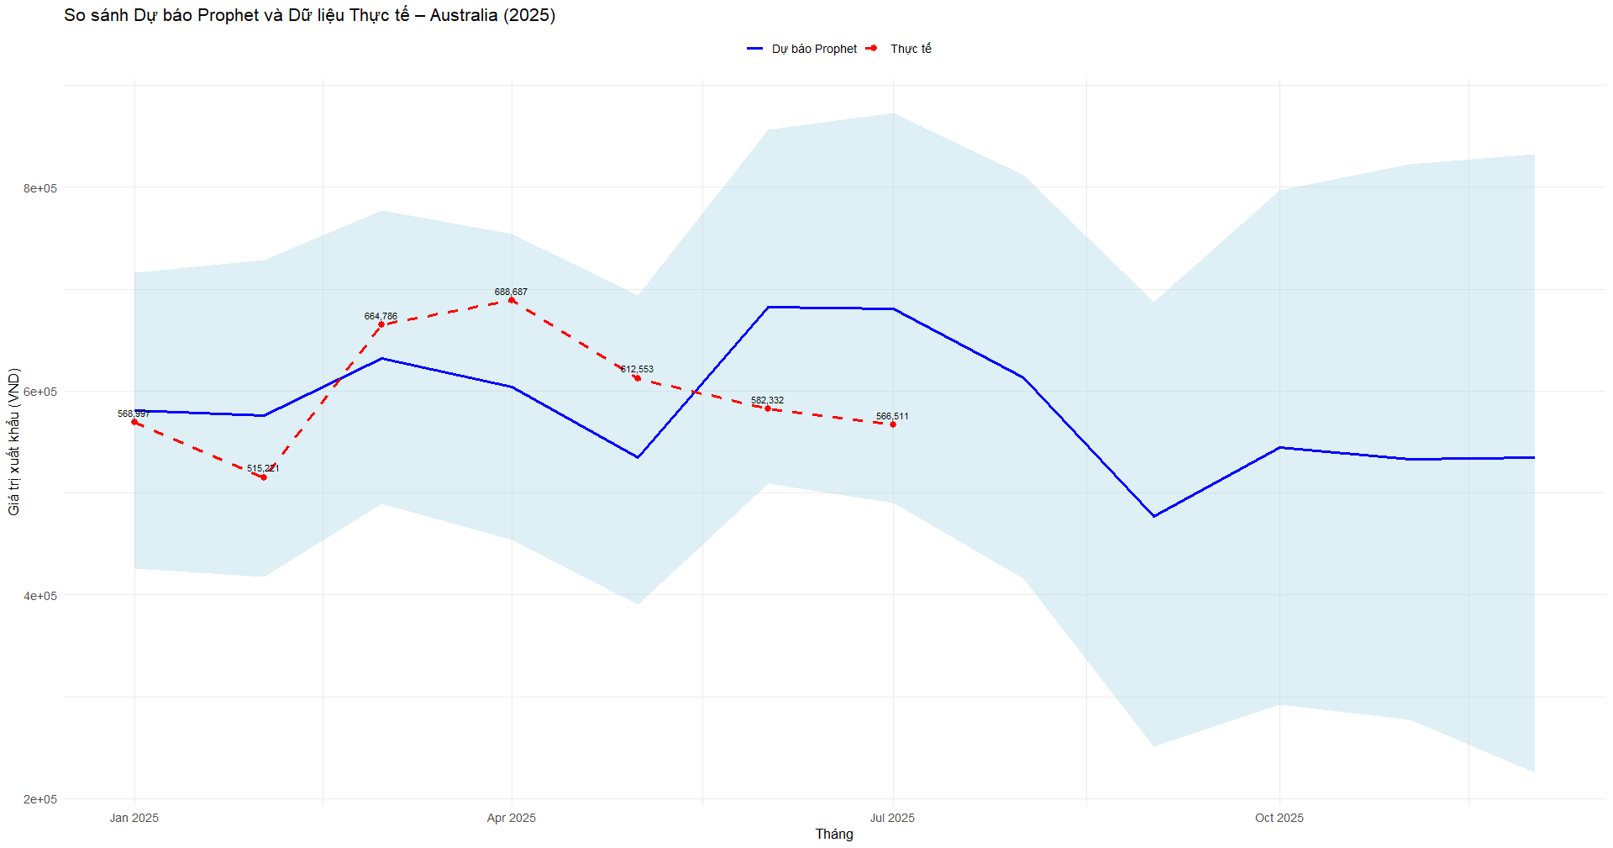
Implement Model
Australia

Slide 35
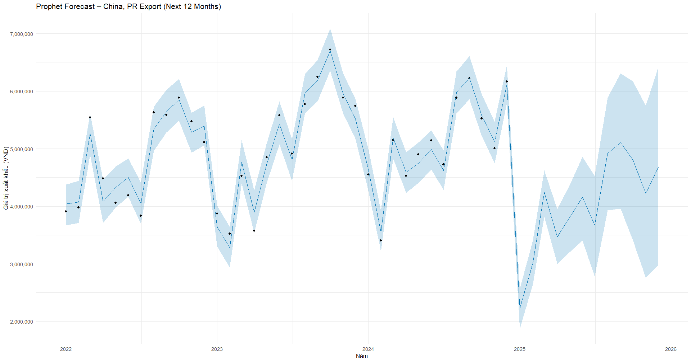
Implement Model
China

Slide 36
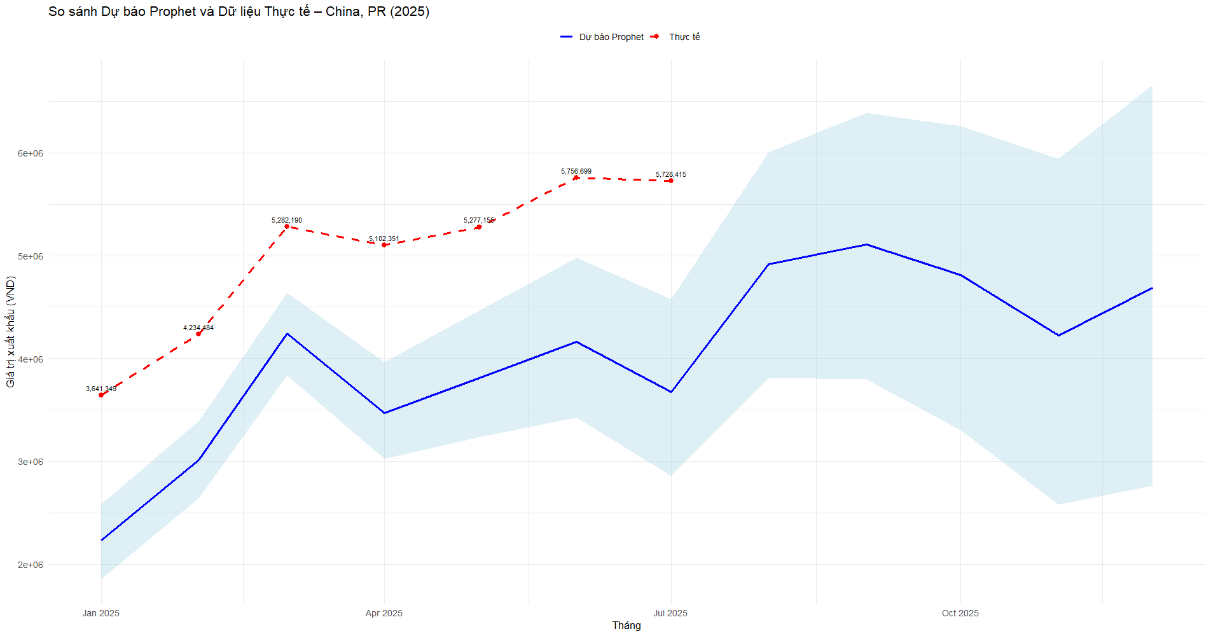
Implement Model
China

Slide 37
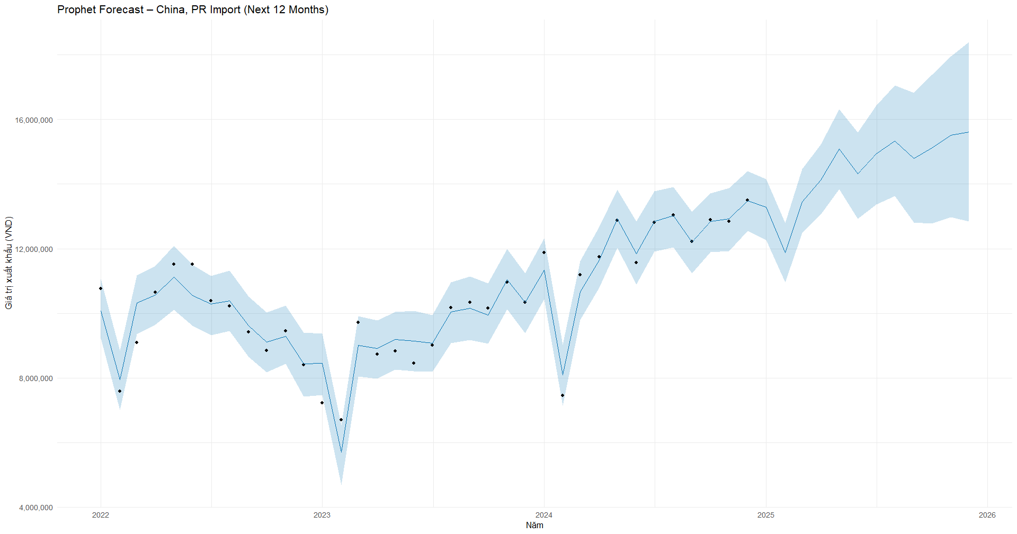
Implement Model
China

Slide 38
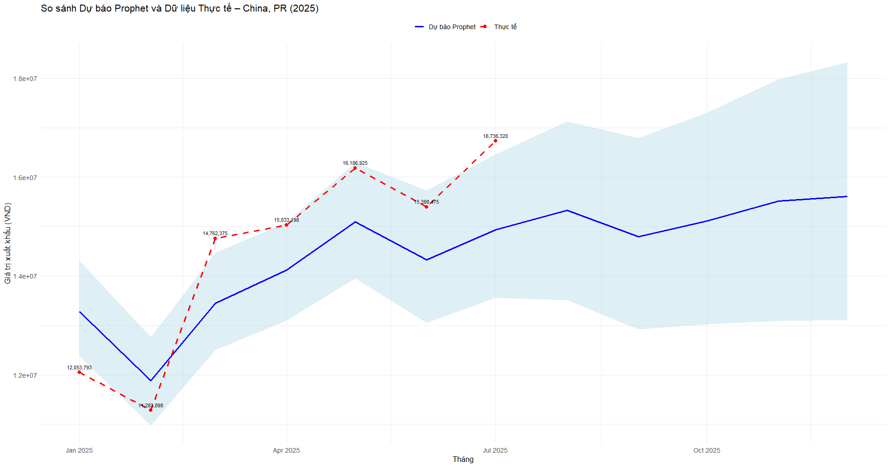
Implement Model
China

Slide 39
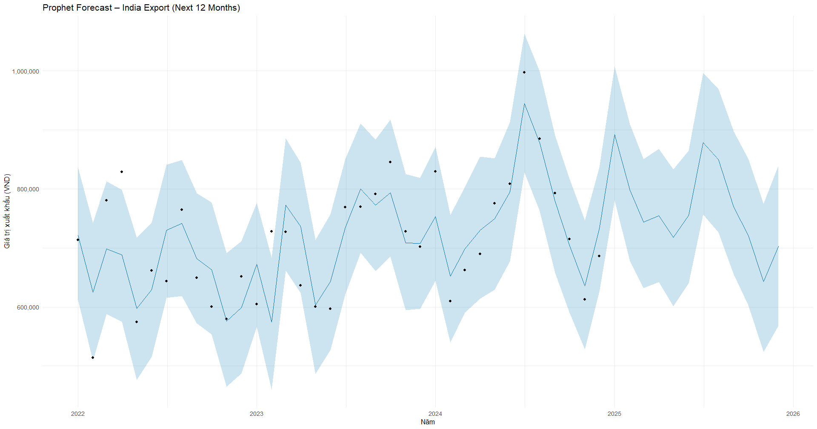
Implement Model
India

Slide 40
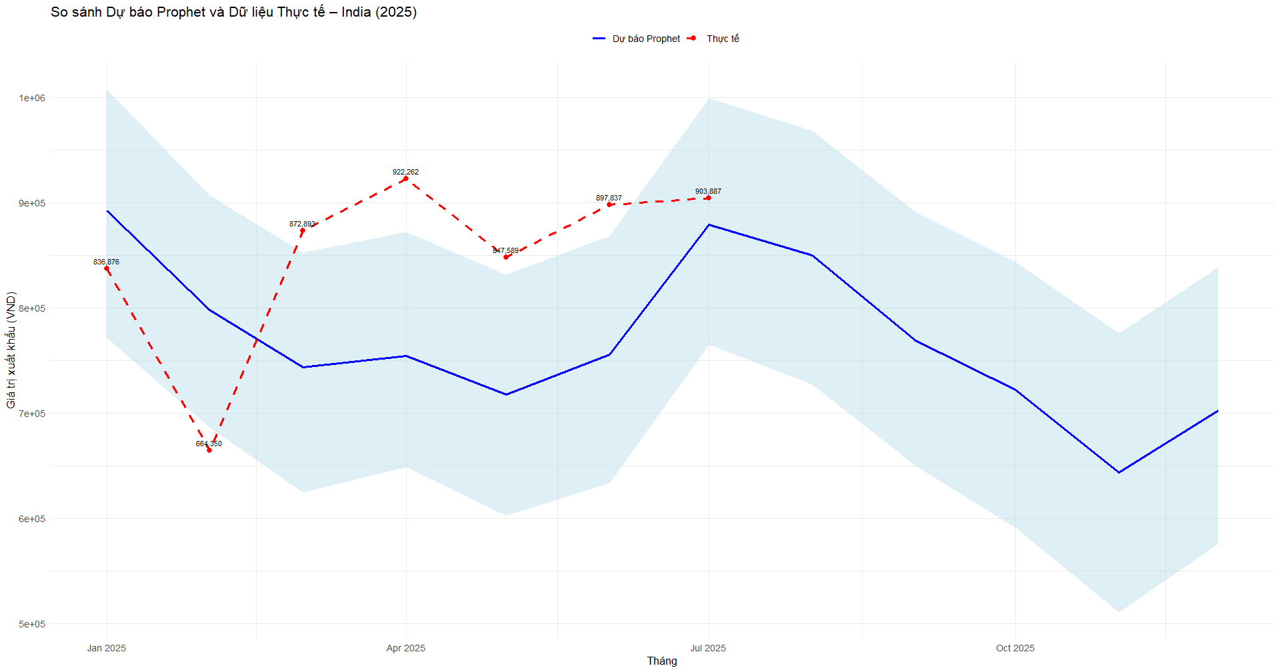
Implement Model
India

Slide 41
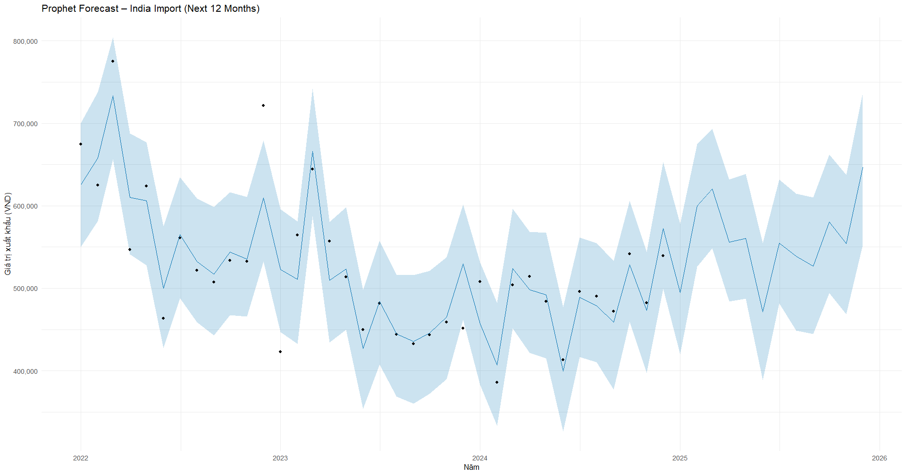
Implement Model
India

Slide 42
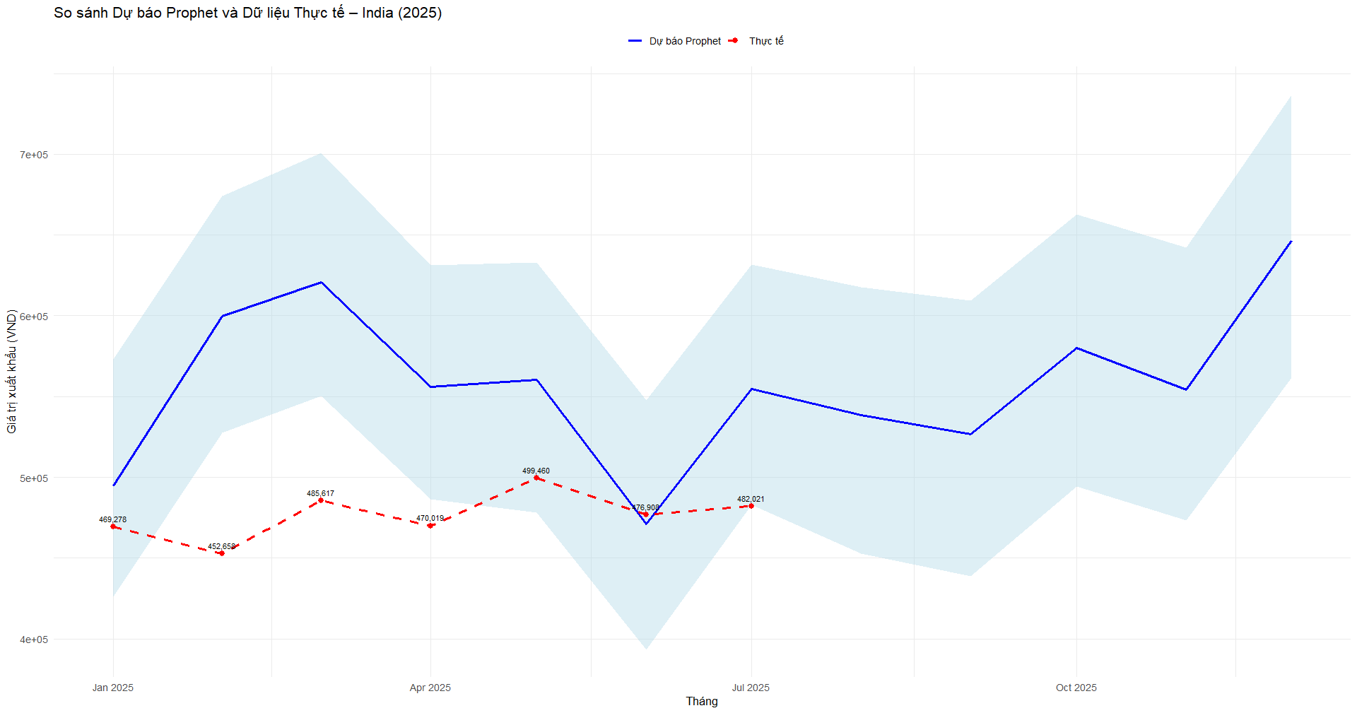
Implement Model
India

Slide 43
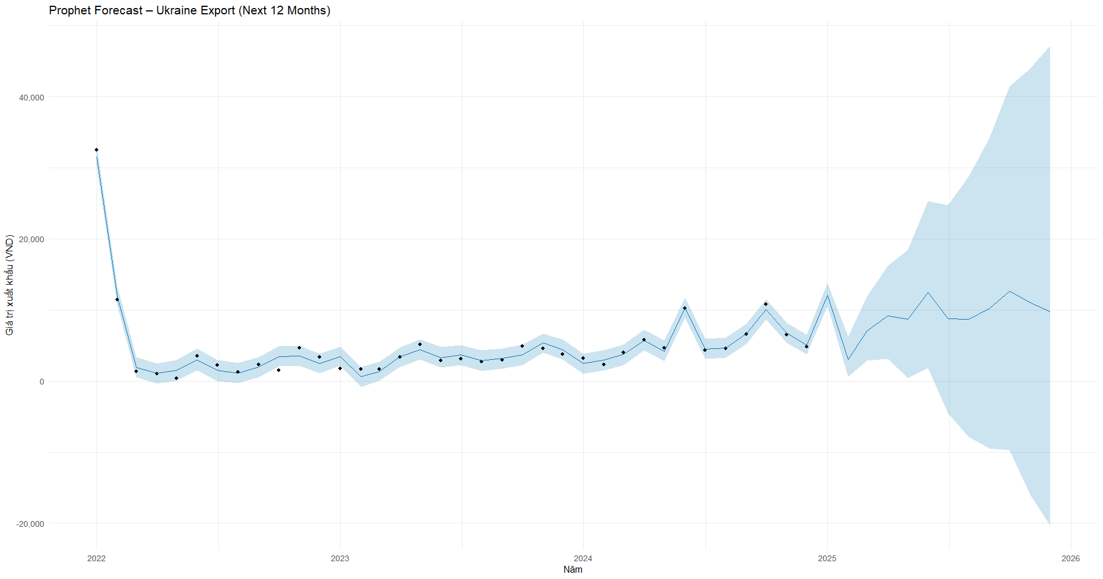
Implement Model
Ukraine

Slide 44
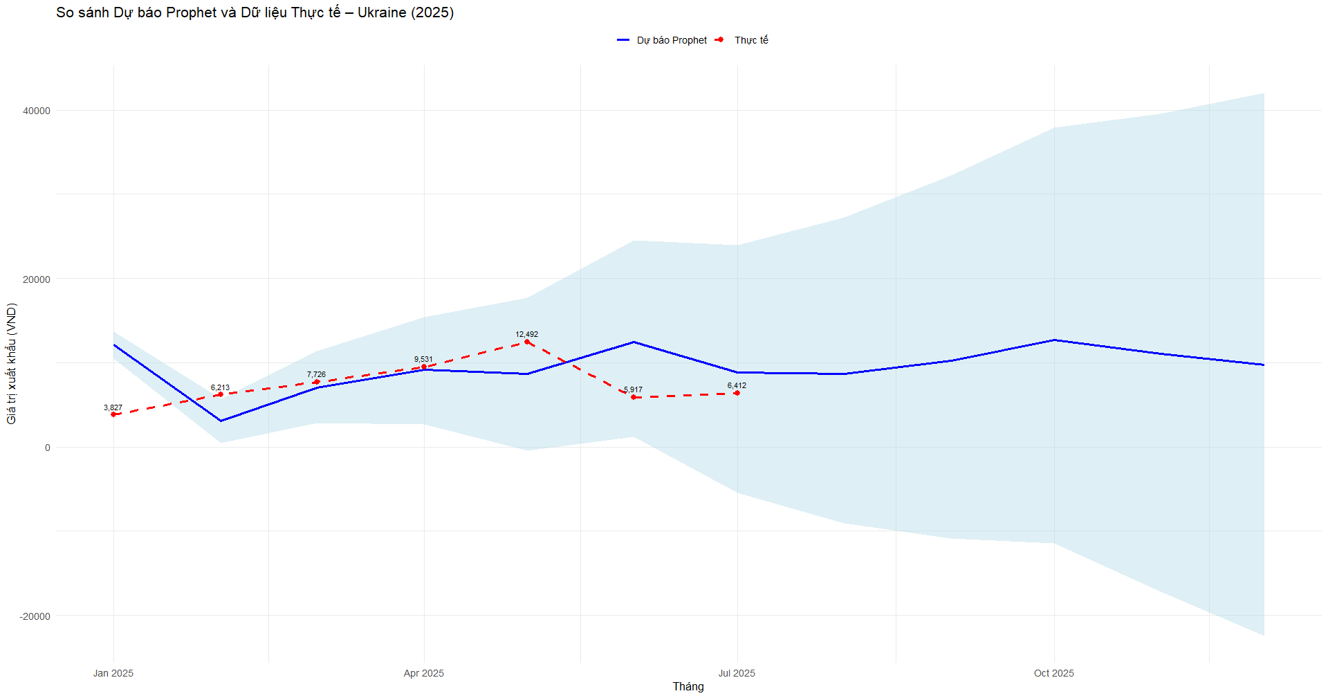
Implement Model
Ukraine

Slide 45
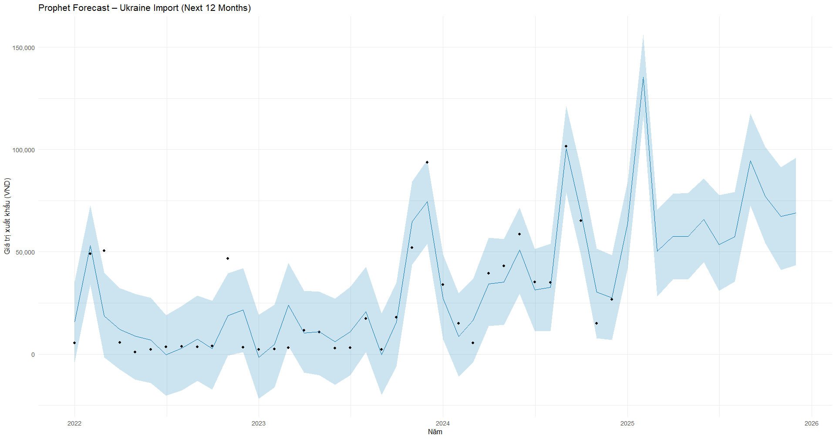
Implement Model
Ukraine

Slide 46
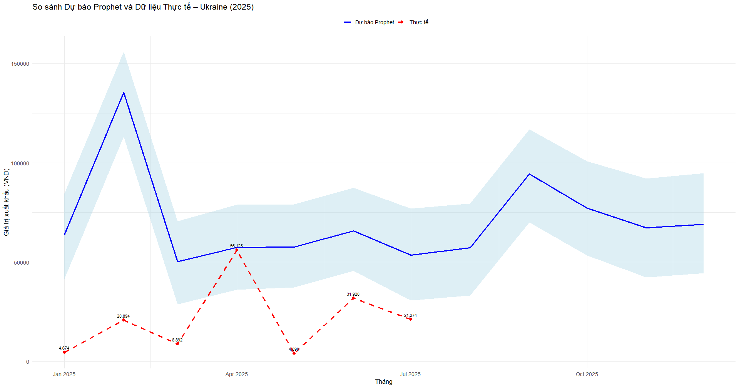
Implement Model
Ukraine

Slide 47


Metric of Model
Result of Model
  1. MAPE (Mean Absolute Percentage Error)
  → shows the average percentage difference between the predicted and actual values.
  → lower is better.
  2. RMSE (Root Mean Squared Error)
  → measures how far predictions are from actual values.
  → lower RMSE means the model predicts closer to reality.
 | EU | ASEAN | United States | Japan | Korea
MAPE | 8.8 % | 16.48 % | 6.05 % | 31.31 % | 4.88 %
RMSE | 126768.6 | 834600.5 | 101389.2 | 621258.3 | 295817.6
 | Australia | China | India | Ukraine
MAPE | 11.57 % | 7.85 % | 16.08 % | 549.81 %
RMSE | 76605.06 | 1195641 | 90225.52 | 57802.77

Slide 48
THANK YOU

