Slide 1
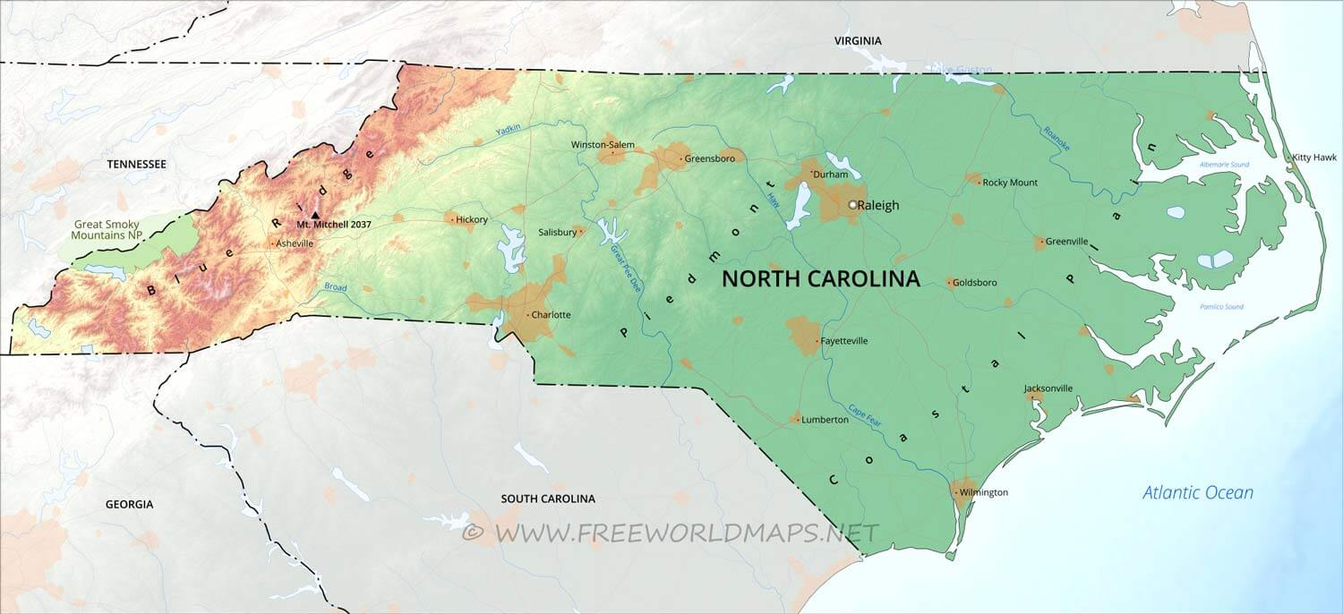
Project 3 Group 1
An analysis of the top 4 Metro Areas in North Carolina with respect to unemployment rate/percentage and statistics, (years 2015-2024): Charlotte, Raleigh, Greensboro, Winston-Salem

Slide 2
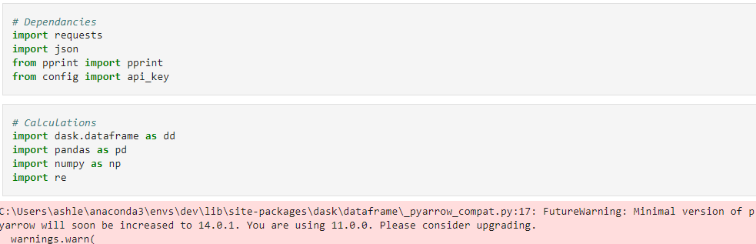

Import Dependencies

Slide 3
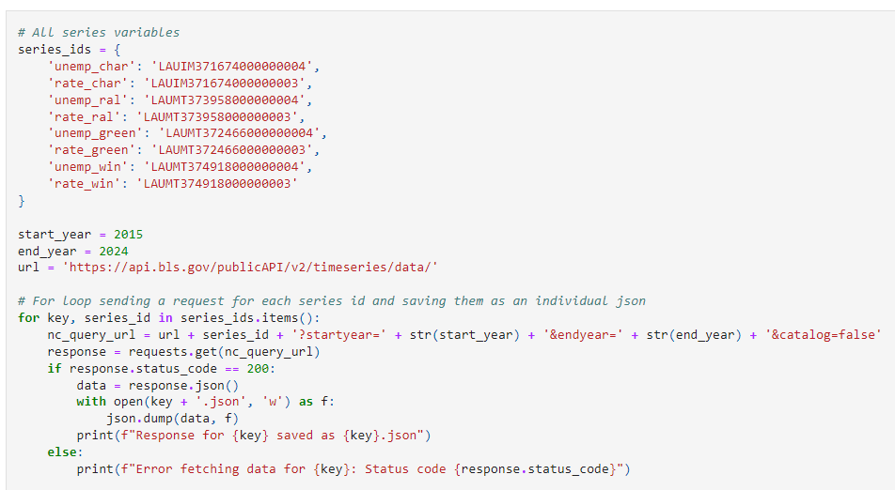
Capture Series ID Numbers and For Loop

Slide 4
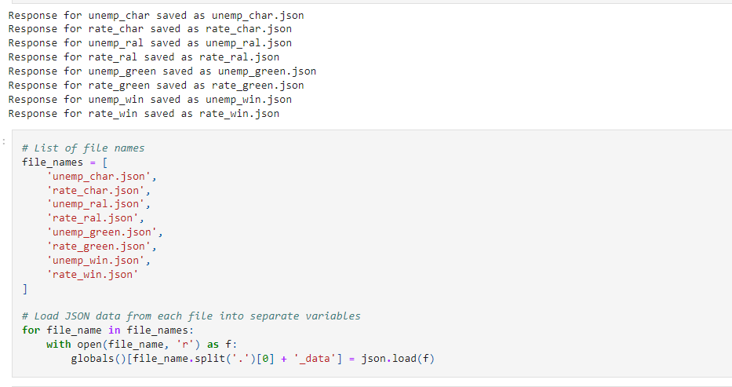
Capture Unemployment Rate and Value JSON’s

Slide 5
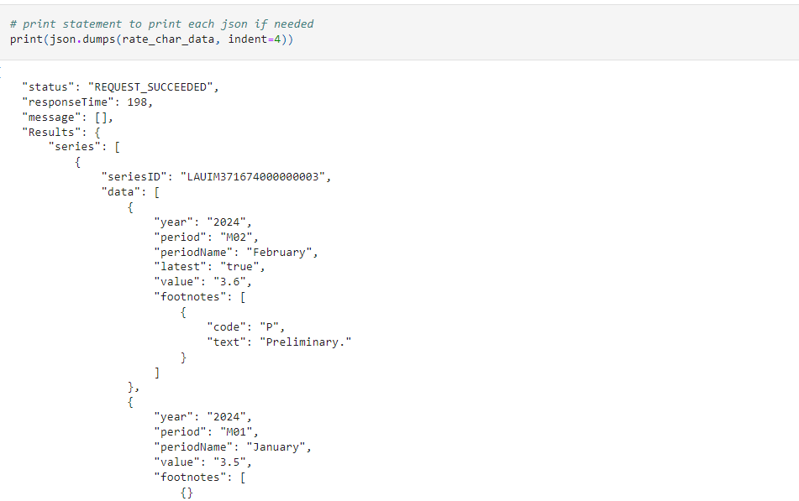
Cycle through all Series ID’s

Slide 6
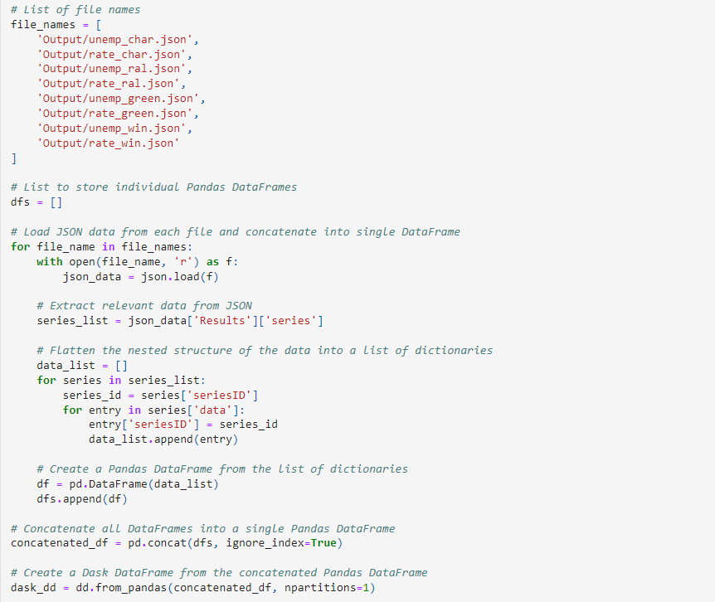
Transform Data

Slide 7
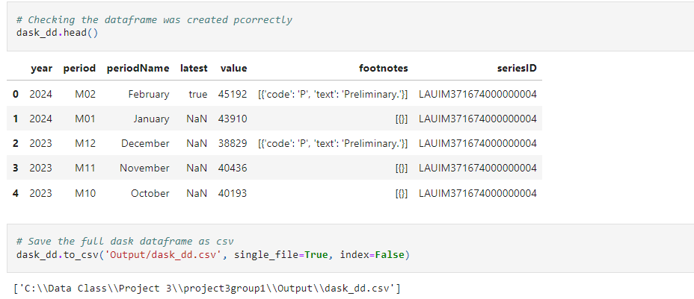
Load into CSV

Slide 8
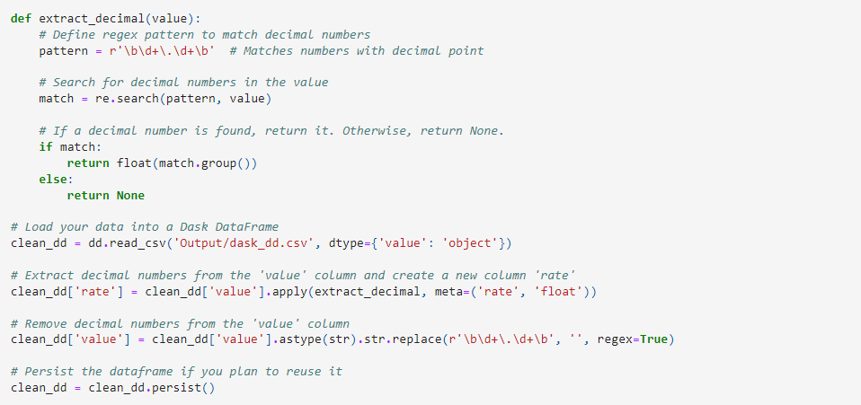
Extract and Transform Data

Slide 9
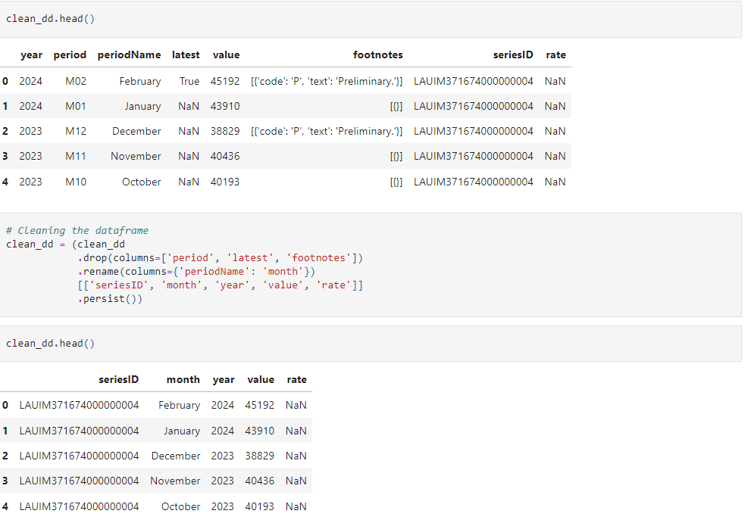
Transform Data

Slide 10
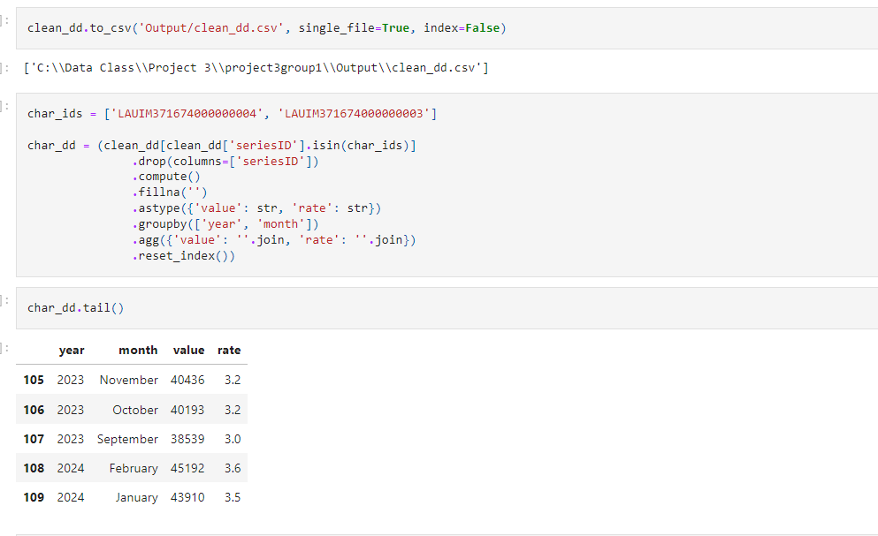
Extract and Transform Charlotte Data

Slide 11
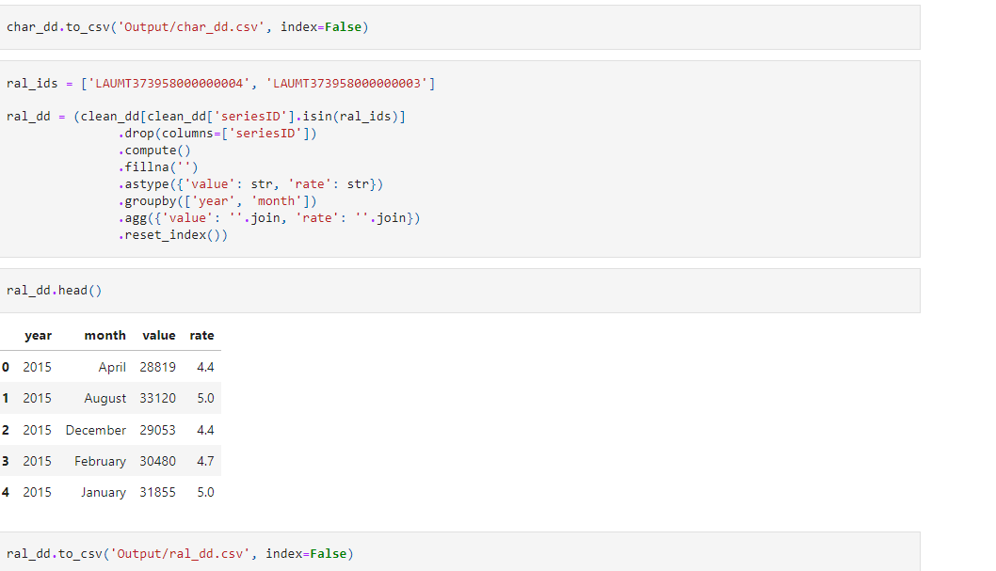
Extract and Transform Raleigh Data

Slide 12
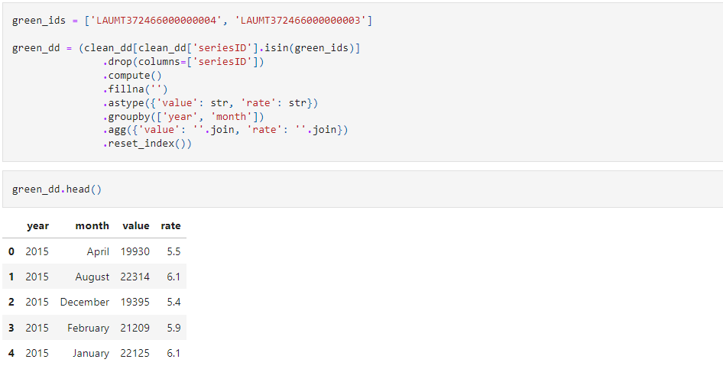
Extract and Transform Greensboro Data

Slide 13
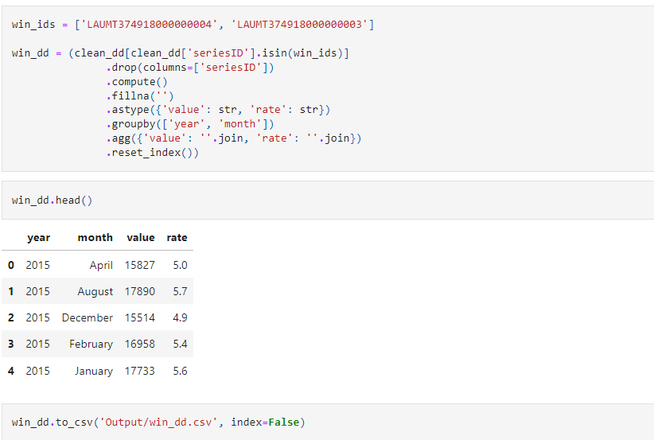
Extract and Transform Winston-Salem Data

Slide 14
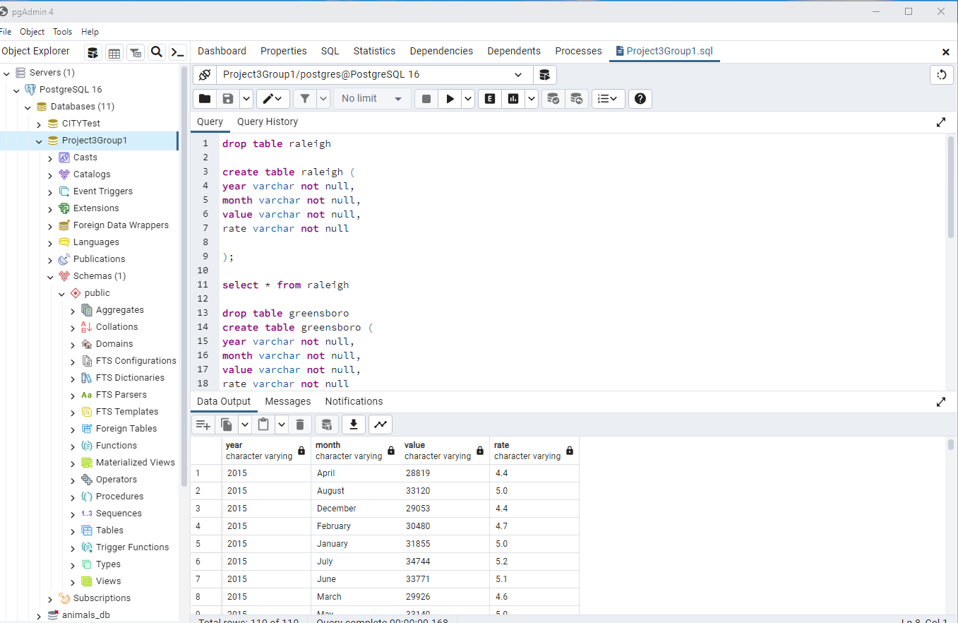
Load Raleigh SQL Table

Slide 15
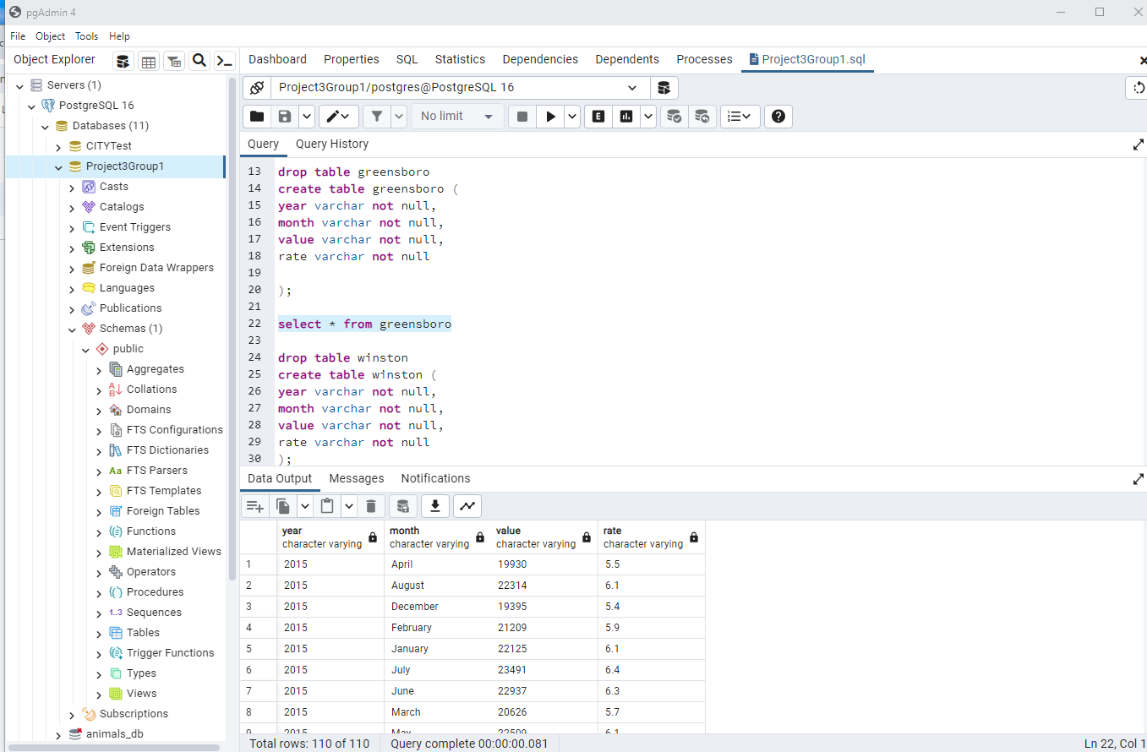
Load Greensboro SQL Table

Slide 16
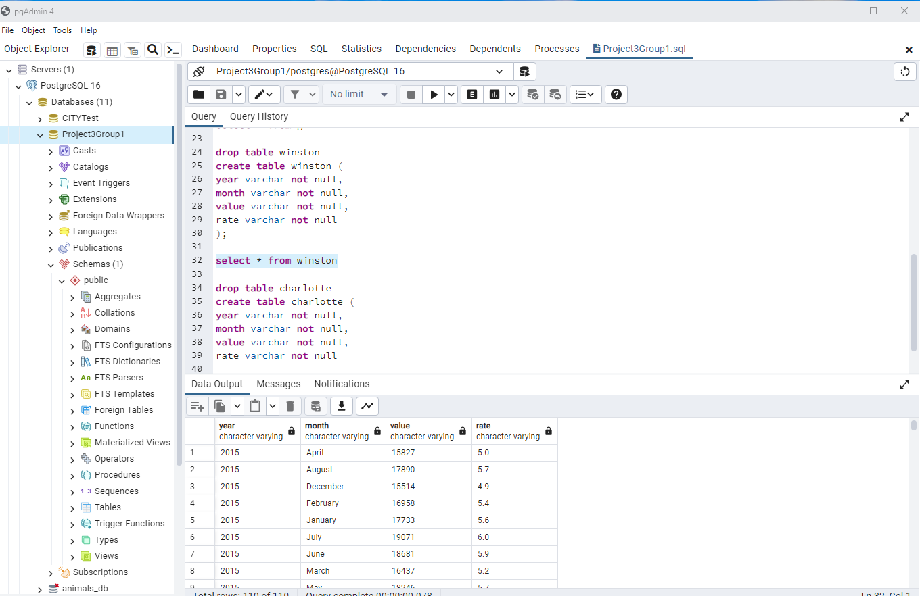
Load Winston-Salem SQL Table

Slide 17
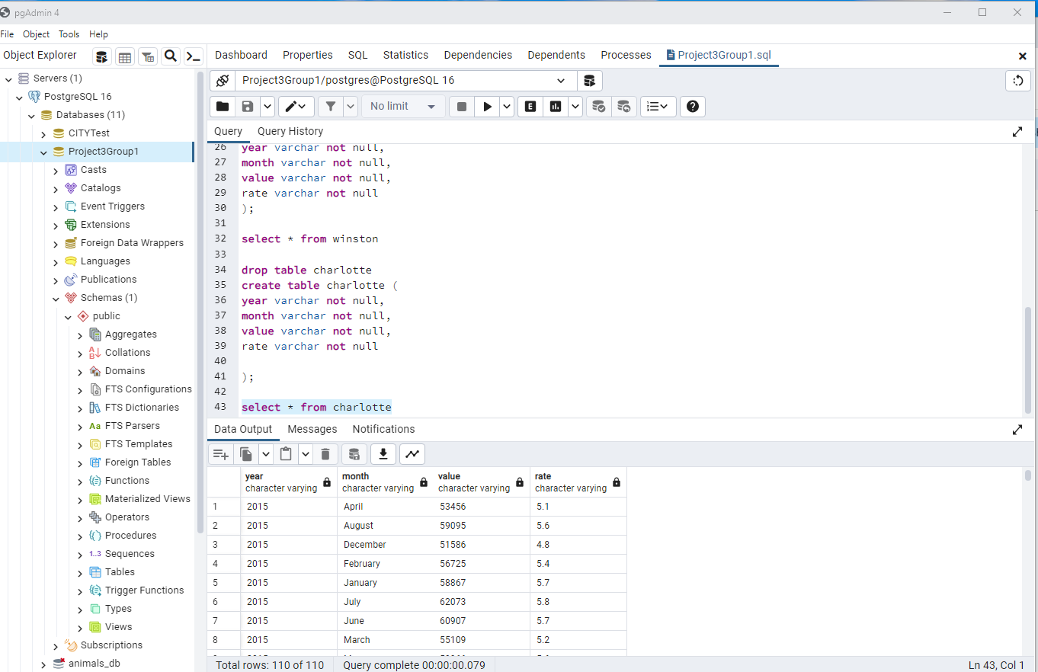
Load Charlotte SQL Table

Slide 18
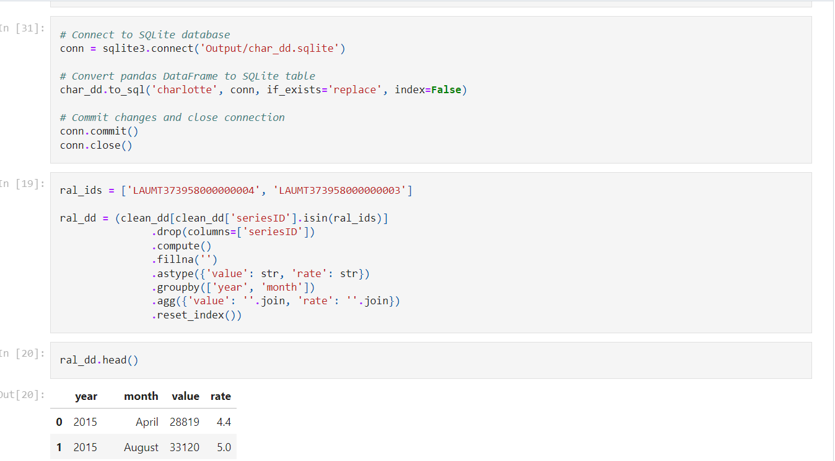
Load Pandas Dataframe and Convert to SQLite for all 4 Cities

