Slide 1
Analyzing CHRONIC DISEASE PREVALENCE HOT SPOTS using CDC “places” data
C. Scott Smith, PhD AICP
Epidemiologist, Cook County Department of Public Health
christopher.smith@cookcountyhealth.org
Notes:
Thanks to Maureen, Pam, Julie, Helen for inviting me here to talk about a few of my favorite topics.
[introduce self]
This presentation may be an about face from last month where you heard about qualitative methods, primary. Today the material emphasizes quantitative data analysis, primarily using secondary data sources. Although not all epidemiological spatial analysis is this way.

Slide 2
OUTLINE
CCDPH background
Limitations of chronic disease data
PLACES small area estimates
Cook County analysis by tract using R
Q & A
Notes:
[note size of group]
Feel free to ask questions along the way. I will also make time for q/a, discussion at the end.
What is spatial data? How does spatial data differ from geographic data? What type of information do you deal with that has a locational component? Most data has a locational component given that activities, phenomena take place somewhere. Always opportunities for spatial analysis.

Slide 3

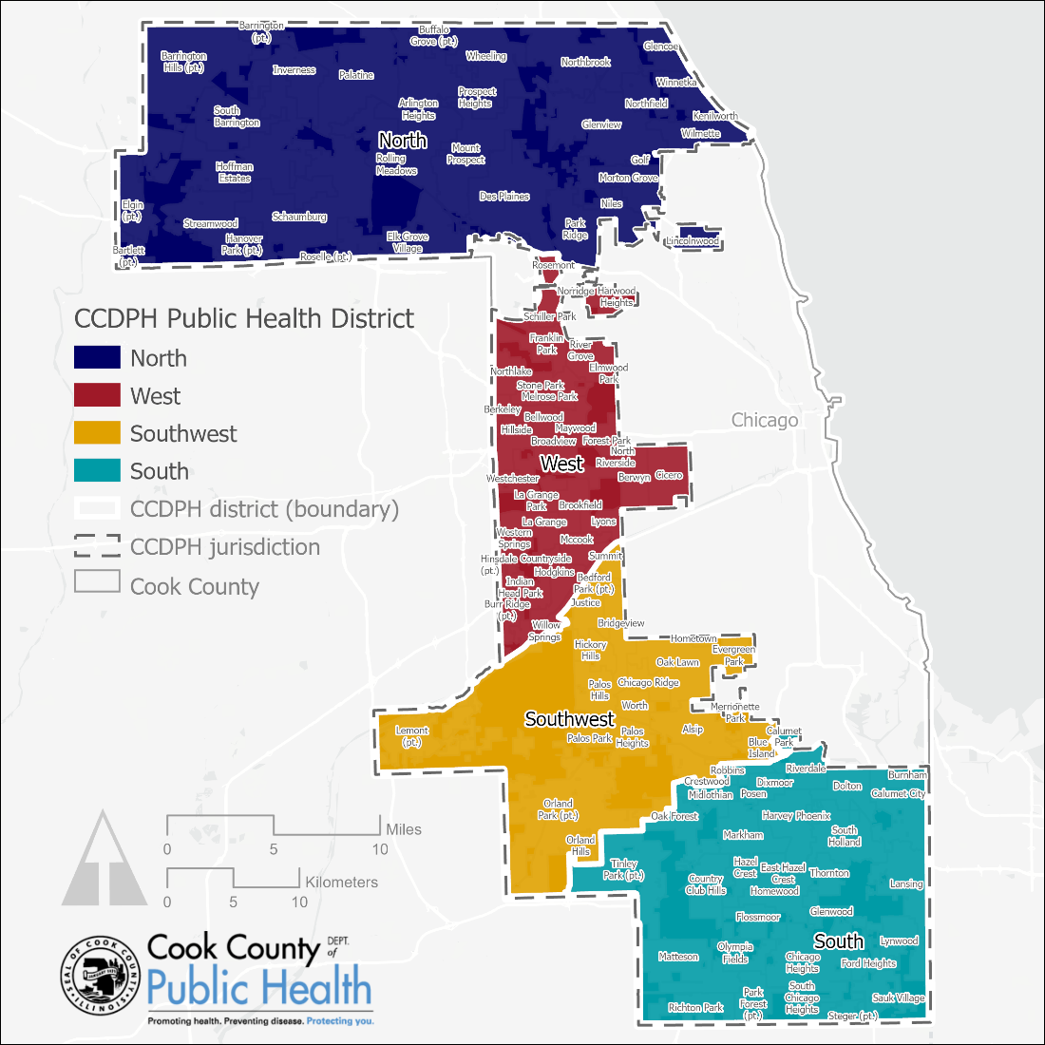


CCDPH JURISDICTION, DISTRICTS AND MUNICIPALITIES
With an estimated residential population of 2.3 million (PL 94-171, 2020), CCDPH is the second largest jurisdiction among local health departments located within Cook County, second only to the Chicago Department of Public Health (CDPH) district, which has a population of 2.7 million. CCDPH’s jurisdiction spans approximately 693 square miles, or 70 percent of Cook County’s total land area.
The CCDPH jurisdiction includes 120 municipalities and has an unincorporated area population of about 104,874, or 4.6 percent of the jurisdiction’s total. CCDPH jurisdiction also includes 27 townships (i.e., minor civil divisions), 10 political Cook County commissioner districts and four CCDPH districts: north, south, southwest and west.

Slide 4
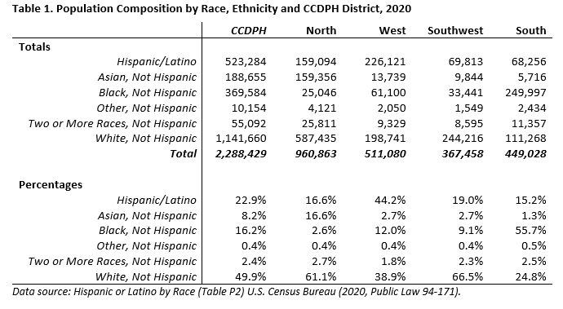
CCDPH JURISDICTION, DISTRICTS AND MUNICIPALITIES

Slide 5
Chronic disease DATA SOURCES
Population-based, large scale health surveys are designed to produce national or state health statistics. Standard survey estimates for the national and major subgroups are termed “direct” estimates because they are based only on the survey data and the selection probabilities for the sample in the subgroup of interest.
National Health Interview Survey (NHIS);
National Health and Nutrition Examination Survey (NHANES);
National Survey of Family Growth (NSFG)
National Survey of Children’s Health (NSCH)
Behavioral Risk Factor Surveillance System (BRFSS)
BRFSS is the premier health survey of U.S. residents regarding their health-related risk behaviors, chronic health conditions, and use of preventive services. Collected annually, the sample size is between 400,000 and 500,000 adults or 0.2 percent of the total adult population.

Slide 6
LIMITATIONS OF LARGE SCALE SURVEYS
Large scale surveys do not have statistically sufficient samples to produce direct survey estimates for most counties or subcounty areas.
Large scale surveys are typically collected/reported by administrative geographic units (e.g., city, county, or state), not legislative districts (e.g., congressional and state legislative districts) or other smaller geographic units (e.g., CCDPH district, community areas). The latter are better to inform decision makers/policy.
Large scale survey data are do not adequately characterize community-level disease hot spots and local health disparities—measures that are increasingly informing public health practice and service delivery.

Slide 7
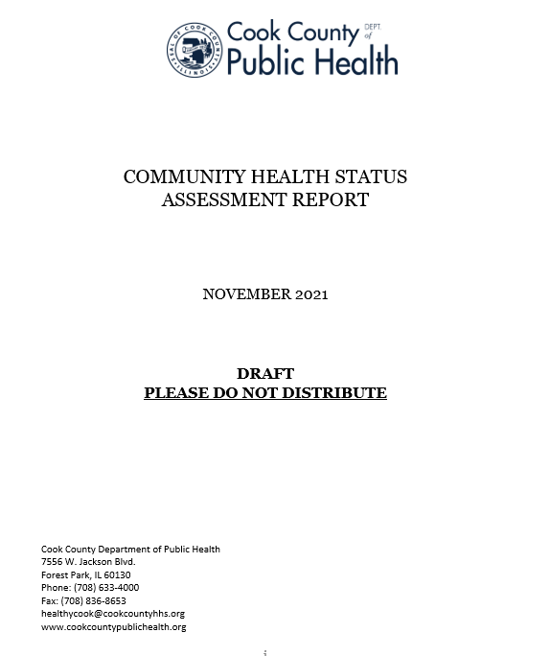
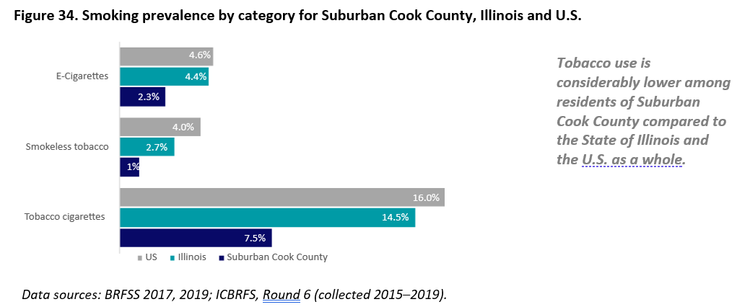
LIMITATIONS OF LARGE SCALE SURVEYS
Notes:
The Illinois County Behavioral Risk Factor Surveys (ICBRFS) is a statewide survey that collects county level health data using a standardized questionnaire and procedures established by the CDC and used for the BRFSS. ICBRFS data for Suburban Cook County (SCC) were downloaded from the IDPH website (2). The latest round 6 release includes information on alcohol use, arthritis, asthma, cardiovascular disease and other chronic health conditions stratified by Chicago, Suburban Cook County and Cook County as a whole.

Slide 8
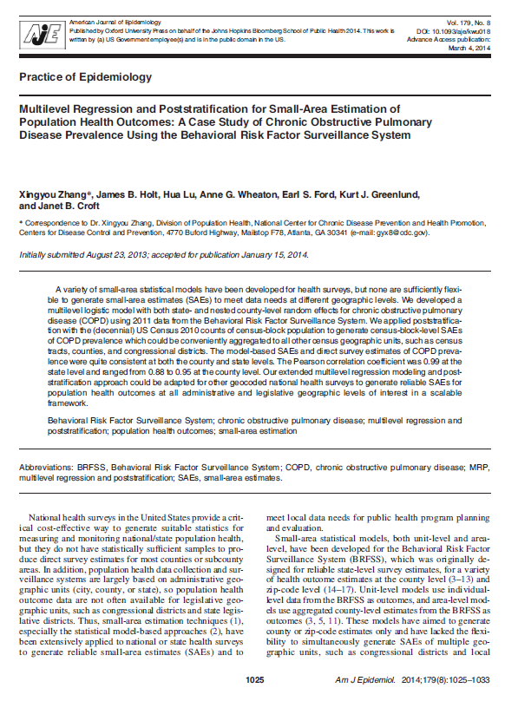
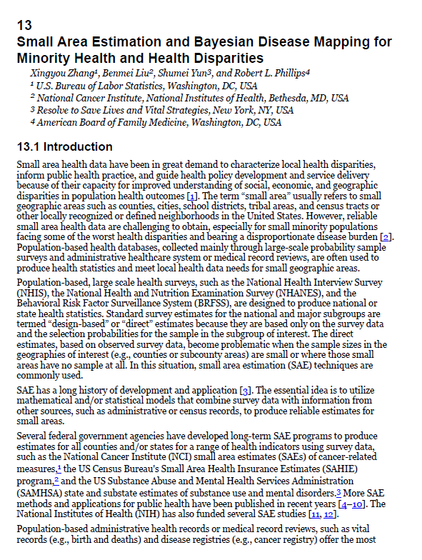
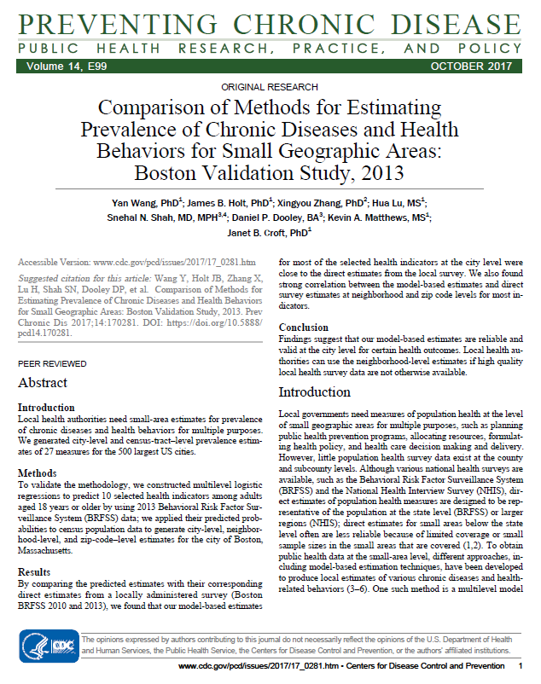
ADVANCES IN SMALL AREA ESTIMATES
Notes:
The CDC uses a multilevel regression and poststratification (MRP) unit-level approach which links geocoded health surveys--specifically, the Behavioral Risk Factor Surveillance System (BRFSS)--with demographic and socioeconomic data made available in the American Community Survey (ACS) to estimate geographic distributions of population disease burden and health behaviors at the community level. These unit-level models first predict the expected responses for all the individuals within a small area; then summarize these predicted values for all individuals to obtain health outcome values for the area as a whole. This approach can be done using more basic statistical approaches (e.g., generalized linear mixed models) and Bayesian approaches. Both models borrow information across space to estimate local disease burden. We are exploring various methods at CCDPH to reliably report out our jurisdiction-wide surveys at smaller geographies.

Slide 9
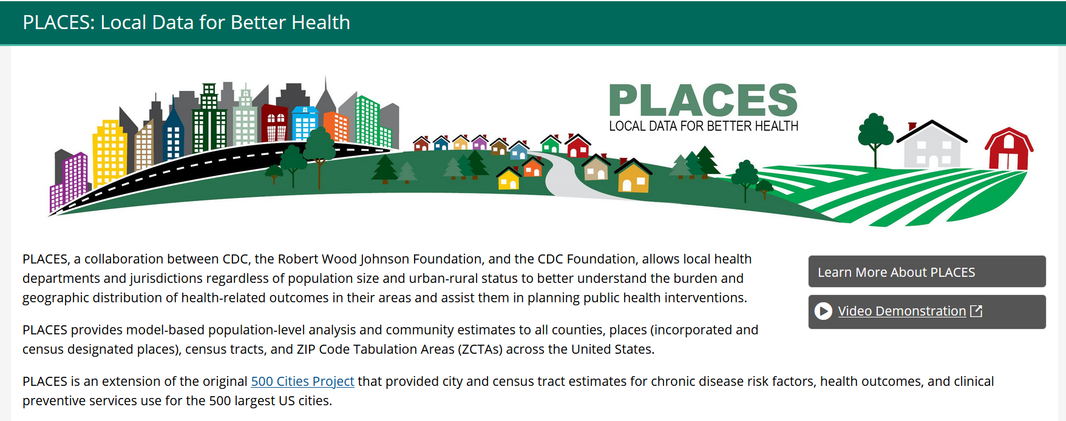
CDC PLACES DATA
https://www.cdc.gov/places/
Notes:
This project reports county-, place-, census tract-, and ZCTA-level data and uses small area estimation methods to obtain 28 chronic disease measures for the entire United States. The data are published through a public, interactive “PLACES” website that allows users to view, explore, and download data by county, place, census tract, and ZCTA. Although limited data are available at the county and metropolitan levels, this project represents a first-of-its-kind data analysis to release information for all US counties, places, census tracts, and ZCTAs. This system complements existing surveillance data by providing estimates necessary to understand the health issues affecting the residents of local areas of all sizes and regardless of urban or rural status; develop and implement effective and targeted prevention activities; identify health problems; and establish key health objectives.
CDC uses an innovative peer-reviewed multilevel regression and poststratification (MRP) approach that links geocoded health surveys and high spatial resolution population demographic and socioeconomic data. The approach also accounts for the associations between individual health outcomes, individual characteristics, and spatial contexts and factors at multiple levels (e.g., state, county); predicts individual disease risk and health behaviors in a multilevel modeling framework; and estimates the geographic distributions of population disease burden and health behaviors. The MRP approach is flexible and will help CDC provide modeled estimates of the prevalence for each indicator at the census tract and city levels. Small area estimates using this MRP approach have been published using data from CDC’s Behavioral Risk Factor Surveillance System (BRFSS) and the National Survey of Children’s Health.

Slide 10
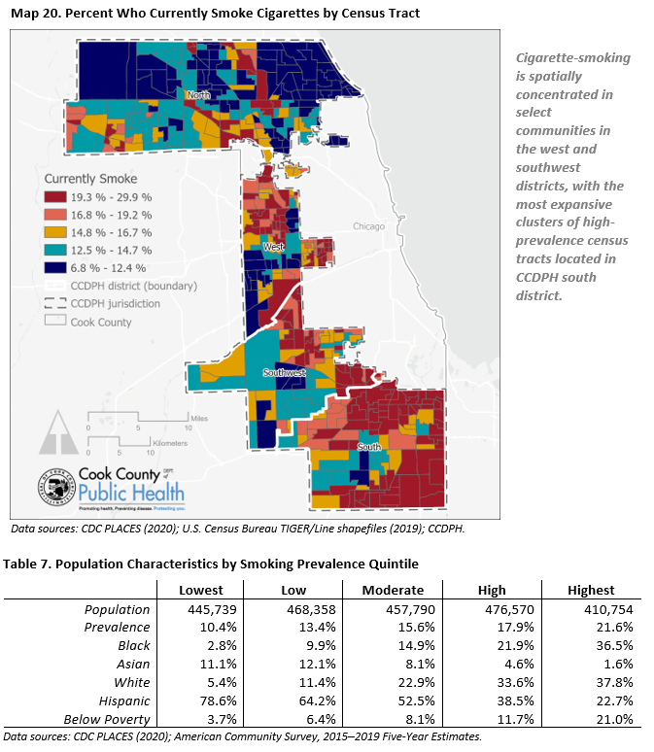
SMALLER AREA SUMMARIES USING PLACES DATA
Cigarette-smoking is spatially concentrated in select communities in the west and southwest districts, with the most expansive clusters of high-prevalence census tracts located in CCDPH’s south district.

