Slide 1
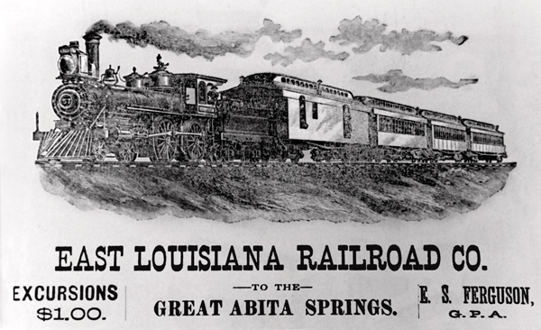
1896—Plessy v. Ferguson
The Supreme Court examined the constitutionality of Louisiana laws (1890, the state adopted its Separate Car Act) that provided for the segregation of railroad car seating by race. The court upheld the "white section" and "colored section" Jim Crow seating law, contending that segregation did not violate any rights guaranteed by the Constitution.
Notes:
After Dred Scott, Plessy is probably the most notorious decision involving race in the history of the United States Supreme Court. It is the case identified with the principle of “separate but equal”—the theory that segregation is not per se discrimination. Plessy is the decision the Supreme Court had to overturn, in Brown v. Board of Education, in 1954, to declare that school segregation violated the equal-protection clause of the Fourteenth Amendment. When the South began instituting Jim Crow, after the end of Reconstruction, laws mandating separate cars on trains appeared across the region. One of the first was passed in Florida, in 1887, followed by Mississippi, in 1888, and Texas, in 1889. When Louisiana passed its separate-cars law, a New Orleans lawyer and newspaper editor named Louis Martinet—his mother was born a slave; his father, a Belgian, bought her freedom—formed the Citizens’ Committee to Test the Constitutionality of the Separate Car Law, and set about building a case. On June 7, 1892, he boarded a train, one travelling only within the state of Louisiana, and sat in the car for white passengers. When the conductor asked if Plessy was colored, he said yes, and was removed from the train and booked. (Train conductors were in a ridiculous position: even if the law required trains to have separate cars, riders could still sue the conductor for misclassifying them.)

Slide 2
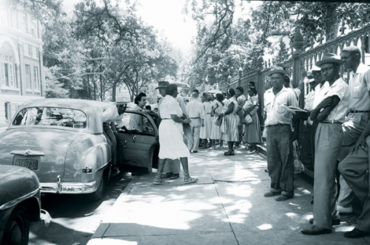
1953—Baton Rouge Bus Boycott
African Americans in Baton Rouge, the capital of Louisiana, staged the nation's first successful bus boycott. African Americans accounted for the overwhelming majority of Baton Rouge bus riders and two-thirds of the bus company's revenue. Their economic boycott effectively disrupted the financial stability of the bus company, costing it over $1,600 a day.
Notes:
The boycott was prompted partly by the 1950 decision by the Baton Rouge city council to support the financially strapped municipal bus company by revoking the licenses of nearly 40 competing black-owned transportation companies. African Americans now had no choice but to ride segregated buses operated by the city-owned bus company. Blacks made about 80% of the bus riders on the city bus system but were required to sit back of the bus or stand even if the front seats reserved for whites remained empty. In January of 1953, the same day bus fares rose from 10 to 15 cents for all riders, Reverend T.J. Jemison, pastor of Mt. Zion First Baptist Church, the largest black church in Louisiana, complained to the city council which in response passed Ordinance 222 which allowed blacks to sit in “white” seats if the bus was crowded and those seats were unoccupied. Blacks however, could not sit next to whites or in front of them.

Slide 3

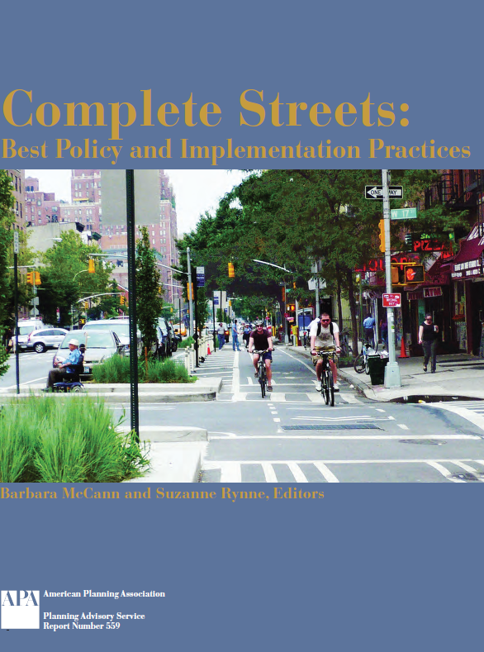
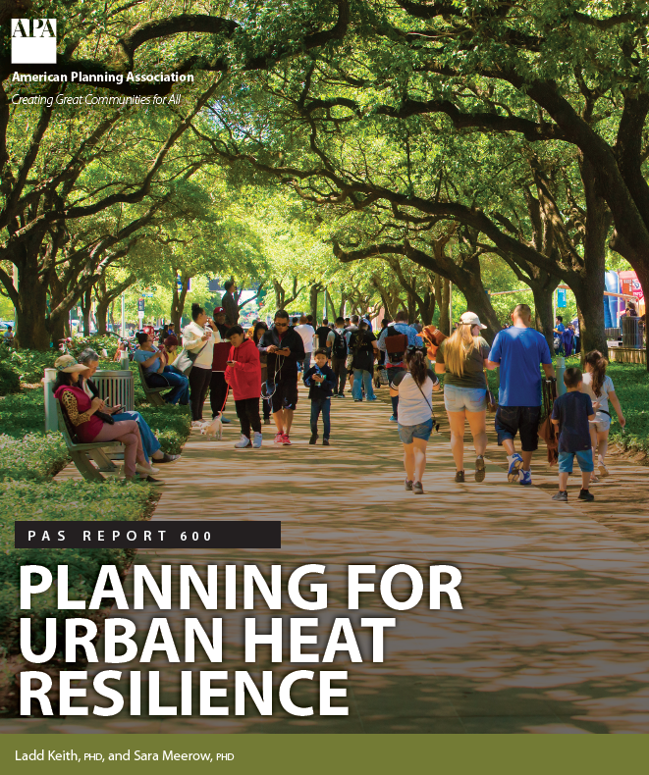
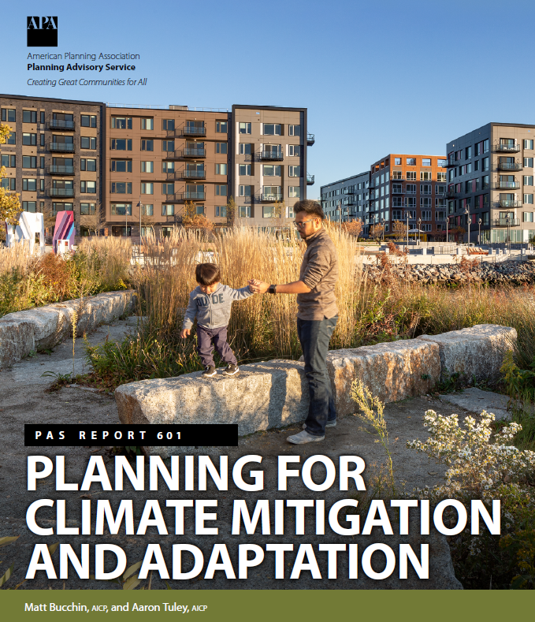
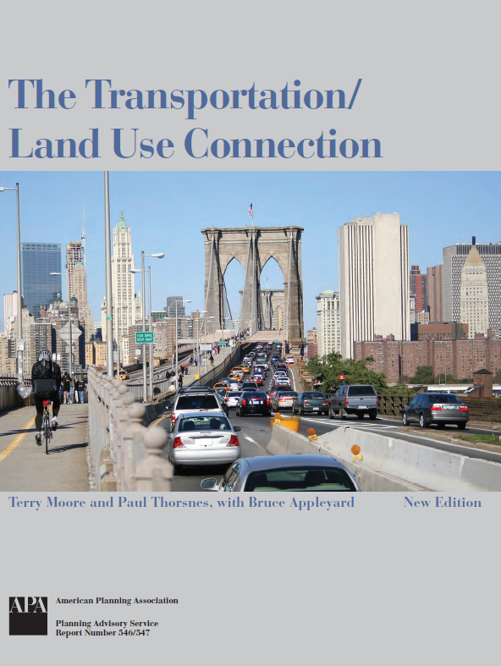

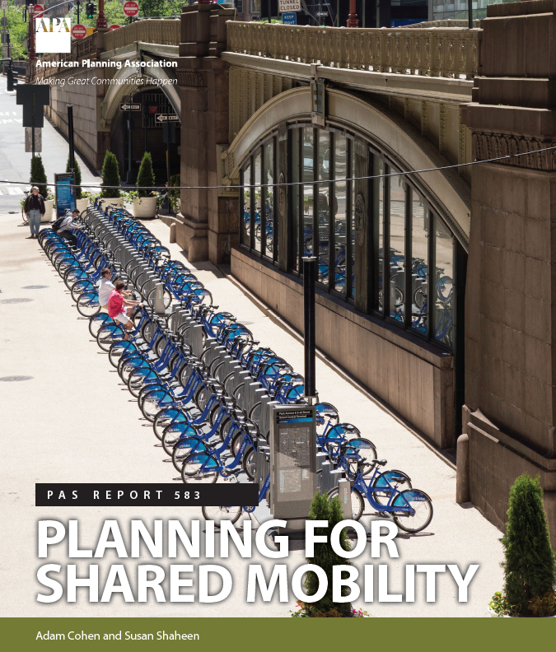
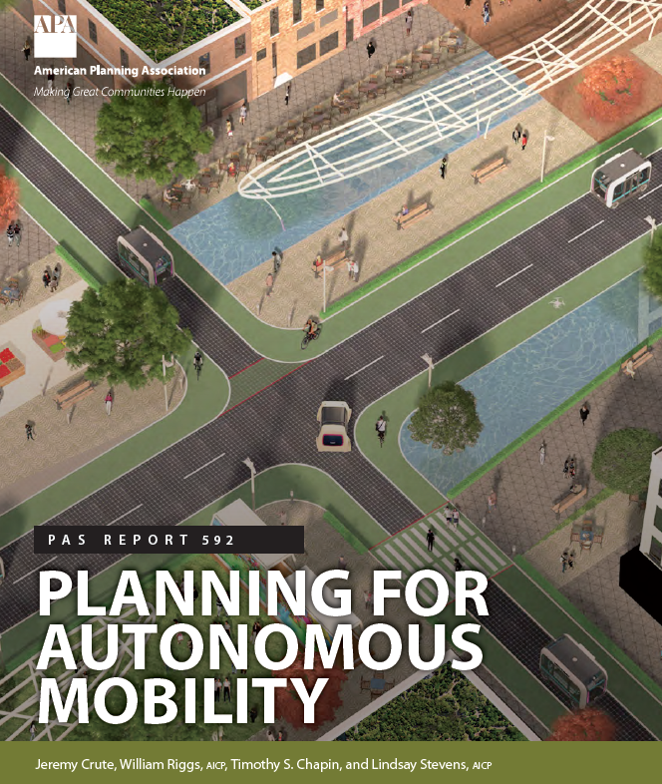

Slide 4
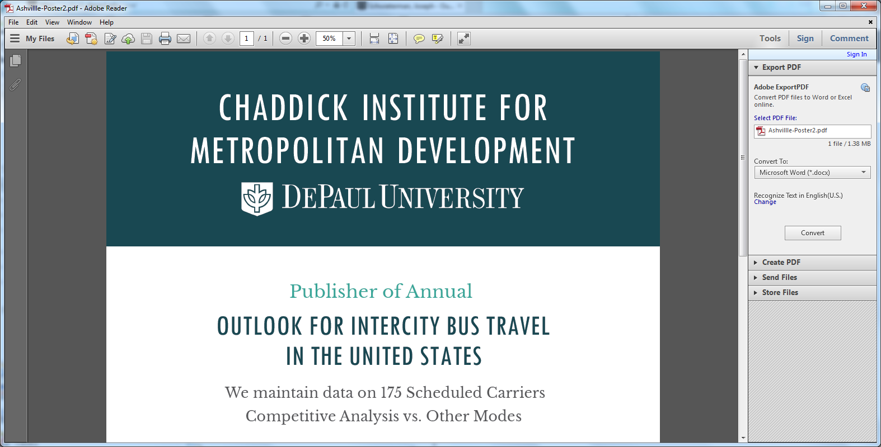
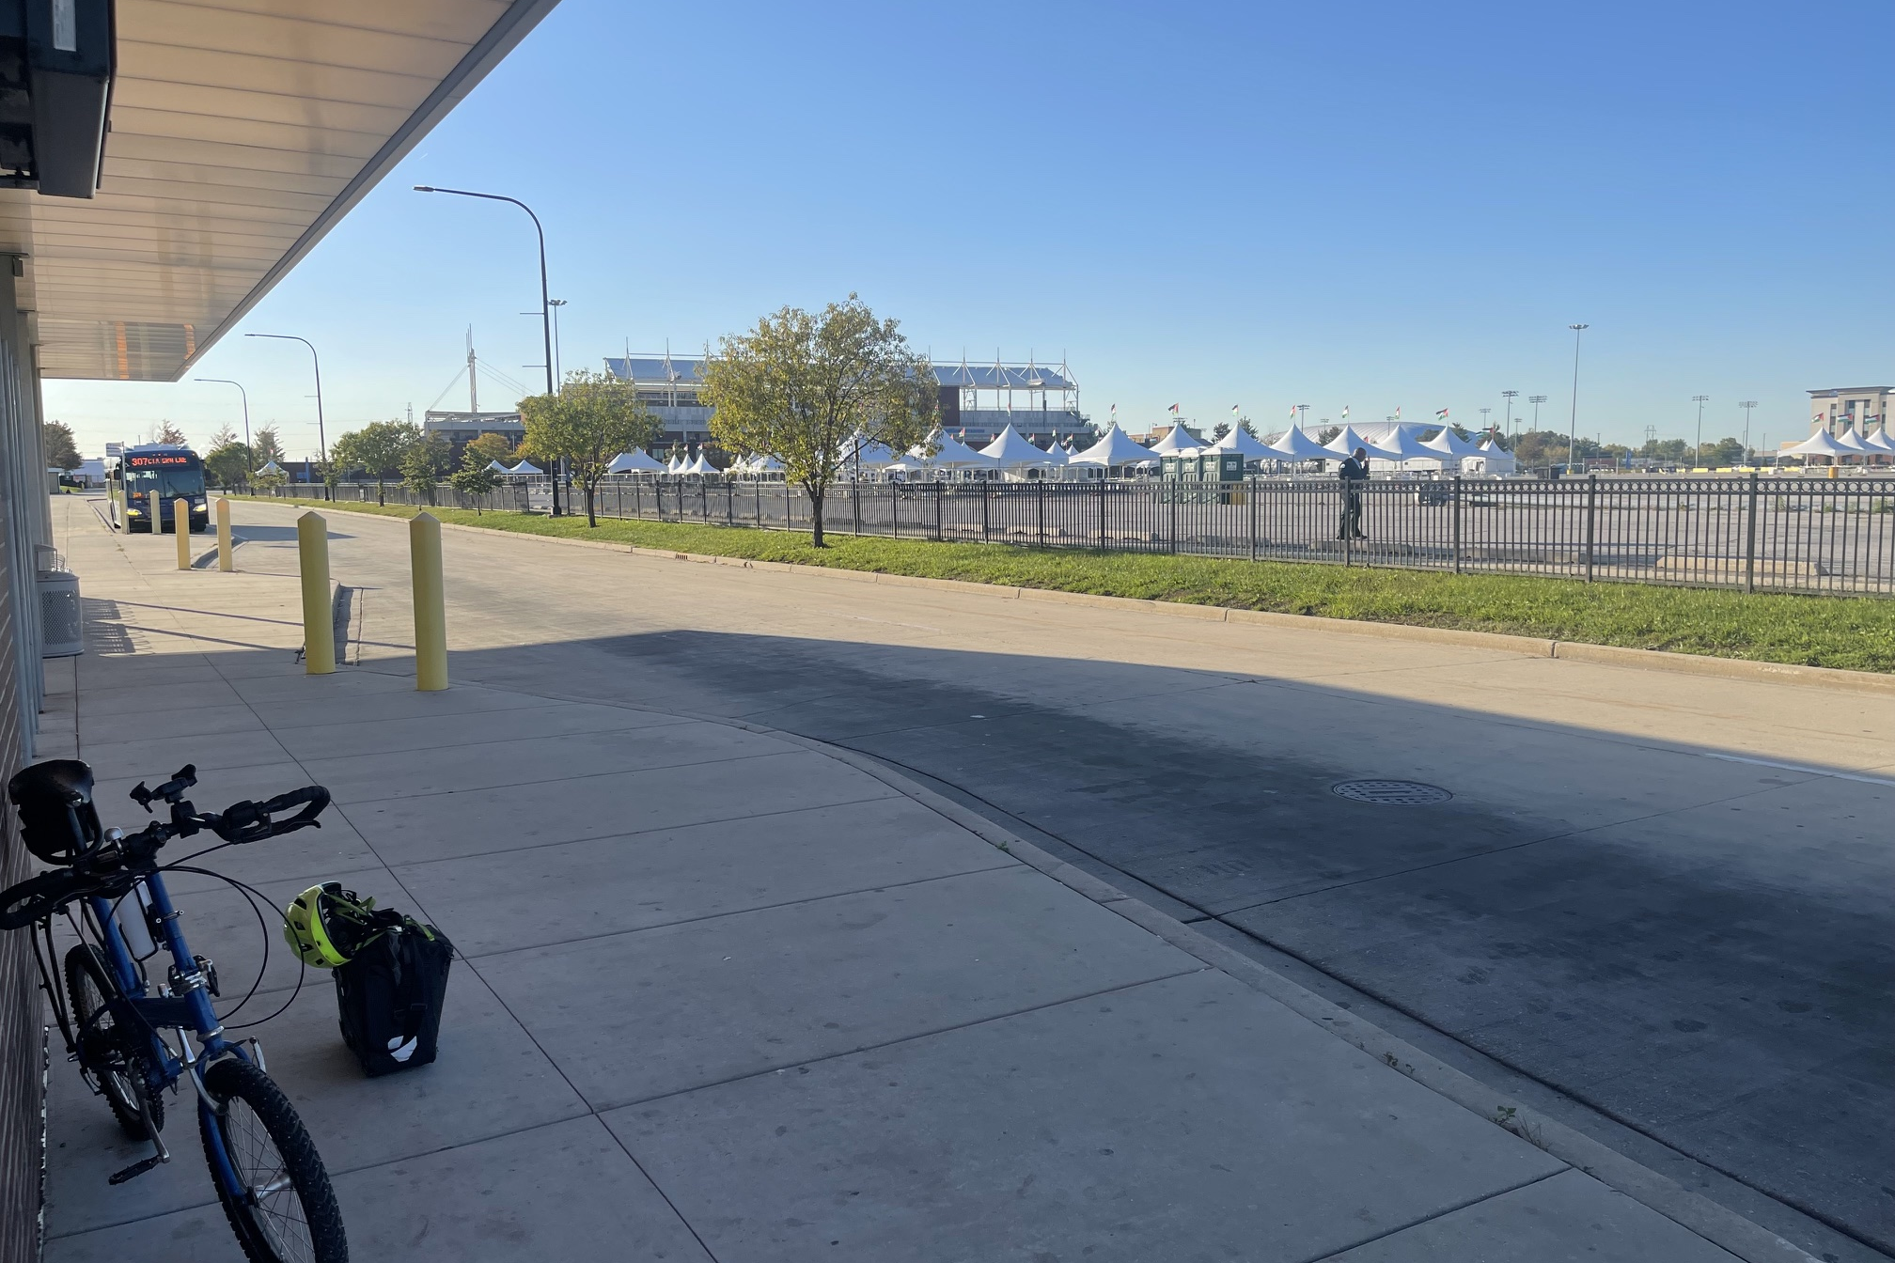
SeatGeek Stadium, Bridgeview Transit Center
Route History
The Harlem bus began in 1927 as West Towns route #7. It was renumbered 307 by the RTA in the mid-1970s and has been run by Pace's West Division since 1985.
Current Pace Bus Route
#307 Grand/Bridgeview
Image source: C. Scott Smith, 10/5/2026
Notes:
Harlem Avenue saw rail service before the bus existed: in 1894 the Cicero & Proviso Street Railway opened streetcar track on Harlem between Chicago Avenue and Madison Street, part of a suburban network the Chicago & West Towns Railway took over in 1913. That company started the Harlem bus in 1927 as route #7, which the RTA renumbered 307 in the mid-1970s and Pace's West Division has operated since 1985. Over the decades the route has expanded and contracted, at times reaching O'Hare and downtown Chicago, and today it runs from Grand/Nordica to Bridgeview Transit Center, with a faster Pulse rapid-bus line planned for the corridor.

Slide 5
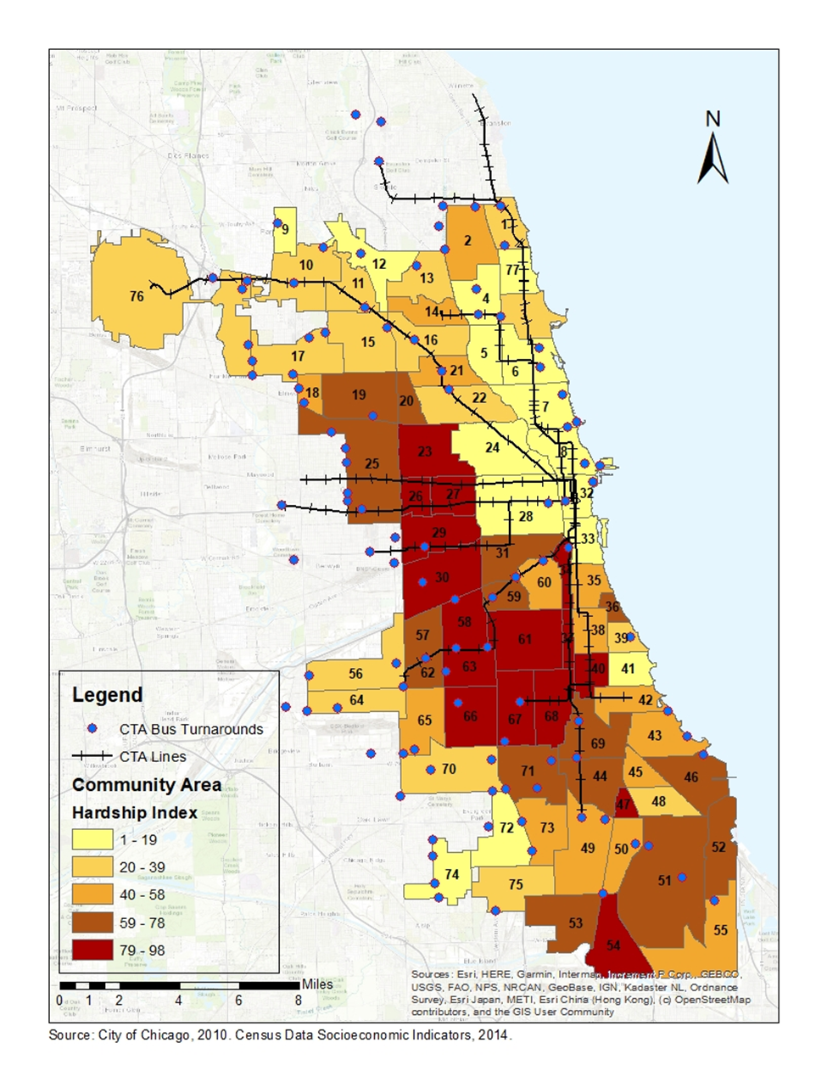
Bus turnarounds in Chicago
A lot of them located on the city´s border
Poor or basic infrastructure
Space enough for a development that activates the area and provide additional services to the community
Potential space for a sustainable component in their design
Potential for increasing public space for gathering and increase the sense of community

Slide 6
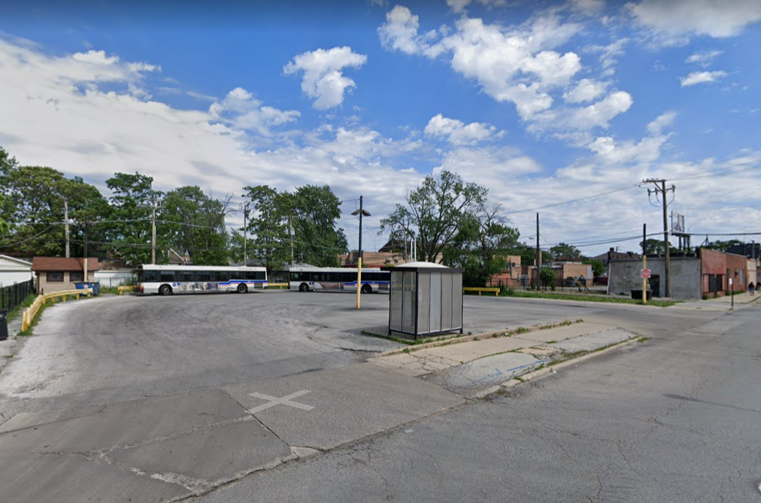
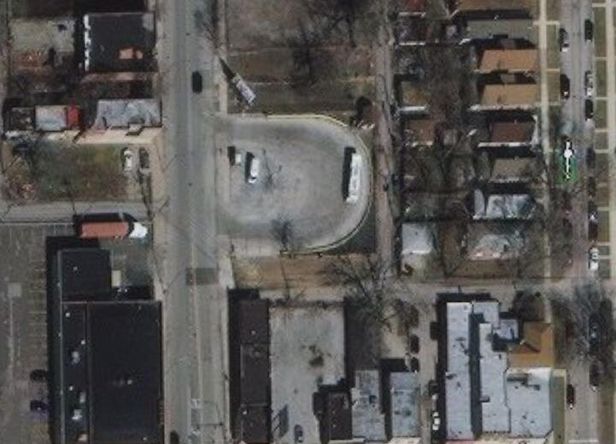
BUS TURNAROUNDS – Racine & 87th St
Route History
The Wallace & Racine route provided service between State & Lake and 87th & Racine with service abandoned 7/27/1951
Current CTA Bus Route
#44 Wallace/Racine
Site Dimensions
0.42 acres
Image source: Google Maps and Google Street View
Notes:
The Chicago Surface Lines (CSL) was operator of the street railway system of Chicago, Illinois, from the years 1913 to 1947. The firm is a predecessor of today's publicly owned operator, the Chicago Transit Authority. The Chicago Surface Line had dozens of routes and over 1,000 miles of trackage at its height. The table below shows a basic overview of CSL routes at their height. Many changes to routing and terminals were made at various times. Abandonment dates noted are dates that routes were completely changed over to bus or trolley bus, or eliminated altogether.
https://en.wikipedia.org/wiki/Chicago_Surface_Lines

Slide 7
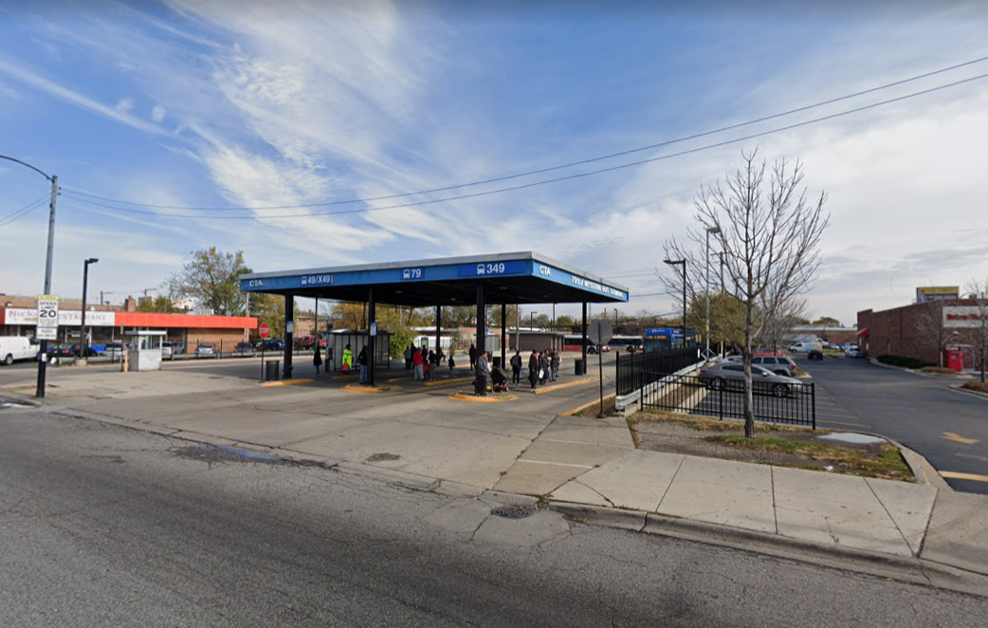
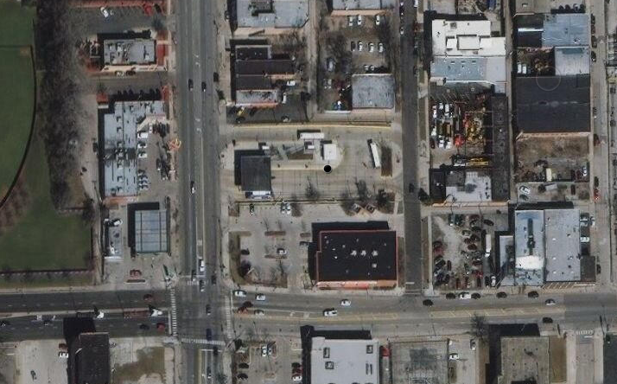
BUS TURNAROUNDS – S Western Ave & 79th St
Route History
From 1931, the Western Ave route between Lake St and 79th St served by streetcar and bus, which was converted to motor bus in 1956
Current CTA Bus Route
X 49 Western Express
49 Western
Site Dimensions
0.9 acres
Image source: Google Maps and Google Street View
Notes:
49 Western
Horse car route introduced by Chicago West Division Railway (between N and S Chicago River)
Streetcar route introduced by Chicago Railways (north of N Chicago River)
Streetcar route introduced by West Chicago Street Railroad/Chicago Railways (between N and S Chicago River)
Streetcar route introduced by Chicago City Railway (south of S Chicago River)
1864 - horse car service introduced from Lake St. to Madison
1878 - extended south to Van Buren
1885 - extended south to Roosevelt
1893 - extended north to Milwaukee Ave.
1894 - extended south to 26th St.
1895 - electric streetcar service introduced Elston to Roscoe
1895 - segment 26th St. to 14th St. converted to electric streetcar
1896 - segment 14th St. to Milwaukee Ave. converted to electric streetcar
1896 - electric streetcar service introduced Milwaukee Ave. to Elston
1898 - electric streetcar service introduced from Archer to 55th St.
1899 - extended south to 71st St.
1/4/11 - extended north from Archer to Chicago River
8/23/11 - extended south from 26th St. to Chicago River
9/5/11 - Through Route streetcar introduced from 71st St. to Roscoe, originally route 10
10/28/12 - extended north to Lawrence
5/1/23 - North Western route combined into main Western route
12/1/24 - extended south to 75th St.
1/11/31 - extended south to 79th St.
8/1/48 - south and north ends converted to buses, transferred to routes 49A and 49B
12/7/52 - buses substituted on weekends
6/17/56 - remaining streetcar segment converted to buses
Western Ave. is the longest street in Chicago. Streetcar service eventually operated through from Howard St. to 111th St., with only one mile from 111th St. to 119th St. not covered by streetcars. Through Route was number 10. Split into the present three separate routes 8/1/48, when buses replaced streetcars on south segment (route 49A) and on north segment (route 49B). Streetcar service continued longer on middle segment, numbered route 49. Three separate routes remained even after buses replaced streetcars on main segment.

Slide 8
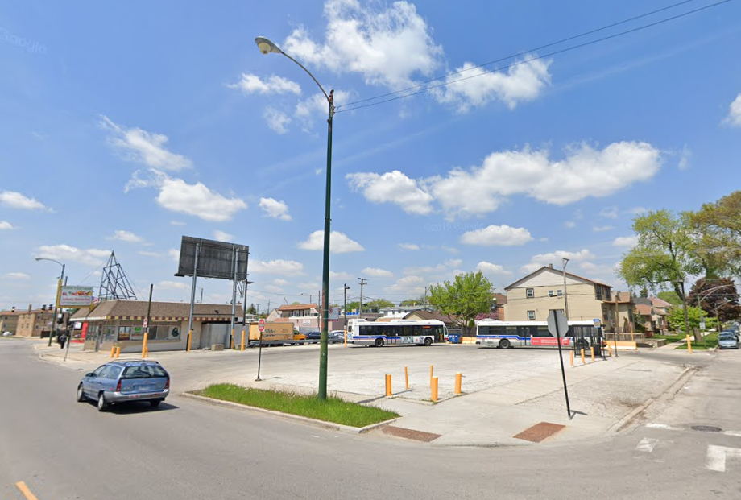
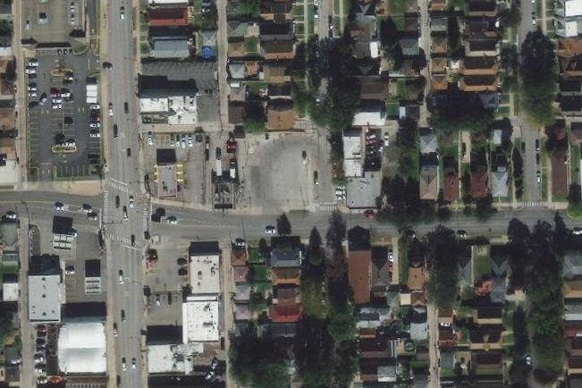
BUS TURNAROUNDS – Diversey & N Neva Ave
Route History
CMC trolleybus route 76 between Kimball Ave and Narragansett Ave
Current CTA Bus Route
76 Diversey
Site Dimensions
0.42 acres
Image source: Google Maps and Google Street View
Notes:
The Chicago Surface Lines (CSL) was operator of the street railway system of Chicago, Illinois, from the years 1913 to 1947. The firm is a predecessor of today's publicly owned operator, the Chicago Transit Authority. The Chicago Surface Line had dozens of routes and over 1,000 miles of trackage at its height. The table below shows a basic overview of CSL routes at their height. Many changes to routing and terminals were made at various times. Abandonment dates noted are dates that routes were completely changed over to bus or trolley bus, or eliminated altogether.
https://en.wikipedia.org/wiki/Chicago_Surface_Lines
https://www.chicagorailfan.com/ctabdate.html
https://arcg.is/1T4f5O

Slide 9
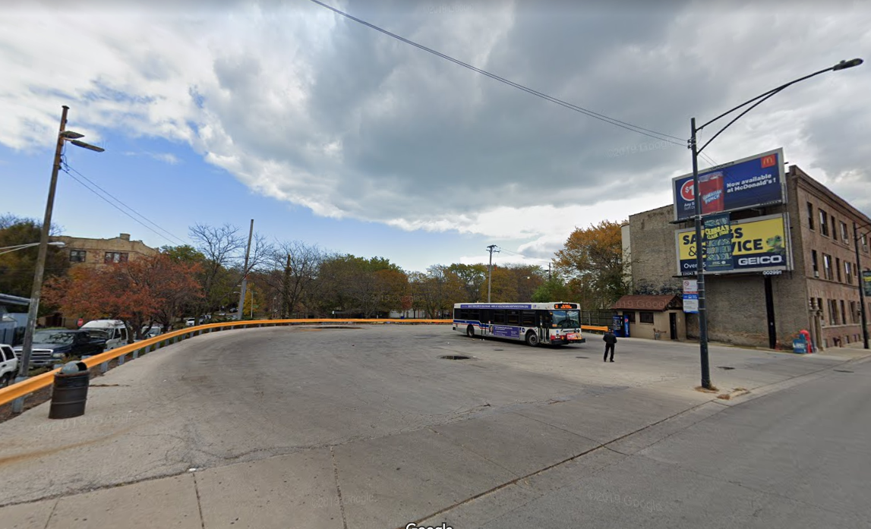
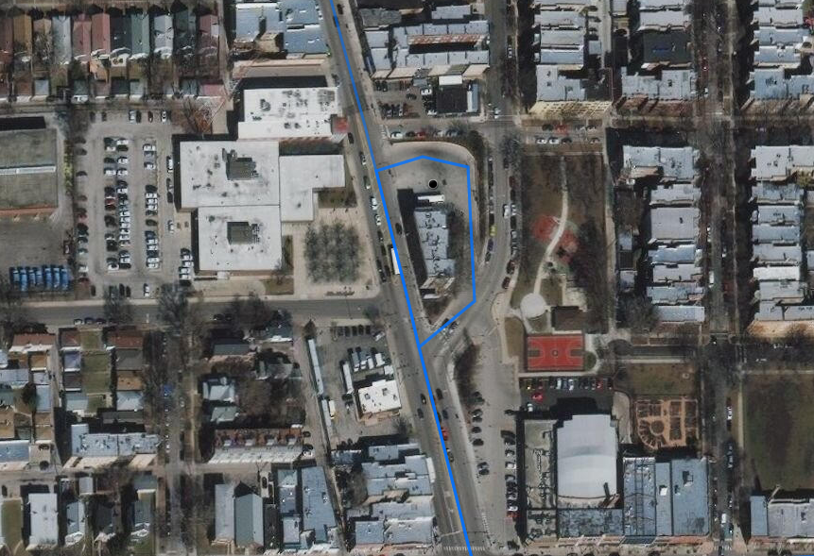
BUS TURNAROUNDS – N Clark St & W Devon Ave
Route History
From 1917 operated as bus route by Chicago Motor Coach (CMC).
Current CTA Bus Route
151 Sheridan
Site Dimensions
0.25 acres
Image source: Google Maps and Google Street View
Notes:
151 Sheridan
Bus route introduced by Chicago Motor Coach Co.
3/25/17 - introduced as bus route 51 Sheridan
10/1/52 - renumbered route 151 after CTA takeover of CMC
6/22/80 - route revised to present form
South of Diversey, previously operated via Cannon Dr., and via Lake Shore Dr. south of Belmont. The present routing through Lincoln Park replaced route 153 local service, serving Lincoln Park Zoo. Had operated north of Devon via Sheridan to Howard St., with service gradually replaced with expanded hours of route 147 Outer Drive Express.
Owl service introduced 6/22/80
Owl service discontinued 3/31/2013
Bus Garage: Rosemont (3/25/17-9/7/57)
North Park (9/7/57-present)

Slide 10
The Austin & Division Bus Terminal
and its Environs

Slide 11
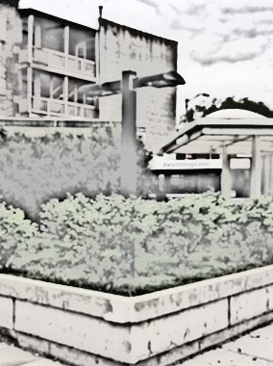

FOUR OBJECTIVES IN FOUR SECTIONS
Section One: Characterizes key social and physical aspects of the bus stop terminal site, its surroundings, jurisdictional boundaries, population and housing patterns, key cultural assets.
Section Two: Summarizes travel behaviors of commuters within study area, focusing on their use of public transit and active transportation. We also examine recent trends in shared use mobility and how these changes in the structure of transportation may have implications for a reimagined Austin and Division CTA bus terminal.
Section Three: We combine existing and emerging best practices for urban transit street and stop design together with other principles of good planning to fashion a menu of strategies with which to inform a high-impact design process focused on sustainability.
Section Four: Report summary, conclusions, next steps and beyond...
Activating the Austin/Division Bus Terminal Site & Environs
Notes:
This report explores the Austin & Division Chicago Transit Authority (CTA) bus terminal site and its environs and proposes various roadmaps to aid in its potential redesign. The exploration is informed by a variety of transportation-, population- and housing-related analyses that help foster a multi-dimensional understanding of the area’s current characteristics and trends over time. In this way, the document serves as a resource for identifying gaps in the functions the bus terminal presently serves for local residents as well as opportunities for reimagining the terminal in order to meet emerging demands. Toward this end, the report is separated into four sections (shown on slide).

Slide 12
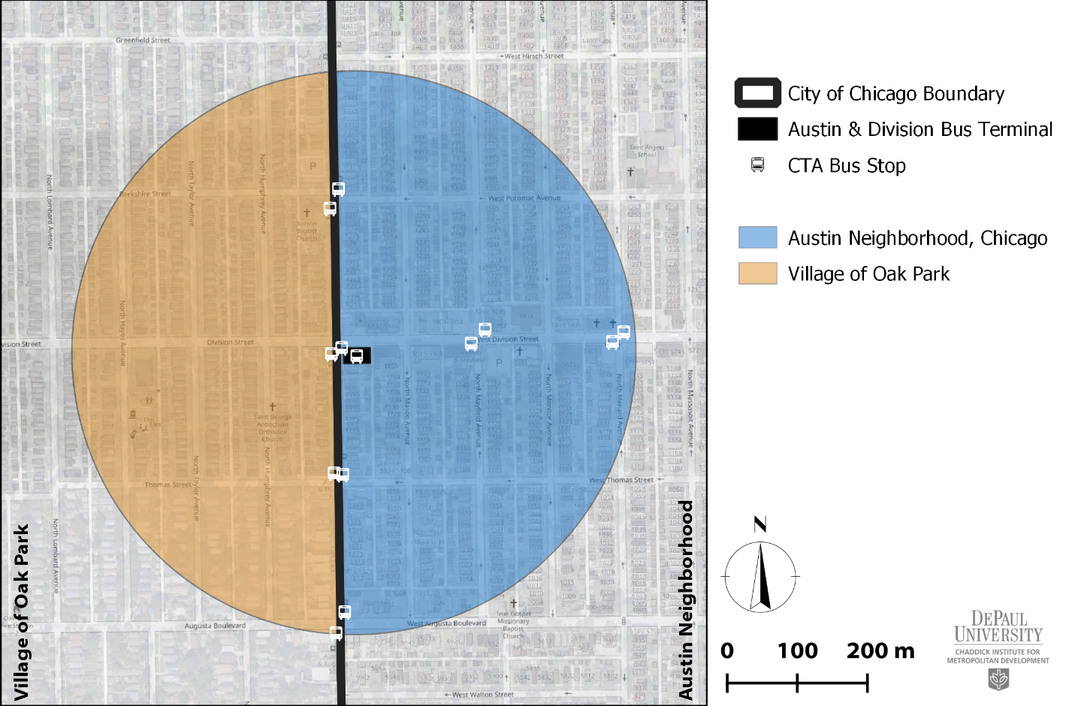
Study Area: ¼-mile buffer from terminal
Notes:
The Austin & Division bus terminal is positioned at the southeast corner of Division St and Austin Blvd and hosts two of the over 11 thousand stops that make up the Chicago Transit Authority’s (CTA) bus network. The terminal site is relatively small, approximately 0.30 acres in area and directly serves the 70 (Division) east-west CTA bus route via its interior bay and the 91 (Austin) northbound CTA route via a stop located on the terminal’s western edge. There is also a 91 southbound bus stop located exterior to the site on the west side of Austin Blvd. Ten other bus stops serving either the 70 (Division) or 91 (Austin) routes are located within a quarter-mile of the bus terminal.

Slide 13
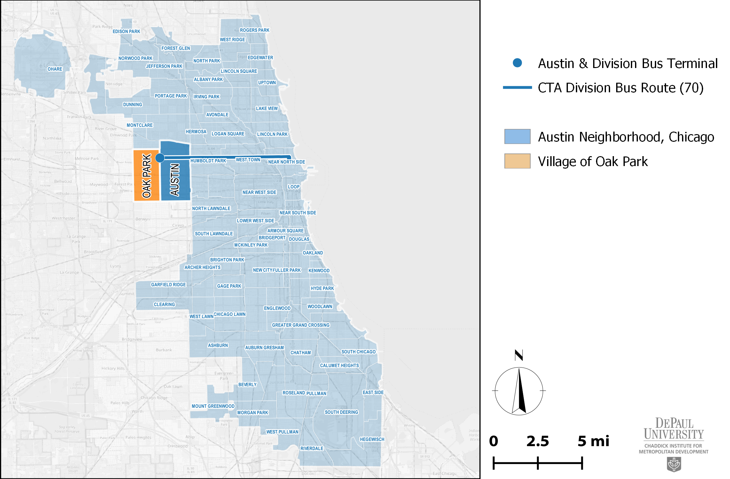
Study Area: The Division St corridor
Notes:
The terminal is located on the western edge of the city of Chicago at the terminus of the 7.5-mile long Division bus route. The route intersects three of Chicago’s community areas and several neighborhoods, beginning in the Near North Side along Lake Shore Drive (including parts of the Gold Coast, Rush & Division, River North and Old Town neighborhoods), proceeding through West Town (including the East Village, Ukranian Village and Wicker Park neighborhoods) and Humboldt Park prior to cutting through a northern section of the Austin neighborhood at its westernmost extent. There are 114 bus stops along the Division (70) CTA route.
Public transportation has always been a core contributor to the Division Street corridor’s vibrant street life and appeal. Segments of this Division Street corridor have been serviced by public transit since 1886 when horsecar service routes were introduced by the North Chicago City and Chicago West Division Railways which provided residents along the street downtown service via Milwaukee Ave.
Beginning in 1895 segments along these routes were gradually converted to electric streetcar which, by 1915, was extended west to its present terminus at Austin Blvd.

Slide 14
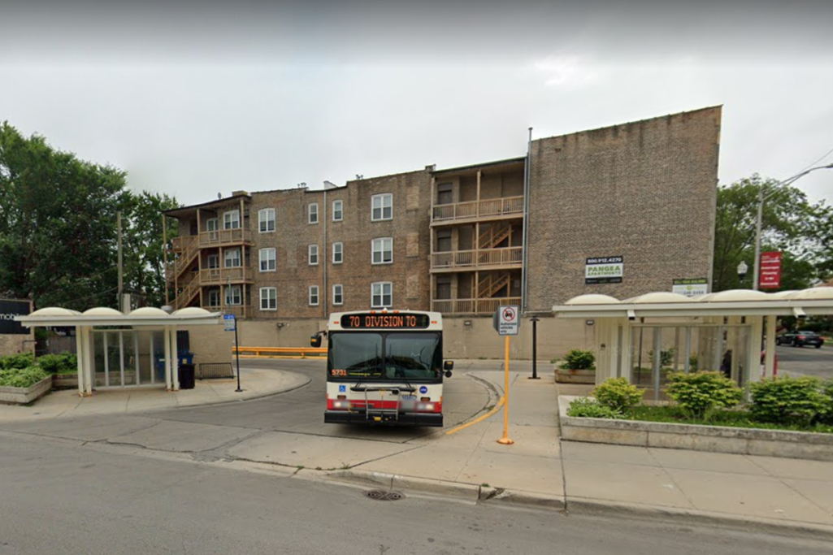
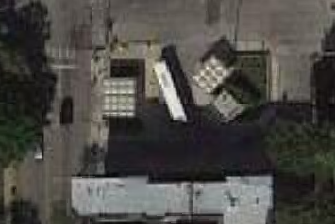
AUSTIN & DIVISION BUS TERMINAL
Route/Terminal History
Segments of the Division St corridor have been serviced by public transit since 1886. The route was gradually converted to electric streetcar which, by 1915, was extended west to its present terminus at Austin Blvd.
Current CTA Bus Routes
#70 Division St
#91 Austin Blvd
Image sources: C. Scott Smith, 2019 (above); Google Maps (right)
Notes:
By 1951, electric streetcar service along Division Street was converted to motor bus, with downtown service discontinued in 1973. The present terminal loop site is likely a remnant of the older streetcar system where cars--constrained by a trolley pole connected to an overhead wire system--turned around via a large radius at the end of the route. The city’s extensive trolleybus system never operated down the Division Street corridor.
Looking east a long Division. CTA #70 bus idling in central access lot at route’s western terminus.
The Austin & Division terminal site hosts two rather large bus shelters; a western shelter accommodating 91 northbound passengers and a smaller, eastern shelter for passengers waiting to board the 70 eastbound bus. Adjacent to the eastern shelter is located a small utility building. The shelters, have plastic bubble roofs, metal columns and glass walls, and, in some cases, show visible signs of wear. Three large planters with landscaping are located at the terminal site as well as two freestanding LED lamps, a dumpster, sidewalk garbage bin and a comb-style, limited security bike rack. There are no public bathroom facilities located on site.

Slide 15
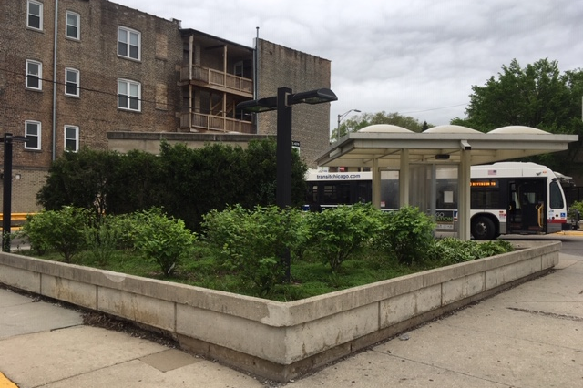
AUSTIN & DIVISION BUS TERMINAL
Looking southwest across large planter and eastern shelter. Multifamily residential building adjacent to south lot line in background.
Image source: C. Scott Smith, 2019

Slide 16
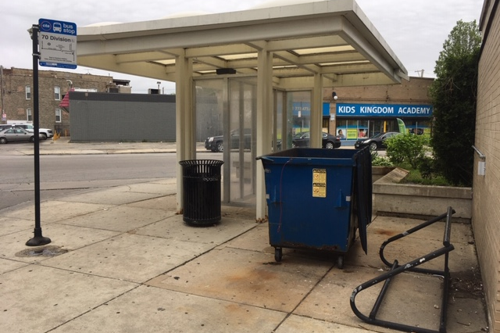
AUSTIN & DIVISION BUS TERMINAL
Looking east along Division at eastern shelter, dumpster and waffle-style bike rack against brick structure. Mixed use building in background.
Image source: C. Scott Smith, 2019

Slide 17
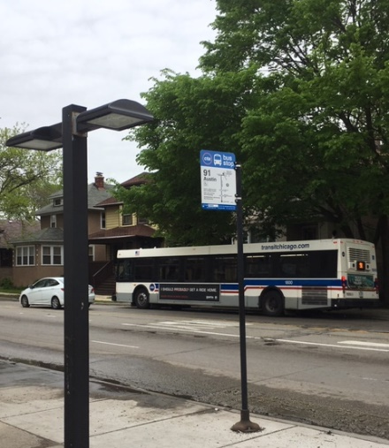
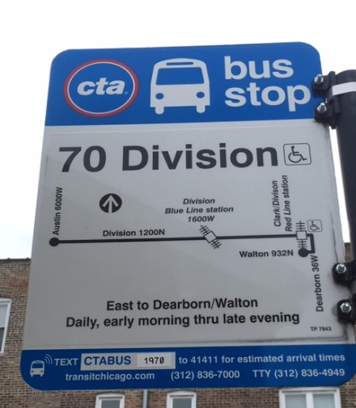
AUSTIN & DIVISION BUS TERMINAL
Looking southwest across Austin Blvd at CTA #91 bus picking up passengers at bus stop traveling southbound.
Bus stop sign located on site showing CTA #70 Division route.
Image source: C. Scott Smith, 2019

Slide 18
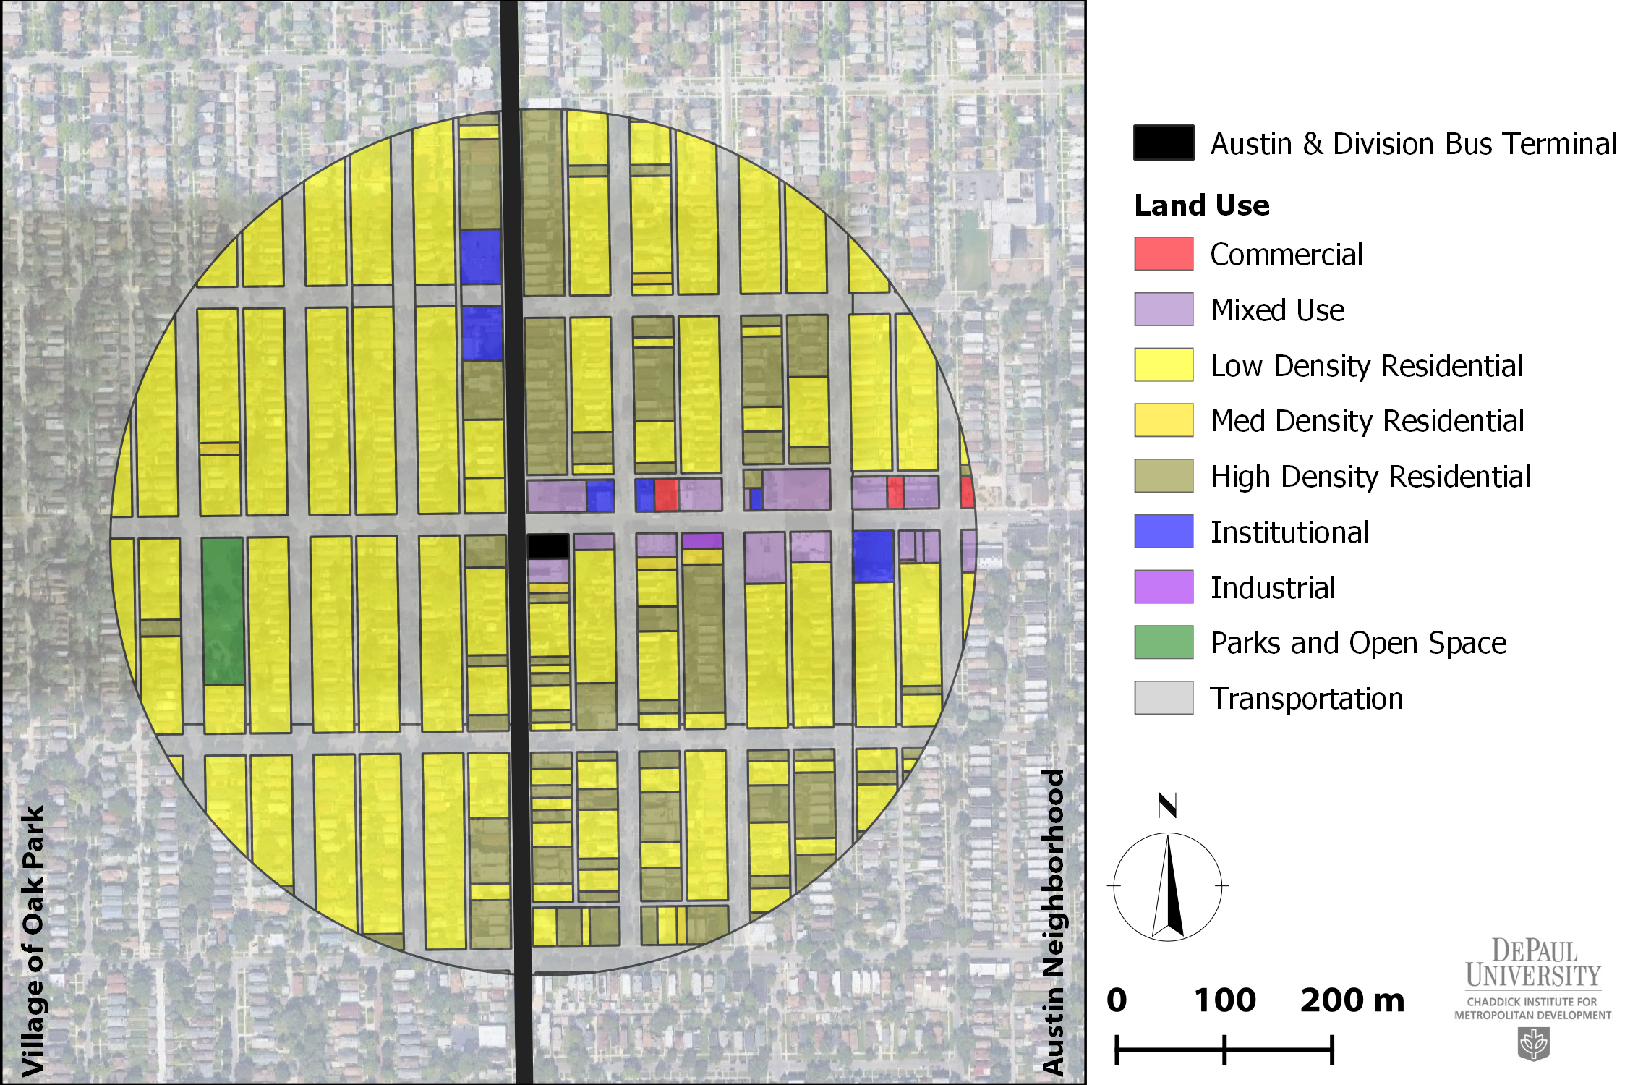
Existing Land Use within ¼ mile of Austin & Division Bus Terminal
Data source: CMAP, 2015
Notes:
The Austin and Division bus turnaround is situated within a predominantly residential area made-up of older, largely single-family and multi-unit dwellings. Figure 4 maps existing land uses within a ¼ mile of the bus terminal. The dominant land use categories include lower-density residential (48.5 percent), followed by multi-family residential (higher-density 12.9 percent) on the south, west and northwest, commercial to the east and northeast and a considerable amount of mixed-use zoning along the Division Street corridor.
There exist marked differences in the distribution of land uses between Oak Park and Austin outside the ¼ mile buffer. Austin, for example, is composed of 4.4 percent open space which translates into 0.7 acres of park per 1,000 residents. Oak Park, while it has a smaller share of open space overall (2.6), provides 1.2 acres of park per 1,000 residents or 71.4 percent more park acreage per capita than the average Austin resident.

Slide 19
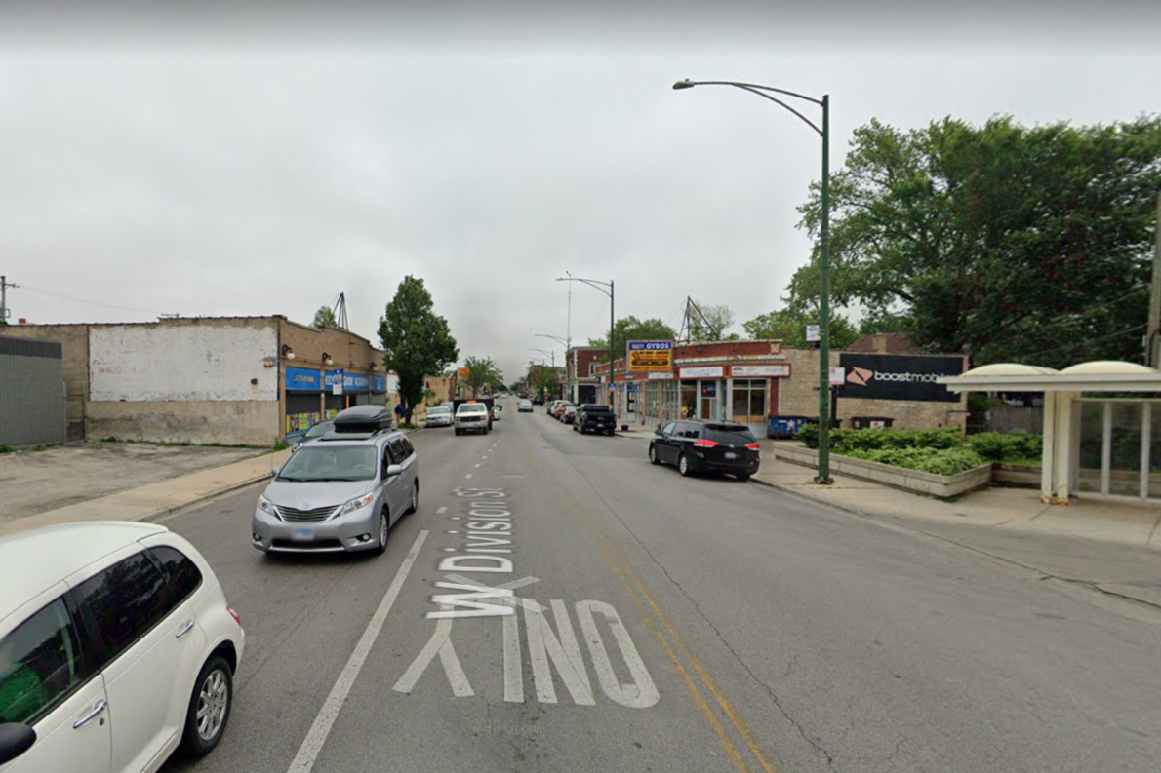
DIVISION STREET STREETSCAPE
Looking east on Division along neighborhood commercial strip occupied by independently-owned restaurant, retail food establishments, hair/nail salons and daycare, religious institutions.
Image source: Google Maps Street View, 2019
Notes:
f the 26 licensed businesses within the ¼ mile radius of the bus terminal, half are designated as small retail (e.g., food, tobacco, cell phones and liquor) with the remaining businesses including day care establishments, hair and nail services, home repair services, payment services, motor vehicle repair and a hazardous waste storage facility (13). The research team also identified one religious institution located within the immediate vicinity of the terminal site.
Not far from the terminal site, however, are other neighborhood commercial districts (i.e., North Avenue, Chicago Avenue) and some large employers including the West Suburban Medical Center which is located less than a mile south on Austin Boulevard.

Slide 20
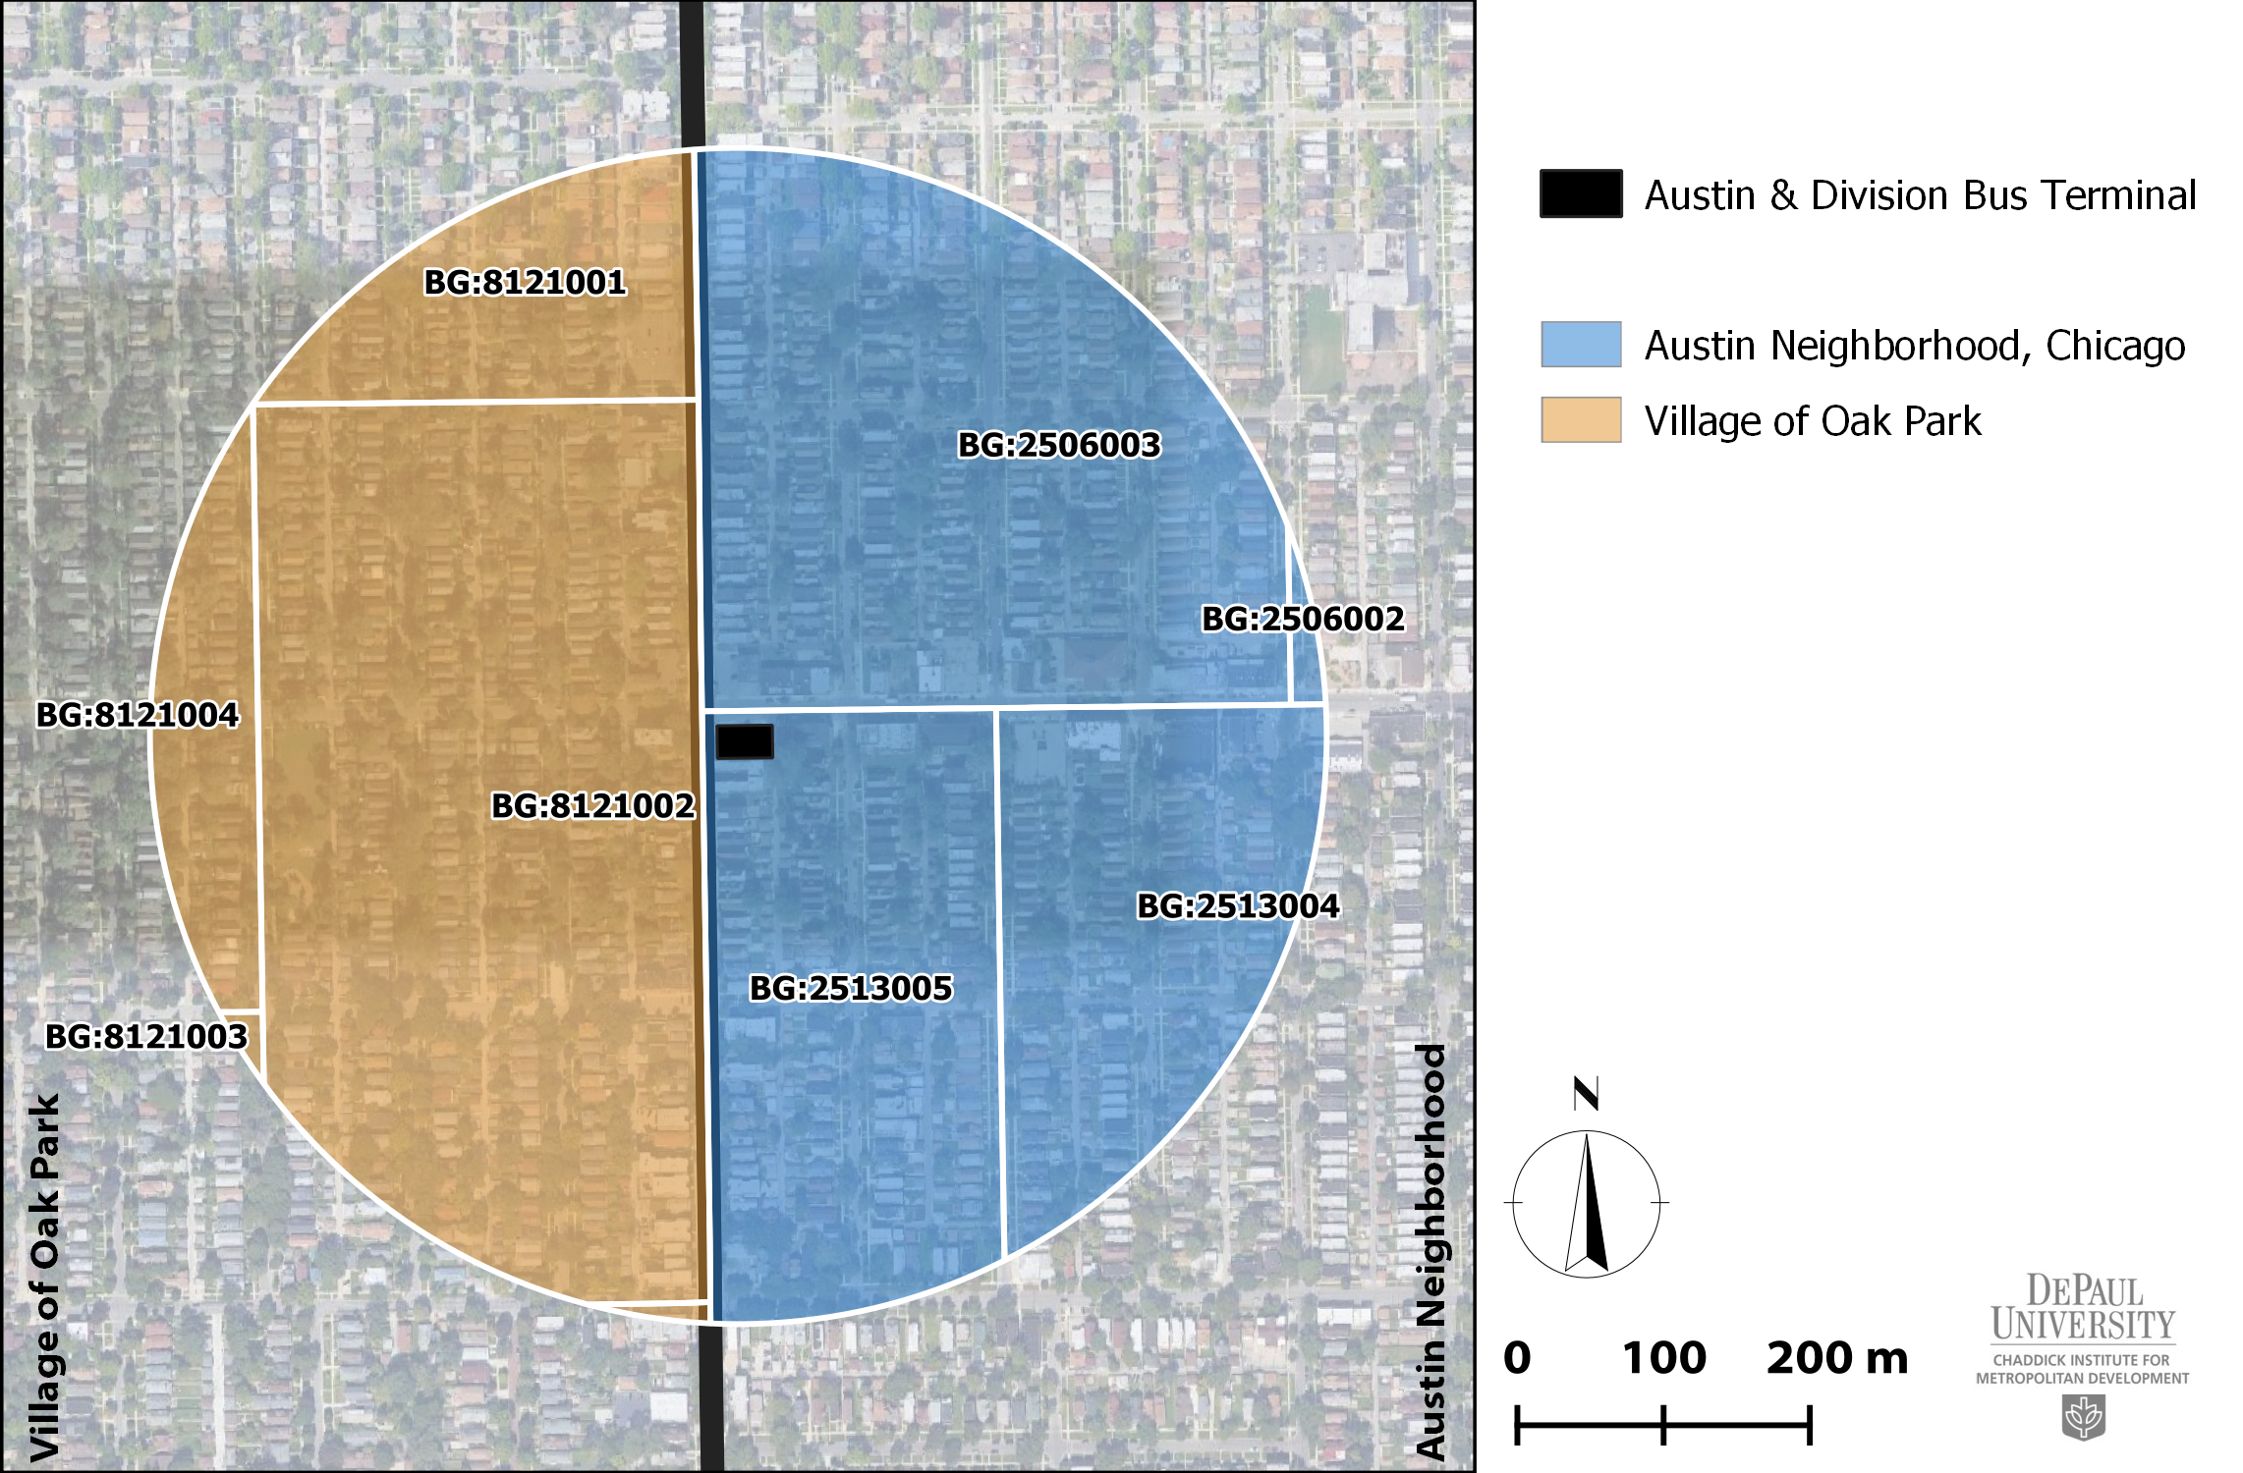
Census Block Groups within ¼ mile of Austin & Division Bus Terminal
Notes:
The US Bureau of the Census organizes their statistical boundaries according to a standard and interrelated system of geographic hierarchy (14). The ¼ mile buffer area spans three census tracts and six census block groups (Figure 3), with half of the block groups located in the Austin neighborhood within the city of Chicago and the remaining three located in the eastern portion of the village of Oak Park. The total population within the six block groups is approximately 7,545 according to the latest American Community Survey (US Census ACS 2018 5-year estimates), split rather evenly across the six areas (Table 2). The study site includes only those census block groups and tracts with the majority of their area inside the buffer.
The Austin and Division bus turnaround is also located on the border of two distinct communities. The terminal site itself resides wholly within the Austin community, the second largest of the city of Chicago’s 77 community areas in terms of both spatial expanse (7.2 mi²) and resident population (87,316) (2).

Slide 21
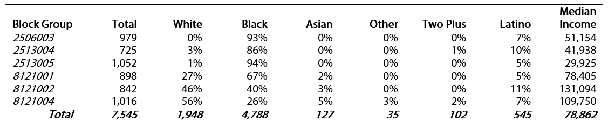
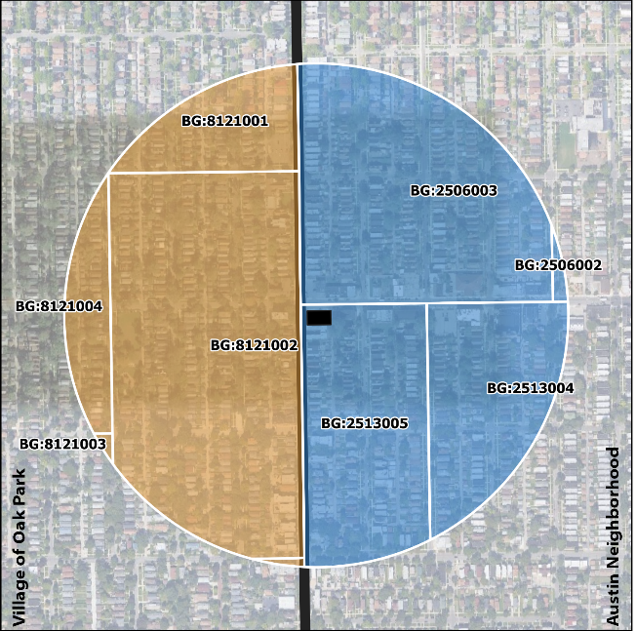
RACE, ETHNICITY AND INCOME CHARACTERISTICS
Block Groups within ¼ mile of Austin & Division Bus Terminal
Data source: ACS 5-year estimates
Notes:
While the population is evenly split between the Austin and Oak Park neighborhoods, sharp demographic divides exist across the designated census areas with respect to racial and ethnic composition and median household income (Table 2). The combined portion of the study area within Austin is 91.5 percent black and 7 percent Latinx, whereas the combined Oak Park portion has near-equal percentages of white (43.5 percent) and black (43.6) populations and a higher share of Asian residents (3.4). These localized distributions of race and ethnicity resemble patterns at the community-wide scale .
Further, annual household income ranges from $29,925 to $51,154 across the Austin census block groups--all of which are lower than the citywide average of $57,238--in contrast to households residing in the Oak Park census block groups which reported incomes between $78,405 and $131,094 in 2018. These inter-community disparities are consistent across other socioeconomic indicators including educational attainment (3.8 percent with less than high school diploma in Oak Park vs 21.3 percent in Austin) and unemployment (6.0 percent in Oak Park vs. 15.4 percent in Austin) and require consideration in the redesign process.

Slide 22
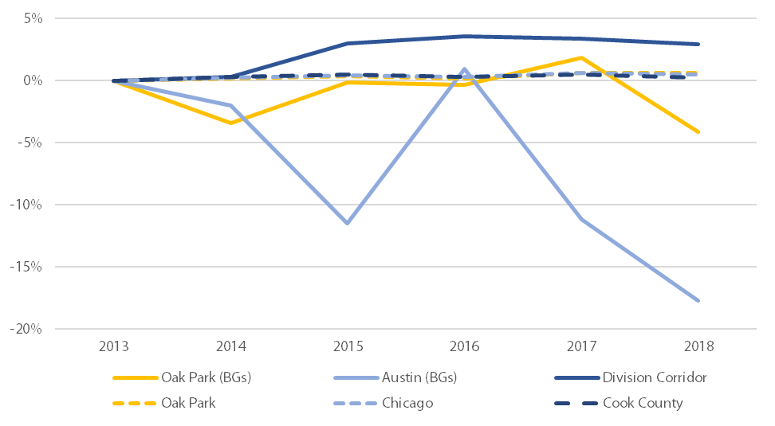
PERCENT CHANGE IN POPULATION, 2013-2018 (2013 base year)
While population has grown along the Division Street corridor, growth has largely been confined to neighborhoods on the city’s east side while areas immediately adjacent to the terminal have lost population in recent years.
Data source: ACS 5-year estimates

Slide 23
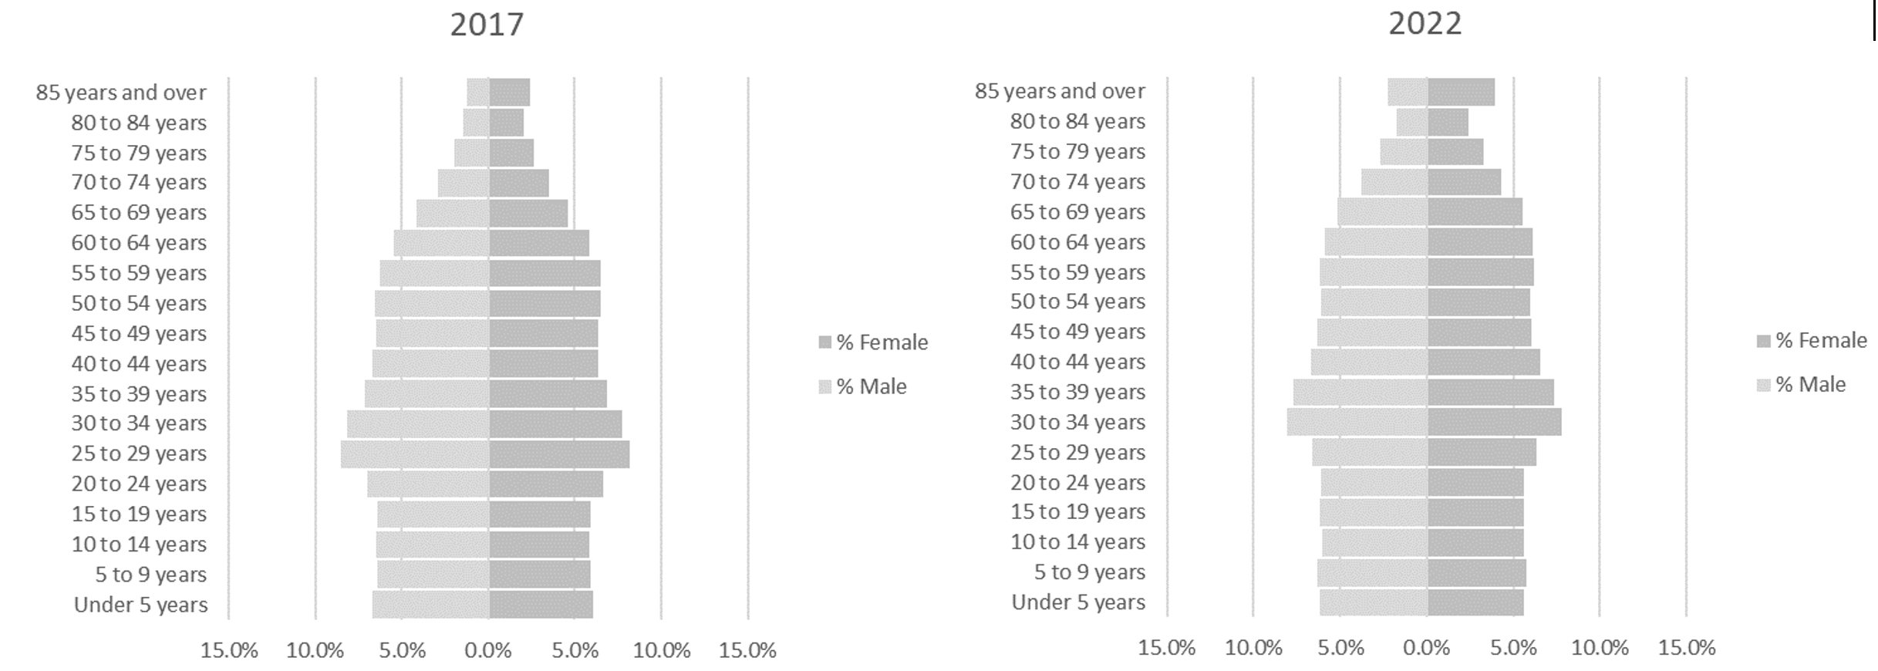
AGE-POPULATION DISTRIBUTIONS FOR COOK COUNTY 2017 AND 2022
55+ grows by 17.3%
65+ grows by 30.9%
75+ grows by 38.9%
Net out migration rate of more than 8 per 1,000 residents.
Total county population anticipated to grow by just 0.7%.
Data sources: Adapted from ACS 5-Year Estimates 2017; Center for Disease Control & Prevention
Notes:
With a net out migration rate of more than 8 per 1,000 residents in Cook County, natural rates of increase will just barely balance this loss, with expected overall growth of just 0.7 percent over the next couple years. However, perhaps more concerning from a transportation and public services perspective is that the county population is growing older. Aging population also translates into different transportation demands.

Slide 24
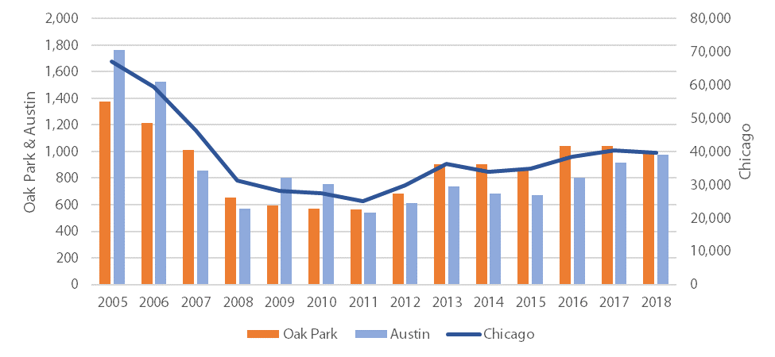
RESIDENTIAL SALES, 2005-2018
Data source: DePaul University Institute for Housing Studies

Slide 25
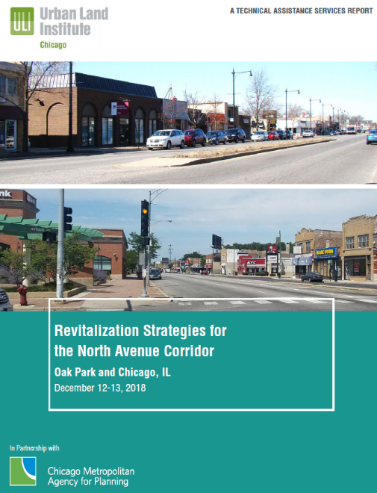
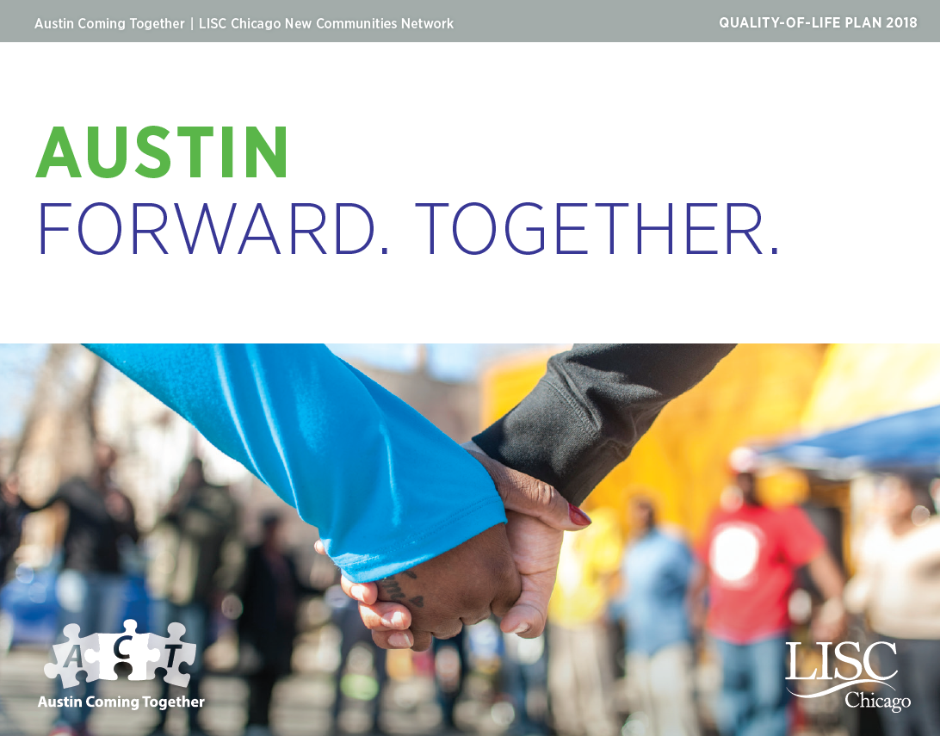
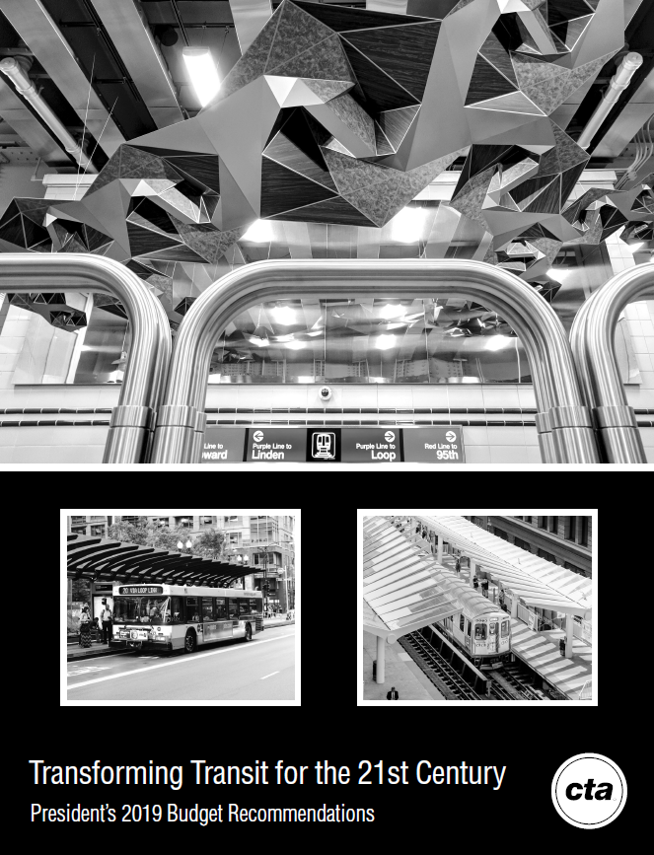
RELEVANT PLANS AND PROGRAMS
UCI in partnership with CMAP recently engaged in an effort to identify strategies for revitalizing a section of North Avenue which has striking similarities to the environs surrounding the Division and Austin terminal site.
Initially driven by a small group of community leaders, the award-winning Austin Quality-of-Life Plan gathered over 400 residents and community stakeholders to coordinate efforts that foster systemic improvements throughout Austin. Importantly, the plan clearly outlines strategies, community assets and project leads.
The CTA has a variety of plans and programs underway that will have direct and indirect implications on the terminal site such as investments in nearby L stations and bus routes (e.g., electrification).

Slide 26
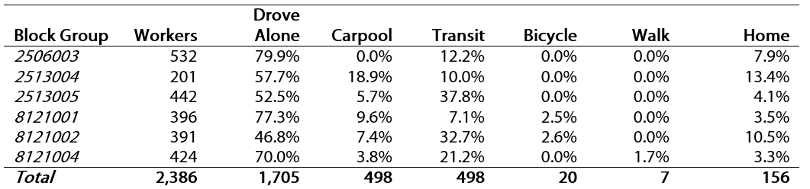
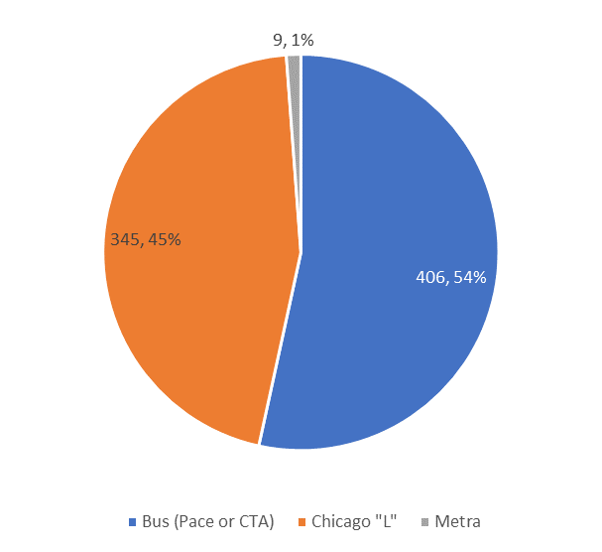
TRANSPORTATION MODE SHARE
Block Groups within ¼ mile of Austin & Division Bus Terminal
Data source: ACS 5-year estimates

Slide 27
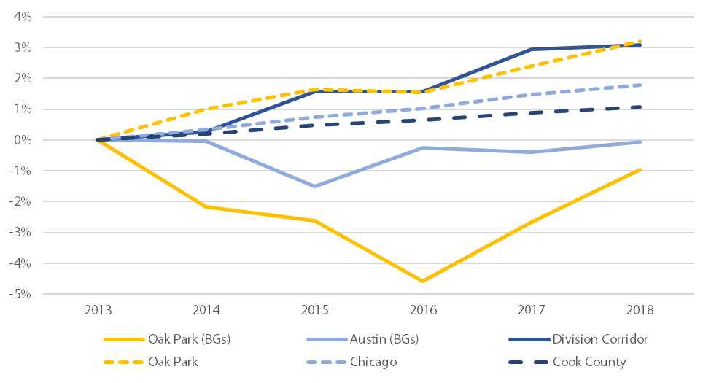
PERCENT CHANGE IN PUBLIC TRANSIT COMMUTERS
Data source: ACS 5-year estimates

Slide 28
Transportation touches every aspect of where we live, work, play, and go to school, as well as the physical and natural world. Transportation also plays a pivotal role in shaping human interaction, economic mobility, and sustainability. (Bullard, 2003)
Adequate transportation is a precondition for participating in life-enhancing opportunities such as employment, education, health care, and social networks. (Martens and Golub, 2018)
Transportation, it can be argued, is a basic right, a primary good/service that should be distributed fairly, equitably.

Slide 29
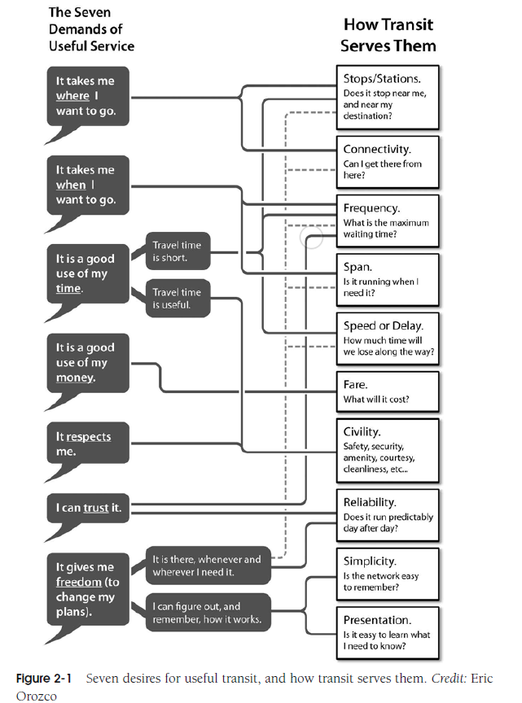
Notes:
The boycott was prompted partly by the 1950 decision by the Baton Rouge city council to support the financially strapped municipal bus company by revoking the licenses of nearly 40 competing black-owned transportation companies. African Americans now had no choice but to ride segregated buses operated by the city-owned bus company. Blacks made about 80% of the bus riders on the city bus system but were required to sit back of the bus or stand even if the front seats reserved for whites remained empty. In January of 1953, the same day bus fares rose from 10 to 15 cents for all riders, Reverend T.J. Jemison, pastor of Mt. Zion First Baptist Church, the largest black church in Louisiana, complained to the city council which in response passed Ordinance 222 which allowed blacks to sit in “white” seats if the bus was crowded and those seats were unoccupied. Blacks however, could not sit next to whites or in front of them.

Slide 30
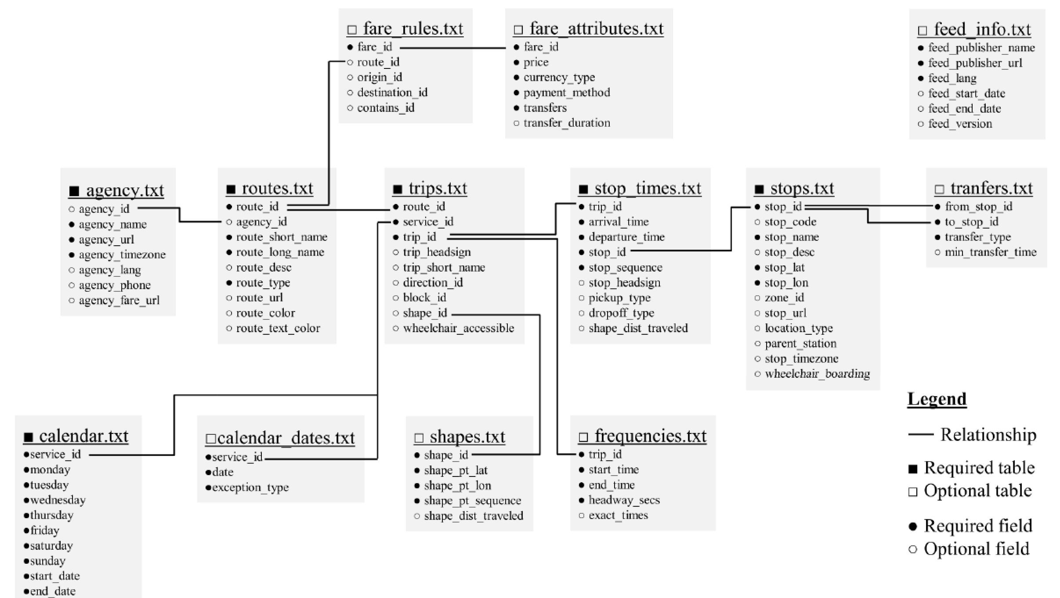
General transit feed specification (GTFS)
The General Transit Feed Specification (GTFS) defines a common format for public transportation schedules and associated geographic information. Source: Transit Developers Google Group website
Source: Reed, 2013
Notes:
The measures produced in the report make extensive use of GTFS data; a framework for sharing information about transit systems---schedules and geographic information--through a series of text files with comma-separated values that represent different fields. The specification has undergone several modifications/upgrades over the years. What the report did not do was make use of these parameters in the GTFS data.
GTFS Real-Time (8/2011)
Wheelchair access (10/2012)
Bikes allowed (2/2014)
Timepoint field (2/2015)
Agency email added (2/2016)

Slide 31
What is the history of GTFS?
A call for Open-Source Public Transit Mapping (Faludi, 2005)
Google Transit Feed System (GTFS)
First iteration 9/25/2006
Chris Harrelson (software engineer, Google)
30+ revisions since
Bibiana McHugh (IT Manager, TriMET)
Notable revisions
GTFS Real-Time (8/2011)
Wheelchair access (10/2012)
Bikes allowed (2/2014)
Timepoint field (2/2015)
Agency email added (2/2016)
More…
In 1998, Bay Area Rapid Transit released schedule data in the comma-separated values (.csv) format; this was the first known release of transit data to the public.
Notes:
The background of open transit data in the United States is as follows. Prior to 1998, data generated by technologies deployed by public transit agencies were not made available to the public. In 1998, Bay Area Rapid Transit released schedule data in the comma-separated values (.csv) format; this was the first known release of transit data to the public. Tri-County Metropolitan Transportation District of Oregon (TriMet) worked with Google in the cre-ation of General Transit Feed Specification (GTFS, originally developed by Google and containing static schedule information for transit agencies, including stop location, route geometrics, and stop times) in 2005. Massachusetts Bay Transportation Authority (MBTA) opened the agency’s data in 2009. As of April 2014, according to City-Go-Round, almost 29% of U.S. transit agencies provided open data. In 2003, the Digital Agenda for Europe, Public Service Information Directive was issued, requiring all European Union member states to release public sector information, including open public transport data. Many pub-lic transit agencies in the Asia-Pacific region are beginning to open their data as well, such as a recent initiative to combine and release the data from many public transit operators in Tokyo, Japan
Faludi; TriMet worker (geography degree); Google together developed the standard as documented…originated out of the frustration. Accurate and up-to-date data is important to any information system. To create an effective traveler information system that includes public transportation, a description of the routes, stops, and schedules that represent transit service is required. However, that data is not always easy to create. TriMet in Portland, Oregon, along with Google, was one of the first public agencies to try and tackle the problem of online transit trip planners through the use of open datasets that are shared with the general public [1]. TriMet worked with Google to format their transit data into an easily maintainable and consumable format that could be imported into Google Maps. This transit data format became known as the Google Transit Feed.
After a successful launch with TriMet, Google Transit offered their trip planner service for free to any agency that formatted and maintained their data in the GTFS format. In 2006, five more agencies were added.Google Transit’s success continued as more and more agencies wanted access to a free trip planner, and were willing to put their data into the GTFS format to get it. Since its creation in 2005, GTFS has become the most popularly-used data format to describe fixed-route transit services in the world. Many agencies have decided to share their GTFS data openly with the public, while others choose to restrict access only to select partners (e.g., Google Maps).
“In my role at TriMet, I worked with transit data every day, so I knew such data was available and the potential was there. We offered our own online transit trip planning tool, as many agencies do. The trouble was, the average citizen often didn’t know where to go to find this information, especially if he or she was unfamiliar with the local transit system. The general public was used to going to certain online destinations for driving directions—Google Maps, MapQuest, and Yahoo were all widely used at the time—but the data they needed to plan a trip using public transit wasn’t available where they were looking.”
Several iterations (23) since initial version was released to public 9/25/2006. Most recent in February of this year. Added trips.txt 'bikes_allowed' proposal to spec: discussion. Wheelchair accessibility for trips was added in October 2012. Interesting from a public policy perspective, each of the revisions was first proposed to the GTFS listserv where a thread-specific discussion would take place.

Slide 32
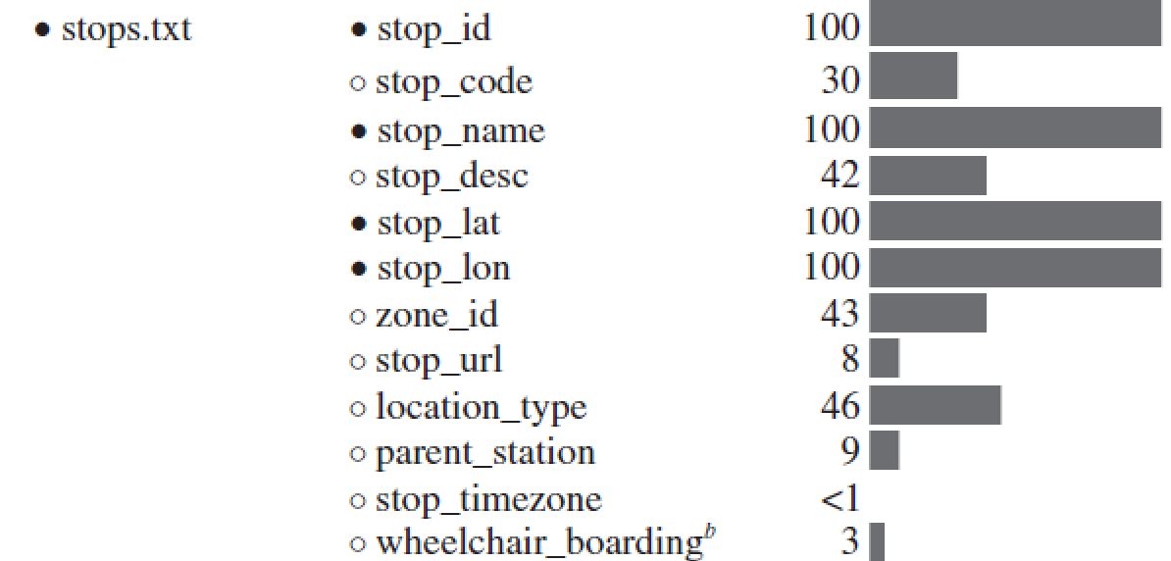
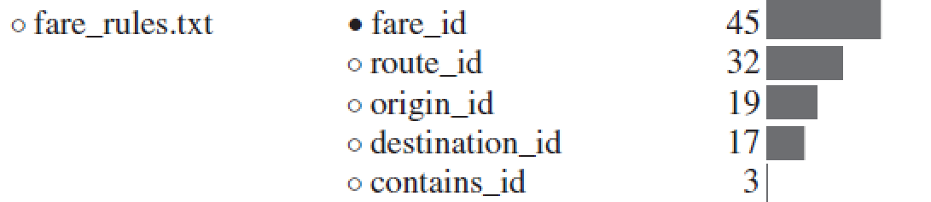
(Wong, 2013)

Slide 33
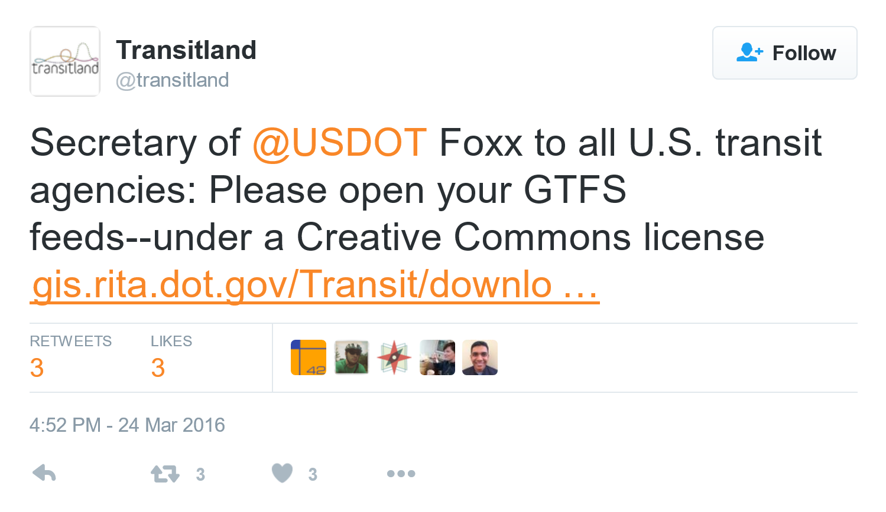
In March 2016 the Secretary of the US DOT wrote a letter advocating broad GTFS contribution and a national registry of GTFS, coming one step shy of requiring it from all agencies.

Slide 34
GTFS implications for livable communities/sustainable development
Enhances usability of transit system by existing transit riders (trip planning)
Makes visible transit as viable option for potential riders (makes transit systems less confusing; approachable)
Cascading positive effects of increased transit use (public health; environmental health; urban design)
Allows for regular performance-based assessments of existing, modified and planned transit systems (transparency; equity; collaborative governance)
Notes:
An important element of livability is having multiple travel options for getting around. The methodology in this book is guiding regional transit to better coordination and unified public transportation for super regions providing. Coordinated regional transit service depends on the needs, resources, and characteristics of the region. Coordination form in this book described as: building a broad coalition of stakeholders, creating a Common agenda for transportation needs by identify regional travel needs and develop regional transportation strategies, and focus on planning, flexibility, and sustainability.

Slide 35
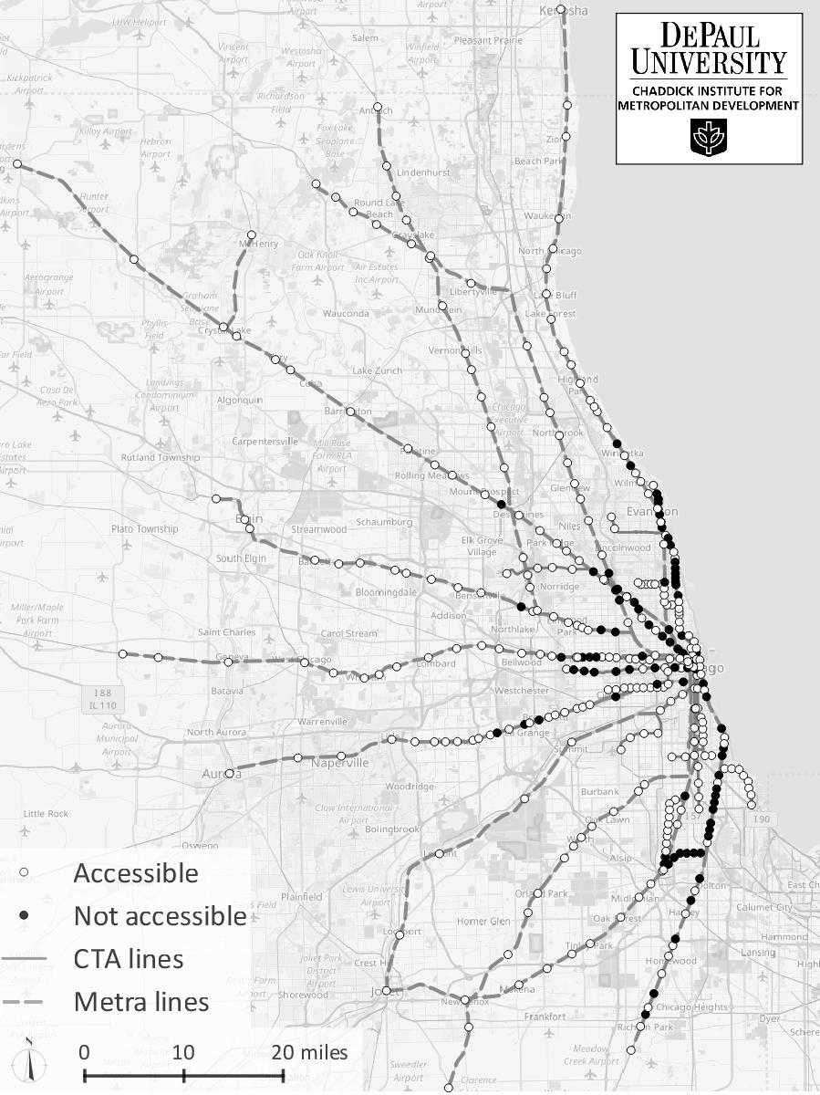
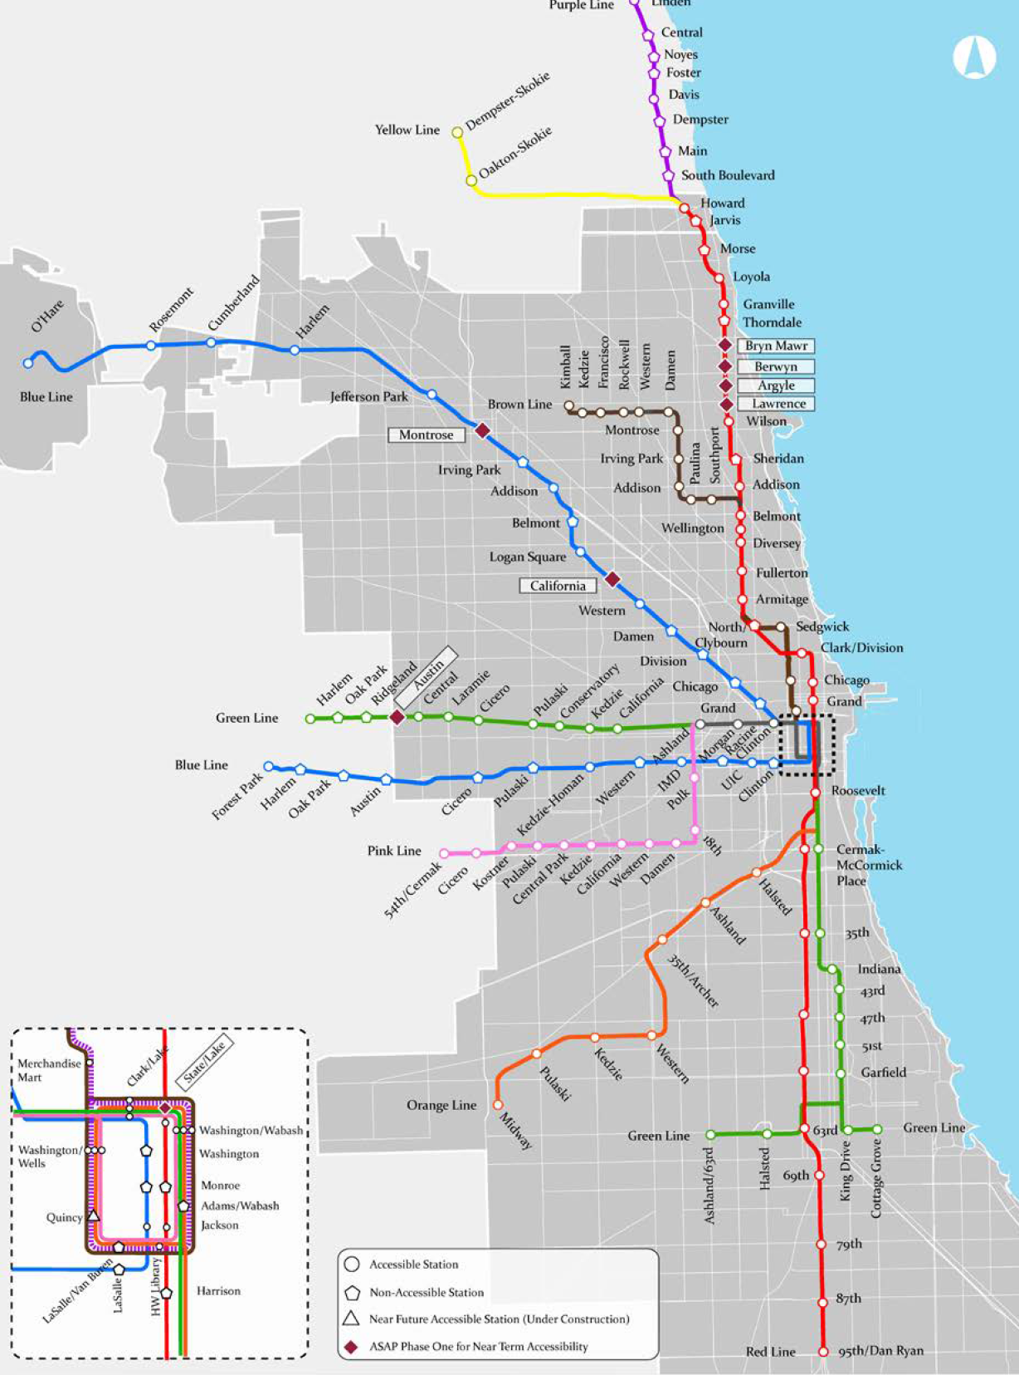
INACCESSIBLE TRAIN STATIONS IN CHICAGO AREA

Slide 36
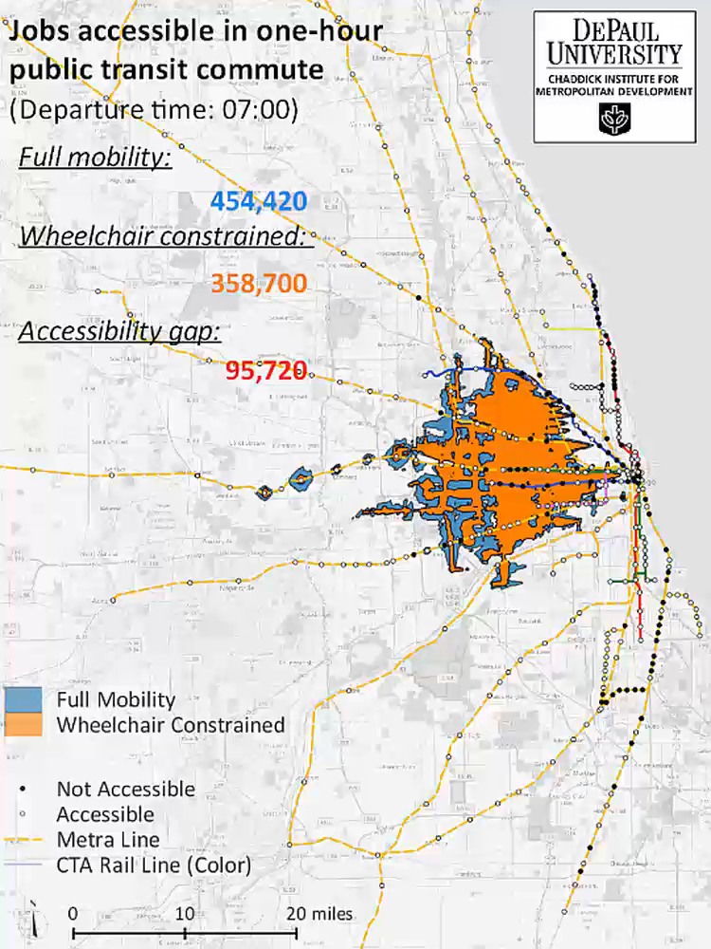

EQUITABLE PUBLIC TRANSIT
Presently, 33 percent of all ‘L’ stations are not fully accessible, or do not support wheelchair boardings.
As mobility becomes more constrained, job opportunities dwindle.

Slide 37

Assessor Parcels within ¼ mile of Austin & Division Bus Terminal
Notes:
Let’s talk a little about walkability of the site. In his book, Walkable City, urban planner Jeff Speck lays out his General Theory of Walkability which lays out four conditions for a walkable environment, namely: it must be useful, safe, comfortable, and interesting (21). The area surrounding the bus turnaround site fulfills many of these physical design characteristics that enhance walkability. For example, the associated parcels are small (N=926 within the ¼ buffer)--especially those in the Austin area--which translates into greater variety in the landscape, adding to the interest and usefulness of the walk. The neighborhoods also have configured in small, rectilinear blocks of smaller length, which creates higher intersection densities and allows for greater freedom of movement for the pedestrian. Altogether, according to CMAP’s walkability index, the area surrounding the bus turnaround ranks high to very high in terms of walkability (22).

Slide 38

PERCENT CHANGE IN ACTIVE TRANSPORTATION COMMUTERS
Data source: ACS 5-year estimates

Slide 39
Potential Benefits
Most of the existing buses turnarounds are on the edge of the city with other municipalities. Having a shared mobility hub could help to integrate the transit users between cities
Increase the number of potential users of sustainable transit modes
The space which it is already own by the CTA, have space for potential businesses that can activate the area

Slide 40
Possible ideas for intervention
Transit Oriented
Bike Sharing
Infrastructure oriented to transit
Public Space Oriented
Enhancing the current infrastructure
Mixed Design
Balance between public space and transit oriented infrastructure
Ride Sharing
Scooter
Charging points for electric cars
Adding art and greenery to made it more welcoming
Increasing the space for social gathering

Slide 41
THREE ROADMAPS
Equity-Focused Planning & Design
Multimodal & Shared Mobility Hubs
Green Infrastructure & Public Health
Informed by:
Collaborative planning
Environmental justice
Universal design
Informed by:
Cross-sector partnerships
Community economic development
Informed by:
Biophilic design
Vision Zero
Active transportation
In partnership with:
APA-IL DEI; MPC
EquitiCity; Access Living
Austin Coming Together
In partnership with:
SUMC; CTA
Lyft; VeoRide
Austin Chamber of Commerce
In partnership with:
Chicago Park District;
CNT; ATA
Westside Health Authority
Notes:
A roadmap is a flexible planning technique to support strategic and long-range planning, by matching short-term and long-term goals with specific solutions.

Slide 42

Source: Shared Use Mobility Center, 2016

Slide 43

Partnerships Between TNCs & Public Transit Agencies

Slide 44
MULTI-MODAL TRANSPORTATION MODEL
INPUT DATA
CALCULATIONS
OUTPUTS
Street Network
(OpenStreetMap)
OpenTripPlanner
Multimodal Transportation Network
Public Transit System GTFS
(CTA)
Python Scripts
Bikeshare System
(Divvy)
e-scooter rental
e-scooter
walk
E-Scooter Scenarios
(Chaddick)
mode-specific trip data and accessibility estimates
car
bike
public transit
bikeshare

Slide 45










Start: 61st St & Champlain Ave
DOUGLAS
End: Lake Meadows Center
Walk
T
Private bicycle
T
T
Divvy bicycle
OAKLAND
Public transit (bus)
E-scooter rental
T
Mode transfer
A
B
C
D
FULLER
PARK
GRAND
BOULEVARD
E
F
KENWOOD
WASHINGTON
PARK
HYDE PARK
T
T
T
T
T
WOODLAWN

Slide 46

CTA System Map

Slide 47

6PM weekday

Slide 48

11PM weekday

Slide 49

1AM weekday

Slide 50

2AM weekday

Slide 51



EQUITABLE PUBLIC TRANSIT

Slide 52



Slide 53



Kalamazoo County
Study Area

Slide 54

Kalamazoo County Population Trends &
Projection by Age Group (2005-2020)
19.5 percent of Michigan’s population will be 65 and older by 2020—an increase of 38.1 percent from 2005.
Source: US Census Bureau ACS, 2015
Notes:
Source: Michigan Department of Information Technology
There are significant trends occurring in the United States relating to the aging of the population. For example, nationally, the two (2) age cohorts with the largest percentage of growth over the last decade were the 50-54 year old cohort and the 45-49 year old cohort. People in these two (2) age groups were primarily born during the post-WWII “baby boom,” defined by the Census Bureau as persons born from 1946 through 1964. As communities approach the year 2010, these baby boomers will begin turning 65 years of age. Further, the Administration on Aging (U.S. Department of Health and Human Services) reports that, based on a comprehensive survey of older adults, longevity is increasing and younger seniors are healthier than in all previously measured time in our history. Quality of life issues and an individual’s desire to live independently will put increasing pressure on existing transit services to provide mobility to this population. This has great significance on the potential need to provide public transit and complementary paratransit services. Estimates of current and future number of persons over the age of 65 years were based on population projections (2005-2020) by age cohort for Kalamazoo County that were produced by the Michigan Department of Information Technology. These are summarized in Exhibit 54. As shown, the portion of the population over 65 years of age is projected to increase from 26,137 in 2005 to 37,202 in 2020. This is a 42.3 percent increase, as compared to a four (4) percent increase in the overall population during the same time period. As a result, the percent of persons over 65 years of the total population increases from 10.9 percent in 2005 to 15.0 percent in 2020.

Slide 55

Over 25% of pedestrian fatalities were seniors, despite making up only around 12% of the region’s population.
Notes:
Source: Michigan Department of Information Technology
There are significant trends occurring in the United States relating to the aging of the population. For example, nationally, the two (2) age cohorts with the largest percentage of growth over the last decade were the 50-54 year old cohort and the 45-49 year old cohort. People in these two (2) age groups were primarily born during the post-WWII “baby boom,” defined by the Census Bureau as persons born from 1946 through 1964. As communities approach the year 2010, these baby boomers will begin turning 65 years of age. Further, the Administration on Aging (U.S. Department of Health and Human Services) reports that, based on a comprehensive survey of older adults, longevity is increasing and younger seniors are healthier than in all previously measured time in our history. Quality of life issues and an individual’s desire to live independently will put increasing pressure on existing transit services to provide mobility to this population. This has great significance on the potential need to provide public transit and complementary paratransit services. Estimates of current and future number of persons over the age of 65 years were based on population projections (2005-2020) by age cohort for Kalamazoo County that were produced by the Michigan Department of Information Technology. These are summarized in Exhibit 54. As shown, the portion of the population over 65 years of age is projected to increase from 26,137 in 2005 to 37,202 in 2020. This is a 42.3 percent increase, as compared to a four (4) percent increase in the overall population during the same time period. As a result, the percent of persons over 65 years of the total population increases from 10.9 percent in 2005 to 15.0 percent in 2020.

Slide 56

Disability Status by Age Group
Kalamazoo County (2015)
32,591 or 12.8% of the county population reports having some form of disability
Source: US Census Bureau ACS, 2015
Notes:
32,591 or 12.8% of the population reports having some form of disability

Slide 57

Disability Status by Age Group
Kalamazoo County (2015)
68.7% of people reporting a disability are of working age 18-64)
Source: US Census Bureau ACS, 2015
Notes:
32,591 or 12.8% of the population reports having some form of disability
15.1% of the county’s population age 35-64 reports having some form of disability.

Slide 58

Disability Category (2015)
Having serious difficulty walking or climbing stairs.
Source: US Census Bureau ACS, 2015
Notes:
Hearing difficulty deaf or having serious difficulty hearing (DEAR).
Vision difficulty blind or having serious difficulty seeing, even when wearing glasses (DEYE).
Cognitive difficulty Because of a physical, mental, or emotional problem, having difficulty remembering, concentrating, or making decisions (DREM).
Ambulatory difficulty Having serious difficulty walking or climbing stairs (DPHY).
Self-care difficulty Having difficulty bathing or dressing (DDRS).
Independent living difficulty Because of a physical, mental, or emotional problem, having difficulty doing errands alone such as visiting a doctor’s office or shopping (DOUT).

Slide 59

Employment by Disability Status
Kalamazoo County (2015)
Source: US Census Bureau ACS, 2015
Notes:
Source: Michigan Department of Information Technology
There are significant trends occurring in the United States relating to the aging of the population. For example, nationally, the two (2) age cohorts with the largest percentage of growth over the last decade were the 50-54 year old cohort and the 45-49 year old cohort. People in these two (2) age groups were primarily born during the post-WWII “baby boom,” defined by the Census Bureau as persons born from 1946 through 1964. As communities approach the year 2010, these baby boomers will begin turning 65 years of age. Further, the Administration on Aging (U.S. Department of Health and Human Services) reports that, based on a comprehensive survey of older adults, longevity is increasing and younger seniors are healthier than in all previously measured time in our history. Quality of life issues and an individual’s desire to live independently will put increasing pressure on existing transit services to provide mobility to this population. This has great significance on the potential need to provide public transit and complementary paratransit services. Estimates of current and future number of persons over the age of 65 years were based on population projections (2005-2020) by age cohort for Kalamazoo County that were produced by the Michigan Department of Information Technology. These are summarized in Exhibit 54. As shown, the portion of the population over 65 years of age is projected to increase from 26,137 in 2005 to 37,202 in 2020. This is a 42.3 percent increase, as compared to a four (4) percent increase in the overall population during the same time period. As a result, the percent of persons over 65 years of the total population increases from 10.9 percent in 2005 to 15.0 percent in 2020.

Slide 60

Work Commute Mode Share,
Kalamazoo County (2000-2015)
Source: US Census Bureau ACS, 2000-2015

Slide 61
Notes:
Map of Kalamazoo County; around 280 square miles; 19 Kalamazoo Metro fixed transit routes and 52 PROWAG compliant bus stops.

Slide 62


Slide 63


Private Auto

Slide 64

Public Transit +
Walking

Slide 65

Public Transit +
Limited Walking

Slide 66

Acc Transit +
Walking

Slide 67

Acc Transit +
Limited Walking

Slide 68


Slide 69


Slide 70


Slide 71


Slide 72


Slide 73


Slide 74


GENDER GAPS
Gender split of L.A. Metro bus and rail riders
How do you use ride-hailing services in relation to public transit
American Planning Association
Planning Magazine
Mind the Gender Gap
February 2020

Slide 75

GENDER GAPS
L.A. Metro riders who have been sexually harassed in the past six months
American Planning Association
Planning Magazine
Mind the Gender Gap
February 2020

Slide 76
IN-CLASS BRAINSTORMING EXERCISE
What are the potential benefits of public transit over other travel modes? (5+)
Why is transit under-utilized in the United States? (5+)
What improvements and/or changes would need to be made for you to take additional public transit trips? (5+)

