Slide 1
methodology
The sf, sp, dplyr, tidyverse, and other R data wrangling packages are used to import and transform NEI and TRI data for facilities that have reported SO2 stack emissions in California.
NEI (2020)
TRI (2020)
NEI
Indicator tables
NEI for CA facilities
Selected indicators
ArcGIS Pro is used to create a custom study area, and create custom visualizations of air dispersion data.
Selected PLACES and SVI indicator data were attached to census tract geometries via attribute joins.
PLACES/SVI indicators by census tract

Slide 2
Us map of counties by population and selected county
Description of your county, including FIPS code, associated state, region of the country, number of tracts and total population.
Data sources: US Census Bureau TIGER/Line; ACS 5-Year Estimates.

Slide 3
Bivariate correlation plot of svi and places variables
Analysis of the correlation plot.
Data sources: CDC PLACES; CDC SVI.

Slide 4
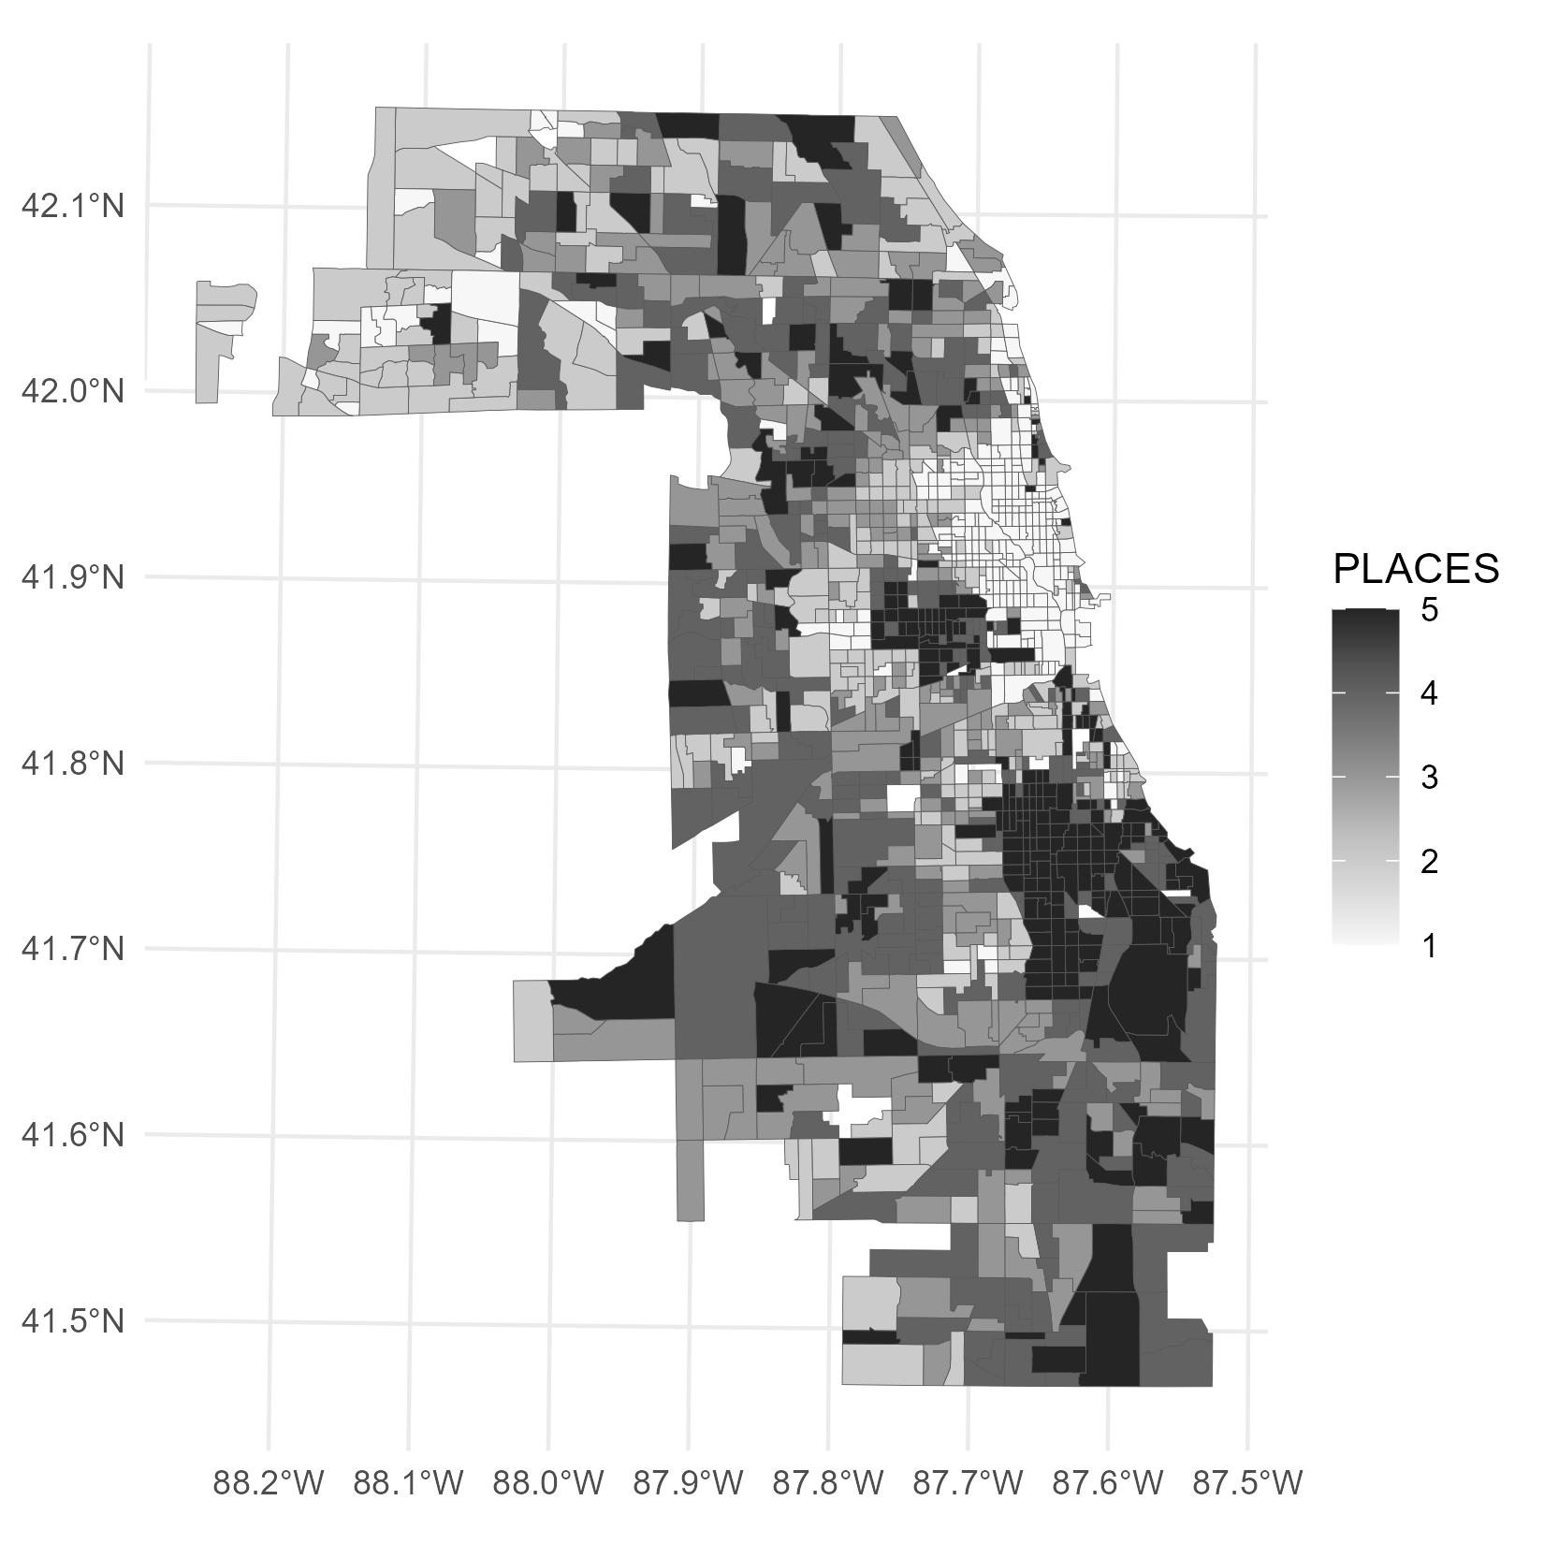
Cdc places measure title units
Description of the component PLACES measure and brief analysis of distributions shown on map.
Data sources: CDC PLACES.

Slide 5
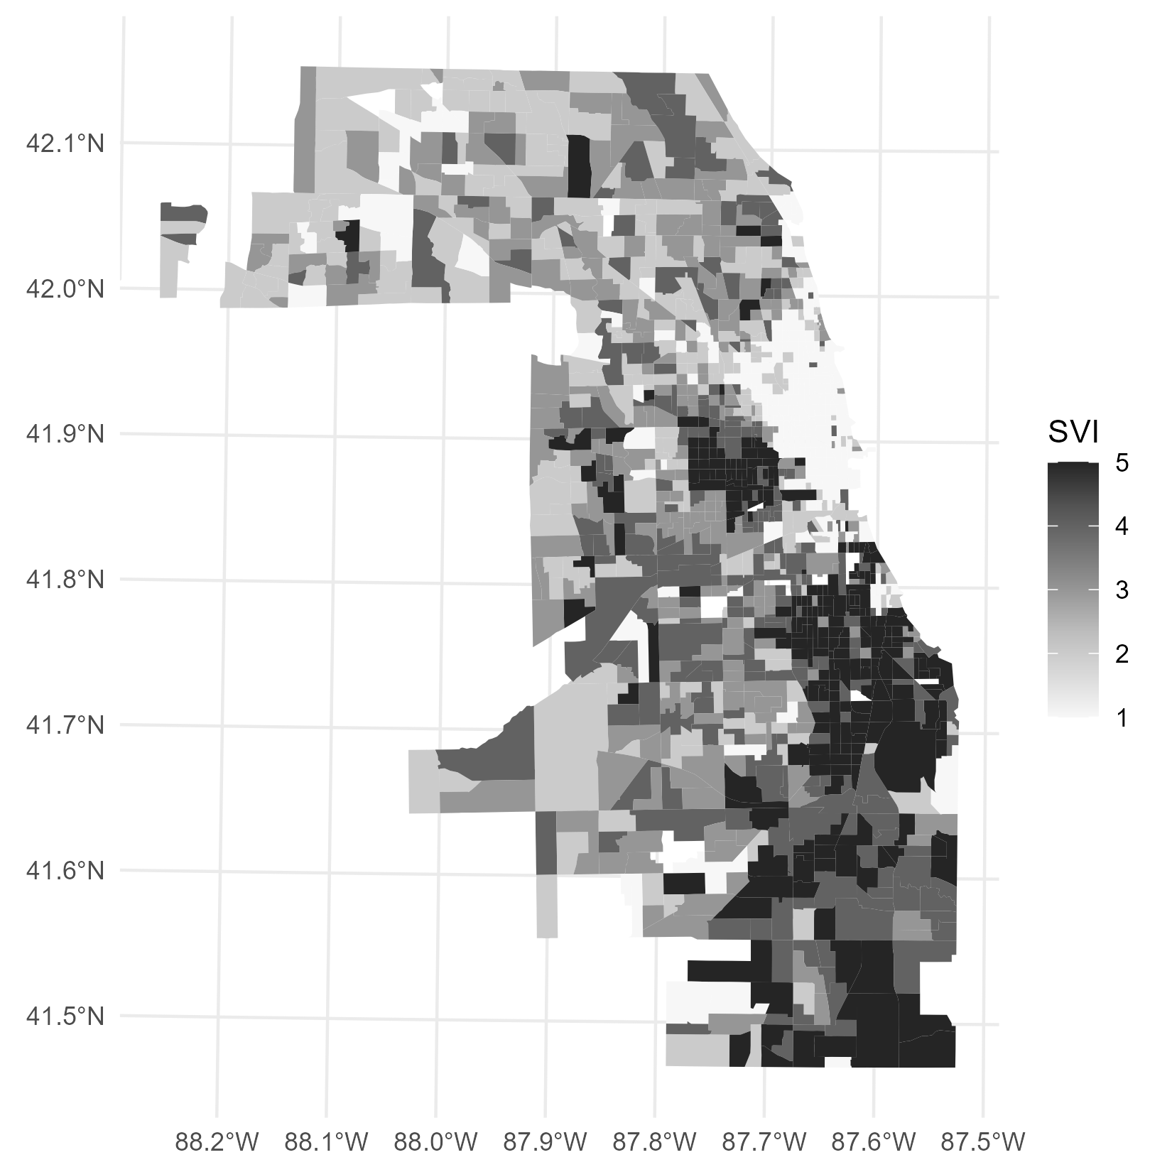
Cdc SVI factor title units
Description of the component SVI factor and brief analysis of distributions shown on map.
Data sources: CDC SVI.

Slide 6
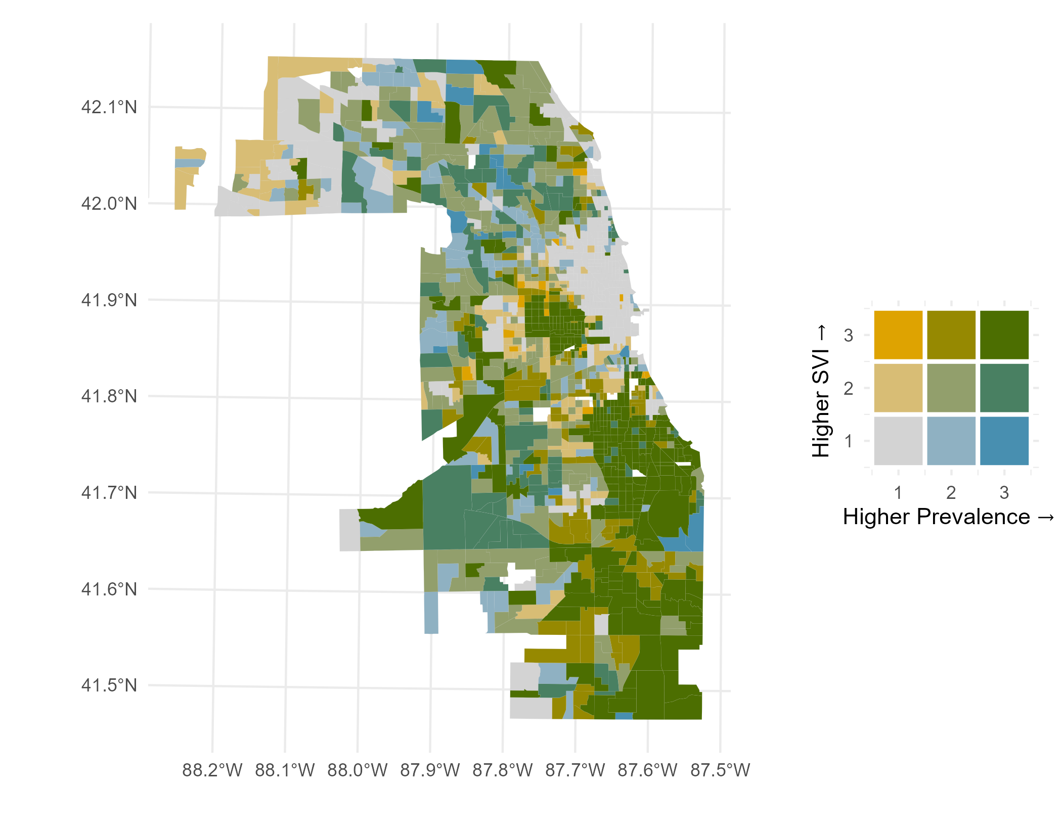
BIVARIATE MAP TITLE UNITS OF COMPONENT VARIABLES
Map description and analysis
Data sources: CDC PLACES; CDC SVI.

Slide 7
Cdc places measure title units
Description of the component PLACES measure and brief analysis of distributions shown on map.
Data sources: CDC PLACES.

Slide 8
Cdc SVI factor title units
Description of the component SVI factor and brief analysis of distributions shown on map.
Data sources: CDC SVI.

Slide 9
BIVARIATE MAP TITLE UNITS OF COMPONENT VARIABLES
Map description and analysis
Data sources: CDC PLACES; CDC SVI.

