Slide 1
methodology
ggplot2, biscale and other Rstudio cartographc packages were used to create component and bivariate maps of the following indicators
PLACES measures
SVI factors
The tigris, sf, dplyr and other R data wrangling packages were used to import and transform US Census and CDC public health and vulnerability data for a selected US county.
Coronary heart disease
Household composition
US Census TIGER/Line
PLACES and SVI CDC data
Census tracts
Indicator tables
Census tracts
Selected indicators
Selected PLACES and SVI indicator data were attached to census tract geometries via attribute joins.
PLACES/SVI indicators by census tract

Slide 2
Us map of counties by population and selected county
Description of your county, including FIPS code, associated state, region of the country, number of tracts and total population.
Data sources: US Census Bureau TIGER/Line; ACS 5-Year Estimates.

Slide 3
Bivariate correlation plot of svi and places variables
Analysis of the correlation plot.
Data sources: CDC PLACES; CDC SVI.

Slide 4
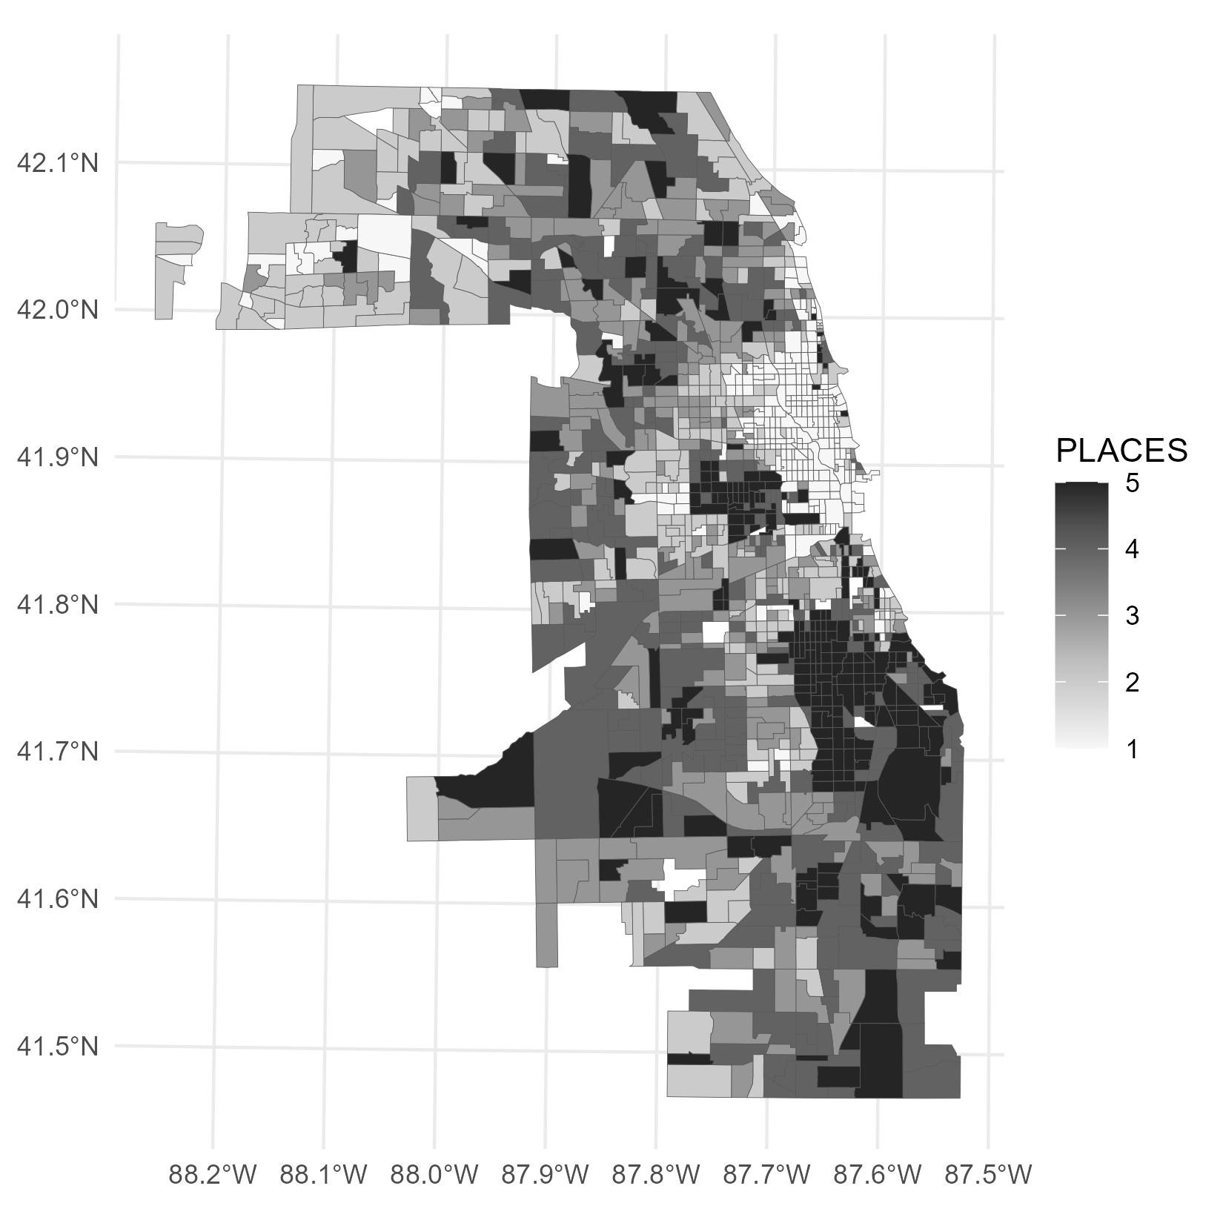
Cdc places measure title units
Description of the component PLACES measure and brief analysis of distributions shown on map.
Data sources: CDC PLACES.

Slide 5
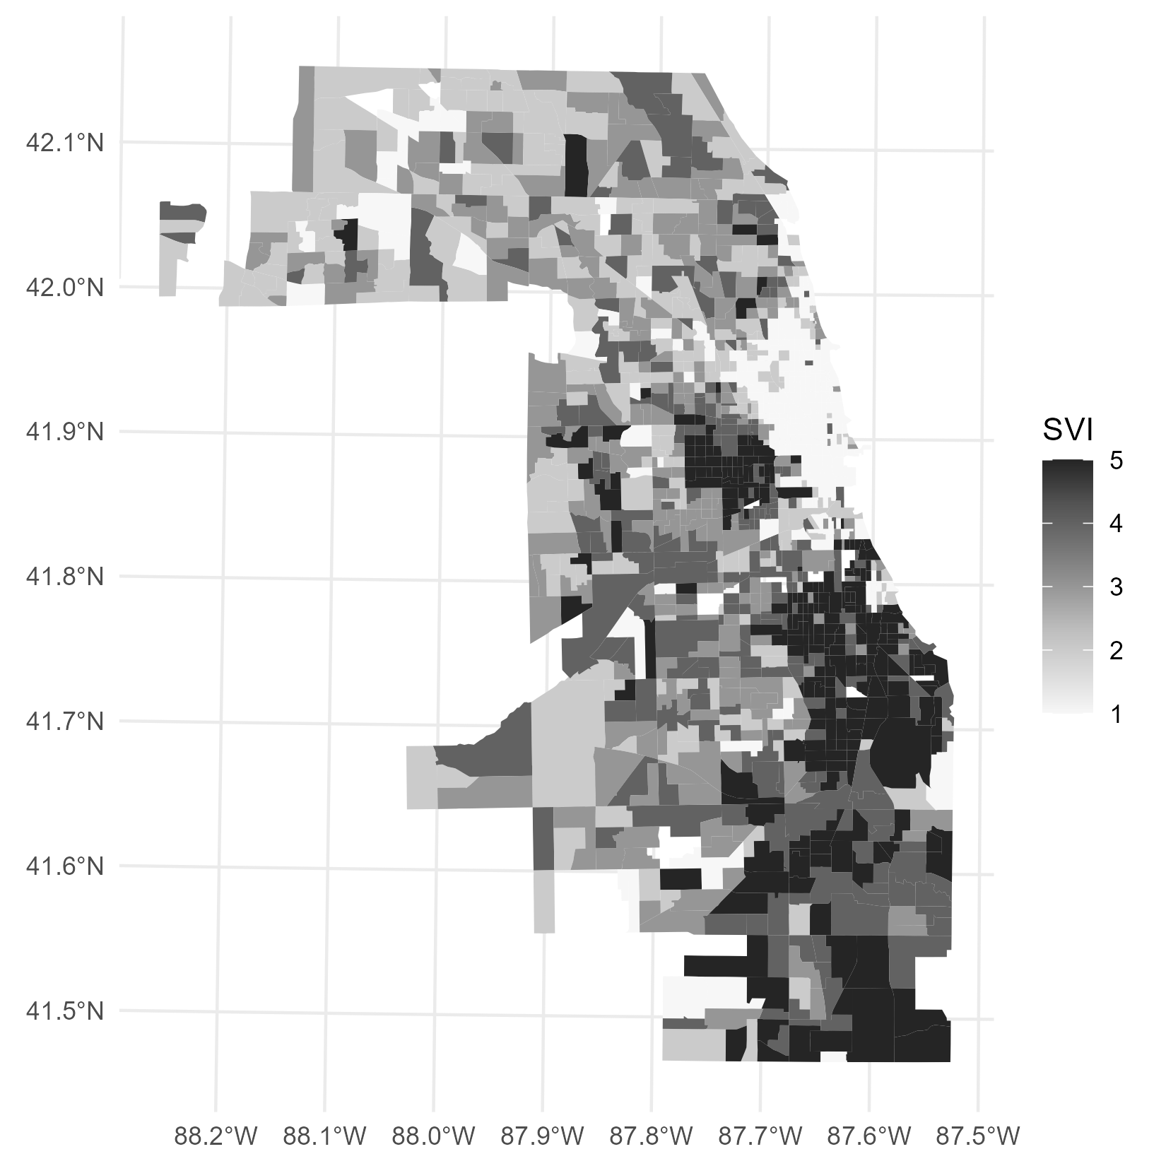
Cdc SVI factor title units
Description of the component SVI factor and brief analysis of distributions shown on map.
Data sources: CDC SVI.

Slide 6
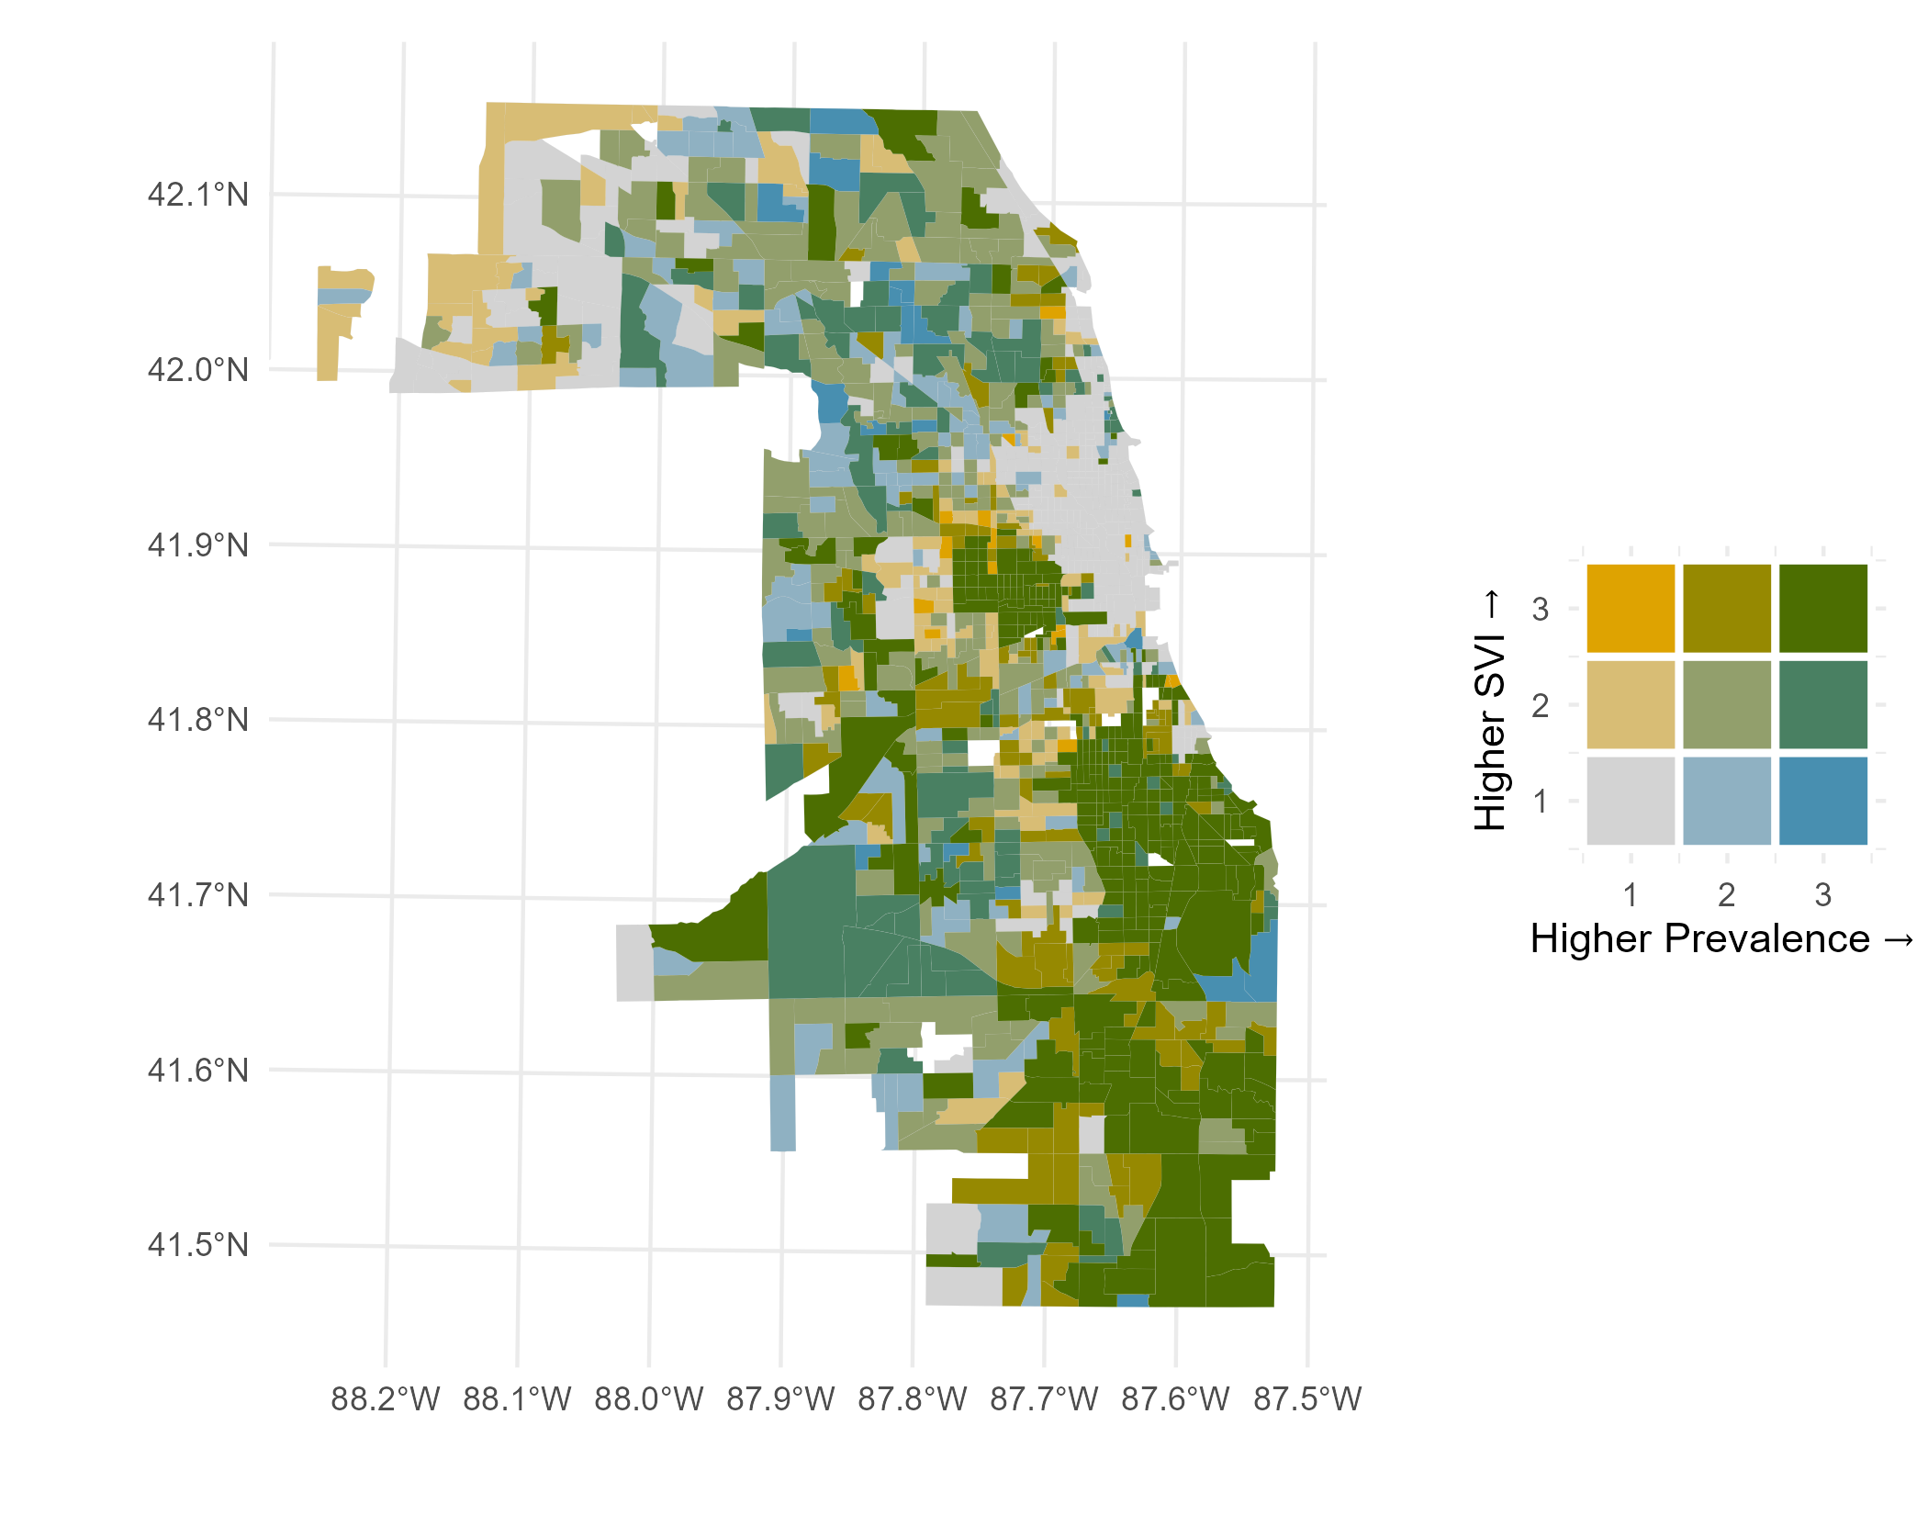
BIVARIATE MAP TITLE UNITS OF COMPONENT VARIABLES
Map description and analysis
Data sources: CDC PLACES; CDC SVI.

Slide 7
Cdc places measure title units
Description of the component PLACES measure and brief analysis of distributions shown on map.
Data sources: CDC PLACES.

Slide 8
Cdc SVI factor title units
Description of the component SVI factor and brief analysis of distributions shown on map.
Data sources: CDC SVI.

Slide 9
BIVARIATE MAP TITLE UNITS OF COMPONENT VARIABLES
Map description and analysis
Data sources: CDC PLACES; CDC SVI.

Slide 10
Cdc places measure title units
Description of the component PLACES measure and brief analysis of distributions shown on map.
Data sources: CDC PLACES.

Slide 11
Cdc SVI factor title units
Description of the component SVI factor and brief analysis of distributions shown on map.
Data sources: CDC SVI.

Slide 12
BIVARIATE MAP TITLE UNITS OF COMPONENT VARIABLES
Map description and analysis
Data sources: CDC PLACES; CDC SVI.

Slide 13
Cdc places measure title units
Description of the component PLACES measure and brief analysis of distributions shown on map.
Data sources: CDC PLACES.

Slide 14
Cdc SVI factor title units
Description of the component SVI factor and brief analysis of distributions shown on map.
Data sources: CDC SVI.

Slide 15
BIVARIATE MAP TITLE UNITS OF COMPONENT VARIABLES
Map description and analysis
Data sources: CDC PLACES; CDC SVI.

