Slide 1
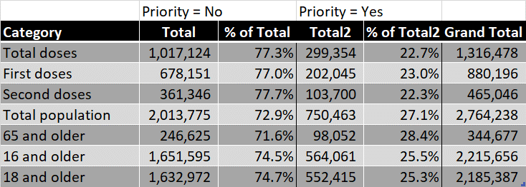
SUMMARY COVID-19 VACCINATION CHARACTERISTICS BY COMMUNITY POPULATION, CATEGORY
Cumulative Total, First and Second Vaccinations
(2/1/2021 to 4/6/2021) and
Select Population Totals, Shares by Community Category
Notes:
If there is no association, we would expect each cell to be the percentage of the total population, adjusted for the frequency of the respective row and column.

Slide 2
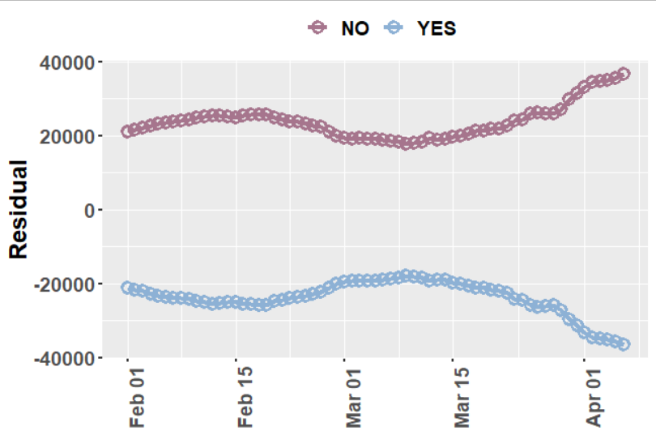

Tests of independence, (first) COVID19 VACCINATIONS by Community CATEGORY
Observed vs Predicted Cumulative First Vaccinations as
Share of Total Population, 2/1/2021 to 4/6/2021
Observed > Predicted
(underpredicted)
H0: There is no association between the distribution of COVID-19 vaccinations and whether the community is prioritized under “Protect Chicago Plus.”
H0 is rejected for all 130 time periods. The chi-square statistic fluctuated across the study period from a high of 14,143 (df =1, p<0.01) on 2/2/2021 to a low of 4,254 (df =1, p<0.01) on March 10, 2021.
Predicted < Observed
(overpredicted)
Example contingency table for 4/6/2021
Notes:
If there is no association, we would expect each cell to be the percentage of the total population, adjusted for the frequency of the respective row and column.

Slide 3
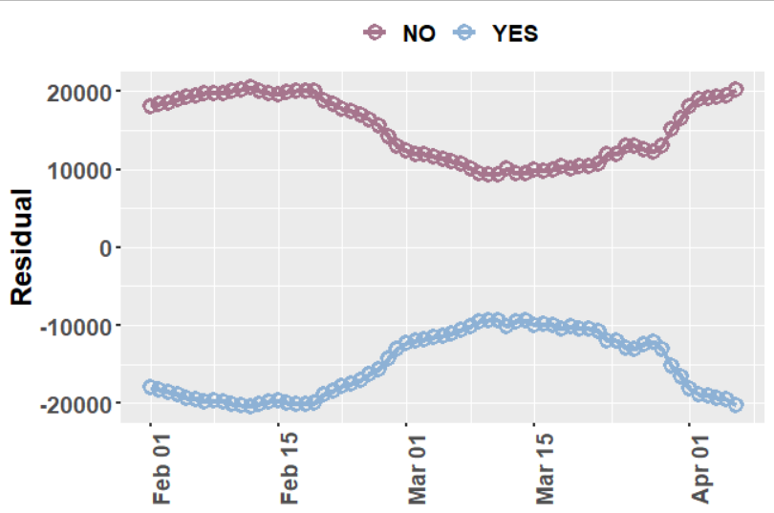

Tests of independence, (first) COVID19 VACCINATIONS by Community CATEGORY
Observed vs Predicted Cumulative First Vaccinations as
Share of Population 18 and Older, 2/1/2021 to 4/6/2021
Observed > Predicted
(underpredicted)
H0: There is no association between the distribution of COVID-19 vaccinations and whether the community is prioritized under “Protect Chicago Plus.”
H0 is rejected for all 130 time periods. The chi-square statistic fluctuated across the study period from a high of 10,877 (df =1, p<0.01) on 2/1/2021 to a low of 1,190 (df =1, p<0.01) on March 14, 2021.
Predicted < Observed
(overpredicted)
Example contingency table for 4/6/2021
Notes:
If there is no association, we would expect each cell to be the percentage of the total population, adjusted for the frequency of the respective row and column.

