Slide 1
Binary search tree

Slide 2
Binary Search Tree, is a node-based binary tree data structure which has the following properties:
The Smaller Elements is compare to root node is always in LEFT side of the tree .
The Bigger Element Compare to root node is always in the RIGHT side of the tree.
Each node has Only 2child node.

Slide 3
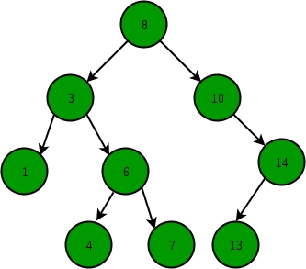
SIMPLE DIAGRAM OF BINARY SEARCH TREE
ROOT
PARANT
Leaf

Slide 4
OPERATIONS OF BINARY SEARCH TREE
INSEARTION OF A ELEMENT
DELETION OF A ELEMENT
SEARCHING OF AN ELEMENT
SORTING

Slide 5
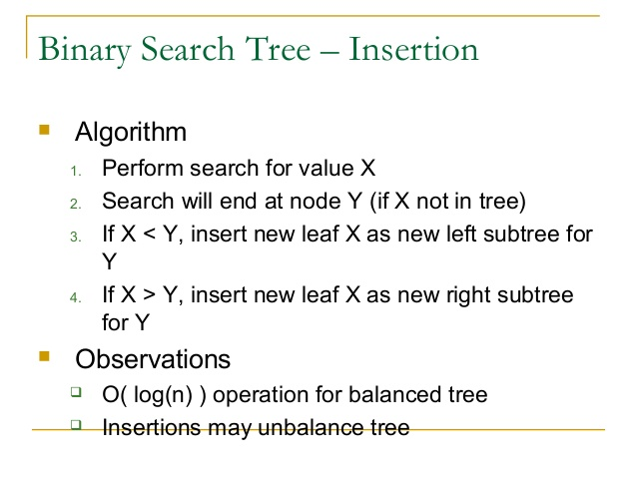

Slide 6
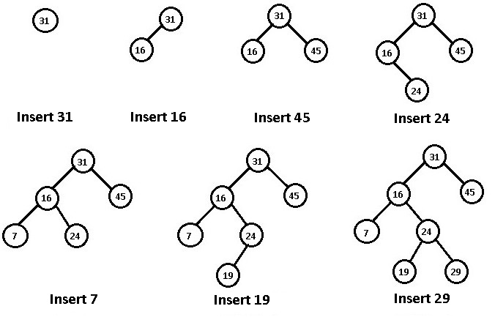
Example : Insert the following element (31,16,45,24,7,19,29)

Slide 7
Binary search tree. Removing a node
Remove operation on binary search tree is more complicated, than add and search. Basically, in can be divided into two stages:
search for a node to remove;
if the node is found, run remove algorithm.
Remove algorithm in detail
Now, let's see more detailed description of a remove algorithm. First stage is identical to algorithm for lookup, except we should track the parent of the current node. Second part is more tricky. There are three cases, which are described below.

Slide 8
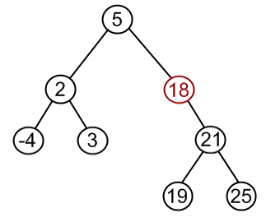
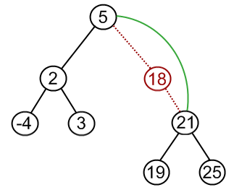
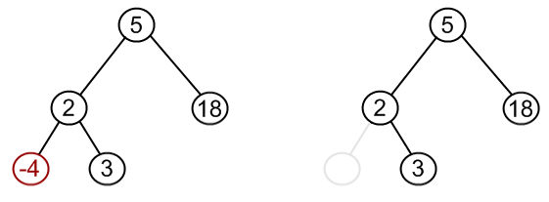
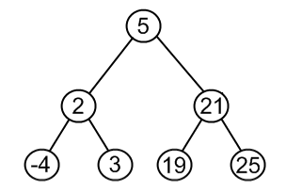
Case1:Node to be removed has no children.
This case is quite simple. Algorithm sets corresponding link of the parent to NULL and disposes the node.
Example. Remove -4 from a BST.
Case 2:Node to be removed has one child.
It this case, node is cut from the tree and algorithm links single child (with it's subtree) directly to the parent of the removed node.
Example. Remove 18 from a BST.

Slide 9
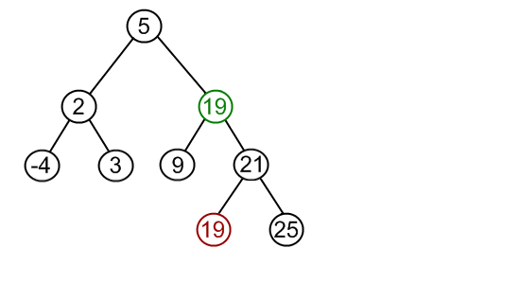
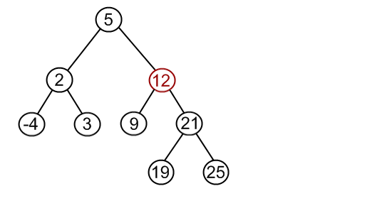
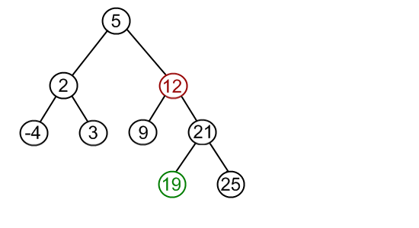
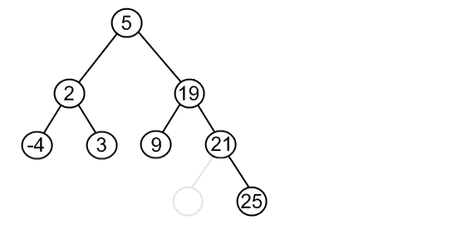
:
Case 3:Node to be removed has two children.
This is the most complex case. To solve it, let us see one useful BST property first. We are going to use the idea, that the same set of values may be represented as different binary-search trees. For example those BST.
Example. Remove 12 from a BST.
Find minimum element in the right subtree of the node to be removed. In current example it is 19.
Replace 12 with 19. Notice, that only values are replaced, not nodes. Now we have two nodes with the same value.
Remove 19 from the left subtree.

