Slide 1
Molecular Dynamics Program
Azad Kirsan, 01.07.2021

Slide 2
1. Aims of the program
Simulate Argon gas particles
Potential: Lennard-Jones / hard spheres
Use Velocity-Verlet-algorithm as integrator
Periodic boundary conditions and hard walls
Visualize the simulation

Slide 3
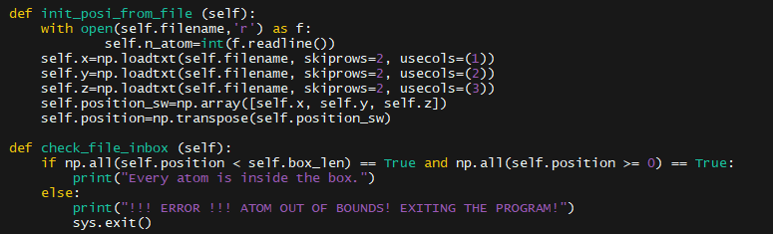
2.1. Initialization of coordinates from file
Load atom coordinates into an array from a given file
Check if all atoms are inside the box

Slide 4
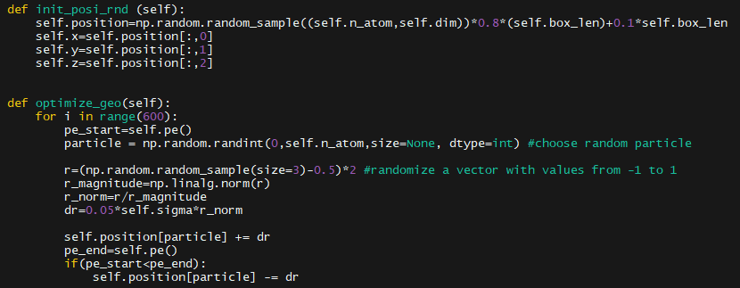
2.2. Initialization of random coordinates
Randomize atom positions inside the box
Optimize the geometry so no atoms are on top of each other

Slide 5

2.3. Initialization of velocities
Initialize random velocities relating to the temperature
Array of random numbers from -1 to 1 in a uniform distribution
Multiply array by the most probable velocity according to the Maxwell-Boltzmann distribution

Slide 6
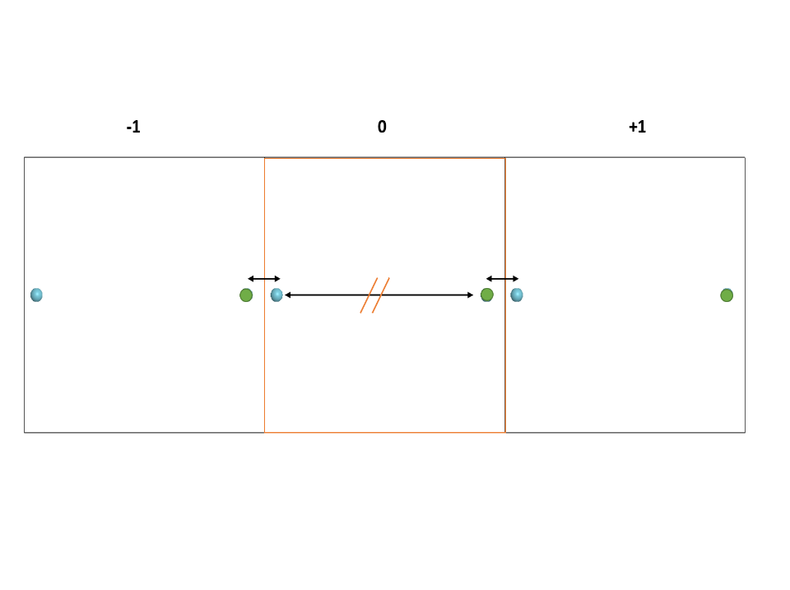
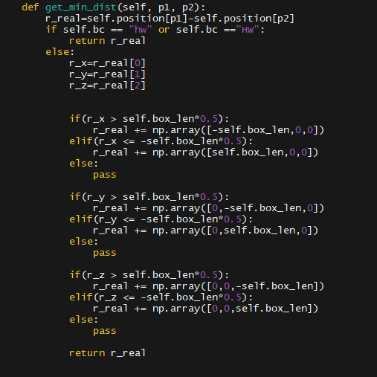
3. Get the minimum distance

Slide 7
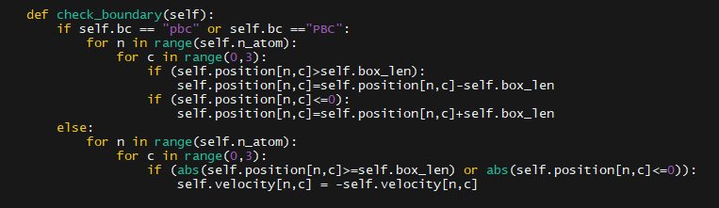
4. Boundary conditions
Periodic boundary conditions
Hard walls

Slide 8
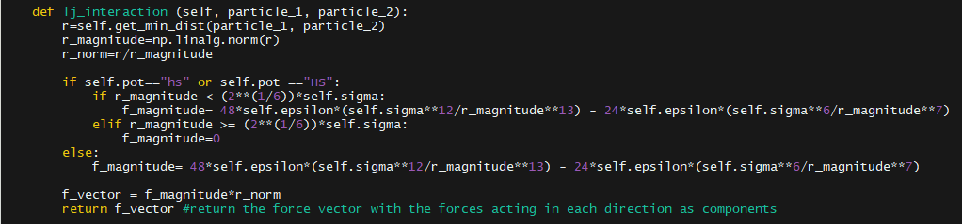
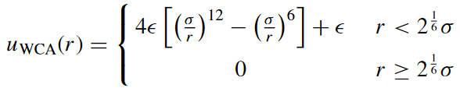

5. Calculating the forces
Weeks-Chandler-Andersen potential (hard spheres)
Lennard-Jones potential

Slide 9
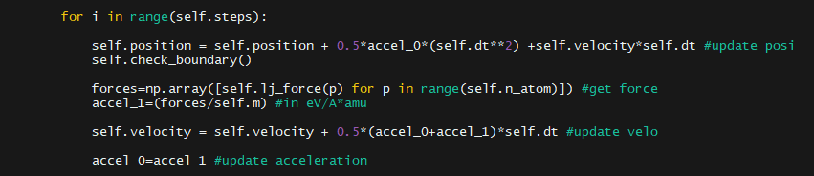




6. Velocity-Verlet Integrator
$$a) x←x+v∆t+ \frac{1}{2}a0∆t2$$
$$b) a1←\frac{F}{m}$$
$$c) v←v+\frac{1}{2}[a1+a0]∆t$$
$$d) a0←a1$$

Slide 10
7. Problems
Initializing useful random velocities
Getting the units right
Visualizing the simulation, since matplotlib was too slow

