Slide 1

LLOYD INSTITUTE OF ENGINEERING & TECHNOLOGY
Department of Computer Science & Engineering
B.TECH IV YEAR SUMMER INTERNSHIP
INSURANCE CHARGE PREDICTOR
at [Organisation name, city]
Duration: [Duration] From: [ DD/MM/YYYY ] To: [ DD/MM/YYYY ]
Internship Presentation | Session 2026–27
FACULTY MENTOR
SUBMITTED BY
[ Name of Faculty Mentor ]
Gurmeet Singh
Roll No. 2301531530027
CSE (AIML), Year IV, Section D
[ Designation, Department of CSE ]
Notes:
Insurance Charge Predictor, an educational regression project. Presenter: Gurmeet Singh, university roll number 2301531530027, CSE (AIML), Section D. Host organisation, duration, dates and mentor details remain editable fields. Dataset source: https://github.com/stedy/Machine-Learning-with-R-datasets/blob/master/insurance.csv. The model estimates historical benchmark medical charges in USD.

Slide 2
01
OVERVIEW
Presentation Agenda
1
Internship Overview
5
Work Done & Workflow
2
Objectives of Internship
6
Learning Outcomes
3
Tools & Technologies Used
7
Documents and Submission Status
4
Weekly Work Log
B.TECH SUMMER INTERNSHIP PRESENTATION · LLOYD INSTITUTE OF ENGINEERING & TECHNOLOGY
2

Slide 3
02
SECTION 02
Internship Overview
Host organisation: [Organisation name, location]
Domain and project: Machine learning / Insurance Charge Predictor
Duration: [Duration] From: [Start date] To: [End date]
Mode: [On-site / Remote / Hybrid]
Supervisors: [Industry supervisor] / [Faculty mentor]
Project task: Estimate medical charges from six profile inputs.
Dataset: 1,338 source rows, 1,337 clean rows, target in USD.
Use: A local academic demonstration of supervised regression.
B.TECH SUMMER INTERNSHIP PRESENTATION · LLOYD INSTITUTE OF ENGINEERING & TECHNOLOGY
3
Notes:
The six inputs are age, sex, BMI, number of dependents, smoking status and US region. Target charges is a continuous amount. The template organisation and internship details require confirmation. Data source: data/SOURCE.md and https://github.com/stedy/Machine-Learning-with-R-datasets/blob/master/insurance.csv.

Slide 4
03
SECTION 03
Objectives of the Internship
1. Estimate the numerical charges recorded in the benchmark.
2. Preserve source data and audit one duplicate before training.
3. Compare a mean baseline, ridge, random forest and boosting.
4. Select by training cross-validation MAE, then test separately.
5. Demonstrate form inputs, profile comparison and CSV predictions.
B.TECH SUMMER INTERNSHIP PRESENTATION · LLOYD INSTITUTE OF ENGINEERING & TECHNOLOGY
4
Notes:
This is regression because the output is a numeric charge. Distinguish it from the earlier classification project. Cleaning retains valid high-cost observations. The app is an academic estimate, not a current policy quote. Local evidence: src/train.py, src/schema.py and reports/data_audit.json.

Slide 5
04
SECTION 04
Tools & Technologies Used
Technology | Purpose in this project
Python 3.12 | Training code and local HTTP server
pandas and NumPy | CSV tables, cleaning and numeric validation
scikit-learn | Preprocessing, regression, cross-validation and metrics
Matplotlib | Actual-versus-predicted and residual charts
Joblib | Save and load the fitted preprocessing pipeline
HTML, CSS and JavaScript | Form, comparison, batch prediction and CSV export
Jupyter notebook | Optional walkthrough of data and measured results
B.TECH SUMMER INTERNSHIP PRESENTATION · LLOYD INSTITUTE OF ENGINEERING & TECHNOLOGY
5
Notes:
The running interface uses Python HTTPServer, not Flask or Streamlit. It has no API keys and does not require internet after dependencies are installed. See requirements.txt and reports/tested_versions.json for versions.

Slide 6
05
SECTION 05
Weekly Work Log
Week / date | Tasks / Activities Performed | Technologies Used | Learning / Outcome
[Date] | Define target, inspect dataset and preserve raw CSV | Python, pandas | Regression problem and data provenance
[Date] | Remove duplicate and validate six input features | pandas, NumPy | Data audit and input schema
[Date] | Build pipelines and compare four approaches | scikit-learn | Encoding and cross-validation
[Date] | Evaluate selected model on held-out records | scikit-learn, Matplotlib | MAE, RMSE, R² and error analysis
[Date] | Implement form, comparison and batch predictions | HTML, CSS, JS, Python | Connect model inference to an interface
[Date] | Verify results and prepare documentation | Python, Jupyter | Reproducibility and evaluation demo
Activities appear in project order. Confirm calendar weeks using the actual internship diary.
B.TECH SUMMER INTERNSHIP PRESENTATION · LLOYD INSTITUTE OF ENGINEERING & TECHNOLOGY
6
Notes:
This is a project activity sequence, not evidence of a six-week internship. Week/date fields must be completed from the actual diary. No company induction, attendance, or duration has been invented.

Slide 7
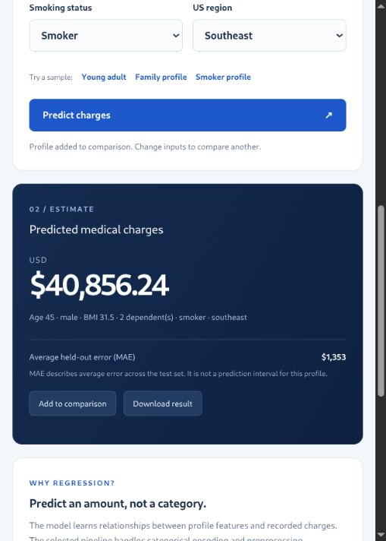
06
SECTION 06
Work Done: Workflow and Results
Model workflow
1. Clean and validate the source data
2. Split 1,069 training / 268 test rows
3. Compare models using five training folds
4. Fit gradient boosting and save the pipeline
5. Validate a profile and return its estimate
Evaluation | MAE (USD) | R²
Training CV | 2,097.37 | 0.8344
Held-out test | 1,352.65 | 0.9246
Test RMSE: $3,297.50. R² is a regression score.
Historical US medical charges in USD. Individual errors can exceed average MAE.
B.TECH SUMMER INTERNSHIP PRESENTATION · LLOYD INSTITUTE OF ENGINEERING & TECHNOLOGY
7
Notes:
Measured results: reports/metrics.json and reports/model_comparison.csv. Gradient boosting: 250 depth-two trees, learning rate 0.04, Huber loss. Lowest mean five-fold training CV MAE selected it. Test MAE $1,352.65, RMSE $3,297.50, R² 0.9246. CV MAE $2,097.37 and CV R² 0.8344. The difference illustrates split variability. The screenshot shows age 45, male, BMI 31.5, two dependents, smoker, southeast, estimate $40,856.24. A matching non-smoker preset estimates $8,934.37. Associations do not establish causality. Source: local app_demo.png and measured project artifacts.

Slide 8
07
SECTION 07
Learning Outcomes
Data preparation
Preserve raw records, validate fields and audit duplicate removal.
Model development
Encode categories in a pipeline and select models through cross-validation.
Evaluation
Interpret MAE, RMSE and R², and keep test records out of selection.
Application delivery
Connect saved-model inference to a working form and CSV interface.
B.TECH SUMMER INTERNSHIP PRESENTATION · LLOYD INSTITUTE OF ENGINEERING & TECHNOLOGY
8
Notes:
Explain model and software learning using the actual code. Limitations include small historical US data, restricted categories and no external validation. The prototype does not establish current Indian pricing or policy eligibility. Reproducibility checks are in src/verify.py and reports/verification.txt.

Slide 9
08
SECTION 08
Documents and Submission Status
Project report and presentation: prepared in the supplied college formats.
✓
Source code, clean data, model and notebook: included in the project folder.
✓
Offer letter and completion certificate: [Attach authentic organisation documents].
…
Supervisor feedback: [To be completed and signed by the mentor].
…
B.TECH SUMMER INTERNSHIP PRESENTATION · LLOYD INSTITUTE OF ENGINEERING & TECHNOLOGY
9
Notes:
Prepared files are available locally. No official institutional submission or certificate issuance is claimed. Offer letter, completion certificate, dates, mentor details and feedback require authentic documents and confirmation.

Slide 10
THANK YOU
Questions & suggestions from the panel are welcome
Lloyd Institute of Engineering & Technology, Greater Noida
Notes:
Suggested demonstration: open http://127.0.0.1:8502; choose Family profile and predict; add to comparison; choose Smoker profile and predict; show evaluation metrics, data audit and batch CSV. Presenter: Gurmeet Singh, 2301531530027, CSE (AIML), Section D.

