Slide 1



RL @ PicsArt
Bandits, exploration, production hacks
Intrinsic motivation in RL

Slide 2
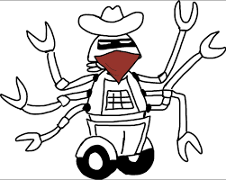
Multi-armed bandits

Slide 3
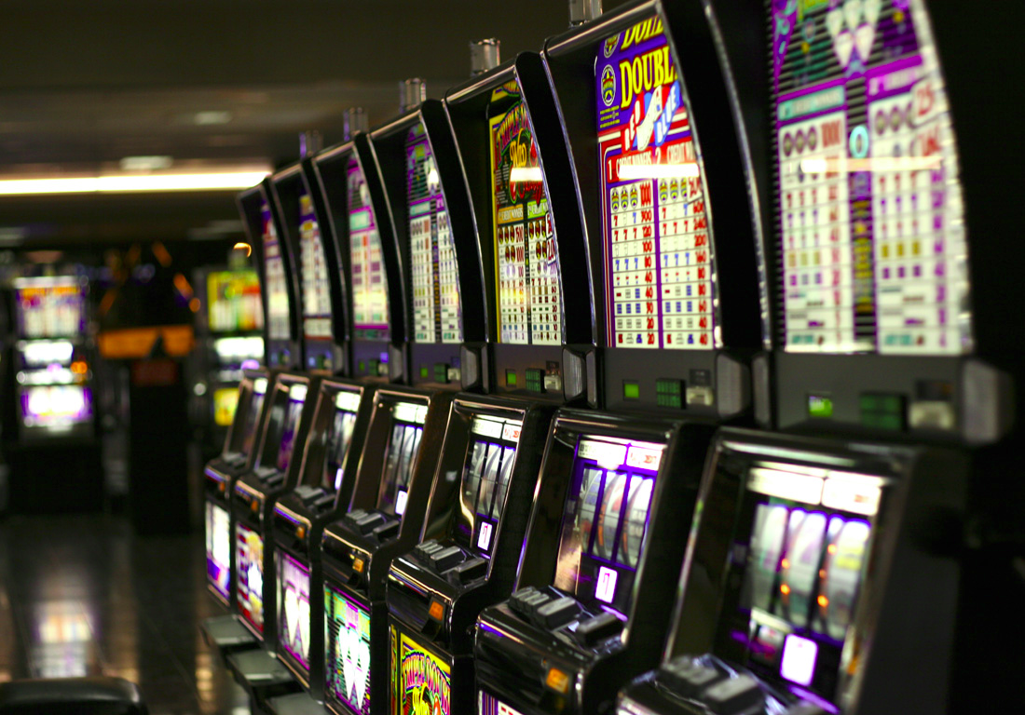
Multi-armed bandits

Slide 4

Multi-armed bandits
A simplified MDP with only one step
observation
Agent
action
Feedback
Why: it's simpler to explain exploration methods,
Formulae are shorter
(we can generalize to MDP if you wish)

Slide 5
What is: contextual bandit
state
Agent
action
r(s,a)
Feedback
Examples:
  banner ads (RTB)
  recommendations
  medical treatment
Basicaly it's 1-step MDP where
  G(s,a) = r(s,a)
  Q(s,a) = E r(s,a)
  All formulae are 50% shorter

Slide 6
How to measure exploration
With convergence properties!

Slide 7
How to measure exploration
Bad idea: with convergence properties
Good idea: with $$$ it brought/lost you
Regret of policy π(a|s):
Consider an optimal policy, π*(a|s)
Regret per tick = optimal – yours
Finite horizon: t < max_t Infinite horizon: t → inf

Slide 8
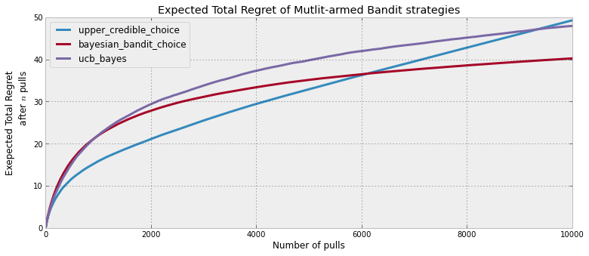
How to measure exploration
Bad idea: with convergence properties
Good idea: with $$$ it brought/lost you
Regret of policy π(a|s):
Regret per tick = optimal – yours

Slide 9
Exploration strategies so far...
Strategies:
    ε-greedy
        With probability ε take a uniformly random action;
        Otherwise take optimal action.
    Boltzman
        Pick action proportionally to transformed Qvalues
    Policy based: add entropy

Slide 10

How many lucky random actions it takes to
          Apply medical treatment
          Control robots
          Invent efficient VAE training
    Except humans can learn these in less than a lifetime

Slide 11
How many lucky random actions it takes to
          Apply medical treatment
          Control robots
          Invent efficient VAE training
We humans explore not with e-greedy policy!

Slide 12
BTW how humans explore?
  Whether some new particles violate physics
  Vs
  Whether you still can't fly by pulling your hair up

Slide 13
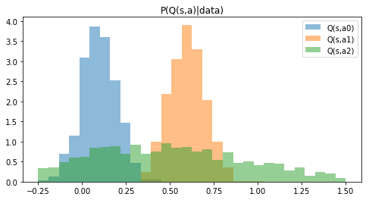
Uncertainty in returns
We want to try actions if we believe there's a chance they turn out optimal.
Idea: let's model how certain we are that Q(s,a) is what we predicted
Q(s,a)

Slide 14
Thompson sampling
Policy:
  sample once from each Q distribution
  take argmax over samples
  which actions will be taken?
Q(s,a)

Slide 15
Thompson sampling
Policy:
  sample once from each Q distribution
  take argmax over samples
  which actions will be taken?
Takes a1 with p ~ 0.65, a2 with p ~ 0.35, a0 ~ never
Q(s,a)

Slide 16
Optimism in face of uncertainty
  Idea:
    Prioritize actions with uncertain outcomes!
    More uncertain = better.
    Greater expected value = better
    Math: try until upper confidence bound is small enough.

Slide 17
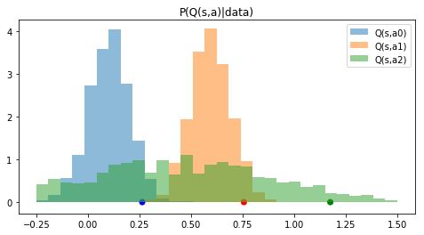
Optimism in face of uncertainty
Policy:
  Compute 95% upper confidence bound for each a
  Take action with highest confidence bound
  What can we tune here to explore more/less?
Q(s,a)

Slide 18
Optimism in face of uncertainty
Policy:
  Compute 95% upper confidence bound for each a
  Take action with highest confidence bound
  Adjust: change 95% to more/less
Q(s,a)

Slide 19

Frequentist approach
There's a number of inequalities that bound
P(x>t) < something
E.g. Hoeffding inequality
Remember any others?

Slide 20
Frequentist approach
There's a number of inequalities that bound
P(x>t) < something
E.g. Hoeffding inequality
Remember any others?
(Chernoff, Chebyshev, over9000)

Slide 21
Count-based exploration
UCB-1 for bandits
  Take actions in in proportion to
  number of time-steps so far
  times action a is taken
Upper conf. bound
for r in [0,1]

Slide 22
Count-based exploration
UCB-1 for bandits
  Take actions in in proportion to
  number of time-steps so far
  times action a is taken

Slide 23
Count-based exploration
UCB generalized for multiple states
where
  visits to state s
  times action a is taken from state s

Slide 24
Count-based exploration
UCB-1 for bandits
  Take actions in in proportion to
  number of time-steps so far
  times action a is taken
Upper bound
For bernoilli r

Slide 25
Count-based exploration
UCB-1 for bandits
  Take actions in in proportion to
  number of time-steps so far
  times action a is taken

Slide 26
Count-based exploration
UCB generalized for multiple states
where
  visits to state s
  times action a is taken from state s

Slide 27
Bayesian UCB
The usual way:
  Start from prior P(Q)
  Learn posterior P(Q|data)
  Take q-th percentile
What models can learn that?

Slide 28
Bayesian UCB
The usual way:
  Start from prior P(Q)
  Learn posterior P(Q|data)
  Take q-th percentile
Approach 1: learn parametric P(Q), e.g. normal
Approach 2: use bayesian neural networks

Slide 29
Parametric
X
tanh
0.3
-0.1
Regular
NN
y
-0.25
tanh
1.3

Slide 30
Parametric
X
tanh
-0.1
mu
0.3
1.3
P(y)
0.2
sigma
-0.25
tanh
Normal distribution
0.05
X
tanh
0.3
-0.1
Regular
NN
y
-0.25
tanh
1.3

Slide 31
BNNs
X
tanh
0.3
-0.1
P(y|x)
Regular
NN
-0.25
tanh
1.3

Slide 32
BNNs (for hackers)
X
tanh
P(y|x)
Bayesian
NN
tanh
X
tanh
0.3
-0.1
P(y|x)
Regular
NN
-0.25
tanh
1.3

Slide 33
BNNs
X
tanh
Idea:
No explicit weights
  Maintain parametric distribution on them instead!
    Practical: fully-factorized normal or similar
P(y|x)
tanh

Slide 34
BNNs
Idea:
No explicit weights
  Maintain parametric distribution on them instead!
    Practical: fully-factorized normal or similar
Learn parameters of that distribution (reparameterization trick)
  Less variance: local reparameterization trick.
wanna explicit formulae?

Slide 35
Lower bound
loglikelihood
-distance to prior
+const

Slide 36
Lower bound
Can we perform gradient ascent directly?

Slide 37
Reparameterization trick
Use reparameterization trick
Using BNN
Better: local reparameterization trick (google it)

Slide 38
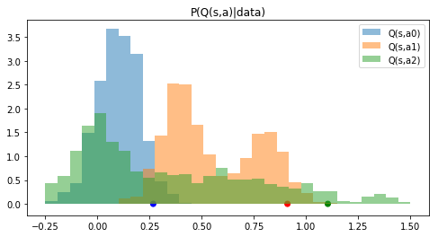
Using BNNs
If you sample from BNNs
  Can learn nonparametric/multimodal distribution
  But it takes running network many times
  Use empirical percentiles

Slide 39
Using BNNs
If you sample from BNNs
  Can learn nonparametric/multimodal distribution
  But it takes running network many times
  Use empirical percentiles

Slide 40

Practical stuff
Approximate exploration policy
  with something cheaper
Bayesian UCB:
  Prior can make or break it
  Sometimes parametric guys win
  (vs bnn)
Of course, neural nets aren't
  always the best model

Slide 41
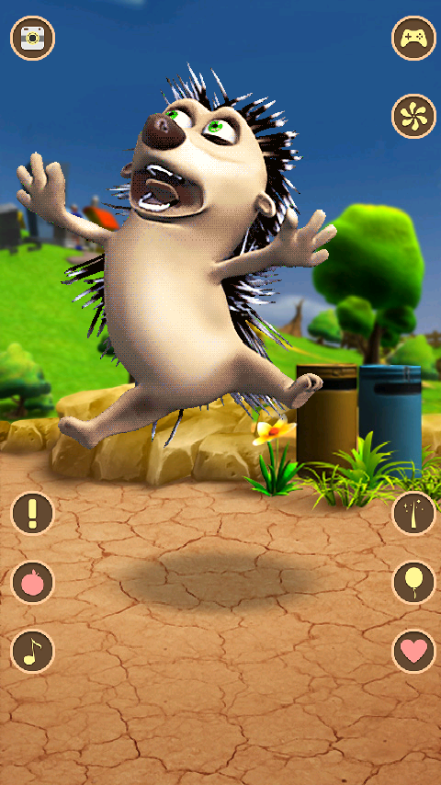
<us talking>

