Slide 1
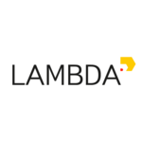


RL @ PicsArt
Outro lecture
RL for deep learning tasks

Slide 2
General formalism
Maximize over π

Slide 3
General formalism
Maximize over π
R(s,a) or R(session) is a black box
  Special case: R(s,a) = r(s,a) + γR(s',a')

Slide 4
General formalism
Maximize over π
R(s,a) or R(session) is a black box
  Special case: R(s,a) = r(s,a) + γR(s',a')
Markov property: P(s'|s,a,*) = P(s'|s,a)
Special case: obs(s) = s , fully observable

Slide 5
General approaches
Idea 1: evolution strategies
  pertrubate π, take ones with higher J
Idea 2: value-based methods
  estimate J as a function of a, pick best a
Idea 3: policy gradient
  ascend J over π(a|s) using ∇J

Slide 6
General approaches
Idea 4: Bayesian optimization
  build a model of J, pick π that is most informative
  to finding maximal J
  e.g. Gaussian processes (low-dimensional only)
Idea 5: simulated annealing
Idea 6: crossentropy method
...

Slide 7
Application domains
Videogames
Online ads
Recommender systems
Conversation systems
Robot control / dynamic system control
Parameter tuning
Financial tasks
Medicine
...

Slide 8
Domains so far
Videogames
Online ads
Recommender systems
Conversation systems
Robot control / dynamic system control
Parameter tuning
Financial tasks
Medicine
...
toy problems
videogames
toy problems
videogames
toy problems
guess what?

Slide 9
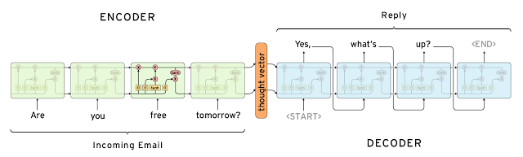
Encoder-decoder architectures
Read input data (sequence / arbitrary)
Generate output sequence
Trivia: what problems match this formulation?

Slide 10
Encoder-decoder tasks
Image to caption
Machine translation
Word to transcript
Conversation system
Image to latex
Code to docstring

Slide 11
Image Captioning
Problem:
Process image
Generate sentence
Sentences must describe image (e.g. BLEU/CIDEr)
Solution?

Slide 12
Image Captioning
Problem:
Process image
Generate sentence
Sentences must describe image (e.g. BLEU/CIDEr)
Solution:
Take large dataset of (image,caption) pairs
Maximize log P(caption|image)

Slide 13
Conversation systems
Problem:
Read sentence from user
Generate response sentence
System must be able to support conversation
Solution:
Take large dataset of (phrase,response) pairs
Maximize log P(response|phrase)

Slide 14
Grapheme to phoneme
Problem:
Read word (characters): “hedgehog”
Generate transcript (phonemes): “hɛǰhag”
Transcript must read like real word (Levenshtein)
Solution:
Take large dataset of (word,transcript) pairs
Maximize log P(transcript|word)

Slide 15
Yet another problem
Problem:
Read x~X
Produce answer y~Y
Answer should be argmax R(x,y)
Solution:
Take large dataset of (x,y) pairs with good R(x,y)
Maximize log P(y|x) over those pairs

Slide 16
Summary
Works great as long as you have good data!
good = abundant + near-optimal R(x,y)
What could possibly go wrong?

Slide 17
Distribution shift
Supervised seq2seq learning:
Inference
???

Slide 18
Distribution shift
Supervised seq2seq learning:
Inference

Slide 19
Distribution shift
Supervised seq2seq learning:
Inference
If model ever generates something that wasn't in data,
It gets unstable from next time-step!

Slide 20
Summary
Works great as long as you have good data!
good = abundant + near-optimal R(x,y)
… and a perfect network ...

Slide 21
Summary
Works great as long as you have good data!
good = abundant + near-optimal R(x,y)
… and a perfect network ...
Spoiler: most of the time we don't. Too bad.

Slide 22

Summary
Works great as long as you have good data!
good = abundant + near-optimal R(x,y)
Spoiler: most of the time we don't. Too bad.

Slide 23
Machine translation issues
There's more then one correct translation.
Source: 在 找 给 家里 人 的 礼物.
Versions:
i 'm searching for some gifts for my family.
i want to find something for my family as presents.
i 'm about to buy some presents for my family.
i 'd like to buy my family something as a gift.
i 'm looking for a present for my family.
...
( Sample from IWSLT 2009 Ch-En, http://bit.ly/2o404Tz )

Slide 24
Machine translation issues
There's more then one correct translation.
You don't need to learn all of them.
Source: 在 找 给 家里 人 的 礼物.
Versions:
i 'm searching for some gifts for my family.
i want to find something for my family as presents.
i 'm about to buy some presents for my family.
i 'd like to buy my family something as a gift.
i 'm looking for a present for my family.
...
( Sample from IWSLT 2009 Ch-En, http://bit.ly/2o404Tz )

Slide 25
Machine translation issues
There's more then one correct translation.
You don't need to learn all of them.
Source: 在 找 给 家里 人 的 礼物.
Model 1 Model 2
Versions: p(y|x) p(y|x)
(version 1) 1e-2 0.99
(version 2) 2e-2 1e-100
(version 3) 1e-2 1e-100
(all rubbish) 0.96 0.01

Slide 26
Machine translation issues
There's more then one correct translation.
You don't need to learn all of them.
Source: 在 找 给 家里 人 的 礼物.
Model 1 Model 2
Versions: p(y|x) p(y|x)
(version 1) 1e-2 0.99
(version 2) 2e-2 1e-100
(version 3) 1e-2 1e-100
(all rubbish) 0.96 0.01
Trivia: which model has better
Mean log p(y|x) ?
not in data

Slide 27
Machine translation issues
There's more then one correct translation.
You don't need to learn all of them.
Source: 在 找 给 家里 人 的 礼物.
Model 1 Model 2
Versions: p(y|x) p(y|x)
(version 1) 1e-2 0.99
(version 2) 2e-2 1e-100
(version 3) 1e-2 1e-100
(all rubbish) 0.96 0.01
better llh worse llh
96% rubbish 1% rubbish
not in data

Slide 28
Conversation system issues
Two kinds of datasets:
  Large raw data
    twitter, open subtitles, books, bulk logs
    10^6-8 samples, http://bit.ly/2nJHmA7
  Small clean data
    moderated logs, assessor-written conversations
    10^2~4 samples

Slide 29
Conversation system issues
Two kinds of datasets:
  Large raw data
    twitter, open subtitles, books, bulk logs
    10^6-8 samples, http://bit.ly/2nJHmA7
  Small clean data
    moderated logs, assessor-written conversations
    10^2~4 samples
Big enough, but suboptimal R(x,y)
Near-optimal R(x,y), but too small

Slide 30
Motivational example
So you want to train a Q&A bot for a bank.

Slide 31
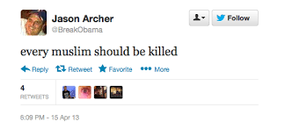
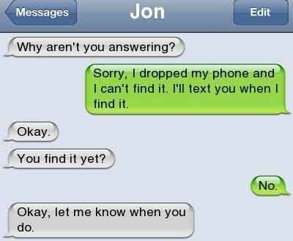
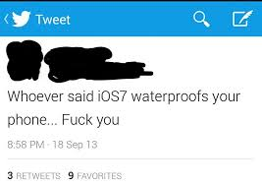

Motivational example
So you want to train a Q&A bot for a bank.
Let's scrape some data from social media!

Slide 32
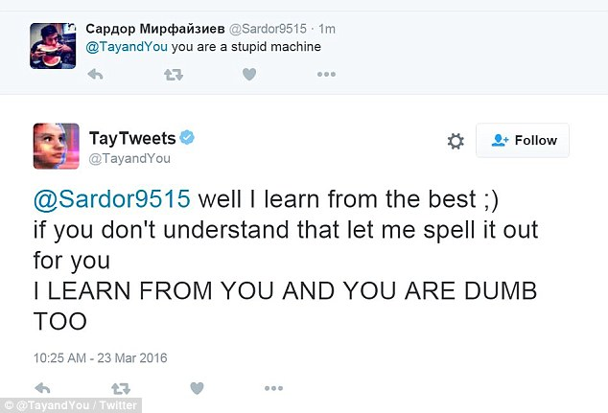
Motivational example
So you want to train a Q&A bot for a bank.
Let's scrape some data from social media!

Slide 33
Seq2seq as a POMDP
a0
a1
a2
a3
Je
suis
étudiant
h0
h1
h2
h3
I
am
a
student
R
Hidden state s = translation/conversation state
Initial state s = encoder output
Observation o = previous words
Action a = write next word
Reward R = domain-specific reward (e.g. BLEU)

Slide 34
Supervised learning Vs policy gradient
Supervised learning:
Policy gradient:

Slide 35
Supervised learning Vs policy gradient
Supervised learning:
Policy gradient:

Slide 36
Supervised learning Vs policy gradient
Supervised learning:
Policy gradient:
Trivia: what's different? (apart from Q(s,a))

Slide 37
Supervised learning Vs policy gradient
Supervised learning:
Policy gradient:
reference
generated

Slide 38
Supervised learning Vs policy gradient
Supervised learning:
  Need (near-)optimal dataset
  Trains on reference sessions
Policy gradient:
  Need ~some data and reward function
  Trains on it's own output

Slide 39
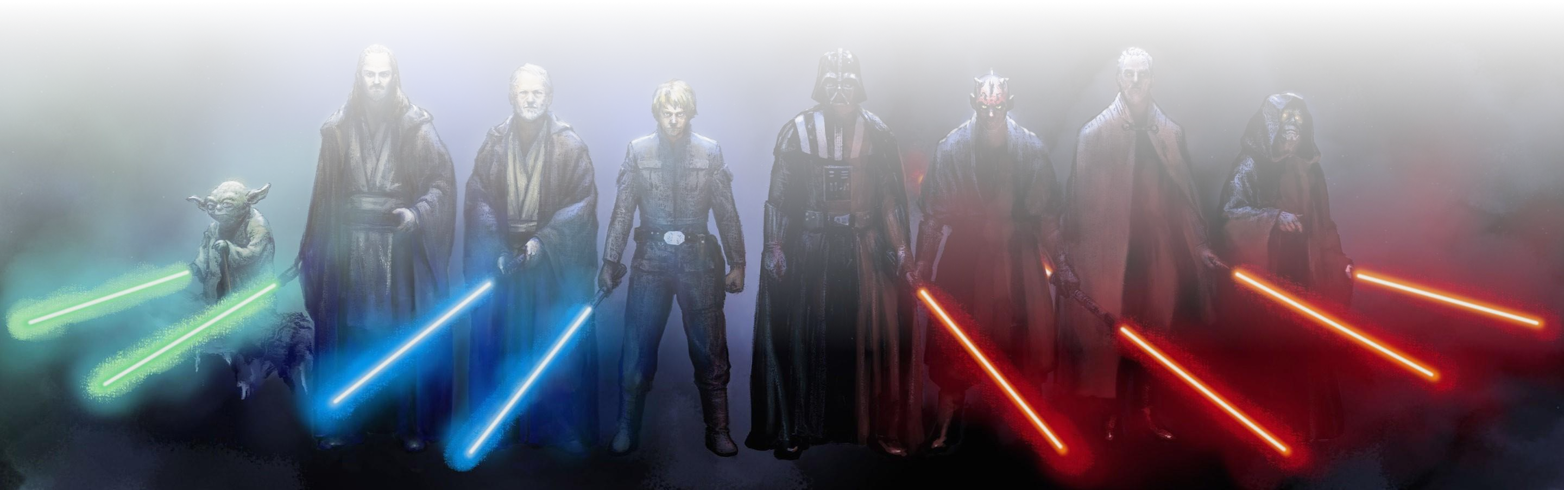
SL VS RL
Train on references
Need good reference (y_opt)
If model is imperfect [and it is],
  training:
  P(y_next|x,y_prev_ideal)
  prediction:
  P(y_next|x,y_prev_predicted)
Reinforcement learning
Need reward function
Model learns to improve current policy. If policy is pure random, local improvements are unlikely to produce good translation.

Slide 40
SL VS RL
Supervised learning
Rather simple
Small variance
Need good reference (y_opt)
Distribution shift
  different h distribution
  when training vs generating
Reinforcement learning
Cold start problem
Large variance (so far)
Only needs x and r(s,a)
No distribution shift

Slide 41
SL VS RL
Supervised learning
Trains from scratch
Small variance
Need good reference (y_opt)
Distribution shift
  different h distribution
  when training vs generating
Reinforcement learning
Cold start problem
Large variance (so far)
Only needs x and r
No distribution shift
pre-training
post-training

Slide 42
SL VS RL
Supervised learning
Trains from scratch
Small variance
Need good reference (y_opt)
Distribution shift
  different h distribution
  when training vs generating
Reinforcement learning
Cold start problem
Large variance (so far)
Only needs x and r
No distribution shift
pre-training
post-training
Trivia: How do we make policy gradient less noisy?

Slide 43
Introducing baselines

Slide 44
Introducing baselines
Trivia: How do we estimate A(s,a) in practice?

Slide 45
Advantage actor-critic
Problem: need to train both π and V!
Can we get V for free?

Slide 46
Training Vs inference
Recap: encoder-decoder rnn
...
h
...
x0
x1
x2
x3
“start”
Input sequence
e.g. source language
Input sequence
e.g. source language

Slide 47
Training Vs inference
Recap: encoder-decoder rnn
sample
...
h
...
x0
x1
x2
x3
“start”
Input sequence
e.g. source language
Input sequence
e.g. source language

Slide 48
Training Vs inference
Recap: encoder-decoder rnn
output sequence
...
h
h
h
...
x0
x1
x2
x3
“start”
Input sequence
e.g. source language
Input sequence
e.g. source language

Slide 49
Training Vs Inference
Training is different from inference!
Encoder
same behavior for
training and inference
sample
sample
sample
...
h
h
h
...
x0
x1
x2
x3
“start”
Input sequence
e.g. source language
Input sequence
e.g. source language
Trivia: how does decoder
change during inference?

Slide 50
Training Vs Inference
Inference mode
Encoder
same behavior for
training and inference
max
max
max
...
h
h
h
...
x0
x1
x2
x3
“start”
Decoder:
Takes best action
instead of sampling
Input sequence
e.g. source language
Input sequence
e.g. source language

Slide 51
Training Vs inference
Simplified scheme
...
Encoder
same behavior for
training and inference
Decoder
mode = inference
h
h
h
...
x0
x1
x2
x3
“start”
Input sequence
e.g. source language
Input sequence
e.g. source language

Slide 52
Self-critical sequence training
Idea: use inference mode as a baseline!
Decoder
mode = inference
greedy
reward
Encoder
same behavior for
training and inference
Input sequence
e.g. source language
Decoder
mode = sampling
sampled
reward

Slide 53
Self-critical sequence training
Idea: use inference mode as a baseline!
Decoder
mode = inference
greedy
reward
Encoder
same behavior for
training and inference
baseline
~ V(s)
~ R(s,a)
Input sequence
e.g. source language
Decoder
mode = sampling
sampled
reward

Slide 54
Self-critical sequence training

Slide 55
Self-critical sequence training
sampling
mode
greedy
mode
(inference)

Slide 56
Self-critical sequence training
Non-trivia: why don't we use sampling mode for baseline?

Slide 57
Self-critical sequence training
Non-trivia: why don't we use sampling mode for baseline?
Sampling mode is more noisy due to... sampling
Also it isn't what we'll use in production

Slide 58
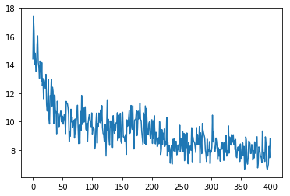
Results on G2P
levenshtein distance
training time

Slide 59
Results on G2P
Supervised pre-training
levenshtein distance
Switched to RL
training time

Slide 60
Image captioning with SCST
Problem:
Process image
Generate caption
Caption must describe image (CIDEr)
Dataset: MSCOCO, http://mscoco.org
What do we do?

Slide 61
Image captioning with SCST
Problem:
Process image
Generate caption
Caption must describe image (CIDEr)
Dataset: MSCOCO, http://mscoco.org
Pre-training: maximize log P(caption|image)
Fine-tuning: maximize expected CIDEr
  Used self-critical baseline to reduce variance

Slide 62
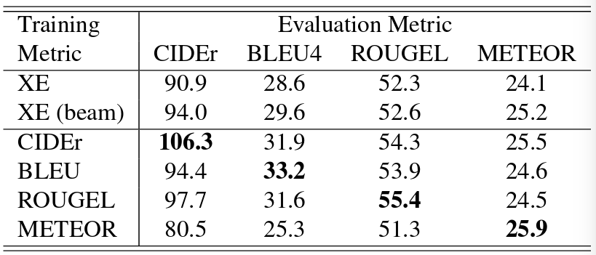
SCST: results
Table: validation score on 4 metrics (columns) for models that optimize crossentropy (supervised) or one of those 4 metrics (scst).
Taken from https://arxiv.org/pdf/1612.00563.pdf

Slide 63
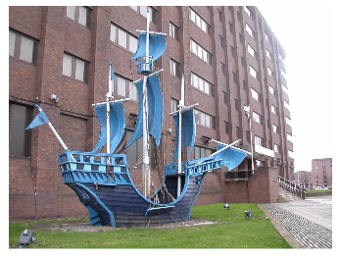
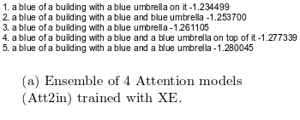
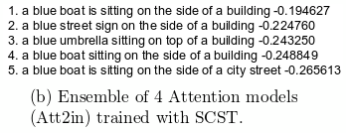
MSCOCO: objects out of context
Taken from https://arxiv.org/pdf/1612.00563.pdf

Slide 64
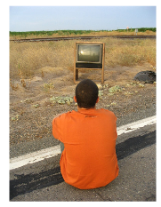
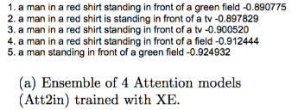
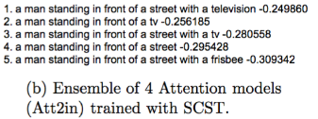
MSCOCO: objects out of context
Taken from https://arxiv.org/pdf/1612.00563.pdf

Slide 65
Common pitfalls
What can go wrong
Make sure agent didn't cheat R(s,a)
  https://openai.com/blog/faulty-reward-functions/
Unlike games, agent can overfit data
  Check validation performance

Slide 66
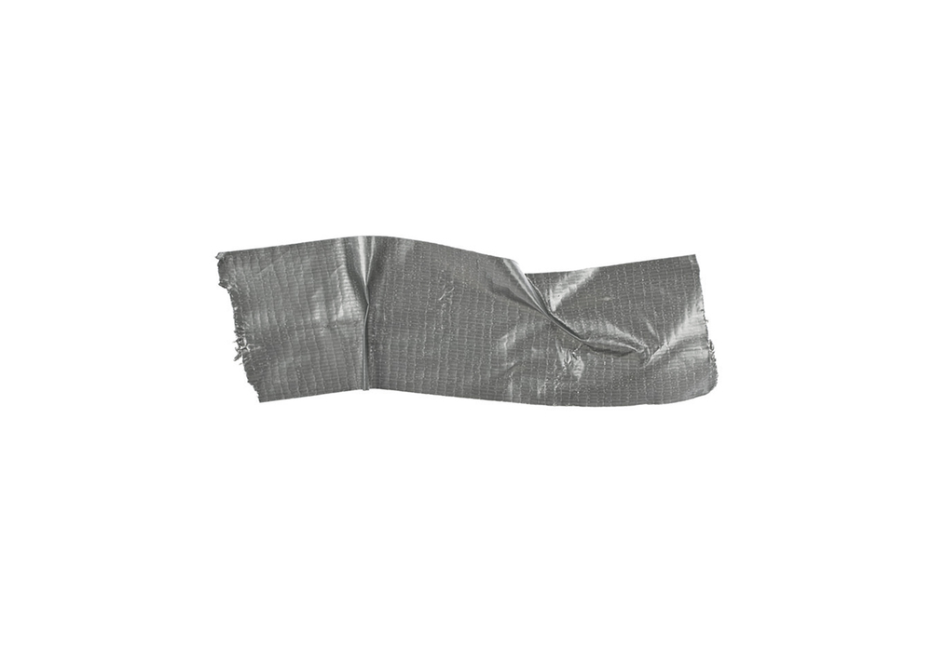
Duct tape zone
Pre-train agent in supervised mode
  RL takes longer to train from scratch
All policy-based tricks apply
  Regularize with entropy / L2 logits
  Better sampling techniques (tree, vine, etc.)
Most seq2seq tricks apply
  Use bottleneck If vocabulary is large
  Some (but not all) softmax improvements

Slide 67
Квестионы?

Slide 68
</course>
You've done it!
@urls – plenty of them in couse folders
(README.md files)
@me - justheuristic@yandex-team.ru
@alx - grox_halfer@mail.ru

