Slide 1
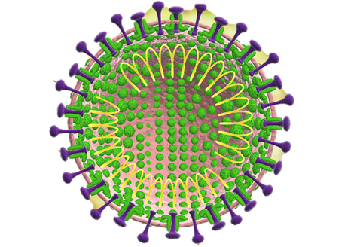
AVID COVID DATA SIMPLIFIER OF VIETNAM
Notes:
© Copyright PresentationGO.com – The free PowerPoint and Google Slides template library

Slide 2
Members
Nguyễn Thị Hoài An – ITDSIU18024
Nguyễn Thị Trường An – ITDSIU18002
Trần Quỳnh Anh – ITDSIU18046
Nguyễn Ngọc Khánh – ITDSIU18025
Notes:
© Copyright PresentationGO.com – The free PowerPoint and Google Slides template library

Slide 3
Table of content
I. Introduction
II. Explanation of each chart
1. Geomap
2. Line Chart
3. Pie Chart + Stacked Bar Chart
4. Parallel Coordinates Chart
III. Conclusion

Slide 4

I. Introduction
Notes:
© Copyright PresentationGO.com – The free PowerPoint and Google Slides template library

Slide 5
Introduction
Provide the actual view of COVID-19 pandemic seriousness in Vietnam
Turn data into accessible information for people from all classes to understand
Notes:
© Copyright PresentationGO.com – The free PowerPoint and Google Slides template library

Slide 6

II. Geomap
Notes:
© Copyright PresentationGO.com – The free PowerPoint and Google Slides template library

Slide 7
Geomap
Illustrate the number of confirmed cases in provinces
Highest number of confirmed cases: Ha Noi, Ho Chi Minh City
Provinces from center to East of Northern Vietnam have higher numbers of confirmed cases
Central Vietnam has the lowest number of confirmed cases

Slide 8

III. Line chart

Slide 9
Line chart
3 attributes: Confirmed case, recovered case, active case
Milestones:
+ February 13th,2020: The start of twenty-two-day period of not recording any new case
+ March 7th,2020: 17th patient is recorded
+ April 1st,2020: The start of social quarantine

Slide 10
IV. Pie chart + stacked bar chart

Slide 11
Pie chart and Stacked Bar Chart
Pie chart attributes: Male, female
Stacked bar chart attributes: Male, female, age group
Percentage of female and male patients are approximately equal
Highest number of confirmed cases: 20-29 age group
Working-age age groups have higher number of confirmed cases comparing with youngsters and elders

Slide 12
V. Parallel coordinates chart

Slide 13
Parallel Coordinates Chart
5 attributes: Confirmed case, recovered case, F0 (quarantined), F0 (social), F1, F2
Ha Noi: Highest in all 4 attributes except for attribute F1
Thai Binh: Ranked 3rd in number of confirmed cases, all cases are quarantined right after the patients’ entrance to the country
Binh Thuan: All of cases were found in society

Slide 14

VI. Conclusion

Slide 15
Conclusion
Gives a general view about the COVID-19 epidemic in Vietnam using visualizations
SARS-COVI-2 pandemic is now under control in Vietnam, thanks to the government and Ministry of Health’s efforts, combined with Vietnamese residents’ cooperation

Slide 16

Notes:
© Copyright PresentationGO.com – The free PowerPoint and Google Slides template library

Slide 17

Notes:
© Copyright PresentationGO.com – The free PowerPoint and Google Slides template library

