Slide 1
Temperature Compensation of a High Precision Ultrasonic Transducer Thickness Measurement System
Justice Boisselle
Research Assistant
Erosion/Corrosion Research Center
Design and Analysis of Experiments
The University of Tulsa
October 31, 2017

Slide 2
Contents
Introduction
Proposal
Layout
Data
Conclusion

Slide 3
Introduction
Project supports a current research project at the ECRC at TU
Need a high precision thickness measurement device
Interested in measuring minute thickness changes
Ultrasonic measurement is ideal for this
Non-intrusive, non-destructive, high precision
Cheap, can place many probes on a test piece at once to measure erosion or corrosion patterns
Ultrasonic measurement is effected by changes in temperature
Speed of sound, actual thickness of object being measured
Need to model the relationship between measured thickness and temperature

Slide 4
Project Proposal
Model relationship between measured thickness and temperature
Determine whether other variables may be effecting measurements
Hardware temperature
Rate of change of temperature
Model will aid in determining whether the instrument meets precision demands

Slide 5
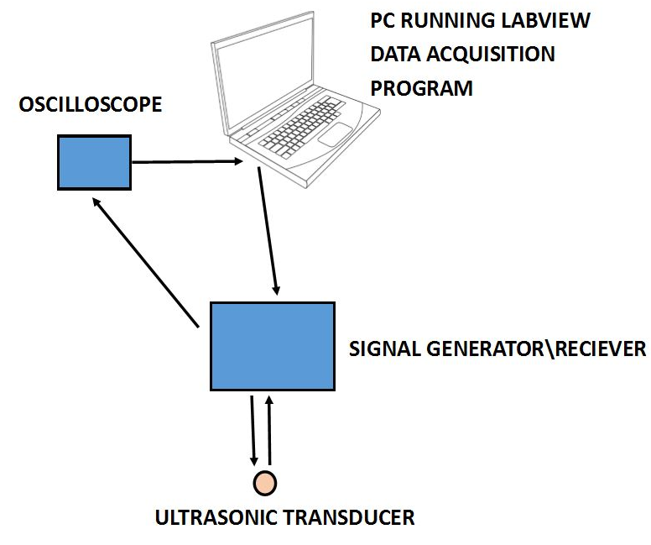
Layout of Ultrasonic Measurement Instrument

Slide 6
Ultrasonic Results, Pre-eroded Sample, Run 1

Slide 7
Temperature Compensated Measurements
Simple temperature compensation fail to make sense of the available data

Slide 8
Conclusion
Project will aid in the completion of a larger ultrasonic thickness measurement project
Will provide feedback on the quality of the overall project

Slide 9
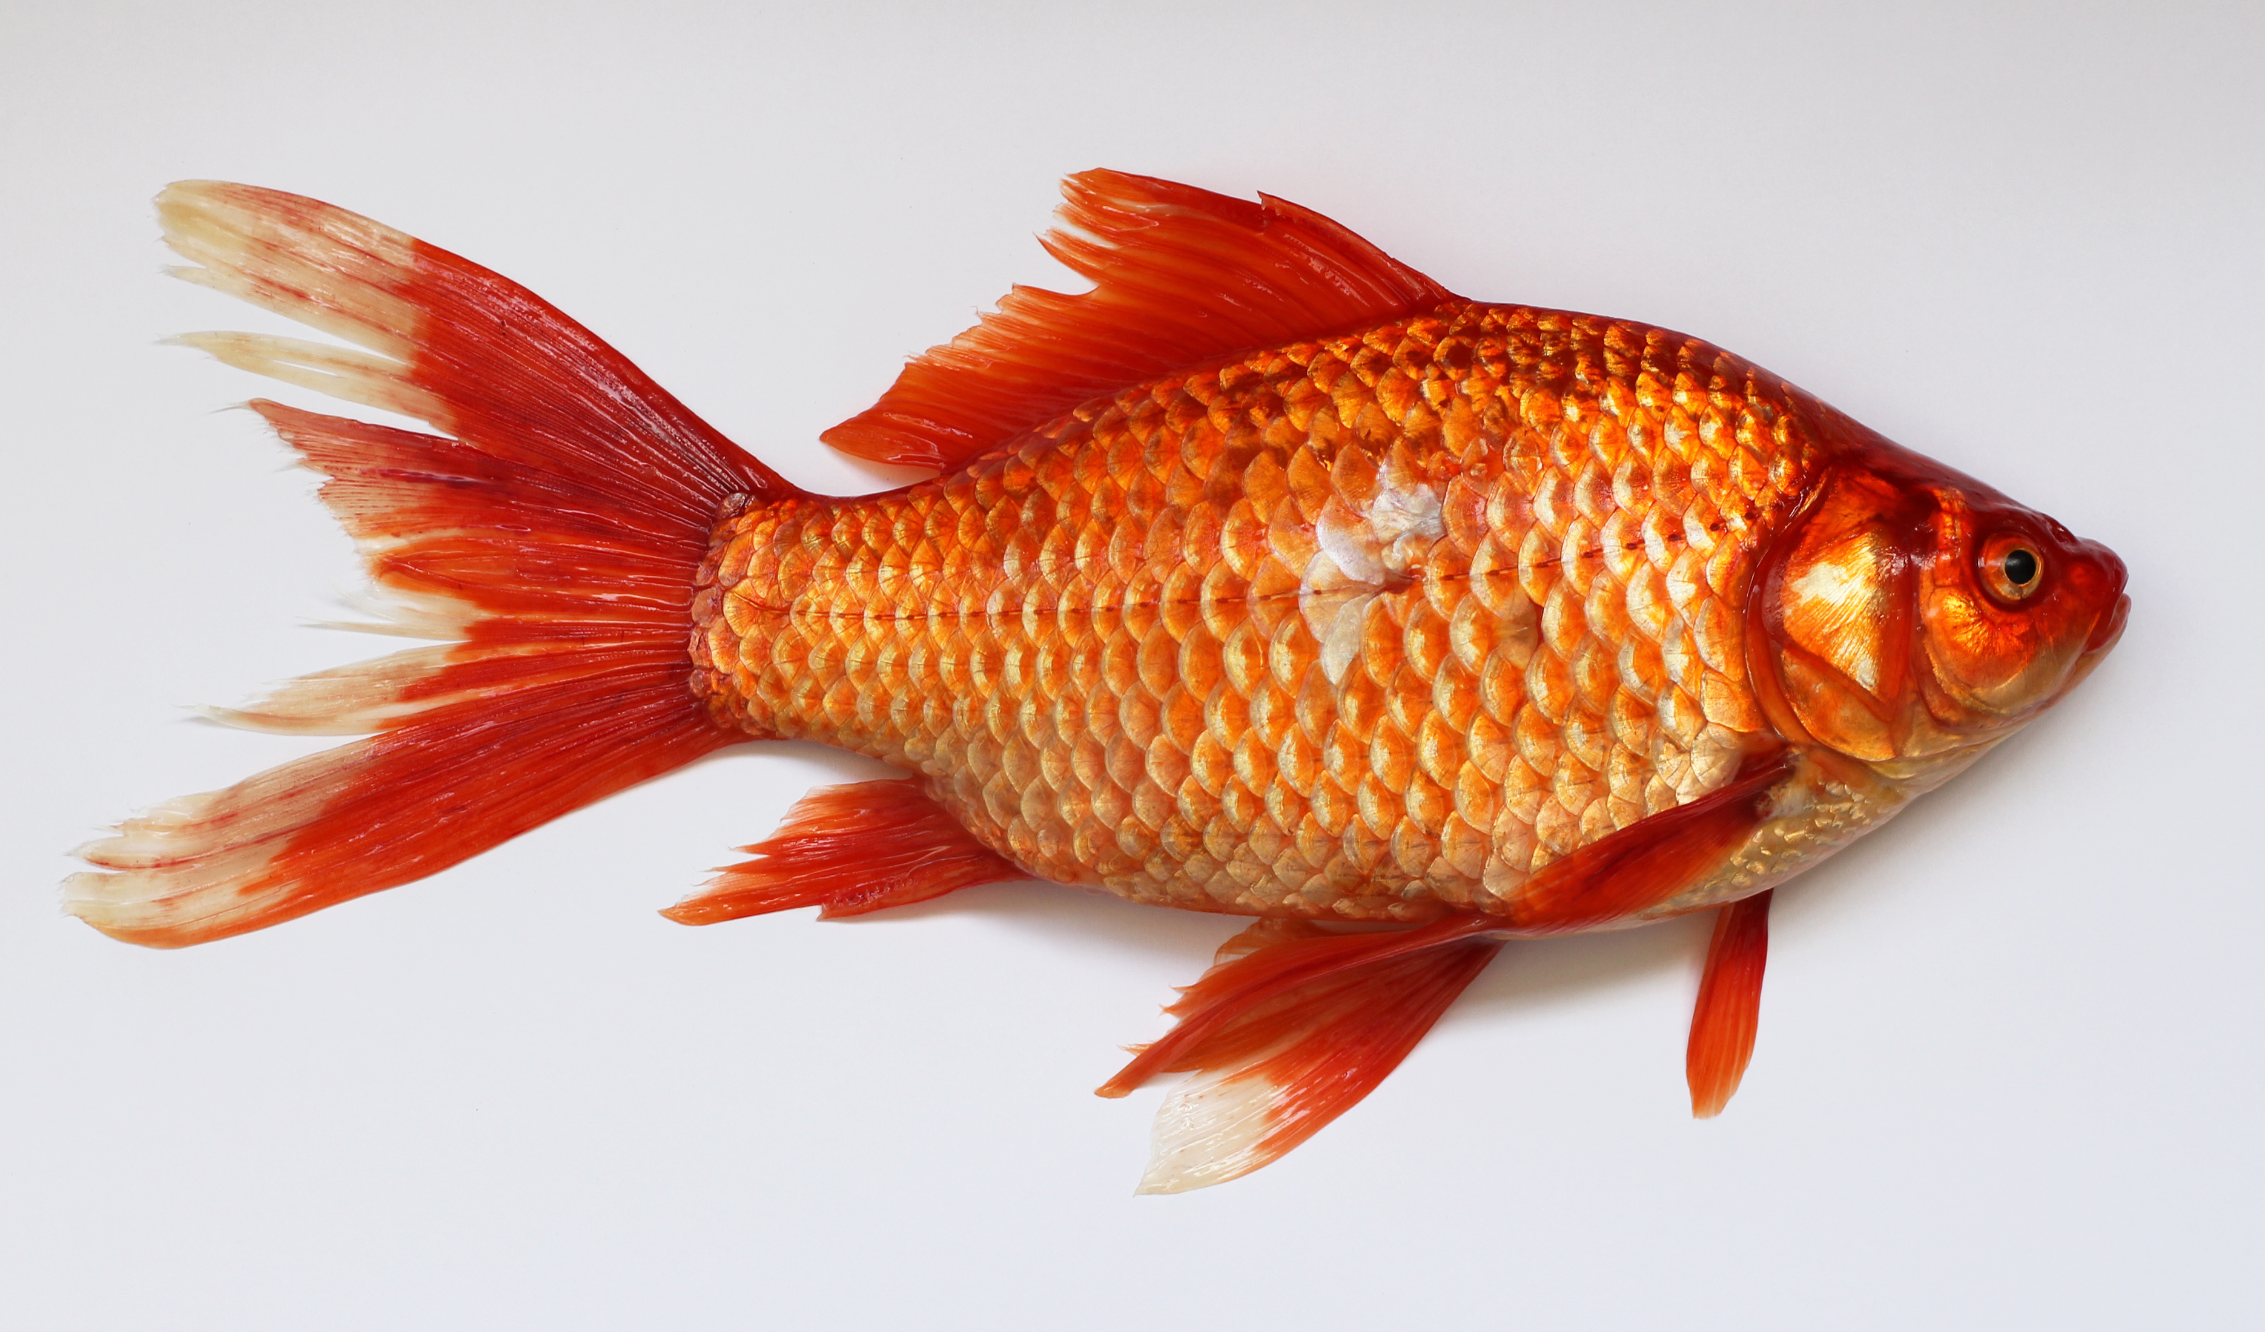
Questions?
This Photo by Unknown Author is licensed under CC BY-SA

