Slide 1
An adaptation of hybrid binary optimization algorithms for medical image feature selection in neural network for classification of breast cancer
JUSTICE TETTEH(10981523)
EMMANUELLA POKUAA DANSO(10980151)

Slide 2
INTRODUCTION
Medical images often present high-dimensional datasets, posing challenges in efficient analysis and feature selection. Traditionally, these challenges have been addressed with standard methods that may not fully optimize classification performance. This project introduces four variants of hybridized binary optimization algorithms which enhance feature selection for medical image datasets by leveraging BEOSA as a base. These algorithms incorporate a novel nested transformation function, creating variants that optimize binary search spaces while preserving the relevance of real-world features. Through experiments on digital mammography datasets, the proposed methods demonstrate superior performance in improving classification accuracy over traditional techniques.

Slide 3
PROBLEM STATEMENT
High-dimensional datasets, particularly in medical image analysis, present significant challenges in machine learning and classification tasks. These challenges include increased computational complexity, overfitting, and reduced model interpretability. Specifically, when working with breast cancer detection from medical imaging data (such as mammograms or histopathology images), the number of features can be vast, leading to a risk of decreased classification accuracy and model performance.
However, relying solely on conventional feature selection methods may not provide optimal solutions for complex medical imaging datasets.

Slide 4
PROPOSED SOLUTION
Adaptation of hybrid binary optimization algorithms for medical image feature selection in neural network, particularly focusing on breast cancer. (HBEOSA-DMO, HBEOSA-PSO, HBEOSA-DMO-NT and HBEOSA-PSO-NT)
These are obtained from the hybridization of BEOSA as the base algorithm with BDMO and BPSO, to obtain HBEOSA-DMO and HBEOSA-PSO. The algorithms are enhanced by nested transformation function, leading to the four variants (HBEOSA-DMO,HBEOSA-PSO,HBEOSA-DMO-NT and HBEOSA-PSO-NT) proposed.

Slide 5
DATASET
This study uses two types of datasets which are:
Text-based dataset(which are classified as high-dimensional, medium dimensional and low-dimensional)
Image-based dataset(which are classified as Normal, Mass, Calcification, benign with calcification, and benign with mass).

Slide 6
METHODOLOGY
The methodology was in two-folds:
Using the following algorithms, BESOA, BDMO, BPSO, and transfer functions s1,s2,v1,v2
And with BESOA as the base algorithm the following algorithms where produce
BESOA
HBESOA-PSO
HBESOA-DMO
HBESOA-PSO-NT
HBESOA-DMO-NT
The first fold involves the use of text-based datasets from various sources to evaluate the ability of the above-mentioned algorithms to select the valid features. By setting the choice of values for recruitment and infection rates of BEOSA , the initial weight and babysitter exchange parameter for BPSO and BDMO to values obtianed from an already existing research which provides values which has proven to be optimal. Which are O. Akinola, O.N. Oyelade, A.E.-S. Ezugwu, Binary ebola optimization search algorithm (BEOSA) using novel S-V transformation functions for solving feature selection and classfication problem, Appl. Sci. (2022) and O.A. Akinola, A.E. Ezugwu, O.N. Oyelade, J.O. Agushaka, A hybrid binary dwarf mongoose optimization algorithm with simulated annealing for feature selection on high dimensional multi-class datasets, Sci. Rep. (2022)

Slide 7
METHODOLOGY
Image Based Dataset (Fold Two)
To eliminate noise from the MIAS and DDSM+CBIS datasets, this study used an image enhancement technique, namely, contrast-limited adaptive histogram equalization (CLAHE). The outcome of the images from the CLAHE operation, a wavelet decomposition packet function is applied to extract high resolution and rich feature representation of each image passed through the seam carving procedure.
Pre-trained Convolutional Neural Network(CNN) model for transforming the images into high-dimensional feature vectors.
A transform function converts the selected features from continuous space to binary space
The binary space feature is sent through the following hybrid binary optimization algorithms using the defined parameters required for these algorithms in the first fold.
BESOA
HBESOA-PSO
HBESOA-DMO
HBESOA-PSO-NT
HBESOA-DMO-NT
The selected features in the binary space are mapped against the extracted features to select the most relevant features which are then passed to the classifiers(KNN, MLP, Dtrees) for traning and finally used to make the predictions.

Slide 8
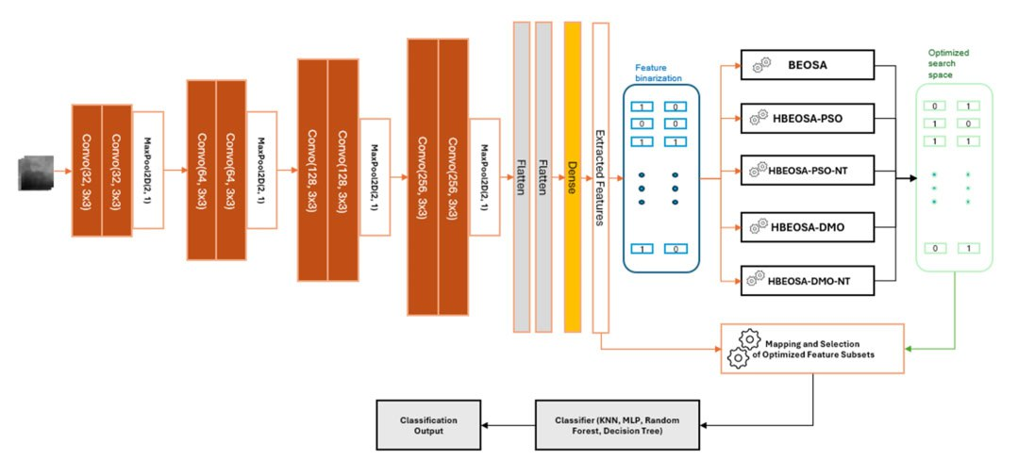
FEATURE EXTRACTION, OPTIMIZATION AND CLASSIFICATION PIPELINE

Slide 9
RESEARCH OBJECTIVES
a. Designed a novel adaptation of the medical image feature representation in continuous space to a binary search space for the hybrid binary optimization strategies.
b. Proposed two hybrid binary optimization algorithms namely HBEOSA-DMO and HBEOSA-PSO.
c. Investigated the influence of the new nested function on the two proposed hybrid methods so that four variants were derived namely HBEOSA-DMO HBEOSA-DMO-NT HBEOSA-PSO and HBEOSA-PSONT.
d. Comparatively investigated the capability of the four binary optimizers with other recent binary methods.
e. Experimentally studied the impact of the new hybrid binary optimizers on improving classification accuracy of applying CNN to digital mammography

Slide 10
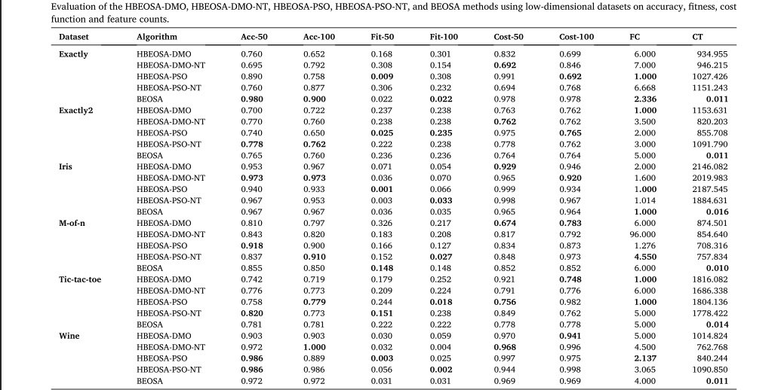
RESULT INTERPRETATION
Evaluation of the HBEOSA-DMO, HBEOSA-DMO-NT, HBEOSA-PSO, HBEOSA-PSO-NT, BEOSA
methods using Low-dimensional datasets on accuracy, fitness, cost function, and feature counts.

Slide 11
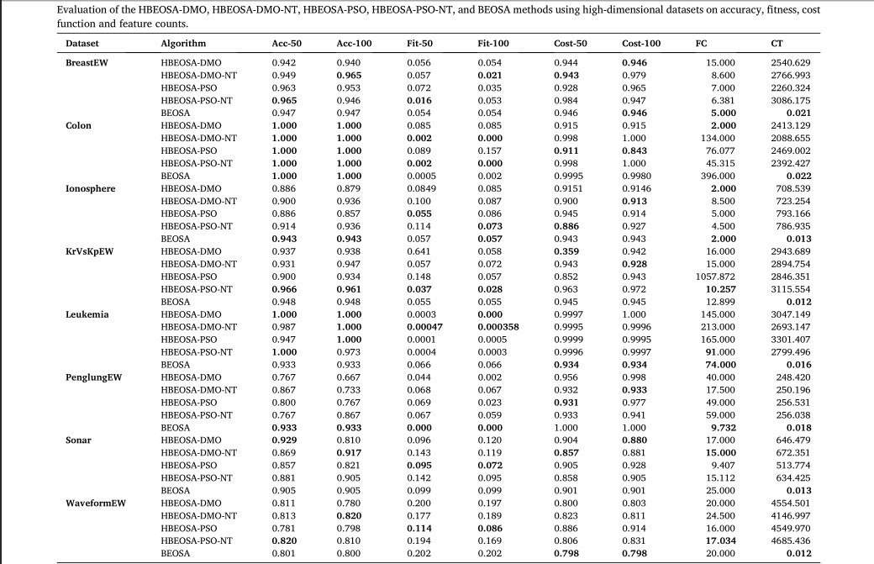
RESULT INTERPRETATION
Evaluation of the HBEOSA-DMO, HBEOSA-DMO-NT, HBEOSA-PSO, HBEOSA-PSO-NT, BEOSA
methods using high-dimensional datasets on accuracy, fitness, cost function and feature counts.

Slide 12
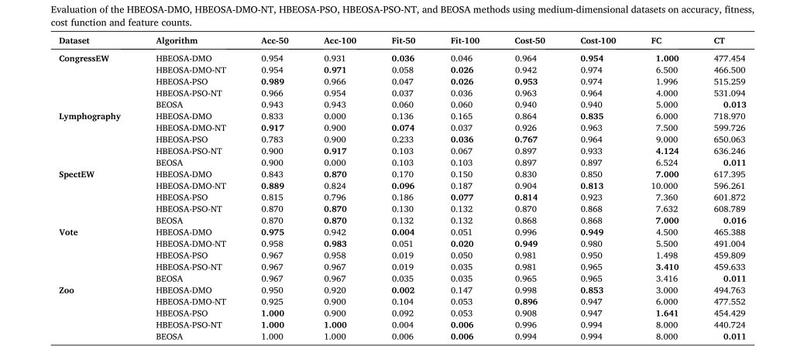
RESULT INTERPRETATION
Evaluation of the HBEOSA-DMO, HBEOSA-DMO-NT, HBEOSA-PSO, HBEOSA-PSO-NT, BEOSA
methods using medium-dimensional datasets on accuracy, fitness, cost function, and feature counts.

Slide 13
FINAL RESULT INTERPRETATION
Classifier | HBEOSA-DMO |  | HBEOSA-DMO-NT |  | HBEOSA-PSO |  | HBEOSA-PSO-NT
 | ACC | AUC | ACC | AUC | ACC | AUC | ACC | AUC
KNN | 0.7002 0.7954 |  | 0.7002 0.7954 |  | 0.7002 0.7954 |  | 0.7002 0.7954
RF | 0.8252 0.8291 |  | 0.8286 0.8280 |  | 0.8212 0.8284 |  | 0.825 0.8288
MLP | 0.6743 0.7922 |  | 0.6743 0.7922 |  | 0.6743 0.7922 |  | 0.6743 0.7922
Dtree | 0.6415 0.7592 |  | 0.6415 0.7592 |  | 0.6415 0.7591 |  | 0.6415 0.7592
Softmax | 0.794 |  | 0.708 |  | 0.794 |  | 0.794

Slide 14
CONCLUSION
Results obtained when the new hybrid binary optimizers were applied to the medical image feature selection in summary, showed that classification accuracy of 0.8286, precision of 0.97, recall of 0.83, and F1-score of 0.99, AUC of 0.8291

Slide 15
Questions

