Slide 1
When a .net dev tries Scala
With Justin Atwell

Slide 2
About…
4 months Scala, Six years total of .net, 2 years of a mix of Coldfusion, and asp.
What I do at WWT
Notes:
Give a great shoutout to WWT AS
Give a shoutout to Nick Bimpasis (he’s in the audience)
I started out at WWT working on web services and fell in love.
Talk briefly about hotel company
Talk briefly about hedge fund
Talk extremely high level architecture at the ag company, but give away nothing
Talk about feedback maybe if you have time

Slide 3
Why Scala?
I only know .NET.
Scala is designed to integrate seamlessly with java
Scala can be used to write object-oriented code or functional code so learning it can give you a taste of each.
Notes:
Before the real reasons I decided on scala:
I don’t like UI’s much. – expand on how scala seems to be nice and back end friendly

Slide 4
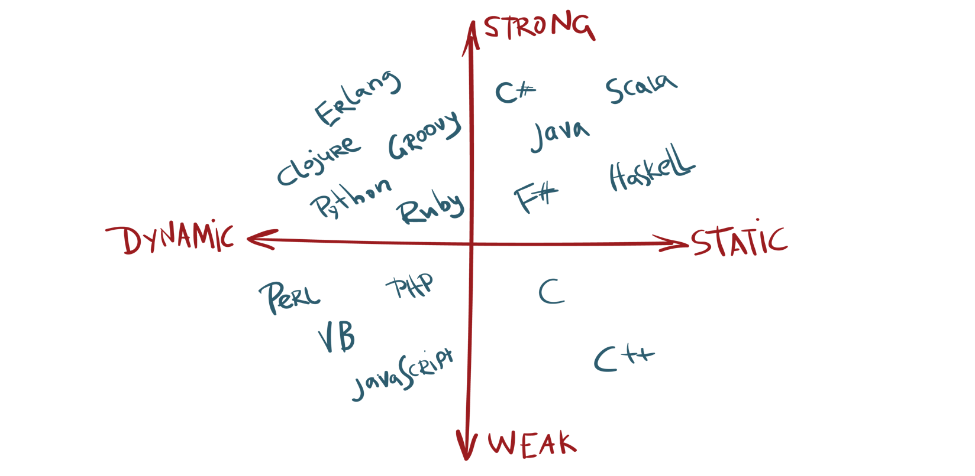

Slide 5
Scala Mission Statement
Scala combines object-oriented and functional programming in one concise, high-level language. Scala's static types help avoid bugs in complex applications, and its JVM and JavaScript runtimes let you build high-performance systems with easy access to huge ecosystems of libraries.

Slide 6
.net Mission statement
.NET is a free, cross-platform, open source developer platform for building many different types of applications.
With .NET, you can use multiple languages, editors, and libraries to build for web, mobile, desktop, gaming, and IoT.

Slide 7
C# vs Scala Naming
Microsoft took the same route at naming c# as they took with naming everything else: in a meeting
Martin Odersky (the creator of Scala) had word plays too
Notes:
The Name C Sharp was coined from two different plays on words.
Give both origins.
A pound sign looks like of like four plus signs
In music, a # (sharp) note is a step higher than a flat
Scala
Scala stands for Scalable Language
Scala is the Italian word for stairway which is appropriate since Scala helps you ascend to a better programming language
The scala logo is an abstraction of a stairway
Scala stands for Scalable Language

Slide 8
IDES
C#
Visual Studio Community 2019
Visual Studio Code

Slide 9
IDEs Continued
Scala
JetBrains Intellij Community Edition
Eclipse
emacs

Slide 10
A look at the Docs for restful services
web api 2
.net Core Middleware
Akka 10.1.8 Server API
Notes:
Talk about the web api (.net framework) 2 pipeline at length
Talk abou the .net core 2.2 middleware at length
Talk about Akka server api at length

Slide 11
Vars and vals
C# var https://dotnetfiddle.net/eYcvOC
Var in C# is just an implicitly typed local variable (compiler looks to the right side of the equals sign)
Var is largely viewed as a time saver
Notes:
In C#, var allows for type inference when the compiler can determine what type the variable is.

Slide 12
Vars and vals (continued)
Scala
Var – Mutable variable https://scalafiddle.io/sf/BTQ94Zs/0
(In .net, the “regular kind”)
These are not used as often in Scala
Val – immutable variable https://scalafiddle.io/sf/sMCzUpj/0
Most local variables
Notes:
In var, talk about functional programming, etc.

Slide 13
The Handling of Null
In C#, null is a literal that represents a null reference, one that does not refer to any object.
Null is the default value for Reference types

Slide 14
The handling of null (Continued)
In Scala, nulls are banned. Ban them. Forever. Period
Scala uses options to handle lack of value: https://scalafiddle.io/sf/hgj7ZGy/0

Slide 15
Algebraic Data Types in Scala (ADT)
There are two types of ADT’s (and a combo of the two called hybrid)
Product – A case class. It’s called a product datatype because we can determine the number of concrete instances by multiplying the possibilities of the constructor fields https://scalafiddle.io/sf/D0Wkp0G/0
Sum – It’s called a sum because it’s arity is equal to the sum of the arities of the types that compose it https://scalafiddle.io/sf/QiVhpvE/0

Slide 16
Bringing Algebraic data types together
Object Oriented Programming with interfaces means there could be implementations of that interface all over the world. This makes it easy to add cases (more implementations), but makes it frozen. No one knows all implementations of an interface since it is public.
Algebraic Data Types are the opposite. All cases of the data are listed in one place (implementation). Writing the implementation to the function is easy. Write the function. This however requires you to go through the entire code base to extend match statements. ADT pattern matching: https://scalafiddle.io/sf/kpbknvE/0

