Slide 1
April 13, 2024.
A Journey Of Failures
A
Presentation by
Justin Babu (231270014)
Debargha Som (231720012)

Slide 2
FAILURE # 1

Slide 3
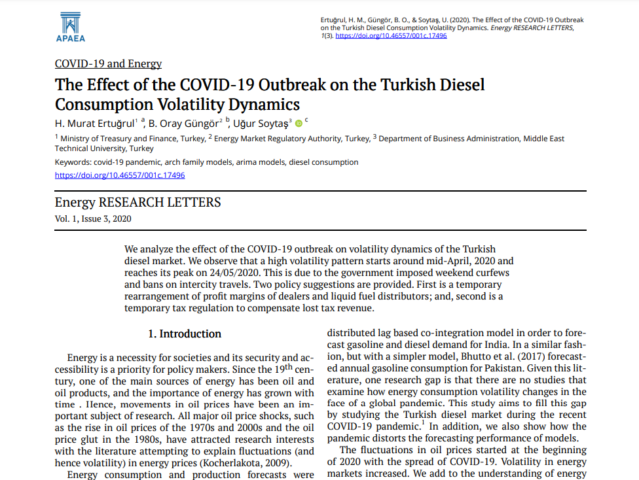
Our First paper
Ertuğrul, H. M., Güngör, B. O., & Soytaş, U. (2020). The Effect of the COVID-19 Outbreak on the Turkish Diesel Consumption Volatility Dynamics. Energy RESEARCH LETTERS, 1(3). https://doi.org/10.46557/001c.17496

Slide 4
FAILURE # 2

Slide 5
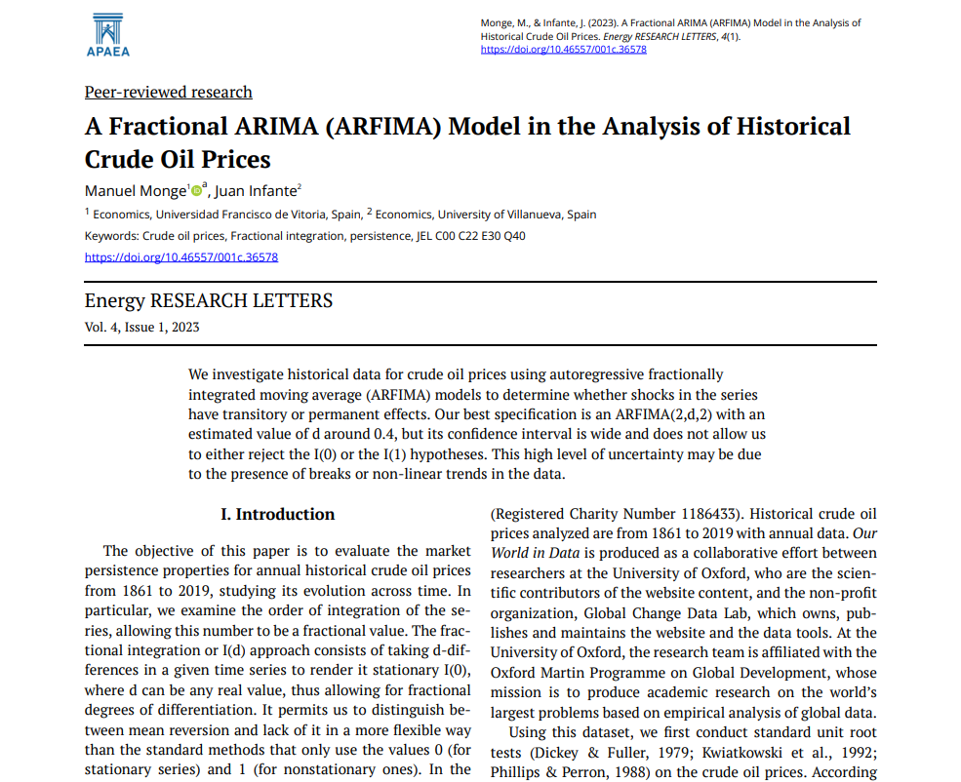
Our Second paper
Monge, M., & Infante, J. (2023). A Fractional ARIMA (ARFIMA) Model in the Analysis of Historical Crude Oil Prices. Energy RESEARCH LETTERS, 4(1). https://doi.org/10.46557/001c.36578

Slide 6
What Is an Autoregressive Integrated Moving Average (AR-I-MA)?
An autoregressive integrated moving average, or ARIMA, is a statistical analysis model that uses time series data to either better understand the data set or to predict future trends.
Ref: https://www.investopedia.com/terms/a/autoregressive-integrated-moving-average-arima.asp

Slide 7
AR-FI-MA?
In the ARIMA process to have the “d” value become a non-integer value, i.e., generalized the ARIMA model to make it have the differencing degree to be fractional values.
The main model’s purpose is to account for the persistence of memory that we find in economic and financial prices in levels while estimating an ARMA model on them.

Slide 8
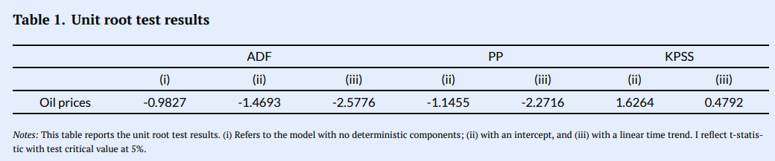
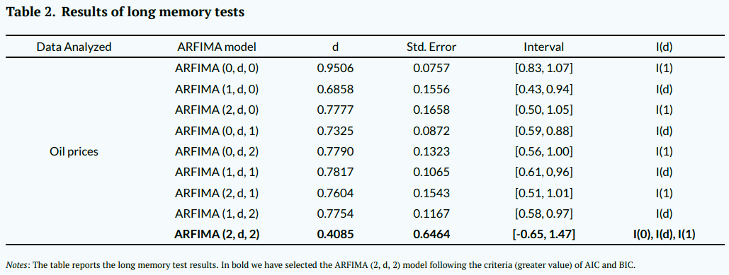
So What Happened?
Soruce: Monge, M., & Infante, J. (2023). A Fractional ARIMA (ARFIMA) Model in the Analysis of Historical Crude Oil Prices. Energy RESEARCH LETTERS, 4(1). https://doi.org/10.46557/001c.36578

Slide 9
FAILURE # 3?
(Not Really!)

Slide 10
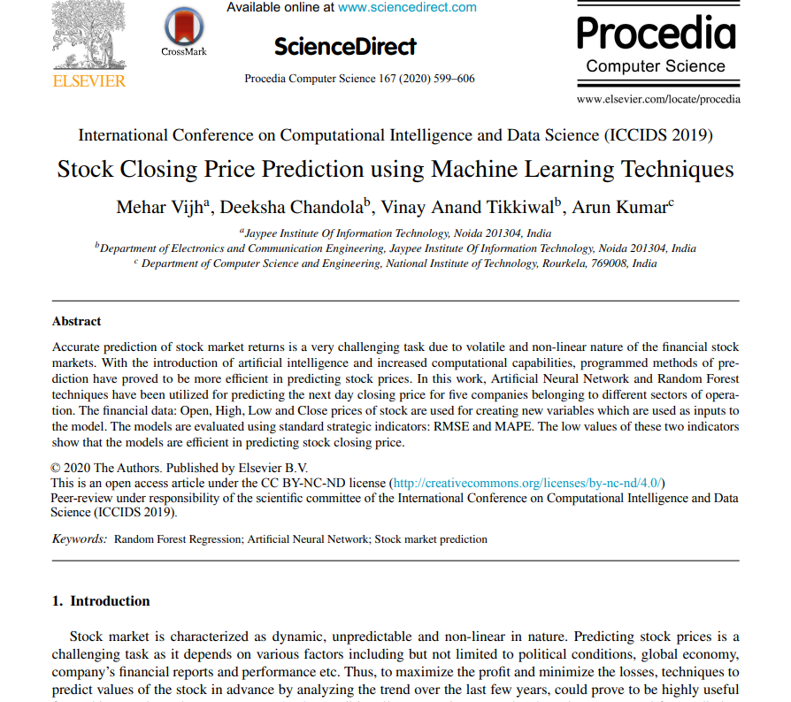
Finally Our Paper!
Vijh, M., Chandola, D., Tikkiwal, V. A., Kumar, A., (2020). Stock Closing Price Prediction using Machine Learning Techniques. Procedia Computer Science, 167, pp. 599-606. https://doi.org/10.1016/j.procs.2020.03.326

Slide 11
The first step to any ML model
Training Data:
2009-05-05 to 2017-04-03
1
Test Data:
2017-04-04 to 2019-04-05
2

Slide 12
1
High minus Low Price
2
Close minus Open Price
3
7 days Moving Average
Features
4
14 days Moving Average
5
21 days Moving Average
7 days Standard Deviation days
6

Slide 13
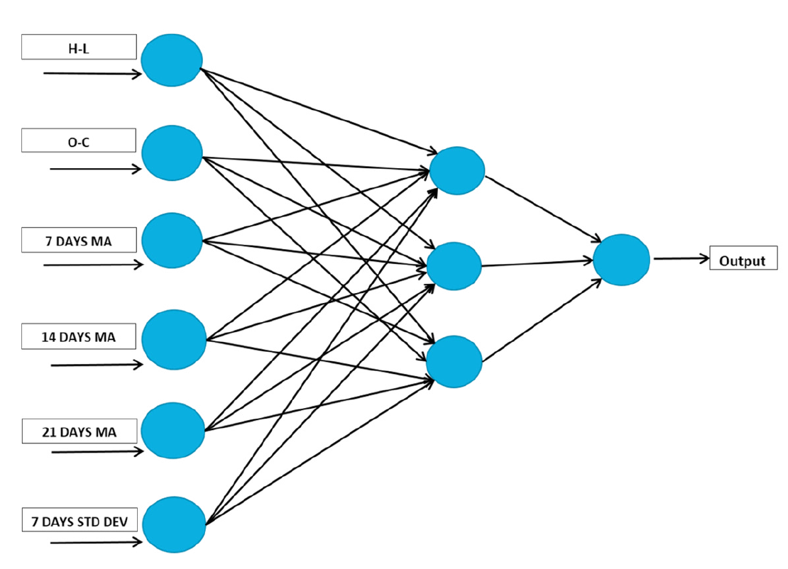

Neural Network Architecture

Slide 14
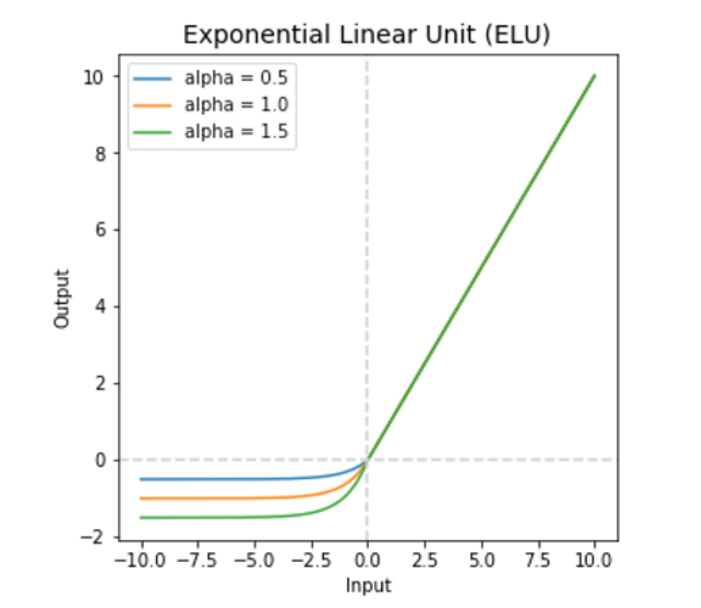
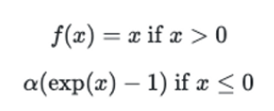
Activation Function-ELU

Slide 15
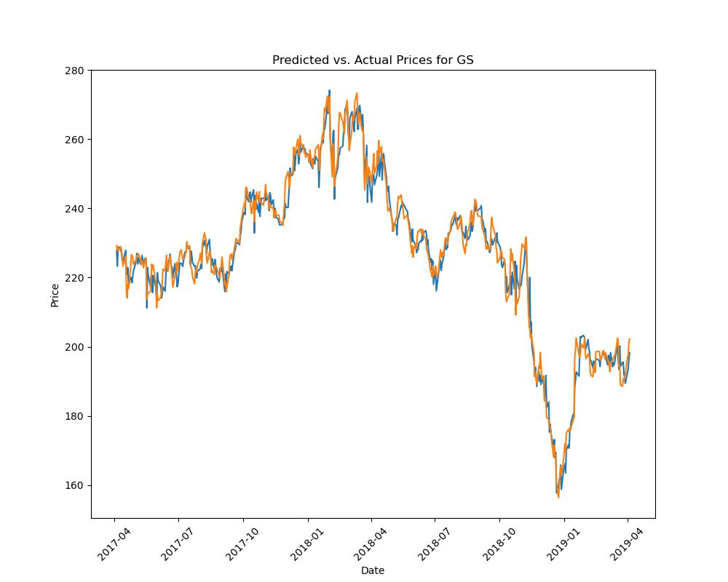
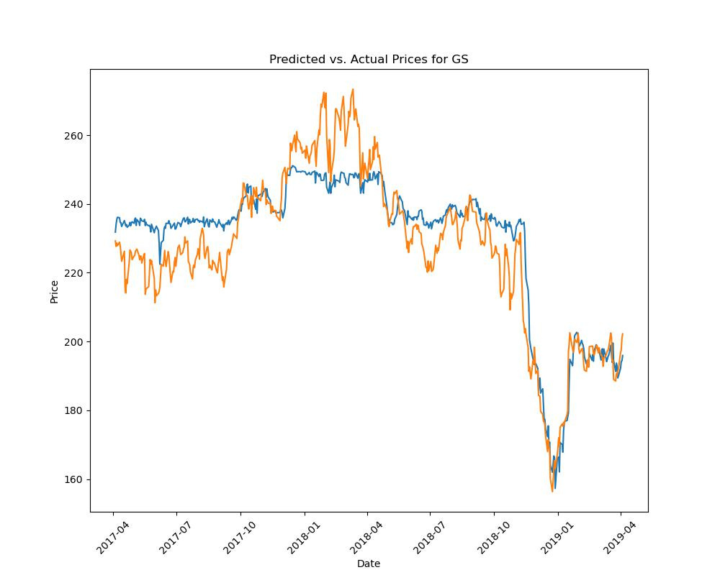
ANN vs RF: Goldman Sachs

Slide 16
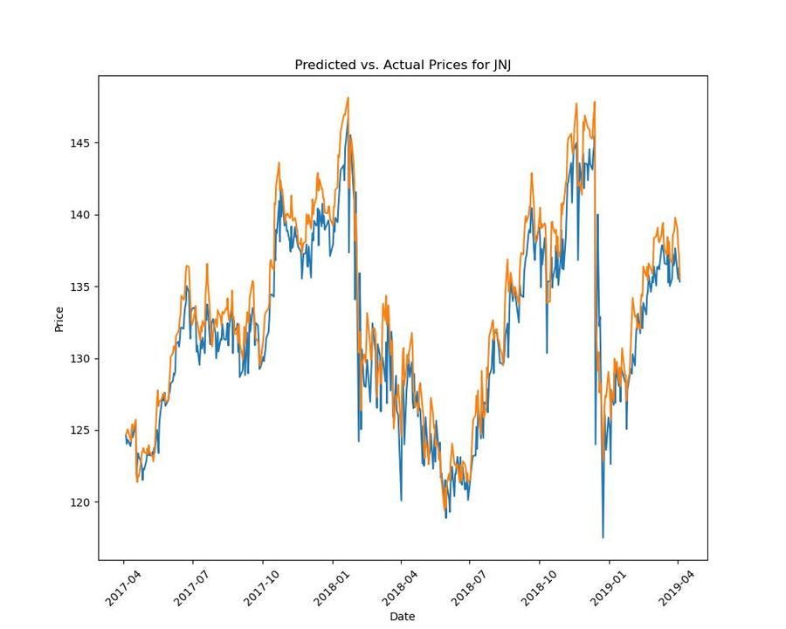
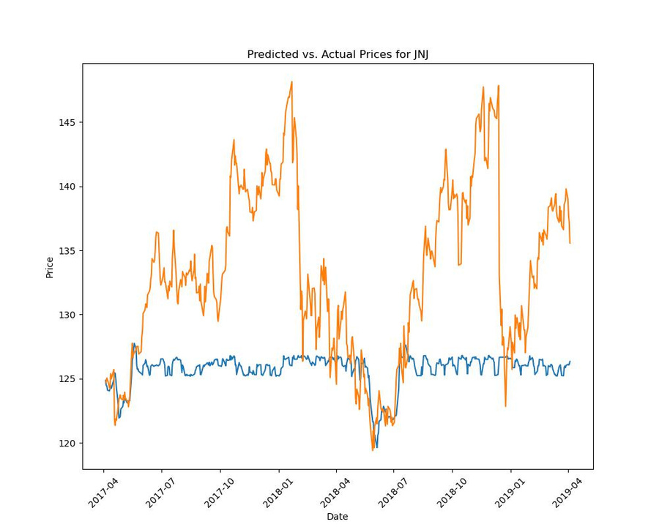
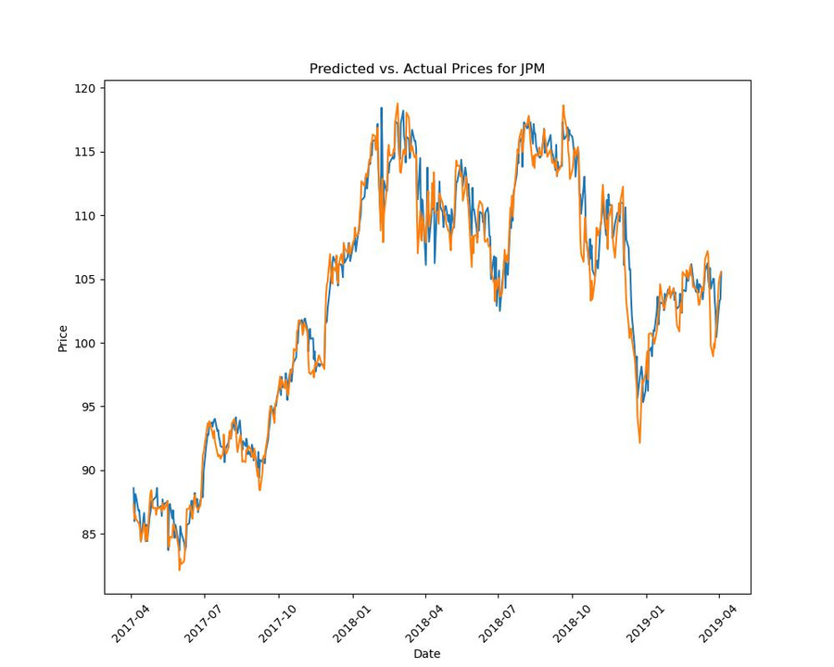
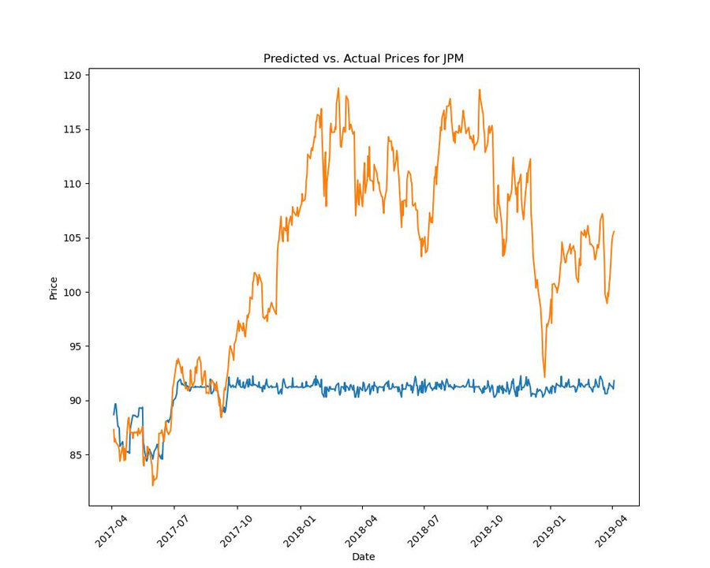
Johnson & Johnson
J P Morgan

Slide 17
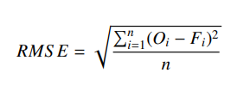


1
What makes a model better?
2
3

Slide 18
Comparative analysis of RMSE, MAPE and MBE values for ANN of authors (A) vs ours (O) | Comparative analysis of RMSE, MAPE and MBE values for ANN of authors (A) vs ours (O) | Comparative analysis of RMSE, MAPE and MBE values for ANN of authors (A) vs ours (O) | Comparative analysis of RMSE, MAPE and MBE values for ANN of authors (A) vs ours (O) | Comparative analysis of RMSE, MAPE and MBE values for ANN of authors (A) vs ours (O) | Comparative analysis of RMSE, MAPE and MBE values for ANN of authors (A) vs ours (O) | Comparative analysis of RMSE, MAPE and MBE values for ANN of authors (A) vs ours (O)
Company | ANN (Authors) | ANN (Authors) | ANN (Authors) | ANN (Ours) | ANN (Ours) | ANN (Ours)
Company | RMSE | MAPE | MBE | RMSE | MAPE | MBE
Nike | 1.1 | 1.07% | -0.0522 | 1.13 | 1.15% | -0.0101
Goldman Sachs | 3.3 | 1.09% | 0.0762 | 3.44 | 1.19% | 0.5252
J.P. Morgan and Co. | 1.28 | 0.89% | -0.031 | 1.5 | 1.02% | -0.318
Johnson & Johnson | 1.54 | 0.70% | -0.0138 | 2.09 | 1.23% | 1.3427
Pfizer Inc. | 0.42 | 0.77% | -0.0156 | 0.42 | 0.81% | 0.0577

Slide 19
Comparative analysis of RMSE, MAPE and MBE values for RF of authors (A) vs ours (O) | Comparative analysis of RMSE, MAPE and MBE values for RF of authors (A) vs ours (O) | Comparative analysis of RMSE, MAPE and MBE values for RF of authors (A) vs ours (O) | Comparative analysis of RMSE, MAPE and MBE values for RF of authors (A) vs ours (O) | Comparative analysis of RMSE, MAPE and MBE values for RF of authors (A) vs ours (O) | Comparative analysis of RMSE, MAPE and MBE values for RF of authors (A) vs ours (O) | Comparative analysis of RMSE, MAPE and MBE values for RF of authors (A) vs ours (O)
Company | RF (Authors) | RF (Authors) | RF (Authors) | RF (Ours) | RF (Ours) | RF (Ours)
Company | RMSE | MAPE | MBE | RMSE | MAPE | MBE
Nike | 1.29 | 1.14% | -0.0521 | 9.44 | 8.28% | 6.1836
Goldman Sachs | 3.4 | 1.01% | 0.0761 | 9.42 | 3.24% | -2.4351
J.P. Morgan and Co. | 1.41 | 0.93% | -0.0313 | 15.35 | 11.81% | 12.5863
Johnson & Johnson | 1.53 | 0.75% | -0.0138 | 9.73 | 5.66% | 7.5587
Pfizer Inc. | 0.43 | 0.80% | -0.0155 | 3.58 | 5.62% | 2.1082

Slide 20
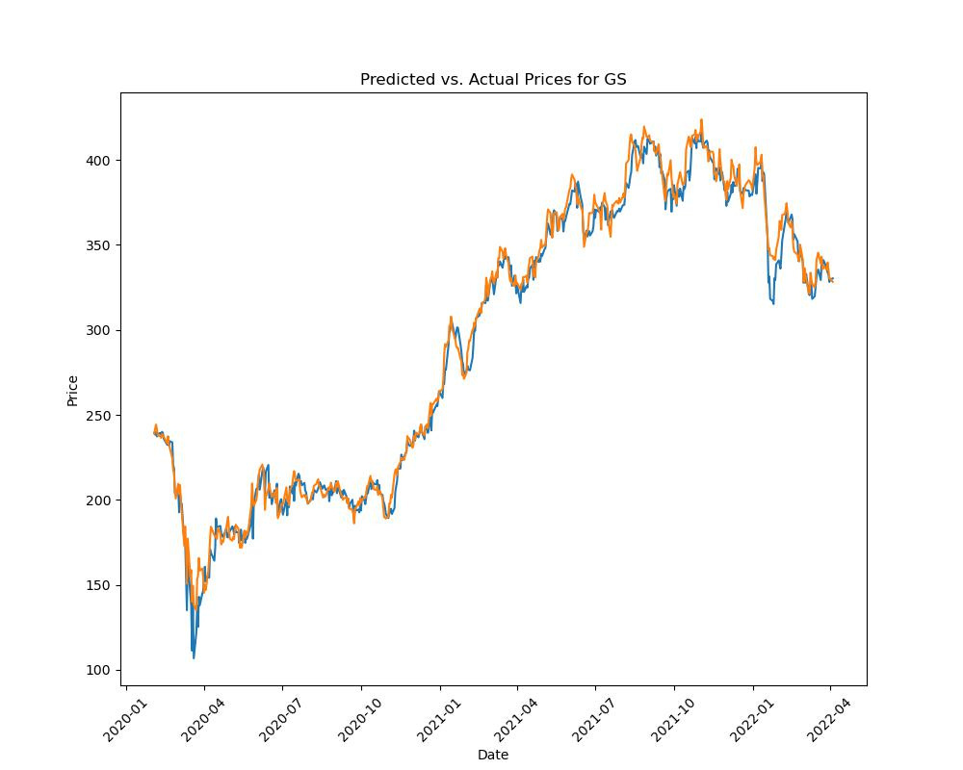
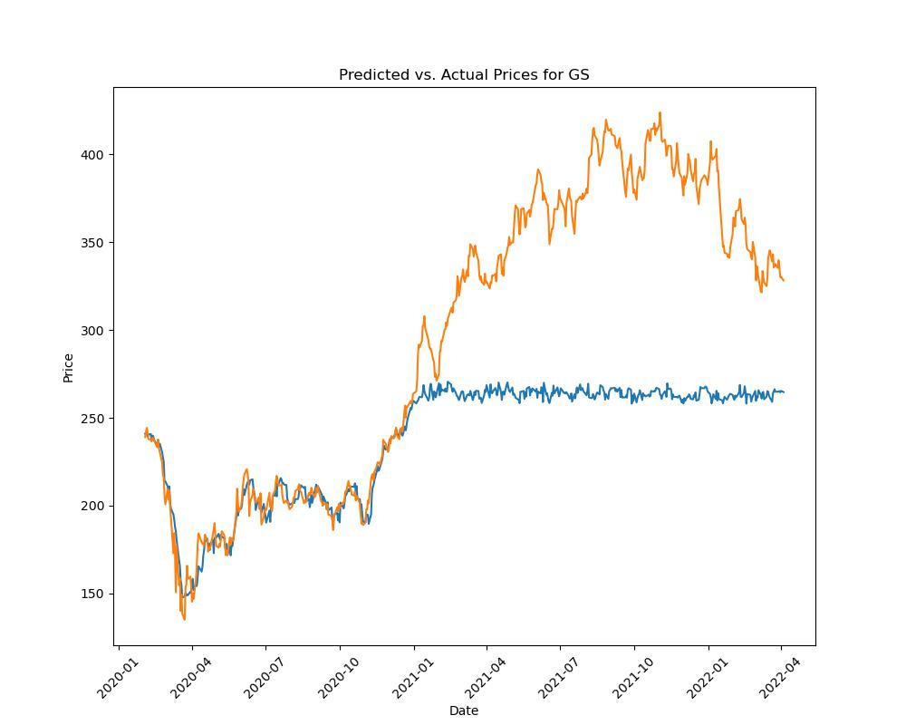
Extension 1
Training Data:
2009-05-05 to 2020-01-31
Test Data:
2020-02-03 to 2022-04-05
1
2
Goldman Sachs

Slide 21
Why would anyone want to predict stock prices?

Slide 22
Extension 2
- Buy if stock increases for 4 consecutive days
- Sell if stock decreases days (and we've made a profit)
Company | ANN ($) | RF ($)
Nike | 1270 | 940
Goldman Sachs | 780 | 860
J.P. Morgan and Co. | 1100 | 940
Johnson & Johnson | 990 | 910
Pfizer Inc. | 950 | 870
Starting Amount: $1000

Slide 23
Thank you!
Have a great
day ahead.

