Slide 1

Predicting Conversion from Normal Cognition to Cognitive Impairment
Justin Bardwell
Supervisors:
Ghulam Mubashar Hassan,
Farzaneh Salami,
Naveed Akhtar

Slide 2
Alzheimer’s Disease
A progressive neurodegenerative disease which destroys memory and other important cognitive functions.
Dementia, including Alzheimer’s Disease (AD), has been the second leading cause of death in Australia since 2013 [1].
People can fall under one of three categories:
Cognitively Normal (NC)
Mild Cognitive Impairment (MCI)
Alzheimer’s Disease (AD)

Slide 3
Early Detection
MCI is a condition in which people experience significant memory loss but do not yet meet the criteria for a clinical diagnosis of AD [2].
Annually, at age 65 [3]:
8% of people will progress from NC to MCI
22% of patients with MCI will progress to a clinical diagnosis of AD.

Slide 4
Conversion from Normal Cognition
Aim
Previous results

Slide 5
Deep Learning in Medical Imaging

Slide 6
Significant Results in the Literature

Slide 7
Our Data – OASIS-3
asd

Slide 8
Patch-Based vs Voxel-Based

Slide 9
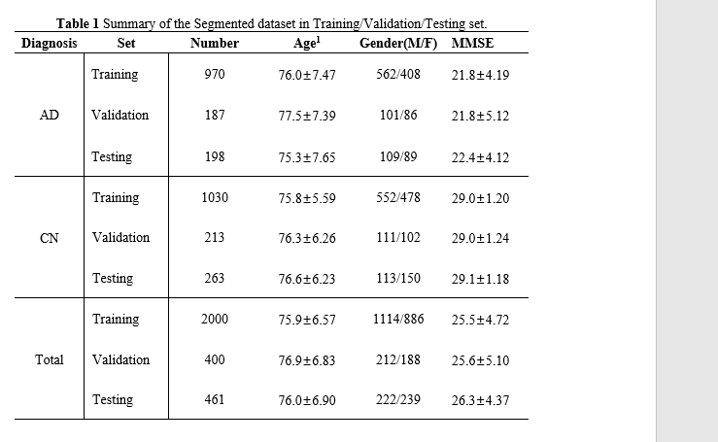
Data Selection

Slide 10
Experiments and Hypotheses

Slide 11
Model Architecture – Voxel-based

Slide 12
Model Architecture – Patch-based

Slide 13
Results

Slide 14
Results

Slide 15
Discussion

Slide 16
References
[1] Australian Bureau of Statistics, “Causes of death, Australia, 2019,” 2020.
[2] R. C. Petersen, R. Doody, A. Kurz, R. C. Mohs, J. C. Morris, P. V. Rabins, K. Ritchie, M. Rossor, L. Thal, and B. Winblad, “Current concepts in mild cognitive impairment,” Archives of neurology, vol. 58, no. 12, pp. 1985{1992, 2001.
[3] M. Davis, T. O'Connell, S. Johnson, S. Cline, E. Merikle, F. Martenyi, and K. Simpson, “Estimating Alzheimer's disease progression rates from normal cognition through mild cognitive impairment and stages of dementia,” Current Alzheimer Research, vol. 15, no. 8, pp. 777{788, 2018.

