Slide 1
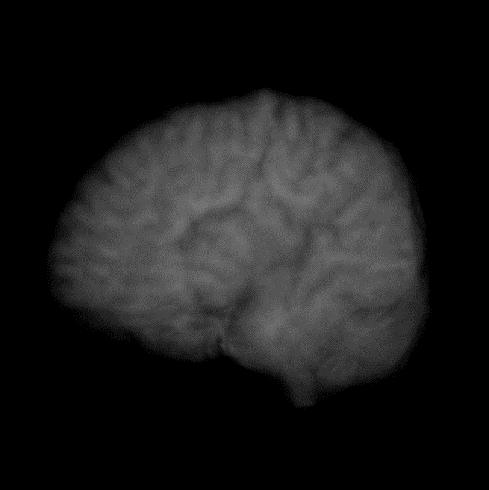
Predicting Conversion from Normal Cognition to Cognitive Impairment
Justin Bardwell
Supervisors:
Ghulam Mubashar Hassan
Farzaneh Salami
Naveed Akhtar

Slide 2
Alzheimer’s Disease
A progressive neurodegenerative disease which destroys memory and other important cognitive functions.
Dementia, including Alzheimer’s Disease (AD), has been the second leading cause of death in Australia since 2013 [1].
People can fall under one of three categories:
Cognitively Normal (CN)
Mild Cognitive Impairment (MCI)
Alzheimer’s Disease (AD)

Slide 3
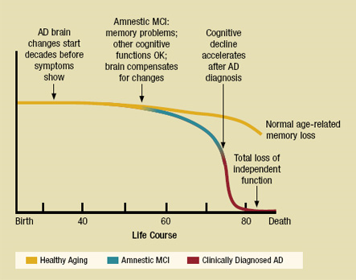
Timeline of Cognitive Impairment
MCI is a condition in which people experience significant memory loss but do not yet meet the criteria for a clinical diagnosis of AD [2].
Annually, at age 65:
8% of people will progress from NC to MCI.
22% of patients with MCI will progress to a clinical diagnosis of AD [3].
Timeline of healthy aging, MCI, and AD [4]

Slide 4
Conversion from Normal Cognition
Diet, exercise and cognitive exercise have been shown to reduce the incidence of development of MCI and dementia [5].
Early intervention should lead to increased life expectancy and less time spent in severe AD health states.
Our goal is to produce a model which can accurately predict whether a cognitively normal person will suffer from cognitive impairment in the near future.
Notes:
Non-pharmacological interventions such as diet, exercise and cognitive exercise have been shown to have an influence on reducing the incidence of development of MCI and dementia [4].
No cure for AD, so early intervention is extremely valuable.
For a cohort of 100 cognitively normal patients at age 65, it was found that a 20% reduction in the progression rate from normal cognition to MCI would avoid 5.7 cases of MCI and 5.6 cases of AD in the future [3].

Slide 5
Deep Learning in Medical Imaging
Applications:
Multiple Sclerosis
Alzheimer's disease
Cancer
COVID-19
CNNs able to learn useful representations of complex images.
Radiological examinations' retrospective error rate is approximately 30% [6].
Notes:
Recently, deep learning has been used to solve many complex medical problems such as detecting Multiple Sclerosis, Alzheimer's disease and various types of cancer [8].
The interest in deep learning for medical imaging has largely been due to the ability of convolutional neural networks (CNNs) to learn useful representations of complex images.
Lee et al. [9] found that radiological examinations' retrospective error rate is approximately 30%. As such, automated approaches are becoming necessary.

Slide 6
Significant Results in the Literature
3D CNNs found to have a greater ability to extract discriminative features from MRI data than 2D CNNs [7].
Problem of binary classification between CN and MCI/AD has been solved [8].
State-of-the-art method for prediction of conversion to MCI has an AUC of 0.85 [9].
Binary classification accuracy comparison[10]

Slide 7
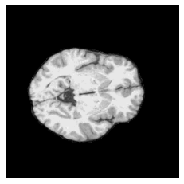
Patch-Based vs Voxel-Based
The two methods for dealing with 3D images are:
voxel-based: uses voxel intensity values from the whole MRI.
patch-based: breaks down the whole image into several small three-dimensional cubes.
Patch-based approaches are able to learn from the whole brain with significantly reduced dimensionality [10].

Slide 8
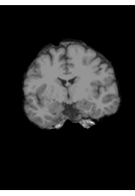
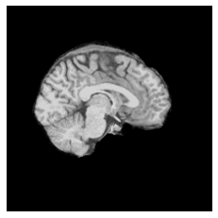
OASIS-3 Data
OASIS-3 is an openly available dataset containing MRI and PET imaging for 1,098 subjects [11].
850 of the participants entered the study as CN.
245 of these converted to a state of cognitive impairment over the 10-year duration of the study.
Notes:
Note skull-stripping, FreeSurfer. Other clinical data also included

Slide 9
Data Selection
We are interested in two classes of subjects:
CN – Those who remained cognitively normal for at least 3000 days after their initial scan.
Converters – Those who converted from normal cognition to cognitive impairment within 1000 days after their scan.
Category | Number of scans
Subjects remaining CN for >3000 days | 154
Subjects converted within 1000 days | 50

Slide 10
Experiments and Hypotheses
Experiment 1 – Compare the performance of a 3D CNN using a voxel-based approach versus a patch-based approach.
Hypothesis: The patch-based model will be able to provide more accurate predictions than the voxel-based model.
Experiment 2 – Explore any improvements in model performance that can be attained using different CNN architectures.
Hypothesis: There will be differences in model accuracy between each model. An ensemble method using all the CNN architectures tested will provide the greatest accuracy for our predictions.

Slide 11
Model Architecture – Voxel-based
Dense Layers
Sigmoid Layer
128 x 128 x 128 whole brain MRI
3D CNN using ImageNet weights
Predicted conversion probability

Slide 12


Model Architecture – Patch-based
1
Predicted conversion probability for each patch
2
Logistic regression model using patch predictions as features
………
27
Final predicted conversion probability for whole scan
64 x 64 x 64 MRI patches
3D CNN using ImageNet weights
Notes:
Show image of the architecture instead of text
Break whole brain down to 27 patches (3x3x3)
Feed each of the patches into a 3D CNN
Save the output predictions from each patch
Using outputs from each patch based model as features to feed in to a logistic regression model for us to make our final prediction.

Slide 13
Results – Experiment 1
Our patch-based model greatly outperforms the voxel-based model.
Model | Accuracy | AUC | Sensitivity | Specificity
Voxel-based ResNet50 | 0.50 | 0.50 | 0.00 | 1.00
Patch-based ResNet50 | 0.90 | 0.99 | 0.80 | 1.00
Voxel-based confusion matrix:
Patch-based confusion matrix:
 | Actual
 | Converted (1) | CN (0)
Converted (1) | 0 | 0
CN (0) | 10 | 10
 | Actual
 | Converted (1) | CN (0)
Converted (1) | 10 | 0
CN (0) | 2 | 8
Predicted
Predicted

Slide 14
Results – Experiment 2
ResNet50 and SEResNet50 provide the greatest prediction results. These two models provide identical predictions.
DenseNet121 does not perform as well as ResNet50.
The ensemble model did not have the greatest performance.
Model | Accuracy | AUC | Sensitivity | Specificity
ResNet50 | 0.90 | 0.99 | 0.80 | 1.00
SEResNet50 | 0.90 | 0.99 | 0.80 | 1.00
SEResNeXt50 | 0.75 | 0.85 | 0.90 | 0.60
ResNet18 | 0.65 | 0.8 | 0.70 | 0.60
DenseNet121 | 0.85 | 0.97 | 1.00 | 0.70
Ensemble Model | 0.85 | 0.97 | 1.00 | 0.70

Slide 15
Results – Comparison
 | Model | Time to outcome | AUC | Sensitivity | Specificity
Albert et al. [9] | Cox regression (MRI data only) | 5 years | 0.740 | 0.641 | 0.710
 |  | 7 years | 0.722 | 0.662 | 0.659
 |  | 9 years | 0.705 | 0.616 | 0.678
 | Cox Regression (MRI + APOE-4 + CSF + cognitive testing) | 5 years | 0.850 | 0.804 | 0.740
 |  | 7 years | 0.843 | 0.815 | 0.724
 |  | 9 years | 0.831 | 0.764 | 0.759
Our approach | Patch-based ResNet50 | 1000 days | 0.990 | 0.800 | 1.000

Slide 16
Discussion for Future Work
Expand our testing to cover longer time-frames for conversion.
Inclusion of clinical data in our models.
Test our models on other datasets.
Investigate the possibility of predicting time to conversion.

Slide 17
Conclusion
Patch-based approach has outperformed the voxel-based approach.
Models with large amounts of parameters tend to outperform those with less.
Our patch-based ResNet50 approach has outperformed the current state-of-the-art approaches for predicting conversion from normal cognition to cognitive impairment.

Slide 18
References
[1] Australian Bureau of Statistics, “Causes of death, Australia, 2019,” 2020.
[2] R. C. Petersen, R. Doody, A. Kurz, R. C. Mohs, J. C. Morris, P. V. Rabins, K. Ritchie, M. Rossor, L. Thal, and B. Winblad, “Current concepts in mild cognitive impairment,” Archives of neurology, vol. 58, no. 12, pp. 1985-1992, 2001.
[3] M. Davis, T. O'Connell, S. Johnson, S. Cline, E. Merikle, F. Martenyi, and K. Simpson, “Estimating Alzheimer's disease progression rates from normal cognition through mild cognitive impairment and stages of dementia,” Current Alzheimer Research, vol. 15, no. 8, pp. 777-788, 2018.
[4] National Institute on Aging, & Alzheimer’s Disease Education and Referral Center, Alzheimer’s disease: Unraveling the mystery. U.S. Department of Health and Human Services NIH Publication Number: 08-3782, 2008.
[5] S. Yao, Y. Liu, X. Zheng, Y. Zhang, S. Cui, C. Tang, L. Lu, and N. Xu, “Do nonpharmacological interventions prevent cognitive decline? a systematic review and meta-analysis,” Translational psychiatry, vol. 10, no. 1, pp. 1-11, 2020.
[6] C. S. Lee, P. G. Nagy, S. J. Weaver, and D. E. Newman-Toker, “Cognitive and system factors contributing to diagnostic errors in radiology,” American Journal of Roentgenology, vol. 201, no. 3, pp. 611{617, 2013.
[7] E. Yagis, L. Citi, S. Diciotti, C. Marzi, S. W. Atnafu, and A. G. S. De Herrera, “3D convolutional neural networks for diagnosis of Alzheimer's disease via structural MRI,” in 2020 IEEE 33rd International Symposium on Computer-Based Medical Systems (CBMS). IEEE, 2020, pp. 65{70.
[8] M. A. Ebrahimighahnavieh, S. Luo, and R. Chiong, “Deep learning to detect Alzheimer's disease from neuroimaging: A systematic literature review,” Computer methods and programs in biomedicine, vol. 187, p. 105242, 2020.
[9] M. Albert, Y. Zhu, A. Moghekar, S. Mori, M. I. Miller, A. Soldan, C. Petti-grew, O. Selnes, S. Li, and M.-C. Wang, “Predicting progression from normal cognition to mild cognitive impairment for individuals at 5 years,” Brain, vol.141, no. 3, pp. 877–887, 2018.
[10] A. Farooq, S. Anwar, M. Awais, and M. Alnowami, “Articial intelligence based smart diagnosis of Alzheimer's disease and mild cognitive impairment,” in 2017 International Smart cities conference (ISC2). IEEE, 2017, pp. 1-4.
[11] P. J. LaMontagne, T. L. Benzinger, J. C. Morris, S. Keefe, R. Hornbeck, C. Xiong, E. Grant, J. Hassenstab, K. Moulder, and A. Vlassenko, “OASIS-3: longitudinal neuroimaging, clinical, and cognitive dataset for normal aging and Alzheimer disease,” MedRxiv, 2019.

