Slide 1
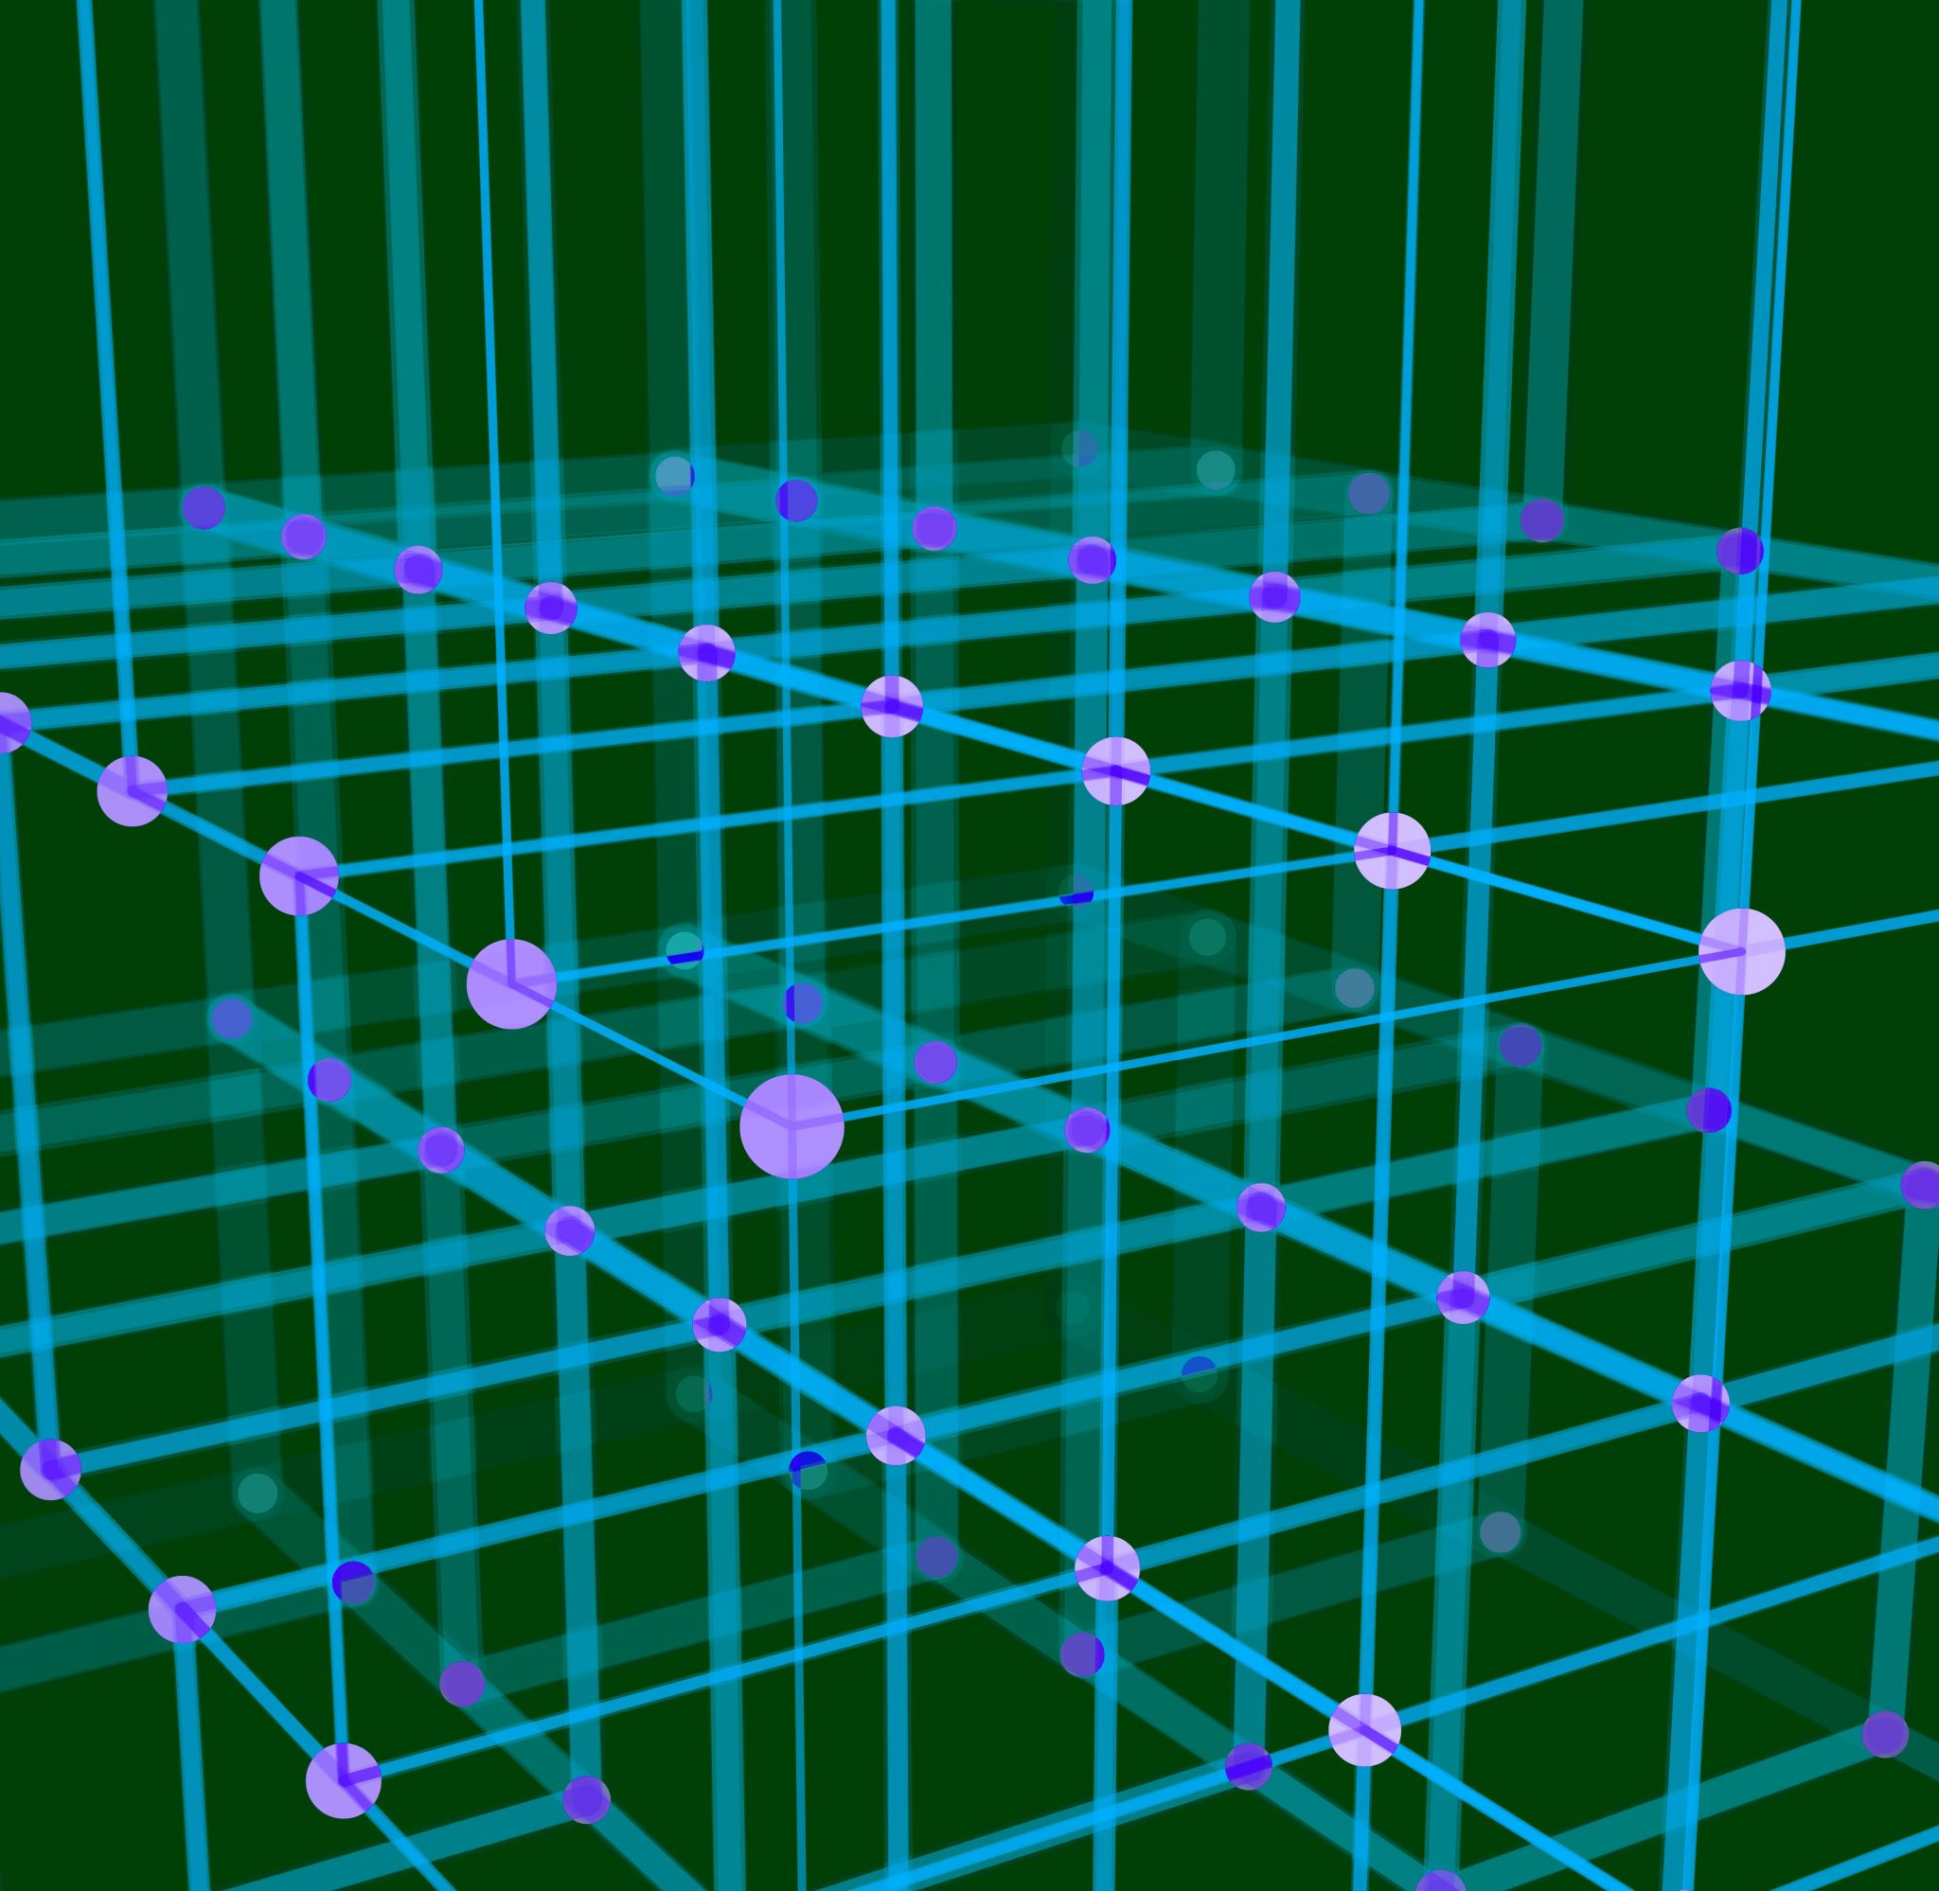
Predicting Conversion from Normal Cognition to Cognitive Impairment
Justin Bardwell
Supervisors:
Ghulam Mubashar Hassan,
Farzaneh Salami,
Naveed Akhtar

Slide 2
Alzheimer’s Disease

Slide 3
Our Data

Slide 4
Early Detection of AD

Slide 5
Conversion from Normal Cognition
Aim
Previous results

Slide 6
Significant Results in the Literature

Slide 7
Patch-Based vs Voxel-Based

Slide 8
Data Selection

Slide 9
Experiments and Hypotheses

Slide 10
Model Architecture – Voxel-based

Slide 11
Model Architecture – Patch-based

Slide 12
Results

Slide 13
Results

Slide 14
Discussion

Slide 15
References

