Slide 1

Redis Iris workshop for CVS
Four labs. Python only. Fictional retail data.
Vector search
Context Retriever
LangCache
Agent Memory
CVS onsite Redis Iris workshop / 01
Notes:
Redis logo source: Redis Iris Retail workshop repository, https://github.com/Redislabs-Solution-Architects/redis-iris-workshop

Slide 2
Workshop path
WORK FROM THE REPOSITORY ROOT
1 Vector search: policy documents 30 min
2 Context Retriever: live orders 45 min
3 LangCache: a public policy answer 20 min
4 Agent Memory: pickup preference 25 min
Allow 20 min for Cloud and Python setup, then 10 min to explain what you built. Total: 150 min.
CVS onsite Redis Iris workshop / 02

Slide 3
Redis Cloud account and free database
CLOUD SETUP
1 Sign up or sign in at cloud.redis.io
2 Select New database
3 Choose Try 30 MB for free
4 Choose vendor and region, then Create database
Redis allows one free database per account.
CVS onsite Redis Iris workshop / 03
Notes:
Source: https://redis.io/docs/latest/operate/rc/databases/create-database/create-free-database/

Slide 4
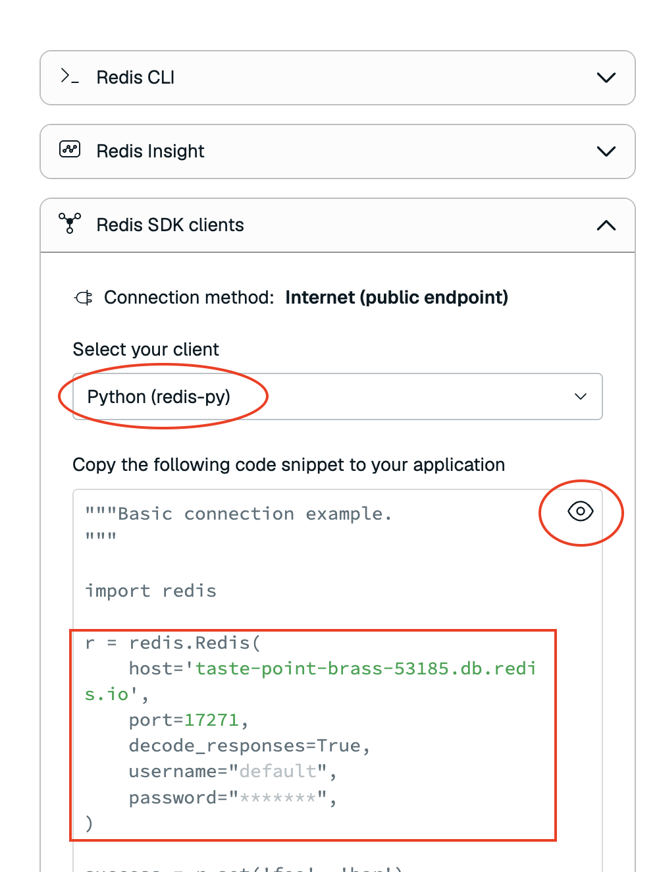
Database endpoint and password
DATABASE CONFIGURATION
Copy the public endpoint: host and port.
Reveal the Default user password.
The Connect wizard shows a Python redis-py example.
Put the values in REDIS_URL inside .env.
CVS onsite Redis Iris workshop / 04
Notes:
Sources: https://redis.io/docs/latest/operate/rc/databases/connect/ ; Illustrative screenshot from https://github.com/Redislabs-Solution-Architects/redis-iris-workshop/blob/main/credentials.png . Console layout can change.

Slide 5
Local Python setup
PYENV-SELECTED PYTHON
pyenv exec python3 -m venv .venv
source .venv/bin/activate
python -m pip install -r requirements.txt
cp .env.example .env
Fill REDIS_URL, pre-download the local Hugging Face model, then run the README ping check.
Use rediss:// when the database requires TLS. Keep .env out of Git.
CVS onsite Redis Iris workshop / 05

Slide 6
Cloud services used by the labs
DATABASE PLUS MANAGED SERVICES
Lab 1: RedisVL vector search on the database
Lab 2: Context Retriever surface over live HASHes
Lab 3: LangCache service, cache ID, service key
Lab 4: Agent Memory service, store ID, service key
Agent Memory Quick create can use Free 30 MB. Confirm service access and keep an instructor service ready.
CVS onsite Redis Iris workshop / 06
Notes:
Sources: https://redis.io/docs/latest/operate/rc/langcache/create-service/ ; https://redis.io/docs/latest/develop/ai/context-engine/context-retriever/quickstart/ ; https://redis.io/docs/latest/operate/iris/agent-memory/create-service/

Slide 7
Lab 1: vector search
EDIT EXERCISES/LAB_1/01_VECTOR.PY
Read eight policy Markdown files.
Embed its body locally with all-MiniLM-L6-v2.
Create a RedisVL HASH index and load records.
Inspect the 1,536-byte vector; query top 2.
python exercises/lab_1/01_vector.py
Expected: pickup policy near top
CVS onsite Redis Iris workshop / 07
Notes:
Sources: https://docs.redisvl.com/en/latest/user_guide/04_vectorizers.html ; https://docs.redisvl.com/en/latest/api/searchindex.html . Workshop guide: exercises/lab_1/README.md

Slide 8
Lab 2: data and entity model
EDIT THE LOADER AND MODELS.PY
Load stores.jsonl and orders.jsonl as HASHes.
Inspect O1001 with HGETALL.
Keep keys aligned with __redis_key_template__.
Mark entity IDs as key components.
Index status as a tag.
workshop:store:S101
workshop:order:O1001
Expected: Stores 2, Orders 3
CVS onsite Redis Iris workshop / 08
Notes:
Source: https://redis.io/docs/latest/develop/ai/context-engine/context-retriever/quickstart/ . Workshop guide: exercises/lab_2/README.md

Slide 9
Context Retriever surface and keys
CLOUD SIGN-IN AND CTXCTL
Sign in with ctxctl. Create an admin key.
Create a surface from exercises/lab_2/models.py and your Redis endpoint.
Create an agent key for tool calls.
ctxctl auth login -u EMAIL
ctxctl admin create --name cvs-workshop-admin
ctxctl surface create --models exercises/lab_2/models.py ...
ctxctl agent create --surface-id ID ...
Admin key manages the surface. Agent key invokes generated tools.
CVS onsite Redis Iris workshop / 09
Notes:
Source: https://redis.io/docs/latest/develop/ai/context-engine/context-retriever/quickstart/

Slide 10
Lab 2: generated order tool
EDIT EXERCISES/LAB_2/02_CONTEXT.PY
Print every generated tool with the agent key.
Inspect get_order_by_id and its input schema.
Call it with id = O1001.
Change the sample order, reload, and call again.
await client.list_tools(agent_key)
await client.query_tool(
agent_key=agent_key,
tool_name='get_order_by_id',
arguments={'id': 'O1001'})
CVS onsite Redis Iris workshop / 10
Notes:
Source: https://redis.io/tutorials/getting-started-with-redis-iris/ . Workshop guide: exercises/lab_2/README.md

Slide 11
Lab 3: LangCache
CREATE SERVICE IN REDIS CLOUD
Open LangCache and create a service on the workshop database.
Copy the API key once. Get the base URL and cache ID from Connectivity.
Store one answer, then check the same rephrasing at three distance thresholds.
for limit in (0.02, 0.10, 0.40):
hits = cache.check(
prompt=similar,
distance_threshold=limit)
print(limit, bool(hits))
CVS onsite Redis Iris workshop / 11
Notes:
Sources: https://redis.io/docs/latest/operate/rc/langcache/create-service/ ; https://redis.io/docs/latest/operate/rc/langcache/use-langcache/ ; https://docs.redisvl.com/en/latest/user_guide/13_langcache_semantic_cache.html . Workshop guide: exercises/lab_3/README.md

Slide 12
Lab 4: Agent Memory
CREATE AN AGENT MEMORY SERVICE
Use Quick create on Free, or set a 1-minute cadence in a custom service.
Copy its API key, endpoint, and store ID. Set a unique WORKSHOP_USER_ID.
Check service health, write one fictional event, then compare session and long-term memory.
python exercises/lab_4/04_memory.py write
python exercises/lab_4/04_memory.py read
The session appears immediately. Long-term extraction runs later.
CVS onsite Redis Iris workshop / 12
Notes:
Source: https://redis.io/docs/latest/develop/ai/context-engine/agent-memory/python-sdk-quickstart/ . Workshop guide: exercises/lab_4/README.md

Slide 13
Debrief: choose the right source
EXPLAIN THE SYSTEM BEHIND EACH ANSWER
What does the pickup policy say?
What is order O1001's status right now?
Have we answered this public question before?
Which store does this fictional user prefer?
For each answer: what was stored, who updates it, and can it become stale?
CVS onsite Redis Iris workshop / 13

