Slide 1
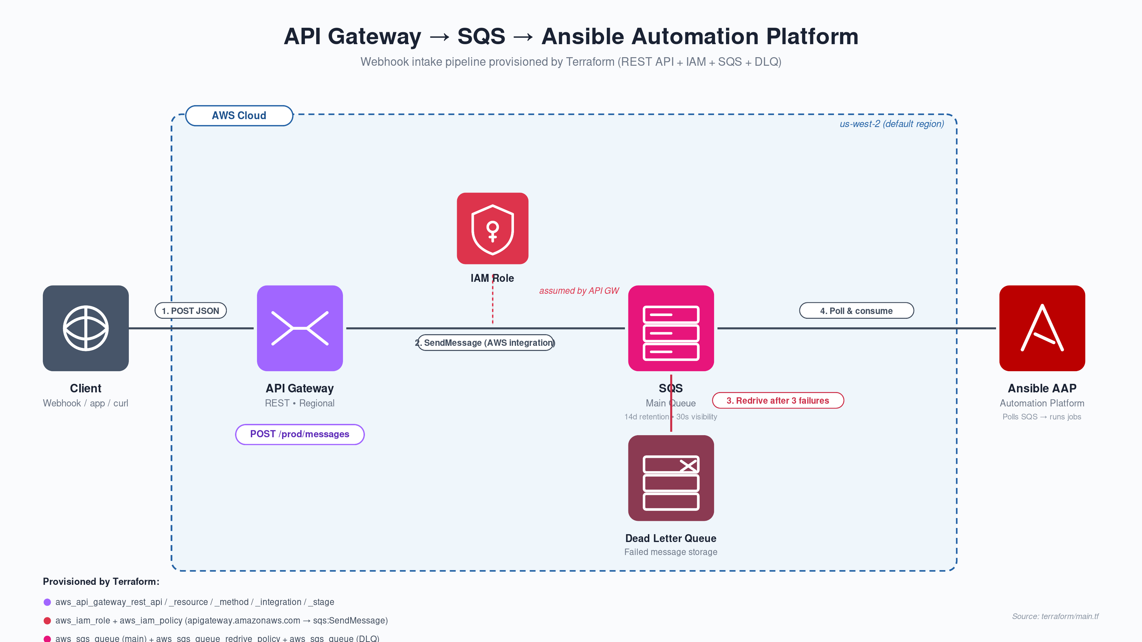
Source: terraform/main.tf │ Resources: API Gateway REST • IAM role/policy • SQS main + DLQ (redrive)

