Slide 1
Preference Query Evaluation Over Expensive Attributes
Justin Levandoski
Mohamed F. Mokbel
Mohamed E. Khalefa

Slide 2
Talk Outline
Expensive Attributes
The problem: preference queries over expensive attributes
Previous solutions
Our solution
Performance Analysis
Conclusion

Slide 3


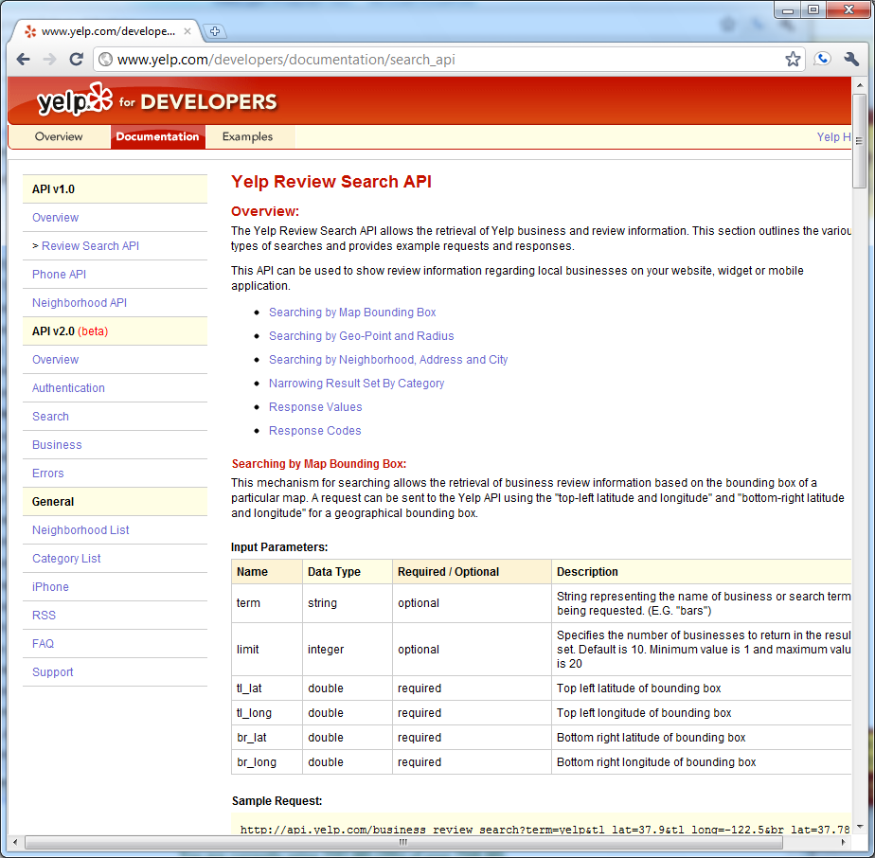
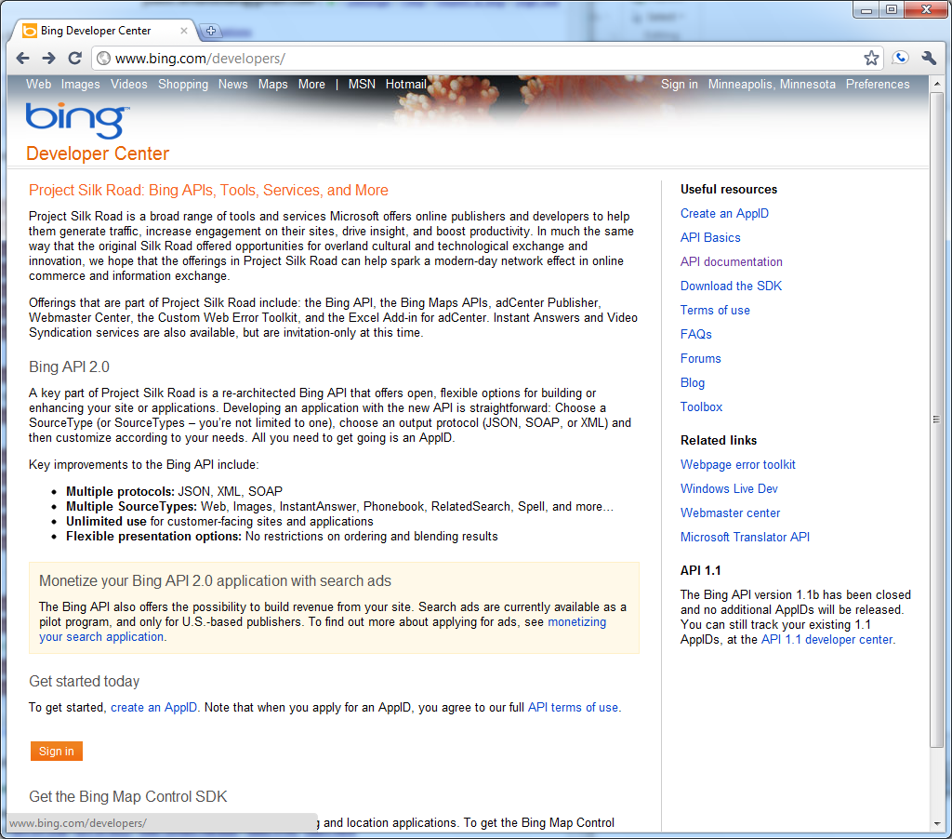
Expensive Attributes
Rich data stored at and retrieved from third party
Third-party = “cloud” or “web”
Restaurant Reviews
Driving Directions

Slide 4

Expensive Attributes
You cannot “download” this data
From Yelp API terms:
“You may not cache, store, analyze or otherwise use Yelp content except for real-time use.”
http://www.yelp.com/developers/documentation/faq

Slide 5



Expensive Attributes
Business
Listings
Restaurant
Reviews
Driving
Directions
Online
News
Weather

Slide 6

Preference Queries Over Expensive Attributes
How expensive is “expensive”?
Experiment implemented in PostgreSQL prototype
Query Processor
Single drive time attribute
From 3rd party web service
502 msec
“Hot” 8K page
From buffer
4.7 μsec
“Cold” 8K page
from disk
27 msec
Order of magnitude difference
Disk
8K Page

Slide 7
Talk Outline
Expensive Attributes
The problem: preference queries over expensive attributes
Previous solutions
Our solution
Performance Analysis
Conclusion

Slide 8
Preference Queries Over Expensive Attributes
Preference queries with a mix of “local” and “expensive” attributes
Goal: retrieve the least amount of expensive attributes
We consider skyline, top-k, and multi-objective preference queries
SELECT *
FROM Restaurants R
PREFERRING MIN R.Price, MIN R.Distance, MAX R.Rating
Restaurants
ID | Price | Distance | Rating
R1 | 1
R2 | 5
R3 | 2
R4 | 3
R5 | 7
Stored locally in DBMS
Notes:
Mention cost model changes and needing to optimize for least number of expensive attribute requests.

Slide 9
Talk Outline
Expensive Attributes
The problem: preference queries over expensive attributes
Previous solutions
Our solution
Performance Analysis
Conclusion

Slide 10
Previous Solutions
Top-K Ranking
Bruno et al. ICDE 2002
Distributed Skyline Queries
Balke et al. EDBT 2004
Chang et al. SIGMOD 2002
Bartolini et al. CIKM 2006

Slide 11
Preference Queries Over Expensive Attributes
Every previous solution assumes sorted access for expensive attributes
All third party data sources we have surveyed are stateless: they do not allow sorted access
Query Processor
Restaurants
ID | Price | Rating
R1 | 1
R2 | 5
R3 | 2
R4 | 3
R5 | 7
3
get next sorted
5
return next sorted
4

Slide 12
Talk Outline
Expensive Attributes
The problem: preference queries over expensive attributes
Previous solutions
Our solution
Performance Analysis
Conclusion

Slide 13
Highlights of Our Solution
Does not assume sorted access to expensive attributes
Assumes two fundamental access operations for expensive attributes
Random: given object ID, return attribute value for that object
Range: return objects with attribute values in given range [b,e]
Framework that works with any existing preference algorithm (top-k, skyline, multi-objective)
We have not invented a “new” preference algorithm
Our framework is complementary to existing algorithms
Implemented and tested in PostgreSQL

Slide 14
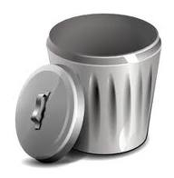
Outline of Solution
Expensive Attribute Requests
Random
Access
Random Access
for objects in S
Range
Access
Dataset
D
Phase I:
Initial Answers
D
Phase II:
Pruning
D - L
Phase III:
Cleaning
Pruned
Objects
L
Guaranteed Preference
Answers
Final Preference Answer

Slide 15
Skyline Query Example
Skyline: find all “non-dominated” objects
SELECT *
FROM Restaurants R
PREFERRING MIN R.Price, MIN R.Distance
Dominance
Region
Restaurants
ID | Price | Distance
R1 | 1 | 10
R2 | 5 | 9
R3 | 2 | 5
R4 | 3 | 7
R5 | 7 | 2
R6 | 9 | 1
R7 | 8 | 4
R8 | 4 | 11
R8
R1
R2
Distance
R4
R3
R7
R5
R6
Price

Slide 16
Running Example Data
SELECT *
FROM Restaurants R
PREFERRING MIN R.Price, MAX R.Rating, MIN R.WaitTime, MIN R.DriveTime
Local DBMS
Restaurants
ID | Price | Rating | Wait Time | Drive Time
a | 84 | 78 | 39
b | 91 | 29 | 19 | ...
c | 27 | 28 | 55 | ...
d | 36 | 12 | 51 | ...
e | 63 | 51 | 39
f | 1 | 13 | 24 | …
g | 15 | 95 | 40 | …
h | 99 | 14 | 30 | …
i | 35 | 47 | 29 | …
J | 49 | 33 | 97

Slide 17
Outline of Solution
Expensive Attribute Requests
Random
Access
Random Access
for objects in S
Range
Access
Dataset
D
Phase I:
Initial Answers
D
Phase II:
Pruning
D - L
Phase III:
Cleaning
Pruned
Objects
L
Guaranteed Preference
Answers
Final Preference Answer

Slide 18
Running example: Phase I
Create set A: known preference answers found by using any skyline algorithm over local attributes
Track dominating object in A for each object not in A
Dominating object depends on the skyline algorithm used
Local DBMS
A
ID | Price | Rating | Wait Time
b | 91 | 29 | 19
f | 1 | 13 | 24
g | 15 | 95 | 40
Other Objects
a | 84 | 78 | 39
c | 27 | 28 | 55
d | 36 | 12 | 51
e | 63 | 51 | 39
h | 99 | 14 | 30
i | 35 | 47 | 29
j | 49 | 33 | 97
Dominating Objects
Phase I:
Initial Answers
Phase II:
Pruning
Phase III:
Cleaning

Slide 19
Running example: Phase I
Local DBMS
A
ID | Price | Rating | Wait Time | Drive Time
b | 91 | 29 | 19
f | 1 | 13 | 24
g | 15 | 95 | 40
RandomRequest
76
80
10
Other Objects
a | 84 | 78 | 39
c | 27 | 28 | 55
d | 36 | 12 | 51
e | 63 | 51 | 39
h | 99 | 14 | 30
i | 35 | 47 | 29
j | 49 | 33 | 97
Boundary Value
Make random request for expensive attributes of A only
Set boundary value for each object not in A based on dominating object’s expensive attribute
Dominating Objects
80
10
80
80
. . .
76
80
10
Phase I:
Initial Answers
Phase II:
Pruning
Phase III:
Cleaning

Slide 20
Running example: Phase II
Local DBMS
Derive range boundary values U and L
Make range request
Details for finding range boundaries in paper
Example with U=10 L=0
A
ID | Price | Rating | Wait Time | Drive Time
b | 91 | 29 | 19
f | 1 | 13 | 24
g | 15 | 95 | 40
76
80
10
Other Objects
a | 84 | 78 | 39
c | 27 | 28 | 55
d | 36 | 12 | 51
e | 63 | 51 | 39
h | 99 | 14 | 30
i | 35 | 47 | 29
j | 49 | 33 | 97
BV
80
10
9
80
Range Request [0,10]
80
76
8
80
10
Phase I:
Initial Answers
Phase II:
Pruning
Phase III:
Cleaning

Slide 21
Running example: Phase II
Local DBMS
Create two sets
P: objects returned from range request and A that have expensive attribute less than or equal to U
Q: All other objects not in A or P
A
ID | Price | Rating | Wait Time | Drive Time
b | 91 | 29 | 19
f | 1 | 13 | 24
g | 15 | 95 | 40
76
80
10
Other Objects
a | 84 | 78 | 39
c | 27 | 28 | 55
d | 36 | 12 | 51
e | 63 | 51 | 39
h | 99 | 14 | 30
i | 35 | 47 | 29
j | 49 | 33 | 97
BV
80
10
9
80
80
76
8
80
10
Phase I:
Initial Answers
Phase II:
Pruning
Phase III:
Cleaning

Slide 22
Running example: Phase II
Local DBMS
Create two sets
P: objects returned from range request and A that have expensive attribute less than or equal to U
Q: All other objects not in A or P
Clean P: run skyline over P, seeding inititial skyline with objects in P taken from A (ensures P contains final answers)
Prune Q: for each object q in Q
Case 1: bounding value (BV) is less than or equal to U
Case 2: compare q to each object in P and discard if found to be dominated
A
ID | Price | Rating | Wait Time | Drive Time
b | 91 | 29 | 19
f | 1 | 13 | 24
76
80
P
i | 35 | 47 | 29
d | 36 | 12 | 51
g | 15 | 95 | 40
8
9
10
Q
a | 84 | 78 | 39
c | 27 | 28 | 55
e | 63 | 51 | 39
h | 99 | 14 | 30
j | 49 | 33 | 97
BV
80
10
80
76
10
Phase I:
Initial Answers
Phase II:
Pruning
Phase III:
Cleaning

Slide 23


Running example: Phase II
Local DBMS
A
ID | Price | Rating | Wait Time | Drive Time
b | 91 | 29 | 19
f | 1 | 13 | 24
76
80
P
i | 35 | 47 | 29
d | 36 | 12 | 51
g | 15 | 95 | 40
8
Cleaned objects in P represent uneccesary expensive attribute retrieval
9
10
Q
a | 84 | 78 | 39
c | 27 | 28 | 55
e | 63 | 51 | 39
h | 99 | 14 | 30
j | 49 | 33 | 97
Pruned objects in Q discarded without retrieving expensive attribute
Phase I:
Initial Answers
Phase II:
Pruning
Phase III:
Cleaning

Slide 24
Running example: Phase III
Local DBMS
Make random request for expensive attributes of all objects left in Q
Find final preference answer by running skyline over Q, seeding initial answer with objects from A and P
A
ID | Price | Rating | Wait Time | Drive Time
b | 91 | 29 | 19
f | 1 | 13 | 24
76
80
P
i | 35 | 47 | 29
g | 15 | 95 | 40
8
10
Q
e | 63 | 51 | 39
RandomRequest
60
Phase I:
Initial Answers
Phase II:
Pruning
Phase III:
Cleaning

Slide 25
Running example: Phase III
Local DBMS
Final preference answer is concatenation of A, P, and Q
A
ID | Price | Rating | Wait Time | Drive Time
b | 91 | 29 | 19
f | 1 | 13 | 24
76
80
Final Answer
ID | Price | Rating | Wait Time | Drive Time
b | 91 | 29 | 19
f | 1 | 13 | 24
i | 35 | 47 | 29
g | 15 | 95 | 40
e | 63 | 51 | 39
P
i | 35 | 47 | 29
g | 15 | 95 | 40
8
76
10
80
9
Q
e | 63 | 51 | 39
10
60
60
Phase I:
Initial Answers
Phase II:
Pruning
Phase III:
Cleaning

Slide 26
Solutions for Other Scenarios
Paper contains details for
Skyline over multiple expensive attributes
Multi-objective queries for a single expensive attribute
Multi-objective queries for multiple expensive attributes
Framework can adapted to top-k queries

Slide 27
Multi-Objective Queries
Multi-objective: mixture of skyline and ranking
SELECT *
FROM Restaurants R
PREFERRING MIN (R.Price + R.Distance), MAX R.Rating
Restaurants
ID | Price | Distance | Rating
R1 | 1 | 10 | 4.5
R2 | 5 | 9 | 3
R3 | 2 | 5 | 3.5
R4 | 3 | 7 | 5
R5 | 7 | 2 | 3.4
R6 | 9 | 1 | 4.8
R7 | 8 | 4 | 2
R8 | 4 | 11 | 2.5
Restaurants
ID | (Price + Distance) | Rating
R1 | 11 | 4.5
R2 | 14 | 3
R3 | 7 | 3.5
R4 | 10 | 5
R5 | 9 | 3.4
R6 | 10 | 4.8
R7 | 12 | 2
R8 | 15 | 2.5

Slide 28
Talk Outline
Expensive Attributes
The problem: preference queries over expensive attributes
Previous solutions
Our solution
Performance Analysis
Conclusion

Slide 29
Performance Analysis
Framework implemented inside Postgres query processing engine
Preference algorithms
Skyline [ICDE 2001]
Multi-Objective [VLDB 2004]
Data
Synthetically generated [ICDE 2001]
Real Minneapolis point-of-interest data using Bing Maps API for driving time

Slide 30
Performance Analysis: Skyline Single Expensive Attr.

Slide 31
Multi-Objective with Mult Expensive Attr.

Slide 32
Talk Outline
Expensive Attributes
The problem: preference queries over expensive attributes
Previous solutions
Our solution
Performance Analysis
Conclusion

Slide 33
Conclusion
Covered problem of preference query processing over expensive attributes
Surveyed existing techniques to addressing this problem and their drawbacks
Proposed new expensive attribute query processing framework
Works with any existing preference algorithm
Three-phase framework
Assumes only random and range access to expensive attributes
Covered performance analysis of framework implemented inside PostgreSQL

Slide 34
Thank You

Slide 35
Choosing a value for U
Local DBMS
Five options for choosing U
MAX: maximum expensive attribute value from A
MIN: minimum expensive attribute value from A
MOSTDOM: expensive attribute from A of object found to dominate the most other objects
BOUNDMAX: Maximum boundary value
BOUNDMIN: Minimum boundary value
Details in paper
A
ID | Price | Rating | Wait Time | Drive Time
b | 91 | 29 | 19
f | 1 | 13 | 24
g | 15 | 95 | 40
76
80
10
Other Objects
a | 84 | 78 | 39
c | 27 | 28 | 55
d | 36 | 12 | 51
e | 63 | 51 | 39
h | 99 | 14 | 30
i | 35 | 47 | 29
j | 49 | 33 | 97
BV
Dominating Objects
80
10
10
80
76
80
10
Phase I:
Initial Answers
Phase II:
Pruning
Phase III:
Cleaning

Slide 36
Performance Analysis: Skyline Mult Expensive Attr.

Slide 37
Performance Analysis: U Derivation Methods
Synthetic Data with 50K objects (default workload)
6-attribute skyline with single expensive attribute

