Slide 1


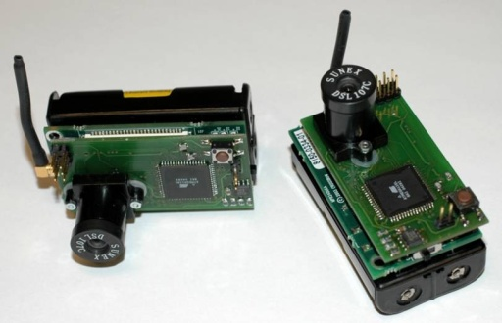

PermJoin: An Efficient Algorithm for Producing Early Results in Multi-join Query Plans
Justin J. Levandoski Mohamed E. Khalefa Mohamed F. Mokbel
University of Minnesota Department of Computer Science
We introduce an efficient algorithm for Producing Early Results in Multi-join query plans (PermJoin, for short). While most previous research focuses only on the case of a single join operator, PermJoin addresses query plans with multiple join operators. PermJoin is optimized to maximize the early overall throughput and to adapt to fluctuations in data arrival rates. PermJoin is a non-blocking operator that is capable of producing join results even if one or more data sources block due to slow or bursty network behavior. Furthermore, PermJoin distinguishes itself from all previous techniques as it: (1) employs a new flushing policy to write in-memory data to disk, once memory allotment is exhausted, in a way that helps increase the probability of producing early result throughput multi-join queries, and (2) employs a novel state manager module that adaptively switches operators between joining in-memory data and disk-resident data in order to maximize overall throughput.
Join Algorithms for Emerging Environments
Goal: Produce early query feedback in new and emerging environments
Constraints
Streaming data: not all data available beforehand
Sources may block
Traditional join algorithms optimized to produce entire result
Applications
Web-based environment with slow and bursty input with streaming data
Sensor networks
Scientific simulations taking days to produce large-scale results with need for early results
Scientific Simulation
Sensor Networks
Query
Remote Source A
Remote Source C
Moving Object Environments
Remote Source B
Web-Based Data Aggregation
General Approaches
PermJoin Architecture
Single-join query plans: Hash-merge Join
Join operator can be in three states
In-memory
Joining memory-resident data
On-disk
Joining disk-resident data
Low priority
Producing results only if resources are available
Low
Priority
Join disk-resident data
Source A
Memory Full or End of Data
Disk
Data Flow
Observed and Collected Statistics
State Manager
Disk
Join
Result
In-Memory Hashing
Both Sources Block or End of Data
On-Disk Sorting and Merging
Consider incoming tuple Rs
If operator not in-memory
Rs temporarily buffered
If operator in-memory
Rs joined with memory-resident data immediately
Flush
Source B
Source Unblocked
Incoming
Data
Buffer
In-Memory Join
Data Flow
Join Result
Data Flow
In-Memory Join
In-Memory: Symmetric-Hash Join
Incoming tuple r at Source A
Compute hash(r)
Probe table B (produce results)
Store in table A
Symmetric operator for Source B
On-Disk: Sort-Merge Join
Join different groups
Example: a_{1,1} and b_{1,2}
No need to join similar groups
Example: a_{1,1} and b_{1,1}
On-Disk Join
Multi-join query plans: PermJoin
Source A
Source B
Source A
Source B
hash(A)
hash(B)
h₁
4
7
9
1
6
h₁
1
4
2
6
7
Main Idea
Collect statistics during query runtime for input sources and data on disk
Memory Flushing
Consider data at each operator equally, flush data least beneficial to query plan
State Manager
Place each operator in optimal state to produce high throughput: in-memory, on-disk, or temporary blocking
(2)
(1)
(1)
(2)
a_{1,1}
a_{1,2}
b_{1,1}
b_{1,2}
1
1
Before Merge
In-memory Results: (4,4), (6,6)
Join Result
After Merge
On-Disk Results: (1,1), (7,7)
2
2
Source A
Source B
Join ABCD
…
…
h₁
1
4
6
7
9
h₁
1
2
4
6
7
N
N
Join ABC
Source D
Hash Table A
Join Result
Hash Table B
Flushing: AdaptiveGlobalFlush
State Manager
Join AB
Source C
Used once hash table memory exhausted
Consider all operators in query plan
Flush partition groups
Symmetric partitions from both sources
Based on three characteristics of in-memory data
Global contribution: the ability to produce overall results
Arrival patterns: changes in data arrival rates at each partition group
Data properties: join attribute distribution or whether data is sorted
Continuous process
Traverse query plan to determine optimal state for each operator
Fundamentally different than flush algorithm
Flushing evicts least-valuable in-memory data
Due to changing nature of query, on-disk data may become valuable later in query runtime
State manager attempts to find this data to increase early throughput, changing each operator to the appropriate state
Source A
Source B

