Slide 1
FlexPref: A Framework for Extensible Preference Evaluation in Database Systems
Justin J. Levandoski
Mohamed F. Mokbel
Mohamed E. Khalefa

Slide 2
Talk Outline
Preference Methods
Implementing Preference Methods in a DBMS
The Challenge: Extensible Preference Evaluation
The FlexPref Framework
Performance Analysis
Conclusion

Slide 3
Preference Methods
SELECT *
FROM Restaurants R
WHERE R.AllowsGroups = True;
What is the
query answer?
Inject Preference Functionality
What preference
method evaluates the
PREFERRING clause?
SELECT *
FROM Restaurants R
WHERE R.AllowsGroups = True
PREFERRING MIN R.Price,
MAX R.Rating,
MIN R.WaitTime,
MIN TravelTime(User.Location, R.Location)

Slide 4



Preference Methods
Quick Exercise
Go to Google Scholar
Search for papers on preference evaluation methods
How many results do you get back?
The list goes on and on and on…
Top-K [VLDB99]
Skyline [ICDE01]
K-Dominance [SIGMOD06]
K-Frequency [EDBT06]
Top-K Domination [VLDB07]

Slide 5
Preference Methods
Notion of “preference” is subjective
Each method challenges notion of “preferred”
No limit to the number of proposed methods!
We want them all inside the DBMS
How do we place all these methods in a DBMS?
Must handle arbitrary queries
Selection over single table
Data may reside in multiple tables
Data may be sorted
Notes:
We’re of the opinion that all preference methods are created equal, we want them all in the DBMS

Slide 6
Talk Outline
Preference Methods
Implementing Preference Methods in a DBMS
The Layered Approach
The Built-In Approach
The Challenge: Extensible Preference Evaluation
The FlexPref Framework
Performance Analysis
Conclusion

Slide 7
Implementing Preference Methods in a DBMS
The Layered Approach
Preference Evaluation
DBMS is a “black box” to the preference method
Top-K
Almost all proposed algorithms take this approach
Skyline
K-Dominance
K-Frequency
Top-K Dom
Severe performance limitations:
Evaluate SQL query
Evaluate preference function
DBMS
DBMS knows nothing about semantics of preference method

Slide 8
Implementing Preference Methods in a DBMS
The Built-In Approach
DBMS
Several thousands of lines of code for each method
Query Processor
Each preference method hand-coded inside query processor. This can get ugly!
Top-K
Single-Table
Join
Index Optimizations
Skyline
Attempted for top-k with success. Very little work addresses skyline. No work addresses other methods.
Single-table
Join
Index Optimizations
Must figure out how to couple preference evaluation with join, selection, etc. Not easy!
K-Dominance
Single-table
Join
Index Optimizations
…
Index
Notes:
Several thousand lines of code for each method

Slide 9



Implementing Preference Methods in a DBMS
“The Good, The Bad, and The Ugly”
We currently have The Bad
The Bad
The Ugly
The Ugly
Still in search of
The Good

Slide 10
Implementing Preference Methods in a DBMS
The Bad: The Layered Approach
Simplicity: easy to implement
The Ugly: The Built-In Approach
Efficient: methods tightly coupled with DBMS
Limited Efficiency: cannot interact with DBMS internals, thus no query optimization
Infeasible: cannot provide custom implementation for every preference method

Slide 11
Talk Outline
Preference Methods
Implementing Preference Methods in a DBMS
The Challenge: Extensible Preference Evaluation
The FlexPref Framework
Performance Analysis
Conclusion

Slide 12
The Challenge: Extensible Preference Evaluation
Wouldn’t it be nice if we had the …
Simplicity of the layered approach
Efficiency of the built-in approach
Our Challenge: DBMS support for preference methods that is …
Practical: injecting preference method does not mean adding to or re-writing parts of the DBMS engine.
Inside the engine: Allows each preference method to “live” within the DBMS
In search of “The Good”:
An extensible preference query processing platform within the DBMS

Slide 13
Talk Outline
Preference Methods
Implementing Preference Methods in a DBMS
The Challenge: Extensible Preference Evaluation
The FlexPref Framework
Architecture
Adding Preference Methods to FlexPref
Performance Analysis
Conclusion

Slide 14
The FlexPref Architecture
FlexPref
DBMS
Preference method automatically coupled with database operators (join, selection, etc)
Query Processor
Modify query processor only once
FlexPref
Top-K
Comparable performance to built-in approach
Specific preference method code implemented outside the DBMS query processor.
Skyline
K-Dominance
K-Frequency
Top-K Dom
Orders of magnitude less code than built-in approach
Index

Slide 15
The FlexPref Architecture
Provides generic query processing support for:
Selection
Join
Index/Sorted Lists
Answer
Answer
Answer
FlexPref
Selection
FlexPref
Join
FlexPref
SortedList
MyPref
MyPref
MyPref
Restaurants
Id | P | D | R
1 | 2 | 5 | 6
2 | 3 | 6 | 8
3 | 5 | 1 | 7
Restaurants
Id | P | D | R
1 | 2 | 5 | 6
2 | 3 | 6 | 8
3 | 5 | 1 | 7
Hotels
Id | P | R
4 | 9 | 9
5 | 4 | 7
6 | 3 | 2
Price
Id | P
3 | 5
Rating
Id | R
3 | 7
2 | 8
Distance
Id | D
1 | 5
2 | 6
1 2
3 1
1 6
2 3

Slide 16
The FlexPref Architecture
The Ugly: Built-In
The Bad: Layered
The Good: FlexPref
Skyline implementation:
Work: ~2000 lines of code for selection only
Performance: Good
Skyline implementation:
Work: ~200 lines of code (selection by nature)
Performance: Bad
Skyline implementation:
Work: ~300 lines of code
Performance: Good
DBMS
DBMS
Preference Evaluation
Top-K
Query Processor
Query Processor
Skyline
FlexPref
Top-K
K-Dominance
Single-Table
Join
K-Frequency
Index Optimizations
Top-K
Skyline
Top-K Dom
Skyline
Single-table
Join
K-Dominance
Index Optimizations
K-Frequency
K-Dominance
…
Top-K Dom
…
DBMS
Index
Index

Slide 17
Talk Outline
Preference Methods
Implementing Preference Methods in a DBMS
The Challenge: Extensible Preference Evaluation
The FlexPref Framework
Architecture
Adding Preference Methods to FlexPref
Performance Analysis
Conclusion

Slide 18
Adding Preference Methods to FlexPref
Adding a new preference method “MyPref” to FlexPref
Query Processor
MyPref.c
FlexPref
Top-K
Skyline
1. Define two macros and three functions in separate “MyPref.c” file outside DBMS/FlexPref
K-Dominance
K-Frequency
MyPref
2. Compile into FlexPref using command: DefinePreference MyPref with MyPref.c

Slide 19
Writing Preference Queries in FlexPref
SELECT * FROM Restaurants R WHERE [Where_clause]
PREFERRING [Attribute List]
USING [Pref Method]
OBJECTIVES [Preference Objectives]
SELECT * FROM Restaurants R
WHERE …
PREFERRING Price P, Distance D, Rating R
USING Skyline OBJECTIVES MIN P, D, MAX R
SELECT * FROM Restaurants R
WHERE …
PREFERRING Price P, Distance D, Rating R
USING TopKDom WITH K=5 OBJECTIVES MIN P, D, MAX R
SELECT * FROM Restaurants R
WHERE …
PREFERRING Price P, Distance D, Rating R
USING TopK WITH K=5 OBJECTIVES MIN Func(P,D,R)

Slide 20
FlexPref Generic Functions & Macros
FlexPref Macros
#define DefaultScore Default score assigned to each object
#define IsTransitive Whether preference function is transitive or not
PairwiseCompare(Object P, Object Q)
INPUT: Two objects P and Q
ACTION: Update the score of P
RETURN: 1 if Q can never be a preferred object
-1 if P can never be a preferred object
0 otherwise
IsPreferredObject(Object P, PreferenceSet S)
INPUT: A data object P and a set of preferred objects S
RETURN: True if P is a preferred object and can be added to S
False otherwise
AddPreferredToSet(Object P, PreferenceSet S)
INPUT: A data object P and a set of preferred objects S
ACTION: Add P to S and remove or rearrange objects from S

Slide 21
Single Table Access in FlexPref
Selection algorithm written in terms of the three generic functions and two macros:
SELECT *
FROM Hotels
PREFERRING Price P,
Distance D,
Rating R
USING Skyline
OBJECTIVES MIN P, MIN D, MAX R
Input: Single Table T
Output Preference set S
Preference Set S ← NULL
For each object P in T
P.score = #DefaultScore
for each Object Q in T
cmp ← PairwiseCompare(P,Q)
if (cmp ==1)
if Q is in S then remove Q
if #isTransitive
then discard Q from T
if (cmp == -1)
if #isTransitive
then discard P from T
read next object P
if (IsPreferredObject(P,S))
then AddToPreferredSet(P,S)
Return S
FlexPref_Select
H

Slide 22
Multi-Table Access in FlexPref
SELECT * FROM Restaurants R, Hotels H WHERE R.city = H.city
PREFERRING R.Price RP, H.Price HP, R.Rating RR, H.Rating HR
USING Skyline OBJECTIVES MIN RP, MIN HP, MAX RR, MAX HR
The Join Operation
Sorted List Access
FlexPref_Select
FlexPref_SortedList
FlexPref_Join
…..
R₁
R₂
R₃
R_{n}
Join
StopSortedEval(Set P, Object O,
Object F)
INPUT: A set of partial objects P and two virtual objects O and F
ACTION: Update objects in P , till it is sufficient to perform preference evaluation
FlexPref_Select
FlexPref_Select
R
S

Slide 23
FlexPref Case studies
We provide case studies for five state-of-the-art preference methods
Skyline [ICDE01]
Top-K [VLDB99]
K-Dominance [SIGMOD06]
K-Frequency [EDBT06]
Top-K Dominance [VLDB07]
Details in paper

Slide 24
Talk Outline
Preference Methods
Implementing Preference Methods in a DBMS
The Challenge: Extensible Preference Evaluation
The FlexPref Framework
Performance Analysis
Conclusion

Slide 25

Performance Analysis
FlexPref prototype implemented in PostgreSQL
Experimental evaluation performed for
Single-table
Multi-table
Sorted lists

Slide 26
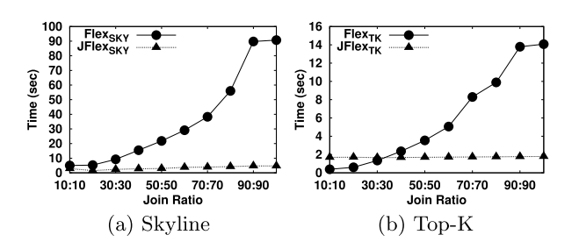
Performance Analysis
Multi-table query processing
Black circle: Join with FlexPref operator on top of join
Black triangle: FlexPref integrated join

Slide 27
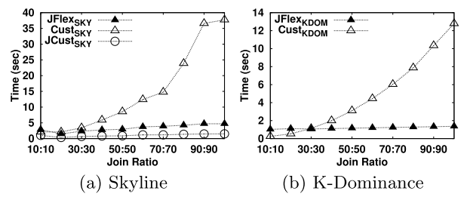
Performance Analysis
Multi-table comparison to built-in approach
Empty triangle: Join then on-top evaluation
Black triangle: FlexPref integrated join
Empty circle: Built-in skyline join [ICDE07]
~200 lines of code
~300 lines of code
~8,000 lines of code

Slide 28
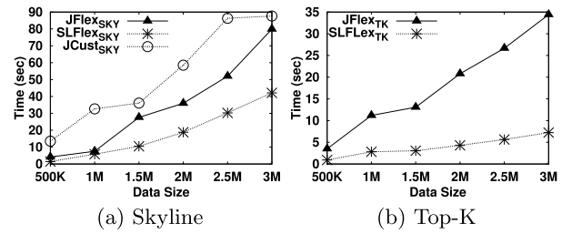
Performance Analysis
Sorted List Evaluation
Black triangle: FlexPref integrated join
Empty circle: Built-in skyline join [ICDE07]
Star: FlexPref sorted list operator

Slide 29
Talk Outline
Preference Methods
Implementing Preference Methods in a DBMS
The Challenge: Extensible Preference Evaluation
The FlexPref Framework
Performance Analysis
Conclusion

Slide 30
Conclusion and Summary
Many (possibly infinite) preference methods
Notion of “preference” is subjective
Many methods have not visited the inside of a DBMS
Three approaches to DBMS implementation
The bad: layered approach
The ugly: built-in approach
The good: FlexPref (our proposed approach)
The FlexPref Architecture
Generic query processing operators (Postgres prototype)
Extensible (plug and play) operator framework
Ease of layered approach, efficiency of built-in approach
Performance Analysis
Experiments with Postgres prototype show that FlexPref support for arbitrary select-project-join queries is beneficial and efficient
Performance comparable to built-in approach

Slide 31
Conclusion and Summary
Questions?

