Slide 1

Identifying Hot and Cold Data in Main-Memory Databases
Justin Levandoski
Per-Åke Larson
Radu Stoica

Slide 2

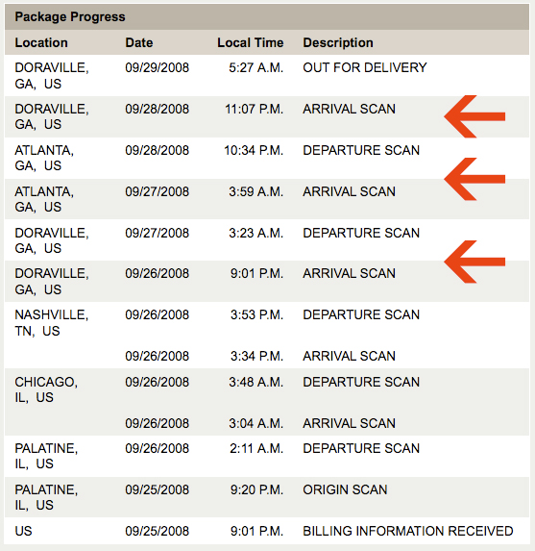

Cold Data
Records accessed infrequently in OLTP setting
May have become irrelevant to workload
Time-correlated and natural skew in real workloads
UPS packages
Some users more active than others

Slide 3
Cold Data (2)
Do we need to keep cold data in memory?
High-density DRAM comes at a large premium
The N-Minute Rule for modern hardware prices
Record Size | Store on Flash After
200 Bytes | 60 Minutes
1 KB | 11.6 Minutes
2KB | 5.8 Minutes
4KB | 2.9 Minutes
Notes:
- Use half for text, half for figures(X)

Slide 4

Microsoft SQL Server “Hekaton”
Main-memory optimized database engine targeting OLTP workloads
Designed for high-levels of concurrency
Multi-version optimistic concurrency control
Latch-free data structures
Record-centric data organization
No page-based organization
Oblivious to OS memory pages

Slide 5
Motivation
First step in managing cold data is identifying it
Why not caching?
No page-based organization to exploit
Only record granularity
Space overhead
Cache techniques requires per-item statistics
Overhead on critical path
Cache techniques require book-keeping on critical path
Queue updates introduce 25% overhead in our system
No need to meet a hard deadline
Property we can exploit
Cold data management is a performance/cost optimization
Notes:
- Record-based organization done for performance reasons – no need to swap pages to/from dis

Slide 6
Requirements
Minimize space overhead
Cannot store access statistics on records in the database
8 Bytes * 50B records = 372 GB
Minimize overhead on critical path
Main-memory systems have short critical paths (speed)
Remove hot/cold classification decision from critical path
Notes:
- Minimize CPU overhead → Minimize overhead on critical path (X)
Exploit no hard deadlines (talk about it when first introducing the property on previous slide) (X)
Remove “classification” (X)

Slide 7
Outline
Overview of approach
Siberia
Logging and Sampling
Exponential smoothing
Classification Algorithms
Performance
Conclusion

Slide 8
Siberia: Cold Data Management
Project studying cold data management in Hekaton
1. Cold data classification (this talk)
Index Cursor
3. Cold data access and migration
Access log
Offline analysis
Cold record cache
Scanner
Hot index scanner
Cold index scanner
4. Cold storage
access reduction
Access filters
Update memo
Memory
(hot storage)
Siberia
(cold storage)
2. Storage techniques
Periodic migration
Notes:
Siberia: point is to make engine user oblvious to cold data
“Automatical” migration and management of cold data

Slide 9
Logging and Sampling
<t₁>
RID2
RID6
RID3
<t₂>
RID1
RID4
RID2
<t₃>
RID1
RID5
Log record accesses
Accesses can be batched and written asynchronously
Write only a sample of record accesses to the log
Sampling minimizes overhead on the critical path
Analyze log to classify hot and cold records
Can be done periodically
Classification can be moved to separate machine if necessary
Notes:
Log accesses delineated by time slice
Sampling by flipping a biased coin

Slide 10

Exponential Smoothing
Used to estimate access frequencies
$$w\left(t_{k}\right)= α∗x_{t_{k}}+\left(1−α\right)∗w(t_{k−1})$$
W(t_{k}): Score at time t_{k}
X_{tk}: observed value at time t_{k}
α : decay constant
In our scenario, x_{tk} = 1 if observed, 0 otherwise
Example timeline for single record:
0
1
0
0
1
1
t_{B}=t₁
t₂
t₃
. . . .
t_{n}=t_{E}
Notes:
Talking points:
Exponential smoothing is widely used classification and forecasting technique (control systems, finance)
We are concerned with using ES efficiently, we are not inventing it

Slide 11
Exponential Smoothing (2)
Chosen due to simplicity and high accuracy
Advantages over well-known caching policies
Works very well with sampling
Lower is better
Vs. Well-known Caching Techniques
Notes:
talking points:
- Analysis of standard error and probability distribution of for LRU-k vs exponential smoothing in the paper.

Slide 12
Outline
Overview of approach
Classification Algorithms
Forward approach
Backward approach
Performance
Conclusion

Slide 13
Classification Algorithms
All of our classification algorithms take the same input and produce the same output
Input
Log of sampled record accesses
Parameter K, signifying number of “hot” records
Output
K “hot” record Ids
All approaches use exponential smoothing
Notes:
All our classification algorithms….take the same input (X)

Slide 14
Forward Algorithm
t₁
Record ID | Estimate | Last Access
A | .45 | t₄
G | .98 | t₂
L | .03 | t₇
P | .34 | t₃
Z | .20 | t₈
t_{n}
Forward algorithm
Scan log forward from time t₁ to t_{n}
Upon encountering an access for a record, update its estimate in a hash table
Update estimate as:
Once scan is finished, classify top K records with highest access frequency estimate as hot (the rest as cold)
$$w\left(t_{k}\right)= α∗x_{t_{k}}+w(t_{prev}){(1−α)}^{t_{k}−Last Access}$$

Slide 15
Forward Algorithm in Parallel
Hash partition by record id
Assign a worker thread per partition
Final classification done using estimates from every partition
Partition the log by time
Assign a worker thread to each log segment
Each thread calculates partial estimate for its segment
Segment₁
Segment₂
Segment₃
t₁
t_{n}
t_{a}
t_{b}
Thread₁
Thread₂
Thread₃

Slide 16
Backward Algorithm
Avoid scanning entire log from beginning to end
Algorithm
Scan log backward from time t_{n} to t₁
Sharpen upper and lower bound for record’s final estimate
Ocassionally attempt classification using estimate bounds
Discard records that cannot possibly be in hot set
t₁
t_{n}
Time slice t_{n}:
Time slice t_{n-4}:
K^{th} lower bound
K^{th} lower bound
thrown
out
below threshold,
disregard
Notes:
- Start with “scan log backward” (X)
Use upper and lower bounds → “upper and lower bounds on final estimate” (X)
Update upper/lower → sharpen (X)
Attempt classification based on estimate bounds (X)
At tn-4, move up kth bound physically (X)
Talking points:
Upper bound can only go down
Lower bound can only go up
Kth lower bound threshold can only go up

Slide 17
Calculating Bounds
Upper_{R}(t_{k})
Assume record will be present in every time slice moving back in the log
w_{R}(t_{k})
Lower_{R}(t_{k})
Assume record will not be observed again in the log
For record R at time t_{k}, calculate base estimate as:
Upper bound on final estimate value
Lower bound on final estimate value
$$w_{R}\left(t_{k}\right)= α∗\left(1−α\right)t_{E}−t_{k}+W_{R}(t_{last})$$
t_{last} is timeslice of last observed record access, where t_{last} > t_{k}
$${Upper}_{R}\left(t_{k}\right)=w_{R}\left(t_{k}\right)+ {(1−α)}^{t_{E}−t_{k}+1}$$
$${Lower}_{R}\left(t_{k}\right)=w_{R}\left(t_{k}\right)+ {(1−α)}^{t_{E}−t_{B}+1}$$
Notes:
Assume record will be present in every time slice

Slide 18
Backward Algorithm in Parallel
Partition log into N pieces using hash function on record id
Log
Hash
Function
….
Log₁
Log₂
Log_{N}

Slide 19
Phase I: Initialization
Coordinator Thread
K=9
Thread₁
Thread₂
Thread₃
Log₁
Log₂
Log_{N}
N worker thread and one coordinator thread
Each worker reads back in log segment to find all records in contention for local top K/N
Each worker may read back different lengths

Slide 20
Phase I: Initialization (2)
Global Statistics
Threshold | .6 - .8
Upper | 21
Lower | 9
Coordinator Thread
Thresh: 0.7
Upper: 6
Lower: 3
Thresh: 0.6
Upper: 7
Lower: 3
Thresh: 0.8
Upper: 8
Lower: 3
Thread₁
Thread₂
Thread₃
0.8
0.7
0.6
Each worker thread reports only three values:
Its local K/Nth threshold value
Upper bound: number of records that are in contention to be in top K/N records
Lower bound: minimum number of records that can be in top K/N records

Slide 21
Phase II: Threshold Search
Final “global” threshold that renders at least K records is between high and low thresholds initialization phase
Controller’s job is to find this final global threshold
Basic idea:
Iterate, choosing new candidate threshold
Polls workers for upper and lower counts for the threshold
Can also ask workers to sharpen bounds for frequency estimates
Details in the paper

Slide 22
Tighten Bounds Operation
Global Statistics
Threshold | .6 - .8
Upper | 21
Lower | 9
Coordinator
TightenBounds
TightenBounds
TightenBounds
Thread₁
Thread₂
Thread₃
Tighten Bounds
Each worker reads backward in log and sharpens estimates for its records
Paper describes details of how far back a worker must read

Slide 23
Report Count Operation
Global Statistics
Threshold | 0.75
Upper | 9
Lower | 6
Coordinator
ReportCounts(0.75)
ReportCounts(0.75)
ReportCounts(0.75)
Upper: 3
Lower: 2
Upper: 2
Lower: 1
Upper: 4
Lower: 3
Thread₁
Thread₂
Thread₃
0.75
Workers calculate upper and lower counts given a threshold value from the coordinator

Slide 24
Phase III: Merge and Report
Global Statistics
Threshold | 0.725
Upper | 9
Lower | 9
Coordinator
{r3, r9, r18}
{r4, r8}
{r17, r20, r32, r70}
Thread₁
Thread₂
Thread₃
r17
r20
r3
r9
r4
r18
r8
r32
r70
0.725
Workers report the ids of all records with lower bounds above threshold

Slide 25
Outline
Overview of approach
Classification Algorithms
Performance
Setup
Wall Clock Time
Space Overhead
Conclusion

Slide 26
Experiment Setup
Workstation-class machine
HP Z400 with Xeon W3550 @ 3 GHz
1 Million Records
1 Billion Accesses
Three access distributions:
Zipf
TPC-E non-uniform random
Uniform random
Eight worker threads used for parallel versions

Slide 27
Wall Clock Time
Classification of 1B Accesses in sub-second times
Notes:
Add bullet about 1B accesses in sub-second times

Slide 28
Space Overhead – Zipf Distribution
6.72
6.72
6.72
6.72
6.72
6.72
6.72
Notes:
Move “baseline” first (color that really stands out), and call it “hot set size” (X)
Forward in one color shade, backward in another color shade (X)

Slide 29
Outline
Overview of approach
Classification Algorithms
Performance
Conclusion

Slide 30
Conclusion
Studied cold data identification in main-memory databases
Cold Data Classification Framework
Microsoft SQL Server Hekaton
No page-based organization
Logging and Sampling Record Accesses
Classification Algorithms
Forward approach
Backward approach
Great Performance
Consistent sub-second classification times for best algorithms
Close to optimal space overhead in practice
Part of Project Siberia
Stay tuned!

Slide 31
Questions?

Slide 32
Tighten Bounds Details
How far to read back?
During every count, remember minimum overlap value from all records straddling the threshold.
Minimum overlap
Bring upper/lower range of all records to value of minimum overlap
Intuition: if bounds are tightened to size of minimum overlap, overall overlap between records should be sufficiently small

Slide 33






Tighten Bounds Details
How far do we read back in the log to tighten bound to given value M?
Recall bounds are calculated as follows:
U$={(1−α)}^{t_{E}−t_{k}+1}$
$$w_{R}\left(t_{k}\right)= α∗\left(1−α\right)t_{E}−t_{k}+W_{R}(t_{last})$$
$$L={(1−α)}^{t_{E}−t_{B}+1}$$
Need to read back to a time slice t_{k} such that:
${(1−α)}^{t_{E}−t_{k}+1 }$ < $w_{R}\left(t_{k}\right)$ - L
Solving for t_{k} gives us:
${(1−α)}^{t_{E}−t_{k}+1 }$ = $X$
$t_{k}= t_{E}+1 − \log_{\left(1−∞\right)}(X)$

Slide 34
Backward Parallel: Three Phases
Phase I: Initialization
Goal: find an initial set of candidates and gather their statistics for defining a beginning search space
Phase II: Threshold Search
Goal: find a suitable threshold estimate value that will yield at least K records (can be within a tolerable error)
Phase III: Merge and Report
Goal: retrieve hot record ids from each worker thread and merge, creating the hot set.
Notes:
Phase 1: find initial set of candidates and their statistics for defining a starting search space
Phase 2: yield “at least” K records

Slide 35
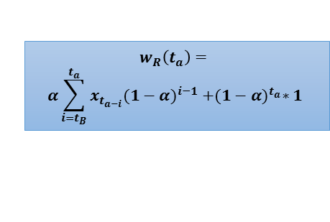
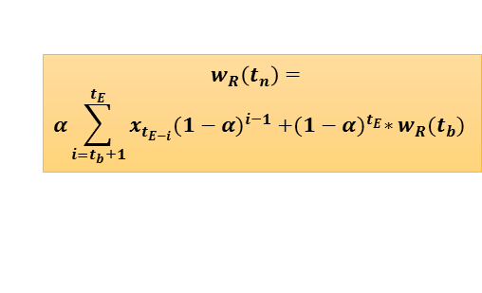
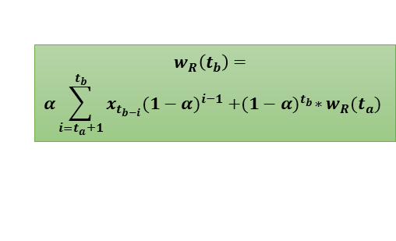
Forward Algorithm in Parallel (2)
Each segment for an estimate calculated independently
Only last term in each segment relies on score from previous piece
Piece₁
Piece₂
Piece₃
t₁
t_{n}
$$w_{R}\left(t_{a}\right)=$$
$$α\sum_{i=t_{B}}^{t_{a}}{x_{t_{a−i}}{(1−α)}^{i−1} +{(1−α)}^{t_{a}}∗1}$$
t_{a}
$$w_{R}\left(t_{b}\right)=$$
$$α\sum_{i=t_{a}+1}^{t_{b}}{x_{t_{b−i}}{(1−α)}^{i−1} +{(1−α)}^{t_{b}}∗w_{R}(t_{a})}$$
$$w_{R}\left(t_{n}\right)=$$
$$α\sum_{i=t_{b}+1}^{t_{E}}{x_{t_{E−i}}{(1−α)}^{i−1} +{(1−α)}^{t_{E}}∗w_{R}(t_{b})}$$
t_{b}
Final aggregation step sums results of each piece

