Slide 1
Toward Context and Preference-Aware Location-based Services
Mohamed Mokbel
Justin Levandoski
MobiDE 2009

Slide 2
Location-Based Research at UMN
M. F. Mokbel, et al. "Towards Scalable Location-aware Services: Requirements and Research Issues". In ACM GIS 2003.
M. F. Mokbel, et al. "SINA: Scalable Incremental Processing of Continuous Queries in Spatio-temporal Databases". In ACM SIGMOD 2004.
M. F. Mokbel, et al. " PLACE: A Query Processor for Handling Real-time Spatio-temporal Data Streams“ (Demo). In VLDB 2004.
M. F. Mokbel. "Towards Privacy-Aware Location-Based Database Servers". In PDM 2006 (co-located with ICDE 2006).
M. F. Mokbel, C.Y. Chow and W. G. Aref. "The New Casper: Query Processing for Location Services without Compromising Privacy". In VLDB 2006.
M. F. Mokbel, C.Y. Chow and W. G. Aref. "The New Casper: A Privacy-Aware Location-Based Database Server“ (Demo). In ICDE 2007.
M. F. Mokbel and J. J. Levandoski. "Toward Context and Preference-Aware Location-based Database Systems". In MobiDE 2009.
Papers and Demo under submission…
189 Citations
139 Citations
Notes:
Would like to cover background on location-based research by members of the UMN data management group
As we can see, the previous work has received a high number of citations in a relatively short amount of time.
With this work, we hope to raise a new set of challenges and research directions dealing with embedding context and preference in location-based services (and in a more general sense, databases)

Slide 3
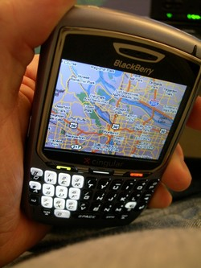
The Problem at Hand
Consider a location-based restaurant finder
Issue a simple query: “Find me a restaurant for dinner”

Slide 4
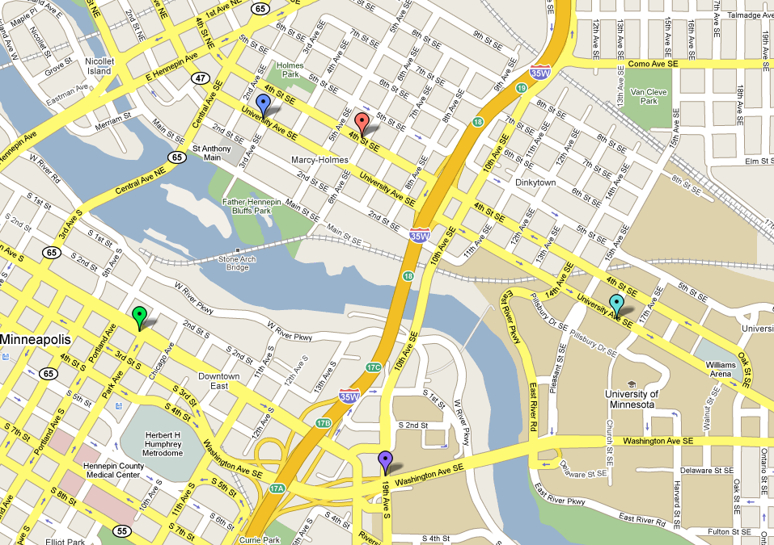
The Problem at Hand
Existing location-based services return k nearest restaurants
1.5 hour wait
Does not meet my dietary restriction
Way too expensive
Traffic accident, drive time extended by 20 minutes
Closed

Slide 5
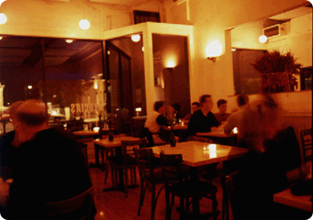
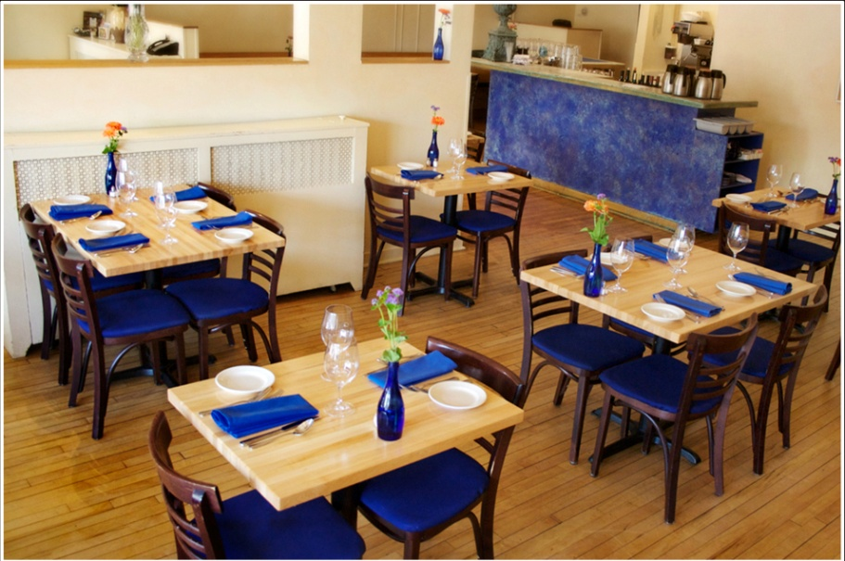
The Problem at Hand
Obviously, the five restaurants are not useful answers
Why? Application/database detached from:
My personal preferences (dietary restrictions, budget)
Extra contextual data (time of day, traffic, waiting times)
Not only location-based databases suffer from this problem
Notes:
Taken together, the concept of preference and context in query processing pose interesting systems challenges.
One solution to this problem is to just build a context + preference-aware restaurant application (fairly easy to do).
-The big drawback: applications built per domain.
-Must worry about how preference evaluation is performed, and what preference method to use
Our proposal: let’s use a database
-Push concept of context+preference query evaluation into the database
-All classic arguments apply:
-abstraction from the application level.
-Give the database preference profile and preference evaluation method, it does the rest
-layers above know the semantics, but not the specifics of how the query is evaluated
As far as we know, no other work has addressed the wealth of systems related research problems in embedding a wide array of preference and context evalution methods inside a database.

Slide 6
Our Proposal
CareDB
A database that is aware of user preferences and surrounding contextual information, and uses this information to give personalized query answers to the user.

Slide 7
Outline
CareDB Architecture
Challenges and Research Directions
Multi-objective preference query processing
Context-aware query processing
Context + preference-aware operators
Continuous queries
Notes:
By no means a comprehensive list of challenges/directions, but these points illustrate what we see as the most important.

Slide 8
Outline
CareDB Architecture
Challenges and Research Directions
Multi-objective preference query processing
Context-aware query processing
Context + preference-aware operators
Continuous queries

Slide 9
CareDB Architecture
User₁
User₂
User_{n}
Environment
Context
. . .
. . .
Preference/Context-Aware
Query Processing and Optimization
Query
Building
User
Queries
Query
Answer
. . .
. . .
Data₁
Data₂
Data_{n}

Slide 10
Context + Preference
“Any information that can be used to characterize the situation of an entity”
User Context
Specific to a CareDB user
Example: User Location, User Status
Environmental Context
Third-party data characterizing environment in which user moves
Example: Traffic, Road Network, Weather
“Database Context”
Some data stored locally
Other data may be dynamic, or come from third party
Example: Restaurant waiting times
Example: Restaurant reviews from www.yelp.com
User Preferences
Examples: maximize restaurant rating, price around $20,
minimize travel time
Manually or automatically generated
Notes:
Our definition of context differs slightly than some related work in the field.
Preferences:
-Trying to be “model independent”, we want to focus more on the systems issues
-We have seen many models in the literature that will work

Slide 11
Context + Preference Model
User Query
User Preferences
Context
Information
Query Building
Enhanced User Query
(Pref + Context)
Query Evaluation

Slide 12
Outline
CareDB Architecture
Challenges and Research Directions
Multi-objective preference query processing
Context-aware query processing
Context + preference-aware operators
Continuous queries

Slide 13
Preference Query Processing Goals
Given a user preference profile
Each preference = an objective
Multiple objectives to fulfill
Many methods are available to evaluate query
Top-k
Skyline (and variants)
Top-k dominating
Which evaluation method should we use?

Slide 14
Preference Query Processing
Two extremes for multi-objective preferences
Skylines
Top-K
ID | Price | Distance
R1 | 1 | 10
R2 | 5 | 9
R3 | 2 | 5
R4 | 3 | 7
R5 | 7 | 2
R6 | 9 | 1
R7 | 8 | 4
ID | F(price + dist)
R1 | 11
R2 | 14
R3 | 7
R4 | 10
R5 | 9
R6 | 10
R7 | 12
R1
R2
Distance
R4
R3
R7
R5
R6
Price

Slide 15
Preference Query Processing
Many other methods available
Top-K
K-Frequency
K-Dominance
Skylines
Top-k Domination
Known in DBMS research
Other approaches are applicable
GroupLens Collaborative Filtering
Item-Item Collaborative Filtering
Recommender systems approaches
Can we support all of these comprehensively in a system?
Notes:
Two-pronged research approach
-Design “new” preference evaluation methods/adapt other relevant methods to databases
-Think about how a database will support these methods
-Have to start thinking about operators and query processor design

Slide 16
Outline
CareDB Architecture
Challenges and Research Directions
Multi-objective preference query processing
Context-aware query processing
Context + preference-aware operators
Continuous queries

Slide 17
Context-Aware Query Processing Goals
Contextual data = expensive to derive
Optimize query processing around expensive attributes

Slide 18



Context-Aware Query Processing
Contextual data
Most likely from third party
Makes applications interesting and useful
All this data is available: use it – do not re-invent the wheel
CareDB

Slide 19
Context-Aware Query Processing
Query Answer
Preference Evaluation
Expensive Contextual Data (Third-party)
Local
Data
Cost model changes
Local data cheap to process relative to third-party data
Optimize to request the least amount data from third-party
Notes:
Important point: must think about how to do this while supporting a wide array of preference methods…

Slide 20
Outline
CareDB Architecture
Challenges and Research Directions
Multi-objective preference query processing
Context-aware query processing
Context + preference-aware operators
Continuous queries

Slide 21
Context + Preference-aware Operators
Provide preference + context query processing support at database core
Inject preference + context into operators
A few examples
Index/Sorted Access
Selection/Aggregation
Join
Answer
Answer
Answer
Index
PrefEval
PrefEval
Join + PrefEval
R
Index
R
Index
S
R
S
Index
T
Notes:
In addition, in location-based systems, likely will involve “range” based on user location.

Slide 22
Context + Preference-aware Operators
One naïve approach to supporting multiple preference evaluation methods
DBMS
Query Processor
Top-K
Selection, Join,…
Skylines
Selection, Join,…
Top-k Domination
Selection, Join,…
K-Dominance
Selection, Join,…
K-Frequency
Selection, Join,…
…

Slide 23
Context + Preference-aware Operators
A better approach (under development)
Generalized preference query processing
Extensible operators that can be customized
Change query processor once
Query Processor
PrefEval
K-Dominance
K-Frequency
Top-k Domination
Top-K
Skylines

Slide 24
Outline
CareDB Architecture
Challenges and Research Directions
Multi-objective preference query processing
Context-aware query processing
Context + preference-aware operators
Continuous queries

Slide 25
Context + Preference-aware Operators
Context + Preference add new dynamic query processing components to location-based services
Traditionally
Now
Change in Location
Change in Location
Change in Environment Context
Change in Data Context
Continuous
Query
Change in Preferences
Continuous
Query
Change in Answer
Change in Answer

Slide 26
Conclusion
Adding preference and context to location-based services leads to more useful systems
Proposed CareDB, a complete system to handle efficient context + preference query processing
Outlined several systems challenges behind CareDB

Slide 27
Location-based Research at UMN
Scalability (2003-2004)
Toward scalable location-based services
[MAH+03]
SINA – SIGMOD ’04
[CITE]
159 Citations
Privacy (2006)
Toward privacy-aware location-based services
[Mok06]
New Casper – VLDB ’06
[CITE]
132 Citations
Preference and Context (2009)
Toward preference and context-aware
location-based services
[ML09]
Paper and demo under submission…

Slide 28
User Preference Profile – One Solution
Attribute | Preference | [Value] | [Importance]
Restaurant.Distance | Lowest
Restaurant.Price | Around | $20
Restaurant.Rating | Highest
Low
High
Low
High
Low
High
Attribute: the data attribute
Preference: user “wish” for that attribute
Value (optional): value for the preference
Importance (optional): allows one to specify importance of the preference
Follows model of Kießling [Kie02]

