Slide 1
Modern Main-Memory Database Systems
Paul Larson | Justin Levandoski Microsoft

Slide 2
Tutorial Overview
Main-memory database research has been going on for a long time
Only recently do we have a number of general-purpose commercial main-memory databases
This tutorial focuses on modern main-memory database design, with examples primarily from:
SQL Server Hekaton
SAP HANA
HyPer
H-Store/VoltDb
Associated survey/book to appear:
Faerber, Kemper, Larson, Levandoski, Neumann, and Pavlo. Modern Main Memory Database Systems in Foundations and Trends in Database Systems.
Ask Questions!

Slide 3
Outline
Introduction
Overview
Historical Overview
Modern Hardware Environment
Issues and Architectural Choices
Data organization
Indexing
Distribution and Clustering
Concurrency control
Durability and recovery
High availability
Query processing and compilation
Supporting operational (real-time) analytics
Research Trends
Non-volatile memory
Hardware transactional memory
Cold-data management
RDMA/Fast networks
Time Permitting
Other systems
Longer historical overview

Slide 4
Historical Overview
Summary of previous research in main-memory database systems

Slide 5
Historical Overview: 1984 - 1994
Assume buffer pool fits in memory
Group commit/fast commit optimizations from University of Wisconsin
IMS Fastpath memory-resident optimizations
Direct memory access to records
Main-memory optimized indexing methods (T-Trees)
Durability and recovery
Functional partitioning of engine into runtime processor and recovery processor
Redo-only logging: avoid space overhead for undo bytes
Partitioned main-memory databases (PRISMA)
Concurrency
Course-grained locking

Slide 6
Historical Overview: 1994 - 2005
Commercial systems targeting specialized workloads (e.g., telecom)
Dali from Bell Labs, later DataBlitz
ClustRa
HP Smallbase, later TimesTen
Multi-core optimizations
P*-Time
Lock-free implementation techniques

Slide 7


Previous Techniques in the Modern Era (Spoiler Alert)
Direct memory pointers vs buffer pool indirection (e.g., MM-DBMS)
Modern systems avoid page based indirection for performance reasons
Data partitioning
Some modern systems like H-Store/VoltDB choose to partition the database (e.g., across cores, machines)
Lock-free (as much as possible), cache-conscious data structures
Coarse-grain locking (e.g., Starburst Memory Resident Storage)
Possibly OK on early systems due to few cores
Not used today due to bottlenecks with raw parallelism on modern machines (as we will see)
Lock-based concurrency control is in fact rare in modern systems
Functional partitioning (e.g., MARS, System M, TPK)
Functional handoff between threads (input, output, recovery duties, durability) is not done in (most)modern systems

Slide 8
The Modern Hardware Environment
Hardware trends that enable the modern breed of main-memory database systems

Slide 9
RAM Prices
RAM prices have made a precipitous fall since the previous era of main-memory database systems
2015 average price per GB of RAM: $4.37
http://www.statisticbrain.com/average-historic-price-of-ram/

Slide 10
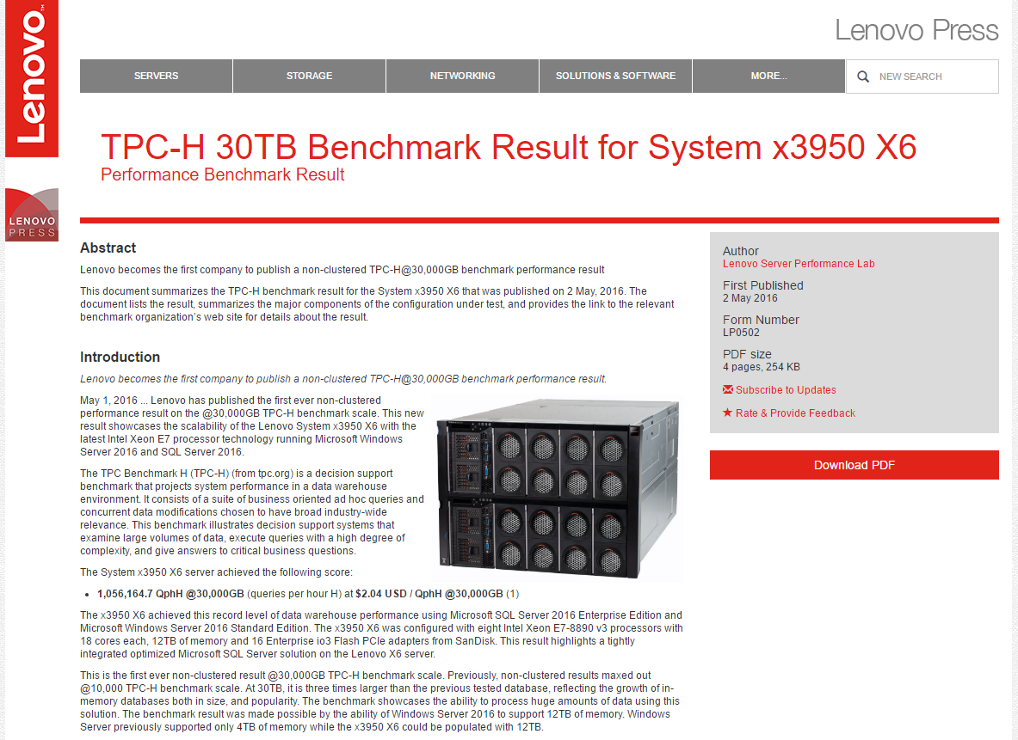
RAM Sizes
Servers can be configured with up to 12TB of RAM
Lenovo System x3950 X6
Non-clustered TPC-H@30,000GB w/ SQL Server
12TB of RAM
144 processor cores
This size can accommodate most OLTP databases
https://lenovopress.com/lp0502-x3950-x6-tpch-30tb-benchmark-result-2016-05-02

Slide 11
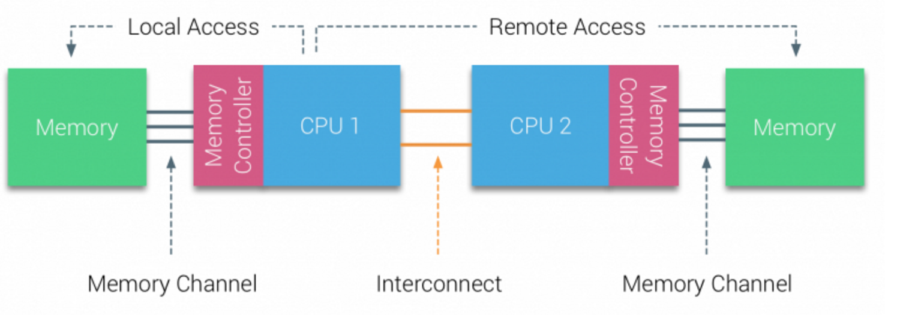
Multi-Core CPUs
Staggering amount of raw parallelism in modern CPUs
Multi-core CPUs
Clock speeds have stopped increasing; each generation of CPU increases parallelism on a chip
Intel Xeon E5-2699 v3 supplies 18 cores (36 hardware threads)
AMD's upcoming Zen chip is rumored to go up to 32 cores
Multi-socket machines
Multiple multi-core CPUs within a single machine adds even more parallelism
These machines display NUMA behavior
Separate memory/cache for each processor
Processor can access memory from another processor through interconnect (e.g., Intel QPI)
Memory access is non-uniform: accessing local memory is faster than accessing remote memory

Slide 12
Main-Memory Optimizations
Where are the optimization opportunities in main-memory database systems?
Remove overheads of
Buffer pool
Lock manager
Making progress in eliminating runtime recovery overhead
Records live in memory, but still need to log to Disk/SSD
NVRAM will help greatly (more later)
Aggressive compilation
All transactions/queries compiled to byte code; no interpretation
Scalable high-performance indexing methods
Latch-freedom coupled with memory-optimized layout
OLTP Through the Looking Glass, and What we Found There
SIGMOD, pp. 981-992, 2008

Slide 13
Data Organization

Slide 14
Disk-Based Relational System
Classical disk-based relational systems page data to and from disk on demand
Pages are fixed-size blocks (e.g., 8KB)
Storage engine manages buffer pool
Page frames are in-memory representation of page
Hash table maps page id to location in pool
If page is not in memory, disk I/O needed to populate a target page frame
Elegant solution for abstracting disk away from other layers of the database stack
Too much overhead for main-memory systems
Frame₁
Frame₂
Frame₃
Frame₄
Frame₅
Frame₆
Hash table
Frame₇
Frame₈
Frame₉
Pages on disk
Buffer pool with page frames

Slide 15
Main-Memory Database Systems
Data lives in RAM in main-memory databases; no need to page from disk
Modern systems avoid page indirection through buffer pool
Avoid logical record identifiers: (page id, offset)
Common practice to use in-memory pointers for direct record access
Can result in order of magnitude performance improvements
Avoids page-based indirection to resolve record pointer
Avoids page latch overhead

Slide 16
Avoiding Page Indirection
record*
Classic relational architectures require two layers of indirection to resolve pointer to record
Hash table access to resolve page frame in buffer pool
Calculate pointer to record using offset within page
No indirection in modern main-memory systems
Internal structures like indexes store memory pointers
Early experimental evaluation from the Starburst main-memory project revealed order or magnitude performance improvement by removing buffer pool
key, page-id
key, page-id
page-id
record
B-tree node
hash table
page frame
key, record*
key, record*
record
B-tree node

Slide 17


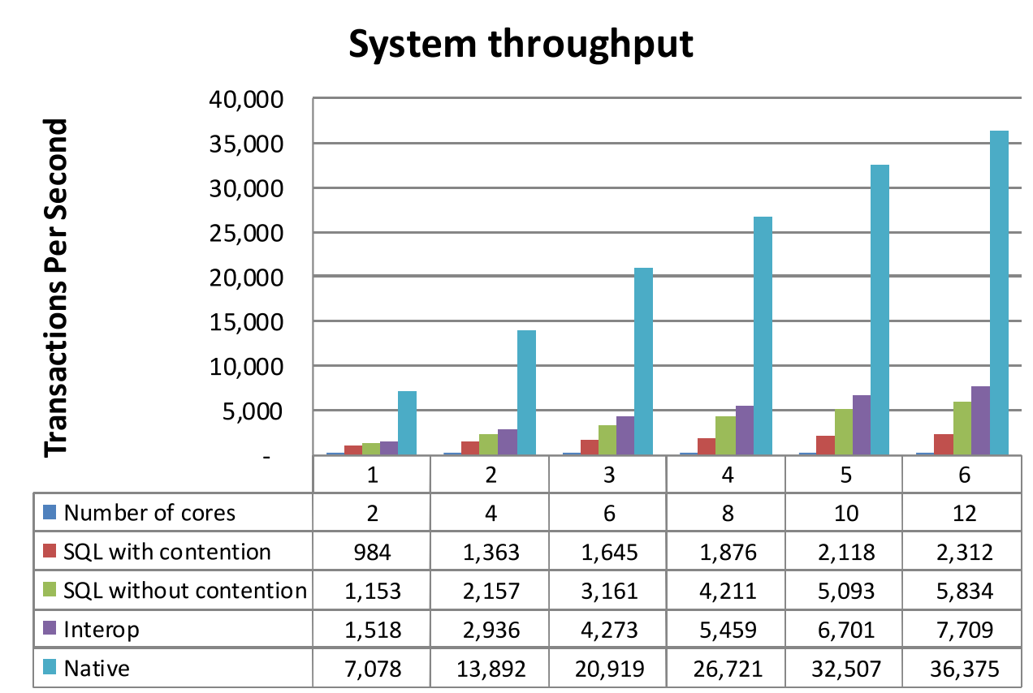
Avoiding Page Latching
Accessing a page in a classical database design requires latch on page frame
Readers: shared latch
Writers: update latch (possibly exclusive)
Latching leads to overhead for main-memory data
Internal manipulation of latch requires atomic operation
Shared read latch: update of reference count
Update latch: variable to mark exclusion
Commercial systems have several latch types, so thread could end up acquiring several latches!
Most commercial systems use partitioned latches to help situation (does not completely overcome the bottleneck)
SQL Server Hekaton achieves a 15.7x performance boost
Hekaton is a completely latch-free design
Scalability of classic engine limited by latch overhead
atomic_cas(latch)
update
read
update
atomic_increment(readers)
read
buffer pool

Slide 18
Organization Choices
Partitioning
Partitioned systems: Disjoint partitioning of the database, assign partition to node, core, etc.
Simple per-node implementation (serial execution, no concurrent data structures)
Partition management burden: rebalance for hotspots
Non-partitioned systems: Any thread/core can access any record in the database
Self-balancing system: no need to worry about partition management
Increased implementation complexity (e.g., concurrent data structures)
Multi-Versioning
Allows for high concurrency; important in multi-core environments
Readers allow to execute uncontested, do not block writers
Row/Columnar Layout
Reasonable OLTP performance on in-memory columnar layout; not true for disk-based column stores

Slide 19
Organization Choices
 | Partitioned | Multi-Versioned | Row/Columnar
Hekaton | No | Yes | Row
HyPer | No | Yes | Hybrid
SAP HANA | No | Yes | Hybrid
H-Store/VoltDB | Yes | No | Row

Slide 20
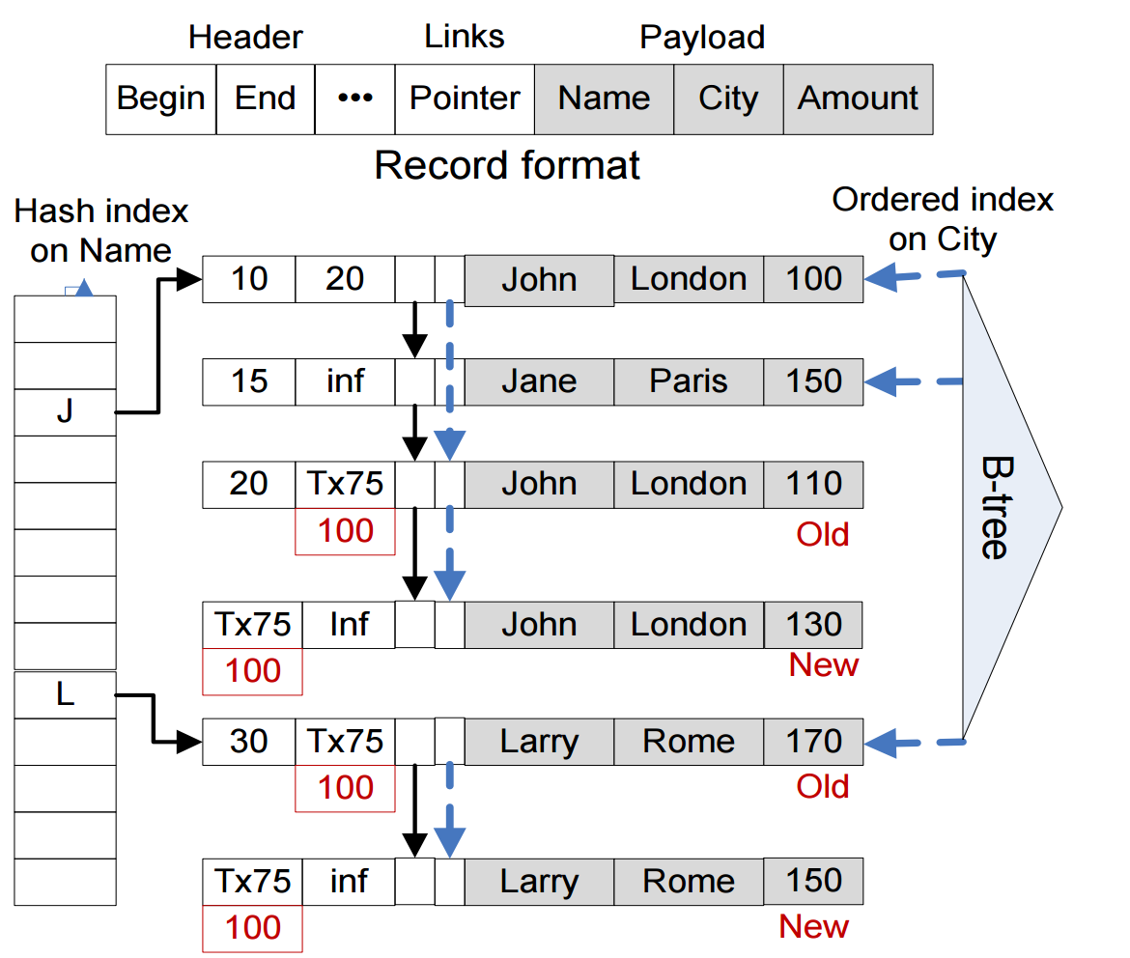
Hekaton
Non-partitioned system
Any thread can access any record
Entirely lock-free engine implementation for thread-safety
Multi-versioned
Records have begin and end timestamps
Timestamps define record visibility for concurrency control
Row-oriented
Records in memory with no clustering, etc.
Up to 8 hash or range indexes can be built over records
Records contain a number of pointer link fields to manager overflow/duplicate chains within indexes (more later)
Begin
time
End
time
Hekaton: SQL server's memory-optimized OLTP engine
SIGMOD, pp. 1243-1254, 2013

Slide 21
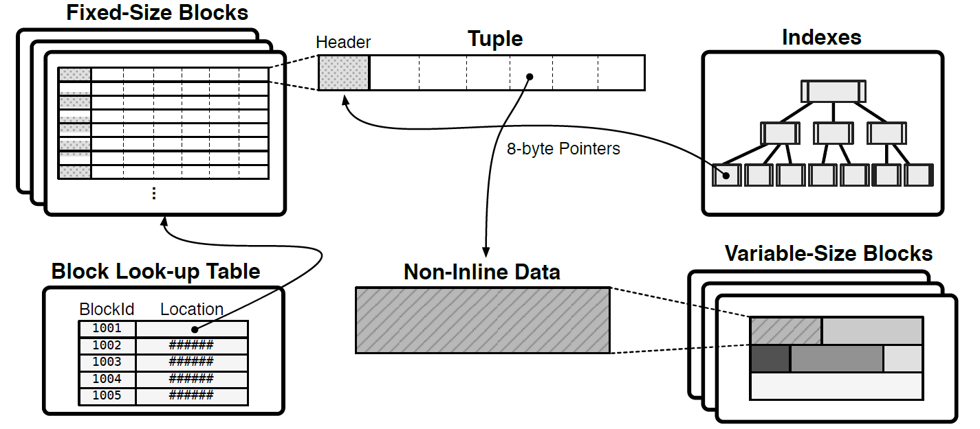
H-Store/VoltDB
Partitioned system
Distributes data across compute nodes (or cores) in shared-nothing configuration
Serial execution at partitions: avoids concurrency control and find-grained locks
Two-tiered architecture
Transaction coordinator
Execution engine: data storage, indexing, and transaction execution.
Single-version Row Store
Execution engines maintain single version of records (snapshots supported)
Storage divided into pools for fixed-size and variable-size blocks, with fixed-pool as primary storage
All tuples are fixed size (per table) to ensure they remain byte-aligned
Fields larger than 8-bytes stored as variable-length blocks, all other fields stored inline in tuple (1 byte for snapshotting)
Lookup table translates block id (4 bytes) to physical location (8 bytes), allows engine to address blocks using 4 bytes.

Slide 22
HyPer (2011)
Partitioned System
Database partitioned across cores in shared-nothing configuration
Serial execution of transactions within a partition
Single versioned
OLTP workloads work on single-version database
OLAP queries run over virtual memory snapshot using fork
Forked snapshot taken between transaction for consistency
Row and Column support
HyPer can be configured as either a row or column store
Initial implementation reported numbers as a pure column store
OLTP Transactions
single-threaded execution within partition
VM
Snapshot
Partition 1
Partition 2
Partition 3
VM
Snapshot
HyPer: A Hybrid OLTP&OLAP Main Memory Database System based on Virtual Memory Snapshots
ICDE, pp. 195-206, 2011
OLAP Queries
OLAP Queries

Slide 23
HyPer (current)
Not partitioned
Any transaction can touch any record due to changes in concurrency control
Versioned
OLAP queries still run over virtual memory snapshots
Support transient per-record undo buffers to support multiple versions for concurrency control (more on concurrency later)
Hybrid row/column layout
HyPer explored a hybrid record layout that clustered frequently-accessed columns together
Most commonly configured as a column store in most experiments
Name
Col
Balance
Col
Version Vector
Ada
10
Undo Buffer
Bob
60
100,Bal, 70
Cid
25
Dan
60
Etta
30
Fran
10
Gene
25
Hoss
20
Ivan
35
105,Bal, 45
105,Bal, 40
Jill
20
Undo Buffer
Kent
25
Larry
5
Fast Serializable Multi-Version Concurrency Control for Main-Memory Database Systems
SIGMOD, pp. 677-689, 2015

Slide 24
HyPer Data Blocks
Immutable cold data storage
Only deletes are possible with tombstones
OLTP and OLAP friendly
Occasional point lookup for OLTP
Mostly OLAP scans
Features
Min/Max per attribute for skipping during scans
SARGable evaluation on compressed data using SIMD
Positional small materialization aggregates (SMAs) serve as lightweight index to find ranges within block
Integrated with JIT-compiled query pipeline
Min₀
Max₀
Positional SMA₀ (lightweight index)
Dictionary₀
Compressed Data₀
String Data₀
Min₁
Max₁
Positional SMA₁ (lightweight index)
Dictionary₁
Compressed Data₁
String Data₁
Data Blocks: Hybrid OLTP and OLAP on Compressed Storage using both Vectorization and Compilation
SIGMOD, pp. 311-326, 2016
…

Slide 25
SAP HANA
Not partitioned
Any thread can access any record
Versioned
Internally, records go through lifetime management (row-to-column)
Versioning persists throughout entire lifetime
Hybrid storage format
Three stages of physical record representation
L1-Delta: Write-optimized row format, no data compression (10K to 100K rows per node)
L2-Delta: Column format, unsorted dictionary encoding (~10M rows)
Main: Column format, highly compressed and sorted dictionary encoding
More on conversion/merge steps in hybrid OLTP/OLAP section
Unified Table
L1-Delta
Row Store
L2-Delta
Column Store
Main
Column Store
Write
Optimized
Read
Optimized
Efficient Transaction Processing in SAP HANA Database: the End of a Column Store Myth
SIGMOD, pp. 731-742, 2012

Slide 26
Indexing

Slide 27
Overview
Cache-awareness
Since the mid-90’s CPU and RAM speed gap has been an issue
Indexing techniques created to keep as much data in CPU cache as possible
Still relevant today
Multi-core and multi-socket parallelism
Modern multi-core machines have massive amount of raw parallelism
Current focus is to enable high performance parallel indexing methods

Slide 28
Indexing on Disk-Based Systems
B+-Tree access method ubiquitous across systems
In general, we will focus on range-based indexing
Index structure is mapped to database pages
Both internal and leaf nodes in B+-tree are page-based
Internal index nodes
Store search keys and page ids “pointers”
Traversal requires search then buffer pool indirection to access next page (repeat)
Leaf nodes
Store keys and (a) inline payloads or (b) record ids
If record ids, another page access is necessary to retrieve record
Metadata
Slots
#
Side Pointer
pid
Sorted Keys
K1
K2
K3
…
Kn
Buffer Pool
Values
V1
V2
V3
…
Vn

Slide 29
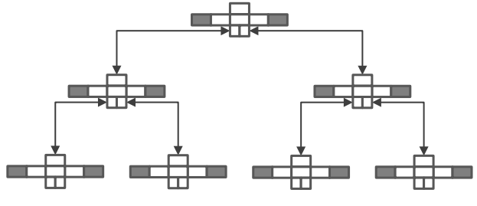
T-Trees: Space Savings in a Main-Memory Environment
Index in the MM-DBMS project at U. Wisconsin (1986)
Based on AVL tree; nodes store record pointers, sorted by key value for that node
Comparison/search requires pointer dereference to retrieve full key
Internal nodes index data; similar to B-Tree, not a B+-Tree
Min/Max boundary values define key space for a node
Advantages
Low memory overhead (important in 80s)
Disadvantages
Rebalance, scans, pointer dereference (though less pronounced today due to cpu vs. cache speed of the 80s)
Used in early commercial main-memory systems (e.g, TimesTen)
key space (low → high)
1
2
3
4
5
6
7
4
2
6
1
3
5
7
parent
min
Record pointers
max
A Study of Index Structures for a Main Memory Database Management System
VLDB, pp. 294-303, 1986
Slide material borrowed from A. Pavlo: http://15721.courses.cs.cmu.edu/spring2016/slides/06.pdf

Slide 30
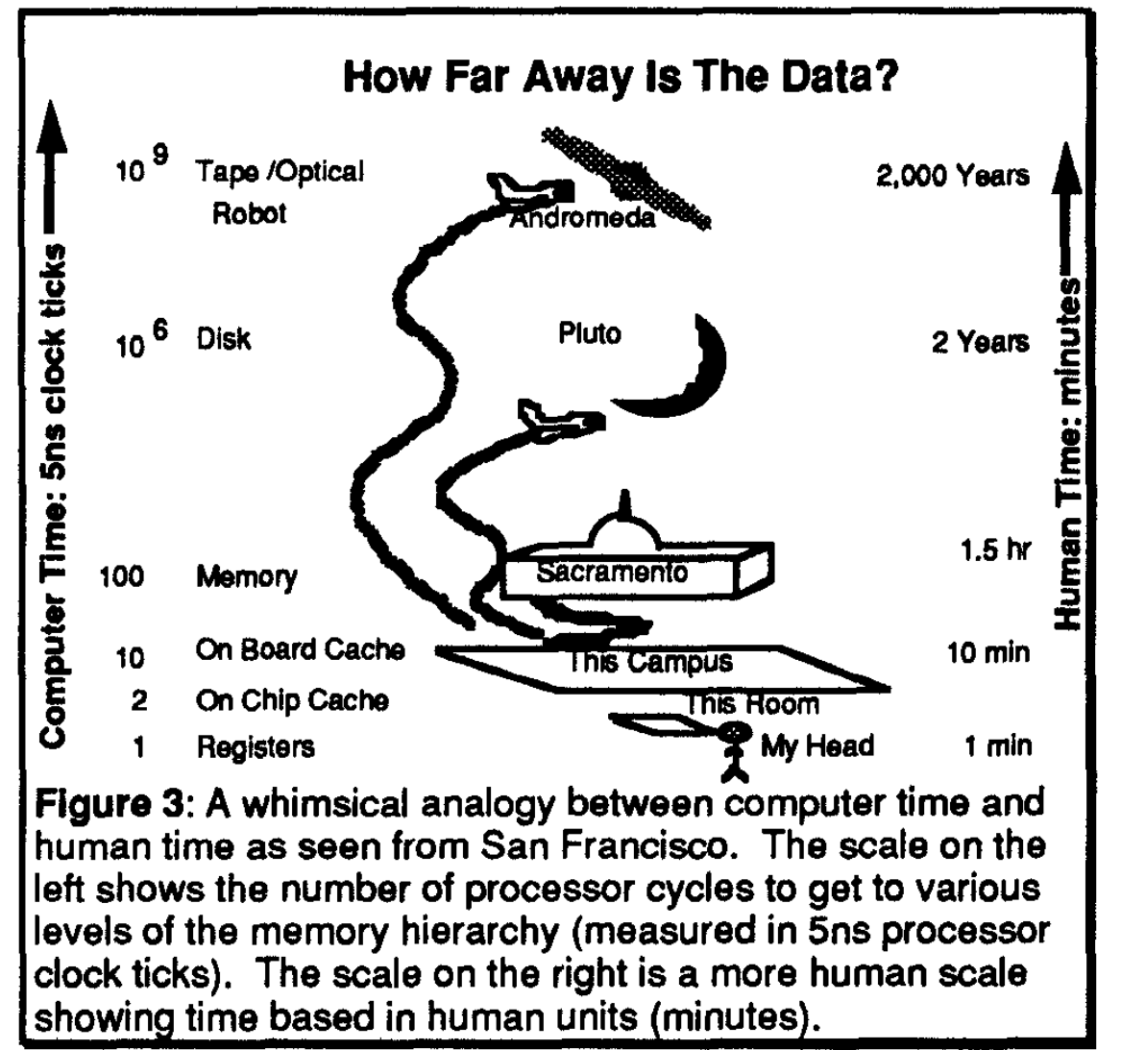
Cache-Awareness
1990s: cache stalls show up as major bottleneck
Significant portion of time going to second-level data cache stalls
First-level instruction cache misses were also a burden
CPU speeds at the time increasing at 60% per year
Memory speeds improving 10% per year
Improvement of cache behavior in database system become a priority (still true)
AlphaSort: A RISC Machine Sort (not indexing, but incredibly illustrative example)
SIGMOD, pp. 233-242, 1994

Slide 31
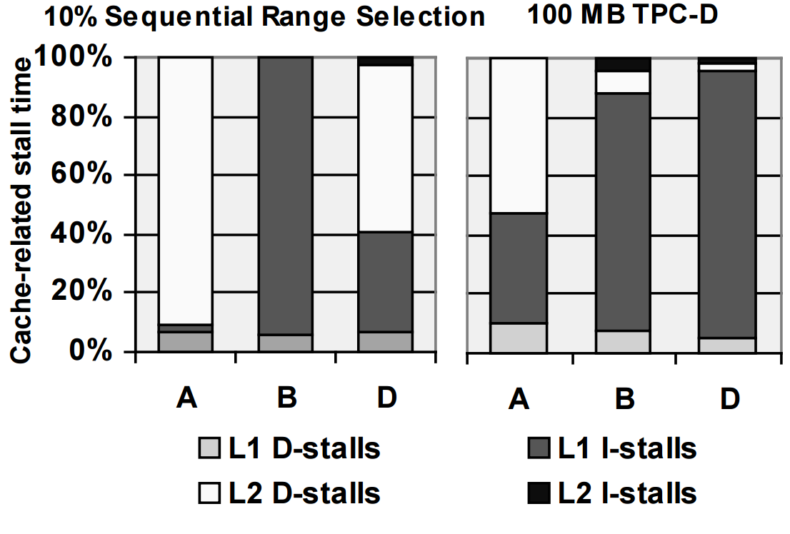
Cache-Awareness
DBMSs on a Modern Processor: Where Does Time Go?
VLDB, pp. 266-277, 1999

Slide 32
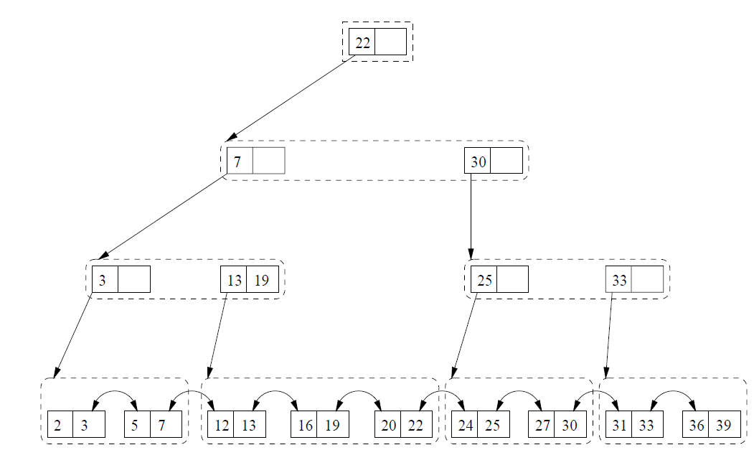
CSB+ and Pb+ Trees
Cache line is the “unit of transfer” in main-memory system
Size B+-tree nodes accordingly
CSB+-Tree
Remove as many B+-tree pointers as possible; use space to pack keys together
All child nodes of a B+-tree parent placed into node group
Parent stores single pointer to node group
Nodes within a node group can be accessed using offset
Pb+-Tree
Explores effect of prefetching on B+-Tree search and scans
Prefetching allows for increased fanout of tree node beyond the “unit of transfer” (cache line in main-memory systems)
Leads to shallower trees and better performance
1.5x improvement for search, 6x improvement for scans
node group
CSB+-Tree
Making B+-Trees Cache Conscious in Main Memory
SIGMOD, pp. 475-486, 2000
Improving Index Performance through Prefetching
SIGMOD, pp. 235-246, 2001

Slide 33
Hekaton: Bw-Tree
B+-Tree range index used in Hekaton
Completely latch-free like the rest of the database engine
Copy-on-write “delta” updates reduce cache invalidation
Uses compare-and-swap atomic operation to change state
Pages are logical; identified by mapping table index
Translates logical page id to memory address
Important for latch-free behavior
Isolates updates to a single page in the index (no pointer propagation)
Address
New Value
M
CompareAndSwap(&M, 20, 40)
30
20
CompareAndSwap(&M, 20, 30)
Compare Value
Mapping
Table
Address
Page A
A
B
Page B
Page C
Logical pointer
The Bw-Tree: A B-Tree for New Hardware Platforms
ICDE, pp. 302-313, 2013
C
Physical pointer

Slide 34
Hekaton: Bw-Tree (2)
Each page update produces a new address in the form of a delta record
Install new page address in mapping table using compare-and-swap
Only one winner on concurrent update to the same address
Eventually install new consolidated page with deltas applied once a threshold has been met
Epoch-based mechanism to enforce stable memory lifetime
Structure modifications also latch-free
Δ: Update record 35
Δ: Insert Record 60
Mapping Table
Address
Δ: Delete record 48
Δ: Insert record 50
P
Page P
Consolidated Page P
The Bw-Tree: A B-Tree for New Hardware Platforms
ICDE, pp. 302-313, 2013

Slide 35
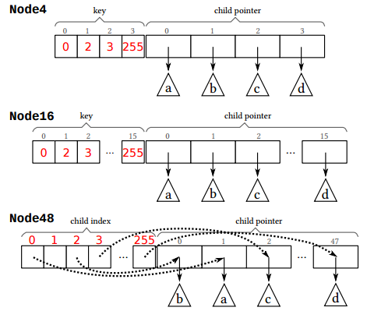
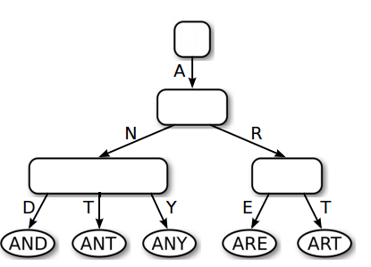
HyPer: ART
Based on radix tree: a trie data structure that store n-ary key chunks
Unlike basic radix tree, ART has an adaptive node structure
Allows for different node sizes within the index
Addresses trade-off between tree height vs. space efficiency of radix tree
Path compression
Collapses nodes with only a single child pointer
Nodes store prefix of key bytes in node header; prefix of length n reduces index height by n levels
Original proposal did not tackle multi-thread concurrency
The Adaptive Radix Tre: ARTful Indexing for Main-Memory Databases
ICDE, pp. 38-49, 2013

Slide 36
HANA P*Time: OLFIT on B+-Trees
P*Time uses a B+-Tree index (hashing supported as well)
OLFIT address index concurrency focusing on CPU cache coherence issues due to latch/lock protocols
Associate latch plus version number with B+-Tree node
B+-Tree node updates
Acquire latch, update content, increment version, unlatch
B+-Tree node reads
Copy version to local register r
Read node content, validate latch is unset and node version is same as local copy, otherwise re-read node
Node splits handled by B-link tree strategy
T1 Cache
T2 Cache
T3 Cache
T4 Cache
N1
N1
N1
N1
N2
N2
N3
N3
N4
N5
N6
N5
N1
N2
N3
N4
N5
N6
N7
Cache-Conscious Concurrency Control of Main-Memory Indexes on Shared-Memory Multiprocessor Systems
VLDB, pp. 181-190, 2001

Slide 37
Skiplists
A linked list of sorted records with “express lanes” built at higher levels to enable fast search
Bottom layer is always a complete list
Key for an item at level i appears at level i+1 with a probability p
Enables (log_{1/p}n)/n search time
Can be made latch-free
Compare-and-swap insert at base linked list
Once successful, build up “tower” at higher levels
Skiplists used in MemSQL database engine
key₂
key₂
key₄
key₁
val
key₂
val
key₃
val
key₄
val

Slide 38
MassTree
Trie of B+-Trees; each layer indexed by 8-byte key slice
Concurrency design leads to high performance on modern hardware
B+-tree nodes versioned
Writer-write coordination: fine-grained spinlock bit in version word
Reader-writer coordination: optimistic concurrency
Writers use aligned writes; mark version word dirty before writing
Reader snapshots version word on node it is reading
Before returning read value, validates whether version is dirty or different from snapshot
Reader retries if validation fails
layer 0
key bytes 0-7
layer 1
key bytes 8-15
Cache Craftiness for Fast Multicore Key-Value Storage
EuroSys, pp. 183-196, 2012
- B+-tree leaf
- records

Slide 39
PLP and PALM: Partitioned Latch-Free Indexing
PLP
Multi-rooted B+-tree partitions key range
Single-threaded execution within partition
Thread given exclusive access to partition
No thread-level concurrency issues within partition
Must deal with hotspots and imbalance
PALM
Latch-free batched B+-Tree design
Read phase performed first
Updates partitioned amongst threads to guarantee no contention and correct ordering of queries in batch
Structure modifications proceed in lock step and redistributed to guarantee single-thread execution
Thread 1
Thread 2
(K₁-K_{m}]
[K_{m} – K_{n}]
N2
N3
N4
N5
N6
N7
PLP: Page Latch-free Shared-everything OLTP
PVLDB 4(10): 610-621, 2011
PALM: Parallel Architecture-Friendly Latch-Free Modifications to B+ Trees on Many-Core Processors
PVLDB 4(11): 795-806, 2011

Slide 40
Distribution and Clustering

Slide 41
Distribution and Clustering
Whether system is designed to run in a distributed manner (or not)
Seamlessly scale-out by adding more machines to the cluster
Influences approaches for achieving high performance
 | Distributed
Hekaton | No*
HyPer | No*
SAP HANA | Yes
H-Store/VoltDB | Yes
*Scale out by routing read-only transactions to secondary replicas

Slide 42



H-Store/VoltDB
Front-end transaction manager coordinating 1 to N back-end query executors that manage disjoint database partition
Horizontal partitioning and distribution of tables
K-way replication of partitions for availability
Transaction sent reliably to all replicas
Transactions processed deterministically in parallel
Secondary-index replication to reduce cross-partition transactions
Heavy-weight partition locks for cross-partition transactions
Transaction Coordinator

Slide 43
SAP HANA
Tables can partition across nodes
Typical setup is one large server for OLTP on hot tables and several (smaller) servers for OLAP on data partitions
Uses distributed locking scheme with global deadlock detection when writes span nodes
Optimized two-phase-commit for cross-node transactions
OLTP
writes
OLAP
High-Performance Transaction Processing in SAP HANA
IEEE Data Engineering Bulletin 36(2):28-33(2013)

Slide 44
HyPer: ScyPer Elastic OLAP
Provides a mechanism to scale-out OLAP queries on HyPer snapshots
Log multi-cast to secondary read-only OLAP nodes
Tested PGM multicast protocol on Infiniband infrastructure
Supports both logical and physical redo log records (no undo)
Distributed snapshots
Supports order-preserving serializability
If Tx preforms update ‘u’ and commits, it will see ‘u’ during later OLAP query
OLAP queries given logical time t (an LSN) by primary, execution at secondary delayed until snapshot with logical time greater than t is available
Avoids diverging distributed reads
Result of same OLAP query run on different node contains results of old Tx state
Solution is to synchronize snapshot creation by propagating fork() system calls in log to secondaries at a given LSN
OLTP
OLAP
snapshots
log
primary
on-demand secondaries
ScyPer: Elastic OLAP Throughput on Transactional Data
DanaC, 2013

Slide 45
Concurrency Control

Slide 46
Main CC approaches (for MM databases)
Multi-version optimistic concurrency control (MVCC)
Multi-versioning: updates create new versions
+ Readers read old versions and never block updaters ➔ higher concurrency
-- Updates more expensive; requires garbage collecting obsolete versions
Optimistic concurrency control
No locks, check for interference with other transactions before committing
+ Much cheaper than traditional locking
+ Scales to high numbers of cores
-- High contention may cause high abort rates
Partitioned serial execution (PSE)
Partition DB by core, execute serially within each partition
+ No locks or validation needed!
+ Very fast for single-partition transactions
-- Multi-partition transactions lock partitions in exclusive mode ==> greatly reduced throughput
-- Unpredictable performance

Slide 47
Hekaton's optimistic MVCC
Txn events
Txn phases
Begin
Get txn read timestamp, set state to Active
Perform normal processing
remember read set, scan set, and write set
Get txn end timestamp, set state to Validating
Validate reads and scans If validation OK, write new versions to log
Set txn state to Committed thereby making changes visible
Fix up version timestamps
Begin TS in new versions, end TS in old versions
Set txn state to Terminated
Remove from transaction map
Normal processing
Precommit
Validation
Commit
Post-processing
Terminate
High-Performance concurrency control mechanisms for main-memory databases
VLDB 2011

Slide 48
Record versions and visibility
Record format
Timestamps
Index ptrs
Name
City
begin
end
Txn 20
H(John)
State = Active
Read TS = 170
Commit TS = ?
•••
T20
∞
John
Madrid
Not visible, ignored
150
T20
John
Rome
Visible if read TS in [150, ∞)
100
150
John
Paris
Visible if read TS in [100, 150)
Hash index on Name

Slide 49
Record versions and visibility
Record format
Timestamps
Index ptrs
Name
City
begin
end
Txn 20
H(John)
Committed
Read TS = 170
Commit TS = 200
•••
T20
∞
John
Madrid
Visible if read TS in [200, ∞)
150
T20
John
Rome
Visible if read TS in [150, 200)
100
150
John
Paris
Visible if read TS in [100, 150)
Hash index on Name

Slide 50
Record versions and visibility
Record format
Timestamps
Index ptrs
Name
City
begin
end
Txn 20
H(John)
Committed
Read TS = 170
Commit TS = 200
•••
200
∞
John
Madrid
Visible if read TS in [200, ∞)
150
200
John
Rome
Visible if read TS in [150, 200)
100
150
John
Paris
Visible if read TS in [100, 150)
Hash index on Name

Slide 51
Transaction validation (Hekaton)
Read stability
Check that each version read remains visible as of the end of the transaction
Phantom avoidance
Repeat each scan checking whether new versions have become visible since the transaction began
Read-only transaction: no validation required
Updated transactions: extent of validation depends on isolation level
Snapshot isolation: no validation required
Repeatable read: read stability
Serializable: read stability, phantom avoidance

Slide 52
When can old versions be discarded?
Txn: Bob transfers $50 to Alice
Transaction object
Old versions
Write set
100
150
Bob
$250
Txn ID: 250
50
150
Alice
$150
End TS: 150
New versions
State: Terminated
150
∞
Bob
$200
150
∞
Alice
$200
Can discard the old versions as soon as the read time of the oldest active transaction is over 150
Old versions easily found – use pointers in write set
Two steps: unhook version from all indexes, release record slot

Slide 53
Hyper’s implementation of MVCC
Three main differences compared with Hekaton’s implementation:
Records are updated in place; older version reached through a linked list
Validation done be checking recent updates against the read predicates of the current transaction
Commit processing currently done serially (get commit timestamp, validation, writing to log).
Fast Serializable Multi-Version Concurrency Control for Main-Memory Databases
SIGMOD 2015

Slide 54
Version storage in Hyper
Accounts
Undo buffers
Transactions
Ada
10
T3
100
Bob->Dan
10
Bob
60
Cid
25
Dan
60
100,Bal, 70
100,Bal, 30
Etta
30
T5
105
Kent->Dan
20
Fran
10
Gene
25
Hoss
20
105,Bal, 45
105,Bal, 40
Ivan
35
Jill
20
Stores old values of updated columns (backwards delta)
Kent
25
Larry
5
Dan’s versions
Version vector
105,---
Dan
60
100,105
Dan
40
---,100
Dan
30

Slide 55
Transaction validation in Hyper
A transaction performs reads as of its start time. If it were to repeat its reads as of its commit time, would it get exactly the same result? If so, the transaction is serializable.
Hyper’s validation approach:
A transaction logs its
Read predicates (point lookup and range scan predicates)
Inserts, deletes, and updates. Updates logged as deltas from which old versions can be constructed.
At commit time, we check all recent updates, inserts, and deletes against the read predicates of the transaction.

Slide 56
High-level validation algorithm
Tv = transaction to be validated
For each transaction Tx whose commit time is between Tv’s start time and commit time do
For every insert, delete, or update done by Tx do
Insert: if the new record satisfies any of Tv’s read predicates, we have a phantom so abort Tv
Delete: if the deleted record satisfies any of Tv’s read predicates, it belonged to Tv’s read set but has now been deleted so abort Tv
Update: if the old or the new version satisfies any of Tv’s read predicates, the update might change Tv’s read result so abort Tv . (Overly conservative but safe – can be refined).
End
End
Note: The actual Hyper implementation has many refinements and optimizations

Slide 57
Concurrency control in HANA
Uses Pessimistic Multi-Versioning (MVCC with row-level write locks)
Used by both the column store and the row store (P*Time)
Rows contain timestamps that determine their visibility
Timestamps are updated lazily after commit
A transaction must acquire a write lock before updating or deleting a row.
The lock is held until the transaction commits or aborts
Deadlock detection is necessary
http://scn.sap.com/docs/DOC-57101

Slide 58
Concurrency control in H-Store/VoltDB
Database partitioned per core with serial execution within a partition
Each partition protected by a single exclusive lock
Before operating on a partition, a transaction must acquire the partition lock
A transaction is aborted when it needs access to a new partition.
It’s restarted when it has acquired locks on the required partitions.
So a transaction may be aborted and restarted multiple times.
Performance:
++ very fast for single-partition transactions
-- slow for multi-partition transactions
-- sensitive to load skew (hotspots)
The VoltDB Main Memory DBMS
IEEE Data Engineering Bulletin, 36(2):21–27, 2013.

Slide 59
Concurrency Control in Silo
Main-memory database from MIT and Harvard designed
To be multicore and NUMA friendly
To avoid all centralized contention points
So readers never write to shared memory
Indexes are a cache-friendly variant of B-trees (Masstree) with versioned nodes
Commit timestamps not drawn from a centralized counter
High-order bits from a slow-moving central counter, low-order bits from a local counter
Single-version optimistic CC with three-phase commit protocol
Phase 1: lock all records in the transaction’s write set (lock bit embedded in record header)
Phase 2: validate reads by checking that record timestamps haven’t changed
Phase 3: apply all updates, release record lock as soon as the record has been updated
Problem: a transaction doesn’t see its own updates!
Unless it checks every read against its write set - very expensive
Speedy Transactions in Multicore In-Memory Databases
SOSP, 2013.

Slide 60
Predetermining serialization order
Daniel Abadi and his students have explored CC approaches where
Transaction serialization order is determined before execution
Transaction read and write sets are known in advance
VLL (Very Lightweight Locking)
Lock information stored with records (counts of exclusive and shared locks)
All locks requested before transaction execution begins
Execution begins when all locks have been granted
BOHM – serializable multiversion CC protocol
Determines serialization order and creates (placeholder) new version prior to execution
Calvin – distributed transactions without a distributed commit protocol
Calvin: Fast Distributed Transactions for Partitioned Database Systems, SIGMOD 2012
Lightweight Locking for Main-Memory Database Systems, PVLDB 2013
Rethinking Serializable Multiversion Concurrency Control, PVLDB 2015

Slide 61
Durability
Never lose Committed DATA!

Slide 62
Durability
Basic approach still based on logging and checkpointing but considerations differ
A checkpoint must contain all rows but not necessarily index data
Much larger than checkpoints in disk-based systems
Optimize logging for high throughput and low latency
Minimize log write latency
Reduce log volume, e.g. redo logging only, don’t log index updates
Use fast log devices
Spread log over multiple devices
Recovery time dominated by rebuilding the database and indexes from a checkpoint
Max out IO bandwidth
Parallelize, parallelize!

Slide 63
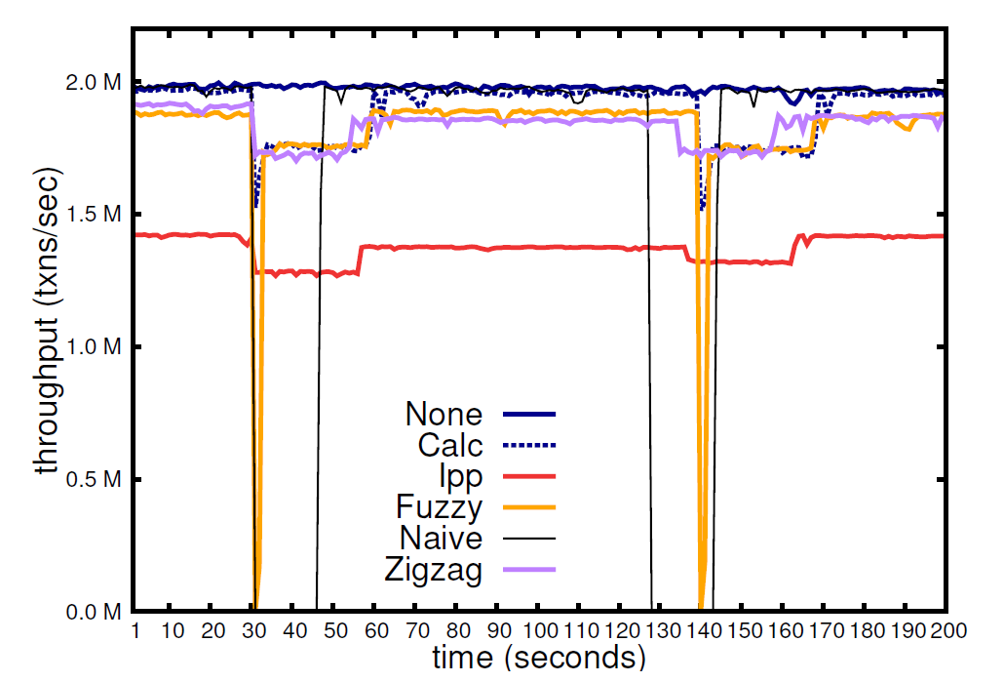
CALC checkpointing algorithm
Creates transaction-consistent checkpoints asynchronously
For systems without multiversioning
Complete checkpoint – all records
Partial checkpoint – only updates since last checkpoint
Maintains two versions while checkpoint is taken
Live version
Stable version - version as of checkpoint time
Partial checkpoints require recording which records have changed since last checkpoint
Bit map, hash table, …
About 10% slowdown during checkpointing
No more than fuzzy checkpointing
Low memory overhead
Low-Overhead Asynchronous Checkpointing in Main-memory Database Systems
SIGMOD 2016

Slide 64
Hekaton checkpoint and recovery
Checkpoint
Recovery
Memory
Memory
Rows and Indexes
Redo
Rows and Indexes
Do
Filter
Filter
Filter
Memory-optimized Filegroup (filestreams)
SQL Log
SQL Log
Memory-optimized Filegroup
Range 100-199
Range 200-299
Range 300-399
Log
Log
Range 100-199
Range 200-299
Range 300-399
Checkpoint
Key
Data file with rows inserted in timestamp range a-b
Delta file with IDs of deleted rows
Hekaton: SQL Server’s Memory-Optimized OLTP Engine
SIGMOD 2013

Slide 65
Other systems
Typically just redo information is logged
Value logging: updated version of each record is logged
Command logging: log procedure calls including parameters (VoltDB)
Periodically write out a consistent snapshot of the database
Indexes may or may not be included
Hyper uses it OS-based (fork) snapshot mechanism
H-Store/VoltDB switches to a copy-on-write mode so old versions are retained. Also needs to ensure consistency across partitions.
Recovery is a two-step process
Rebuild the database including indexes from the latest checkpoint (dominates recovery time)
Apply the tail of the log
Value logging: copy in new values
Command logging: re-execute transactions – must guarantee exactly the same result
Rethinking Main Memory OLTP Recovery
ICDE 2014

Slide 66
Break
Time for tea

Slide 67
High Availability (HA)
Never lose the database service!

Slide 68
Primary HA architectures
Site A
Site B
Site C
Site D
Primary
Replica (sync)
P1
P1
P1
P2
Replica (async)
Replica (sync)
P3
P2
P2
P3
P4
P4
P3
P4
Replica (async)
Primary plus failover replicas
Fast failover to a replica if primary fails
Read-only load can be offloaded to replicas
Partitioned and replicated database
Service remains available even if two sites are lost

Slide 69
Primary plus failover replicas
Replication protocol
Primary ships log to replicas
Replica writes the log records to its log and send an ack to the primary (safest option)
Replica updates its database copy
Commit options: The primary commits a transaction when
All replicas have written the transaction’s log records to their logs (foolproof)
All replicas have the log records in memory (data loss if all replicas lose power)
When the log records have been sent (data loss likely on failover)
Failover – typically completes in a few seconds
A replica detects missed heartbeats from the primary and begins failover
The replicas select a leader that becomes the new primary
The new primary and the replicas synchronize the state of their database copies
The primary begins accepting connections
Work can be offloaded to replicas
Read-only transactions, database back-ups, shipping data to additional replicas, ….
Used by SQL Server, SAP HANA, Hyper/Scyper

Slide 70
SQL Server and HANA HA configuration
Primary cluster
Standby cluster
Primary
Replica (sync)
Primary
Replica (sync)
Replica (async)
Replica (sync)
Primary
Replica (sync)
•••
Replica (async)
Replica (async)
SAP HANA
One standby replica (sync) close by
One TIER 3 async replica for disaster recovery, geodistributed
SQL Server
Max 8 replicas, 2 sync
Read-only offloading
Backup offloading
Replica (async)
TIER 3 cluster

Slide 71
Partitioned and replicated database
With K replicas, up to K-1 sites can fail and the DB still remains available
When the master site detects that a site has failed, it starts the process of rebuilding the failed site
The new site rebuilds the required partitions, catches up with the update activity, and rejoins
Copy partitions from other sites and catch up by applying their logs
If the master fails, a new master (leader) is selected
Is logging to durable storage really needed when we have N copies in RAM?
Most customers are conservative and insist on logging and backup
Used by VoltDB – each transaction is executed at K sites
Must be deterministic, producing exactly the same result at each site
The VoltDB Main Memory DBMS
IEEE Data Engineering Bulletin, 36(2):21–27, 2013.

Slide 72
Compilation and Query Processing

Slide 73
Traditional Volcano-Style Processing
Traditional RDBMS query processing translates query into physical query plan
Each operator processes tuples by calling get-next on its input
Simple interface
Arbitrary combination of operators
Overhead in main-memory DBMS environment
Small amount of generic operators must handle wide variety of scenarios
Get-next function called for every tuple (millions of times)
Get-next call is usually virtual (or call via function pointer)
Expensive
Degrades branch prediction on modern processors
Poor code locality
Interpretation-based execution with runtime checks
join
get-next
get-next
σ
scan
S
get-next
scan
R

Slide 74
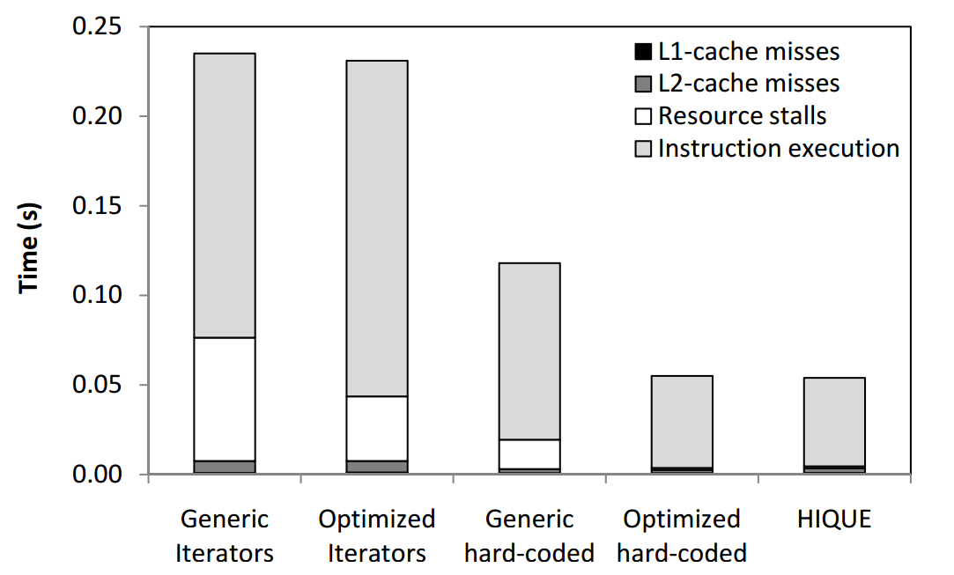
Benefits of Query Compilation in Main-Memory Systems (HIQUE)
HIQUE technique creates C/C++ program that implements query’s execution
Use compiler to convert code into shared object
Link it to the DBMS process and invoke the execution function
Generating Code for Holistic Query Evaluation
ICDE, pp. 613-624, 2010

Slide 75
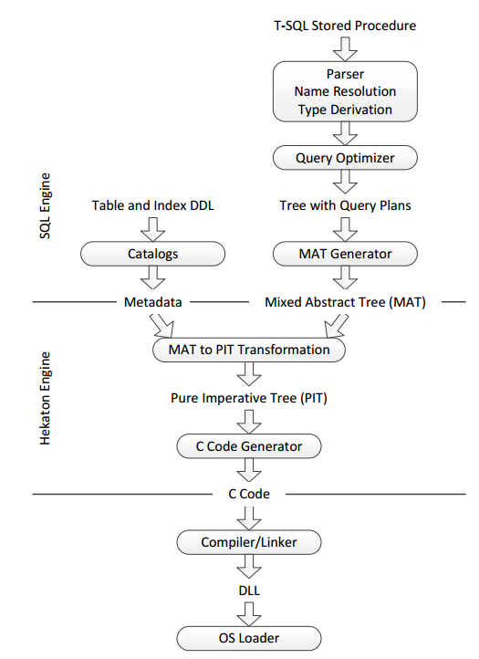
Query Compilation in Hekaton
Compile queries directly into machine code
Compile once; execute many times (typical OLTP scenario)
Do as much as possible at compile time
Types known at compile time; avoids interpretation
Collapse logic into single function as much as possible
Schema compilation
Compile table definition when created
Needed for two main reasons
Hekaton storage engine treats records as opaque objects (use callbacks for comparison, calculating hash values, etc.)
Interoperation with SQL-Server interpreted query executor
Optimize T-SQL query then compile to C (then to machine code)
Leverage existing compiler technology within Microsoft
3-4X observed speedup
Compilation in the Microsoft SQL Server Hekaton Engine
IEEE Data Eng. Bull. 37(1): 22-30 (2014)

Slide 76
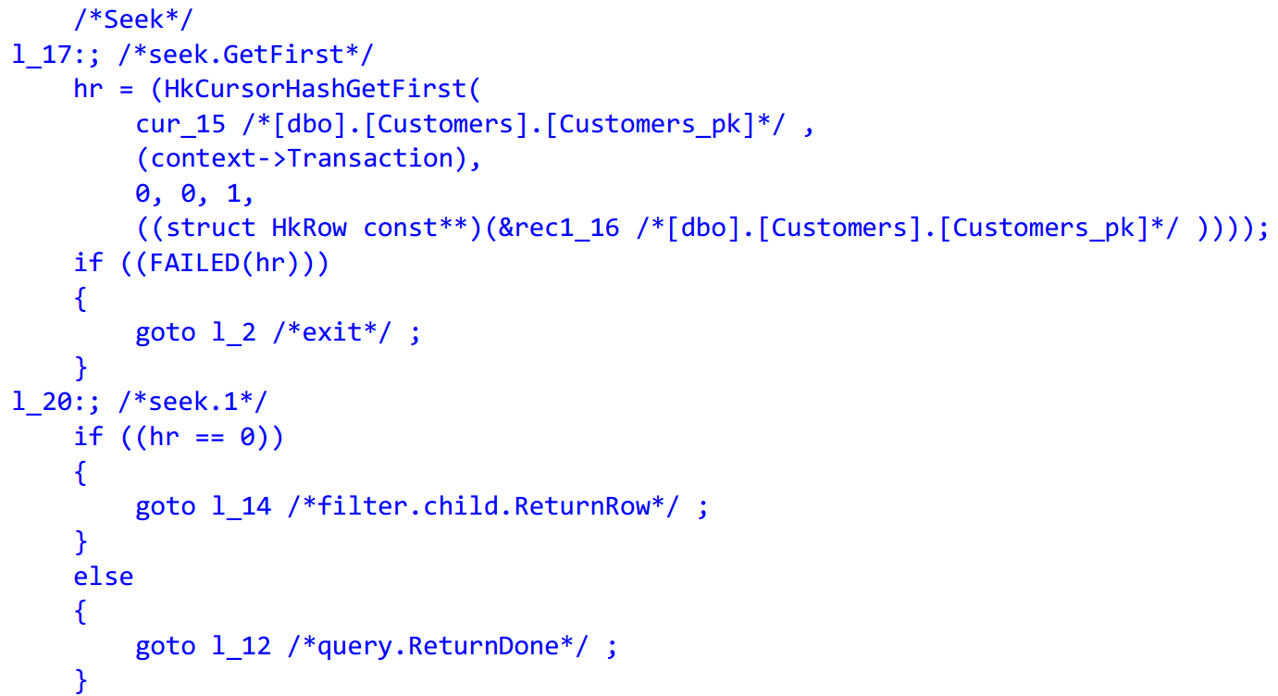
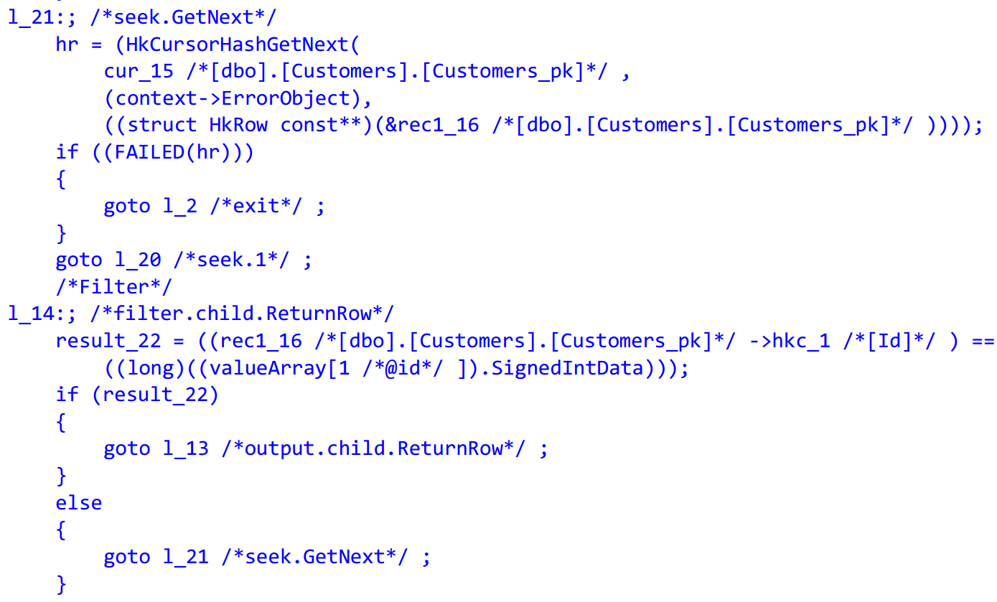
Example Hekaton Query

Slide 77
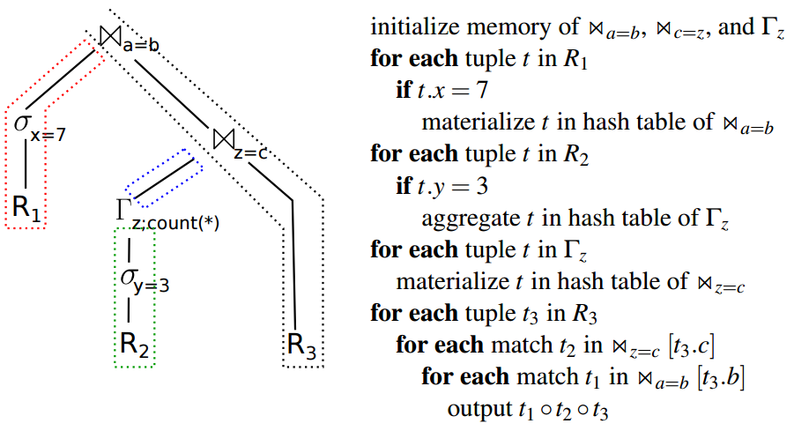
Query Compilation in HyPer
Data centric: maximize data locality by keeping attributes in CPU registers as long as possible
Query broken into pipeline fragments
Pipeline defined by materialization points in plan
Tuple passes through all operators in pipeline before materialization into next pipeline breaker
LLVM backend and JIT compilation
Operators partially implemented in C++ while performance and query-specific logic is generated
Compiling Database Queries into Machine Code
IEEE Data Eng. Bull. 37(1): 3-11 (2014)

Slide 78
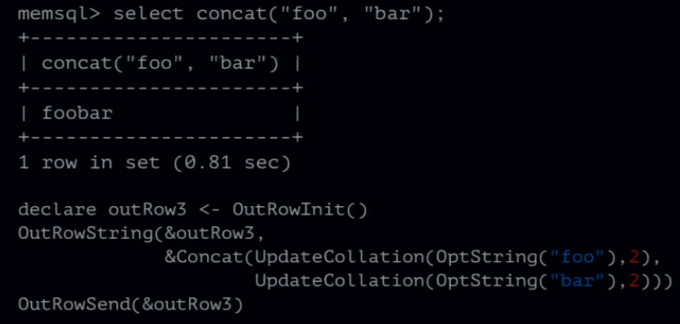
Query Compilation in MemSQL
Current release uses specialized programing language MemSQL Programming Language (MPL)
SQL operator trees converted directly to MPL abstract syntax trees
MPL translated to MemSQL Bytecode
MemSQL Bytecode can interpreted or transformed to LLVM bitcode for compilation to machine code
MemSQL guest lecture at CMU
https://scs.hosted.panopto.com/Panopto/Pages/Viewer.aspx?id=05931d2c-fe66-4d50-b3f2-1a57f467cf96

Slide 79
Cloudera Impala
LLVM JIT compilation for expression evaluation and record parsing
Not a main-memory system
Need to optimized record parsing to deal with various formats read from HDFS
Show up to a 5.7X improvement using an Avro TPC-H benchmark
Impala: A Modern, Open-Source SQL Engine for Hadoop
CIDR 2015

Slide 80
Real-Time Analytics
Faster, fresher, cheaper!

Slide 81
“Real-time analytics” means what?
Real-time analytics = running analytical queries on the live operational database
Also called
Operational analytics
HTAP, Hybrid Transactional and Analytical Processing (Gartner)
OLxP
Provides access to the freshest data
Real time analytics doesn’t necessarily mean in-memory analytics
In practice, real-time analytics requires the following to be sufficiently fast
column store support
parallelism in query execution
exploiting SIMD instructions

Slide 82
10-100X faster analytics with column stores
Scan type | Elapsed time (sec) | Reduction in elapsed time
Range index scan, interop | 70.3
Heap scan, interop | 41.6 | 41%
Heap scan, compiled stored proc | 18.4 | 56%
CS index scan, interop | 1.53 | 92%
Example gains using Hekaton
TPC-H Lineitem table, 60M rows
Range index on (l_orderkey, l_linenumber)
Single threaded on an old Nehalem server
Test query:
Select l_discount, sum(l_quantity*l_extendedprice*l_discount) from lineitem where l_partkey < 1000000 group by l_discount
Real-Time Analytical Processing with SQL Server
PVLDB 2015

Slide 83
Hekaton: columnstore indexes
Rows not yet added to CS index
Add CS index on large tables used for analytics
Compressed, increases space by 10-20%
Stored on disk, only frequently used columns cached in memory
Tail segment stores recently inserted or updated versions (hot rows) and is typically small
Full scan: scan CS segments and tail segment
Fast query execution by
Batch mode execution
Parallel query plans
Pushing predicate evaluation, preaggregation, etc. into scans
Using SIMD instructions
Offload analytics to replicas to minimize impact on OLTP workloads
Tail segment
Main segment
In-memory table
Columnstore index

Slide 84
HyPer: hybrid storage
Hybrid row/column layout
A hybrid record layout that clustered frequently-accessed columns together
But typically configured as a pure column store
Snapshotting
OLAP queries run over virtual memory snapshots by using fork
Compilation
Stored procedures JIT’ed into machine code
SIMD
Work pushed into scan operator (pred evaluation, preaggregation,…) exploits SIMD instructions
Tom
100
Rome
Jane
400
Paris
Bill
50
Lima
Neil
300
Riga
Mary
650
Cairo
Tina
100
Tokyo
Jack
150
Seoul
Jill
200
Oslo
Column group 1
Column group 1
Note: data is stored compressed

Slide 85
HANA: primarily a column store
The bulk of the data in columnar format
Main store and L2-delta
L1-delta stores recent inserts and updates
Designed primarily for fast analytics
Not a high-performance OLTP engine
Main store
Merge
L2-delta
Merge
L1-delta

Slide 86
Non-Volatile RAM
Memory Content survives power failures

Slide 87
Topics discussed
NVRAM characteristics and types
The NVRAM atomic update problem
Speeding up logging with NVRAM
Storing the database in NVRAM

Slide 88
NVRAM characteristics and types
NVRAM: byte-addressable, persistent RAM
Slower than DRAM: reads 2-4X, writes 2-5X slower possibly asymmetric
Many potential technologies
NVDIMM, 3D Xpoint, Memristor, STT-MRAM, PCM, …
NVDIMM: DRAM content flushed to flash on power failure
Require a power source: battery, capacitor, UPS
Typically small (10s of MB), available now, as fast as DRAM
3D Xpoint (Intel, Micron) announced July 2015
Used in Intel’s Optane SSD, released by the end of 2016
DIMMs to be released in 2017

Slide 89
NVRAM atomic update problem
NVRAM data can be cached
Caches are not flushed on power failure (but write buffers are)
A cache line must be explicitly flushed to ensure that it’s persisted
CLFLUSH – flush and evict cache line
CLWB – flush but do not evict cache line
But updating a cache line and flushing it is not an atomic operation
Another thread may read a non-persisted value V, take action based on the value read, and persist its changes
If the system then crashes before V has been flushed we may have an inconsistent state
Must prevent premature reading of non-persisted data
Example code sequence
PersistentInt is initially = 0
PersistInt = 100
MFENCE
CLWB &PersistentInt
MFENCE
Thread 1 blocks after line 2
Thread 2 reads PersitentInt, copies it to PersistentInt2, persists PersistentInt2 and commits.
System crashes
On recovery we have an inconstant state

Slide 90
Speeding up logging with NVRAM
Having the tail of the log (a few MB) in NVRAM is sufficient – the whole log is overkill
Write log records to NVRAM buffers and commit to NVRAM
Write out NVRAM log buffers to storage in large chunks
Benefits: fast commit (10-50 microsec), higher log throughput
No group commit needed!
Can also be applied to speed up HA
Write log records locally to NVRAM
Write them also to NVRAM buffers at every synchronous replica
Commit transaction
No need to wait for disk writes to complete
Scalable Logging Through Emerging Non-Volatile Memory
PVLDB 2014

Slide 91
Storing the database in NVRAM
Need a persistent memory allocator to manage NVRAM space
Store row/columns in NVRAM
Store the transaction table and any undo information in NVRAM
These structures must be recoverable and never leak NVRAM space
Indexes can be stored in NVRAM or DRAM
NVRAM has higher latency so NVRAM indexes are slower than DRAM indexes
Maintaining indexes in NVRAM is somewhat tricky and potentially expensive
But rebuilding indexes consumes he majority of recovery time – no instant recovery
Instant Recovery for Main-Memory Databases, PVLDB 2014
Storage Management in the NVRAM Era, PVLDB 2013

Slide 92
Hardware Transactional Memory
Hardware-supported atomic transactions

Slide 93


The Goal of HTM: Ease of Multi-Threaded Programming
Lock-free Programming
Hardware Transactional Memory
If (BeginTransaction())
Then
< Critical Section >
CommitTransaction()
Else
< Abort Fallback Codepath >
EndIf
Carefully design/implement using CAS/FAI
Cross fingers
System crashes or corruption
Goto 1

Slide 94
HTM Lock Elision
Drop-in replacement for locked critical sections
Thread elides lock when entering critical section
Thread starts HTM transaction
Adds lock word to transaction read set (does not set it)
Manipulates data within critical section
HTM conflict causes abort
On conflict thread retries by taking lock
aborting all other threads in critical section since lock word is in their read set

Slide 95



HTM Lock Elision B+-Tree Example
Fine Grain Locking
HTM
Performance
Coarse Grain Locking
Concurrent Threads

Slide 96
HTM in HyPer
Cannot execute database transactions using HTM
Limitations in space (L1 cache for buffer, associativity)
Limitations in time (interrupts cause HTM aborts)
Break database transaction into several HTM transactions
Use HTM transaction for single-tuple access
Use timestamp order concurrency control to detect larger transactional conflict
Propose several data structure optimizations to avoid false HTM aborts
Zone segmentation: avoid conflicting inserts at tail of memory segment when adding new record
Use chunk allocation for surrogate key generation to avoid conflict at tail of range index
Exploiting Hardware Transactional Memory in Main-Memory Databases
ICDE, pp. 580-591, 2014

Slide 97
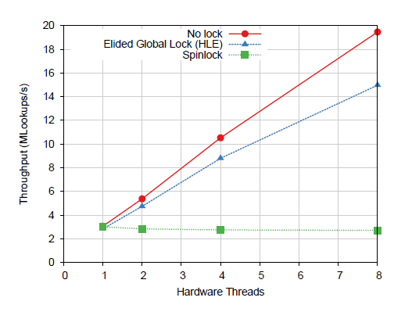
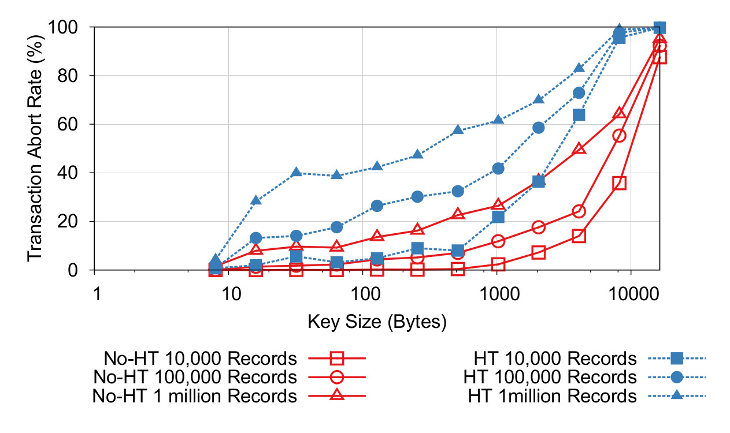
HTM vs. Lock-Free Index Designs
Experimental study that asked three questions
Q1: Does HTM obviate the need for lock-free designs
Answer: No, technical limitations prohibit use of HTM as a general-purpose solution
Experimented with single-threaded B+-tree made multi-threaded using HTM lock elision and the Bw-Tree
Lock elision shows near optimal performance when contention is low with small keys
Abort rate is unacceptable for larger variable-length keys
Lock crabbing not possible with current HTM offerings
To Lock, Swap, or Elide: On the Interplay of Hardware Transactional Memory and Lock-Free Indexing
PVLDB 8(11): 1298-1309 (2015)

Slide 98
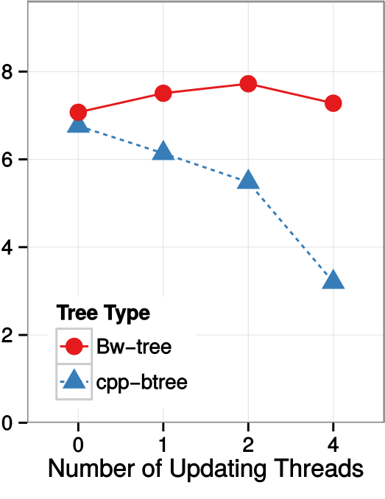
HTM vs. Lock-Free Index Designs
Q2: Will HTM work if all technical limitations are overcome?
Answer: No, there are still important fundamental differences
Lock-free copy-on-write (MVCC-like) and HTM-based (update-in-place) approaches have different behavior under read-write contention
Read-write conflict using HTM can cause aborts
Readers not affected in lock-free approach
Q3: Can HTM help lock-free implementations?
Answer: yes, use HTM to perform multi-word CAS for difficult-to-design multi-word manipulations
Read Throughput (M ops/sec)
To Lock, Swap, or Elide: On the Interplay of Hardware Transactional Memory and Lock-Free Indexing
PVLDB 8(11): 1298-1309 (2015)

Slide 99
Managing Cold Data
Moving infrequently accessed data out of memory

Slide 100
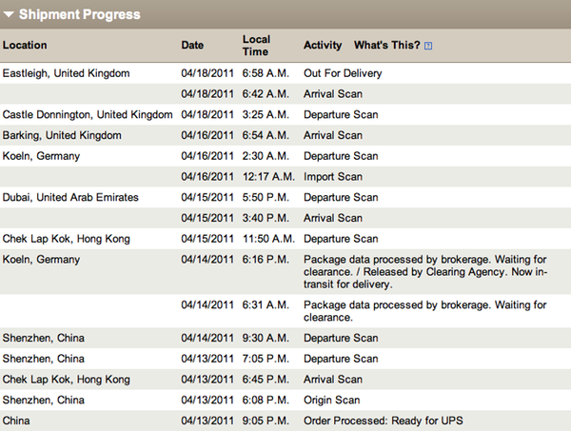



Cold Data Management Motivation
Infrequently accessed data that has become irrelevant to OLTP workload

Slide 101

Cold Data Management Motivation (2)
Record Size | Store on SSD After
200 Bytes | 60 Minutes
1 KB | 11.6 Minutes
2KB | 5.8 Minutes
4KB | 2.9 Minutes

Slide 102
H-Store Anti-Caching
Architecture
Block table: secondary storage holding migrated tuples
Evicted table: in-memory mapping of evicted tuple to its offset in block table
LRU-chain: per-table chain embedded in the in-memory tuple header (LRU is “coldness” measure)
Eviction
Special single-partition transaction sweeps coldest tuples and serializes to blocks
Keys for tuples still exist in indexes, etc. Tuple is marked as “evicted”
Transaction execution
Accessing evicted tuple during transaction aborts and restarts transaction
Before restart, transaction goes into a “pre-pass” phase that attempts to identify all evicted tuples and brings them into memory
Data from I/O is staged in cache; a migration thread locks partition and installs tuples in memory and restarts transactions
Anti-Caching: A New Approach to Database Management System Architecture
PVLDB 6(14), pp.1942-1953, 2013

Slide 103
Hekaton Siberia
Hides cold/hot split below Hekaton cursor API
Compact filters limit cold data access
Non-transactional cold store
Transactional consistency for updates spanning cold/hot storage
Live migration of data between stores while database is online and active
Timestamp updates and validation performed entirely in memory
Hekaton Index Cursor
Access log
Cold record cache
Hekaton Scanner
Hekaton In-Memory Scanner
Siberia Cold Index Scanner
Access filters
Memory
(hot storage)
Siberia
(cold storage)
Migration
Trekking Through Siberia: Managing Cold Data in a Memory-Optimized Database
PVLDB 7(11), pp.931-942, 2014

Slide 104
Siberia Cold Data Classification
Example for K=3
Traditional caching classification techniques are too heavyweight for main-memory database systems
Updating LRU-K chains, etc.
Log record accesses and use exponential smoothing to “score” records “hotness”
Avoids reading entire log by scanning log in reverse
While reading in reverse, calculate upper and lower bounds for record’s final score
Filter and stop once K records are found as the hot set
Cold records are migrated to cold storage
Time t_{n}:
K^{th} lower bound
below threshold,
disregard
Time t_{n-4}:
K^{th} lower bound
thrown
out
Identifying Hot and Cold Data in Main-Memory Databases
ICDE, pp. 26-37, 2011

Slide 105
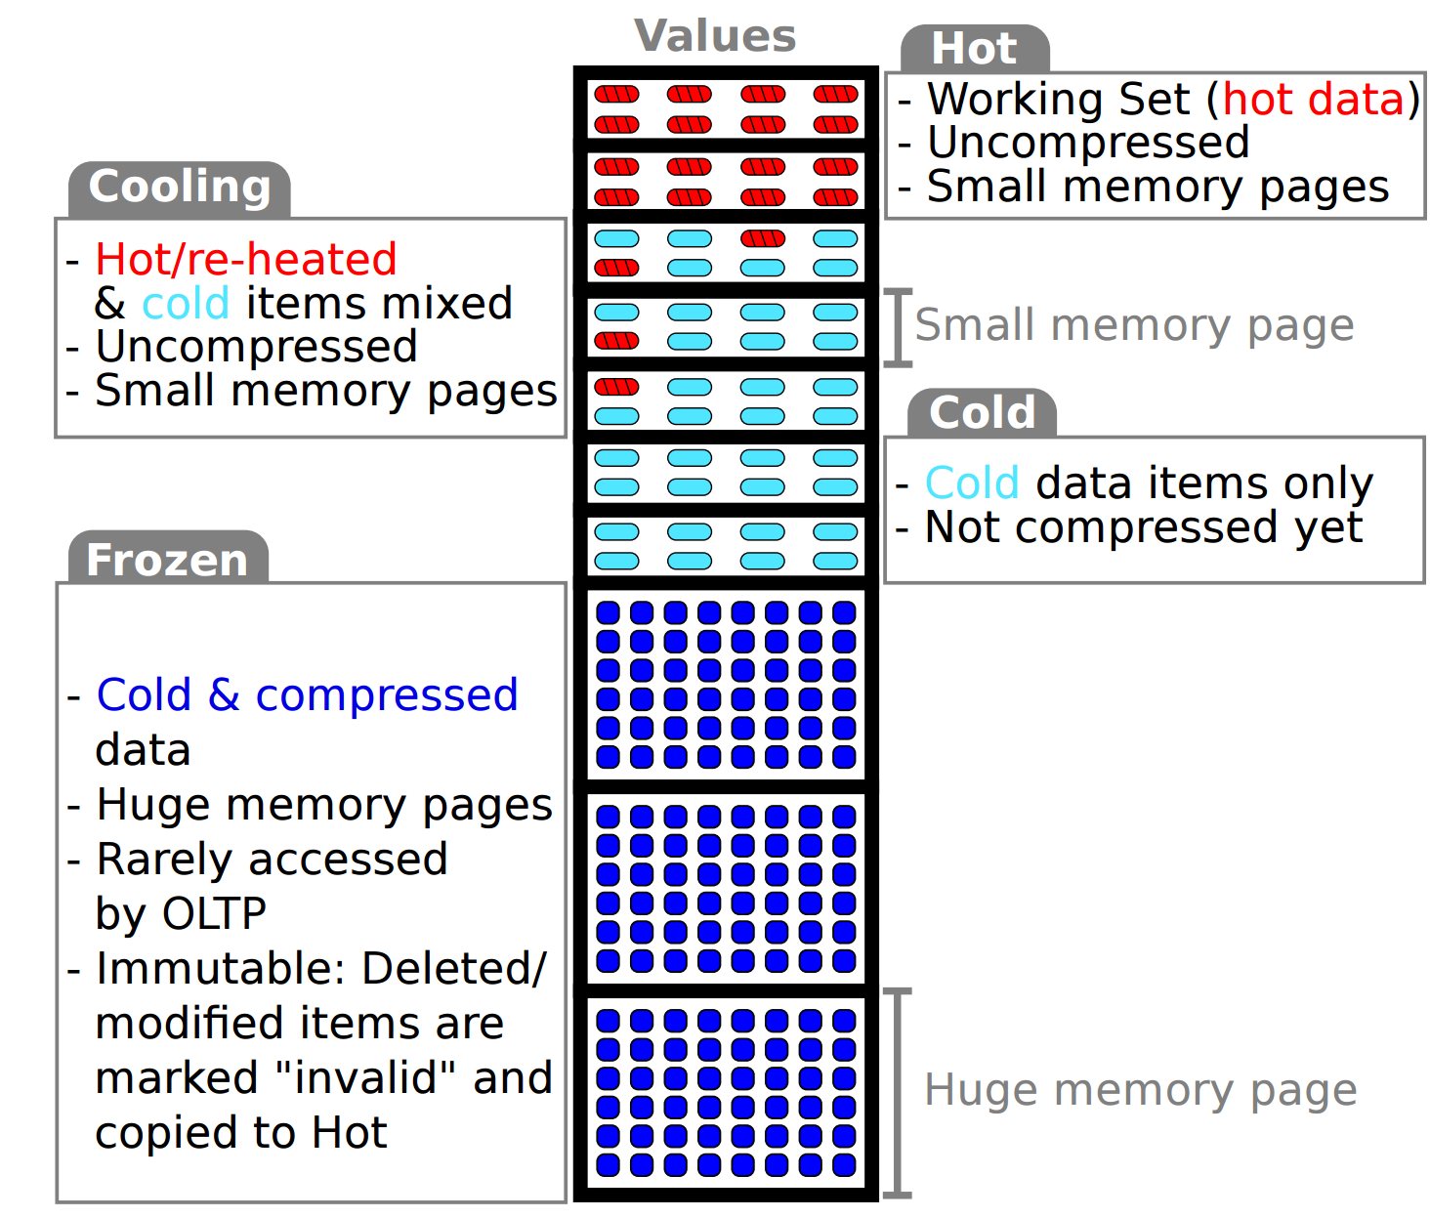
HyPer Compaction
Performs hot/cold classification at virtual memory page level
Piggyback’s on CPU memory management unit setting dirty page flags
HyPer pins pages in memory
Read and reset dirty page flags for classification purposes
Cold data compacted and transferred to huge pages
Compacting Transactional Data in Hybrid OLTP & OLAP Databases
PVLDB 5(11): 1424-1435, 2012

Slide 106
Fast Networks

Slide 107
Modern High Performance Network Characteristics
Remote Direct Memory Access (RDMA)
Once expensive high-bandwidth network only used in high-performance computing
Currently becoming cost-competitive
Bandwidth/latency characteristics improving
Four dual-port FDR 4x NICs provide roughly the same aggregate bandwidth as DDR-31600 four-way memory channel
Kernel and CPU bypass: read and write memory directly
Data Direct I/O
First released in Intel Sandy-Bridge series
DMA execution places data directly into CPU L3 cache (if target address is cache-resident)
Infiniband Type | Latency (us) | Throughput (GB/s)
SDR (2003) | 5 | 1
DDR (2005) | 2.5 | 2
QDR (2007) | 1.3 | 4
FDR (2011) | 0.7 | 6.8
EDR (2014) | 0.5 | 12.1
High-Speed Query Processing over High-Speed Networks
PVLDB 9(4), pp. 228-239, 2015

Slide 108
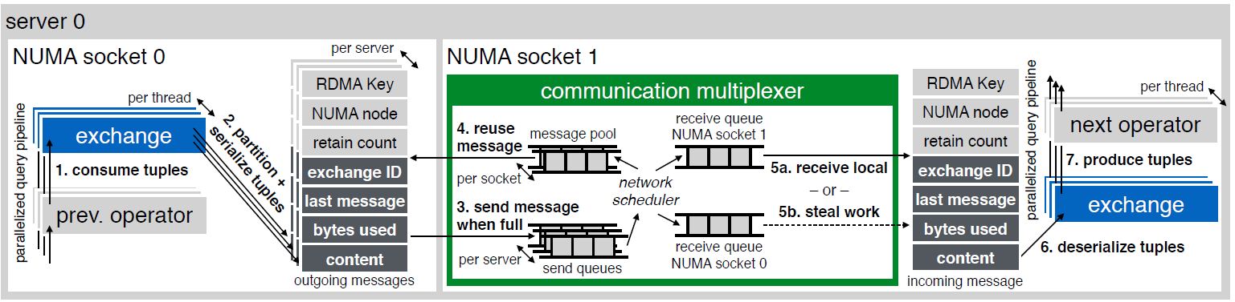
HyPer: Morsels + Decoupled Exchange Operators
NUMA nodes connected by QPI
Uses “morsel-driven” parallelism: break work into fixed-size morsels and partition/dispatch for NUMA locality
Machines connected by RDMA: avoid broadcast overhead of traditional exchange operators
Communication multiplexer
Manages NUMA-aware message pools, round-robin network scheduling
Receives local work and signals waiting exchange operators, stealing work from other NUMA queues to balance load
Decoupled broadcast exchange operators
Partition tuples and serialize messages that are sent to communication multiplexer
Received from multiplexer at destination, deserialized, and pushed through pipeline
High-Speed Query Processing over High-Speed Networks
PVLDB 9(4), pp. 228-239, 2015
Morsel-Driven Parallelism: A NUMA-Aware Query Evaluation Framework for the Many-Core Age
SIGMOD 2014

Slide 109
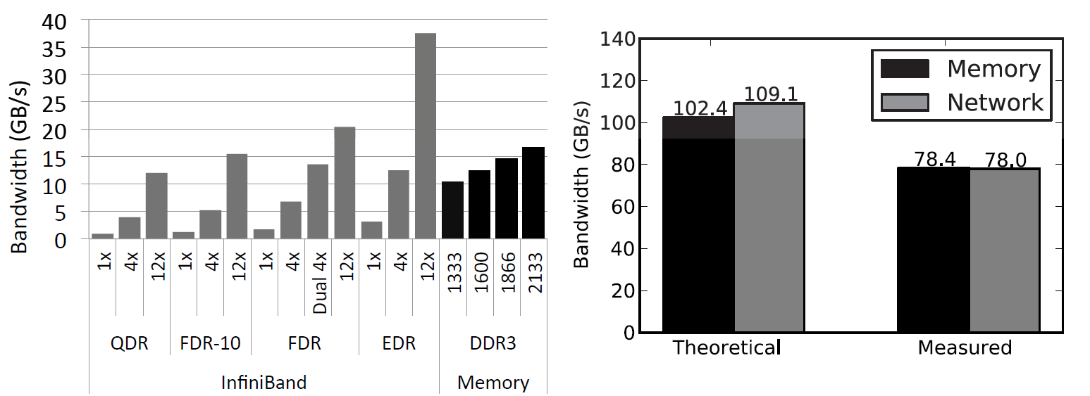
DBMS Redesign for Fast Networks
Experiment with FDR 4x Infiniband network
Aggregate bandwidth over RDMA is in the ballpark of CPU memory controllers
Survey three candidate architectures
Shared nothing IPoIB: cannot take full advantage of RDMA
Distributed shared memory: cache coherencency is difficult
Favor network-attached memory: compute and storage nodes (memory pool)
Initial techniques for both OLTP and OLAP
New snapshot isolation approach with RDMA-specific optimizations
RDMA join and aggregation optimizations for OLAP
Experiment on Dual Socket Machine
Specification
Measured
The End of Slow Networks: It’s Time for a Redesign
PVLDB 9(7), pp. 528-539, 2016

Slide 110
Other Systems

Slide 111
solidDB
Founded 1992 in Helsinki, Finland, bough by IBM in 2007, sold to UNICOM in 2014
Hybrid database system: both disk-based and main-memory optimized engine
Indexing using Vtrie (variable-length trie)
Uses pessimistic locking
Snapshot consistent checkpoints for recovery
IBM solidDB: In-Memory Database Optimized for Extreme Speed and Availability
IEEE Data Eng. Bull. 36(2): 14-20 (2013)

Slide 112
Oracle TimesTen
Began as research project at HP Labs named Smallbase
Spun off into separate company in mid 1990s and acquired later by Oracle in 2005
Flexible engine deployment
Standalone DBMS engine
Transactional cache on top of Oracle RDBMS
In-memory repository for BI workloads
Concurrency control through locking
Row-level latching to handle write-write conflicts
Uses write-ahead logging and checkpointing for durability
Oracle TimesTen: An In-Memory Database for Enterprise Applications
IEEE Data Eng. Bull. 36(2): 6-13 (2013)

Slide 113
Altibase
Founded in 1999 in South Korea
Large customer base spanning telecom, financial, and manufacturing companies
Stores records on pages
Checkpoints written at page granularity
Compatibility with disk-based engine
Multi-versioned concurrency control
Uses write-ahead logging and checkpointing for durability/recovery
Latch-free checkpointing process when writing page data to checkpoint file

Slide 114
MemSQL
Hybrid database aimed at high-performance transactions and analytics
Designed to scale out on commodity hardware
Aggregator node interface for query routing
Leaf nodes provide in-memory storage and query processing
Latch-free skiplists for indexing
Multi-version concurrency control
Row locks for read committed and snapshot isolation concurrency control
Durability through flushing redo-only transaction log
Query compilation using LLVM using MemSQL Programming Language (MPL)
MemSQL FAQ
https://docs.memsql.com/docs/memsql-faq

Slide 115
Silo
High-performance main-memory database system built on top of the MassTree
Reduces atomic writes to hotspots
Key to performance on multi-core, multi-socket machines
Unique timestamp generation (classic example of a hotspot)
Use epoch-based approach: global epoch E (incremented every so often) occupies high-order bits of each transaction
Serializable concurrency through tracking read sets and installing at commit time
Phantom protection through versioning and tracking range index leaf nodes
Exploits multi-core parallelism throughout durability and recovery design
Redo-only logging in parallel across multiple disks
Parallel checkpointing
Speedy Transactions in Multicore In-Memory Databases
SOSP, pp.18-32, 2013

Slide 116
History
A brief survey of main-memory database research prior to the modern era

Slide 117
The Early Years: 1984-1994
1976: IMS Fastpath [45] (published 1985) main-memory resident database optimizations
Fine-grained record-level locking
Install record updates at commit time
Group commit
1984: DeWitt, Katz, Olken, Shapiro, Stonebraker, Wood [32]
Assume database fit in main-memory buffer pool
Access method optimizations, join techniques, group/fast commit, parallel log and checkpoint I/O
1986: MM-DBMS from University of Wisconsin [83, 84, 85]
Use of pointers for direct record access (no buffer pool)
T-Trees: memory optimized indexing
Partitioned recovery method: main processor and recovery processor

Slide 118
The Early Years: 1984-1994 (2)
1987: MARS from SMU and System M from Princeton [36, 51]
Partitioned into database processor and recovery processor: lazy copy of volatile updates to storage
Showed benefits of avoiding undo logging in main-memory systems
1987: IBM Office by Example [17]
Main-memory optimizations for read-mostly data: inverted indexes using memory pointers
1988: TPK from University of Wisconsin [91]
Executed transactions serially using collection of specialized threads (input, output, execution, recovery)
1988: PRISMA [9, 10]
Two-phase locking and two-phase commit over partitioned main-memory database
1991: IBM Starburst Memory Resident Storage Component
Used many techniques from MM-DBMS
Concurrency: single latch to protect table and indexes (serial execution), direct addressing of lock data

Slide 119
New Millennium: 1994-2005
1994: Dali from Bell Labs [19, 63] (later DataBlitz[14])
Gave applications direct shared access to main-memory records
Data replication (fast failover), redo-only logging (reduce I/O), fuzzy action-consistent checkpoint scheme (reduce lock contention)
ClustRa Distributed Main-Memory DBMS [62]
High performance and availability using fully replicated main-memory DBMS at each node (2-safe)
Targeted telecom workloads
System K from NYU[164]
In-memory partitions assigned to CPU cores (no distribution across machines)
Transactions run serial within partition with logical logging

Slide 120
New Millennium: 1994-2005 (2)
HP Smallbase and TimesTen [152, 153, 154]
Unique architectural design: used as both server and linkable library
Fully ACID-compliant, with ability to relax for performance and use elsewhere (e.g., mid-tier cache)
Used T-Trees initially, multi-versioning, along with other main-memory optimizations
P*Time[23]
Light-weight OLTP database optimized for CPU cache consciousness
Use of lock-free index read protocol (OLFIT)
Fine-grained parallel logging
Eventually became the main-memory OLTP engine in SAP HANA

Slide 121
Graveyard
Extra slides

Slide 122
Index Page Layout
Index page layout (especially B+-trees) has been an important topic since inception; there could be a whole tutorial on it
Much of this work still applies today
Prefix/tail compression for space savings within a node
Increase chance of fixed-length comparison when searching a page
This tutorial will focus elsewhere, for instance:
Different data structure designs for cache efficiency
Thread-level concurrency
Keys
bigbird
bigcat
bigdog
Prefix Compression
Keys
bird
cat
dog
Fixed Length Key Prefix
bi
ca
do
Key Suffixes
rd
t
g
Prefix B-Trees
ACM TODS 2(1), 1977, pp. 11-26
The Evolution of Effective B-tree Page Organization and Techniques: A Personal Account
SIGMOD Record 30(3), 2001, pp. 64-69

Slide 123
CSB+-Tree
Size nodes to cache line: “unit of transfer” in main-memory system
Basic idea: reduce node pointer storage
Similar to B+-Tree in spirit
All child nodes of a parent placed into node group
Parent stores single pointer to node group
Nodes within a node group can be accessed using offset
Splits
Whole node groups allocated to accommodate new node
Entire node group copied over to new memory (pointer at parent replaced with new group pointer)
Optimizations
Segmented node groups: essentially more node groups with more pointers stored at parent
Whole nodes groups: avoid reallocation by pre-allocating max node group space
node group
Making B+-Trees Cache Conscious in Main Memory
SIGMOD, pp. 475-486, 2000

Slide 124
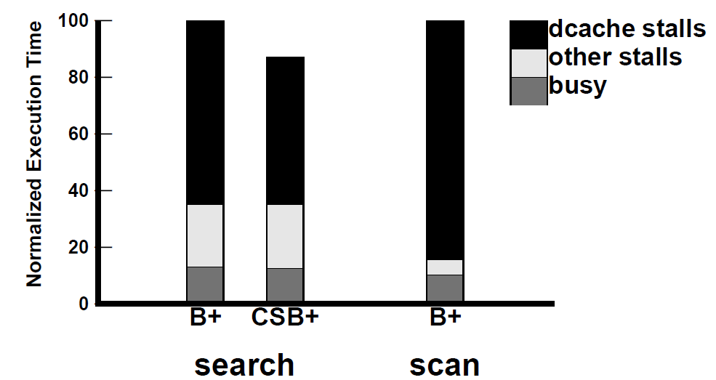
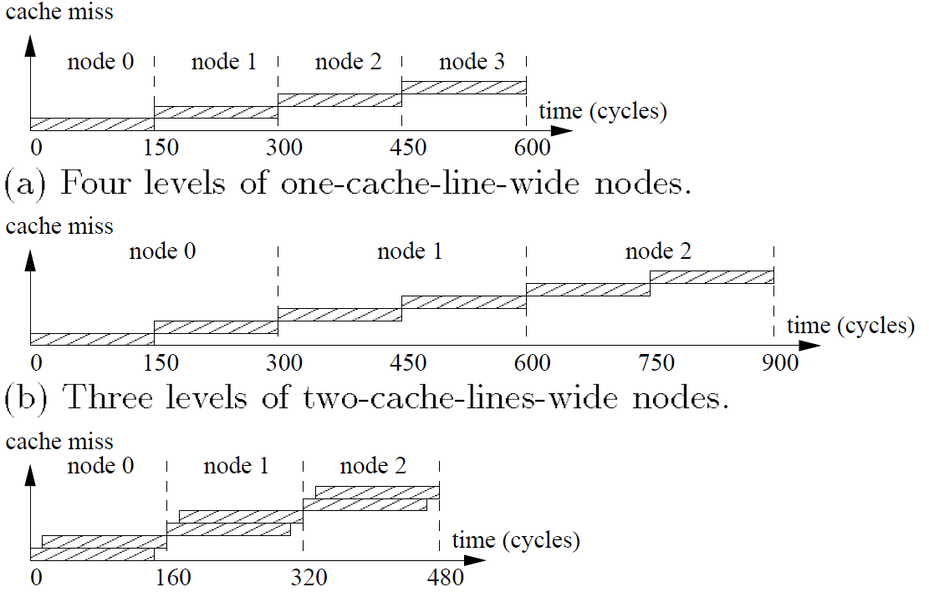
Pb+-Trees
Explores effect of prefetching on B+-Tree search and scans
Prefetching allows for increased fanout of tree node beyond the “unit of transfer” (cache line in main-memory systems)
Leads to shallower trees and better performance
1.5x improvement for search, 6x improvement for scans
Search requires very little change
Prefetch all lines that comprise a node
Single “expensive” cache miss when traversing from parent to child
Scan implements a jump pointer array
Leaf nodes contain offset into pointer array
Can calculate N subsequent prefetch addresses from jump array
Tunable to machine running code
Improving Index Performance through Prefetching
SIGMOD, pp. 235-246, 2001

