Slide 1




To Lock, Swap or Elide: On the Interplay of Hardware Transactional Memory and Lock-free Indexing
Darko Makreshanski
Department of Computer Science
ETH Zurich
Justin Levandoski
Microsoft Research Redmond
Ryan Stutsman
Microsoft Research Redmond

Slide 2
Motivation
Hardware Transactional Memory
Proposed as hardware support for lock-free data-structures [1]
Introduced in Intel Haswell (2013)
Existing Lock-free data-structures
Relying on CPU atomic primitives (CAS, FAI)
Notoriously difficult to get right
[1] Transactional Memory: Architectural Support for Lock-Free Data Structures, M. Herlihy, J. E. B. Moss, ISCA ‘93

Slide 3

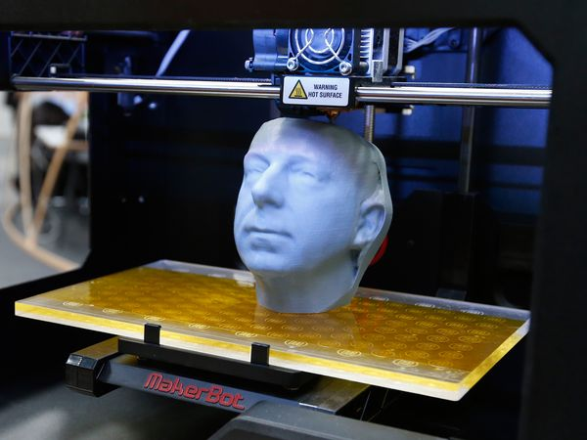
Lock-free Programming
Hardware Transactional Memory

Slide 4
Overview
Q1: Does HTM obviate the need for crafty lock-free designs?
A1: No. Technical limitations prohibit use of HTM as a general purpose solution.
Q2: What if all technical limitations are overcome?
A2: No. There are still important fundamental differences.
Q3: Can lock-free data-structures benefit from HTM?
A3: Yes. Using HTM for MW-CAS can simplify lock-free designs

Slide 5
Hardware Transactional Memory
Sequence of instructions with ACI(D) properties
Programming Model:
Lock Elision:
If (BeginTransaction())
Then
< Critical Section >
CommitTransaction()
Else
< Abort Fallback Codepath >
EndIf
AcquireElidedLock()
< Critical Section >
ReleaseElidedLock()
Transaction buffers stored in core-local (L1) cache
Conflict-detection and ensuring atomicity piggyback on cache-coherence protocol

Slide 6
Bw-Tree¹ (A Lock-free B-Tree)
Mapping Table
Page A
Address
A
B
Page B
Page C
Page D
C
D
Logical pointer
Physical pointer
[1] The Bw-Tree: A B-tree for New Hardware. Levandoski, Lomet, Sengupta. ICDE ‘13

Slide 7
Bw-Tree¹ (Lock-free Updates)
Δ: Update record 35
Δ: Insert Record 60
Mapping Table
Address
Δ: Delete record 48
Δ: Insert record 50
P
Page P
Consolidated Page P
[1] The Bw-Tree: A B-tree for New Hardware. Levandoski, Lomet, Sengupta. ICDE ‘13

Slide 8
Overview
Q1: Does HTM obviate the need for crafty lock-free designs?
Q2: What if all technical limitations are overcome?
Q3: Can lock-free data-structures benefit from HTM?

Slide 9
HTM Parallelized B-Tree
Q1: Does HTM obviate the need for crafty lock-free designs?
Wrap individual tree operations in a transaction
Effortless parallelization of existing single-threaded implementations
State-of-the-art in using HTM for database indexing [1,2]
Using the Google B-Tree implementation [3]
In-memory single-threaded B-Tree
[1] Exploiting Hardware Transactional Memory in Main-Memory Databases. V. Leis, A. Kemper, T. Neumann. ICDE 2014
[2] Improving In-Memory Database Index Performance with Intel®Transactional Synchronization Extensions
Karnagel et al. HPCA 2014
[3] https://code.google.com/p/cpp-btree/

Slide 10
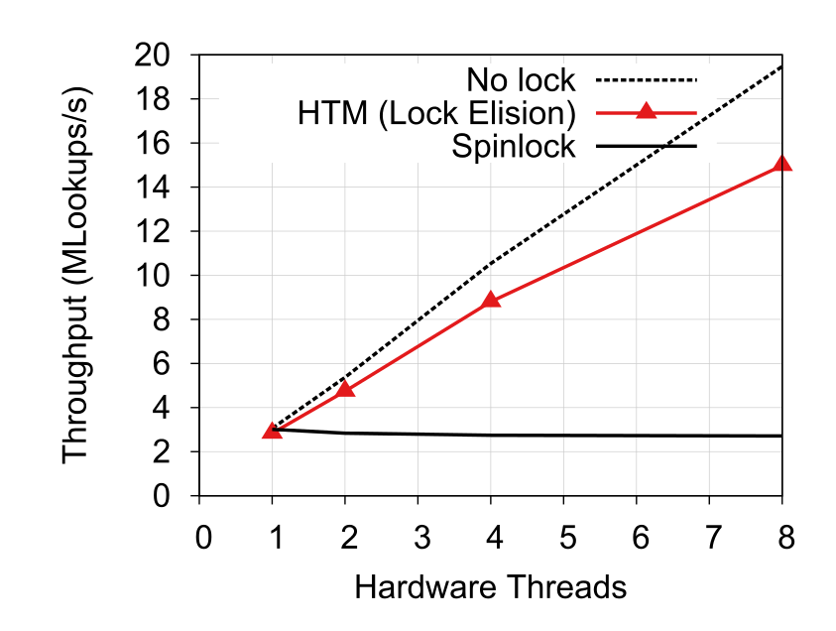
HTM Parallelized B-Tree
Q1: Does HTM obviate the need for crafty lock-free designs?
Works well for simple use-cases
Small key and payload sizes
8B Keys, 8B Payloads
4M Key-Payload pairs
Random read-only workload

Slide 11
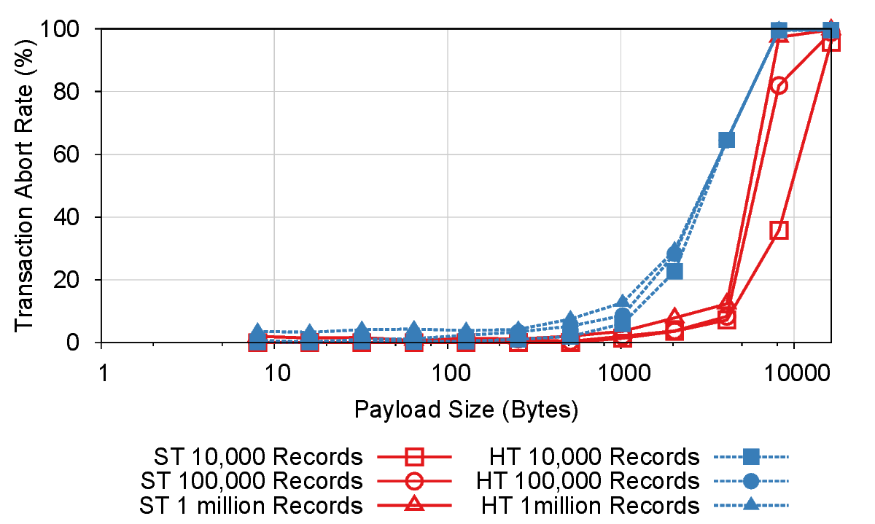
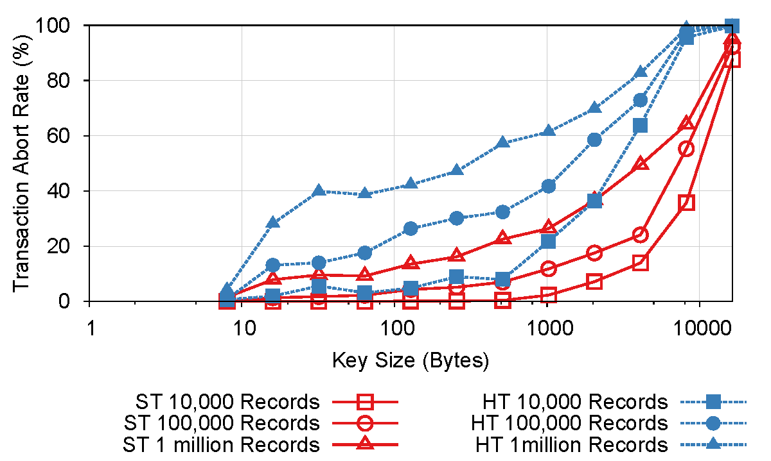
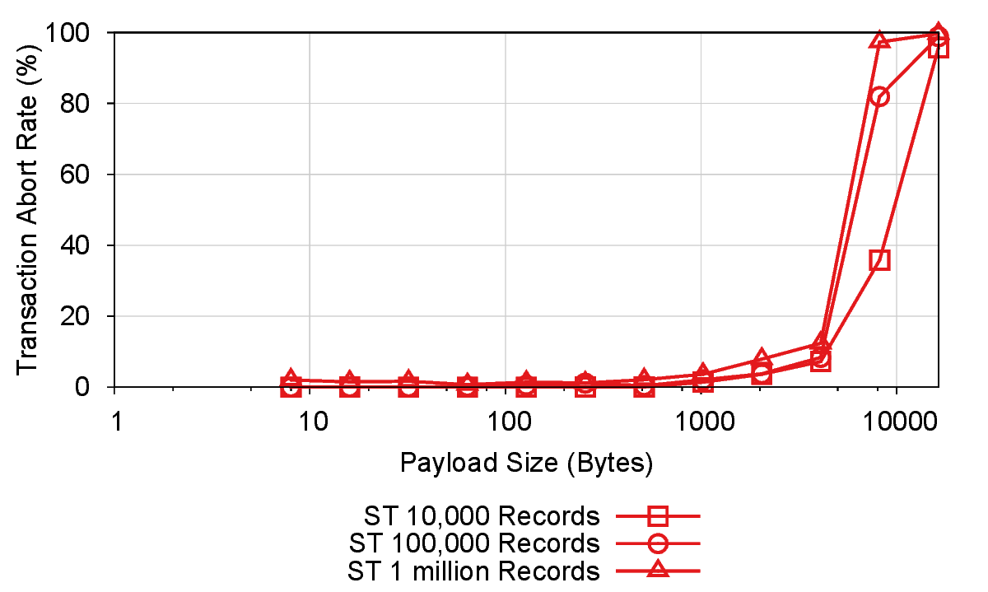
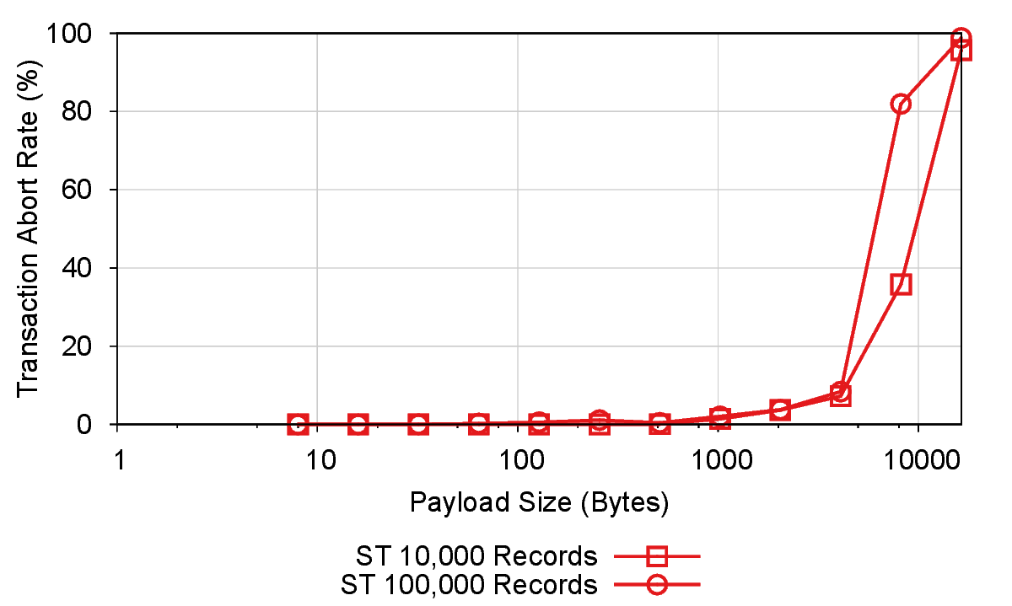
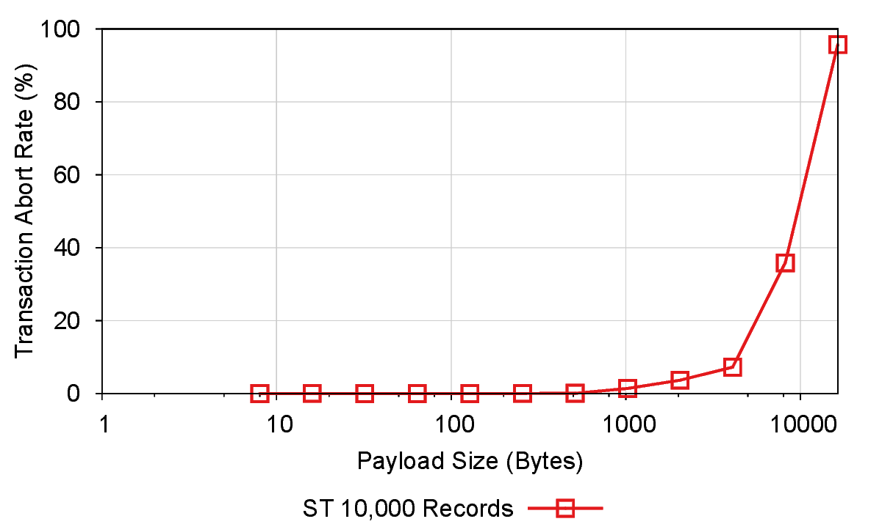
HTM Parallelized B-Tree
Q1: Does HTM obviate the need for crafty lock-free designs?
Transaction size limited by cache size. (32KB L1 cache, 8-way associativity)
Sensitive to payload size
Even more sensitive to key size
Sensitive to tree size
Hyper-threading

Slide 12
Overview
Q1: Does HTM obviate the need for crafty lock-free designs?
Q2: What if all technical limitations are overcome?
Q3: Can lock-free data-structures benefit from HTM?

Slide 13
Lock-free vs HTM
Q2: What if all technical limitations are overcome?
Lock-free Bw-Tree and HTM both offer optimistic concurrency control
HTM-parallelized data-structures can also provide lock-freedom
Can HTM be seen as a hardware-accelerated version of lock-free algorithms?
Fundamental difference:
Lock-free (Bw-Tree) -> copy-on-write (MVCC-like)
Transactional memory -> atomic update in-place (2PL-like)
Different behavior under read-write contention

Slide 14
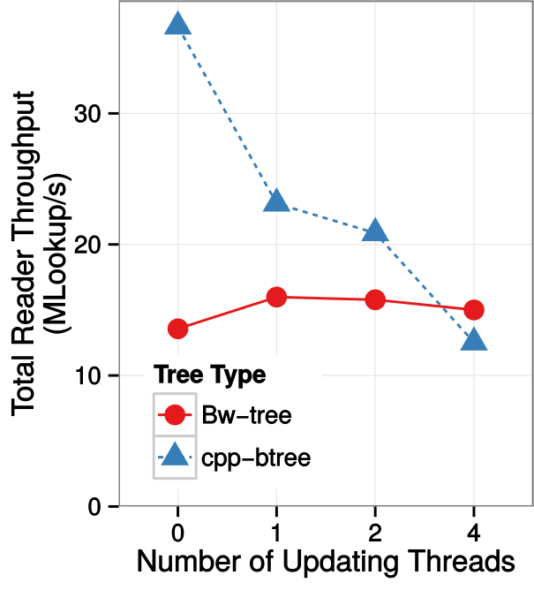
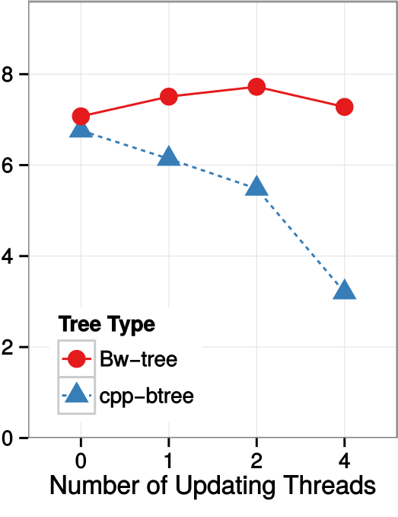
Read-write Contention
Q2: What if all technical limitations are overcome?
Workload A
Workload B
Experimental Setup
4 read-only point lookup threads
0-4 write-only point update threads
Zipfian skew (s = 2)
Workload A
Fixed-length 8-byte keys & payload
Workload B
Variable length (30-70 byte keys)
256-byte payloads

Slide 15
Overview
Q1: Does HTM obviate the need for crafty lock-free designs?
Q2: What if all technical limitations are overcome?
Q3: Can lock-free data-structures benefit from HTM?

Slide 16
HTM-enabled Lock-free B-Tree
Q3: Can lock-free data-structures benefit from HTM?
Bw-Tree Problem: Code complexity
Structure modification operations (SMOs) such as page split, merge require multi-word CAS
Bw-Tree separates SMOs into multiple sub-operations
Reasoning about all possible race-conditions is hard
Use HTM as hardware support for multi-word compare-and-swap
SMOs can be installed in a single operation
Small transaction footprint -> avoid capacity problems

Slide 17
Conclusion
Does HTM obviate the need for crafty lock-free designs?
No. Technical limitations prohibit use of HTM as a general purpose solution.
What if all technical limitations are overcome?
No. There are still important fundamental differences.
Can lock-free data-structures benefit from HTM?
Yes. Using HTM for MW-CAS can simplify lock-free designs

Slide 18
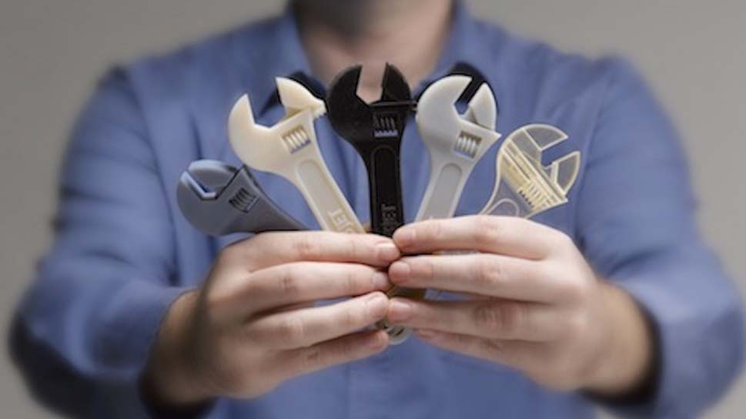



Conclusion

