Slide 1





SALSA
Stochastic Approach for Link-Structure Analysis
A comprehensive exploration of fundamental algorithms for web search ranking and link structure analysis
PR
SALSA
HITS
PageRank
SALSA
HITS
Justin-Marian Popescu | DMDW

Slide 2

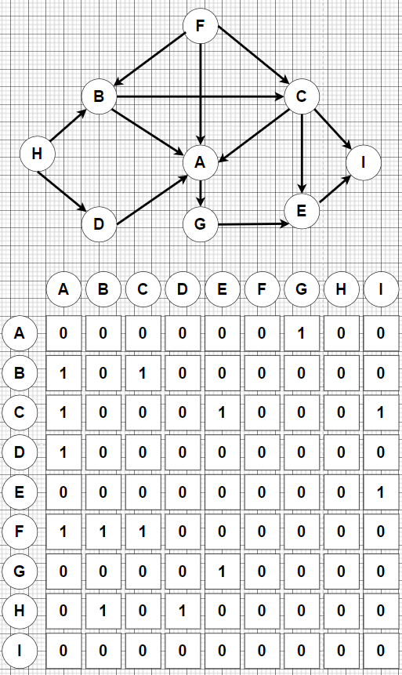


Introduction and Problem Context
Link analysis algorithms assess the significance of nodes in networks through their connections, offering key methods for web search ranking and structural network analysis.
Web Search Applications
PageRank formed the foundation of Google's search algorithm
SALSA combines benefits of both approaches for community discovery
HITS provides topic-specific search by distinguishing hubs and authorities
Graph Theory Applications
Centrality measurement for network analysis
Identification of authoritative sources in information networks
Community detection in social networks
SALSA (Stochastic Approach for Link-Structure Analysis)
2 / 17

Slide 3

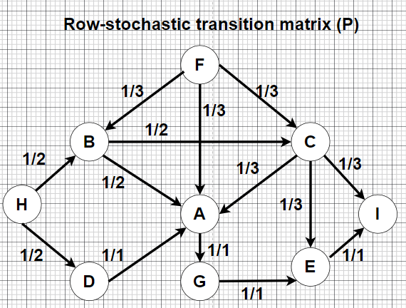

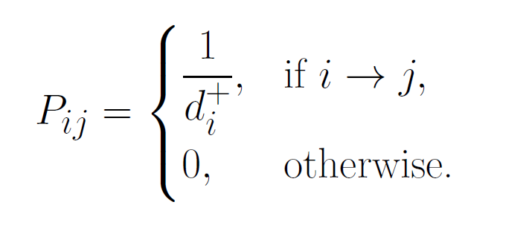








PageRank Formulation
Definition
Given a directed graph with adjacency matrix , let the row-stochastic transition matrix P be:
where di+ is the out-degree of node i.
Damped Random Walk
Key Properties
Unique stationary distribution (because of teleportation)
Captures global influence, not just local structure
where α ∈ (0, 1) is the damping factor (usually 0.85),
and v (vector) is the teleportation vector (often uniform: vi = 1/n).
Equivalent to eigenvector centrality on the Google matrix M
Iterative Computation
Interpretation
Convergence is guaranteed because the matrix M
is stochastic, irreducible, and aperiodic.
πi = steady-state probability that a random surfer visits node i.
A node's PageRank is high if many important nodes link to it, forming a recursive definition of importance.
SALSA (Stochastic Approach for Link-Structure Analysis)
4 / 17

Slide 4


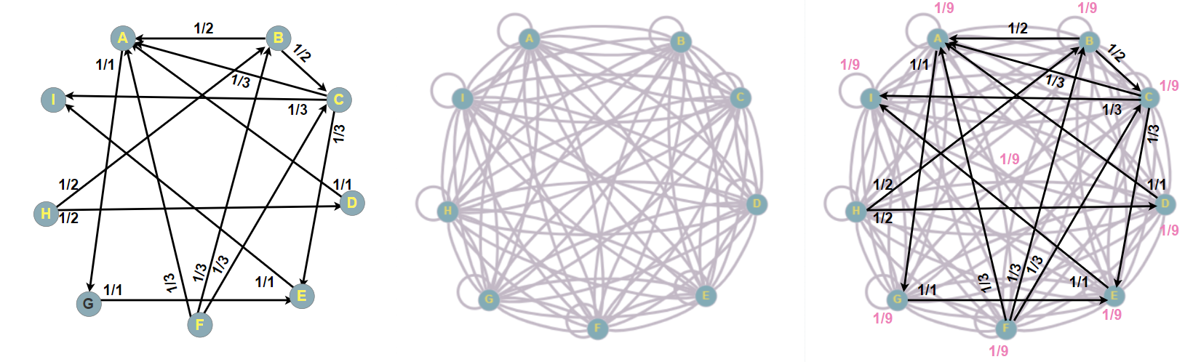




PageRank Algorithm Overview
What is PageRank?
PageRank measures the global importance of
web pages based on the probability that a random surfer lands on them.
Random Surfer Model
Models a user who randomly follows hyperlinks
Occasionally jumps to a random page
(teleportation)
Ensures every node can be reached
Global Importance
Key Insight
Captures global influence, not just local structure
Recursive definition of importance
For the added edges must be multiplied with (1- α) and for the existing ones with α.
Forms the basis of Google's search algorithm
A node's PageRank is high if many important nodes link to it, forming a recursive definition of importance.
SALSA (Stochastic Approach for Link-Structure Analysis)
3 / 17

Slide 5















PageRank Properties and Applications
Key Properties
Practical Applications
Unique Stationary Distribution
Web Search Ranking
Teleportation ensures a unique steady state probability vector.
Measures importance of nodes in networks.
Global Influence Measurement
Graph Centrality
Captures global importance, not just local neighborhood structure.
Foundation of Google's PageRank algorithm since 1998.
Convergence Guarantees
Matrix is stochastic, irreducible, and aperiodic.
Eigenvector Centality
Equivalent to eigenvector centrality on the Google matrix M.
SALSA (Stochastic Approach for Link-Structure Analysis)
5 / 17

Slide 6








HITS Algorithm
Introduction
HITS (Hyperlink-Induced Topic Search) introduces a dual-role link analysis model in which each page is evaluated both as an authority and as a hub.
Dual Role Model
Hub Score: Good collector of authority pages
Key Insight
Authority Score: Good information source
HITS differs from PageRank by using a dual ranking approach. While PageRank assigns a single global importance score, HITS provides two complementary scores that reveal different aspects of a node's role in the network. Developed in 1999.
Mutual Reinforcement
Hubs point to authorities, and authorities are pointed to by hubs,
creating a self-reinforcing cycle.
Web Context
Hubs
Authorities
Directories or aggregators
Content-rich pages
SALSA (Stochastic Approach for Link-Structure Analysis)
6 / 17

Slide 7










HITS Formulation
HITS algorithm computes hub and authority scores by performing eigenvector analysis on the network’s adjacency matrix, revealing nodes that best represent information sources and authorities.
Mathematical Formulation
Authority scores:
Authority of a node: sum of hub scores of nodes linking to it.
Hub of a node: sum of authority scores of nodes it links to.
Hub scores:
Authority:
Hub:
Key Mathematical Properties
Step-by-step
Converges to principal eigenvectors of (hub, authority)
1) Start with initial vectors: h(0)=1n, a(0)=1n
Non-stochastic, may produce multiple disconnected eigenpairs
2) Repeat until it converges or maximum number of iterations reached:
Sensitive to local subgraphs and query-dependent subwebs
2) Update authority scores: a(t+1) = $A^{T}$h(t)
3) Update hub scores: h(t+1) = Ah(t+1)
4) Normalize after each step
SALSA (Stochastic Approach for Link-Structure Analysis)
7 / 17

Slide 8











HITS Properties and Characteristics
Non-stochastic Nature
Unlike PageRank, HITS uses algebraic normalization
May produce multiple disconnected eigenpairs
Convergence depends on the graph structure
Local Structure Sensitivity
Key Implications
Highly sensitive to local subgraphs
HITS dual ranking system makes it particularly effective for topic-specific search, identifying both directories/aggregators (hubs) and content-rich pages (authorities). However, its sensitivity to local structures limits its applicability in broader network analysis.
Query-dependent subwebs can dramatically change results
May not reflect global network structure
Dual Ranking System
Produces 2 separate rankings:
Hub scores: Quality as a collector of authority pages
Authority scores: Quality as an information source
SALSA (Stochastic Approach for Link-Structure Analysis)
8 / 17

Slide 9
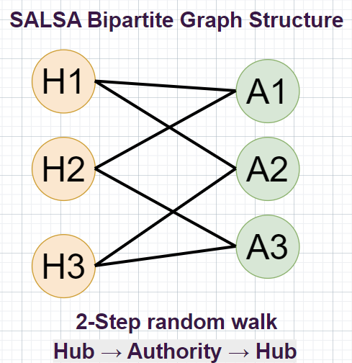








SALSA Algorithm
What is SALSA?
SALSA (Stochastic Approach for Link-Structure Analysis) merges PageRank's stability with HITS' role distinction.
Key Features
Builds a bipartite graph of hubs and authorities
Runs two Markov chains on different graph sides
Uses stochastic normalization for stability
Performs two-step random walks on the bipartite graph
Algorithmic Benefits
Hubs
Authorities
Robust against local structure changes
SALSA vs. PageRank vs. HITS
Detects natural communities in networks
PageRank
SALSA
HITS
Produces stochastic hub and authority scores
Global importance
Stochastic roles
Role separation
Guaranteed convergence
Teleportation
Bipartite walks
Eigenvector
SALSA (Stochastic Approach for Link-Structure Analysis)
9 / 17

Slide 10
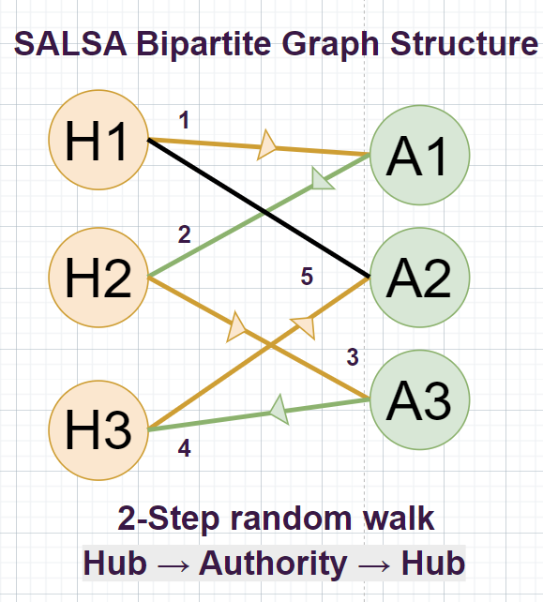

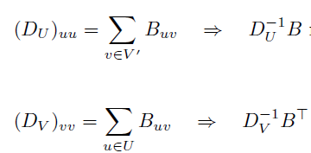





SALSA Formulation
Bipartite Graph Construction
Given directed graph G = (V, E):
U = {u ∈ V: du > 0} (hubs – offers links to others)
V' = {v ∈ V: dv > 0} (authorities – receives links from others)
Bipartite adjacency (B):
Two-Step Random Walk
Hubs
Authorities
For hubs: u → v → w (hub → authority → hub)
Key Properties
For authorities: v → u → w (authority → hub → authority)
Stochastic normalization ensures convergence
Robust to local structure changes
SALSA (Stochastic Approach for Link-Structure Analysis)
10 / 17

Slide 11






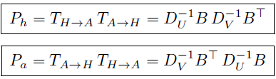
SALSA Properties and Benefits
Key Properties
Key Benefits
Stochastic Normalization
Community Detection
Stability
Random walks with teleportation, ensuring stable
results regardless of graph structure.
Identifies natural hub and authority clusters
Robust to graph structure changes
Role-Based Ranking
Hybrid Approach
Dual Ranking
Hubs & authorities as separate dimensions
Combines global and local information
Produces 2 stochastic role rankings (hubs + authorities)
instead of one global ranking.
Transition Matrices Pa & Ph + PageRank applied on them
Moderate Sensitivity
More robust than HITS but still captures local structure
information effectively.
SALSA (Stochastic Approach for Link-Structure Analysis)
11 / 17

Slide 12













Experimental Setup and Datasets
Framework & Parameters
Evaluation Metrics
Dataset Characteristics
Parameter
Value
Accuracy
Web Graphs ego-Facebook
Damping Factor (α)
0.85 (PageRank)
Proportion of correctly ranked nodes
Directed links between web pages
Global structure analysis
Maximum Iterations
1000
Computational Time
Convergence Threshold
1e-6
Execution time and convergence rate
Social Networks soc-sign-bitcoin-otc
User-follow relationships
Community detection
Teleportation Vector
Uniform (1/n)
Scalability
Random Restart Rate
1-α = 0.15
Performance on varying network sizes
Academic Networks wiki-Vote
Normalization
Stochastic (sum=1)
Citation patterns
Authority detection
SALSA (Stochastic Approach for Link-Structure Analysis)
12 / 17

Slide 13














Comparative Results Analysis
Performance comparison across different graph structures and applications:
Characteristic
PageRank
SALSA
HITS
Normalization
Stochastic (probabilistic)
Stochastic (probabilistic!)
Algebraic (eigenvector)
Random walks
Global with teleportation
2-step on bipartite
None
Sensitivity
Global
Moderate
Local (query-based)
Output
Global importance
Stochastic hubs & authorities
Hubs & authorities
Convergence
Guaranteed (ergodic)
Guaranteed (Markov chain)
Depends on structure
PageRank Strengths
SALSA Strengths
HITS Strengths
Very stable (teleportation)
Robust stochastic approach
Topic-specific analysis
Global importance measurement
Community discovery capability
Clear role separation (hubs/auths)
Guaranteed convergence
Hybrid ranking performance
Identifies link structure patterns
Application Recommendations
Web search ranking: PageRank
Community discovery: SALSA
Topic-specific search: HITS
Link analysis: PageRank
Hybrid ranking: SALSA
Link structure analysis: HITS
SALSA (Stochastic Approach for Link-Structure Analysis)
13 / 17

Slide 14























Algorithm Comparison Summary
Comparison Aspect
PageRank
SALSA
HITS
Normalization
Stochastic
Stochastic
Algebraic
Convergence
Guaranteed
Guaranteed
Depends on structure
(Ergodic)
(Markov chain)
Output Type
Single global rank
Two stochastic ranks
Two role-specific ranks
Sensitivity
Global
Moderate, robust
Local (query-based)
Unique Characteristics
Key Insight
Algorithm Selection
PageRank: Global importance
via teleportation
Web search: PageRank
(global importance)
SALSA uniquely combines PageRank's global approach with HITS' role-based separation, creating a robust algorithm that's sensitive to local structure while maintaining global stability.
HITS: Dual role model with
mutual reinforcement
Topic-specific search: HITS
(role separation)
SALSA: Stochastic normalization
ensures stability
Community discovery: SALSA
(role separation + global importance)
SALSA (Stochastic Approach for Link-Structure Analysis)
14 / 17

Slide 15

























Discussion and Practical Implications
Global vs Local Ranking Approaches
Global Approaches
Local Approaches
PageRank: Random surfer model → global importance
HITS: Topic-specific search → role separation
Captures global network influence, not just local structure
Sensitive to local subgraphs and query-dependent subwebs
Very stable with teleportation guaranteeing convergence
May have multiple dominant eigenpairs for bipartite graphs
Algorithm Selection Criteria
Algorithm
Best Use Case
Key Advantage
Implementation Note
PageRank
Web search ranking, graph centrality
Global importance with teleportation
Parameter α = 0.85
SALSA
Community discovery, hybrid ranking
Stochastic role-based with communities
Better for query-independent tasks
HITS
Topic-specific search, link analysis
Role separation (hubs & authorities)
May need multiple runs for stability
Key Insight 1
Key Insight 2
Algorithm choice depends on whether you need global importance (PageRank) or role-based analysis (HITS/SALSA).
For practical applications, consider stability requirements and convergence guarantees before algorithm selection.
SALSA (Stochastic Approach for Link-Structure Analysis)
15 / 17

Slide 16

















Conclusions and Future Directions
PR
PageRank
SALSA
SALSA
HITS
HITS
Global importance measurement
Combines PR and HITS benefits
Role separation (hubs/authorities)
Very stable with teleportation
Community detection capability
Mutual reinforcement mechanism
Convergence
Guaranteed
Convergence
Guaranteed
Convergence
Depends on structure
Recommendations
Web Search:
PageRank for global importance, SALSA for topic communities
Temporal link analysis for evolving networks
Link Analysis:
Integration with content analysis for semantic ranking
HITS for topic-specific hubs/authorities, SALSA for dynamic communities
Scalable implementations for massive graphs
Community Detection:
Robustness to link spam and adversarial attacks
SALSA for natural communities, HITS for topic clusters
SALSA (Stochastic Approach for Link-Structure Analysis)
16 / 17

Slide 17








References and Bibliography
PageRank
SALSA
Page, L. and Brin, S. (1998).
Lempel, R. and Moran, S. (2000).
Anatomy of a large-scale hypertextual Web search engine.
The stochastic approach for link-structure analysis (SALSA) and the role of authorities.
Proceedings of the 7th International Conference on World Wide Web (WWW), 539-550.
Proceedings of the 9th International Conference on World Wide Web (WWW), 552-561.
Page, L., Brin, S., Motwani, R., and Winograd, T. (1999).
The PageRank citation ranking: Bringing order to the Web.
Technical Report, Stanford University.
HITS
Additional Resources
Kleinberg, J.M. (1999).
SNAP (Stanford Network Analysis Project)
Authoritative sources in a hyperlinked environment.
Collections of datasets and tools for link analysis.
Journal of the ACM, 46(5), 604-632.
https://snap.stanford.edu/index.html
Kleinberg, J.M. (1998).
UCLA Office of Advanced Research Computing (OARC)
Hubs, authorities, and communities.
https://www.youtube.com/watch?v=V_liCwE_ZoI
ACM Computing Surveys, 30(2), 173-177.
SALSA (Stochastic Approach for Link-Structure Analysis)
17 / 17

