Slide 1
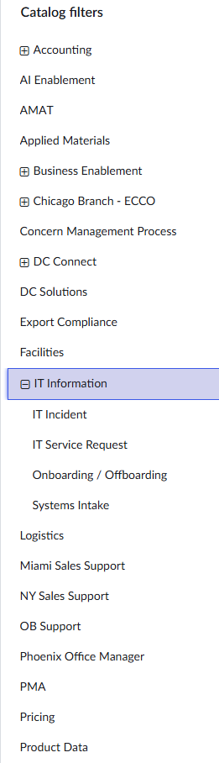
PROBLEM · 1/6
We rent a ticketing system we fight with
• ServiceNow costs ~$300k/year — and every workflow change requires a lot of human effort
• Agents spend their time ROUTING tickets, not fixing them: manual categorization, priority guessing, the Service Desk relay to other departments
• Requesters get a form with 12 dropdowns and a black hole afterward
★ Over 3 years: ~$950k for software that still makes a human read every ticket first
From our ticket intake web portal - 52 different queues! ->
METS — Master Electronics Ticketing System

Slide 2
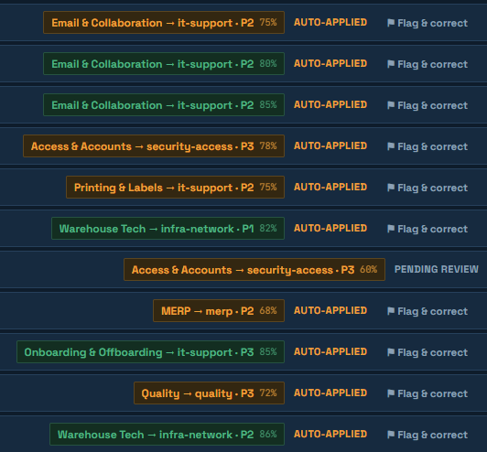
APPROACH · 2/6
Describe the problem. The system does the rest.
• METS (Master Electronics Ticketing System) - Built in one week, solo, with Claude Code — AI-native, not AI-bolted-on, plus the whole helpdesk toolkit: SLAs, approvals, escalations, RBAC, public API, ServiceNow import
★ Every ticket is read by AI as it lands: category, queue, priority in seconds — auto-applied above a confidence gate, held for a human below it, every decision logged and one click to revert
• Corrections become routing patterns: dragging a ticket to the right queue IS training
• Ten AI workflows on one pipeline: triage that reads screenshots and shows its work, deflection, outage detection, KB drafting, fix suggestions from past resolutions, guided intake, bilingual tickets, weekly briefing, search, draft replies
• It spends like an engineer: rules route deterministic tickets for free (SOTO suggests them itself), a mid-tier model triages the routine, the big model steps in only under the gate.
METS — Master Electronics Ticketing System

Slide 3
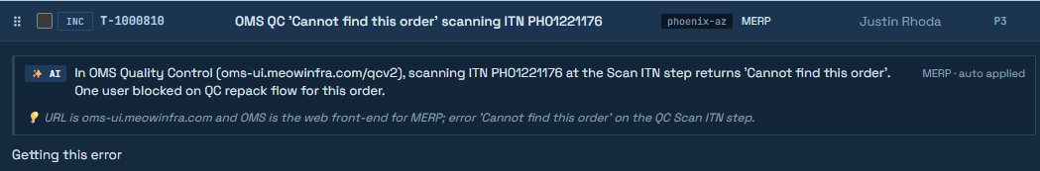
DEMO HIGHLIGHTS · 3/6
Live Demo - http://10.164.0.235/
★ Paste a screenshot — no category, no subject → SOTO shows its work signal by signal, routes with confidence meters, and writes the subject with the error code read from the image
• Three “Zoom is down” reports → one suspected incident, company-wide banner, every requester told “you’re not alone”, one status change closes them all — and admins can Flag → Escalate any ticket instantly, no AI needed
• 💡 Suggest fix → SOTO proposes the resolution cited from the past tickets that fixed it — 665 resolutions embedded locally as searchable institutional memory, one click to insert into the reply
• A ticket arrives in Spanish → the agent reads and replies in English; the requester gets it back in Spanish — nobody translates anything
• ✨ SOTO suggests → it notices ticket patterns it keeps routing the same way and proposes bypass rules to stop paying for its own calls
METS — Master Electronics Ticketing System

Slide 4
ALSO IN THE BOX · 4/6
What a 15-minute demo can’t fit
• Self-service deflection — SOTO answers from the KB before the ticket is even filed
• KB auto-drafting — resolved tickets become draft articles for one-click review, with internal-only visibility control
• Weekly problem briefing — SOTO reads the whole queue and names the recurring problems worth root-causing
• Draft replies — grounded in KB articles, edited by the agent, never auto-sent
• Agent chat → ticket — one click turns a chat thread into a routed ticket; work stops hiding in chat
• Snooze & scheduled wake — drag to Holding, pick a date; the ticket comes back on its own
• Public API + live playground — key-scoped REST API; imported tickets still answer to their old ServiceNow numbers
• ServiceNow CSV import — history, ticket numbers, and requesters ride along on migration day
• Recurring tickets — the monthly printer PM files, triages, and routes itself on schedule
• AI kill switch + daily budget cap — one click degrades to keyword rules; spend can never run away
• Merge with a part-number guard — similar tickets combine; lookalikes with different part numbers don’t
• The table stakes, all real — SLAs, approvals, CSAT, VIP scoring, round-robin assign, templates, RBAC, audit trail
★ Every one of these is running live on this network.
METS — Master Electronics Ticketing System

Slide 5
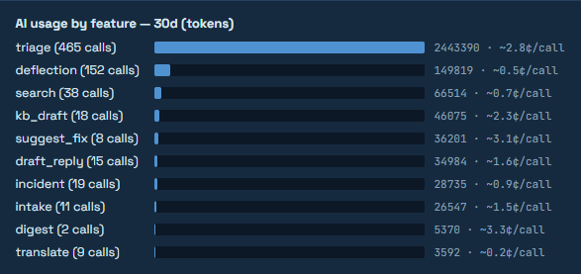
BUSINESS IMPACT · 5/6
The numbers are measured, not projected
★ ~$210k+/year saved vs the ServiceNow renewal (3-yr TCO: ~$90–320k vs ~$950k)
• AI routing: 89% accuracy · 78% fully automatic — measured from the audited decision log, not projected
• AI cost: 1-3¢ for a typical ticket, $0 for rule-routed ones — tiered models (cheap first, big only under the confidence gate), prompt caching, and self-suggested bypass rules bend the curve down; every call metered per model
• Self-service deflection + bot first-responses = agent hours back on real work
• Keywords, SLAs, approvals, VIPs, queues, even SOTO’s company knowledge — all live admin settings
METS — Master Electronics Ticketing System

Slide 6
WHAT'S NEXT · 6/6
What’s next: more AI, less toil
• On the roadmap now: asset tracking tied to tickets, problem management on top of the weekly briefing, a bilingual requester portal (ticket content already translates both ways)
• No lock-in: the AI vendor is a plug-in behind one interface — a one-click kill switch drops to keyword rules and the helpdesk keeps running
• Two activations, not builds: Entra SSO and mailbox email are written and dormant — one app registration each; migration day is a CSV upload (history, numbers, requesters come along)
• Honest debt, documented (PROPOSAL.md) — and the learning loop compounds: every correction and KB article makes next month better
METS — Master Electronics Ticketing System

