Slide 1
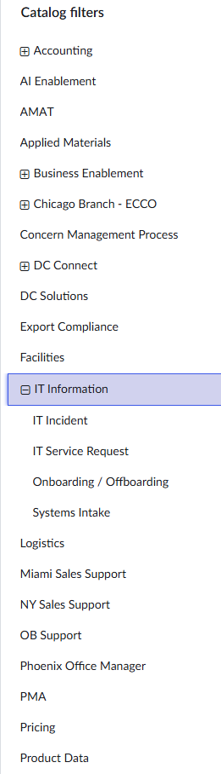
PROBLEM · 1/5
We rent a ticketing system we fight with
• ServiceNow costs ~$300k/year — and every workflow change requires a lot of human effort
• Agents spend their time ROUTING tickets, not fixing them: manual categorization, priority guessing, the Service Desk relay to other departments
• Requesters get a form with 12 dropdowns and a black hole afterward
★ Over 3 years: ~$950k for software that still makes a human read every ticket first
From our ticket intake web portal - 52 different queues! ->
METS — Master Electronics Ticketing System

Slide 2
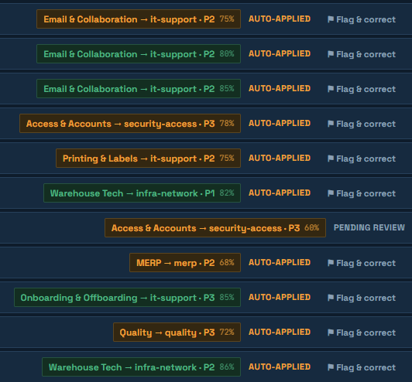
APPROACH · 2/5
Describe the problem. The system does the rest.
• METS (Master Electronics Ticketing System)— built in one week, solo, with Claude Code. AI-native, not AI-bolted-on.
★ Every new ticket is read by AI the moment it lands: category, queue, and priority assigned in seconds — applied automatically above a confidence bar, held for a human below it, every decision logged and one click to revert
• Corrections become routing patterns: dragging a ticket to the right queue IS training
• Nine AI workflows on one pipeline: triage (reads screenshots, writes subjects), deflection, outage detection, KB drafting, guided intake, bilingual tickets, weekly problem briefing, NL search, draft replies
• And the whole helpdesk toolkit: SLAs, approvals, escalations, RBAC, public API, ServiceNow import
METS — Master Electronics Ticketing System

Slide 3
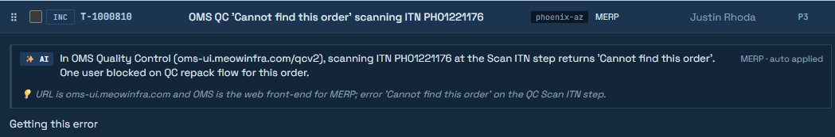
DEMO HIGHLIGHTS · 3/5
Five moments — in the video and live to try
★ Paste a screenshot, no category, no subject → routed at 97% confidence; the error code was read from the image
• Three “Zoom is down” reports → one suspected incident, company-wide banner, one status change closes them all — live in one click: the ⚠️ Incident Demo button
• “VPN keeps dropping” → SOTO Bot sends the fix; requester replies “solved”; ticket closes with zero agent involvement
• Databricks access → SOTO asks only what the ticket didn't answer, then routes straight to the Data Team
• A ticket arrives in Spanish → the agent reads and replies in English; the requester gets it back in Spanish — nobody translates anything
METS — Master Electronics Ticketing System

Slide 4
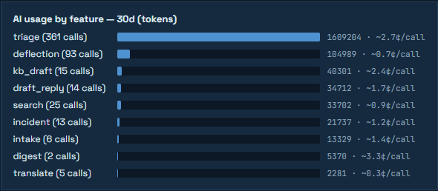
BUSINESS IMPACT · 4/5
The numbers are measured, not projected
★ ~$210k+/year saved vs the ServiceNow renewal (3-yr TCO: ~$90–320k vs ~$950k)
• AI routing: 88% accuracy · 80% fully automatic — from the audited decision log
• AI cost: ~2-3¢ to triage a ticket; ~$12/month at demo volume — scales linearly
• Self-service deflection + bot first-responses = agent hours back on real work
• Keywords, SLAs, approvals, VIPs, queues — all live admin settings
METS — Master Electronics Ticketing System

Slide 5
WHAT'S NEXT · 5/5
What’s next: more AI, less toil
★ On the roadmap: routing that learns from every past resolution, AI-suggested fixes surfaced to agents as they work, and asset tracking tied to tickets
• Two activations, not builds: Entra SSO and mailbox email are written and dormant — one app registration each
• Migration day is a CSV upload: history, numbers, and requesters come along
• Honest debt, documented: durable jobs, embedding scale, retention (PROPOSAL.md)
• The learning loop compounds — every correction and KB article makes next month better than this one
• Try it yourself during judging: http://10.164.0.235/— file a ticket, press ⚠️ Incident Demo
METS — Master Electronics Ticketing System

