Slide 1
Harmonic, Statistical, and Topological Methods for
Audio Classification
Justin Rogers

Slide 2
Preliminary: how do we store digital audio?
Wave formats (.wav, .mp3, .flac)
Ordinary way to store audio data.
Discrete approximation of the actual sound waves.
Large file size.
MIDI
“Digital sheet music”, standard across all electronic instruments.
Stores pitch, timing, velocity for each note.
Small file size.
Notes:
Wave formats are what you use if you actually want to listen to sound. They tell your speakers how to reproduce the original sound waves. There are different formats like .mp3, .flac, .alac, but the differences are negligible.
MIDI is basically digital sheet music. It’s a set of instructions for how to recreate the original song. You can’t listen to sheet music directly, it needs to be performed. Similarly, you don’t listen to MIDI files- you connect them to digital instruments, and then the digital instrument will render the song for you.
For the rest of the talk, if I say “MIDI note”, I’m talking about a note that you can find on a normal piano, like Bb4.

Slide 3
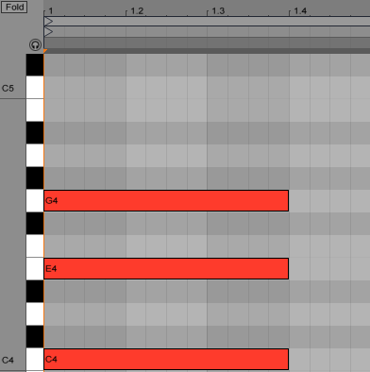
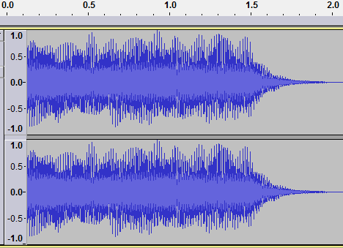
C Major chord: waveform and MIDI

Slide 4
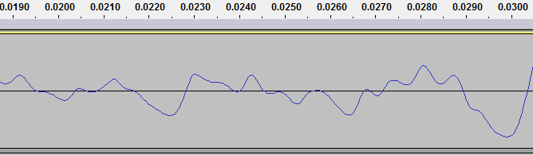
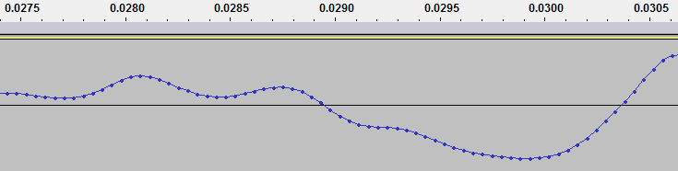
Same waveform, zoomed in
Notes:
Although it looks like a continuous wave at first, it’s not. As you zoom in, you can see that it’s just a lot of points with lines drawn between them.

Slide 5
Dataset and problem
NSynth dataset: an audio dataset with over 300,000 notes.
Each note is a 4-second recording of an instrument, stored in wave format.
There are 1006 different instruments, 88 possible pitches, 5 different velocities.
Instruments come from 11 different classes: e.g., guitar, keyboard, string.
Main Problem: Given an audio file containing a single note, what is its pitch?
Side problem: What sort of instrument is playing the note?
Notes:
We didn’t use the full dataset because it’s extremely large: we used 4000 notes. This is still plenty of data: over 7 hours of audio.
The velocity of a note indicates the musical dynamic: in this dataset, it ranges across “very soft,” “soft,” “medium,” “loud,” and “very loud”.
In terms of the information stored, each of these notes is a time series with 64000 data points. So, if we want to perform automatic classification, we somehow need an algorithm that starts with these 64000 data points and determines the pitch of the note as well as the instrument playing it.
For now, we’re going to focus on pitch classification.

Slide 6
Broad approaches to the problem
Signal processing methods
A collection of techniques for dealing with waves.
They work on an individual basis: we only need one datapoint.
Machine learning classification methods
A collection of techniques for data-based predictions.
Requires a large dataset, usually requires a lot of computing power.
Notes:
The main advantage of signal processing methods: we’re taking advantage of the structure of the problem. There’s a lot of math that we can use to analyze waves.
Machine learning methods generally “work for everything”: they look for patterns in your data, and make predictions based on those patterns.
SP is a bottom-up approach: it looks at individual notes. ML is a top-down approach: it studies large datasets of notes.

Slide 7
A combined approach
Machine learning methods aren’t optimized for high-dimensional data.
Signal processing ignores large-scale patterns in the dataset.
Approach: start with SP by compressing the data and making predictions.
Use ML on the compressed data+predictions, and end up with one final prediction that takes all information into account.
Notes:
Audio files are very high-dimensional: each of our notes has 64000 dimensions. This is generally bad in machine learning: it’s a phenomenon known as the “curse of dimensionality”. Having a higher dimension increases your runtime, memory usage, and gives worse results.
Signal processing methods are great if we’re looking at a single note, but we’re looking at 4000 notes-- we want to use the data to its fullest extent, and we might miss some important patterns in the data if this happens. It also doesn’t help very much with instrument classification-- we want to use machine learning for that.
So we use both methods: first we use signal processing, to compress the data into its most useful format and reduce the dimension as much as possible. Once we do that, we can make some predictions about the note’s pitch. Then we can use machine learning methods on the compressed data and our predictions, and come up with a final answer. The idea here is that we might have a few algorithms to classify pitch: they all make mistakes, but they’re different mistakes. Then we squish all of these algorithms together, and we end up with one final prediction that’s more reliable than all of its components.

Slide 8
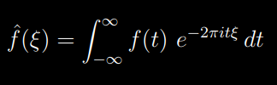

Fourier transforms
The Fourier transform is an operator that converts a function of time to a function of frequency.
For practical evaluation, we use the discrete Fourier transform.
Animation due to Lucas V. Barbosa
Notes:
Given some waveform, like a snippet of audio, we can think of it as a sum of sine waves. If you’ve taken Calc 2 and worked with Taylor series, this is pretty similar: in Taylor series, you approximate functions with polynomials. In the Fourier version, you approximate functions with sine and cosine. If you’ve taken linear algebra: sine and cosine are an orthonormal basis for a vector space of periodic functions.
To actually compute it, we have to evaluate this complicated-looking integral. “F hat of xi” is the amplitude of frequency xi: how much does it contribute to the total wave? For instance, maybe we want to know if our signal uses the frequency 440 hz-- we can plug in 440 for xi, evaluate the integral, and it tells us how important 440 hz is. Notice the “e^(-i)” part of the integrand-- that breaks down into a sine part and a cosine part, by Euler’s theorem.
For practical applications on real data, we can’t take that integral-- we’re working in a discrete setting, since we only have a finite amount of data. So that integral turns into a sum over all your data, and the Fourier transform becomes a lot easier: it can actually be computed by matrix multiplication, which is much easier than the continuous transform.
A less technical version: think of a spectrogram-- those rising/falling bars on a stereo. They tell you how much bass is playing, how much treble, how much of everything in the middle. The Fourier transform takes audio and converts it to the frequency spectrum.
It’s like buying IKEA furniture: instead of storing the entire sound, we store all the components necessary to build the sound.
If you’ve done some graphic design, there’s an analogous situation between raster and vector graphics: the former tells your computer exactly what pixels to light up, and what colors to use. The vector graphics format tells your computer what to draw, in terms of curves and polygons.

Slide 9
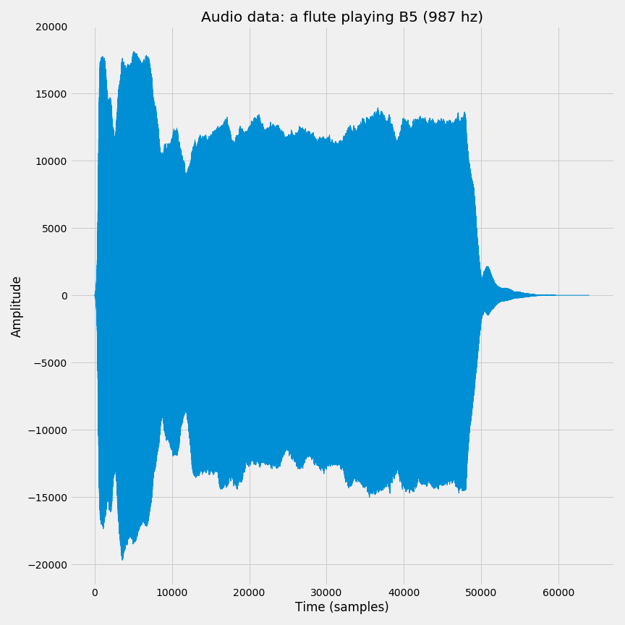
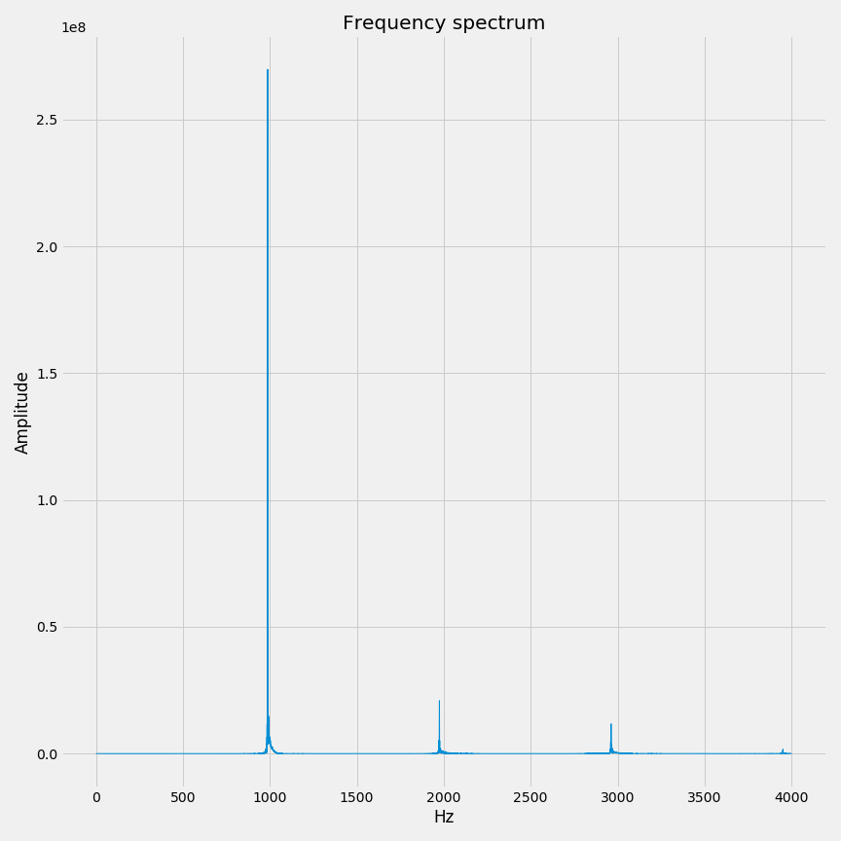
Fourier transform example
Notes:
The Fourier transform is incredibly important across most scientific disciplines, not just audio: it’s important in quantum physics, engineering, geology, astrophysics, optics, and anything that involves sending information, like the entire internet. In math it helps us solve differential equations and work with certain probability distributions.

Slide 10
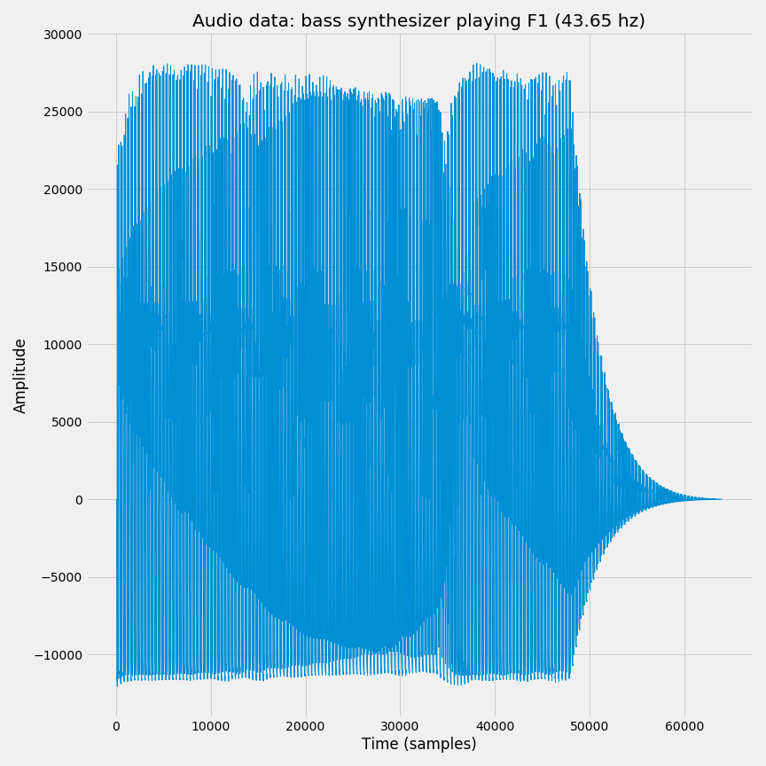
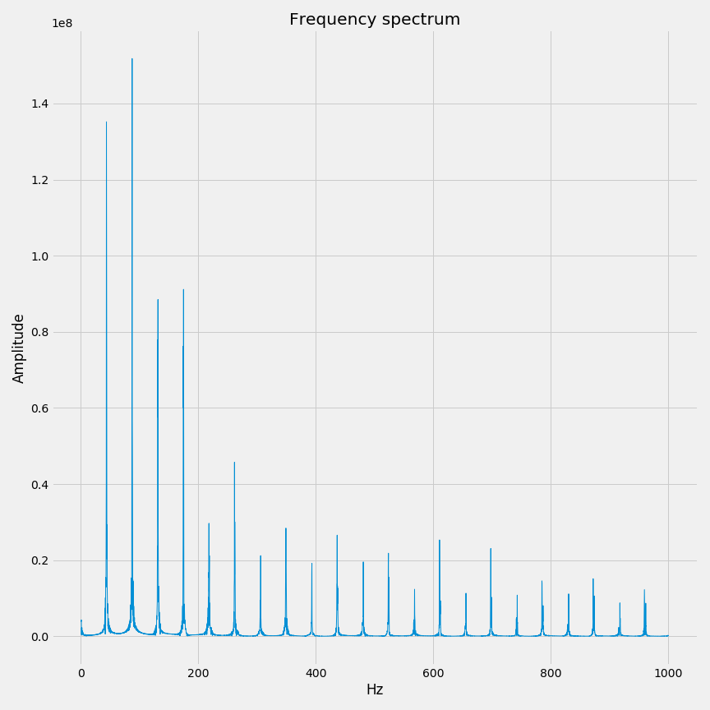
Another example
Notes:
In addition to being enormously useful, it can be performed very quickly. In 1964, mathematicians Cooley and Tukey published an efficient algorithm called the “fast Fourier transform”. This was a huge breakthrough, and it’s one of the most cited papers in math. Some people mark this as the beginning of the “information age,” because it’s so useful for data transmission.
It was later found that Gauss had discovered the same algorithm in 1805, used it to track the location of an asteroid, and then never published his work. This was actually over 15 years before Joseph Fourier introduced the Fourier transform. Gauss is magical like that.

Slide 11
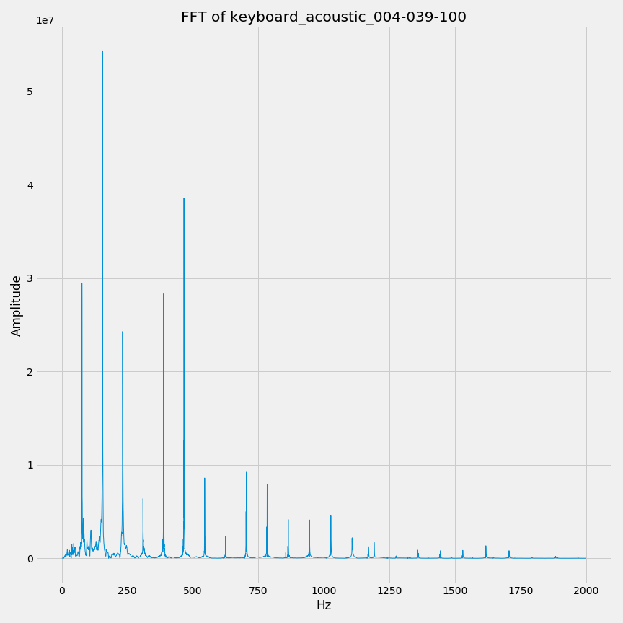
Algorithm 1: Most significant frequency
Given a note’s waveform, we take the Fourier transform.
Find the biggest peak in the Fourier transform.
Convert the frequency at that peak to a MIDI note- that’s our guess.
Notes:
So now that we have the frequency spectrum, this gives us a method to determine notes. It works about 60% of the time, which is pretty good! But what’s happening with the other 40%? We’ll have to clarify what exactly “pitch” means.

Slide 12
What do we mean by pitch?
If we wanted to reproduce some sound, what note would we have to play?
(E.g., D#4)
Instruments generally don’t produce pure tones: they produce a blend of frequencies.
Harmonics: all the individual frequencies that make up the note.
Fundamental tone: the lowest-frequency harmonic.
The pitch of a note is determined by its fundamental tone.
Notes:
Pitch usually refers to the human perception of frequency. Most instruments produce a lot of frequencies on top of each other, but we usually only perceive the lowest frequency, which is called the fundamental tone.
The rest of the harmonics change the timbre of the note: they help us distinguish the sound of a guitar from the sound of a flute. Let’s see what this looks like.

Slide 13
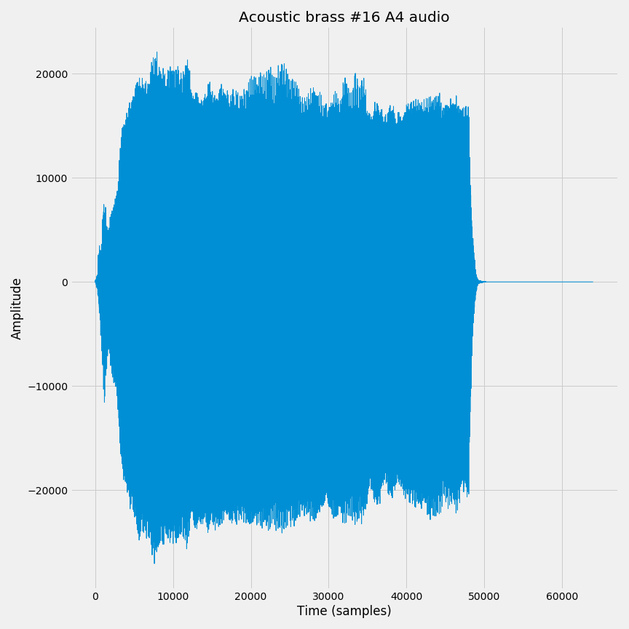
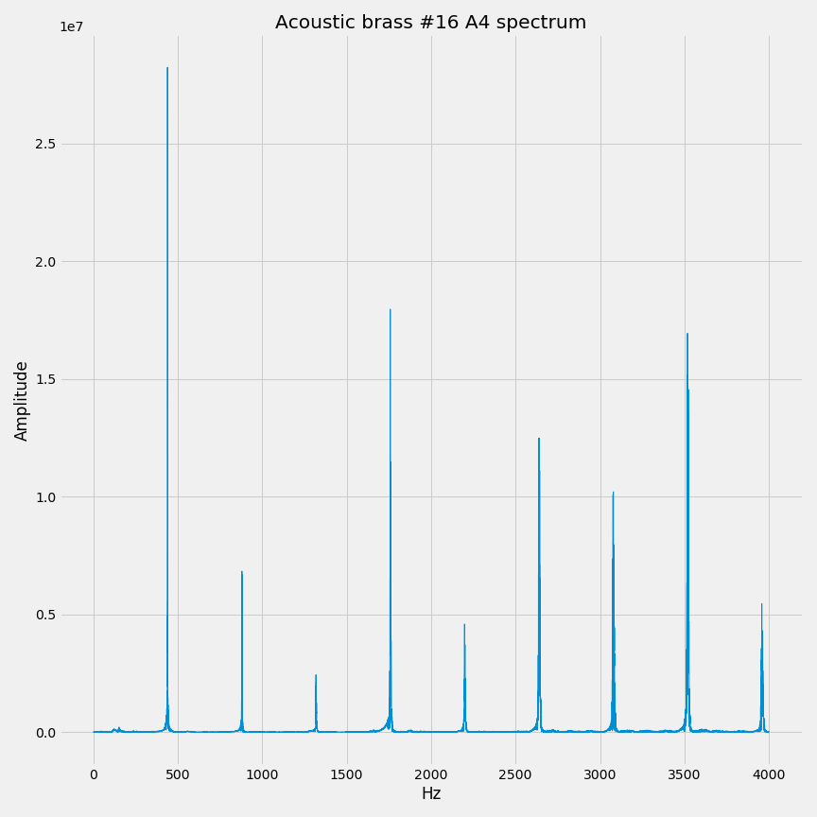
Example: A4 (440 hz), brass
Notes:
Let’s see some examples of this: 4 instruments playing the same note, but with very different spectra.
So far, we’ve been finding the “largest” harmonic: the one that stands out most in the signal. But what we actually need to find is the lowest-pitch harmonic, the fundamental tone. For this instrument, our method works: the biggest harmonic is also the lowest harmonic. [show with laser pointer]

Slide 14
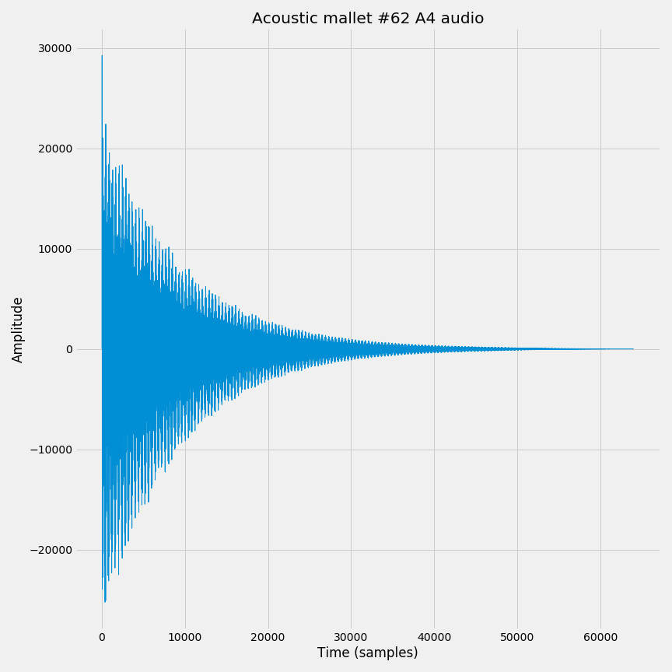
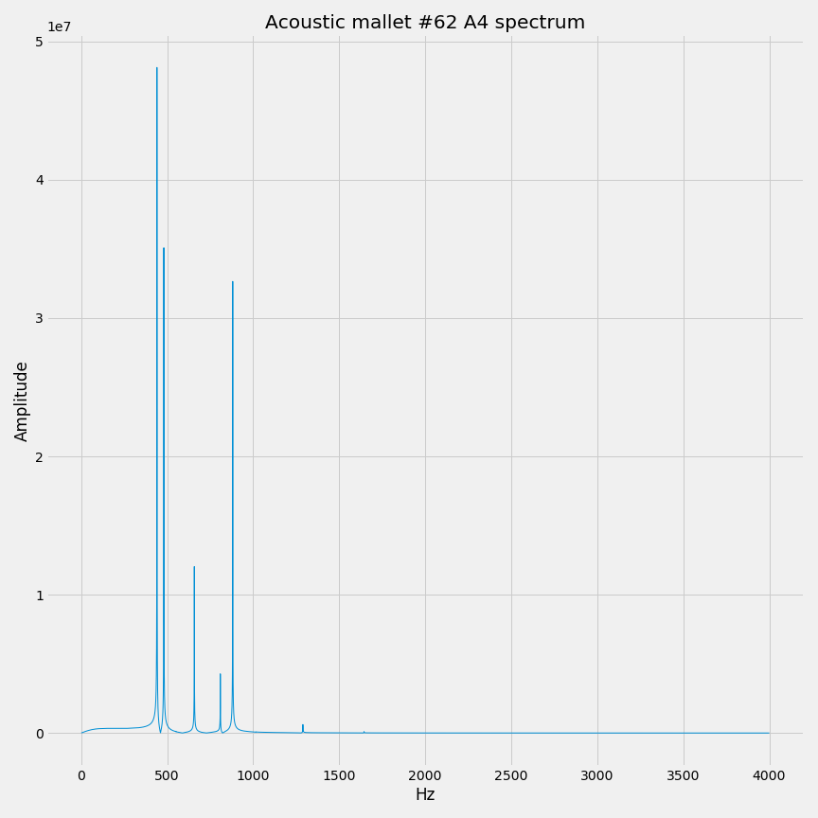
Example: A4 (440 hz), mallet
Notes:
This is the same note, but it’s played on a mallet-type instrument like an xylophone. The spectrum looks a little weird, but the method still seems to work. [Show how we get the biggest harmonic]

Slide 15
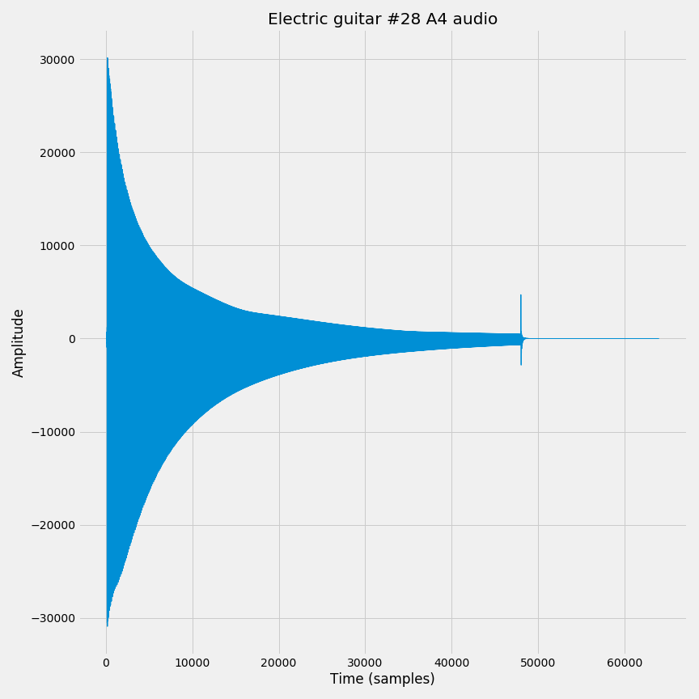
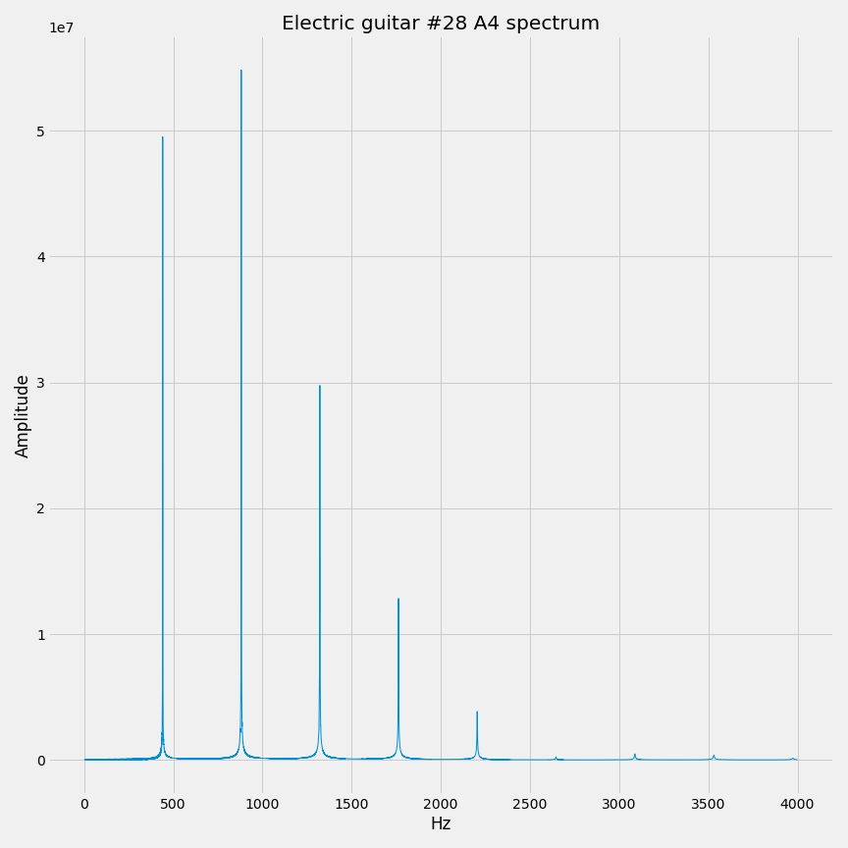
Example: A4 (440 hz), guitar
Notes:
This is an example where our algorithm fails. See that the biggest harmonic is right here, at 880 Hz? We would guess 880-- but the correct answer is 440. So we’d be an octave too high here.

Slide 16
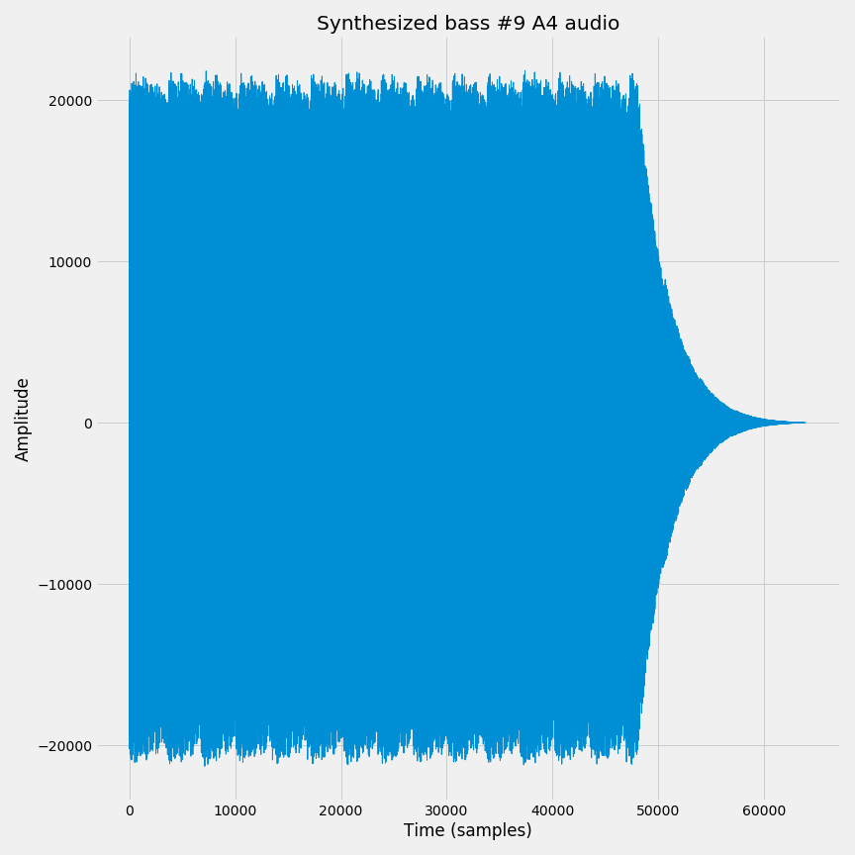
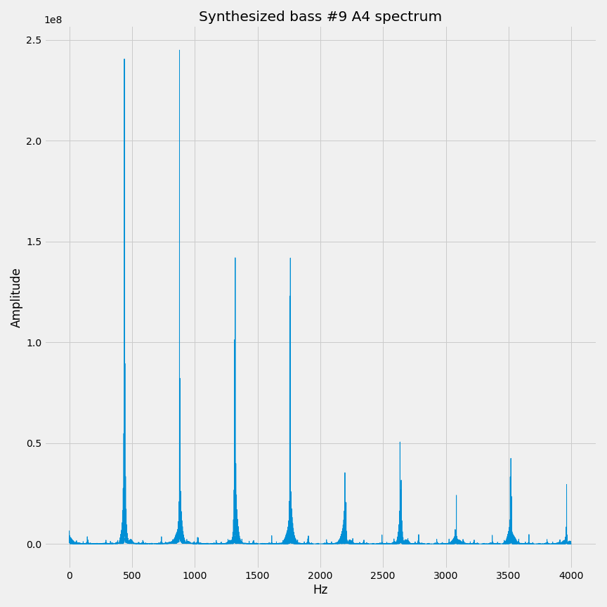
Example: A4 (440 hz), synth bass
Notes:
Last example is a bass synthesizer. It’s pretty close, but we’re an octave off here, as well.
So what can we actually do about this? We need to find a way to describe all the peaks in the spectrum, since each peak corresponds to a harmonic.

Slide 17
Peak difficulty 1: Distinguishing peaks
How can we tell if two points are on the same peak or not?
Notes:
The peaks are obvious to us, but how can we tell a computer to find peaks? It would be really nice to pull out, say, the 5 biggest peaks, since they probably correspond to harmonics. But how do we do this? If we just take the 5 biggest *points*, they might all be on the same harmonic. We need a way to determine if points are on the same harmonic, or different ones.
And if the situation looks like the split peak, we should count those as the *same* peak, not different peaks.
[Show noise in a graph: this collects at the low-end]
Problem 1. How can we tell if several points are part of the same peak?
Problem 2. Peaks are defined relative to their neighbors-- but we don’t want to call tiny bumps peaks.
Problem 3. How do we deal with split peaks? (Try to avoid counting the same peak twice.)

Slide 18
Peak difficulty 2: Rough edges
Peaks aren’t the same as local maxima-- the data is too noisy.
Notes:
My first thought was that peaks should correspond to local maxima in the graph. But this doesn’t work very well: these graphs are too erratic. Even after performing some smoothing operations, like convolution with bump functions, you’ll still get bad results. We need a notion of “big peak” versus “small peak,” and this just says “yes, this is a peak / no, this isn’t a peak” without a sense of scale.
Return to the last image with synth bass: local maxima aren’t good enough, because we’d pick up on all this noise.

Slide 19
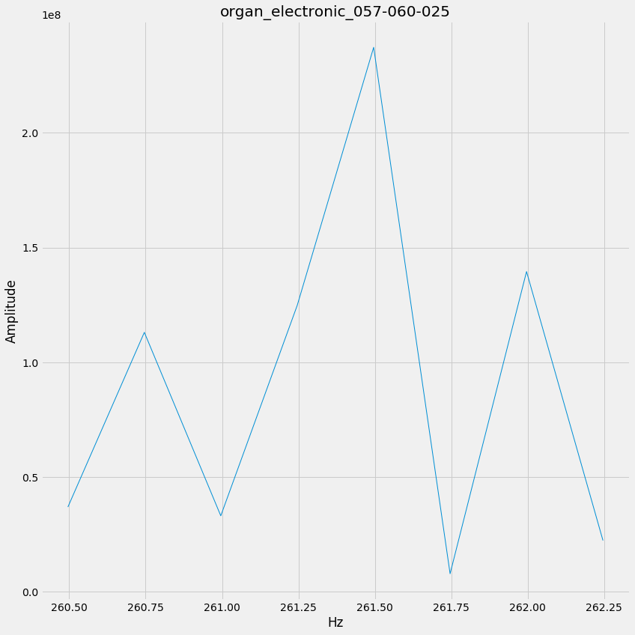
Peak difficulty 3: Split peaks
Notes:
In this situation, we zoomed in really close on the spectrum of an organ note. It looks like there’s two peaks at 261.5 and 262. But realistically, these should be part of the same harmonic- and if we have a situation like this, we don’t want to count it as two separate peaks.
So peak finding is kind of a tricky problem: it’s easy for humans, but hard to pin down exactly what we want for a machine.

Slide 20
Zero-dimensional persistent homology on graphs
0D homology: How many connected pieces make up the graph?
So far, all our graphs have only one component.
Persistent homology: If we build a graph piece by piece, how do its connected pieces change?
Notes:
The technique we use to solve the peak problem is called zero-dimensional persistent homology. This is a bit of a tricky topic, so bear with me for a minute, and then we’ll work an example. I’m sweeping most of the mathematical details under the rug, but ask me about at the end if you want something more precise.
Homology is a tool that gives us algebraic descriptions of topological spaces: instead of this mushy, hard-to-characterize geometric entity, you have a nice description you can write down. We’re interested in 0-dimensional homology of graphs, which tells us how many separate pieces, or connected components, make up the graph.
Persistent homology is a generalization of homology to filtered spaces. The idea is that we have a big, complicated graph along with a “complexity dial”. If the complexity dial is at 0, the graph is totally empty. As we turn it up, we add extra points and edges to our graph. If we turn the dial all the way up, then we have the whole graph. How does the homology change as we turn that dial?

Slide 21
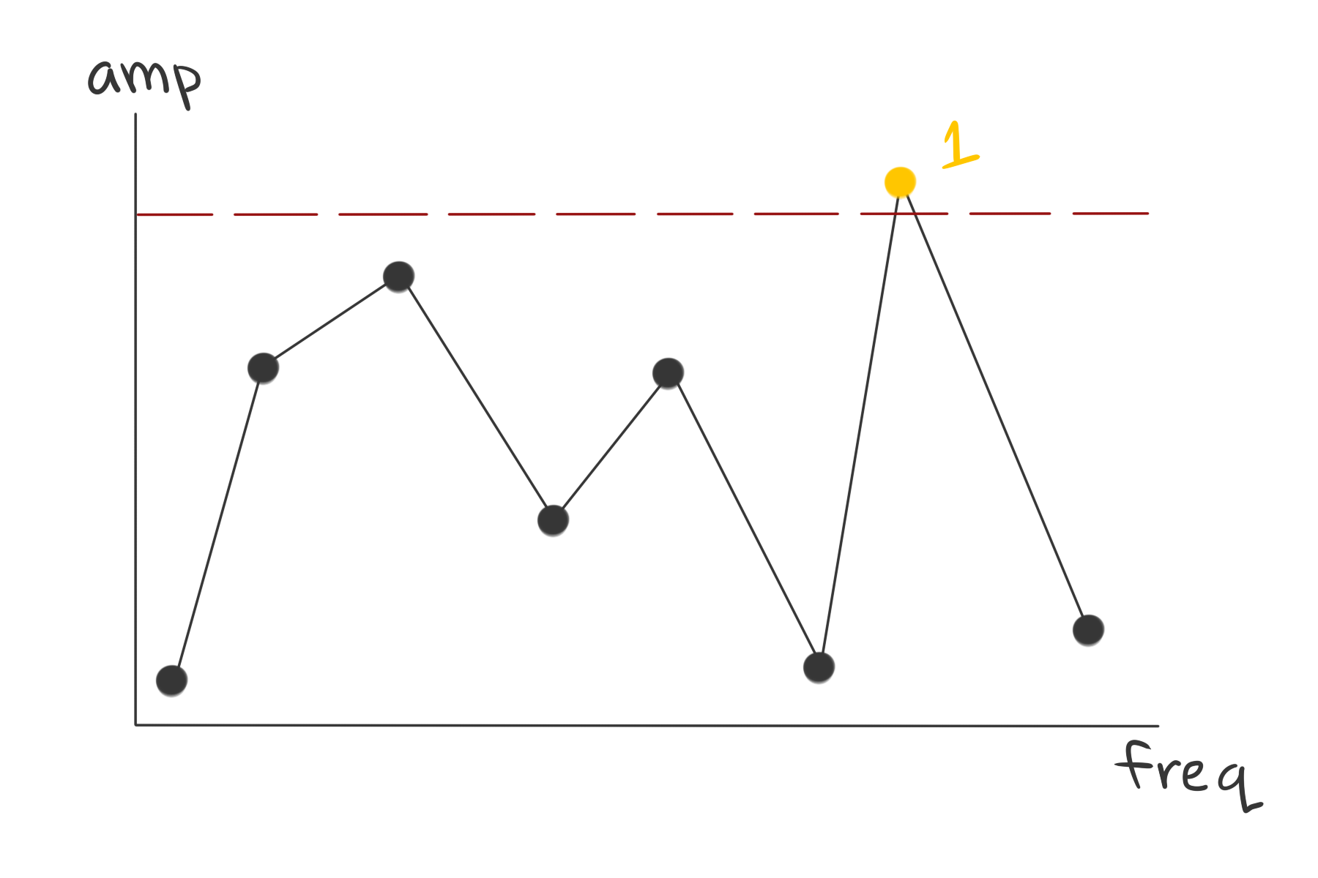
birth: a new component appears
death: if two components merge, the more recent component dies
persistence = time of death - time of birth
Notes:
I referred to a “complexity dial”, but it might be better to think of it as a “complexity slider.” We control the dashed bar: we slide it downward at a constant speed.
We only care about the upper portion of the graph, above the bar-- it’s highlighted in yellow. As we slide the bar down, we’ll keep adding points and lines to our graph.
We start out with a single node: this is a component being born.

Slide 22
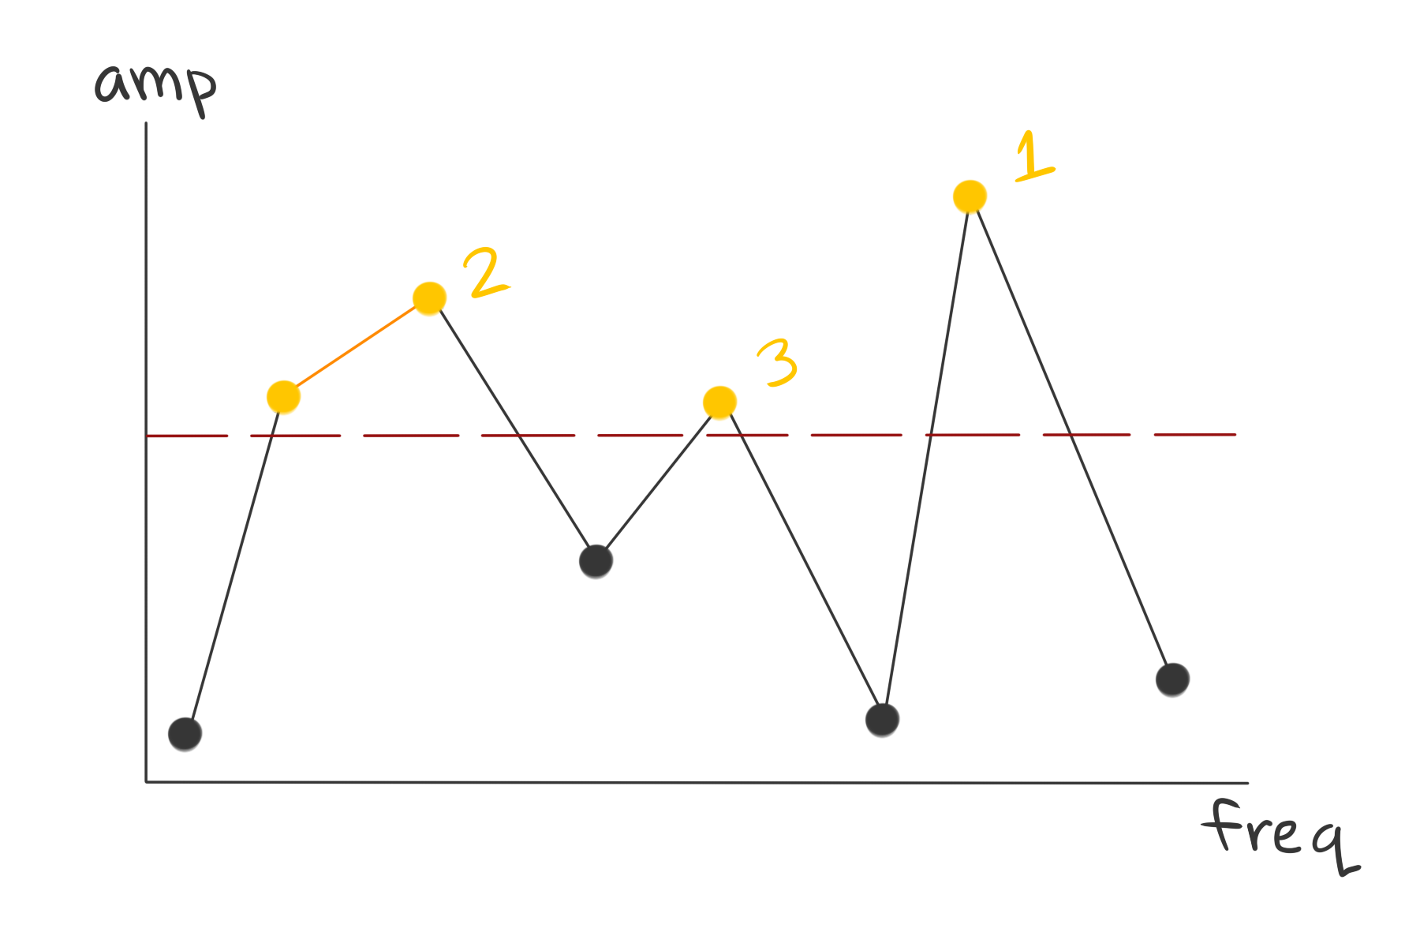
birth: a new component appears
death: if two components merge, the more recent component dies
persistence = time of death - time of birth
Notes:
As we slide the bar down a little, we get a couple more component births. Every time a component is born, we give it a label. Note that on the left, we didn’t get a component birth-- Component 2 just got a little bit bigger. Our yellow graph is still only 3 pieces.

Slide 23
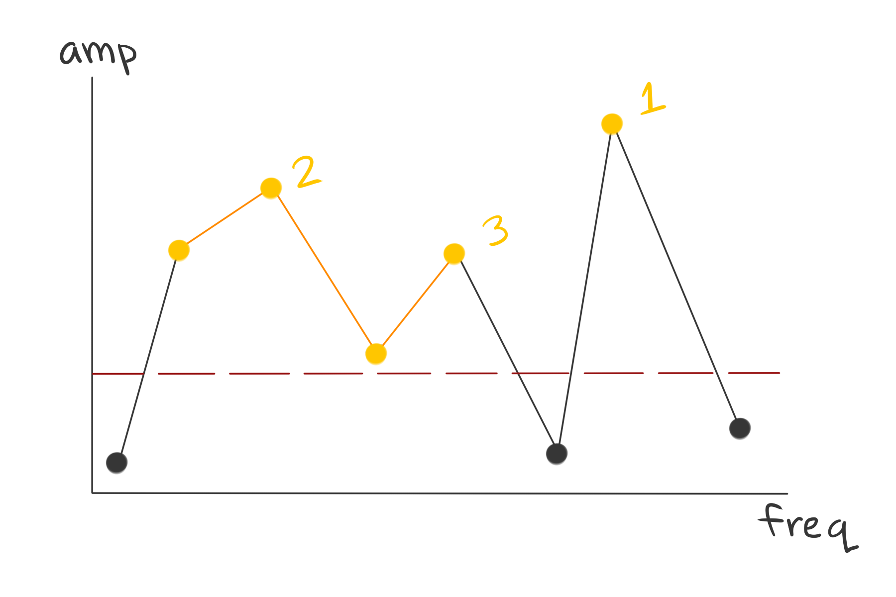
birth: a new component appears
death: if two components merge, the more recent component dies
persistence = time of death - time of birth
Notes:
As we slide the bar down, sometimes two pieces merge together: this is called the death of the younger component. In this case, the third component died-- it was absorbed by the second component.

Slide 24
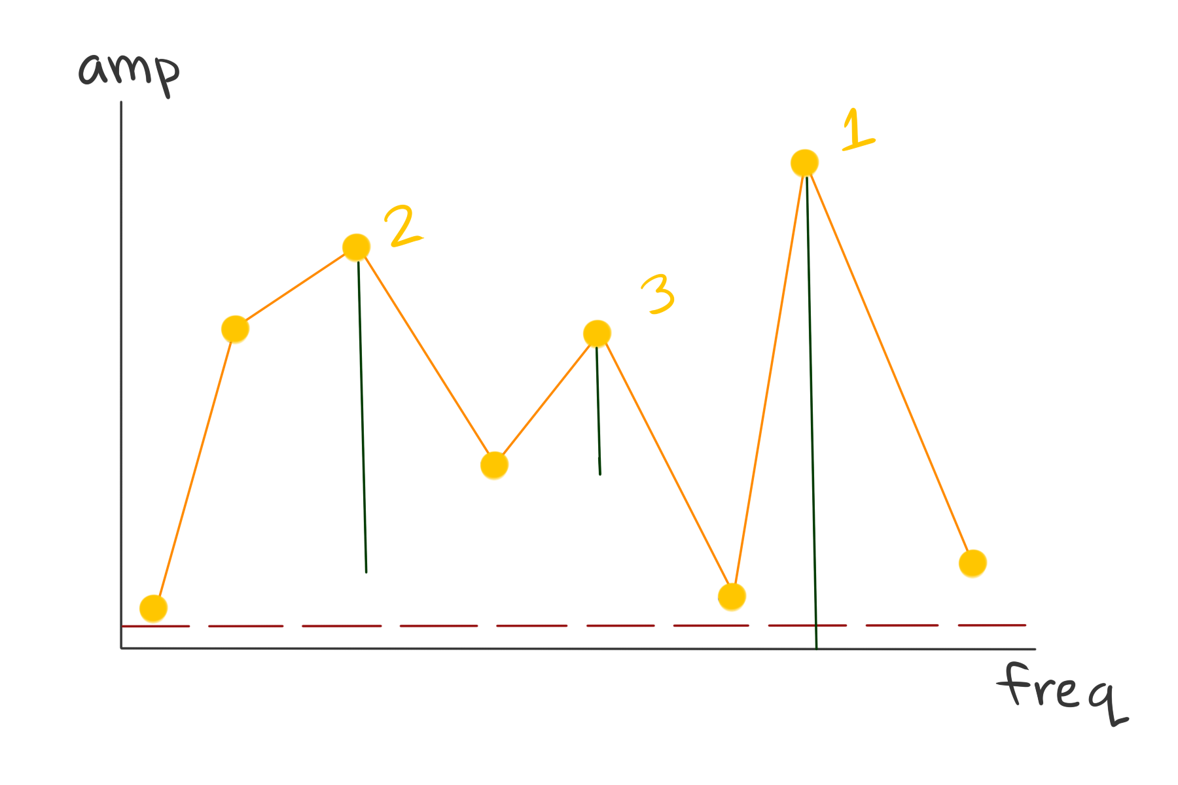
birth: a new component appears
death: if two components merge, the more recent component dies
persistence = time of death - time of birth
Indicated as vertical green bars.
Notes:
When the bar reaches the bottom of the graph, everything is connected again.
How long does each component last before it gets absorbed? That’s its persistence, indicated as a length in green. High persistence corresponds to significant peaks.

Slide 25
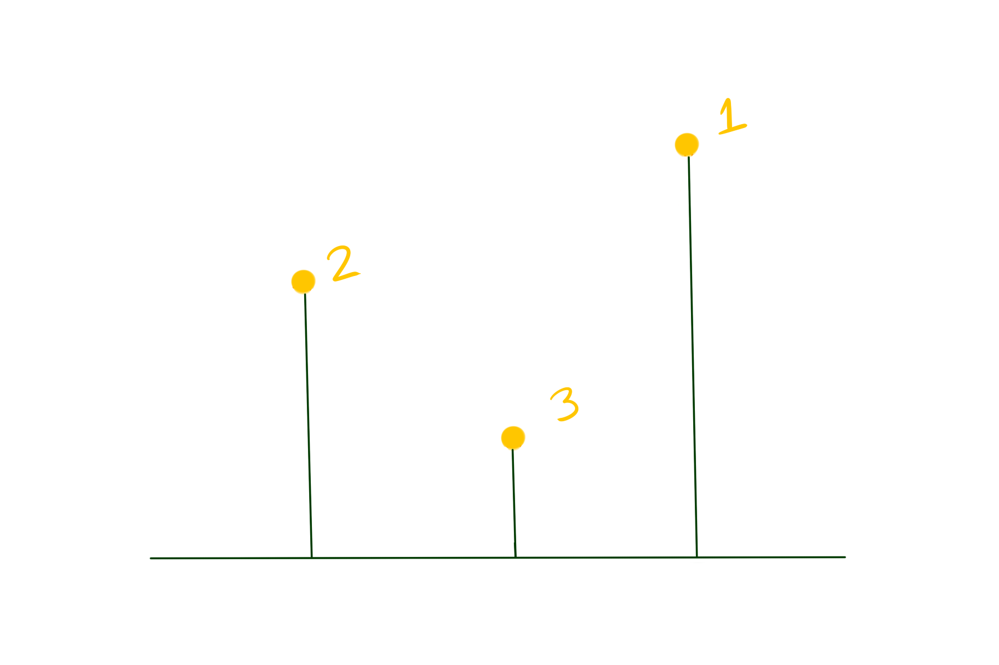
Persistence diagram
Notes:
If we clear away all the clutter and look only at the persistent components, we get this object called the persistence diagram. Big persistence corresponds to big peaks, small persistence corresponds to small peaks, tiny persistence corresponds to noise.
We had three difficulties with the peak problem before, so let’s revisit them.
Problem 1. How can we tell if several points are part of the same peak?
The persistence diagram solves this, too-- if several points are part of the same peak, the component absorbs all of those points.
Problem 2. Peaks are defined relative to their neighbors-- but we don’t want to call tiny bumps peaks.
The persistence diagram solves this problem: if there is a small bump, it will have small persistence, and we can ignore it.
Problem 3. How do we deal with split peaks? (Try to avoid counting the same peak twice.)
The persistence diagram does this as well-- look at the low persistence of component 3. Since it gets absorbed by 2 quickly, it has low persistence.

Slide 26
Benefits of the persistent approach
Summarizes important parts of the Fourier transform, using less memory.
Exact knowledge of peak locations.
We can decide experimentally which peaks are big enough to use.
Our cutoff: ignore anything below 15% of the highest persistence in the diagram.
Notes:
Persistent homology is really useful if you’re dealing with fuzzy, poorly-defined questions like “what is a peak?” It asks you “What do you mean by peak?” and tells you everything that might be a peak. Things that are definitely peaks have high persistence, things that might just be bumps have low persistence. We can then set a threshold: ignore everything below a certain persistence. After some trial and error, I set this threshhold to be 15% of the max persistence.

Slide 27
Persistence classification algorithms
Leftmost peak
Best peak
Persistent spectral harmonic correlation
Augmented version of Zahorian’s “Spectral harmonic correlation”.
Notes:
So, now we have a way to find all the peaks in the spectrum. [Leftmost peak]
Best peak essentially takes a large set of plausible guesses for the pitch, and then tests them all-- how closely do they fit the diagram? It predicts the harmonics that we should see, and checks to see if they’re actually there.
Spectral harmonic correlation is a method from the literature that’s pretty similar to my “best peak” method. It looks for the harmonics that should be there, and scores plausible guesses accordingly. This can be a little memory-intensive since you need the entire spectrum. I created a version that uses the persistence diagram instead of the whole spectrum-- this ends up using way less time and memory, and the results are within +-1% of the original SHC method.

Slide 28
Blending our algorithms: results on test dataset.
Best result: random forest classifier.
85% pitch accuracy
80% instrument accuracy
Notes:
I squished all my predictions together and fed them into some classification algorithms. The most effective was a random forest classifier: it attained 85% accuracy on pitch classification, and 80% accuracy on instrument classification across the 11 families of instruments. (Explain train/test split.)
These results could probably be improved-- the vast majority of my time was spent getting to this point, where we can plug data into a classifier. This was primarily nice as a proof-of-concept: the idea works!

Slide 29
Applications
Automatic music transcription
Speech recognition algorithms
Anything related to wave or time series analysis
Notes:
My dad is an engineering professor. I was recently talking to him about my research, and he was very interested-- he said that it could have applications in bioengineering, towards a solution of the “gait problem”. This is a tricky problem that needs to be solved before we can build a cool Iron Man exoskeleton. So hopefully this will be beneficial there.

Slide 30
Future work
Bottleneck distance
Wavelets
Real-time approaches
Chords

Slide 31
Acknowledgements
Dr. Panaggio (thesis advisor)
Dr. Gaebler (harmonic analysis consultant)
Stephanie Rose (graphical assistance)

Slide 32
Bibliography
Zahorian, Stephen A., and Hongbing Hu. “A Spectral/Temporal Method for Robust Fundamental Frequency Tracking.” The Journal of the Acoustical Society of America, vol. 123, no. 6, 2008, pp. 4559–4571., doi:10.1121/1.2916590.
Pereyra, M. & Ward, L. (2012). Harmonic Analysis: From Fourier to Wavelets.
Edelsbrunner, H. & Harer, J. (2010). Computational Topology: An Introduction.
Hastie, T., Tibshirani, R.,, Friedman, J. (2001). The Elements of Statistical Learning.

Slide 33
Bib
Scikit-learn: Machine Learning in Python, Pedregosa et al., JMLR 12, pp. 2825-2830, 2011.
https://magenta.tensorflow.org/datasets/nsynth
https://en.wikipedia.org/wiki/Cooley–Tukey_FFT_algorithm
https://en.wikipedia.org/wiki/File:Fourier_transform_time_and_frequency_domains_(small).gif
https://jeremykun.com/2012/07/18/the-fast-fourier-transform/

Slide 34
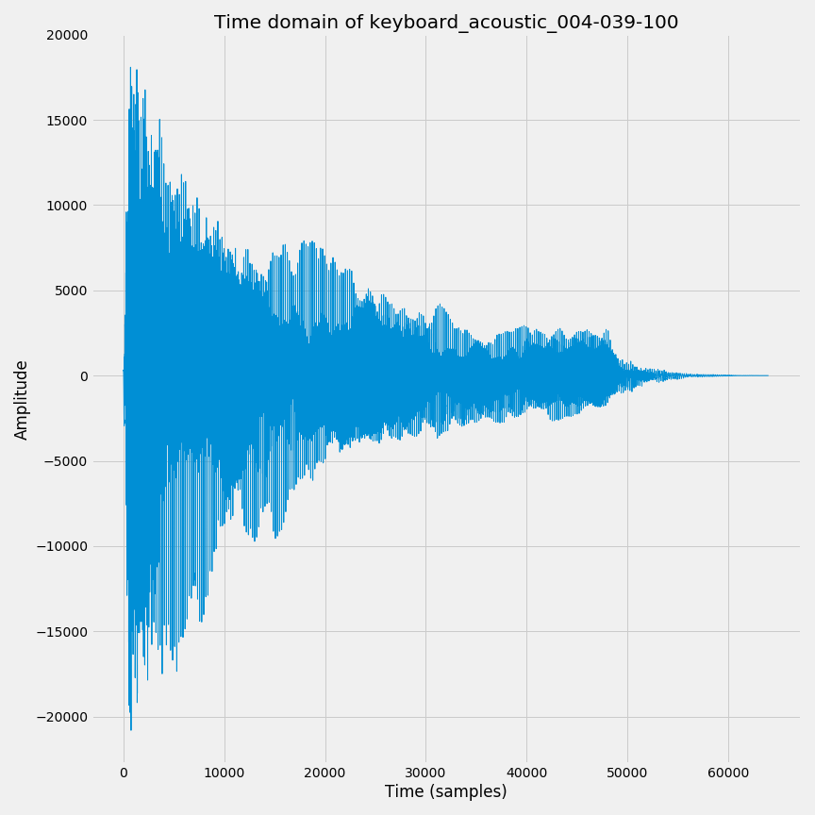
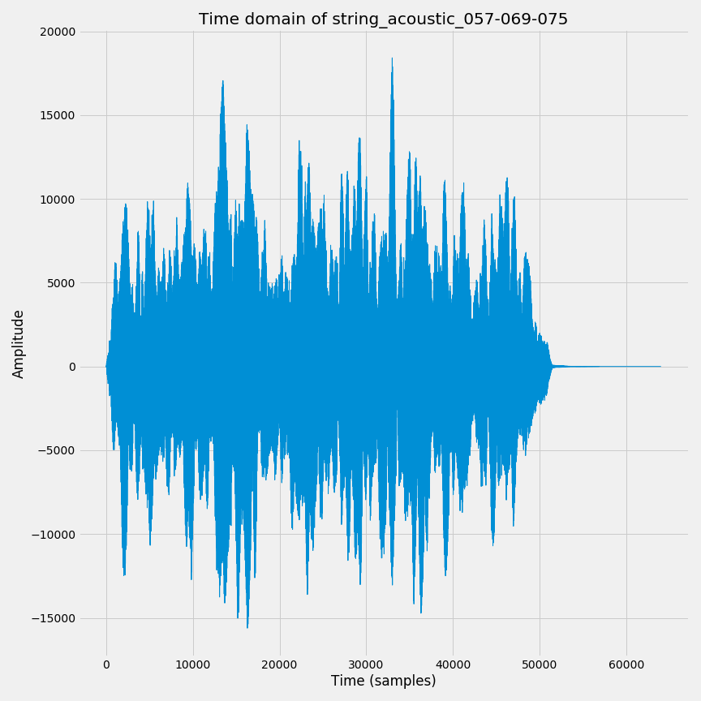
Example wave format audio

