Slide 1
Exploring Lasso Regression
Justin Torok

Slide 2
GraphLassoCV summary
Full precision matrix (3124 x 3124) took ~27.8 hours to calculate using GraphLassoCV
Biofilm, swarming, and 3122 unique words
Saved both the precision and covariance matrices for future use
Number of off-diagonal, nonzero entries = 8070 (0.0829%)
Used sparsity parameter = 0.0863
Tested 17 different parameter values between 0 and 0.116
All settings set to default
Biofilm:
Swarming:

Slide 3
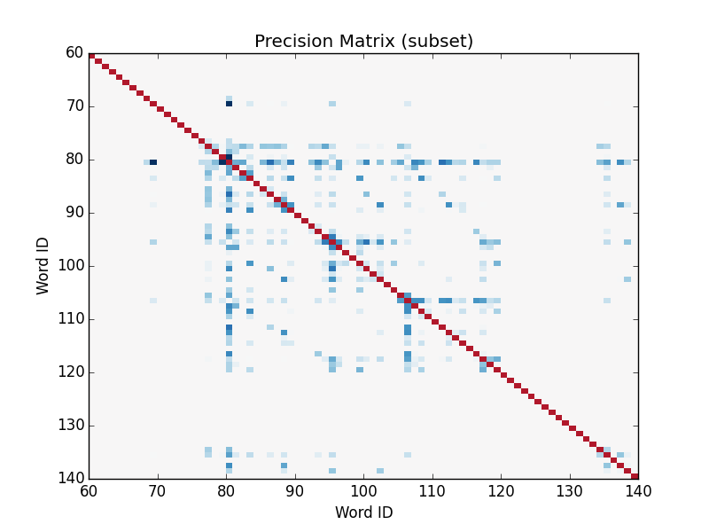
Example ‘hot spot’ in precision matrix
The biofilm, swarm diameter, and the first 48 words are conditionally independent
All off-diagonal, nonzero elements are negative
Intuitive value is in the covariance matrix that results from inverting the estimated precision
For clarity, on-diagonal elements were set to 1 for the heatmap

Slide 4
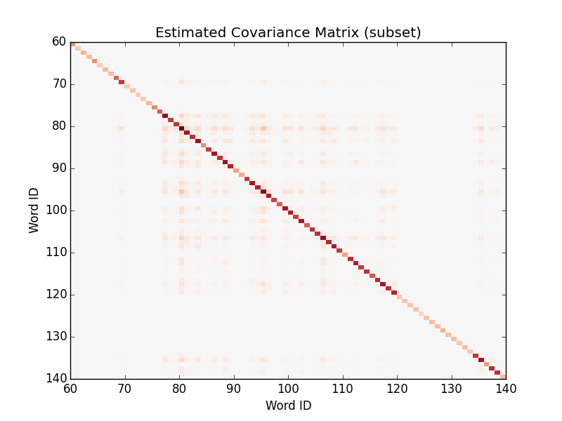
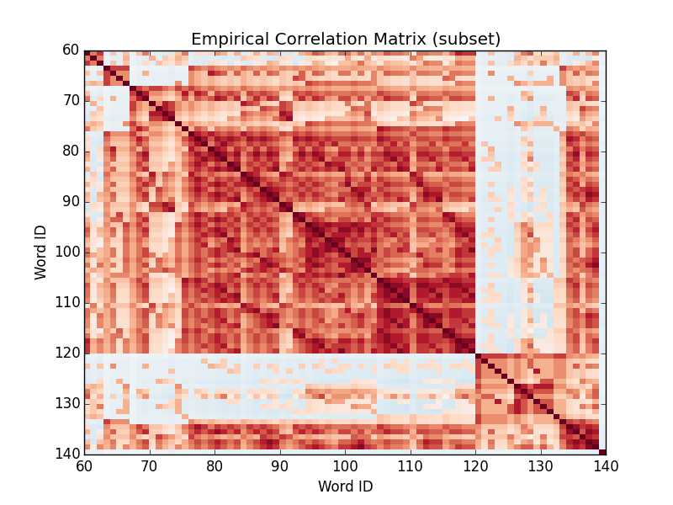
Hot spot: lasso covariance vs correlation
Qualitatively similar, though the estimated covariance is estimated to be weaker and much sparser

Slide 5
Concerns
Length of time required to calculate the precision matrix is very long
500 x 500 is on the order of minutes, 200 x 200 takes a few seconds
Computing efficiency is not likely to improve by building the algorithm de novo
Difficult to implement parallel computing in Python

Slide 6
Notes - 12/1/15

