Slide 1
Research Update and Thesis Proposal
Justin Torok
Xavier Lab
10/19/15

Slide 2
Outline
Summary of Previous Work
Initial Progress
Thesis Proposal
Additional Considerations
Acknowledgements

Slide 3
A. Previous Work
?
Biofilm
Swarming
Summer Goal: Use statistical analysis on a genomic scale to explore if these two traits are inversely regulated and identify causal links between genotype and phenotype
Notes:
We have shown, using phylogenetic GLS regression and experimental evolution, that a there is a trade-off between swarming and biofilm formation in P. aeruginosa
To this end, I conducted a genome-wide association study (GWAS) using existing SNP and gene presence/absence data among 30 strains

Slide 4
Genomic analysis and phylogeny
Goal of genomic analysis - correlate genotype with phenotype (biofilm formation and swarming)
Problem: Phylogeny
Some of the strains of P. aeruginosa are highly related to each other
Hypothesis testing without accounting for inherent genotype-genotype correlations generates false positives
Solution: Model variation as principal components

Slide 5
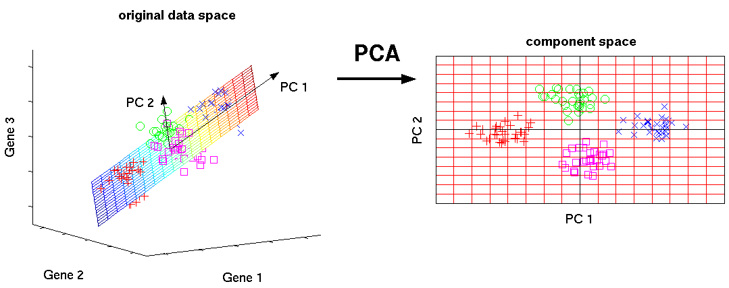
Principal Component Analysis (PCA)
Goal of PCA - dimensionality reduction through a change of basis
Recasting high-dimensional data onto the axes of greatest variability preserves the structure of the data

Slide 6
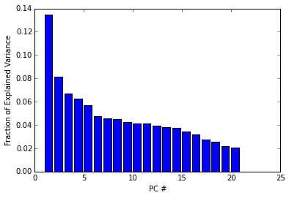
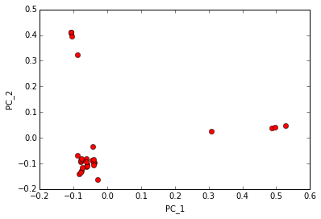
Genotypic variation in P. aeruginosa
~94% variance in 20 components; clustering apparent from the first two PCs

Slide 7
Linear regression
We would like to create a linear model against which we can test each genomic feature (N independent tests):
y = 𝛂 + β_{gen}x + 𝜖; 𝜖 ~ N(0, 𝜎_{𝜖}²)
However, a direct test will produce spurious FPs
Instead, model principal components (3) as covariates:
y = 𝛂 + β_{gen}x + β′z_{PC} + 𝜖
Assumption 1: Most of the variation in the data is due to phylogeny and not related to phenotype
Assumption 2: Data normally distributed*

Slide 8
Hypothesis testing
Hypotheses:
Null (H₀): y = 𝛂 + β′z_{PC} + 𝜖
Alternative (H_{A}): y = 𝛂 + β_{gen}x + β′z_{PC} + 𝜖
Likelihood Ratio Test:
L₀ = P(𝛂,β′,β_{gen}=0|y), L_{A} = P(𝛂,β′,β_{gen}≠0|y)
LRT = 2 ln(L_{A}) - 2 ln(L₀)
The LRT statistic should follow a chi-squared distribution with one degree of freedom

Slide 9
PCA Significant (p_{corr}<0.05) hits
Biofilm Formation |  | Swarming
Feature | -log10(p-value) | Feature | -log10(p-value)
NCGM2_3887 | 7.89 | PA1330, T54N | 5.25
PA14_40040, A359T | 8.91 | PA14_48100, E71V | 5.08
PA14_00180, A58V | 8.91 | PA14_45930, A160V | 4.93
PA14_21320, D206G | 8.66

Slide 10
PCA Significant (p_{corr}<0.05) hits (2)
Biofilm Formation |  | Swarming
Feature | Ontology | Feature | Ontology
NCGM2_3887 | hypothetical | PA1330, T54N | short chain dehydrogenase
PA14_40040, A359T | penicillin acylase | PA14_48100, E71V | alkaline protease secretion protein AprE
PA14_00180, A58V | tRNA/rRNA cytosine-C5 methylases | PA14_45930, A160V | hypothetical
PA14_21320, D206G | alpha/beta hydrolase

Slide 11
B. Phylogenetic GWAS
We would like to create a linear model against which we can test each genomic feature (N independent tests):
y = 𝛂 + β_{gen}x + 𝜖; 𝜖 ~ N(0, 𝜎_{𝜖}²)
Instead of using PCs as covariates, use transformed genotypes:
y = 𝛂 + β_{gen}x* + 𝜖
x* = T⁻¹x, R = TTʹ = Cov(G)
G is the SNP/presence-absence matrix
Assumption 1: Most of the variation in the data is due to phylogeny and not related to phenotype
Assumption 2: Data normally distributed*

Slide 12
Hypothesis testing 2
Hypotheses:
Null (H₀): y = 𝛂 + 𝜖
Alternative (H_{A}): y = 𝛂 + β_{gen}x* + 𝜖
β_{MLE} has an analytical solution: (x*ʹ x*)⁻¹(x*ʹ y)
Calculate a p-value for each genotype using a paired t-test
Account for multiple hypothesis testing by using a Bonferroni-corrected significance level: p_{corr} = p_{𝛼}/N

Slide 13
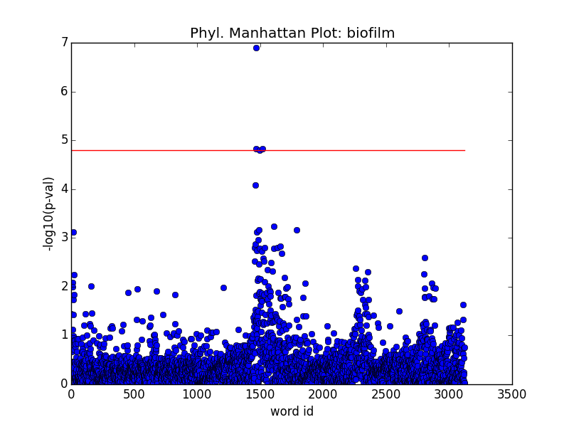
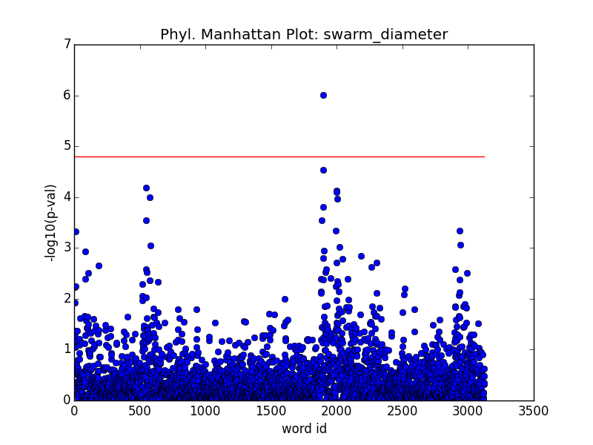
Manhattan Plots

Slide 14
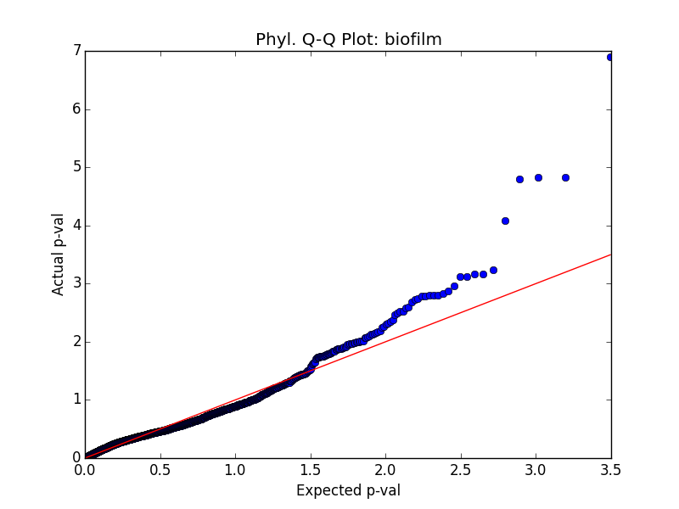
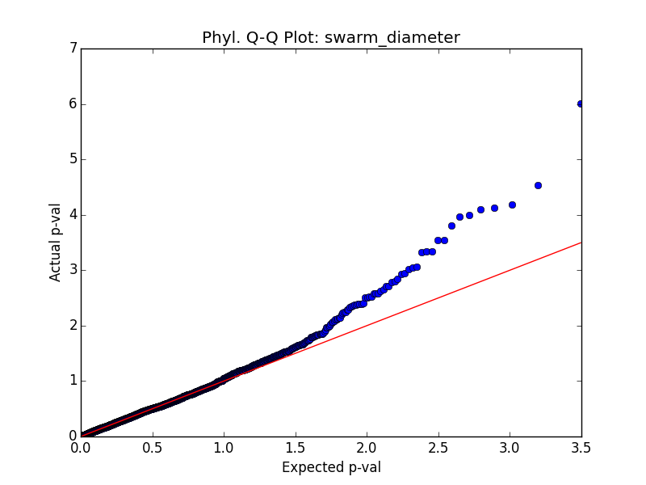
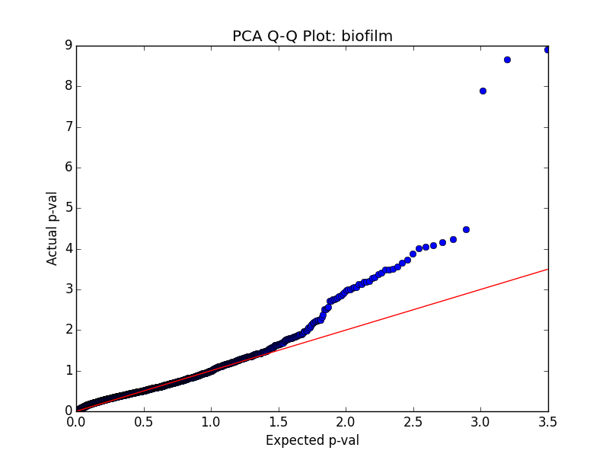
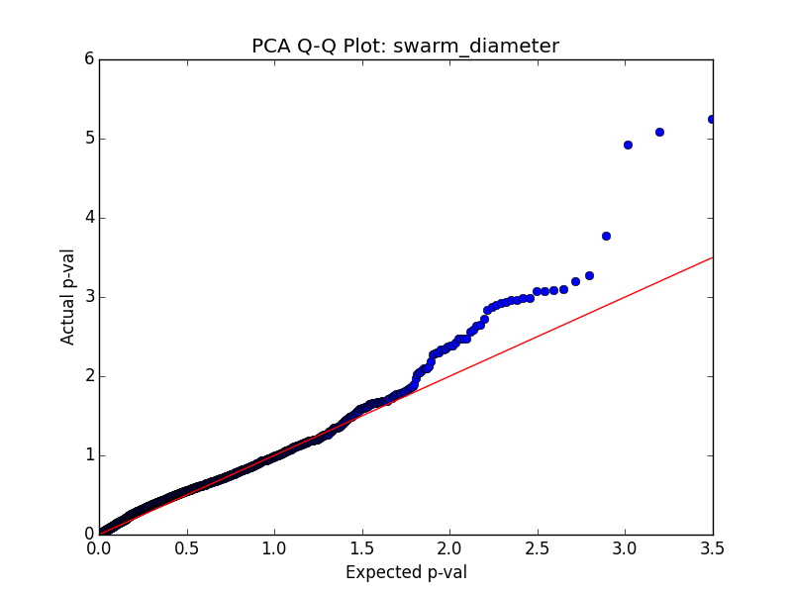
QQ Plots - Comparison
Qualitatively similar
Phyl. QQ has less p-value inflation for biofilm and slightly more for swarming
Neither are fully correcting for hidden variables
Would using the maximum entropy method better control p-value inflation?

Slide 15
Phyl GLS Significant (p_{corr}<0.05) hits
Biofilm Formation |  | Swarming
Feature | -log10(p-value) | Feature | -log10(p-value)
PA14_40040, A359T | 6.90 | PA14_45930, A160V | 6.01
PA14_00180, A58V | 6.90
All three of these mutations were captured by the PCA regression
PA14_40040 - penicillin acylase
PA14_00180 - tRNA/rRNA cytosine-C5-methylases
PA14_45930 - hypothetical protein
Conclusion: Both methods are consistent, though these hits may be noncausal. More genomic/phenotypic data is necessary to increase the power of these tests.

Slide 16
C. Thesis Proposal
Theme: Explore the evolutionary dynamics of genomes in the context of social evolution. Given the whole genomes of two or more coexisting strains, predict the system’s possible evolutionary trajectories.
Motivation: Understanding intraspecies competition in the CF lung
Some Guiding Questions:
What is the genetic basis of the killing/resistance phenotypes observed between different strains of P. aeruginosa?
What is the metabolomic diversity of P. aeruginosa? What genetic factors contribute to this diversity?
Given the genomes of two (or more) strains under a set of culture conditions, how will the population evolve?

Slide 17
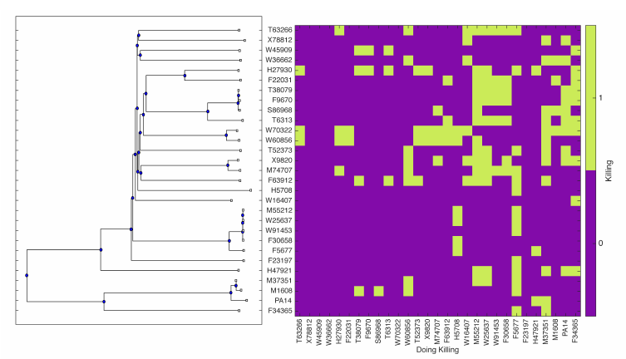
Strain-on-strain killing (Dave and Nate)

Slide 18
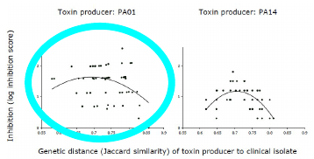
Aim 1A: Killing vs. Genetic Distance
Schoustra et al 2013
The Kassen lab proposed and demonstrated experimentally in P. a. that strain-on-strain killing is maximized at intermediate genetic distance
Statistically significant but relatively poor correlations
Goal: Evaluate the relationship between killing and genetic distance in our isolates
R² = 0.098
R² = 0.164

Slide 19
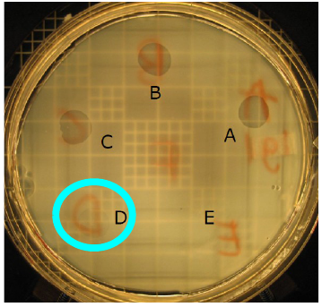
Refined experimental approach
The original assay involved plating one strain on top of another
A clearer demonstration of killing is to spot several dilutions of cell extract on a lawn of P. a.
Cell extract contains pyocins and toxic waste products
MIC provides a clear quantitative metric to define killing
Schoustra et al 2013

Slide 20
Aim 1B: Genetic basis for killing
Goal: Use GWA to find genes associated with killing (and resistance)
Use the results of the killing assay and the existing genomic data to perform a phylogenetic regression
Killing profiles for the strains are not independent - requires a different approach
CCA transformation (Ferreira and Purcell 2009)
MultiPhen (Coin 2012)
MultiPhen performs the reverse (multiple) regression, using the phenotype matrix as the predictor and the individual genotype vectors as dependent
In our case, use the genotypic covariance matrix to first transform the genotypes to account for phylogeny

Slide 21
Aim 2: Metabolomics
Goal: Determine the genetic basis for differences in strains’ metabolic profiles
Experimentally determine metabolic profile by culturing each strain on a range of different growth media
Result would be an ordinal (perhaps?) matrix of media composition and strain identity
Using the statistical framework from Aim 1B, find causal genetic links to explain the variation in metabolic profiles
Build a partial metabolome using experimental results and KEGG pathway information
Determine (e.g. using FBA) the identity of the necessary metabolites and waste products for each strain under each media condition

Slide 22
Aim 3: Strain interactions
Waste
Pyocins
A
Nutrients
B
Waste
Pyocins

Slide 23
Aim 3 (cont)
Goal 1: Use the results of the first two aims to predict how two (or more) strains would interact
Create an ‘interaction pool’ of pyocins, resources, and waste products the strains would produce (and antibiotics, perhaps)
Determine which strain will win or if they can stably coexist
Goal 2: Experimentally probe the robustness of these predictions
Is the model correct? Use results to improve model
Is there more than one outcome? Sequence strain(s) after interaction
Is there evidence of horizontal gene transfer or spontaneous mutations that effected different outcomes?

Slide 24
D. Additional Considerations
Build in flexibility to accommodate new phenotypes/strains (mostly complete)
Incorporate new strains to the database (in progress, Qiu lab)
Incorporate existing phenotype data
Add to database (incomplete)
Piping in manually in the interim
Alternative statistical frameworks
Maximum Entropy - A potential alternative to phylogenetic regression
Other genotypic data - differentiate between clonal strains phylogenetically
Use features such as recombination and gene rearrangement to further establish phylogeny (if possible)

Slide 25



E. Acknowledgements
Joao Xavier
Xavier Lab Members
Jinyuan Yan
Nathan Campbell
Weigang Qiu and the Qiu Lab
Cornell University, Tri-I CBM Program
MSKCC

