Slide 1
Lendingclub.com loan data
Exploring LendingClub.com loan data and looking to predict if a loan will ultimately be paid off in full or charged off.

Slide 2
Introduction
Banks make a significant portion of their money in the form of interest from loans. In addition to many of the other risks that banks face, an important risk factor is if a loan will be paid off. The risk that the payer of the loan is unable to pay the full amount of the loan.
Thus the ability to foresee who these customers are is valuable in that we can charge them appropriately in order to adequately account for the risk, or deny them completely.
The client could be any variety of firms that hand out loans to potential customers from large banks to small businesses like car dealerships and medical companies looking to keep loans ‘in-house’.
Clients will be able to use this information for a variety of purposes from pricing interest rates to marketing more aggressively to particular audiences.

Slide 3
The Data
LendingClub is a website that allows individuals and institutions to either apply for or sell loans.
The data acquired as a result of these loans from 2007 to present is publicly available in the link below.
Since some of the data is split up into multiple sheets, we will have to recombine these files to apply algorithms to all these data points.
https://www.lendingclub.com/info/download-data.action

Slide 4
Data Wrangling
Once the data was loaded after downloading the csv files. We wanted to separate out the loans that had already been completed. There were some loans that were extended for various reasons, but they did not make up a substantial portion of the total loans and were dropped.
For purposes of this project, we will consider those whom have been charged off to have defaulted.
Columns with dates were not in the pandas datetime format and had to be converted. A new column that counted the length of the borrower’s credit in years was created from the dates.

Slide 5
Data Wrangling (cont.)
The data set came with up to 151 columns per file, many of which were completely blank or referred to factors that happened after a loan was charged off. The number of columns was reduced to those that had completed or nearly completed columns and used information that was collected before the loan began. This reduced the columns down to 26.
Next, percentage signs were removed and restated as a decimal.

Slide 6
Exploratory Data Analysis
After reducing the loans to just those that had been completed, we were still left with $5.6 billion in loans with an average loan of about $13,000.
Inquiries in the last six months and delinquencies in the last two years had long narrow tails that were binned together and plotted as their respective own columns. The variables: pub_rec, revol_util, revol_bal, dti, total_acc also had outliers, but these were with the other histograms.

Slide 7
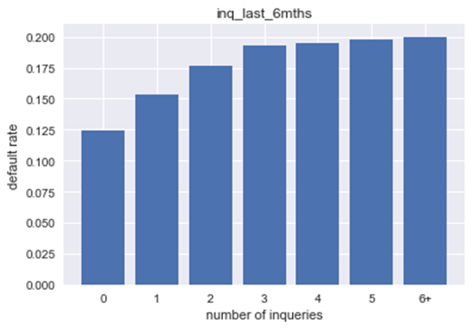
Credit Inquires in the last 6 months
More inquires means borrowers are more likely to default

Slide 8
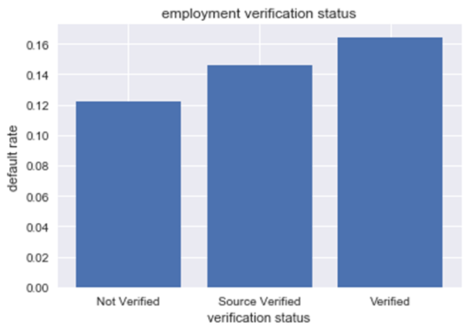
Employment Verification Status
Customers that verified their income were more likely to not pay off their loans.
To be explored further

Slide 9
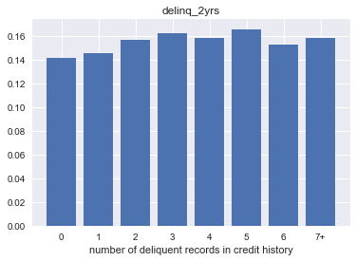
Delinquent records in the last 2 years
These numbers do not appear to have much predictive power about whether or not the borrower will pay off the loan.

Slide 10
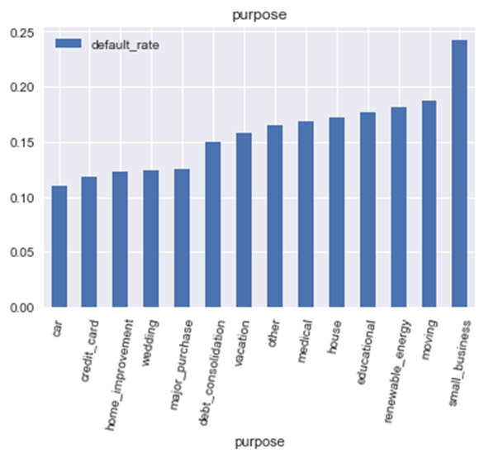
Purpose of the loan
Small business loans appear to be higher risk than loans used for any other reason.

Slide 11
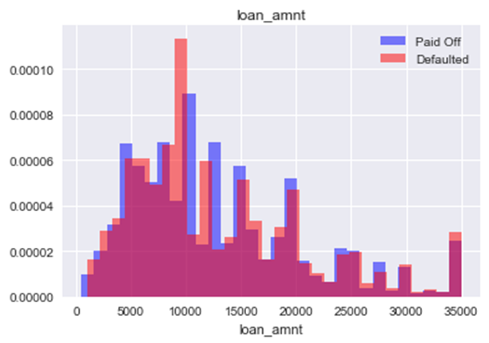
Amount of the loan
There are several spikes loans of certain amounts are lent, but there is a large amount of overlap between paid and defaulted.

Slide 12
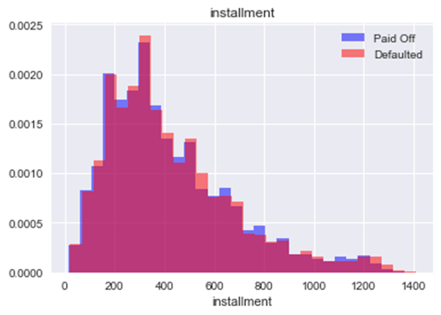
Amount of each payment
Again the overlap is almost identical for each group

Slide 13
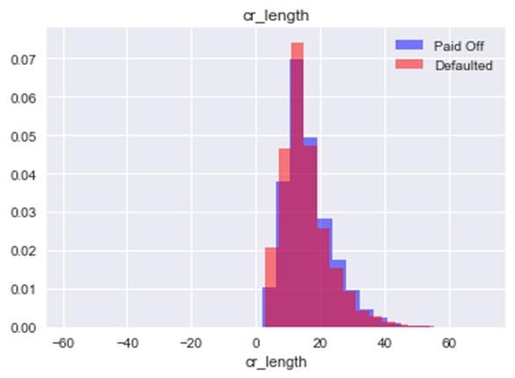
Credit Length
Here we begin to see that those with shorter credit histories tend to default more often.

Slide 14
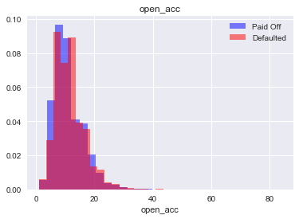
Open accounts
Borrowers with fewer accounts tend to be more likely to pay off their loans.

Slide 15
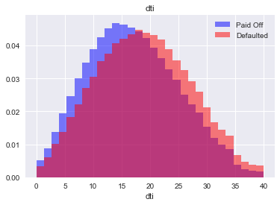
Debt-to-income ratio
Those with ratios lower than about 17 tend to be more successful in paying off their loans.

Slide 16
Scaling
As one may expect, there are not as many people who fail to pay off their loans as those who do.
To balance the data, we up-sampled the default column to give equal amounts during the training set.
Before Scaling:
True | 65257
False | 387170
After Scaling:
True | 308090
False | 308090

Slide 17
Feature Engineering
When setting up for modeling, features that used string statements were converted to binary variables using the pandas.get_dummies function.
Three more binary variables were created to distinguish borrowers that:
Had a debt-to-income ratios over sixteen.
Had an income over $50,000 per year.
Had a revolving utility above fifty percent.

Slide 18
Machine Learning
Focusing on building a precise model would be ideal as the loans predicted as safe would not be charged off.
Four different machine learning algorithms were tested to find which model would do the best in measuring precision.
Models were cross validated and hyperparameters were adjusted to optimize the results.

Slide 19
Logistic Regression
Pro:
Simple
Fast and does not take up much memory
Cons:
Works best with linear data
Has trouble with multicollinearity
Used ridge regression and a regularization value (C) of 1.

Slide 20
Linear Stochastic Vector Classifier
Pro:
Fast predictions
Low memory
Cons:
Hard to tell the significance of individual features
Does not work well if decision boundary is not linear

Slide 21
K Nearest Neighbors
Pro:
Works well with lots of data
Works well even with multicollinearity
Cons:
Uses a lot of memory
Testing for the right K value can be time intensive
K was found to be the best value to use for the model.

Slide 22
Random Forest
Pro:
Strong against overfitting
Preforms well with lots of data
Cons:
These models can take a lot of memory
Can be slow to train
The number of trees were limited to 75 and the maximum branches were set to 50.

Slide 23
Modelling the Data
Four different models were tried to see which approach would provide the best results: Logistic Regression, Linear SVC, K-Nearest Neighbors, and Random Forest.

