Slide 1
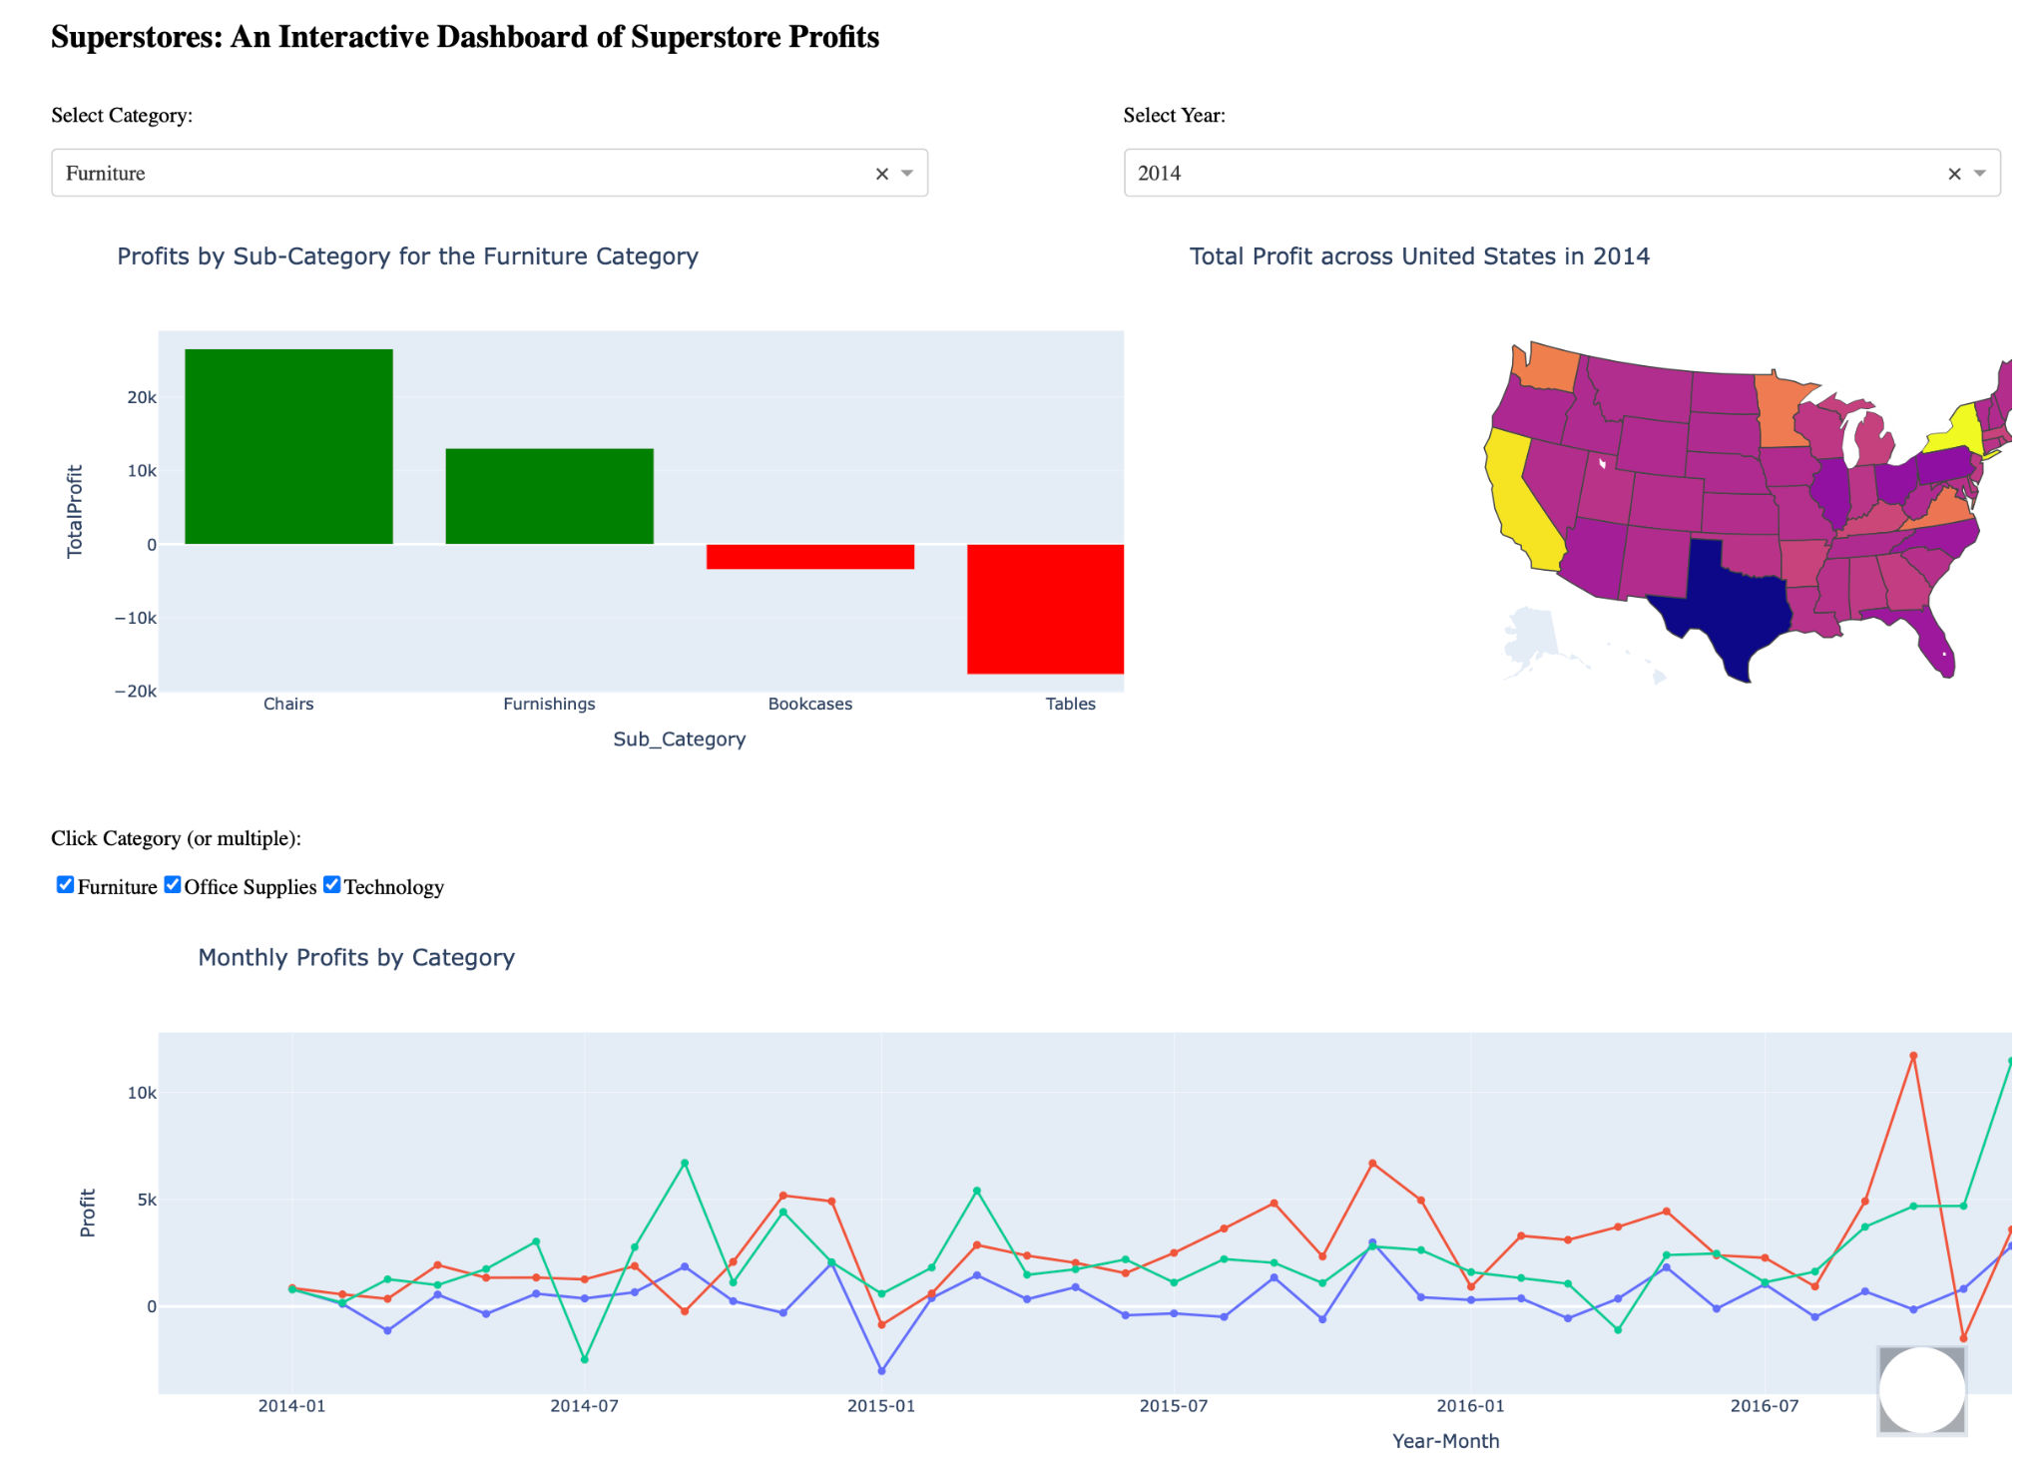
Superstore Data Profits Justin Wee & Andy Lin DS3500 Northeastern University
A dropdown menu allows the user to select which category they would like to display with the options of Furniture, Office Supplies, or Technology. Each product in the sub-category is shown alongside its total sum
User selects which year they would like to view from the dropdown menu with years ranging from 2014-2017
The user will click on which of the three segments using the checkboxes on the dashboard. Multiple categories may be selected

