Slide 1


PAYPRO
DYNAMICS

Slide 2
INTRODUCTION
Pay Pro Dynamics is a web-based Employee Payroll Management System built with PHP, HTML, CSS, JavaScript, and MySQL, running locally on XAMPP. Manages employee records, departments, positions, attendance, deductions, and semi-monthly payroll.
Payroll is computed on the server and produces printable payslips.

Slide 3
OBJECTIVE
1. Maintain complete employee, department, and position records with search and filtering.
2. Record daily attendance and apply overtime and late hours to payroll.
3. Compute accurate semi-monthly payroll with Philippine deductions and a Draft-Processed-Paid workflow.
4. Generate printable payslips searchable by employee name, plus printable and exportable reports.
5. Enforce role-based access so each account type only reaches its allowed modules.

Slide 4
SCOPE AND LIMITATIONS
SCOPE:
Employee, department, and position management.
Attendance, Overtime, late hours, and deduction recording.
Semi Monthly payroll computation and processing.
Payslip generation, printing and reports with CSV export.
Role based acces using ADMIN, MANAGER, and EMPLOYEE accounts.

Slide 5
LIMITS:
The system is documented as running locally on XAMMP.
Only ADMIN and MANAGER can create or payroll.
The share EMPLOYEE account is intended for payslip searching and printing.
The source documen does not specify cloud or mobile access.

Slide 6
SYSTEM COMPONENTS
Authentication - Secure login and role based access.
Dashboard - System overview and payroll charts.
Employee Management - Employee, Department, and position records.
Attendance - Daily attendance, overtime, and late hours.
Deductions - Tax, SSS, PhilHealth, Pag-IBIG, and loans.
Payroll & Payslip - Computation, processing, and printable payslips.
Reports & Database - reports, CSV export, and MYSQL data storage.

Slide 7
SYSTEM FLOW
  Log in using the appropriate account role.
  Record attendance and deductions for the pay period.
  Create payroll and review the computed amounts.
  Process the payroll through Draft → Processsed → Paid.
  Seach the employee name in My Payslip.
  Generate the payslip and print or save it as PDF.
  View or print reports or export data to CSV.

Slide 8
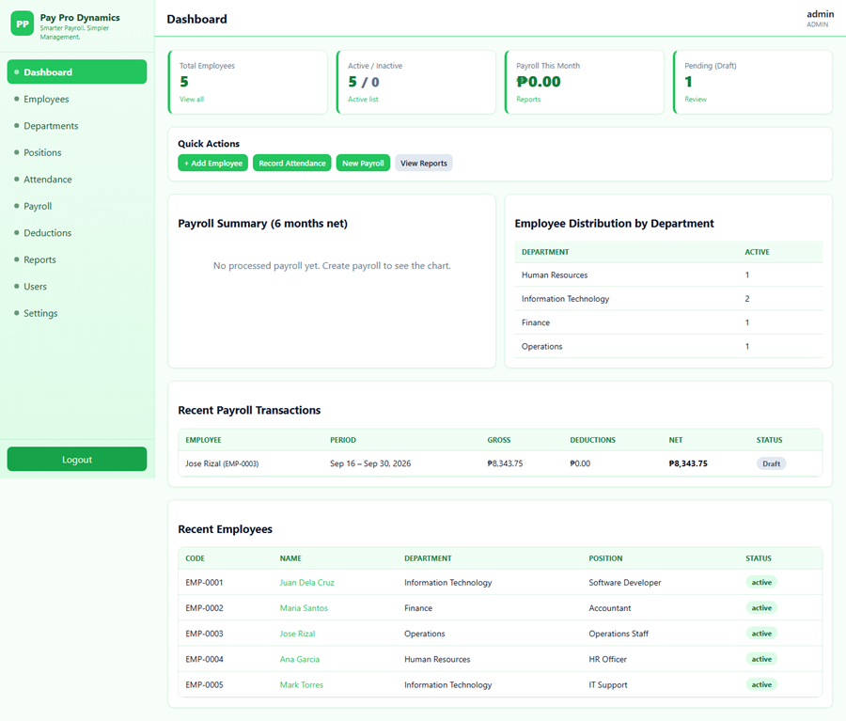
DASHBOARD
Enter the correct credentials to access the system, then user the dashboard as the home page.

Slide 9
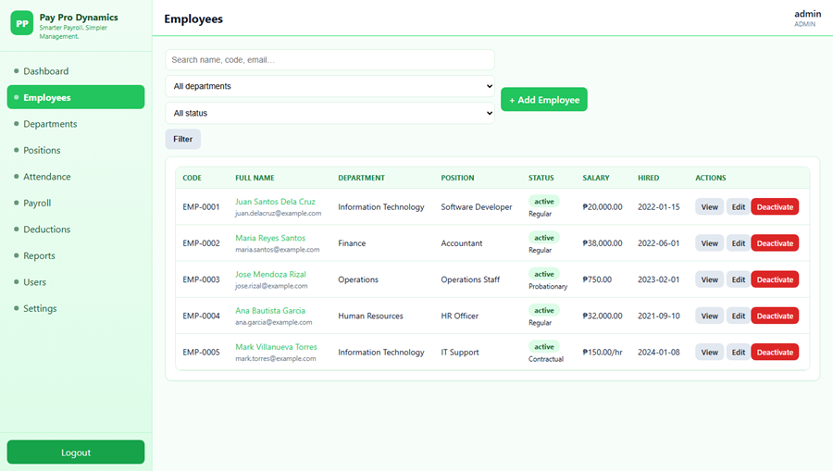
EMPLOYEE MANAGEMENT
Employee management is where worker records are stored and maintained, including departments and positions.

Slide 10
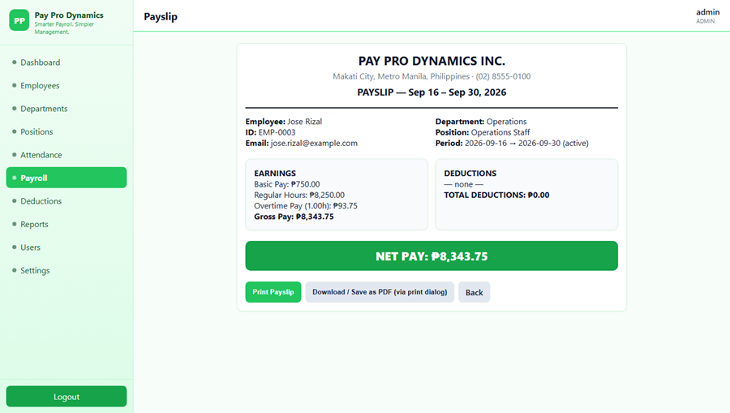
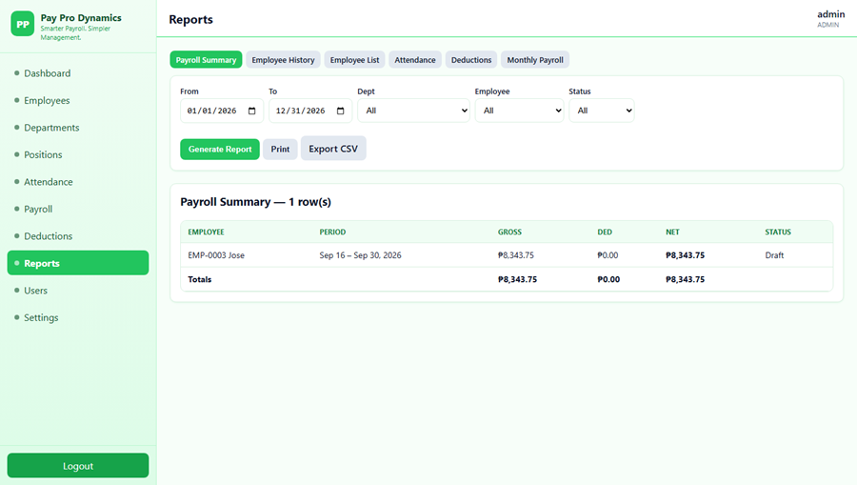
PAYROLL REPORTS AND PAYSLIP
Payroll reports shows informations of employess, and payslips allows the user to seach for an employee.

Slide 11
Thank You
Justin Manzano - Programmer
Kurt Bensurto - UI/UX Designer
Juan Miguel Ramos - Tester
John Elias Aguilar - Documentation
John Paul Guiruela - Documentation

