Slide 1

NEWS ARTICLES CLASSIFICATION
Presented by:
Justin Ndivhuwo Sinenkosi Sikhakhane
Aiden Geluk Kentse Mphahlele
Ntokozo Hadebe Obed Segwate Mabowa

Slide 2
TABLE OF CONTENT
Introduction
problem statement
Objectives and Goals
Data cleaning
Exploratory Data Analysis
Model Training
Model Matrics Evaluation
Model Performance Analyses
Conclusion

Slide 3


INTRODUCTION
Rapid modern changes and developments
Daily publication of numerous news articles by Maji Ndogo’s news24
Overwhelming quantity of news
Difficulty for readers in finding relevant information

Slide 4



INTRODUCTION
Challenges in the News Article Industry:
Information Overload
Misclassification
Incorrect Trend Analysis

Slide 5


PROBLEM STATEMENT
Rapid increase in digital news content.
Difficulty to efficiently categorize and manage information.
How accurately can news articles be classified into the different categories?
Assess the effectiveness of classification algorithms in accurately categorizing news articles
.

Slide 6


OBJECTIVES AND GOALS
Primary objectives:
Analyze a dataset of news articles and develop a robust classification model.
Accurately categorize articles into predefined categories
Goal:
To deliver an effective and efficient news classification application for Maji Ndogo News24.

Slide 7


DATA CLEANING
Data cleaning includes:
Removing Punctuation and Special Characters
Handling Missing Values
Removing Non-Textual Elements

Slide 8

EXPLORATORY DATA ANALYSIS (EDA)

Slide 9
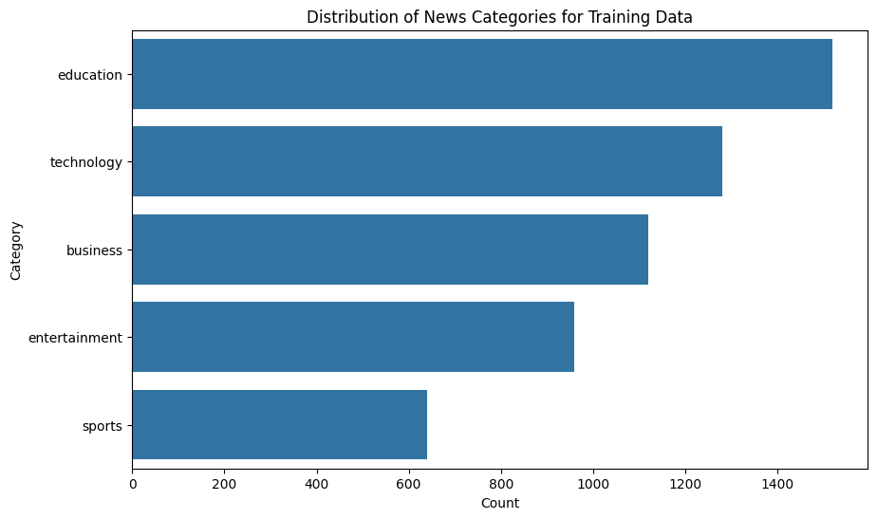
CATEGORY DISTRIBUTION FOR TRAINING DATA
Results: we observed that education has the highest count.

Slide 10
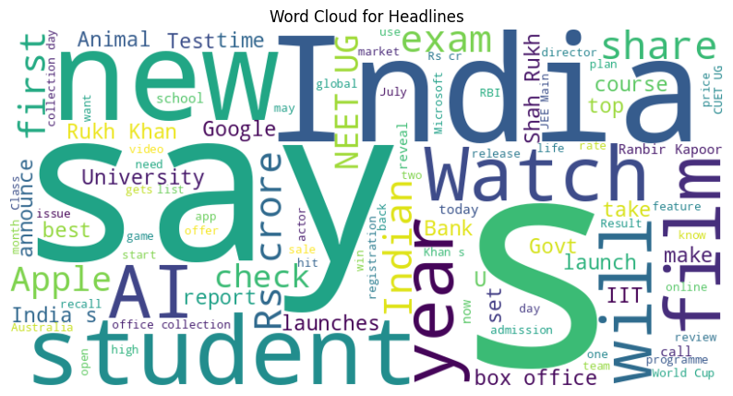
CATEGORY DISTRIBUTION FOR TEST DATA
Headline Word Cloud

Slide 11
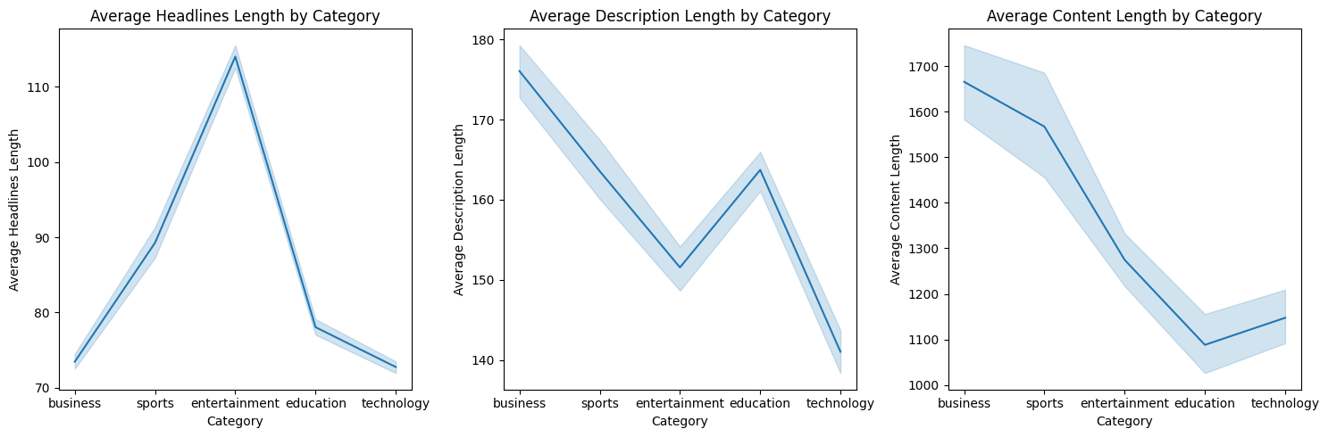
TEXT LENGTH DISTRIBUTION BY CATEGORY
The line plots visualize the average length of headlines, descriptions, and content across different categories of news articles.

Slide 12
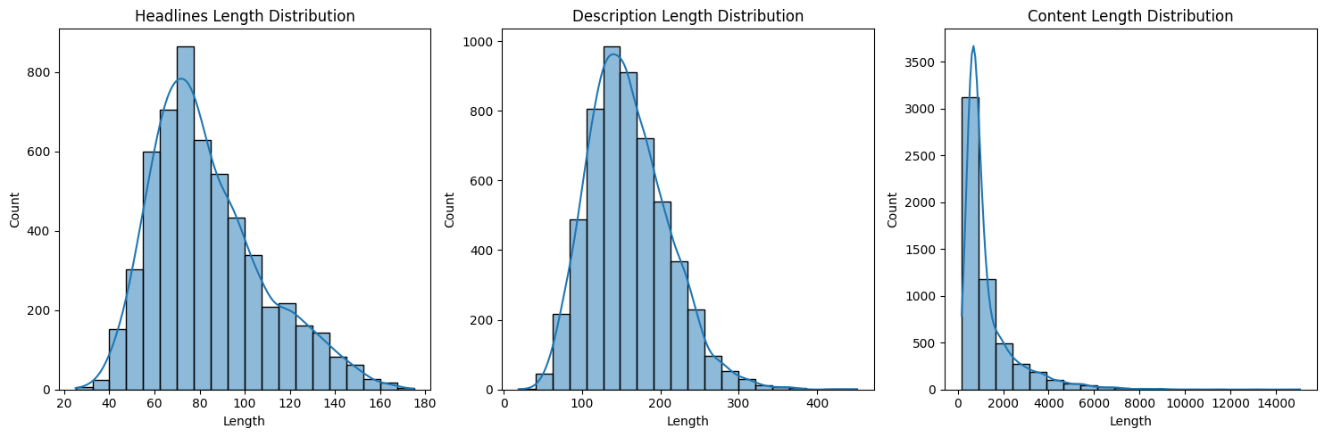
TEXT LENGTH ANALYSIS
The histogram plots visualize the total length of headlines, descriptions, and content across different categories of news articles.

Slide 13

MODEL TRAINING

Slide 14


DATA PREPROCESSING
Data preprocessing includes:
Lowercasing
Tokenization
Removing Stop Words
Lemmatization
Handling Imbalanced Data
Vectorization (TDIF)

Slide 15
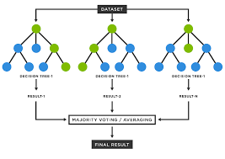
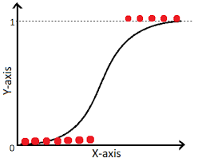
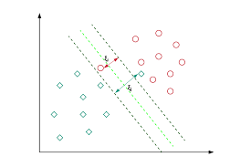
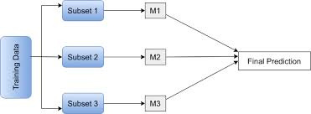
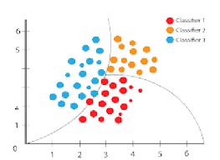
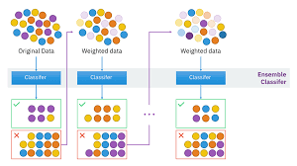
MODEL TRAINING
Models Trained:
Logistic Regression
Random Forest
Support Vector Machine (SVM)
Bagging
Naive Bayes
AdaBoost

Slide 16

MODEL TUNING
We Tune Models to:
Optimize Performance, prevent Overfitting/Underfitting, improve Efficiency, and adapt to Data.
Tuning Method Used:
We tuned our model using RandomSearchCV

Slide 17
MODEL METRICS EVALUATION

Slide 18
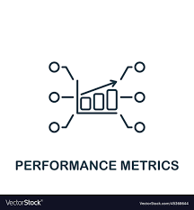
MODEL METRICS EVALUATION
Evaluation Metrics used:
Accuracy
F1 Score
Confusion Matrix
Classification Report

Slide 19

MODEL PERFORMANCE ANALYSIS

Slide 20
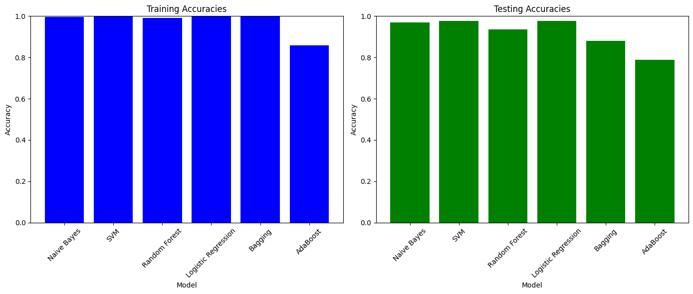
MODEL COMPARISON
0.996
1.00
0.991
0.999
0.999
0.970
0.976
0.975
0.934
0.858
0.885
0.789
The bar plot visually compares the performance of various models on the test data based on their accuracy scores for the training and test data.

Slide 21

MODEL COMPARISON
0.997
1.00
0.991
0.999
0.999
0.970
0.976
0.975
0.934
0.866
0.880
0.789
The bar plot visually compares the performance of various models based on their F1 scores
on the training and test data.
v

Slide 22
STREAMLIT APPLICATION
https://justin9503-news-classifier-base-app-h5anzs.streamlit.app/

Slide 23




IMPLICATIONS OF THE FINDINGS
AND
SUGGESTIONS FOR FUTURE WORK
Technology
Education
Business
Sports
Entertainment
Using deep learning techniques like BERT

Slide 24
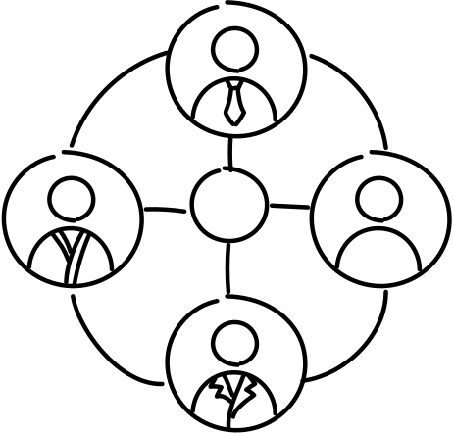

CONCLUSION

Slide 25


CONCLUDING THOUGHTS
Education
Business
Sports
Technology
Entertainment
The excellent performance of SVM, Naive Bayes, and Logistic regression, are highly effective in classifying news articles.
These models can be utilized by platforms to tag and categorize articles automatically.

Slide 26

THANK YOU!
QUESTIONS ARE WELCOME

