Slide 1

Introduction to the Object-Oriented
Nguyễn Văn Tuấn- VDC Trainning

Slide 2

Introduces
(OOP): is one of the most popular methodologies in software development. It offers a powerful model for creating computer programs. It speeds the program development process, improves maintenance, and enhances reusability of programs

Slide 3
Introduces main
introduces object-oriented methodology
concepts of objects, classes, messages and methods

Slide 4
We will learn(Purpose)
Explain features of the object-oriented methodology
Describe the phases of the object-oriented
methodology Define classes in C#

Slide 5
Object-Oriented Methodology
Object-orientation is a software development methodology that is based on modeling a real-world system. An object is the core concept involved in object orientation. An object is the representation of a real-word entity or concept

Slide 6

The Foundation of Object-Orientation
An object-oriented program consists of object, classes and methods

Slide 7
object
object is a tangible entity that may exhibit some well-defined behavior
object is a combination of messages and data

Slide 8
Object
can receive and send messages and use messages to interact with each other
It has a state.
It may display behavior.
It has a unique identity.

Slide 9
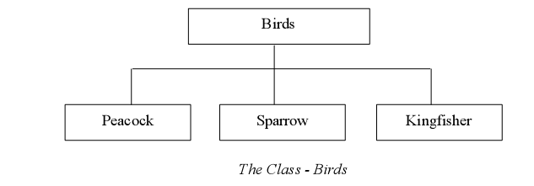
Classes
class as a declaration, a template, or a blueprint that can be used to classify objects

Slide 10
Messages and Methods
“Behavior is how an object acts and reacts, in terms of its state changes and message passing.”

Slide 11
Characteristics of the Object-Oriented
Realistic Modeling
Reusability
Resilience to Change
Existence as Different Forms

Slide 12
Phases of Object-Oriented
The Analysis phase
The Design phase
The Implementation phase

Slide 13
The Analysis Phase

Slide 14
The Design Phase

Slide 15
The Implementation Phase

Slide 16

TRANSITIONAL PAGE

Slide 17
elements
www.animationfactory.com

