Slide 1
DONaid – Donation Marketplace
Capstone Project Presentation Justina Bosco | March 2026
Notes:
Introduce DONaid and what it does in one sentence. Mention this is a full‑stack capstone with real-time chat and CRUD listings.

Slide 2
Problem & Opportunity
Usable household items are often discarded instead of donated
Donation coordination is fragmented across multiple informal channels
Opportunity: One platform for listings + search + item-specific messaging
DONaid Capstone • Justina Bosco
Notes:
Explain why the problem matters: waste reduction, community reuse, and convenience. Keep this slide under 30 seconds.

Slide 3
Project Objectives
Allow users to register and log in securely
Enable donors to create item listings with photos
Help recipients browse, filter by category, and search by keywords
Support real-time messaging about a specific item
Enforce owner-only edit/delete permissions
DONaid Capstone • Justina Bosco
Notes:
Walk through objectives and link them to features you will demo: login, create item, browse/filter, chat, edit/delete.

Slide 4
Stakeholders & Value
Donors: list items quickly and coordinate pickup
Recipients: discover available items and contact donors
Community organisations (future): reuse and distribution support
Value: reduces waste, improves accessibility, and speeds up coordination
DONaid Capstone • Justina Bosco
Notes:
Mention who benefits and why. Emphasise community value and sustainability outcomes.

Slide 5
System Architecture
Express API (MVC Routes/Controllers)
MySQL (Sequelize ORM)
React Frontend (MUI + Context)
REST JSON
DB read/write
Store messages
Socket events
Auth: Bearer Token (Sessions table)
Socket.IO Realtime Chat
Save/serve
Uploads Folder Saved Images
DONaid Capstone • Justina Bosco
Notes:
Describe the high-level architecture: React UI calls Express REST endpoints for auth/items and uses Socket.IO for chat. Data is stored in MySQL via Sequelize. Images are saved in uploads and served back to the client.

Slide 6
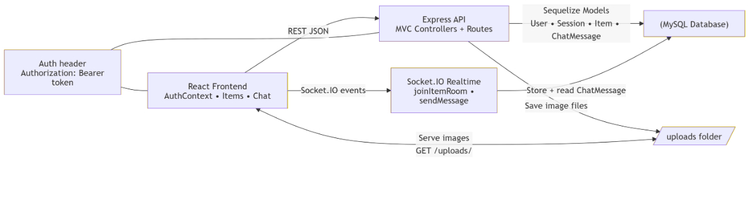
Design Progression – Early Wireframes
Low-fidelity planning helped confirm layouts and user flow before implementation.
DONaid Capstone • Justina Bosco
Notes:
Explain that wireframes were used early to validate layout and flow. The final UI is high-fidelity using Material UI components.

Slide 7
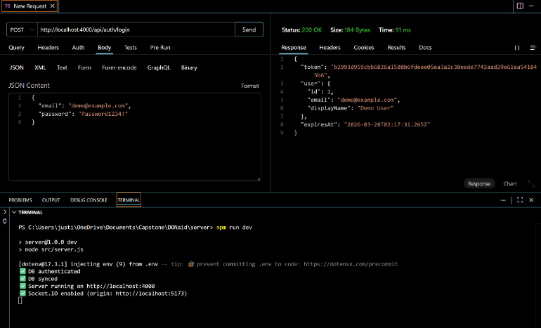
Authentication – Login
Login returns a Bearer token used to access protected endpoints.
DONaid Capstone • Justina Bosco
Notes:
Explain the login flow: user submits credentials, API returns token, client stores token and sends it in Authorization header for protected routes.

Slide 8
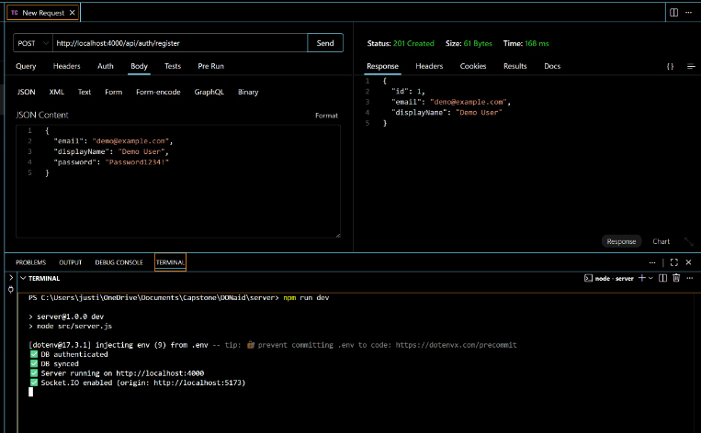
Authentication – Register
Register creates a user account and enables login.
DONaid Capstone • Justina Bosco
Notes:
Show register endpoint working. Note email uniqueness and password hashing.

Slide 9
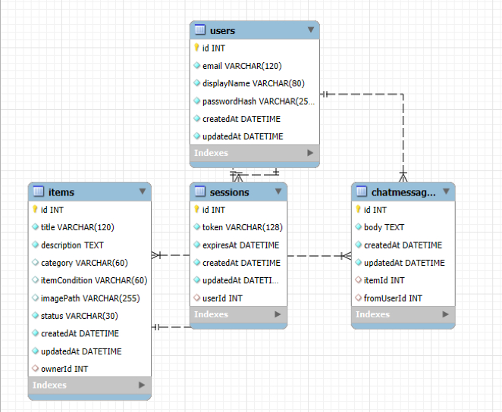
Database Schema (ERD)
Core entities: Users, Sessions, Items, ChatMessages.
DONaid Capstone • Justina Bosco
Notes:
Explain relationships: Users own Items, Users have Sessions (tokens), Items have ChatMessages, ChatMessages link to sender and item.

Slide 10
Core Features (What the app can do)
Create item listings (title, description, category, condition, image)
Browse items with category filter + keyword search + My Items toggle
View item detail (photo, owner info) and chat about the item
Owner-only edit/delete via secured API routes
Real-time chat per item (Socket.IO room) with message persistence
DONaid Capstone • Justina Bosco
Notes:
Quickly list the core features, then transition to testing evidence and live demo plan.

Slide 11
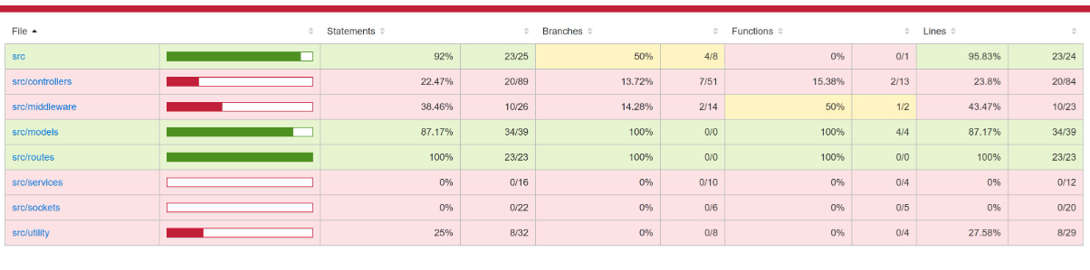
Testing & Coverage (Jest + Supertest)
Automated API tests with coverage reporting.
DONaid Capstone • Justina Bosco
Notes:
Describe testing approach: Jest + Supertest hitting endpoints. Mention separate test DB. Highlight what is covered (auth, CRUD, permissions) and what could be improved (more controller branches, socket tests).

Slide 12
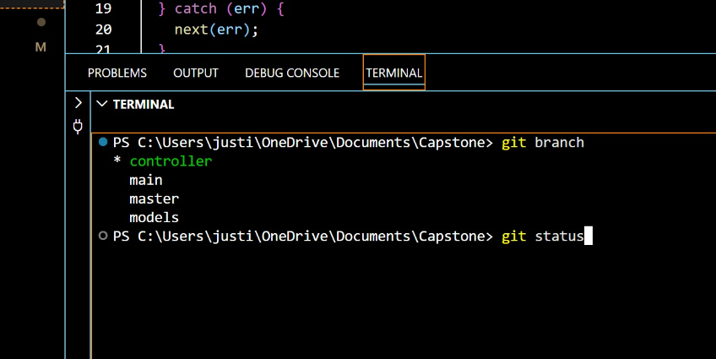
Version Control – Branching
Feature branches used for organised development and easier debugging.
DONaid Capstone • Justina Bosco
Notes:
Explain your branching approach: feature branches and merges. Mention meaningful commits and using tags/releases if applicable.

Slide 13
Challenges & Learnings
Token/session handling: ensuring Authorization header is attached consistently
Multi-user behaviour: reconnecting Socket.IO when user changes
UI polish: sticky AppBar + scroll offset to keep controls visible
Testing setup: isolated test DB and stable, repeatable test runs
DONaid Capstone • Justina Bosco
Notes:
Share 2–3 key challenges and what you learned. Emphasise debugging skills and how you improved robustness.

Slide 14
Live Demo Checklist (2–3 minutes)
1) Login (or register a new user)
2) Browse items and use filters (category + search)
3) Add a new item with an image
4) Open item detail and send a chat message
5) Edit the item status (owner only) and optionally delete
6) Show coverage report quickly (proof of testing)
DONaid Capstone • Justina Bosco
Notes:
Follow this exact order during the demo. Keep it short and focused. If something fails, return to Items page and continue.

Slide 15
Conclusion & Next Steps
Delivered a full-stack donation marketplace MVP
Secure auth, CRUD listings with images, and real-time chat
Automated tests provide confidence and support future changes
Next steps: admin moderation, improved chat privacy, deployment pipeline
DONaid Capstone • Justina Bosco
Notes:
Summarise what you built and why it matters. End with 2–3 future enhancements and invite questions.

