Slide 1
DONaid
Capstone Project Presentation
GITHUB LINK
2025-10-07-se-pt-au Justina Bosco | 2 April 2026
Notes:
(0:00–0:45) Hi everyone, as you know, I’m Justina Bosco and this is my capstone project, DONaid which sounds like Donate.
Today I will walk you through the problem, the solution, the key features, the architecture and database design, testing evidence, and a short timeline of how the project was delivered.
At the end, I will summarise what was achieved and the future improvements that could be added.

Slide 2
What is DONaid
Notes:
(0:45–1:15) DONaid a donation marketplace is a website where people can list items they want to donate, browse what is available, and message each other to organise pickup.
The goal is to make donating simple and structured, and to reduce the friction people experience when trying to give items away.
Instead of using multiple channels, DONaid brings listings and communication into one place.

Slide 3
Overview
DONaid is a lightweight donation marketplace web application.
Notes:
(1:15–1:35) I want to acknowledge the support I received during this capstone.
Thank you to our trainer for guidance, feedback and support throughout the build process.

Slide 4
Core features
User registration + login
Create donation listings (title, description, category, condition, image)
Browse and search available donation items
Real‑time messaging using Socket.IO
Notes:
(1:35–1:55) Special thanks to Mirza Arshad for training and support during the capstone journey.

Slide 5
Stakeholders
Donors: post items and coordinate handover
Recipients: browse items and request via message
Community groups/charities: source items
Notes:
(1:55–2:40) What is DONaid? DONaid is a lightweight web application focused on item donation.
Users can create an account, log in, post items with images, browse available items, and message donors in real time.
The keyword here is lightweight: it is a focused solution for donations, not a full commercial marketplace.

Slide 6
Business problem
Many households have usable items they no longer need, while others cannot easily afford replacements. A simple platform for local donation reduces waste and helps communities.
Notes:
(2:40–3:20) Overview: the app supports the full donation workflow.
Donors list an item, recipients discover items through browsing and filtering, and both parties coordinate using item-specific messaging.
This reduces wasted items and supports community reuse.

Slide 7
How is DONaid different from other platforms?
Notes:
(3:20–4:20) These are the core features.
First, users can register and log in.
Second, users can create donation listings with details like title, description, category, condition, and an image.
Third, users can browse available items and search/filter in the UI.
Finally, messaging is implemented using Socket.IO for real-time communication about a specific item.
If your slide text mentions Server-Sent Events, update it to Socket.IO to match the implementation.

Slide 8
VALUE
Lower landfill waste and carbon impact
Improves access to essential household goods
Strengthens community support networks
Notes:
(4:20–5:05) Stakeholders: The primary users are donors and recipients.
Donors want an easy way to list items and organise pickup.
Recipients want to quickly find items and contact donors.
Community groups or charities could benefit in future by sourcing items through listings.

Slide 9
Non-functional requirements
Usable and responsive UI (Material UI)
Secure authentication and authorization
Maintainable MVC backend architecture
Automated testing to support reliability
Notes:
(5:05–5:55) Business problem: many households have usable items they no longer need, while others may not be able to afford replacements.
A simple local donation platform reduces waste and supports communities.
The value is both environmental and social: fewer items in landfill, and better access to essential goods.

Slide 10
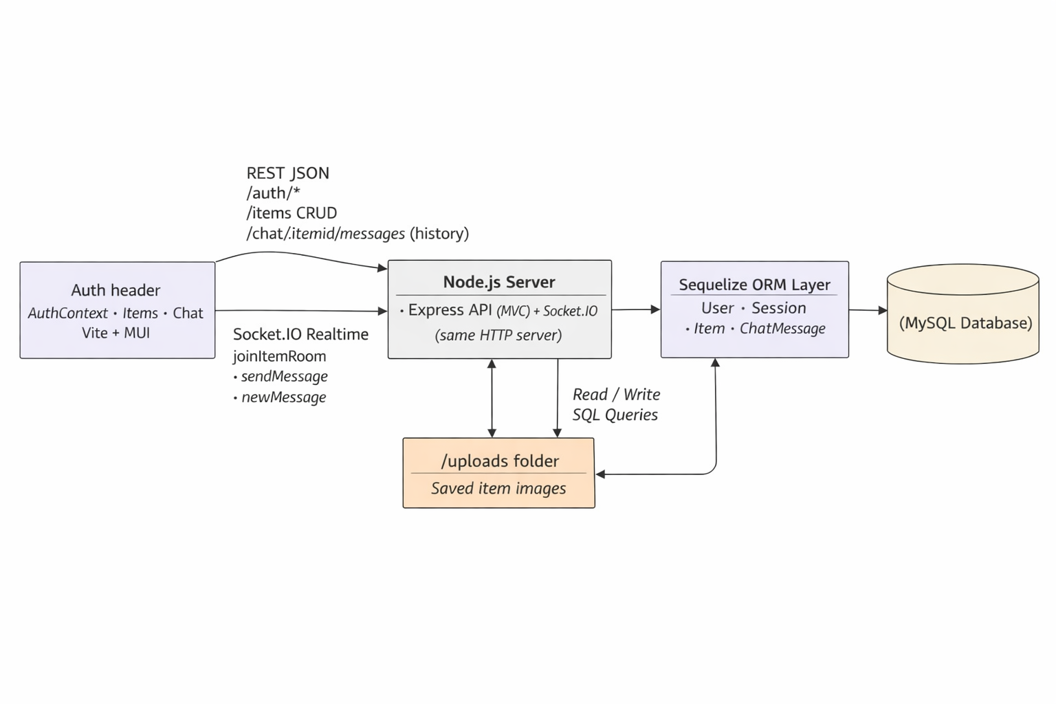
Architecture
Notes:
(5:55–6:45) DONaid differs from other platforms in a few ways.
It is purpose-built for donation, so it is less distracting than general marketplaces.
It includes item-specific chat, which makes coordination clearer.
And it enforces ownership permissions so only the owner can edit or delete a listing.

Slide 11
User Stories
As a Donor | As a Recipient
As a donor, I want to log in securely so that only I can modify my items. | As a recipient, I want to browse available items so I can find what I need.
As a donor, I want to list items with images and descriptions so that recipients can clearly understand what I’m offering. | As a recipient, I want to search and filter items so I can narrow down results based on category or name.
As a donor, I want to edit or delete my own listings so I can keep my available items up to date. | As a recipient, I want to message donors directly about specific items so I can ask questions or arrange collection.
As a donor, I want to receive messages from interested recipients so I can coordinate item pickup or delivery. | As a recipient, I want to view item details and images so I can decide whether the item meets my needs.
Notes:
(6:45–7:25) The value delivered: lower landfill waste and carbon impact through reuse.
Improved access to household items for people who need them.
And stronger community support networks by simplifying donation coordination.

Slide 12

Dependencies
npm express
dotenev
sequelize
mysql2
test
supertest
Notes:
(7:25–8:15) Non-functional requirements include usability, security, and maintainability.
The UI is designed to be easy to learn and responsive using Material UI.
Security includes authentication with tokens and owner-only permissions for item changes.
Maintainability includes an MVC backend structure and a modular React frontend.

Slide 13
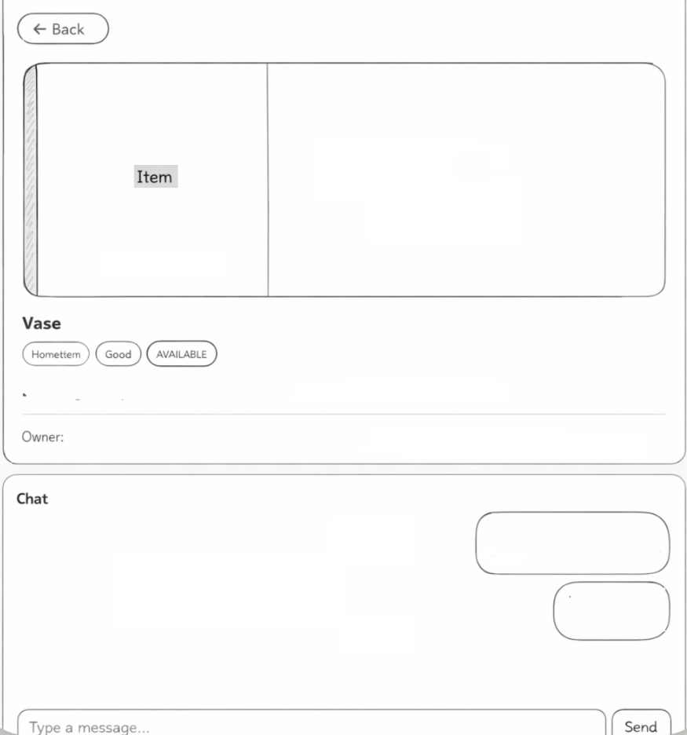
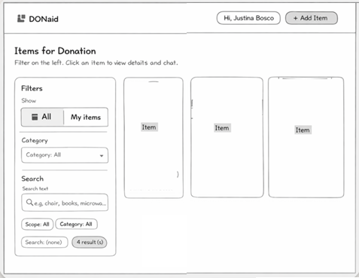
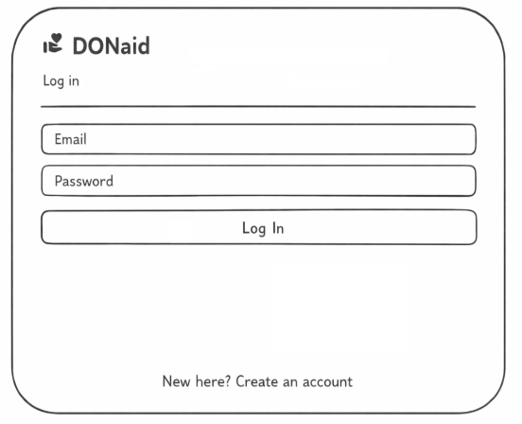
Wireframe
Notes:
(8:15–9:35) This slide shows the system architecture.
The React frontend communicates with the Node.js server using REST for login, items CRUD, and chat history.
Real-time chat uses Socket.IO events, with rooms per item.
The backend uses Sequelize ORM to read and write to a MySQL database.
Item images are saved in an uploads folder and served back to the client.

Slide 14
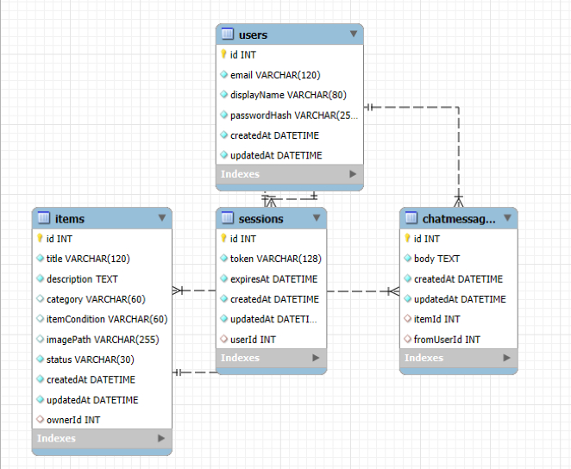
Schema
Notes:
(9:35–10:45) These user stories guided the build.
From the donor perspective: secure login, create listings with images, edit or delete listings, and receive messages.
From the recipient perspective: browse items, search and filter, view details, and message donors.
These stories map directly to the screens and endpoints implemented in the application.

Slide 15
Testing
Using Thunder Client
Notes:
(10:45–11:40) Dependencies: The backend uses Express, dotenv, Sequelize, and mysql2.
Real-time messaging uses Socket.IO.
Testing uses Jest and Supertest for automated API tests.
The frontend uses React with Vite, Material UI, and supporting MUI icon packages.

Slide 16
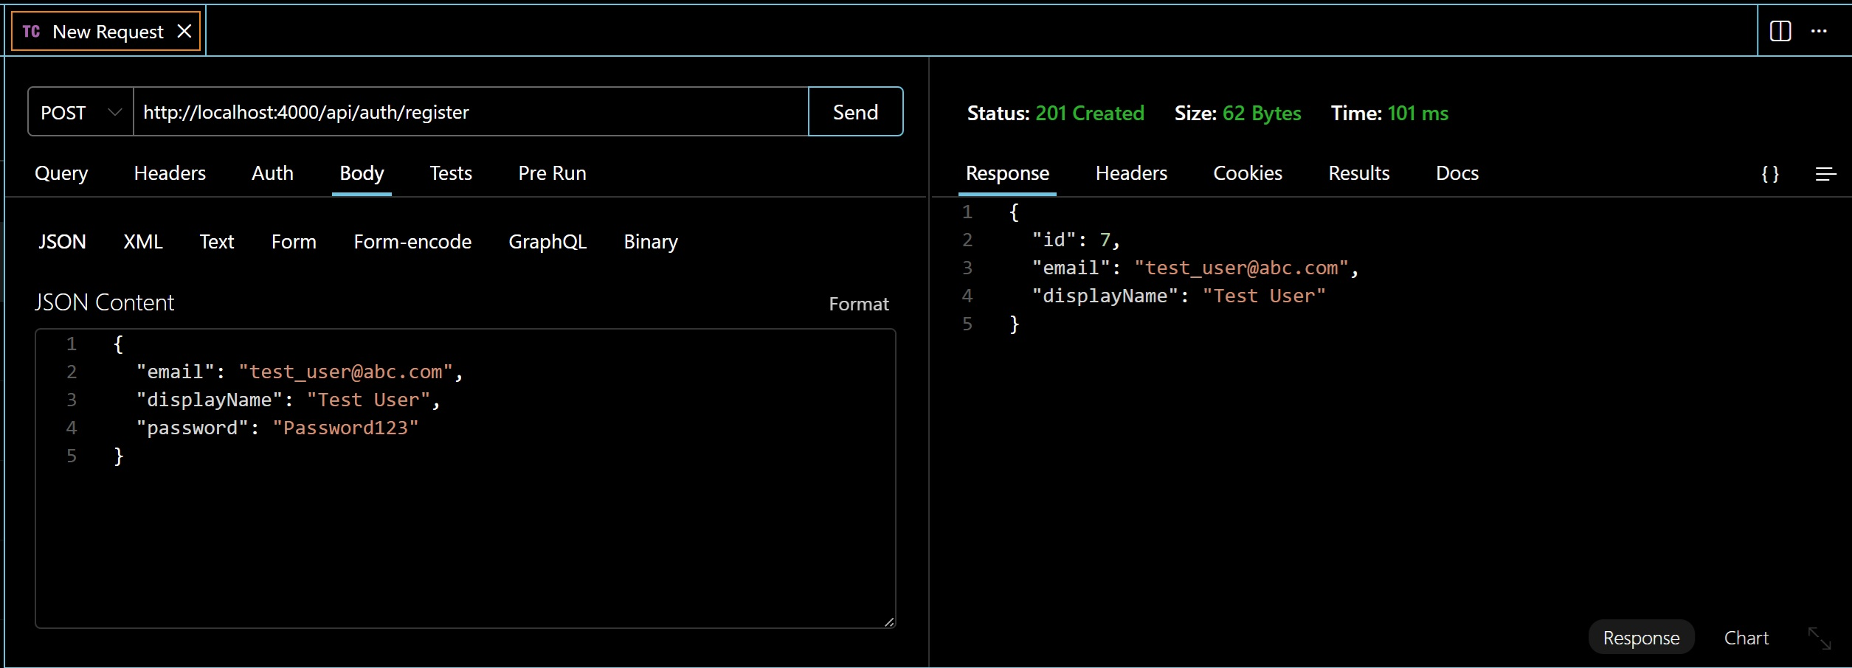

Registering a new user
Unlocking new horizons
Notes:
(11:40–12:30) Wireframes were used early to plan the layout before implementing the final UI.
The final interface was improved from the lo-fi concept into a polished Material UI design with a filter sidebar, item cards, and dialogs.

Slide 17
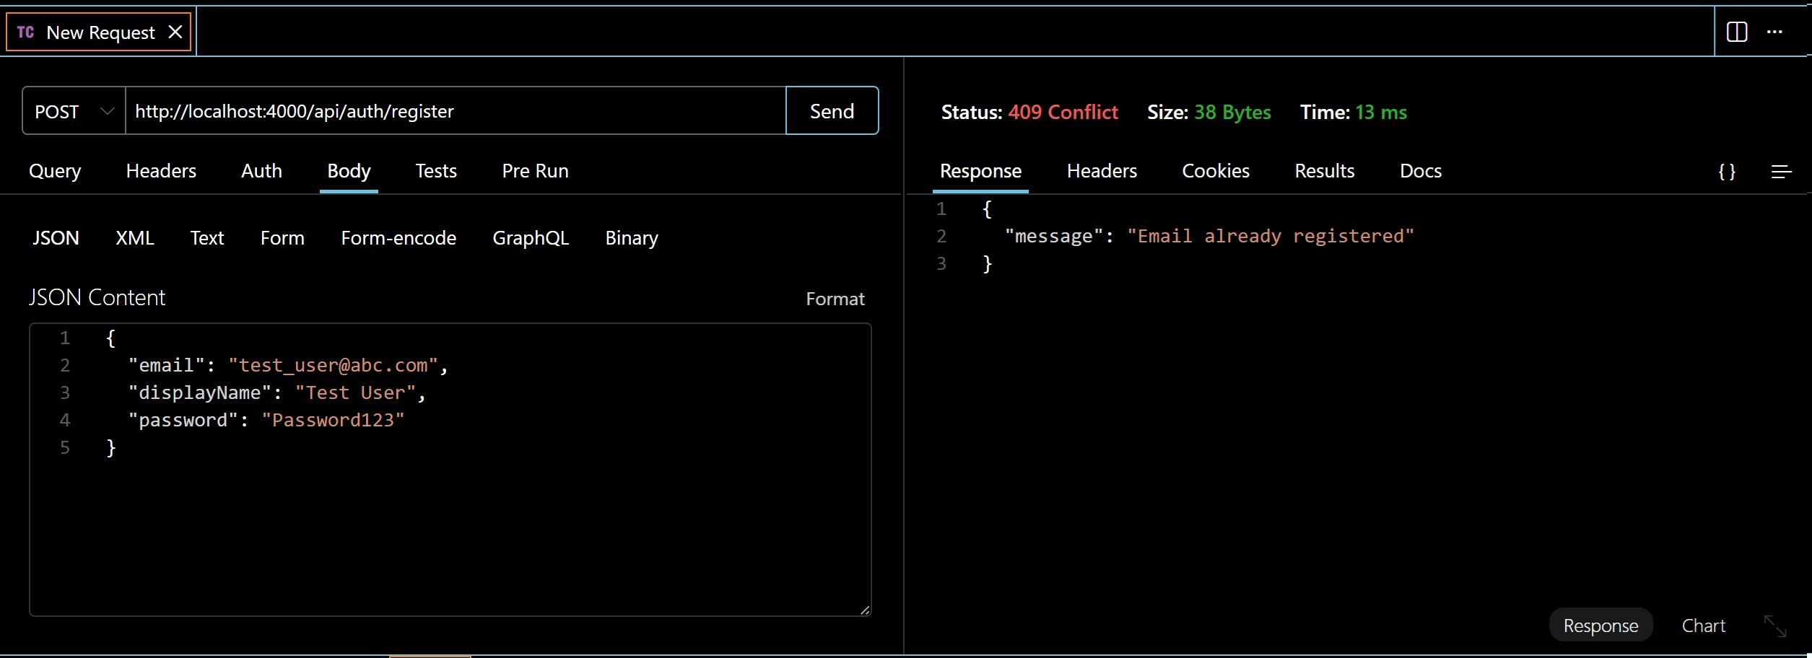
Registering an existing user
Unlocking new horizons
Notes:
(12:30–13:30) This is the database schema.
There are four key entities: Users, Sessions, Items, and ChatMessages.
Sessions store login tokens and expiry information.
Items belong to a user owner.
ChatMessages link to an item and a sender user so conversations remain item-specific and persist over time.

Slide 18
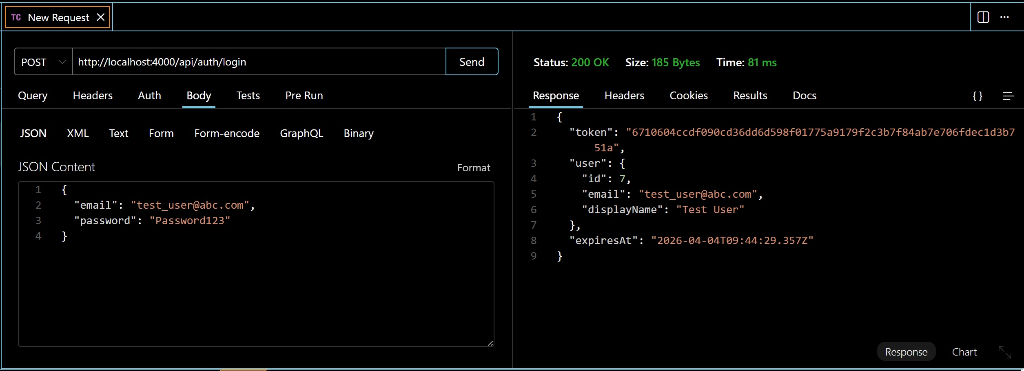
Logging in using correct credentials
Unlocking new horizons
Notes:
(13:30–14:10) Testing approach: I used both manual endpoint testing and automated tests.
Thunder Client was used to quickly validate endpoints during development.
For automated testing and regression prevention, Jest and Supertest were used with a separate test database.

Slide 19
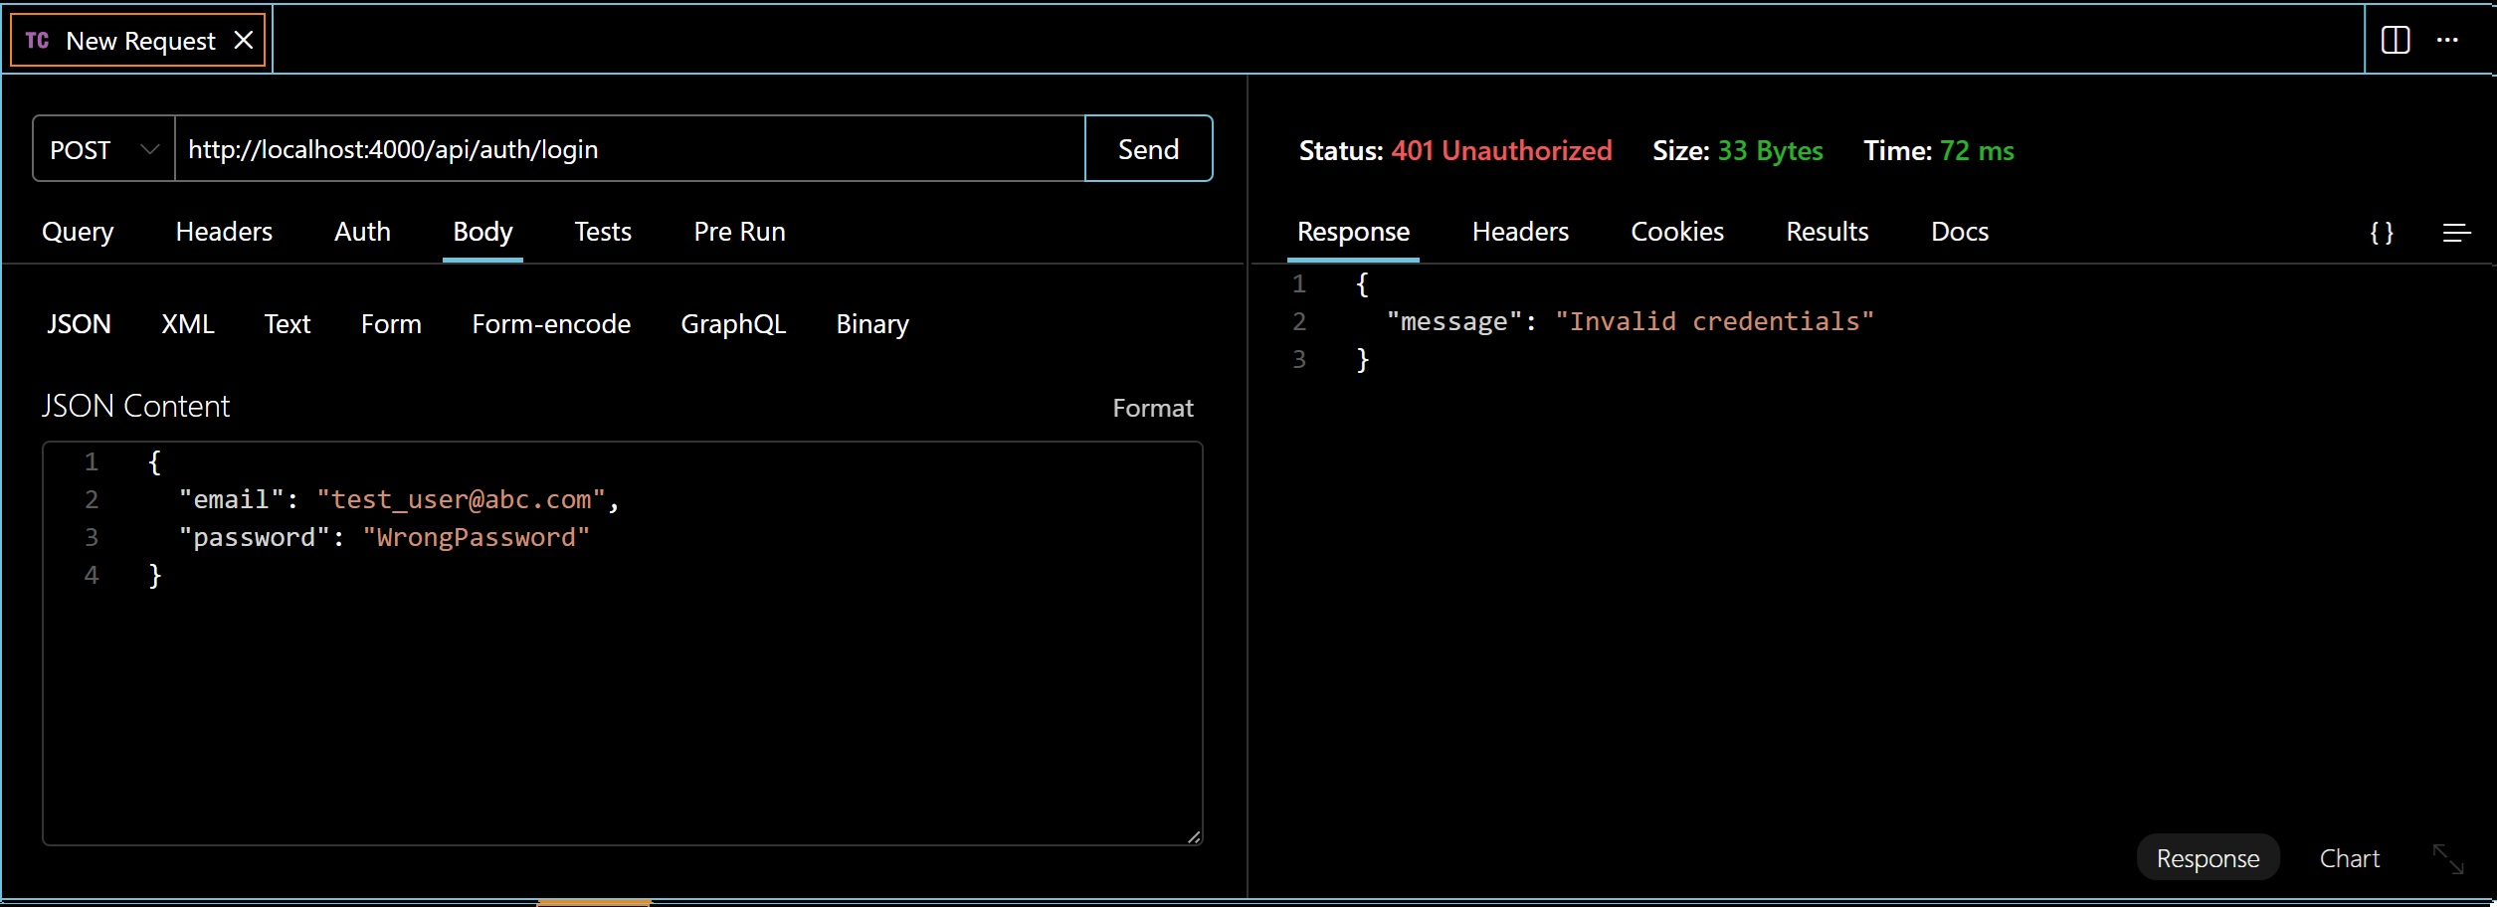
Logging in using invalid credentials
Unlocking new horizons
Notes:
(14:10–14:55) This screenshot demonstrates registering a new user.
The API validates required fields, creates the user, and returns a success response.
This is the foundation for secure access to creating listings and messaging.

Slide 20
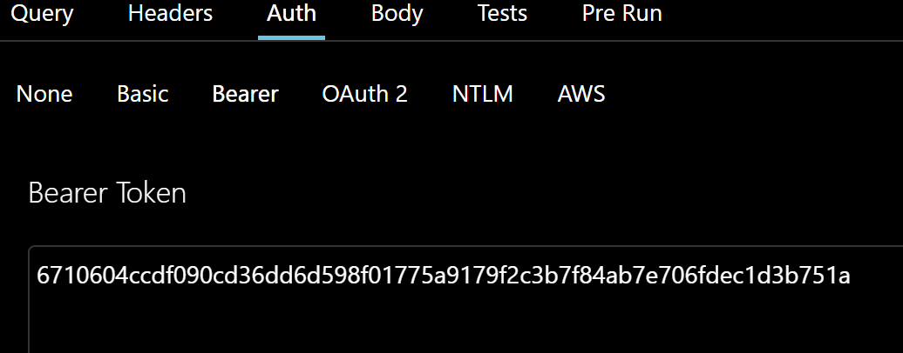
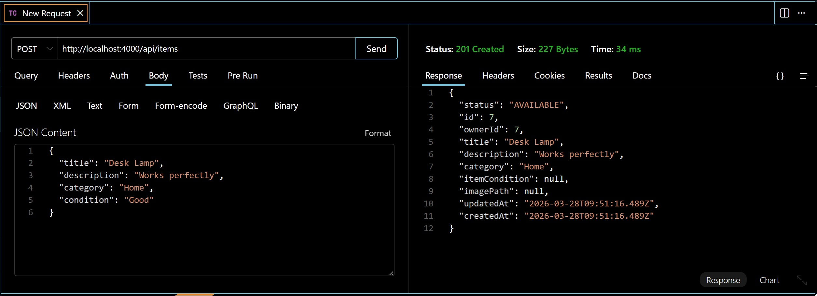
Posting item using valid token
Unlocking new horizons
Notes:
(14:55–15:30) This shows the behaviour when attempting to register an existing user.
The system prevents duplicates, typically by checking for unique email and returning an error response.
This supports data integrity and correct account handling.

Slide 21
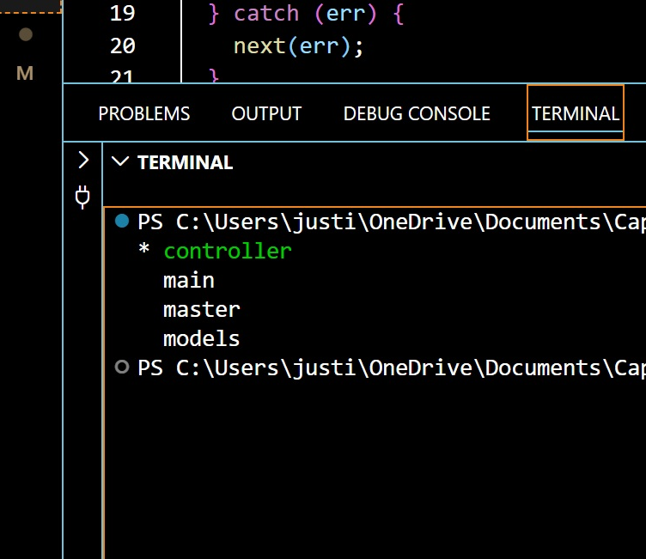
GIT Branches
Notes:
(15:30–16:05) This slide shows a successful login with correct credentials.
A token is returned and used as a Bearer token in the Authorization header for protected endpoints.
This token links to a session stored in the Sessions table.

Slide 22
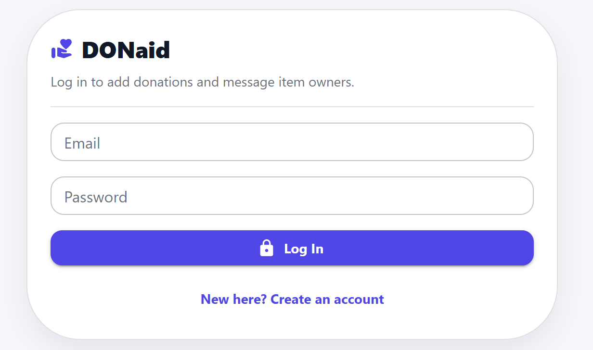
Log in Page
For existing users to log in using correct credentials
Notes:
(16:05–16:40) This demonstrates login with invalid credentials.
The API correctly rejects the request and returns an error response.
This confirms authentication rules are working as expected.

Slide 23
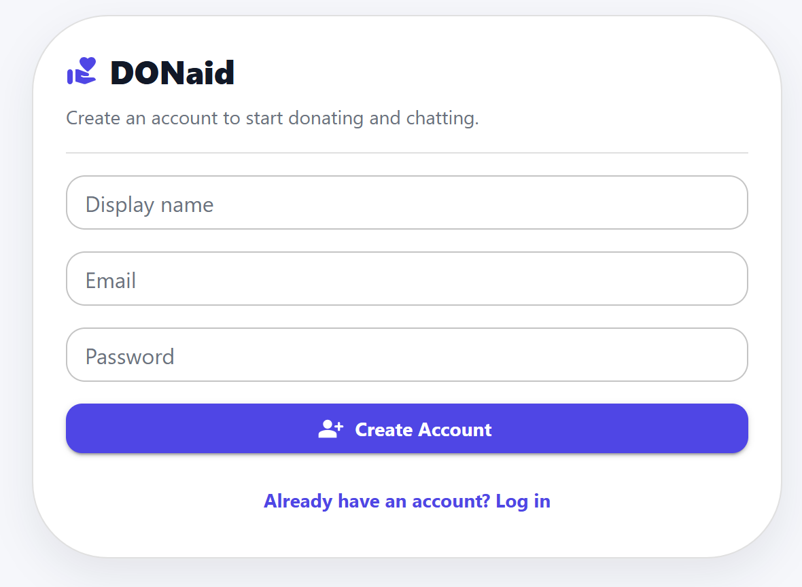
Sign up Page
For new users to create an account
Notes:
(16:40–17:30) This shows posting an item using a valid token.
The request includes the Authorization Bearer token header.
The backend associates the created item with the logged-in user and saves it into the Items table.
If an image is provided, it is saved to the uploads folder and the filename is stored in the database.

Slide 24
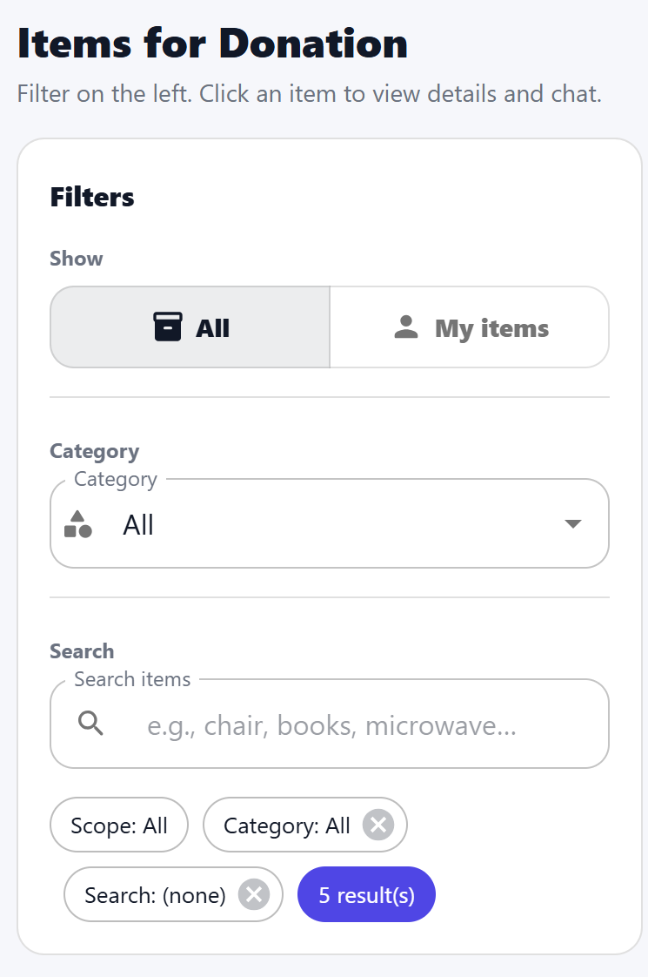
Filtering Pane
For users to search for all listed items
For users to manage their posted items
To filter items according to requirement
Notes:
(17:30–18:05) Git branches: I used branching to organise development and reduce risk.
Feature branches allowed me to implement changes safely and merge stable work into the main branch.
This supports good version control practice and easier debugging.

Slide 25
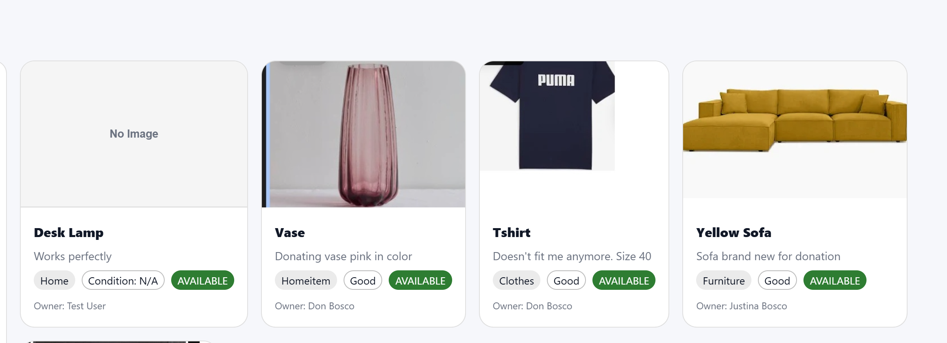
Listed Items
The right side of the page displays all the items listed by all the users by default
Notes:
(18:05–18:35) This is the Login page UI.
Existing users enter their credentials and log in to access protected features such as posting items and messaging.

Slide 26
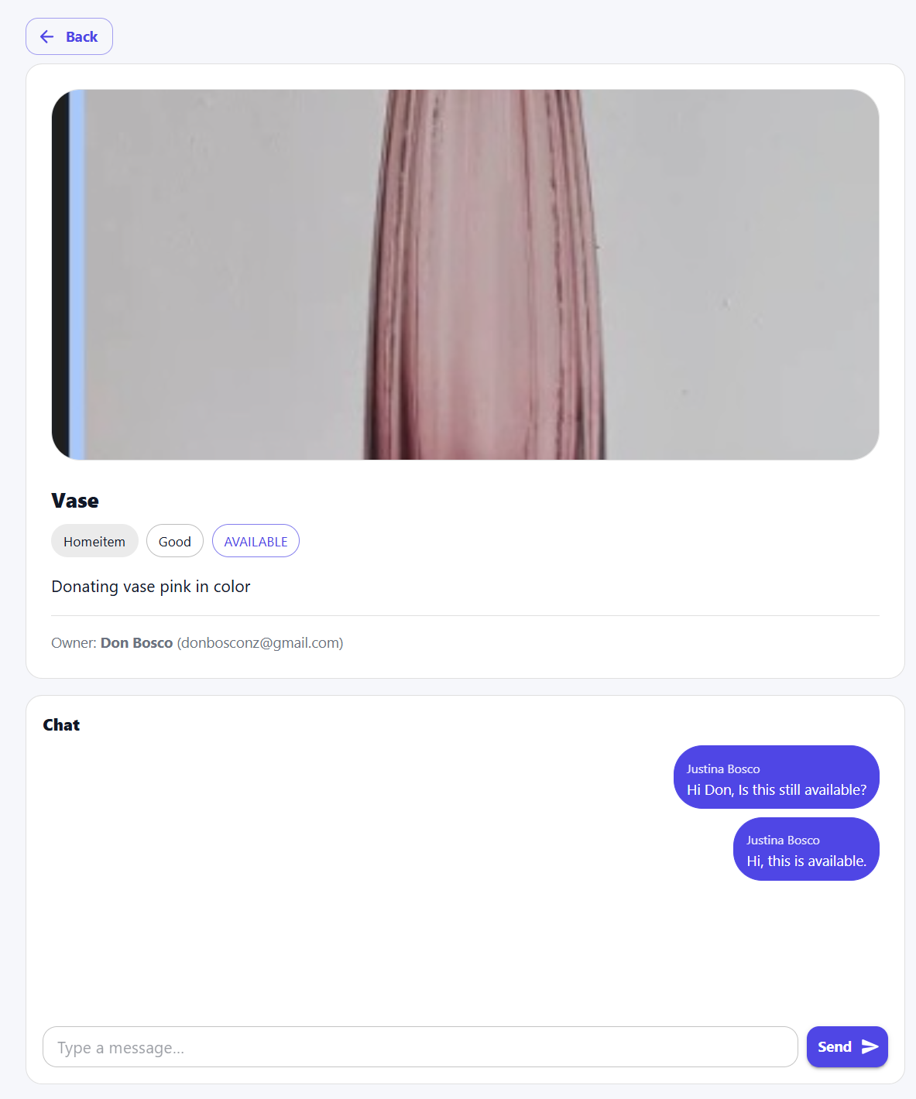
Individual Items Page
Individual item with description to enable real-time chatting, connecting donor and recipient
Notes:
(18:35–19:00) This is the Sign up page UI.
New users can create an account so they can post donation items and communicate with other users.

Slide 27
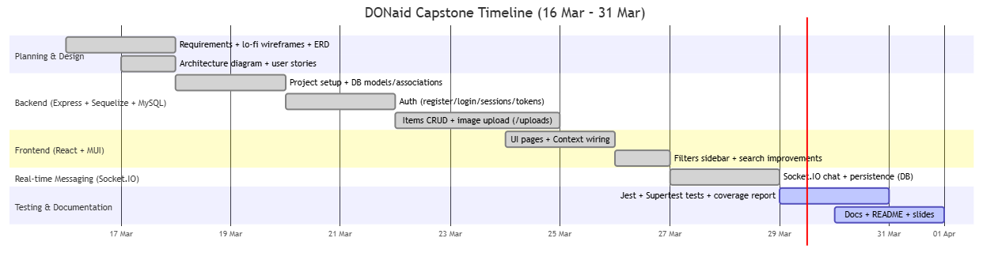
Project timeline
Notes:
(19:00–19:35) This is the Filtering Pane.
Users can filter by category and search by keyword.
The filter pane is designed to stay visible and support quick discovery of relevant items.

Slide 28
Future Improvements
Email Notification | Future enhancement will enable email notifications to donors when any user is interested in their item
Location | Geographic Information System (GIS) functionality can help users locate the donor
Password Reset | Very essential, users will be able to reset their password

Slide 29
Special thanks to our trainer for his guidance throughout the project
Notes:
(19:35–20:10) This is the Items list view.
By default, it shows items listed by all users.
Users can use the filter sidebar to refine results, and can also switch to view only their own items.

Slide 30
Thank You
Justina Bosco
justinabosconz@gmail.com
https://www.linkedin.com/in/justina-bosco-514b86188/
Notes:
(20:10–21:10) This is the Individual Item page.
It shows the full details of the item and provides an embedded chat interface.
Messages are sent in real time using Socket.IO and saved to the database so the conversation remains available after refresh.

