Slide 1
US Migration Flows
JIN DAI
ALEX LEDGER
JOSEPH MCMANUS
MICHAEL GONZALEZ
JUSTIN BOGGS

Slide 2
Overview
What drives migration flows in the United States?
We pulled financial data to see what factors correlate most to flow in and out of counties in the US.
We then pulled a sampling of the top 50 most populated counties and analyzed if more populated counties had better financial data.

Slide 3
Sources Part 1
IRS.gov flow data – Includes number of static returns filed, number of inflow and outflow returns (returns filed in a county different from the county where the previous year’s return was filed.
IRS.gov – showing the adjusted gross income by county.
50 percent rent data from HUDuser.gov - showing the mean rent per month of 1 and 2 bedroom apartments by county.

Slide 4
Sources Part 2
National Association of Realtors (NAR.realtor) – showing the median home value by county.
U.S. Bureau of Labor Statistic (bls.gov) – showing the unemployment rate by county.
Tax Policy Center (TaxPolicyCenter.org) – showing the highest marginal income tax rate per state.

Slide 5
Research Question
Hypothesis: There is a statistically significant positive relationship between a county's financial prospects and population inflow into that county. If a county has more beneficial financial elements, then population inflows into that county will be higher.
Null Hypothesis: There is no statistically significant relationship between a county’s financial elements and population inflow into that county.

Slide 6
Data Cleaning
Just over 3,000 counties as of 2017
Sorted in descending order on “Returns Total”
Input Data
6 .csv files
1 .xlsx file

Slide 7
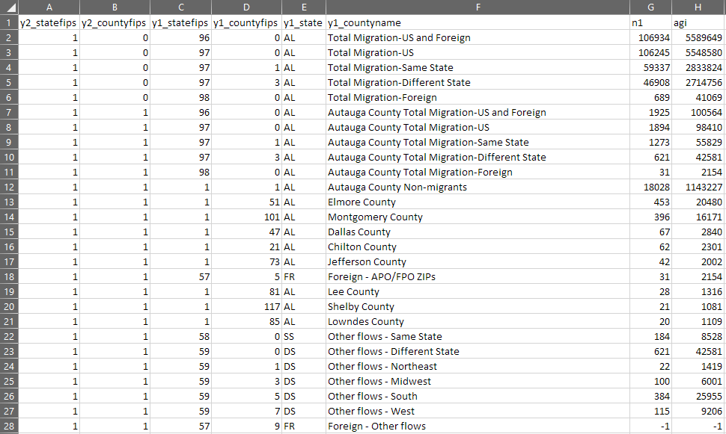
Data Cleaning

Slide 8
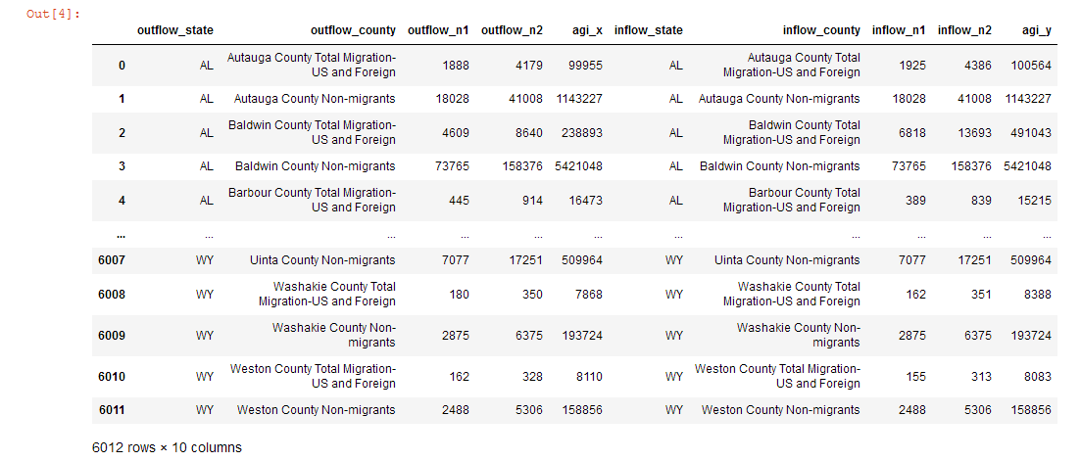
Data Cleaning

Slide 9
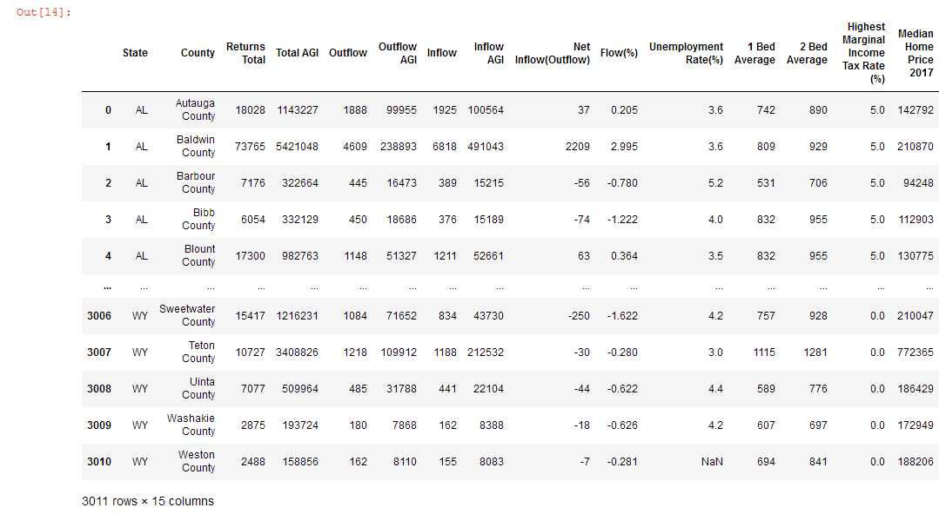
Data Cleaning

Slide 10
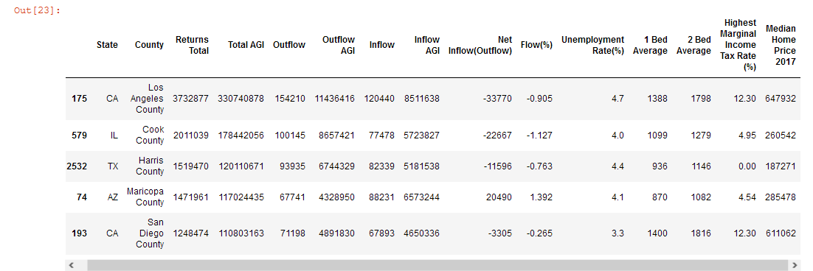
Data Cleaning
Sorted in descending order by “Returns Total”
Top 50

Slide 11
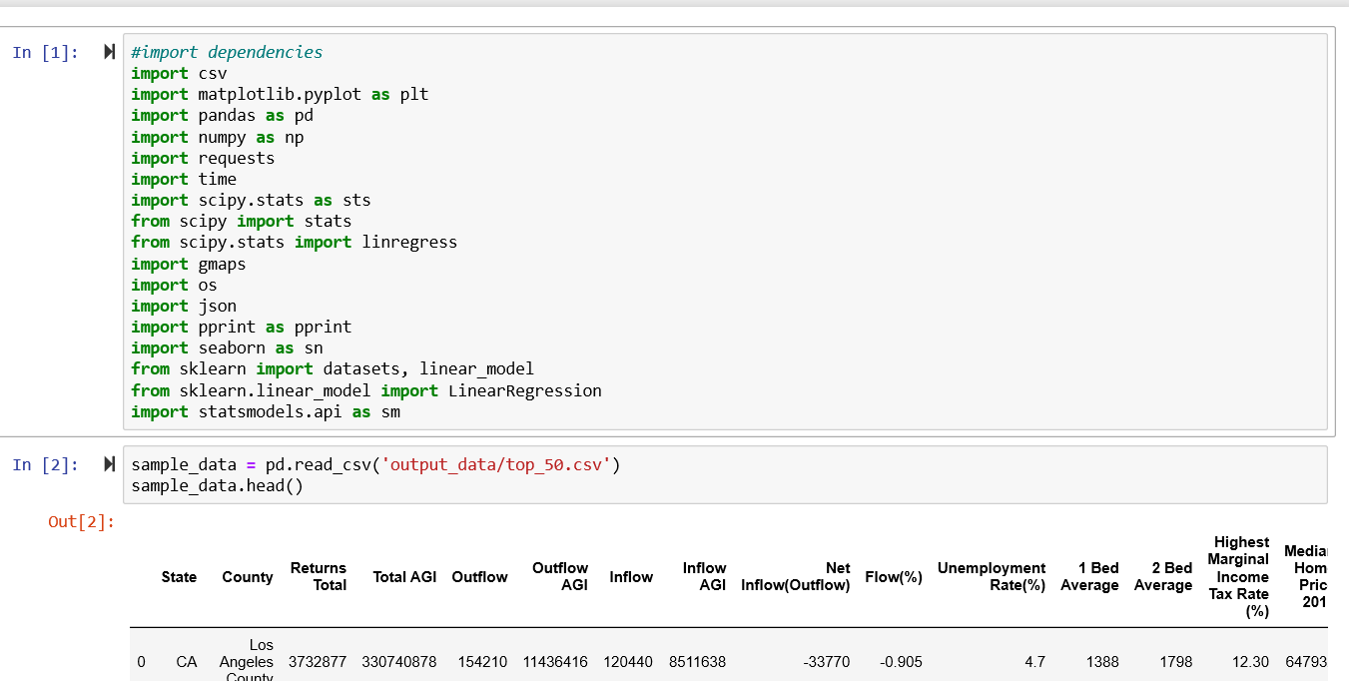
Visualizations Code
Sources:

Slide 12
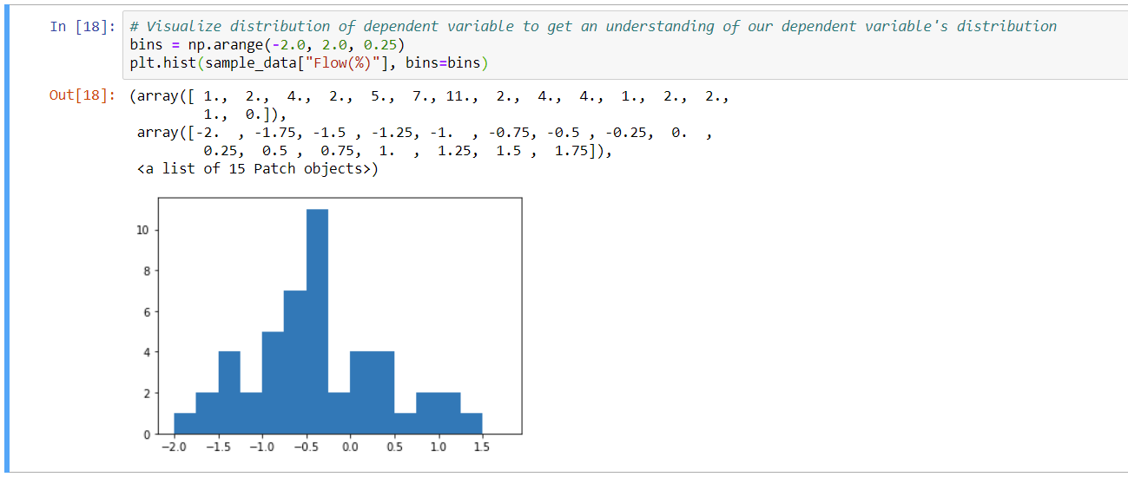
Bar Graph – Counties by flow percentage

Slide 13
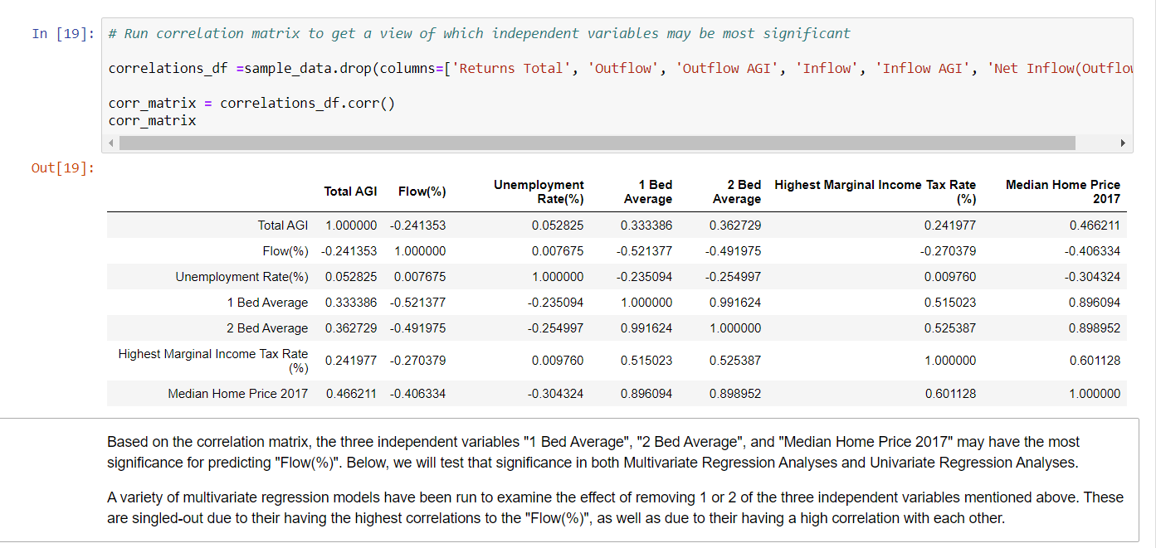
Correlation Matrix

Slide 14
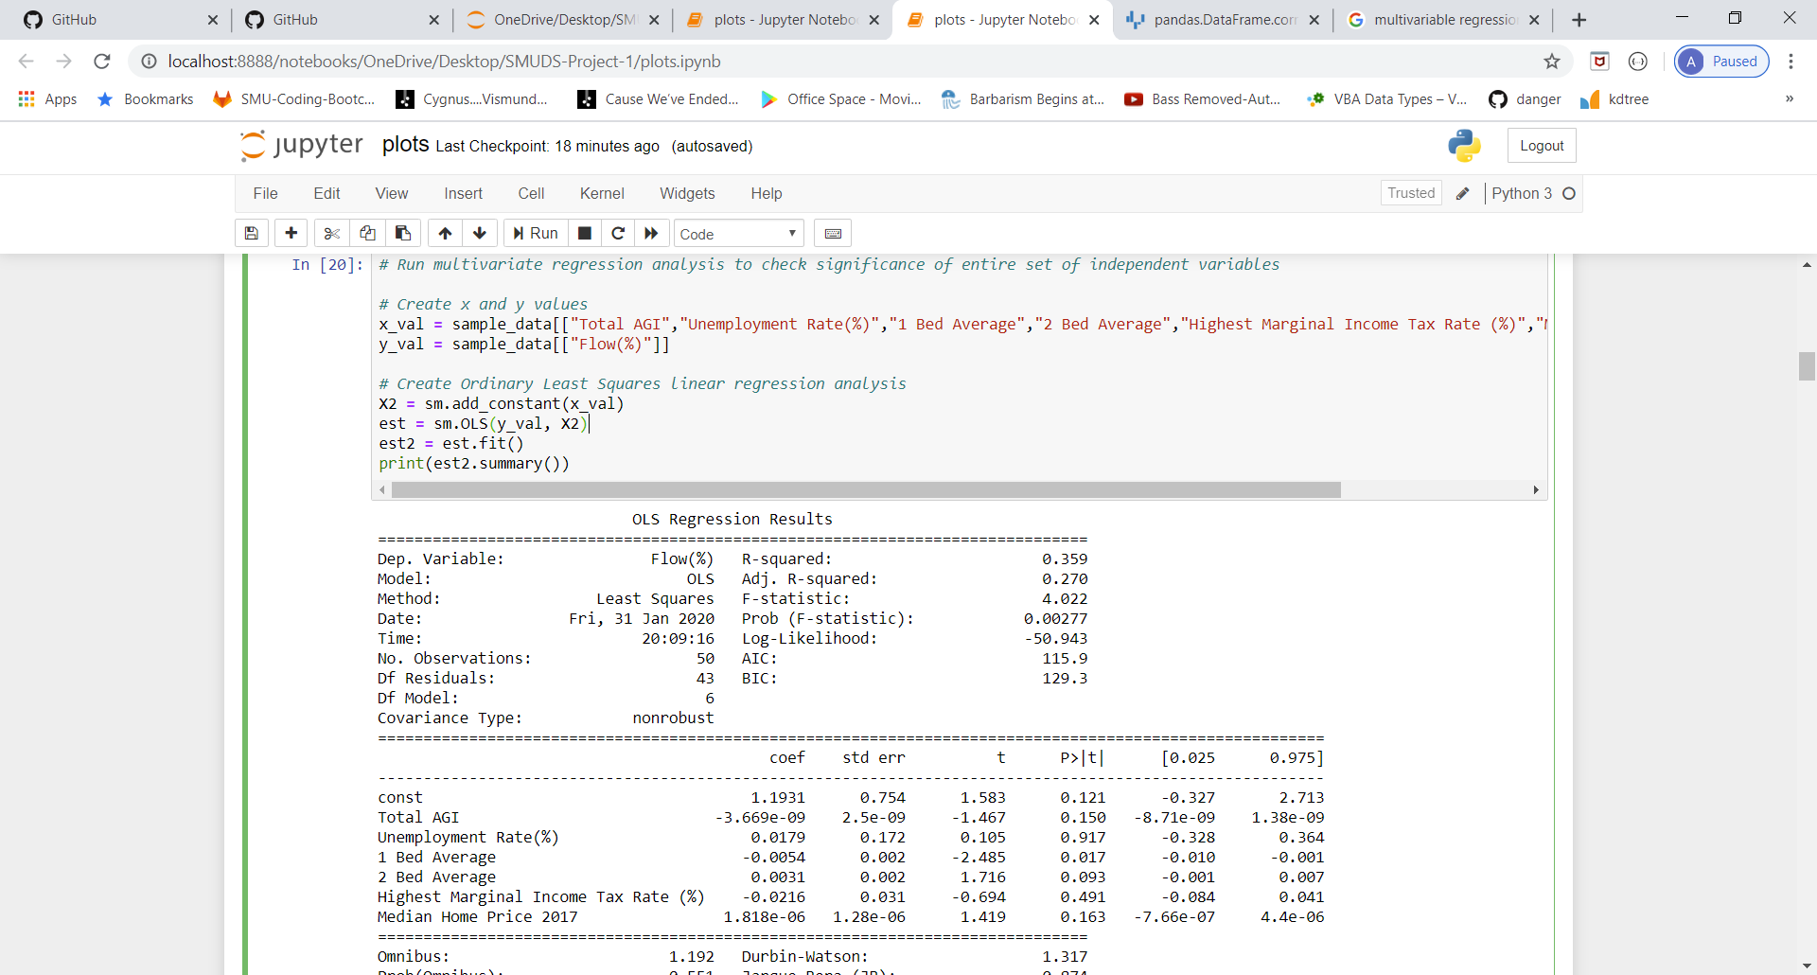
Multi variable Correlation

Slide 15
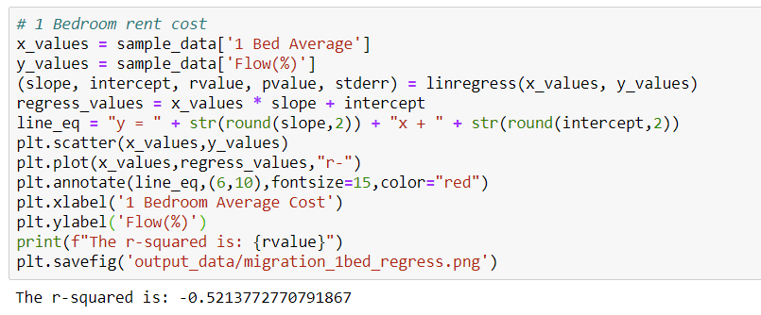
Scatterplot Code
Sources:

Slide 16
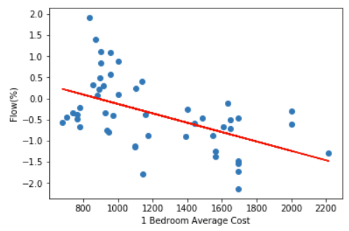
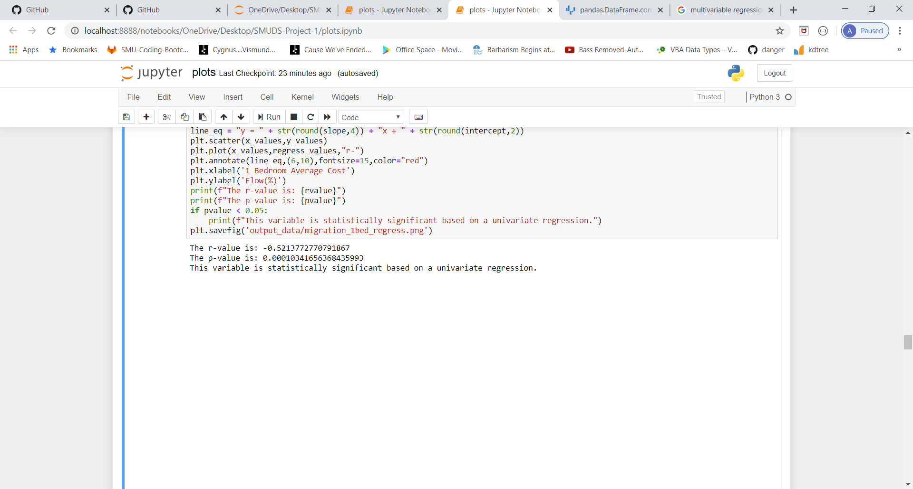
Scatterplot Example
Scatterplots were created for all independent variables individually, showing potential correlation between.

Slide 17
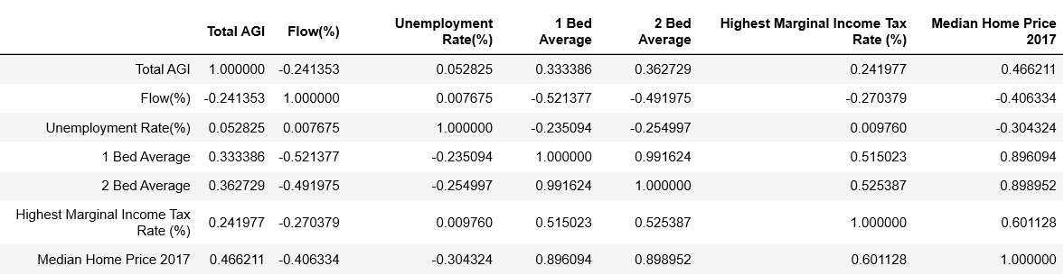
Correlation table
- Identify variables that are likely to have strong relationships to the Migration Flows
- Identify potential risks for multicollinearity

Slide 18
Results of various models of multivariate regression
Test whether our independent variables in aggregate have a significant influence on Migration flows
 | All ind. variables | All ind. variables, ex-2 Bed Avg | All ind. variables, ex-1 Bed Avg | All ind. variables, ex-Median Home Price 2017 | All variables, ex-2 Bed Avg & Median Home Price 2017
F-statistic | 4.022 | 4.059 | 3.214 | 4.325 | 4.579
Degrees of freedom for regression : df₁ | 6 | 5 | 5 | 5 | 4
Degrees of freedom for error: df₂ | 43 | 44 | 44 | 44 | 45
Critical Value | 2.318 | 2.427 | 2.427 | 2.427 | 2.579
Statistically Significant? | YES | YES | YES | YES | YES
Adjusted r² | 0.359 | 0.316 | 0.268 | 0.330 | 0.289

Slide 19
Results of Univariate Regression for each independent variable
Test whether any of our independent variables, in isolation, have a significant influence on Migration flows
 | 1 Bed Average | 2 Bed Average | Median Home Price 2017 | Highest Marginal Income Tax Rate % | Total AGI | Unemployment Rate %
p-value | 0.0001 | 0.0003 | 0.0034 | 0.0576 | 0.0913 | 0.9578
Statistically significant? | YES | YES | YES | NO | NO | NO
r-value | -0.5214 | -0.4920 | -0.4063

Slide 20
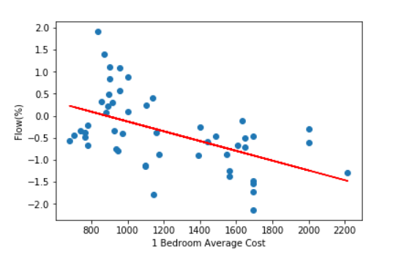
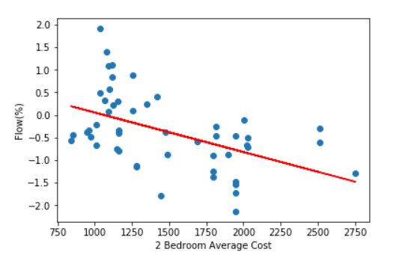
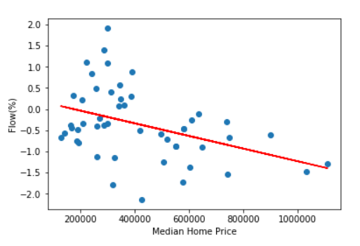
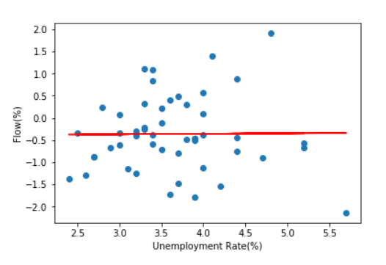
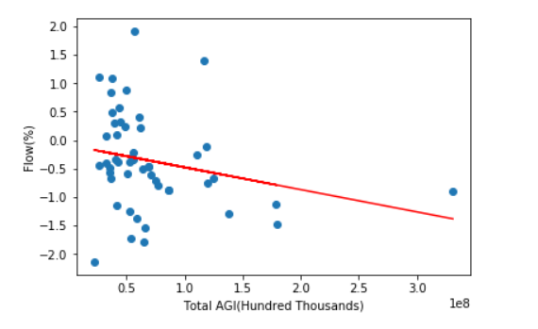
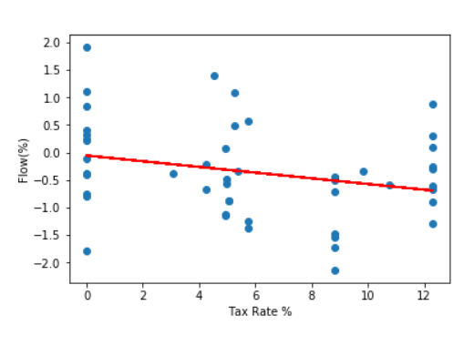
Scatterplot Analysis – Univariate Regression

Slide 21
Summary
No correlation between unemployment rate and migration rate
Very week correlation between Average Gross Income, State income tax rate and migration rate
Positive relationship between house prices, monthly rent and migration rate
Housing affordability has the most significant influence among all the financial statistics
Sources:

Slide 22
Conclusion
There is a positive relationship between financial data and migration rate.
The influence is not as strong as expected.

Slide 23
Questions?

