Slide 1
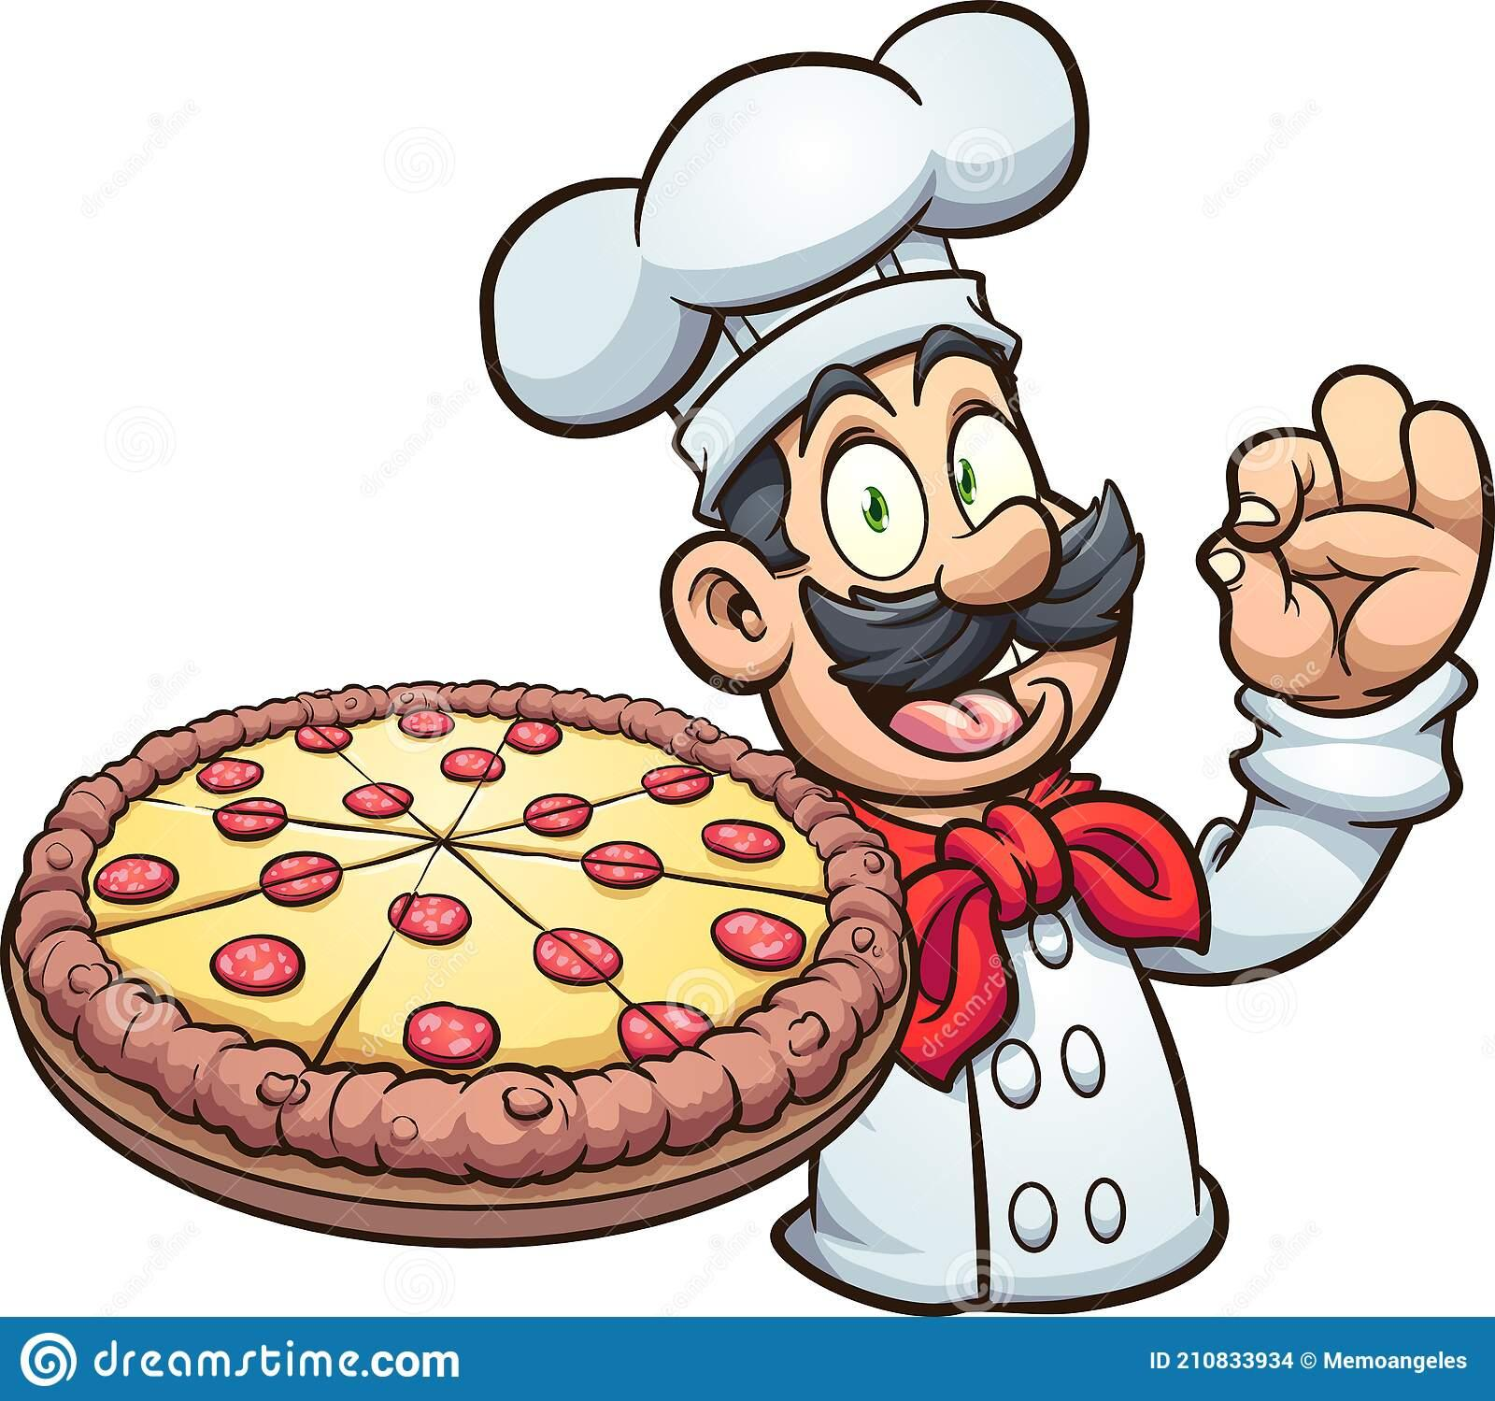
Golden-Pepperoni 2.0
Team: Pending
Marshall, Kris, & Justin

Slide 2
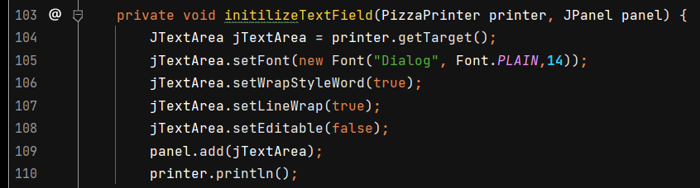
Challenges/ Lessons Learned
Any guesses what happens if line 110 is moved to directly above line 106?

Slide 3
Challenges/ Lessons Learned
Gson -> totally different code stack
Working with another group’s code and Ideas
Github challenges with versioning and .gitIgnore
Trying to get an auto scaling map
Text wrap in GUI

Slide 4
Highlights of the Game
Immersive exploratory game
Persistent Map
Quest rewards
Reputation System

Slide 5
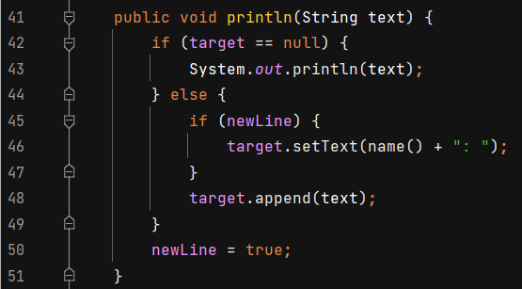
Code Highlights
Extracting methods
Creating new constructors for more functionality
Refactoring for consistency (e.g. leftovers from hard-coded data vs JSON)
GUI -MVP

Slide 6
Let’s Play Golden-Pepperoni!

Slide 7
What we would do next!
Create an Auto - Scaling Map
Live map with player position
Vehicle functionality to shorten travel time
Adding a crafting system

Slide 8
Frequently used Agile Principles
Our highest priority is to satisfy the customer through early and continuous delivery of valuable software.
3. Deliver projects frequently (3 day sprints)
7. Working software is the measure of progress
8. Agile processes promote sustainable development.

Slide 9
Questions?

