Slide 1
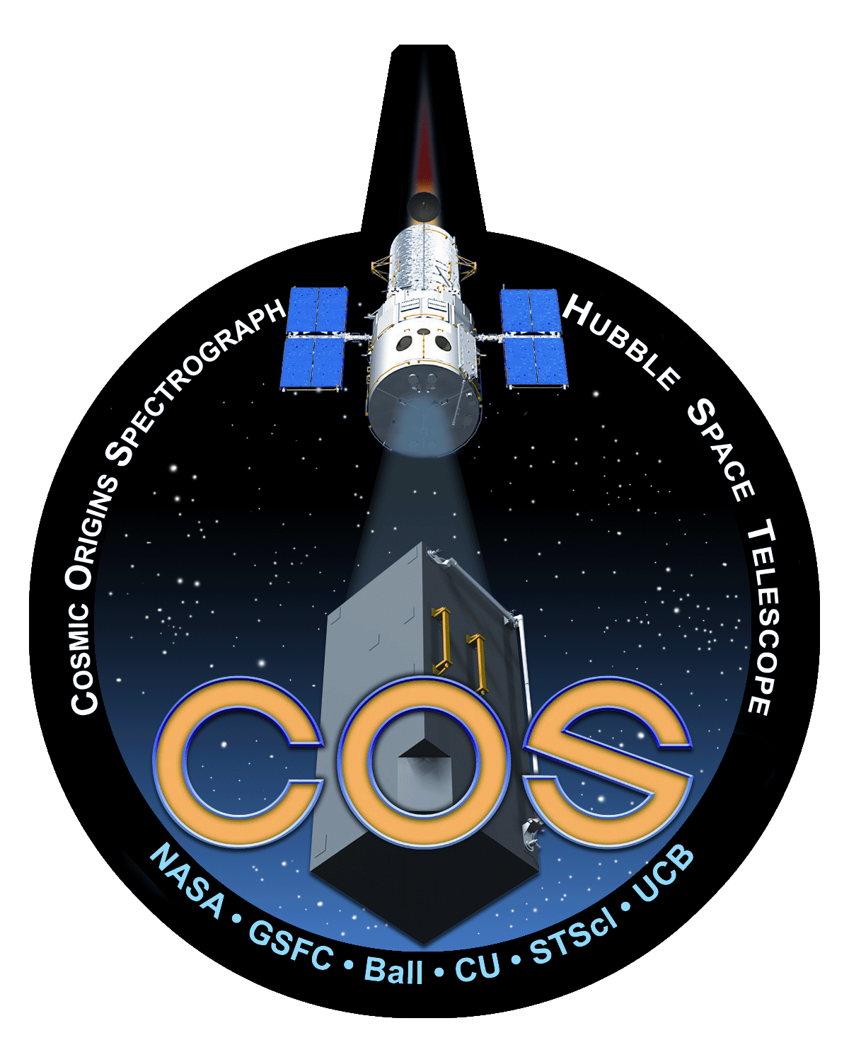
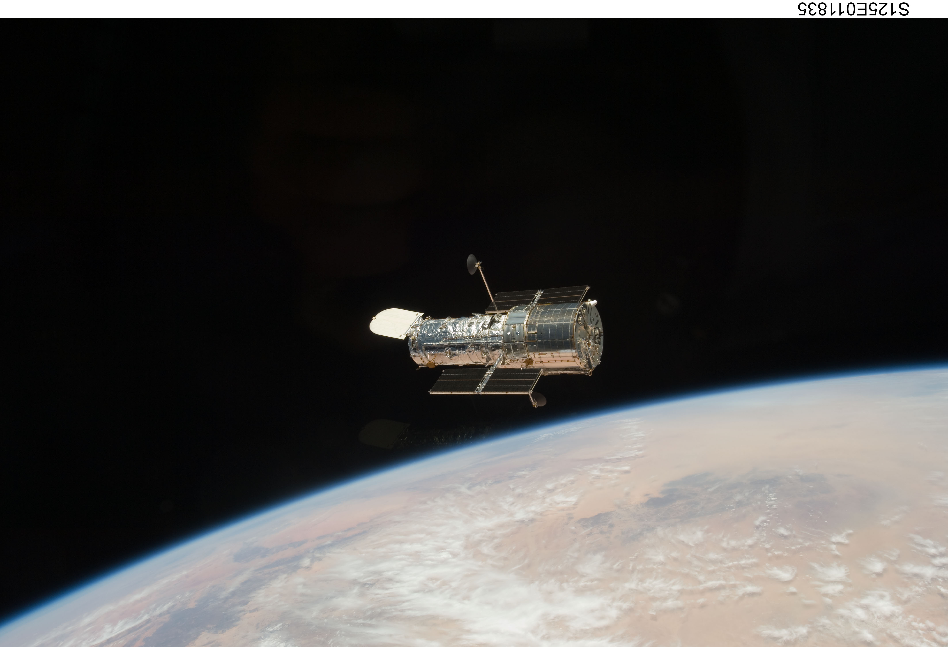
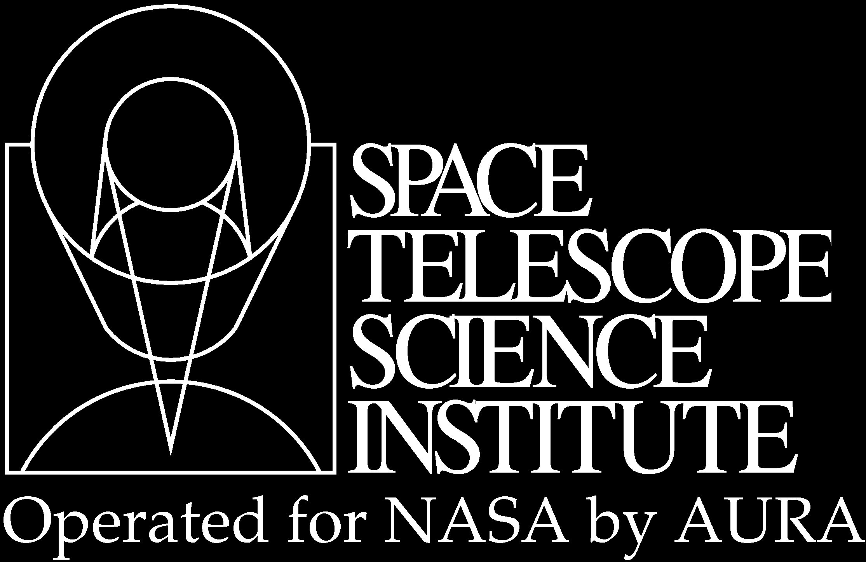


Advanced Time-domain Calibrations and Data-reduction Techniques with HST/COS
Justin Ely¹, K. A. Bostroem¹, John H. Debes^{1, 3}, Svea Hernandez¹, Philip Hodge¹, Robert I. Jedrzejewski¹, Kevin Lindsay¹, Derck Massa^{1, 4}, Cristina M. Oliveira^{1, 3}, Steven V. Penton¹, Charles R. Proffitt^{2, 1}, Julia Roman-Duval^{1, 3}, David J. Sahnow¹, Hugues Sana^{1, 3}, Paule Sonnentrucker^{1, 3}, Joanna M. Taylor¹
1. STSCI, 2. CSC, 3. ESA, 4. SSI
Abstract
The Hubble Space Telescope/Cosmic Origins Spectrograph (HST/COS) detectors have a time-tag mode of observation in which the arrival time of each photon is recorded individually. Although the COS calibration pipeline (CalCOS) makes use of this capability in many aspects of routine processing, there remains a number other ways that this information can be used to improve the calibration for specific science cases. This has led to the development of tools and techniques to perform additional calibrations that are not part of the standard data products output by CalCOS, but have been made available to the user. Here we demonstrate a few of these techniques including day/night filtering, extracting spectra on sub-exposure timescales, producing photometric light-curves, and performing additional dark-count screening.
CORRTAG files
There are many data products associated with the CalCOS calibration pipeline, but one file at the heart of COS data is the *_corrtag_* file. This file contains a list of every event detected during an observation, along with a large amount of associated formation used in later processing: incident time, detector position, data quality, wavelength, and pulse-height amplitutde (PHA) to name just a few. Other extensions in the file also include tables of times with good data quality and a second-by-second accounting of various orbital parameters.
It is this file that makes possible the special calibrations mentioned here. Each one is a specialized re-arranging, slicing, or filtering of that event list and associated metadata followed by re-extraction with CalCOS or other specialized software. For more information, you can review the COS Data Products section of the current Data Handbook.
Splittag
Another way to sample variability in a target is to split up an observation in time and re-extract a dispersed spectrum from each. This means that, data quality permitting, each individual COS exposure can become a sample of spectra separated in time.
Splittag can be used to separate data by specifying either:
Start, stop and increment times
or
An explicit list of time intervals.
The task will break apart the input corrtag file, copying the events from the specified times to new output files. After that, simply re-running CalCOS on the newly created corrtag files will re-extracted the spectrum from each.
Pulse Height Filtering
The typical Pulse Height Amplitude (PHA) of detected photons continues to evolve as the detectors continue to be used. Regions of the detector that experience heavy count rates, particularly those that see the LyA airglow emission, evolve faster than others.
To reduce the observed background, events are screened on PHA during CalCOS processing. The standard pulse height parameters table (PHATAB) specifies a lower bound of 2 and an upper bound of 23 for good data. Everything outdside of these bounds is excluded.
While these values are applicible for the entiretly of the COS archive to date, individual datasets could instead use tighter boundaries to further remove background contamination in spectra.
Lightcurves
1D dispersed spectra are the standard products produced by CalCOS, but their time-averaged nature intrinsically masks any small-scale variability inherent in the source. However, COS typically operates in time-tag mode, counting photons with a precision of 32 ms, which making it possible to uncover this variability with special extraction software.
Additionally, the spatial information associated with each event makes it possible include only specific wavelength or detector regions during extraction. Given adequate signal-to-noise, multiple lightcurves over different wavelengths can be extracted from a single dataset; providing the means to perform wavelength-dependent variability studies.
TimeFilter
The TimeFilter task can be used to exclude unwanted times from a COS dataset. Primarily, this is done to remove the contamination from geo-coronal airglow emission in the COS bandpass, but the data can be filtered on a variety of parameters such as:
Sun Altitude
Airglow Strength (Ly Alpha, OI)
Longitude, Latitude
Darkrate
Figure 2 shows two COS x1d spectra as extracted by CalCOS. The variable emission features seen between 1300 and 1310 Angstroms are due to Oxygen I in the atmosphere at HST’s orbit. Their presense in the spectrum can be hiding the presence of intrinsic features in the spectrum.
Figure 4 shows spectra of IY-UMa; the archival spectrum (top panel), and the split and re-extracted spectra from 3 different time segments (bottom panel) of the same data. The dataset used here is the same as in Figure 1, and the datasets have been split up into segments of before (0-400 seconds), during (400-900 seconds), and after (900-1300 seconds) the observed transit and re-extracted with CalCOS. Large differences in the flux leves of the time periods can be seen. Data has been binned by 15 pixels.
Figure 5 shows the pulse height distributions for FUVA (top) and FUVB (bottom) for a dataset taken in 2010. Red lines indicate the PHA limits imposed by the current reference file. Grey regions indicate the approximate additional range of pulse-heights that could be screened out for this particular dataset. Data has been binned across the entire detector.
Figure 1 gives an example of the time-series information contained in a single COS exposure of the Cataclysmic Variable IY-UMa. The top panel shows the standard CalCOS x1d spectrum, and the bottom panel displays the summed counts in each second of the exposure. Clearly evident in the lightcurve is variability on ~sub 100 second timescalse, along with an evident transit.
Lightcurve Source
The library used to extract the lightcurves on this poster is available on both GitHub and the Python Package Index. You can find more information, download the source, or contribute to the library at the following:
Tutorials
Running the calibration and analysis shown here can be a complicated process, and not very amenable to display in a poster format. As such, In-depth tutorials for each of the topics explained here can be found at the following location. https://github.com/justincely/AAS224
This link connects to a GitHub repository containing step-by-step demonstrations using the mentioned tools and techniques. Each tutorial is written in Python and contained in an iPython notebook such that they can be re-run and modified at will. PDF and HTML versions of the tutorials, this poster, all plots, and the raw datasets are also included.
Figure 3 shows the same spectra extracted by CalCOS after first being processed with the TimeFilter tool. Any data taken during orbital day (when the sun’s altitude was above the horizon as seen by HST) was excluded by the processing. Since data was removed, the signal-to-noise of the remaining spectrum was reduced, and one spectrum was removed entirely. However, absorption features in the airglow region can now be detected and analyzed.
http://justincely.github.io/lightcurve/

