Slide 1






Agile
Development
Sprint Cycle
Define
Develop
Deliver
Do it again…
Design
Notes:
To change the image on this slide, select the picture and delete it. Then click the Pictures icon in the placeholder to insert your own image.

Slide 2

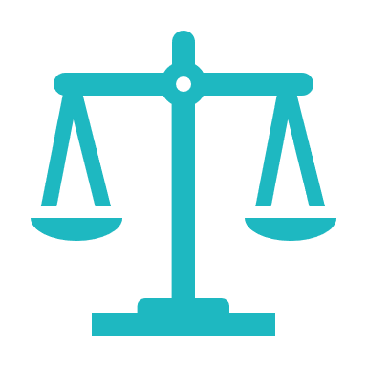
Agile Manifesto
“Agile is a collection of evolving delivery and management frameworks for dynamic and innovative delivery environments.”
The Manifesto for Agile Software Development
We are uncovering better ways of developing software by doing it and helping others do it. Through this work we have come to value:
Individuals and interaction over processes and tools.
Working software over comprehensive documentation.
Customer collaboration over contract negotiation.
Responding to change over following a plan.
That is, while there is value in the items on the right, we value the items on the left more.
Advantages
Disadvantages
Speeds up development
Quicker course correction
Lowers costs
Increases value
Not meant for all projects
Documentation deficiencies
Can lack structure
Potential ambiguity
Notes:
Advantages
Without being bogged-down with many processes and procedures, especially if it doesn’t make sense for particular projects, there is much more time available to do actual development work. Plus, by working more collaboratively with a project focus, ideas are able flow much freely between team members who are focused on different aspects as they work towards the shared goals. The shorter times with smaller deliverables allow for mistake in planning or expectations to come to the surface much quicker, thus enabling much quicker course correction. This in turn greatly helps lower development costs. Lastly, Agile is primarily focused on increasing value by continually making a product better by adding usable features and updates within very short Sprint cycles.
Disadvantages
Having Agile implemented haphazardly or not fully, plus a lack of structure can lead to potential ambiguity on unmotivated developers. For example, I was on a team that tried to implement aspects of Agile without fully embracing it and we ended up having developers siloed even worse than when we started. The lack of collaboration forced developers to work in a Waterfall fashion while touting the banner of Agility. Lack of documentation is another aspect of Agile that I have personal experience with. On the same project there was so much focus on individual developers making quick turnarounds for the business segment customers that there lacked much important documentation on what work was being done or why, that when a main developer left I inherited mess of “copies of copies of copies” of code, all of which had minor tweaks and each copy with its own unique bugs. And because there was such a lack of documentation, and a high amount of bugs, it was really difficult to understand what segments of code were doing… not to mention trying to figure out the interrelated cross-dependencies. Lastly, Agile is not meant for all project types. For example, if Elon Musk wants to fly people to the Planet Mars, there would need to be very extensive planning for all aspects before anyone can launch on such a perilous adventure. You simply can’t make revisions to a rocket after it launches with humans aboard.
Can lack structure
Documentation deficiencies
Potential ambiguity

Slide 3





Best Practices
Follow the 4 Agile Values
Individuals and interaction over processes and tools.
Working software over comprehensive documentation.
Customer collaboration over contract negotiation.
Responding to change over following a plan.
Notes:
Individuals and interaction over processes and tools.
Having a group of motivated developers that know how to communicate effectively and organize appropriately opens the door to greater innovative solutions, rather than having a bunch of disparate teams churning over lifeless processes that kill the soul.
Working software over comprehensive documentation.
If software works then it provides value, if that same software won’t be ready until all its comprehensive documentation is flushed out 3 months from now, then there is no value until the software is finally released.
Customer collaboration over contract negotiation.
Oftentimes customers don’t really know what they need until they have something to work with, and what they think they need vs what the really need is not quite the same. So having a contract to do something that might end up being irrelevant can waste a lot of time and money.
Responding to change over following a plan.
Things change, and plans need to change when needed. If a plan has been generated that doesn’t make since, or if a situation changes then developers need to be able to respond to the change quickly.

