Slide 1
Information Technology Project Management – Fifth Edition
By Jack T. Marchewka
Northern Illinois University
2-<number>
Copyright 2015 John Wiley & Sons, Inc.

Slide 2
Project Methodologies and Processes
Chapter 2
2-<number>
Copyright 2015 John Wiley & Sons, Inc.

Slide 3
Learning Objectives
Define what a methodology is and describe the role it serves in IT projects.
Describe the project life cycle (PLC).
Describe the Project Management Body of Knowledge (PMBOK®) and be familiar with its knowledge areas and process groups.
Describe PRINCE2® and be familiar with its core principles, processes, and themes.
Describe the Systems Development Life Cycle ( SDLC).
Describe the Waterfall method for developing the project’s product or system.
Describe the Agile approach for developing the project’s product or system as well as two commonly used approaches called eXtreme Programming (XP) and Scrum..
Describe and apply the concept of Leaning Cycles and lessons learned.
2-<number>
Copyright 2015 John Wiley & Sons, Inc.

Slide 4
Introduction
Project Methodology
  A strategic-level plan for managing and controlling the project
  Game plan for implementing project and product lifecycles
  Recommends phases, processes, tools, and techniques for supporting an IT project
  Must be flexible and include “best practices” learned from experiences over time.
Can be
  Traditional (e.g., Waterfall)
  Agile (e.g., XPM, SCRUM)
2-<number>
Copyright 2015 John Wiley & Sons, Inc.

Slide 5
The Project Life Cycle
  Collection of logical stages or phases that
  maps the life of a project
  from its beginning, through its middle, to its end,
  to define, build, and deliver the product.
2-<number>
Copyright 2015 John Wiley & Sons, Inc.

Slide 6
Project Phases
Phase Exits, Stage Gates, Kill Points
  These are the phase-end review of key deliverables
  Allows the organization to evaluate project performance and take immediate action to correct errors or problems
Fast Tracking
  Starting the next phase of a project before approval is obtained for the current phase
  Can be used to reduce the project schedule
  Can be risky and should only be done when the risk is acceptable
2-<number>
Copyright 2015 John Wiley & Sons, Inc.

Slide 7
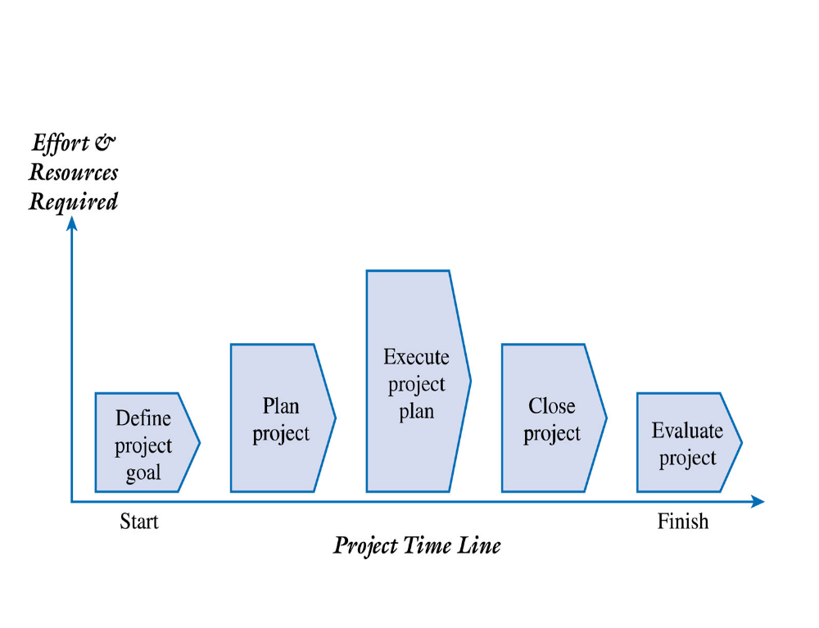
Figure 2.1 – A Generic Project Life Cycle
2-<number>
Copyright 2015 John Wiley & Sons, Inc.

Slide 8
Project Life Cycle – Define and Plan
Define Project Goal
  The project goal should be focused on providing business value to the organization
  Provides a clear focus and drives the other phases of the project
  How will we know if this project is successful given the time, money, and resources invested?
Plan Project
  Project Objectives
  Resources
  Controls
2-<number>
Copyright 2015 John Wiley & Sons, Inc.

Slide 9
Project Life Cycle – Execute, Close, and Evaluate
Execute Project Plan
  Manage the project scope, schedule, budget, and people to ensure the project achieves its goal
  Progress must be documented and compared to the baseline plan
  Project performance must be communicated to all of the stakeholders
Close and Evaluate Project
  Ensures that all of the work is completed as planned
  Final project report and presentation to the client
  Postmortem review
  Lessons learned and best practices documented and shared
2-<number>
Copyright 2015 John Wiley & Sons, Inc.

Slide 10
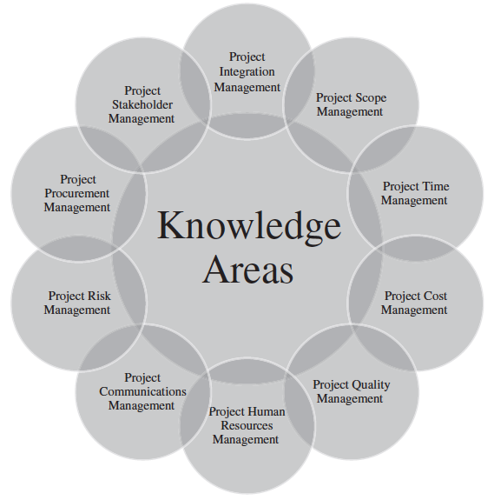
Figure 2.2 – The PMBOK® Guide – The 10 Project Management Knowledge Areas
2-<number>
Copyright 2015 John Wiley & Sons, Inc.

Slide 11
PMBOK® Guide – The 10 Project Management Knowledge Areas
Project integration management
Project scope management
Project time management
Project cost management
Project quality management
Project human resource management
Project communications management
Project risk management
Project procurement management
Project stakeholder management
2-<number>
Copyright 2015 John Wiley & Sons, Inc.

Slide 12
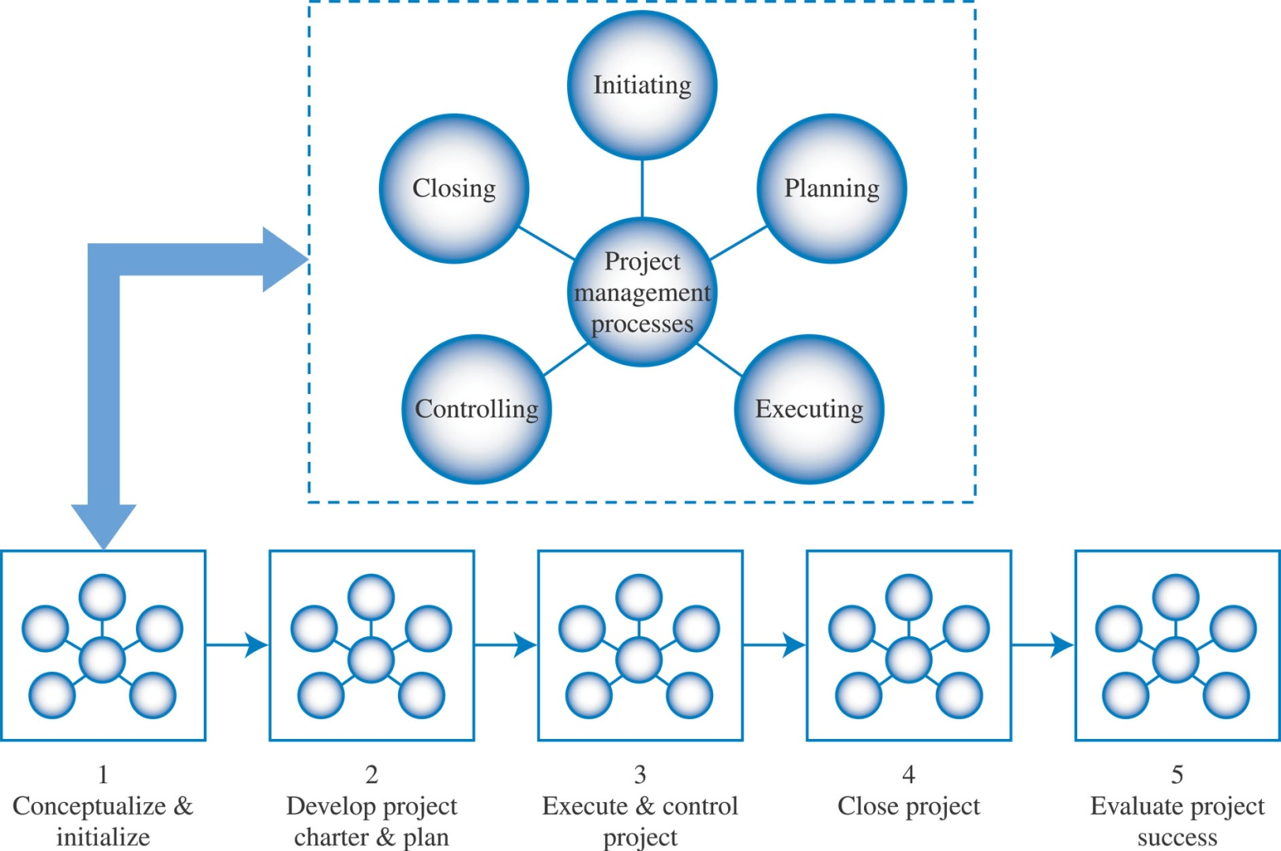
Figure 2.3 – PMBOK® Project Management Process Groups
2-<number>
Copyright 2015 John Wiley & Sons, Inc.

Slide 13
The Five (5) PMBOK® Project Management Process Groups
Initiating
Planning
Executing
Monitoring and Controlling
Closing
2-<number>
Copyright 2015 John Wiley & Sons, Inc.

Slide 14
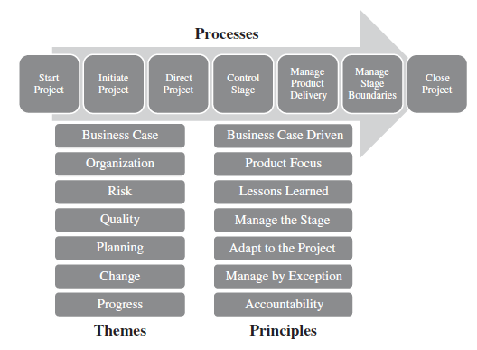
Figure 2-4 – PRINCE2® – The Seven (7) Processes
2-<number>
Copyright 2015 John Wiley & Sons, Inc.

Slide 15
The PRINCE2® – Seven (7) Processes
PRINCE2® = Projects IN Controlled Environments
Start Project
Initiate Project
Direct Project
Control Stage
Manage Product Delivery
Manage Stage Boundaries
Close Project
2-<number>
Copyright 2015 John Wiley & Sons, Inc.

Slide 16
The PRINCE2® – Themes (guidelines to aid project goal achievement)
PRINCE2® = Projects IN Controlled Environments
Business Case
Organization
Risk
Quality
Planning
Change
Progress
2-<number>
Copyright 2015 John Wiley & Sons, Inc.

Slide 17
The PRINCE2® – Principles (Universal guidance for all projects)
PRINCE2® = Projects IN Controlled Environments
Business Case Driven
Product Focus
Lessons Learned
Manage the Stage
Adapt to the Project
Manage by Exception
Accountability
2-<number>
Copyright 2015 John Wiley & Sons, Inc.

Slide 18
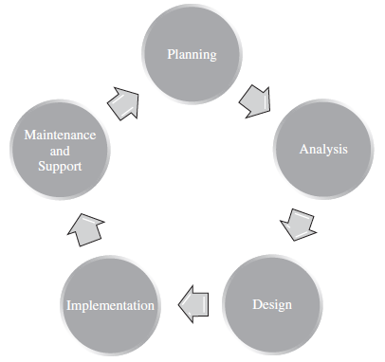
Figure 2.5 The Systems Development Life Cycle
2-<number>
Copyright 2015 John Wiley & Sons, Inc.

Slide 19
Systems Development Life Cycle (SDLC)
Planning
Analysis
Design
Implementation
Maintenance and Support
2-<number>
Copyright 2015 John Wiley & Sons, Inc.

Slide 20
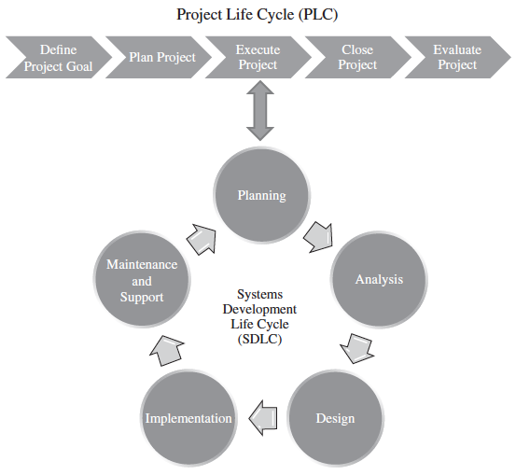
Figure 2.6 – The Project Life Cycle (PLC) and the Systems Development Life Cycle (SDLC)
2-<number>
Copyright 2015 John Wiley & Sons, Inc.

Slide 21
Implementing the SDLC
Defines all of the subphases and deliverables associated with the Execute and Control Project Management Life Cycle phase.
Number of Ways to implement the SDLC
  Waterfall
  Agile
2-<number>
Copyright 2015 John Wiley & Sons, Inc.

Slide 22
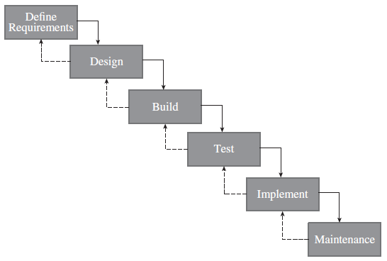
Figure 2.7 – The Waterfall Model
2-<number>
Copyright 2015 John Wiley & Sons, Inc.

Slide 23
Agile Systems Development – What is Agile?
Condenses the SDLC into an iteration or sprint
Users and developers work closely together to define and prioritize important (“must have”) features
Emphasize working software to measure progress and rely heavily on face-to-face communication
Umbrella term that includes a number of approaches or methods
2-<number>
Copyright 2015 John Wiley & Sons, Inc.

Slide 24
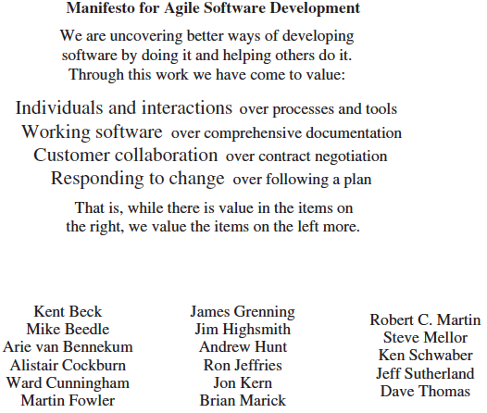
Figure 2.8 – The Agile Manifesto
2-<number>
Copyright 2015 John Wiley & Sons, Inc.

Slide 25
Agile Systems Development – Four (4) Themes or Categories
Customer
Product
Project Team
Performance
2-<number>
Copyright 2015 John Wiley & Sons, Inc.

Slide 26
Agile Methods: Extreme Programming (XP) and Scrum
Methods for project management that are becoming increasingly popular
Characterize many of today’s projects that exemplify speed, uncertainty, changing requirements, and high risks
XP
  User requirements first documented as user stories
  Document user stories in an object oriented model called a class diagram
  Transfers the system in a series of versions called releases
Scrum
  Three important roles:
    Scrum master – similar to project manager
    Product owner – represents the business side, ensures the most important features are included
    Development team – responsible for delivering a quality product or system
  Product backlog – team prioritizes features that need to be developed/delivered
  Sprint – iterations lasting a few weeks (usually) and delivers a complete product
  Daily scrum – short stand-up meeting
2-<number>
Copyright 2015 John Wiley & Sons, Inc.

Slide 27
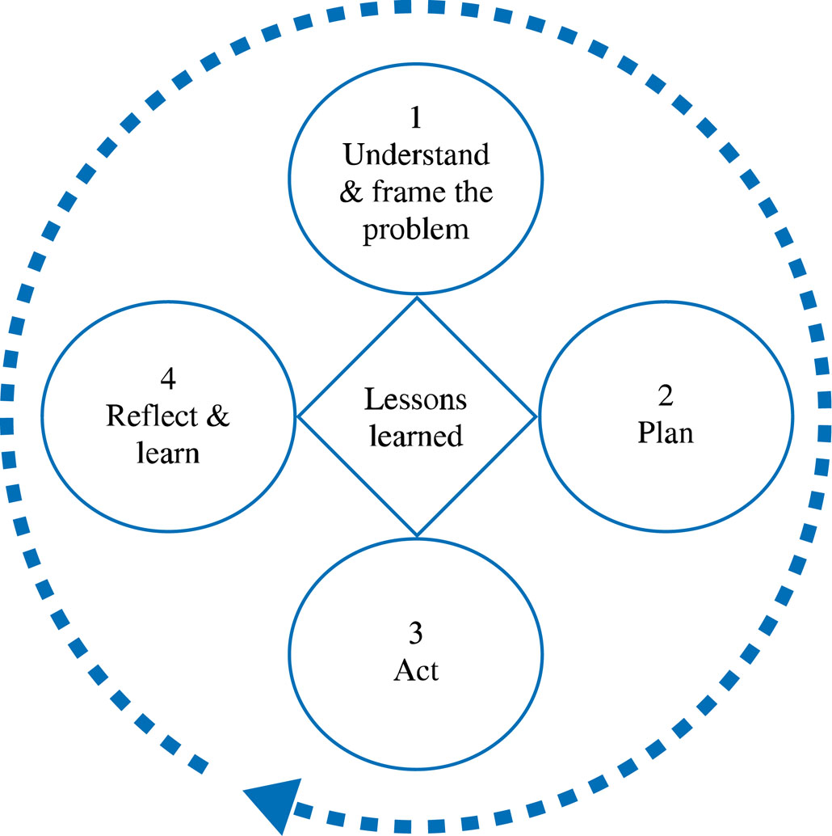
Figure 2.10 – A Learning Cycle
2-<number>
Copyright 2015 John Wiley & Sons, Inc.

Slide 28
Figure 2.11 – An Example of a Team Learning Record
What we know (Facts) | What we think we know (Assumptions) | What we don’t know (Questions to be Answered)
Company has too much inventory on hand | It may be an efficiency problem | Why are inventory levels so high?
Cost of maintaining current inventory is becoming prohibitive | Management believes a new information system will improve efficiency and therefore lower inventory levels | What are the current levels of inventory?
Inventory turnover needs to be increased |  | What is the desired level of inventory?
2-<number>
Copyright 2015 John Wiley & Sons, Inc.

Slide 29
Figure 2.12 – An Example of an Action Plan
Who? | Does What? | By When?
Shedelle and Steve | Interview sales team to understand past, current, and future trends for the company’s product. | Tuesday
Myra | Provide a detailed count of the current physical inventory on hand. | Thursday
Corean | Research potential inventory management system commercial packages | Thursday
Steve | Research average inventory levels for the industry | Wednesday
2-<number>
Copyright 2015 John Wiley & Sons, Inc.

Slide 30
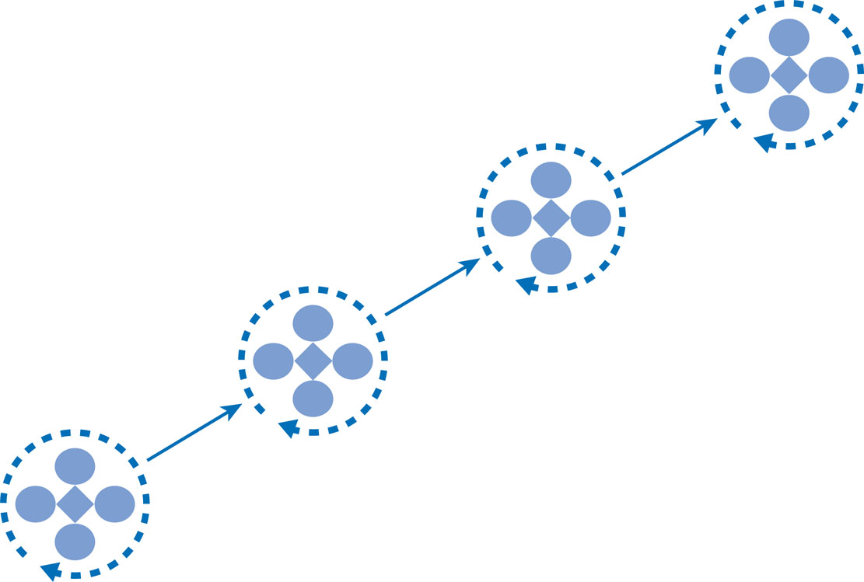
Figure 2.13 – Team Learning Cycles over the Project Life Cycle
Each cycle provides the opportunity to
challenge framing assumptions, create new understanding & find radical solutions
2-<number>
Copyright 2015 John Wiley & Sons, Inc.

Slide 31
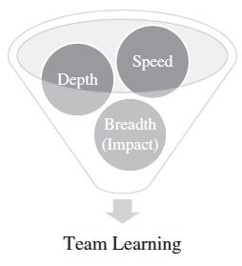
Team Learning
2-<number>
Copyright 2015 John Wiley & Sons, Inc.

